Slide 1


RAC R PERINATAL COMMITTEE
3.10.26

Slide 2
Attendance
Baptist Beaumont
Maternal: Rebekah Landry
Neonatal: Michelle Bordelon, Amie Coble
Christus St. Elizabeth
Maternal: April Waguespack
Neonatal: Kellie Huebel
Medical Center of SE Texas
Maternal:
Neonatal:
UTMB Angleton Danbury
Maternal:
Neonatal:
UTMB Galveston
Maternal: Kim Stewart
Neonatal: Amy Shapley

Slide 3
Tchmb ob committee updates
January 22nd meeting was cancelled
Next meeting scheduled for March 26th, 5-6PM

Slide 4
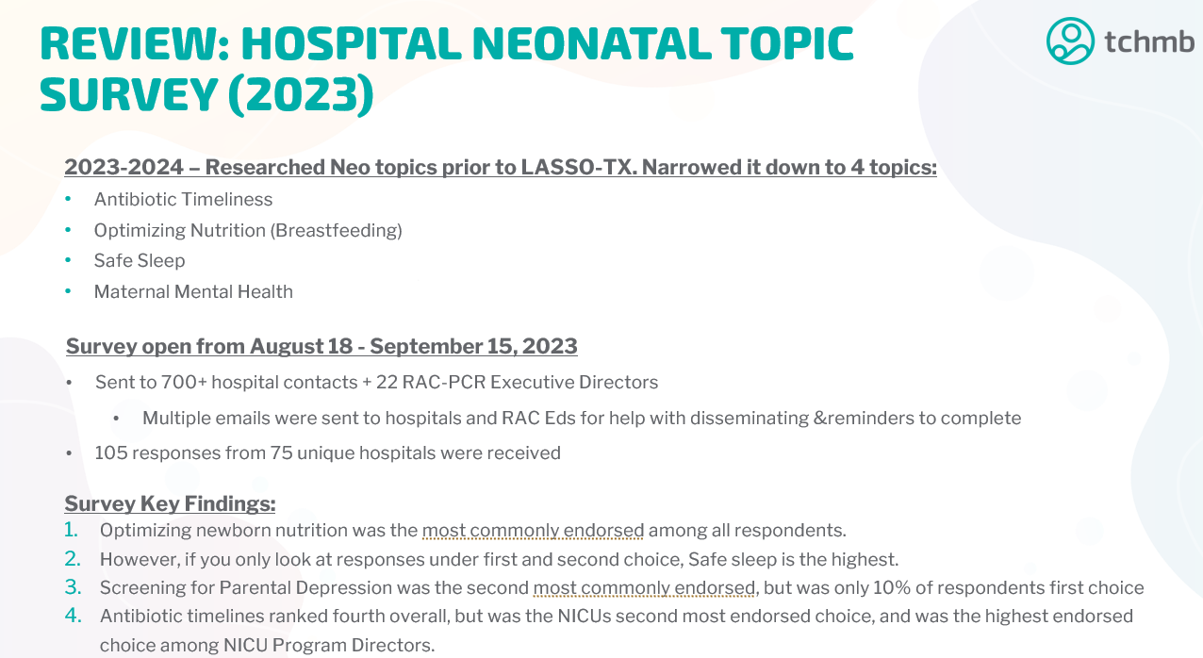
Tchmb NEO committee updates

Slide 5
Hospital Neonatal topic survey (2023)

Slide 6
Dshs Perinatal Meetings
Level I Meetings
April 1st, 2-3PM
May 6th, 2-3P
July 1st, 2-3PM
Level II-IV Meetings
March 18th, 2-3PM
April 15th, 2-3PM
May 20th, 2-3PM
June 17th, 2-3PM

Slide 7
Pac meeting updates 3.5.26
Next meeting scheduled for 6.16.26, 9AM
-Perinatal Bereavement, HB 37 (Everly’s Law)
-PHWB for neonates
-Neonatal back transfers

Slide 8
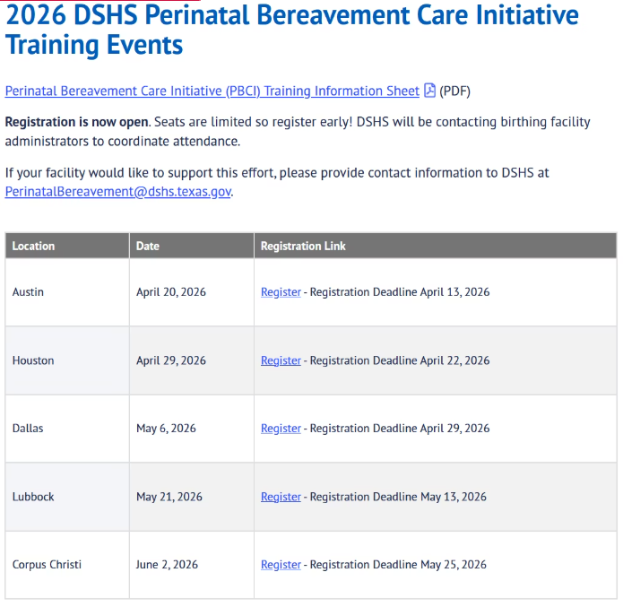
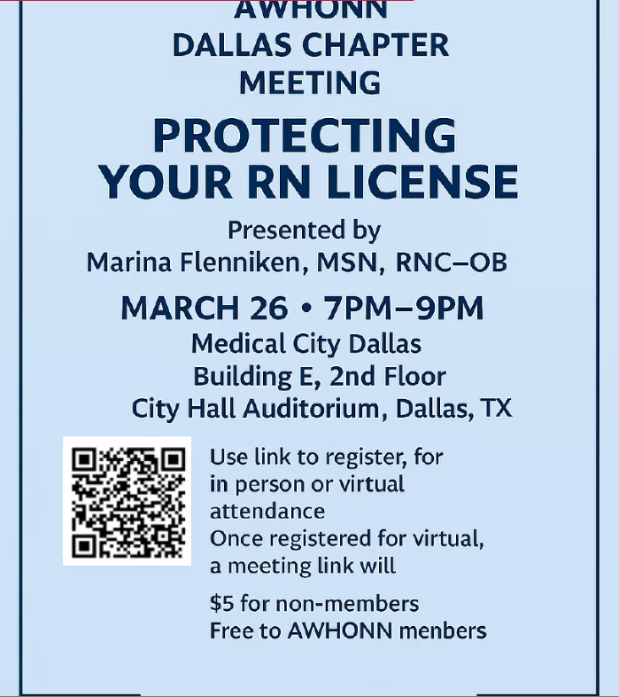
Tetaf and mighty networks

Slide 9
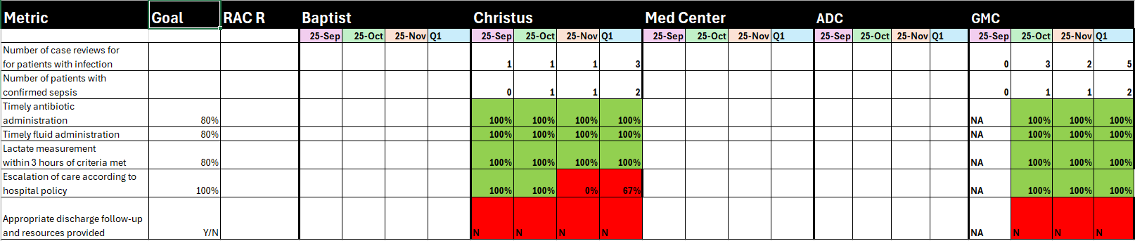
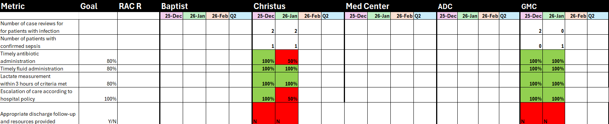
MATERNAL PROJECT:SEPSIS

Slide 10
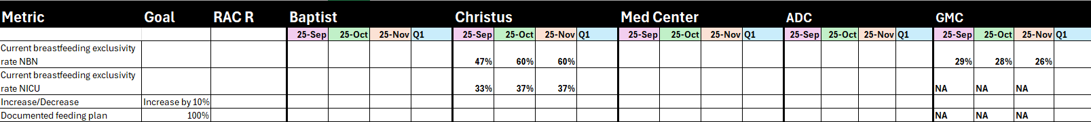
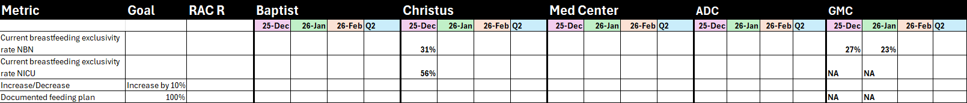
NEONATAL PROJECT:LASSO

Slide 11
When we meet again
Medical Directors meeting this Friday,
March 13th
Next General Assembly
June 9th

Slide 12
