Slide 1


RAC R medical director meeting
3.13.26

Slide 2
Attendance
Baptist Beaumont
Maternal: Dr. C. Dowdy
Neonatal: Dr. S. Doshi, Michelle Bordelon
Christus St. Elizabeth
Maternal: , April Waguespack
Neonatal: Dr. L. Thompson
Medical Center of SE Texas
Maternal:
Neonatal:
UTMB Angleton Danbury
Maternal:
Neonatal: Dr. S. Jain
UTMB Galveston
Maternal:
Neonatal: , Amy Shapley

Slide 3
Tchmb ob committee updates
January 22nd meeting was cancelled
Next meeting scheduled for March 26th, 5-6PM

Slide 4
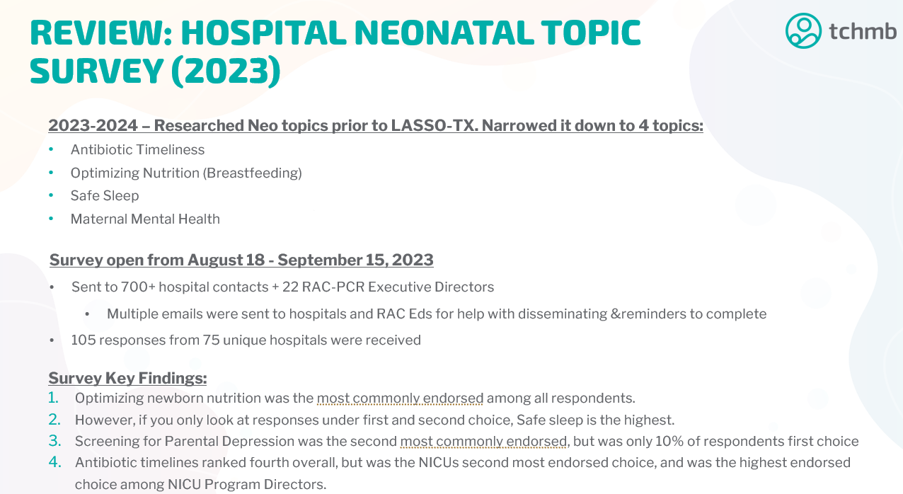
Tchmb NEO committee updates

Slide 5
Hospital Neonatal topic survey (2023)

Slide 6
Dshs Perinatal Meetings
Level I Meetings
April 1st, 2-3PM
May 6th, 2-3P
July 1st, 2-3PM
Level II-IV Meetings
March 18th, 2-3PM
April 15th, 2-3PM
May 20th, 2-3PM
June 17th, 2-3PM

Slide 7
Pac meeting updates 3.5.26
Next meeting scheduled for 6.16.26, 9AM
-Perinatal Bereavement, HB 37 (Everly’s Law)
-PHWB for neonates
-Neonatal back transfers

Slide 8
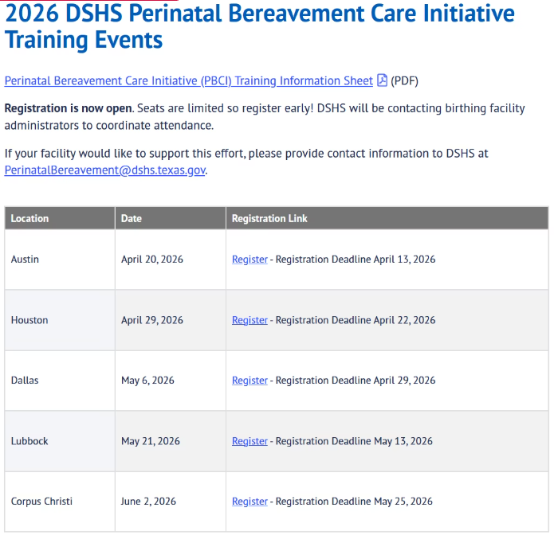
Tetaf and mighty networks

Slide 9
Viral Infections in Pregnancy: April 8th 9AM
Life of the Mother Act (SB 31): April 15th 8AM (Attendance will fulfill the TMB SB31 mandatory requirement)
Upcoming Maternal Lunch and Learns include Trauma informed care and DKA
Suggestions for Neonatal Lunch and Learn topics?

Slide 10
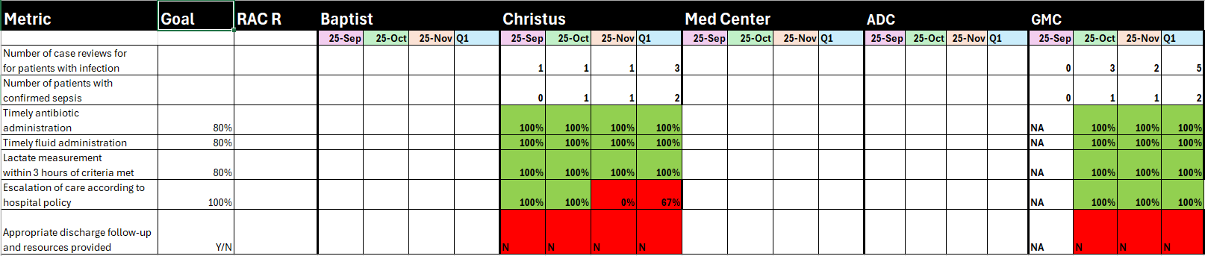
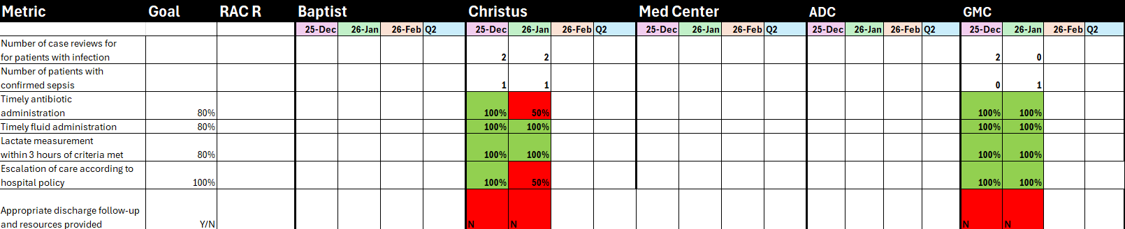
MATERNAL PROJECT:SEPSIS

Slide 11
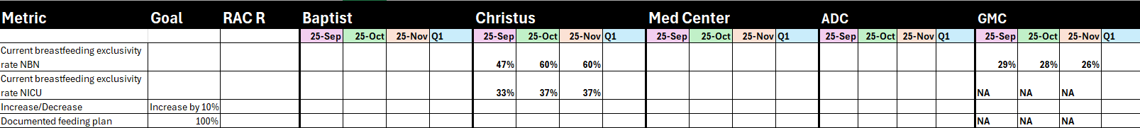
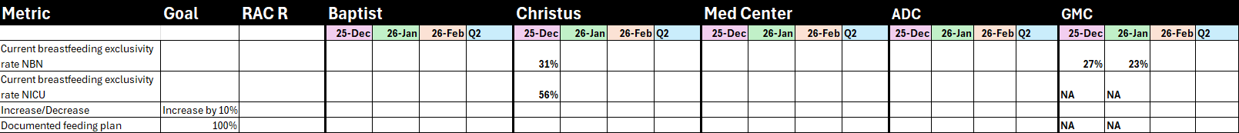
NEONATAL PROJECT:LASSO

Slide 12
When we meet again
Next General Assembly
June 9th
Medical Director Meeting
June 12th

