Slide 1


RAC-R Perinatal medical directors 12.12.25

Slide 2
Attendance
Baptist Beaumont
Maternal: Dr. Dowdy
Neonatal: Dr. Doshi
Christus St. Elizabeth
Maternal: A. Waguespack
Neonatal: Dr. Thompson
Medical Center of SE Texas
Maternal:
Neonatal: S. Maccamond
UTMB Angleton Danbury
Maternal: C. Delacruz
Neonatal:
UTMB Galveston
Maternal: Dr. Pacheco, K. Stewart
Neonatal: Dr. Huff, A. Shapley

Slide 3

RAC-R MEETING
FIFA World Cup preparation: June 11, 2026-July 19, 2026
Volunteer needed for RAC-R PI Committee (ad-hoc membership)
Need to submit 2024 transfers out for maternal and neonatal patients for wristband distribution discussion

Slide 4
TCHMB NEO COMMITTEE MEETING UPDATES
9.19.25
LASSO enrollment is now closed (however if you still need to enroll you can contact them at tchmb-lassotx@uth.tmc.edu
Cohort 2 (Houston) February 26th and 27th
Intake survey and prework packets are being sent

Slide 5
TCHMB OB COMMITTEE MEETING UPDATES
9.25.25
Dr. Jaime Morgan is now the new co-chair
Dr. Eppes provided a lecture regarding time zero; ultimately depends on what the facility has defined
LASSO TX update
Joint Commission has approved new requirements that will go into effect January 2026 and are aligned with the new CMS COPs
Texas AIM Action Period 2 call will be Thursday, December 18th 1:30-3:00 pm (Kim can forward the email with registration link if you did not receive)

Slide 6
PAC MEETING
Next meeting scheduled for Wednesday, December 17th at 8:30 am

Slide 7
Dshs Perinatal calls
The meeting series for 2025 has ended. A new link will be available once the 2026 series is scheduled.

Slide 8
TETAF & mighty networks
September forum “Solutions for team-based learning in the NICU” and December “Collaboration in maternal care” recordings available in case you missed them
Nursing-led M&M conference: https://www.myamericannurse.com/nursing-led-mm-conferences/
Congenital syphilis toolkit: https://www.aap.org/en/patient-care/congenital-syphilis/congenital-syphilis-toolkit/

Slide 9
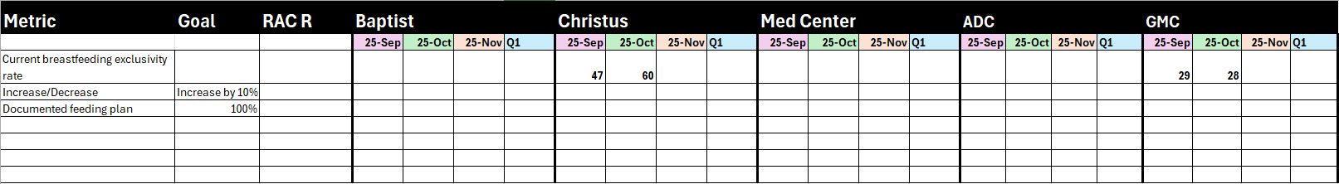
Neonatal committee project

Slide 10
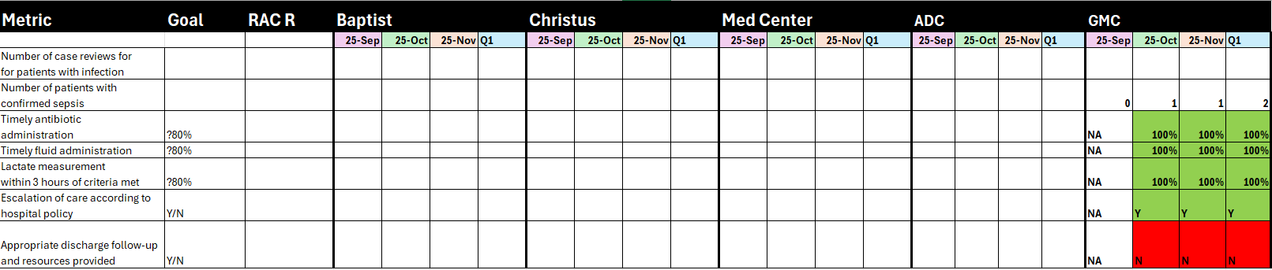
Maternal committee project

Slide 11
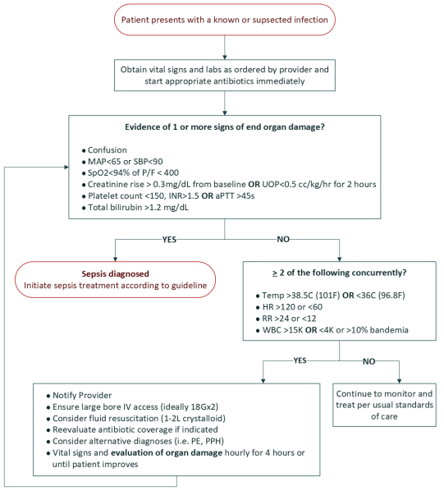
UTMB Sepsis Algorithm

Slide 12

Happy holidays!
Next General Assembly 3.10.26
Medical Directors Meeting 3.13.26

