Slide 1

RAC R Perinatal committee-Medical Directors meeting
9/16/2022

Slide 2
attendance
Baptist – NEO: Dr. Doshi; Maternal: Dr. Dowdy and Ashleigh Williams, MPM
CHRISTUS St. Elizabeth – Neo: Dr. Thompson, Kelli Huebel, NPM ; Maternal: Dr. Sherman, A. Waguespack, MPM
CHI Brazosport - Both: did not attend
Medical Center of SETX –Neo: did not attend Maternal: did not attend
UTMB – Neo: Dr. Shattuck Maternal: L. Spencer, MPM
UTMB ADC – Both: Dr. Chang, Dr. Lam, C. Patton - PM

Slide 3
Agenda
Texas AIM Updates 9/14/2022
Update on Draft Rules
TCHMB CCHD Screening Project
Discuss Data Submission
Discuss Perinatal Committee SOP
Discuss Identification of Medical Director alternates
Discuss Prehospital guidelines for care of Maternal/Neonatal patients
Open Discussion

Slide 4
Texas AIM Education opportunities
Society for Maternal-Fetal Medicine
Access to a 4-Hour CME/CNE Course on Using Quality Improvement and Safety Science to Eliminate Pregnancy-Related Racial and Ethnic Health Inequities (Subscription ends May 1, 2023) Target audience: Obstetrician-gynecologists, maternal-fetal medicine (MFM) subspecialists, midwives, family nurse practitioners, women’s health nurse practitioners, nurses, hospital safety and quality staff, and administrators who are involved in implementing maternal safety and quality improvement at their hospitals to eliminate health disparities. After this course, the learner will be able to:
Describe the importance of racial and ethnic inequities as major contributors to potentially preventable pregnancy-related death in the United States;
Develop an organizational team and strategy to make health equity a priority;
Understand the use of disaggregated data by race, ethnicity, and language to identify and track disparities; and
Incorporate health equity into quality improvement and safety science strategies to eliminate racial/ethnic disparities.
Course brochure: smfm_brochure.pdf (texinstitute.com)
Institute for Healthcare Improvement (IHI) Open School Access to a variety of online courses and certificates to track participation (Subscription ends August 15, 2023)
Maintenance of Certification (MOC) Part 2 for select medical specialty Boards; and a Basic Certificate in Quality and Safety.
8-18-Access-to-Institute-for-Healthcare-Improvement-Open-School.pdf (texinstitute.com)

Slide 5
Texas Aim
New Maternal Mental Health Hotline
National Maternal Mental Health Hotline | MCHB (hrsa.gov)
The revised Obstetric Hemorrhage patient safety bundle was released in April 2022
Obstetric Hemorrhage (+AIM) | AIM Program (Previously Council on Patient Safety) (safehealthcareforeverywoman.org)

Slide 6
TCHMB CCHD Screening Project
Newly formed subcommittee
First workgroup meeting last week
Chair – Dr. Charleta Guillory
Discussions to develop a survey to be distributed through the RACs to gain a better understanding of individual hospital’s processes related to CCHD screening and reporting
More to come…

Slide 7
Update on Draft Rule Status
Maternal Rules:
Publish in Texas Register – Completed
Formal Public Comment – Closed.
Proposed Adoption – October 13, 2022.
Hospitals Required to Implement PASD – October 1, 2022.
Full Implementation (Hospitals surveyed to requirements) – January 1, 2023.
Neonatal Rules:
Publish in Texas Register – Any day now. Reportedly in Governor’s office
Formal Public Comment – Any day now and will be open for 30 days for comments.
Proposed Adoption –possibly November, 2022
Full Implementation (Hospitals surveyed to requirements) – June 1, 2023
We will be developing an “Evidence of Requirements Met” document for facility guidance in meeting the new rules.

Slide 8
PCR Rules
§133.211. Perinatal Care Regions (PCRs).
(a) The PCR shall consider and facilitate transfer agreements through regional coordination.
(b) The PCR shall coordinate regional perinatal system QAPI Plan reviews.
(c) The PCR integrates with the Regional Advisory Council (RAC) system plans to ensure there is a written perinatal system plan specific to the regional area utilizing the regional advisory council’s criteria and self-assessment tools.
(d) The PCRs are administratively supported by the RAC; and shall have fair and equitable representation on the board of the applicable RAC.
(e) Each PCR is responsible for defining data needs and regional collaboratives.
(f) Maternal medical directors and program managers must participate in the PCR meetings, QAPI regional initiatives, and regional collaboratives. (language matches in Neonatal)

Slide 9
Perinatal Committee SOp
Discussed prior to COVID
Committee reviewed at September 13th meeting
Will send out for comments/recommendations – to be closed by next GA meeting
Will approve at next meeting
Will bring to BOD for final approval at December BOD meeting.

Slide 10
Committee data submission
Neonatal Measure(s)
Golden Hour ABX
Antenatal Steroids
VLBWs
Maternal Measure(s)
One hour to treat Severe Hypertension
DC Follow-up for Severe Hypertension
Identified vs. De-identified?
Committee agreed to identified D/T no actual patient information being shared (only rates) and small size of committee
Committee agrees to submit data 1 month after the conclusion of the period
example:
March 2022-June 2022 data due first Monday of August 2022
July 2022 – September 2022 data due first Monday of November 2022
October 2022-December 2022 data due first Monday of February 2023
Committee agrees the data set and submission schedule will not cause undo burden to Programs

Slide 11
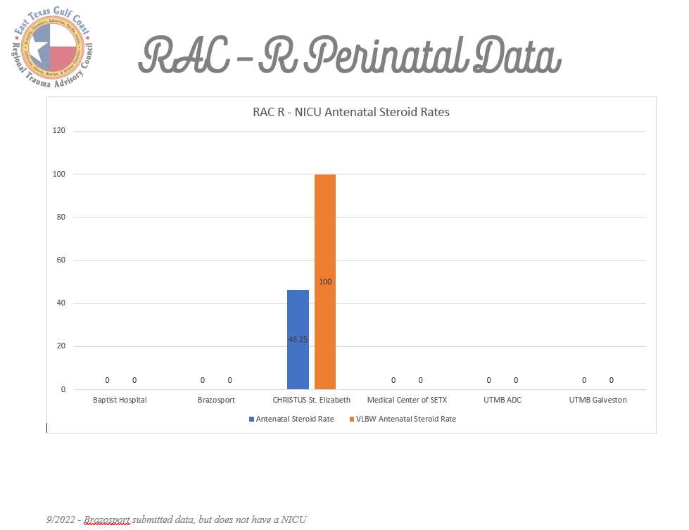
NICU data

Slide 12
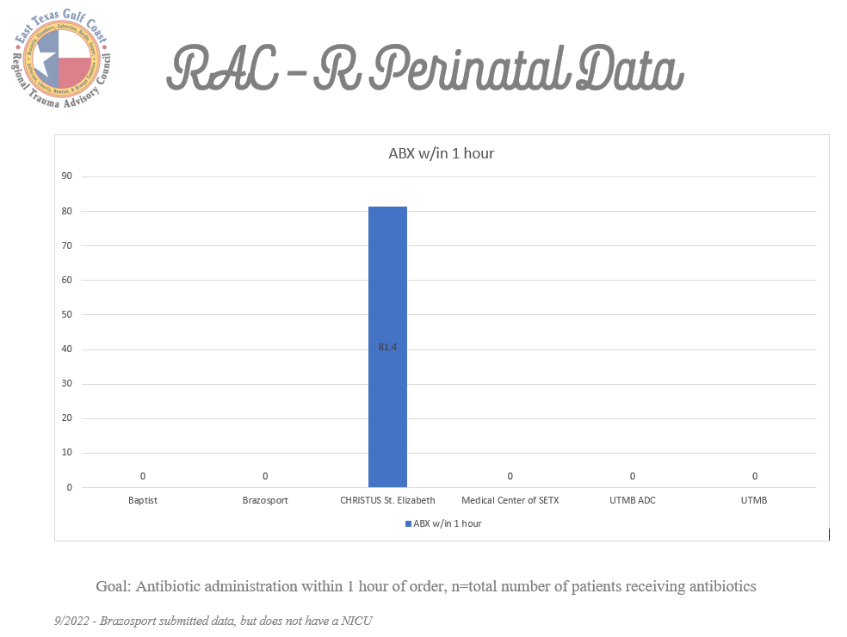
Nicu data

Slide 13
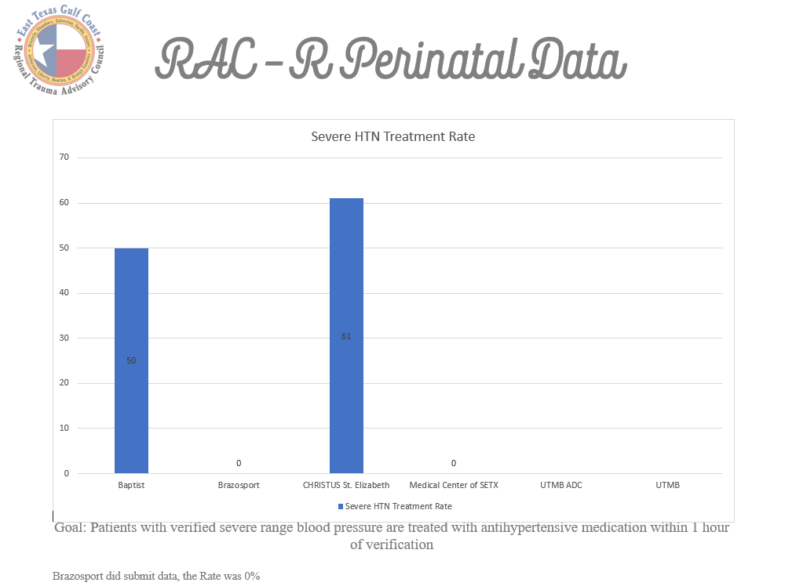
Maternal data

Slide 14
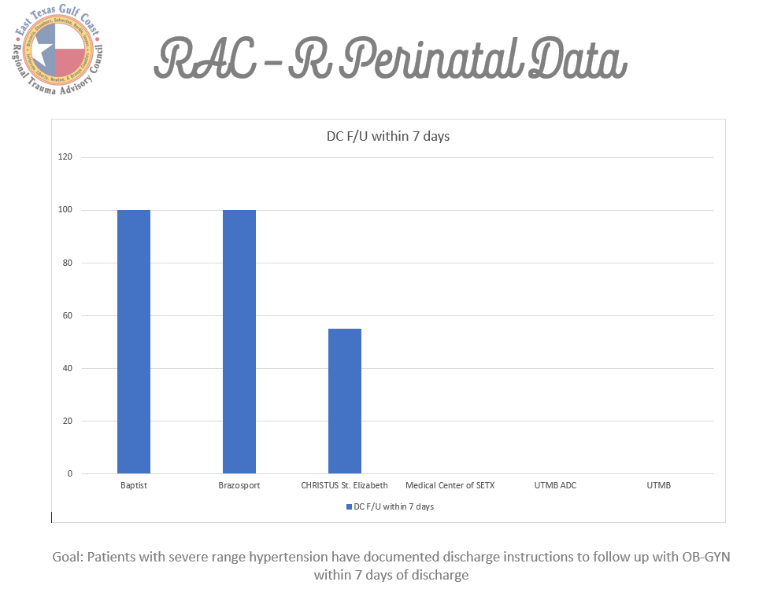
Maternal data

Slide 15
Discuss Identification of Medical Director alternates
The Perinatal Committee does allow for alternates attendance for General Assembly meetings
Must be Nurses of the appropriate discipline
Example: if the Maternal Program Manager is unable to attend, she may send another Maternal nurse; the Neonatal Program Manager is not an appropriate alternate
For Medical Directors – Medical Directors agree that it is appropriate for an alternate to attend as available for each facility and program

Slide 16
Prehospital guidelines for care of Maternal/Neonatal patients
Intention – provide EMS service education on management of maternal patient and provide their Medical Control with evidence-based guidelines for care of the specialty patients.
Have you encountered EMS patients that had opportunities for improvement for the care provided to your patient?
How can our committee assist those services in providing optimal care for the specialty patient?

Slide 17
NRP for prehospital
Committee worked to develop a survey for the prehospital services in our RAC to determine need/number of EMT/Paramedics that would be interested
The BOD voted and agreed to add NRP Essentials as a paid course for prehospital providers
Plan on doing one day of as many instructors as possible in one location for the services to come to and have multiple stations available (won’t need warmers – they don’t have those out in the prehospital world)
Plan for a North region day and a South region day
Anticipate to schedule in the Spring of 2023

Slide 18
Prehospital guideline
Discussed in committee to possibly additionally having maternal stations set up to discuss immediate post delivery care, severe hypertension, etc.
Would be a good opportunity to discuss what their treatment guidelines are and provided evidence-based guidelines for care

Slide 19

Upcoming PAC Meetings
Upcoming meetings (Microsoft TEAMS):
Oct 26, 2022, 9 a.m.
Dec 07, 2022, 9 a.m.
Perinatal Advisory Council | Texas Health and Human Services

Slide 20
Questions/comments/concerns
L. Spencer – UTMB MPM noted that the RN that would submit data is on vacation and will submit upon her return. Kelli Huebel did note that there have been some issue with the Google Docs, she thought they had been resolved. Requests that when RN needs access to please send email to notify Kelli of the request.
Dr. Shattuck – UTMB NMD brought up concern of the Nursing managers time at the General Assembly meetings all day in person in Baytown. Several of the committee members agreed. Kelli Huebel –Committee Chair will send request to the BOD requesting that the nurses have the option to attend the virtual Perinatal Committee Medical Directors meetings that occur on the Friday following the scheduled General Assembly meetings.

Slide 21
Upcoming RAC-R Perinatal meetings
2022 General Assembly meetings
12/13/2022
2022 Medical Director Virtual meetings – TEAMS Meetings @ 0730-0830
12/16/2022
Calendar invites for Medical Director meetings sent yesterday – to the contacts that I have
Agenda items for Next meeting

