Slide 1


RAC R MMD/NMD Committee
3/15/2024

Slide 2
Attendance
Baptist Beaumont
MAT- Dr. Christopher Dowdy & MPM Ashleigh Williams
NEO- Dr. Snehal Doshi
CHRISTUS St. Elizabeth
MAT- Dr. Deborah Sherman & MPM April Waguespack
NEO-
Medical Center of Southeast TX- Port Arthur
MAT-
NEO-
UTMB Angleton Danbury
MAT-
NEO- Dr. Linda Shelmire
UTMB Galveston
MAT- Dr. Luis Pacheco, Dr, Shannon Clark and Kim Stewart ANM
NEO-
Reminder if change in medical director, program manager or CEO- Complete form on DSHS site

Slide 3
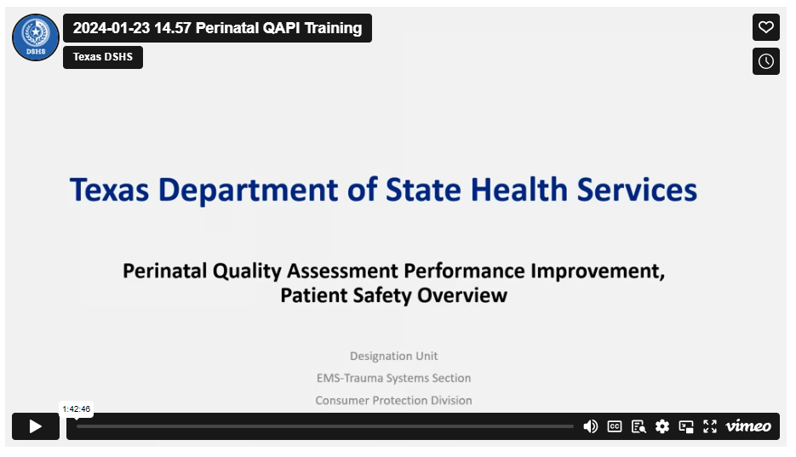
DSHS QAPI Patient Safety Overview Available
https://www.dshs.texas.gov/sites/default/files/emstraumasystems/Perinatal/PDF/Handout-Perinatal-QAPI-January-23-2024.pdf

Slide 4

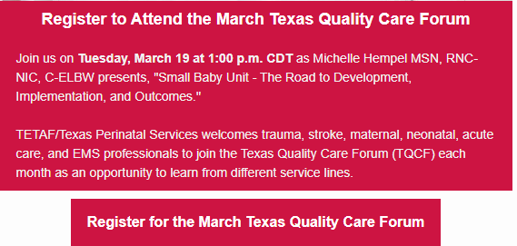

Slide 5
Upcoming DSHS Perinatal Calls
Level 3 and 4, March 20th 2-3 PM - Occurs 3rd Wednesday of every month
Level 1 and 2, April 3rd 2-3 PM - Occurs 1st Wednesday of every month
Next PAC meeting
Thursday, March 28th at 0900. Will be streamed on PAC website.
https://www.hhs.texas.gov/about/leadership/advisory-committees/perinatal-advisory-council

Slide 6
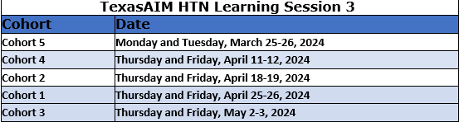
Texas AIM
Updated AIM Data Reporting Forms (Project Updates, Data Collected, Disaggregated & Aggregated Data) Data Disaggregation Tips Race & Ethnicity page . Prework information, registration, video instruction avail from TX AIM.
Travel Scholarship avail to a limited number of attendees. Reside more than 50 miles from venue and established member of Texas AIM. Apply by March 21st. Form on website.
If you need to submit corrections to your data email TexasAIM@dshs.text.gov
If you need to attend a different cohort than your own, register your team for your preferred event, and then email TexasAIM@dshs.texas.gov with the names of your team members and hospital name so that we can ensure you receive cohort-specific reminders.
Save the date for Learning Session 3

Slide 7
Texas Collaborative for Healthy Mothers and Babies “ Leading Change and Fostering Collaboration in Perinatal Quality Involvement” 2/28- 3/1/2024
RAC Commmittee Comments
UTMB Galveston and Angleton Campus attended

Slide 8
TCHMB OB and Neo MTG
New TCHMB OB Project Manager- Onyinye Omega- Njemnobi MTG 1/24/24 (next mtg 3/24)
RAC check-in, rereviewed individual RAC updates
Several new Program Managers in RACs
Discussed PPED projects currently ongoing, had a successful PPED Webinar
Texas Maternity Map https://www.tchmb.org/pped#map
Neo Project Manager- Sarah McConnor MTG 1/29/24 (next mtg 3/15)
RAC check-in, reviewed individual RAC updates
End of NAT project Dec 2023 https://www.tchmb.org/newborn-admission-temperature
Analysis and cleaning ongoing, to send out exit surveys to hospital by end of Jan.
Reviewed options of new Neo projects- discussion surrounding need, interest, and feasibility of topics
Overall choice was " Optimizing Newborn Nutrition," which is what RAC-R submitted too. To send out a last reach for further comments.
2nd choice was Screening for Parental Depression in the NICU and MBU, 3rd, Safe Sleep

Slide 9
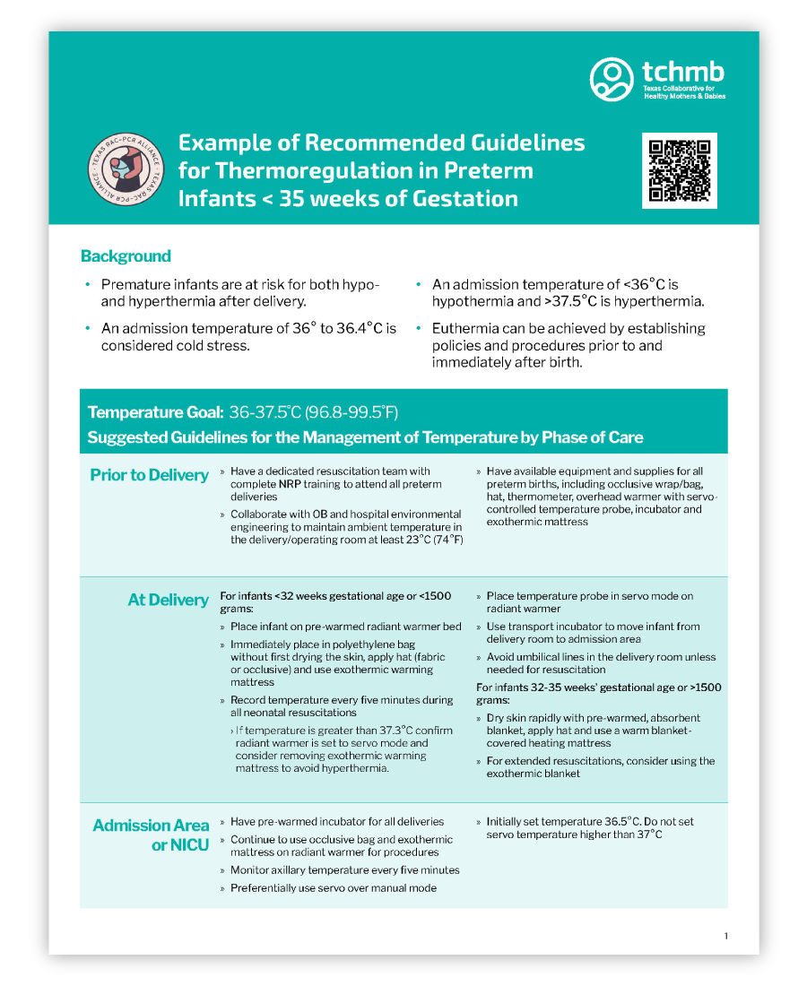
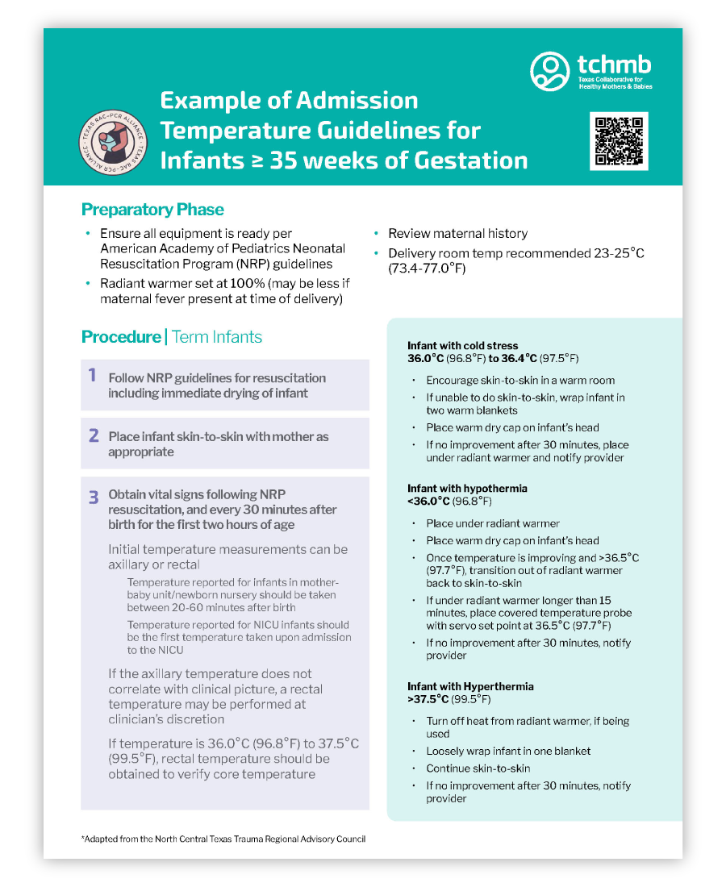
TCHMB Example Temp Guidelines <35 weeks and ≥ 35 weeks of Gestation

Slide 10
Optimizing Newborn Nutrition- Approved by RAC-R MPMs & NPMs 12/12/23
QI focused with TCHMB on an increase of the percent on newborns who receive human milk as their first feeding and/or increase the percent of newborns breastfeeding at discharge. Joint MICU/MBU and L&D project.
Basic definition of the project:
Supporting newborns with optimal nutrition. Mothers Own Milk (MOM) is optimal nutrition for the newborn
The questions to address:
a. The Problem the project seeks to address/improve (defined) – Data (NICU/MB unit/LPI/VLBW)
• Low % of TX newborns with MOM feeding in first 24 hours of life
• Low % of newborns discharged on MOM feeding
b. The potential Outcome measure(s) – Data (in All NICU, MB, VLBW, LPI neonates discharged or died)
• % of babies receiving ANY MOM feeding in first 24 hours of life
• % of babies receiving ANY MOM feeding on discharge/death/transfer
• % of babies receiving exclusive MOM feeding on discharge/death/transfer (fortification not included…. Careful definitions needed)
• % of babies receiving initial feed as MOM

Slide 11
Optimizing Newborn Nutrition
c. the potential Intervention (s) – may be process measures
• Breastmilk log
• Golden Hour breastfeed or hand express/pump or skin to skin
• Direct breastfeeding from non-nutritive to direct to breast
• Daily breastmilk supply question checklist with positive reinforcement and lactation emergent consult triggered prn
• Lactation specialist involvement in daily rounds
d. Does this project address Disparities/inequities?
• Lower versus higher breastfeeding use among differing racial/ethnic groups
• Lower versus higher breastfeeding use among differing economic/educational status groups
e. Is this project Achievable statewide (practicality)? Would be heavy lift but very important and likely huge buy-in with DSHS/RAC PCR Alliance and many other organizations supporting

Slide 12
Optimizing Newborn Nutrition
Commentary on Core interventions that could be implemented:
Parental education, pre-birth planning infant nutrition, skin to skin at birth and attempting to latch infant within the golden hour if both mom and baby are stable. State providing an incentive to exclusive breastfeeding mothers. All participating hospitals in each RAC to initiate interventions at same time to create city-wide awareness of efforts to optimize infant nutrition. PR campaigns (grant money?), huge need for provider training (nursing and physician/APP buy-in is essential), quantification of milk pumped and received in NICU babies, GO MOM checklists, parent and provider standardized education), donor milk education as bridge to MOM
Other considered Basic measures:
Measure the percentage of infants who breastfeeding within the golden hour in L&D.
Measure the percentage of infants who breastfeed exclusively during the entire hospital stay in mother-baby.
Measure the percentage of NICU patients receiving some/all breastmilk at discharge.

Slide 13
Committee Data Submission - Thoughts for now?
Neonatal Measures
Maternal Measures
Committee members will think on this and make a plan at the next meeting, if TCHMB project is not approved statewide by then.

Slide 14
Updated RAC-R Maternal & Neo Disaster Grid and Program Manager & Medical Director emailed 3/5/24.
Suggestion for Maternal and Neo to alternate committee education during MPM and NPM committee timeframe.
Reminder new rules are in effect for Maternal or Neo Survey. Survey guidelines are on the DSHS website. They are very helpful!
Dr. Shannon Clark with UTMB will be speaking on debriefs at the MPD/NPD meeting Friday, 3/15 @ 0730.

Slide 15

AORN – Elevated Patient Safety with Structured Hand-Off Protocols
A Closer Look at New Updates to the Guideline for Team Communication
https://www.aorn.org/article/elevate-patient-safety-with-structured-hand-off-protocols?utm_campaign=periop_today&utm_medium=promotional&utm_source=email&utm_content=guidelines_mpl_240228&mkt_tok=NTQ1LUtDUC0xNjMAAAGRkUvg95oMznFTVVZj2ybna7ac6-CqI1xUp2s2Z0owkp3MFExsNL1iiqjqqCkjeX-7A72baWQm1m-a9tUciGgFm5Lg-zW8suhZSCcTF7X9W0Ok
Structured Hand-Off Protocols
Importance of a Customized Structured Hand-off Process
Elements of an Effective Structured Hand-off Process
Improving Quality of Information Exchanged at Hand-off
Standardized Process and the Elements to Include in Hand-off
This Photo by Unknown Author is licensed under CC BY

Slide 16
Maternal Chair: Lisa Spencer, UTMB Galveston
Neonatal Co-Chair: Yesenia Sandino, UTMB Galveston
*RAC Meetings 2024 – June 4th, Sept 10th, Dec 12th
*RAC Medical Director Meetings 2024 – June 7th, Sept 13th, Dec 13th
June meeting is earlier due to availability of Baytown Community Center Availability
TEAMS invites sent for director mtgs, please let me know if you haven’t received.

Slide 17

DEBRIEFING IN OBSTETRICS
Shannon M. Clark, MD
Professor
Director, UTMB Levels of
Maternal Care-Level IV
Designation
Dept. ObGyn
Div. MFM
UTMB-Galveston

Slide 18
Questions?

