Slide 1

DEBRIEFING IN OBSTETRICS
Shannon M. Clark, MD
Professor
Director, UTMB Levels of
Maternal Care-Level IV
Designation
Dept. ObGyn
Div. MFM
UTMB-Galveston

Slide 2
Debriefing is Defined as:
Brief, informal exchange and feedback session.
Occurs after an event.
Designed to improve teamwork skills and outcomes.
An accurate reconstruction of key events.
Analysis of why the event occurred.
What should/could be done differently next time.
Identify systems issues to be addressed.
Allows acknowledgement of strengths and identifies opportunities for improvement.

Slide 3
Debriefing…
It may be led by an individual or a group.
The person or persons leading a debriefing may or may not have been involved in the event that is being discussed.
The flow of information is multidirectional - both between and among the leader(s) of the debriefing and those being debriefed.
Debriefing is different than feedback, where the flow of information is in one direction - from a person (or a device) to another person.

Slide 4
Debriefing Basics
Preparing
Preparing team members:
Clearly communicate expectations.
Initiating
Initiating debriefings:
“What happened in 10 words or less?”
Sequencing
Sequencing debriefings:
Chronological order is easiest to follow.
Pacing
Pacing debriefings:
Maintain awareness of time remaining for debriefing.
Terminating
Terminating debriefings:
“Any final questions/comments?”

Slide 5
Debriefing in Clinical Healthcare
Debriefing can be a first step to identify critical areas of focus from front line team members involved in major or critical events which can guide further review.
Identify ways to improve patient care and outcomes.
Learning is relevant and timely, focused on actual patient care events.
Debriefing elicits learner-centered feedback.
  Self-reflection and discovery.
  Enhanced retention of learned ideas.
Process feelings and provide education about coping with stress.

Slide 6

Debriefing in Obstetrics
Who?
Entire interdisciplinary team (obstetrics, nursing, pediatrics, and anesthesia)
Social Work: most severe events
What?
Identify certain trigger events
When?
As close to an event as possible to maximize the potential for information gathering and identification of systems issues
Before documenting the event when possible
Where?
Safe space where participants feel comfortable enough to express opinions and offer suggestions.
Why?
To help the team identify opportunities for improvement in teamwork, skills, and outcomes
Emotional well-being
How?
Trained debriefers
Use of a debriefing guide

Slide 7
Ground Rules for Successful Debriefing
The basic assumption…
We believe that everyone participating is intelligent, well-trained, cares about doing their best, and wants to improve.
Discussion during debriefings should remain confidential.
The debriefing environment must be non-threatening.
It is ok to politely disagree, but do not assign blame.
Participants should maintain professional behavior.
Be polite, respectful and curious.
There should be no interruptions or outside conversations.
Debriefings are a time for critical reflection.

Slide 8
Debriefing Guidance & Pitfalls
Key elements of good debriefing:
Empathetic, non-blaming, non-threatening
Conversational
Pair advocacy with inquiry
Avoid grilling when asking questions…
“Don’t you know…?”
“Did it occur to you…?”
“Why didn’t you double check?”
Guess what I am thinking…

Slide 9
When to Debrief
After any emergency
After any unexpected event
After a near-miss
When the team requests a debriefing
Routine event

Slide 10
Obstetrics Trigger Examples
Maternal Events:
Maternal Death
Unanticipated hysterectomy
Unanticipated admission to ICU
Whenever a member of the team thinks it would be useful.
At UTMB:
PPH
Severe hypertension requiring meds
Stat CD
Shoulder dystocia

Slide 11
Active Listening & Questions to Facilitate Discussion
Patient care:
Can you tell more about what happened then? At what point did we realize we needed more resources? How well did we follow the phases of care for managing obstetric hemorrhage?
Technical skills:
How did the cesarean section go?
Resources:
Who was present? What additional resources did you need?
Teamwork:
How well did the team work together? How can we better support each other?
Communication:
What did we know about the patient? What information would have helped you? How was the communication
with the family and the other teams involved?

Slide 12
Encourage Self-Assessment
De-emphasizing leader viewpoint:
Limit use of first-person pronouns.
Avoiding qualitative statements:
Draw performance assessment from team members.
Minimizing personal anecdotes:
Emphasize team member (not leader) experiences.
Eschewing hindsight bias:
Debrief as if experiencing the event for the first time.

Slide 13
Start with what went well…
Check if “yes”
 Communication
 Role clarity (leader/supporting roles identified assigned)
 Teamwork
 Situational awareness
 Decision-making
 Other: ___________________

Slide 14
Opportunities for improvement:
Identify opportunities for improvement-“human factors”
(Check if “yes”)
 Communication
 Role clarity
 Teamwork
 Situational awareness
 Decision-making
 Human error
 Other: __________________

Slide 15
Opportunities for improvement:
Identify opportunities for improvement-“systems issues” (Check if yes)
 Equipment/supplies/accessibility
 Medications
 Blood products availability
 Inadequate support (in unit or other areas of the hospital)
 Delays in transporting the patient (within hospital or to another facility)
 Staffing
 Other: ___________________

Slide 16

Create Lists of Debriefing Points & Questions from 4 Sources
Primary:
Learning objectives upon which the scenario is based
Secondary
Unexpected events during the scenario
Tertiary
Concerns raised during the debriefing
Quaternary
Hypothetical situations

Slide 17
Drilling Down to Root Causes
What happened/what did you notice (at that point in the scenario)?
What circumstances led to that?
What happened to the patient as a result?
What can be done to:
Facilitate the recurrence of that positive event?
Prevent that negative event from happening again?

Slide 18
Benefits of Debriefing
Real time identification of opportunities for improvement in:
Teamwork
Knowledge/ skills
Systems
“Emotional debriefing”
Team members feel empowered, supported and heard
Allows identification of potential “second victims”

Slide 19
Emotional Debriefing
Critical Incident Stress Management (CISM)
  Comprehensive package of interventions intended to:
    mitigate impact of a traumatic event
    facilitate recovery of individuals having normal reactions to traumatic event
    restore adaptive function for individuals, communities, or organizations
    identify individuals who could benefit from additional support services or referrals for further evaluation and treatment
  May take precedence over “fact-finding” debriefing after most severe events (death or serious injury)
https://www.icisf.org/a-primer-on-critical-incident-stress-management-cism/

Slide 20

Medicolegal Considerations
Are debriefings legally protected?
Variations in state laws make this difficult to answer
To help ensure success of debriefing make certain that protections are in place.
Collaborate and coordinate within existing quality and patient safety structures
Work closely with legal and risk management

Slide 21
The PEARLS Healthcare Debriefing Tool

Slide 22
The PEARLS Healthcare Debriefing Tool

Slide 23
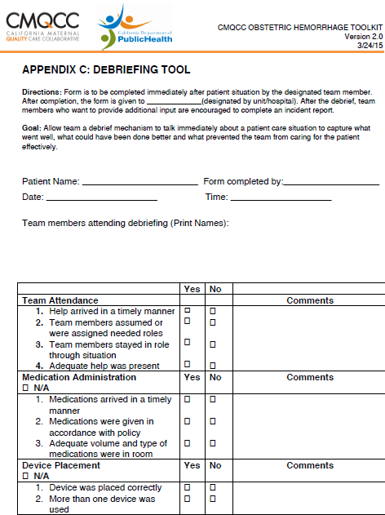
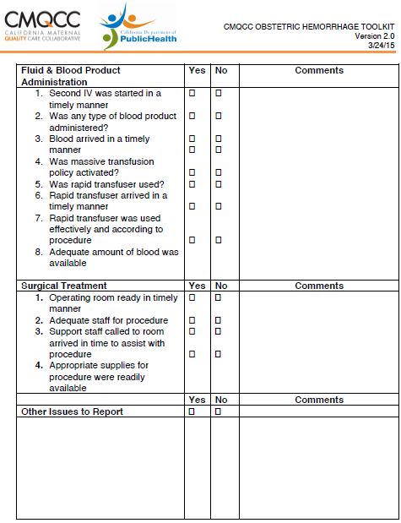
https://www.cmqcc.org/resource/ob-hem-appendix-c-debriefing-tool
Notes:
Intro, ground rules, set the tone
Understanding (facts and feelings), Reactions, Summary

