Slide 1
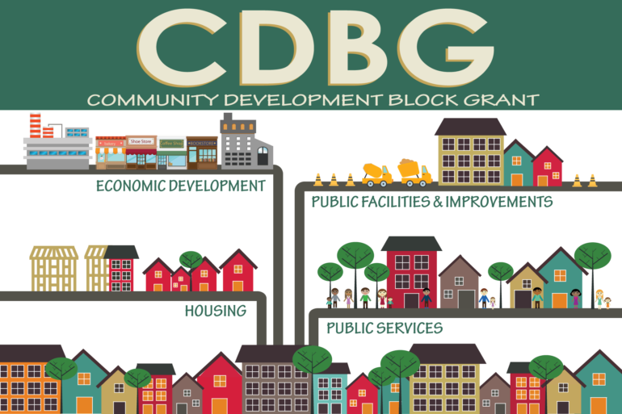


EAST STROUDSBURG BOROUGH
Public Hearing on Housing and Community Development Needs
Tuesday, September 1, 2026
2026 Community Development Block Grant Program
Notes:
Good evening. My name is Jennifer Petersen, and I am the Executive Director of the Monroe County Redevelopment Authority, and our agency is designated as the County’s Community Development Block Grant Program Administrator.
This evening, I will provide an overview of the Community Development Block Grant Program, which I will refer to as “CDBG.”
The Borough of East Stroudsburg, along with Monroe County, and the Borough of Stroudsburg, will begin their grant planning and the application process for the FY 2026 CDBG.
Pursuant to the County’s Citizen Participation Plan, this is the 1st public hearing that is required during this process. This public hearing is to provide citizens with information about the Community Development Block Grant, its eligible activities, program requirements, and expected funding allocation. An ad notifying the public of this hearing was posted on August 24, 2026, on the Monroe County, East Stroudsburg, and Stroudsburg Boroughs’ various media sites.
A 2nd public hearing to identify the activities proposed for the 2026 CDBG funds is scheduled for October 6th.
The FY 2026 CDBG allocation for East Stroudsburg Borough is $155,079.

Slide 2

CDBG Overview
CDBG 101
What is CDBG?
The Community Development Block Grant (CDBG) is an annual grant program funded by HUD (known as the Department of Housing & Urban Development) to localities and states to assist in the development of viable communities. These viable communities are achieved by providing principally for persons of low- and moderate-income:
Decent housing
A suitable living environment
Expended economic opportunities
Notes:
CDBG is a federally enacted program adopted by the US government in 1974. The Department of Housing and Urban Development (HUD) administers the program. HUD distributes funding to the Commonwealth of Pennsylvania.
In 1984, the Commonwealth enacted Act 179, which created a system for distributing CDBG program funds in the Commonwealth. Distribution occurs through three categories: State Administration, Competitive Application, and Direct Entitlement Allocation.
In Monroe County, three government entities receive direct entitlement allocations. Those include: Monroe County, East Stroudsburg Borough, and Stroudsburg Borough.
While the program has changed very little since its inception, the need for the program remains. CDBG is an important investment tool for communities and neighborhoods, but program funding must increase to meet local needs to ensure CDBG grantee communities are healthy, vibrant, and thriving.

Slide 3
CDBG PROGRAM OVERVIEW
  CDBG Program Activities
  There are a wide range of more than 20 activities that are eligible under the CDBG Program. Grantees are free to select those activities that best meet the needs of their communities. However, in order to ensure that the primary objective of the CDBG Program is met – the benefit to –low and moderate-income persons – grantees must ensure that all activities meet a National Objective:
  Benefit low- and moderate-income persons
  Aid in the prevention or elimination of slums or blight
  Meet a need having a particular urgency (urgent need) that the grantee is unable to finance
  Grantees must be able to show that every CDBG-funded activity fits into one of these categories.
  By regulation, at least 70% of funds must be allocated to programs benefitting low/moderate income persons annually.
Notes:
Each project activity must meet one of three (3) federally mandated national objectives as set by HUD:
Benefit to low-and moderate- income persons
Prevention or elimination of blight
Urgent need
Grantees must be able to show that every CDBG-funded activity fits into one of these categories. By regulation, at least 70% of funds must be allocated to programs benefitting low/moderate income persons annually.
Historically, the CDBG program in Monroe County has served 100% low to moderate income persons.

Slide 4
CDBG - OVERVIEW
Eligible Activities
CDBG can support a variety of project types.
Most activities that benefit low- and moderate-income individuals and meet the needs of the community are eligible.
However, the regulations make the funding complicated to use.
Four Primary Funding Categories:
Public Service
Public Facility or Infrastructure Improvements
Economic Development
Housing

Slide 5
CDBG - Overview
Public Services: Direct, quantifiable social service delivery to eligible clients.
Category capped per regulation – 15% of funding
Activities eligible under this category include (but are not limited to):
Job Training
Child Care
Health Services
Senior Services
Afterschool Programs
Homeless Services
Domestic Violence Prevention
Legal Services
Housing Counseling
Food Banks

Slide 6
CDBG – OVERVIEW
Public Facility Improvements: Improvements to publicly-owned facilities and infrastructure such as streets, playgrounds, and underground utilities, and buildings owned by non-profits that are open to the general public.
Activities eligible under this category include (but are not limited to):
Rehabilitation or construction of a neighborhood community center
Rehabilitation o construction of a homeless shelter
Rehabilitation or construction of facilities serving persons with disabilities
Improvements to public libraries
ADA modifications at public facilities
Installation of broadband infrastructure
Notes:
Under the Public Facility Improvements category, the most common CDBG-funded activity for Stroudsburg Borough is Street and Road Improvements.
For the past three years, the Borough has completed street improvements using CDBG funds on:
South Green Street
North Green Street
Stemple Street
East Broad Street
Maple Avenue & Berwick Heights

Slide 7
CDBG - OVERVIEW
Economic Development: Activities to foster economic opportunity, including microenterprise and small business development, commercial and industrial development, and job creation, job retention, and job training activities.
Activities eligible include:
Technical assistance programs and workshops for small businesses
Grant programs for small businesses
Business district façade improvement programs

Slide 8
CDBG - OVERVIEW
Housing: activities to foster safe, affordable housing opportunities for low/moderate income households.
Activities eligible include:
Housing rehabilitation programs
Energy efficiency & weatherization programs
Acquisition & site improvements for housing.

Slide 9
LOW & MODERATE INCOME BENEFIT
In order for a project or program to qualify for CDBG funds, 51% of the program beneficiaries must meet low and moderate income as defined by HUD.
2026 Adjusted HOME Income Limits for Monroe County (MFI=$94,900)
(BASED ON A HOUSEHOLD OF 4)
Effective: 06/01/2026 (updated annually)
Family/Household Size | Low-Mod Income (80% AMI) | Very Low Income (50%AMI)
1 person | $55,550 | $34,750
2 person | $63,500 | $39,750
3 person | $71,450 | $44,650
4 person | $79,350 | $49,600
5 person | $85,700 | $53,600
6 person | $92,100 | $57,600
7 person | $98,400 | $61,550
8 +person | $104,750 | $65,550
Notes:
“Low and Moderate Income” (LMI) means a family or household with an annual income less than 80 percent of the area median income.
Monroe County’s median family income = $94,900, which is a decrease from $104,400 in 2025.

Slide 10

PROGRAM REQUIREMENTS
CDBG funds are federal funds, therefore, there are a number of significant Federal Overlay Statutes, which must be followed in order to comply with federal requirements. Some of these are:
70% of funds must benefit low-to moderate income persons.
Only 18% of CDBG funds can be used for administrative purposes in any proposed program
ALL activities must be eligible for funding and meet a National Objective
Survey Methodology (Census or Sampling)
Citizen Participation Requirements
Fair Housing, Equal Opportunity, Handicapped Accessibility
Procurement and Conflict of Interest
Environmental Standards
Testing (Lead and Radon)
Labor Standards (Davis Bacon)
Section 3
Financial Management
Reporting and Monitoring
Recordkeeping and Closeout
Notes:
The Authority is responsible for monitoring all grant compliance including fair housing, procurement, equal opportunity, Section 504 (accessibility), labor standards (Davis-Bacon), environmental standards, and testing such as lead/radon which is required in the owner-occupied housing rehabilitation program.

Slide 11

FY 2026 CDBG ALLOCATIONS
EAST STROUDSBURG BOROUGH = $155,079
Notes:
As stated earlier, the 2026 CDBG allocation for East Stroudsburg Borough is $155,079.

Slide 12
East Stroudsburg Borough
CDBG Award History
Notes:
What has changed in recent years?
Funding from HUD! CDBG funding has declined in recent years. The program has never been adjusted for inflation, even though program operating costs increase annually.
These incremental cuts over time have meant that local applications for funding go unmet, staff positions are cut, and local projects are delayed and canceled.
The need for CDBG is absolute. Even though the number of communities eligible for CDBG funding has grown, this has caused a reduction in current CDBG allocations to states and local governments because of the lack of adequate CDBG funding that is actually needed.

Slide 13

How are the funds distributed?
An annual open proposal process is conducted allowing community agencies (non-profits and units of local government) to apply for use of funds.
Process has begun!

Slide 14
APPLICATION PREPARATION SCHEDULE
2026 CDBG Program
September 1, 2026
1st Public Hearing
October 6, 2026
2nd Public Hearing
October 30, 2026
DCEDs Submission Deadline
March 2027:
Anticipated Application Approval by PaDCED
Notes:
As mentioned earlier, today’s public hearing is the 1st of 2 hearings that is required to seek input from citizens. The County has to hold two public hearings to be eligible for program funding.
The 2nd Public Hearing will be held on October 6th, 2026. At this time, the Borough Council will share the proposed projects for the 2026 CDBG activities for application and authorize their submission to DCED by Resolution.
Thank you for your time.

