Slide 1

General Product Studies
Hosted by PAL's U65 Marketing Team
Jeffrey Urbano
Dave Collett
Confidential and proprietary; redistribution, recording or copying is prohibited without written consent from Philadelphia American Life Insurance Co.
Copyright © 2024 by Philadelphia American Life Insurance Company. All rights reserved.
Notes:
Assistant Vice President in Marketing for U65 Products
Not an agent or sales man
21 years of experience
Attended over 1,000 agent sales presentations
Can’t pronounce all terms
You and I will be bffs for the next 3 days. Simply means you get to ask me any questions.

Slide 2
Marketing
Overview
1990 | 2023
0 members | 220K+ members
$0 in AP¹ | $520M in AP¹
1 state license | 48 state licenses
48 states
Washington D.C.
Virgin Islands
¹Annualized Premium

Slide 3



Markets
& Product Lines
U65 Health
Market
Annuity Market
Senior
Market
Hospital indemnity
Other Supplemental A&H plans
Low surrender
Short duration
Higher credit interest
Guaranteed interest
Medicare Supplement
Final expense

Slide 4
Marketing Outlook
Annuity
New Money Products
New Business Premium
(Issued and Paid)
Medicare
Supplement Products
New Business Premium
(Issued and Paid)
Under 65
Insurance Products
New Business Premium
(Issued and Paid)
2019 | $71 million
2020 | $71 million
2021 | $120 million
2022 | $52.7 million
2023 | $120.2 million
2024 (P) | $120.0 million
2025 (P) | $120.0 million
2026 (P) | $120.0 million
2019 | $34 million
2020 | $19 million
2021 | $19.4 million
2022 | $14.7 million
2023 | $8.3 million
2024 (P) | $9.0 million
2025 (P) | $10.0 million
2026 (P) | $11.5 million
2019 | $101.2 million
2020 | $114.5 million
2021 | $114.5 million
2022 | $89.7 million
2023 | $72.5 million
2024 (P) | $80.0 million
2025 (P) | $90.0 million
2026 (P) | $100.0 million
Notes:
-reverse order
-change to 2019

Slide 5

Hospital Confinement
Hospital Stay
Intensive Care Unit (ICU)
24 Hour Observation Stay
Doctor’s Office Visit
Specialist
Chiropractor
Preventive
Mammogram
Colonoscopy
Annual Physical/Blood Work
Labs
Imaging
MRI, X-Ray, PET/CAT Scan, etc.
Including FREE New Era Telehealth
Unlimited
No charge
Emergency / Urgent Care
And more…..

Slide 6

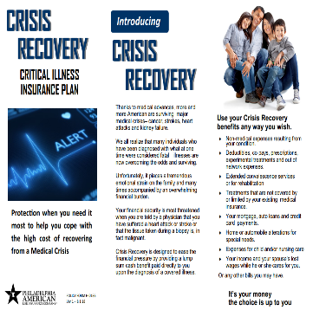



Health and Income Protection Series
Foundational Health Plan
Optimum Health Saver
Alternative
Approach
PAL plans bundled together for comprehensive coverage
CI Rider
Major Illness Enhancement
Critical Illness
Accident Enhancement
24-Hour Enhanced
Major Illness Comprehensive
Specified Disease
Major Accident Comprehensive
Catastrophic
Accident
Notes:
COMPLETE

Slide 7
Bundling for Health & Income Protection
Optimum Health Saver
24-Hr Enhanced Accident
Individual Accident Expense
Critical Illness Rider / Policy
Specified Disease Policy
Rich outpatient benefits with
$0 deductible
  Physicians Care
  Preventive Care
  Urgent Care
  Labs, X-rays, Testing, MRIs, etc.
Inpatient benefits to help cover healthcare expenses
No network restrictions
Accidental Injury benefit
Accidental Death benefit
Ground or Air Ambulance benefit
Hospital income benefit
Dismemberment benefit
Riders:
  Medical Expense
  Disability Income
No network restrictions
Actual charges (as defined) for covered expenses incurred while Hospital Confined due to a costly Injury
No network restrictions
Lump sum of cash to use if diagnosed with a covered illness
  Cancer (internal)
  Non-invasive carcinoma in-situ
  Heart attack
  Stroke
  Coronary artery bypass
  Angioplasty
  Pacemaker implant
  End Stage Renal Failure
  Organ transplant
Provides additional income* to help pay for mortgage, travel expenses, etc.
No network restrictions
Actual charges (as defined) for covered expenses incurred for a costly covered diagnosis or procedure
  Stroke
  Heart attack
  Cancer (internal)
  Angioplasty
  Coronary artery bypass surgery
  Pacemaker implant or insertion of defibrillator
  Heart valve surgery
  Amputation
  Joint replacement
  End Stage Renal Failure
  ALS
  Major organ failure / organ transplant
  Ruptured aneurysm
Protection on a permanent basis (unlike STM)
Expanded network available
No network restrictions

Slide 8
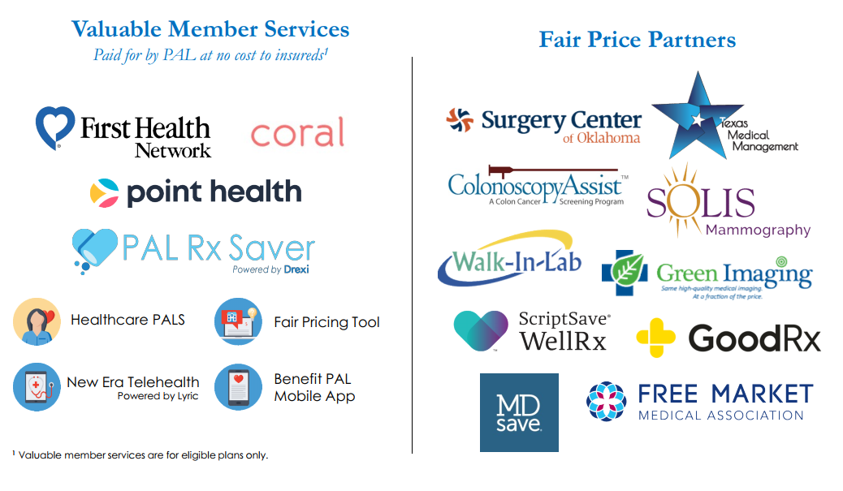

Slide 9

We're pleased to announce a major WIN as we celebrate our 100th anniversary this month!
We've secured our AM Best A- Excellent Rating for 2024!
We are confident that this rating will give you peace of mind knowing that your clients are in good hands with New Era Life.
We're not just good, we're AM Best A- Excellent good!

Slide 10
New Era’s Risk Assessment Is Equivalent to an A (Very Strong) Rating
Did you know? AM Best uses their own formulas to determine financial strength of a company? Based on their primary indicator, the Best’s Capital Adequacy Ratio (BCAR), New Era’s risk assessment has remained in the “very strong” category since 2017. The “very strong” category is equivalent to an A rating!
A-
Excellent
“New Era Group’s consumer-focus has proven to be an effective strategy for the Group. The ratings reflect New Era Group’s balance sheet strength, which AM Best assesses as strong ... supported by its very strong level of risk-adjusted capitalization. The Group’s capital and surplus continued to increase in 2021 … with primary drivers being an increase in net income and unrealized gains. The Group has no financial operating leverage, low reinsurance and no surplus notes.”
-A.M. Best Company, Inc.
AM Best Rating
for New Era Life Insurance Companies
Notes:
-BCAR on 12 &17
-Explain to general public; under AM best primary calculation New Era has scored equivalent of an A very strong rating; formula generated by AM best
-define bcar as most important indication; balance street strength is very strong and that is A+
-new eras risk assessment is very strong based on based capital ration = very strong equivalent to a very strong rating
-most important to have capital to support liabilities
Risk Based Capital (RBC) Ratios
New Era Life Insurance Group exceeds 775% overall
New Era Life Insurance Company: 849%
Philadelphia American Life Insurance Company: 702%

Slide 11
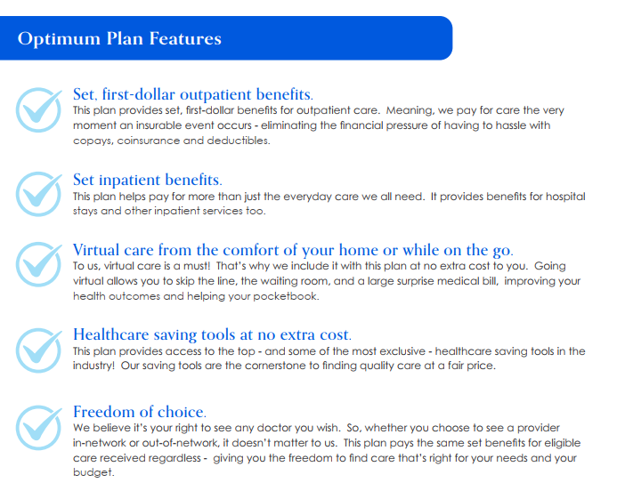


Slide 12

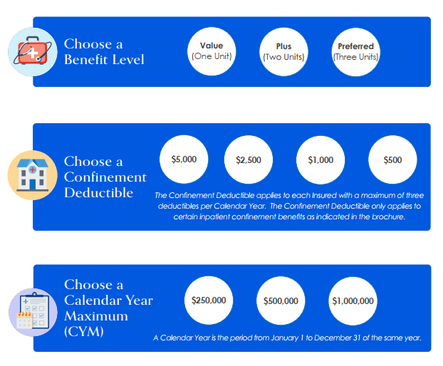

1 Member = $5,000,000
5 Members = $5,000,000
Per Member

Slide 13

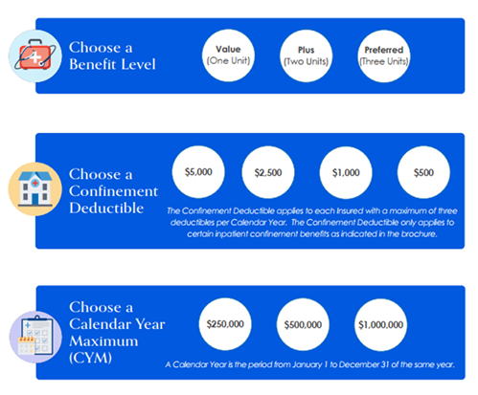


$250,000 Calendar Year Max
1 Unit
$2,500 Calendar Year Deductible
Notable Benefits:
Physician’s Benefit $80 per day
Urgent Care $150 per day
Generic Prescription $5 per
Brand Name Prescription $10 per day
Hospital Confinement $3,000 per day
Preventive Services $125 per year
Unlimited Telehealth FREE
$250,000 Calendar Year Max
2 Units
$5,000 Calendar Year Deductible
Notable Benefits:
Physician’s Benefit $120 per day
Urgent Care $200 per day
Generic Prescription $10 per
Brand Name Prescription $20 per day
Hospital Confinement $6,000 per day
Preventive Services $125 per year
Unlimited Telehealth FREE
$1,000,000 Calendar Year Max
3 Units
$1,000 Calendar Year Deductible
Notable Benefits:
Physician’s Benefit $160 per day
Urgent Care $250 per day
Generic Prescription $15 per
Brand Name Prescription $30 per day
Hospital Confinement $9,000 per day
Preventive Services $125 per year
Unlimited Telehealth FREE
$78.97 Per Month
$130.07 Per Month
$358.94 Per Month

Slide 14
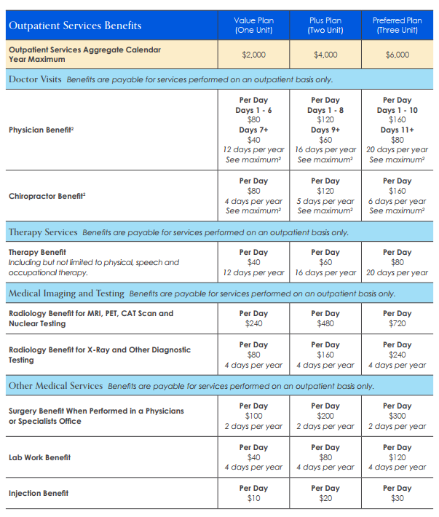
Yellow = 1 Unit
Blue = 2 Units
Red = 3 Units
$250,000 Calendar Year Max
1 Unit
$2,500 Calendar Year Deductible
Notable Benefits:
Physician’s Benefit $80 per day
Urgent Care $150 per day
Generic Prescription $5 per
Brand Name Prescription $10 per day
Hospital Confinement $3,000 per day
Preventive Services $125 per year
Unlimited Telehealth FREE
$1,000,000 Calendar Year Max
3 Units
$1,000 Calendar Year Deductible
Notable Benefits:
Physician’s Benefit $160 per day
Urgent Care $250 per day
Generic Prescription $15 per
Brand Name Prescription $30 per day
Hospital Confinement $9,000 per day
Preventive Services $125 per year
Unlimited Telehealth FREE

Slide 15
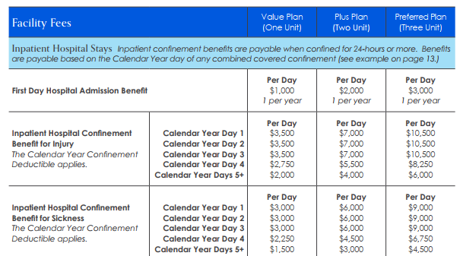
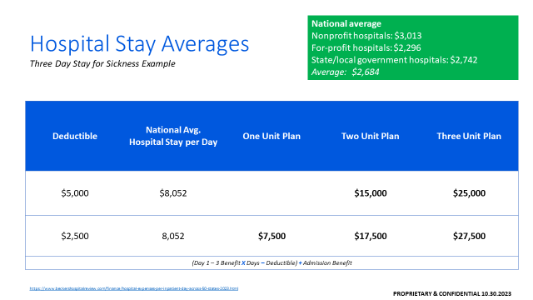
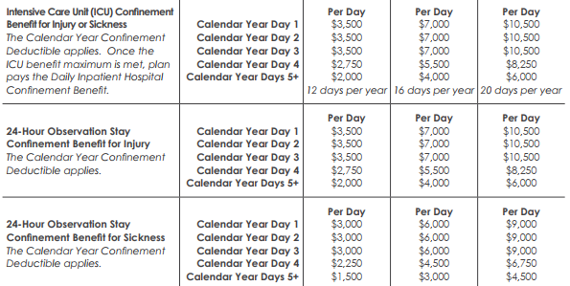
PAL Average Hospital Stay since 2011 is 3.5 days

Slide 16
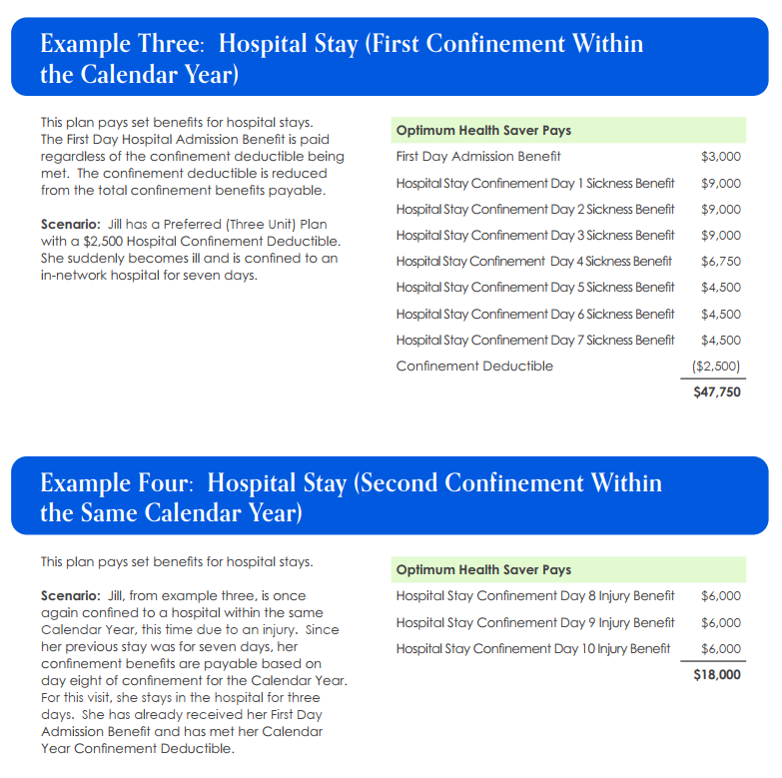
Hospital Confinement Benefit is based on the number of days you have stayed in a calendar year.

Slide 17
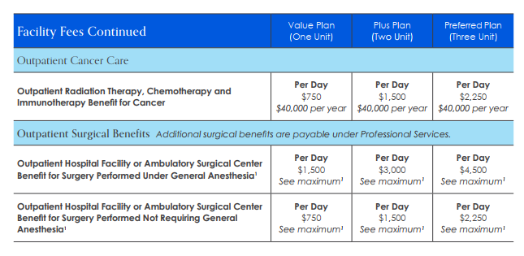
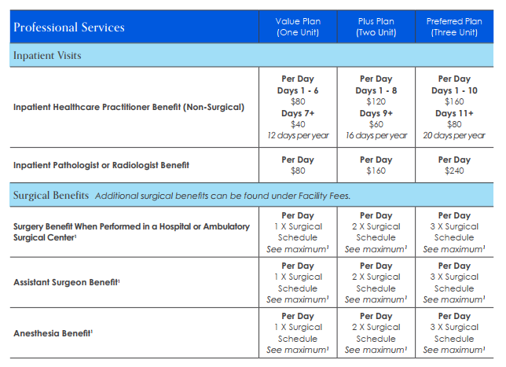
Outpatient Hospital or
Ambulatory Center Benefits
Laparoscopic Cholecystectomy
Gall Bladder Surgery
3 Units
PAL Surgical Schedule for Gallbladder
Surgeon
Assistant Surgeon
Anesthesia
Facility ($4,500) + Surgeon ($655 x 3) + Assistant Surgeon ($131 x 3) + Anesthesia ($163 x 3)
PAL Total Benefits 3 Units
$7,347*
PAL Fair Price Tool
Avg. $7,657
MD Save National Price
Avg. $19,748
Oklahoma Surgery Center
All-In Bundle Cost: $6,836
*Estimated Benefits
Benefit availability, exclusions and limitations may vary by state. Please refer to the policy in your state for more information.
²There is a maximum of combined limit for the Urgent Care and Emergency Department Benefits; includes up to 4 days per Calendar Year.
³The Calendar Year Maximum for Surgical Benefits is $50,000.
⁴The Surgical Schedule can be found in the Policy.

Slide 18
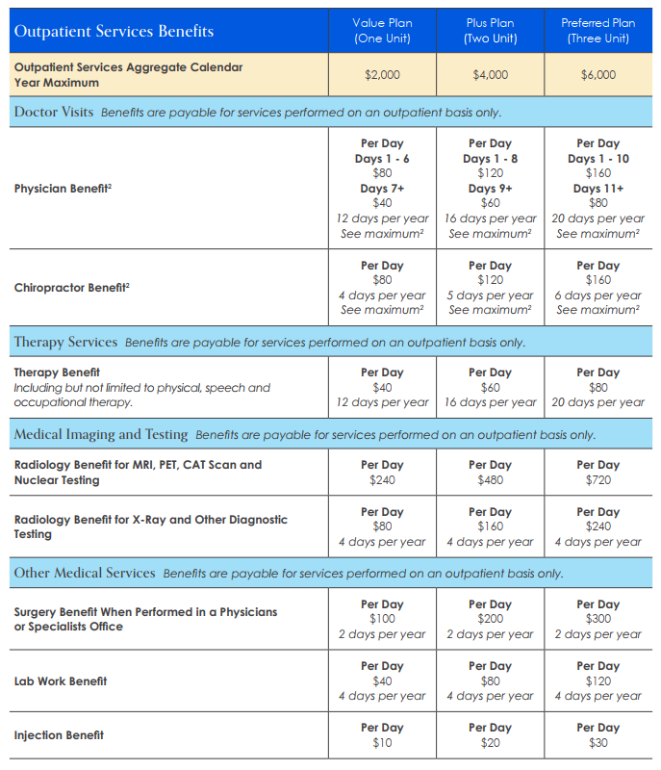
Outpatient Services
<.005% of policyholders reach their outpatient calendar year max per year*
6% of policyholders utilize more than 6 doctor visits per year*
New benefit due to the popularity of therapy services
*Based on PAL claims data for hospital indemnity plans
Benefit availability, exclusions and limitations may vary by state. Please refer to the policy in your state for more information.
¹There is a maximum of combined limit for the Physician and Chiropractor Benefits; includes up to 20 days for Three Unit Plans, up to 16 days for Two Unit Plans, and up to 12 days per One Unit Plan, per Calendar Year.
PROPRIETARY & CONFIDENTIAL 10.27.2023

Slide 19
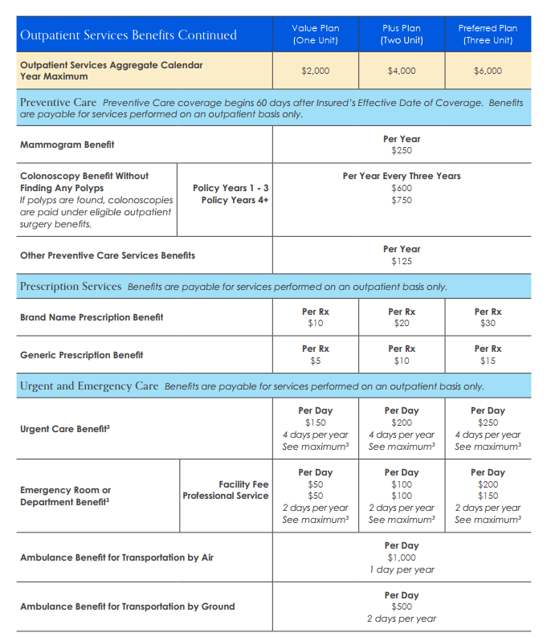
Outpatient Services
60 days
waiting period
Benefit availability, exclusions and limitations may vary by state. Please refer to the policy in your state for more information.
²There is a maximum of combined limit for the Urgent Care and Emergency Department Benefits; includes up to 4 days per Calendar Year.
³The Calendar Year Maximum for Surgical Benefits is $50,000.
⁴The Surgical Schedule can be found in the Policy.
PROPRIETARY & CONFIDENTIAL 10.30.2023

Slide 20
Bundling for Health & Income Protection
Optimum Health Saver
24-Hr Enhanced Accident
Individual Accident Expense
Critical Illness Rider / Policy
Specified Disease Policy
Rich outpatient benefits with
$0 deductible
  Physicians Care
  Preventive Care
  Urgent Care
  Labs, X-rays, Testing, MRIs, etc.
Inpatient benefits to help cover healthcare expenses
No network restrictions
Accidental Injury benefit
Accidental Death benefit
Ground or Air Ambulance benefit
Hospital income benefit
Dismemberment benefit
Riders:
  Medical Expense
  Disability Income
No network restrictions
Actual charges (as defined) for covered expenses incurred while Hospital Confined due to a costly Injury
No network restrictions
Lump sum of cash to use if diagnosed with a covered illness
  Cancer (internal)
  Non-invasive carcinoma in-situ
  Heart attack
  Stroke
  Coronary artery bypass
  Angioplasty
  Pacemaker implant
  End Stage Renal Failure
  Organ transplant
Provides additional income* to help pay for mortgage, travel expenses, etc.
No network restrictions
Actual charges (as defined) for covered expenses incurred for a costly covered diagnosis or procedure
  Stroke
  Heart attack
  Cancer (internal)
  Angioplasty
  Coronary artery bypass surgery
  Pacemaker implant or insertion of defibrillator
  Heart valve surgery
  Amputation
  Joint replacement
  End Stage Renal Failure
  ALS
  Major organ failure / organ transplant
  Ruptured aneurysm
Protection on a permanent basis (unlike STM)
Expanded network available
No network restrictions
$130.07
$31.05
$21.16
$30.98
$239.78
$26.52

Slide 21
Standalone
Optimum Health Saver
Bundled
Optimum Health Saver
$250,000 CYM
Three Units
$5,000 CY Deductible
+ 24-Hr Accident, Two Unit
+ Critical Illness, $15,000
+ Specified Disease, $50,000 Deductible
+ Catastrophic Accident, $50,000 Deductible
$1,000,000 CYM
Three Units
$2,500 CY Deductible
$291
$299

Slide 22
Example: Chemo Treatment
Standalone
Optimum Health Saver
Bundled
Optimum Health Saver
Plan Benefit | Payable
Optimum Chemo Benefit (12*$2,250) | $19,000
SPD ($180,000 - $50,000) | $130,000
Critical Illness | $15,000
Plan Benefit | Payable
Optimum Chemo Benefit (12*$2,250) | $19,000
Total Payable $19,000
Total Payable
$164,000

Slide 23
Critical Illness Rider
Major Illness Enhancement
Why Critical Illness?
Eases financial pressure by providing a lump sum payment
Can be used to help cover out-of-pocket expenses, replace lost income, etc.
Pays in addition to HCS
^{Covered Conditions}
^{Stroke}
^{Coronary Artery Bypass Surgery}
^{Angioplasty}
^{Cancer (Internal Cancer)}
^{Non-Invasive Carcinoma In Situ}
^{Heart Attack}
^{Pacemaker Implant}
^{End Stage Renal Failure}
^{Major Organ Transplant}
Coverage¹
Coverage from $10,000 - $50,000
Available in $5,000 increments
30 Day Elimination Period
Benefits for certain conditions may be reduced
Pays face value once
Children may have up to $10,000 in coverage if they are part of a policy with an adult
¹Refer to underwriting guide for more details

Slide 24
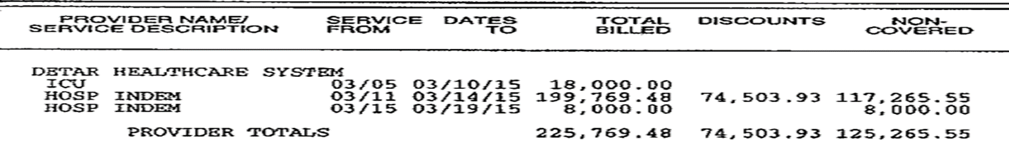
Bundling Example One:
14 Day Confinement Due to Severe Stroke
Plans
HSP Gold - Two Unit Plan; $5,000 CY Deductible
Critical Illness Rider - $30,000 Benefit
Specified Disease Plus - $75,000 deductible; $250,000 CYM
Confinement for Major Illness
5 nights in ICU
9 nights in hospital room
Provider/Facility/Hospital Charges
$225,769.48 original charge
$125,265.55 after network discount

Slide 25
Benefits Payable
Example One
Initial Provider Charges | $225,769.48
Network Discount | - $74,503.93
Actual Provider Charges | $125,265.55
HSP Gold ICU Benefit ($4,500 per day X 5 days) | $22,500
HSP Gold HC Benefit ($3,000 per day X 9 days) | + $27,000
HSP Gold Admission Benefit | + $2,000
HSP Gold Total Benefits Payable | $51,500 $5,000 = $46,500
HSP Gold Benefits Paid | Critical Illness Benefits Paid | Specified Disease Benefits Paid | Total Benefits Paid | Outcome
$46,500 | $30,000 | $50,265.55 | $126,765.55 -$125,265.55 Bill | $1,500 Excess Benefits
$46,500 | None | $50,265.55 | $96,765.55 -$125,265.55 Bill | $28,500 Out-of-Pocket / Balance Bill
Critical Illness Rider | $30,000.00
Critical Illness Rider Benefits Payable | $30,000.00
Specified Disease Charges | $125,265.55
Deductible to meet | - $75,000.00
Specified Disease Benefits Payable | $50,265.55

Slide 26


Slide 27

24-Hour Enhanced Accident Expense
Accident Enhancement
Why 24-Hour Accident?
World-wide protection
Core component to client’s bundle
Pays actual charges for covered medical treatment up to amount shown per unit¹
Pays in addition to HCS
Helps plug the ER and ambulance holes in HCS
Coverage²
Up to $10,000 for ambulance transportation
Up to $100,000 accidental death benefit
$50 deductible applies for expenses incurred in an emergency room only
Expenses must be incurred within 45 days of the accident causing injury
¹Except in states where the indemnity version is approved
²Refer to underwriting guide for more details
Copyright © 2021 by Philadelphia American Life Insurance Company. All rights reserved.
Notes:
Jimmy
Today I quoted you three different policies from the same company to use as freestanding health insurance. The accident/critical illness rider and specified disease are not frivolous extras. They are necessary to minimize your out of pocket costs were you to need emergency services such as care flight or ER services due to an accident/heart attack/cancer/stroke

Slide 28

Accident Disability Income Rider
24-Hour Accident Available Rider
This rider is for the policy owner only
Must be fully disabled due to an accident
Options for 12 months or 24 months of benefits
Options for up to $1,000 or $2,000/month of benefits
Cannot be more than 60% of income
31 day elimination period, then 30 days before first check
Copyright © 2021 by Philadelphia American Life Insurance Company. All rights reserved.
Notes:
Amy tyler

Slide 29
24-Hour Enhanced Accident Expense
Accident Enhancement
Uninsurable Occupations
Professional Athletes
Crop Duster
Security Guards
Rodeo Riders
Migrant Workers
Taxi Drivers
Window Washers
Miners
Federal Workers
Policemen
Highway Workers
Quarry Workers
Loggers
Oil Field Workers
Firemen
Entertainers
Copyright © 2021 by Philadelphia American Life Insurance Company. All rights reserved.
Notes:
Kent

Slide 30
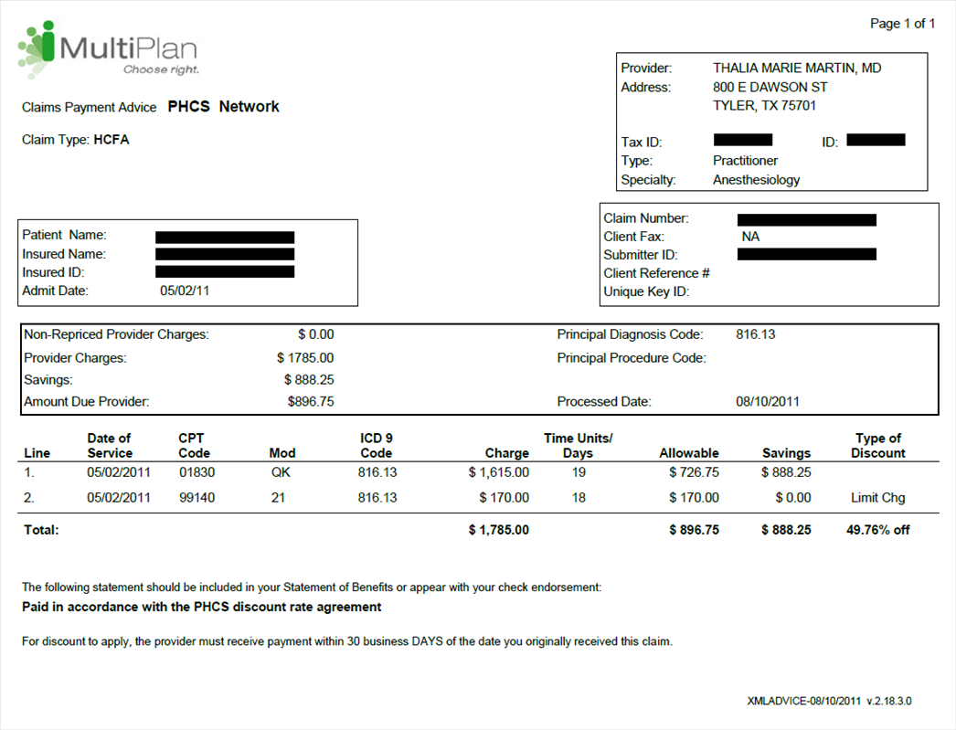
General Anesthesia

Slide 31
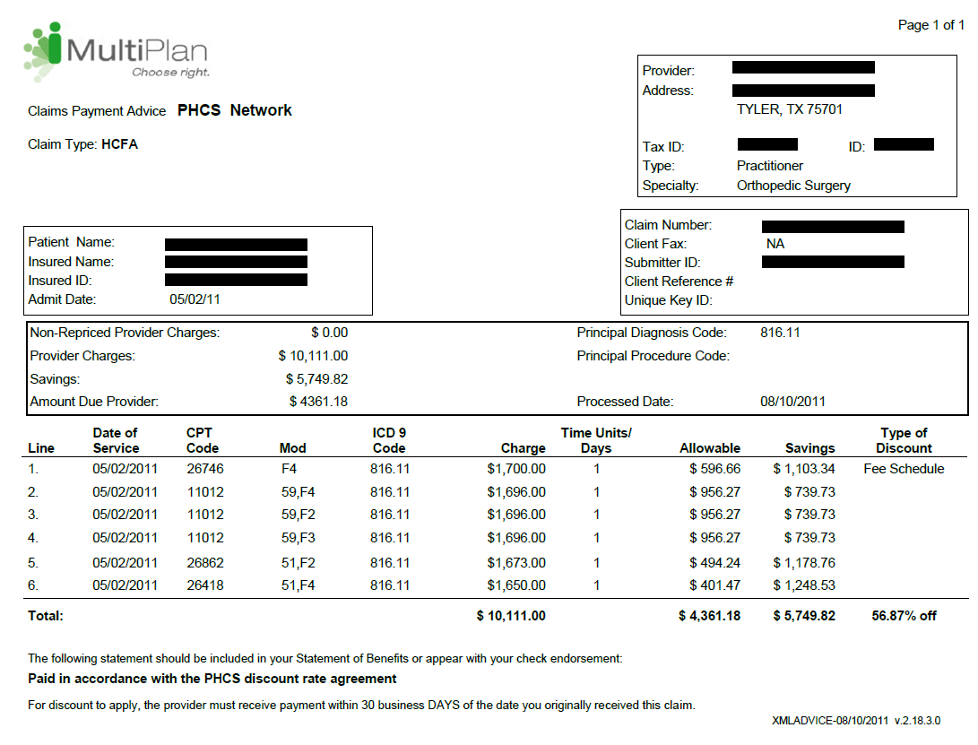
Metacarpal Fracture

Slide 32
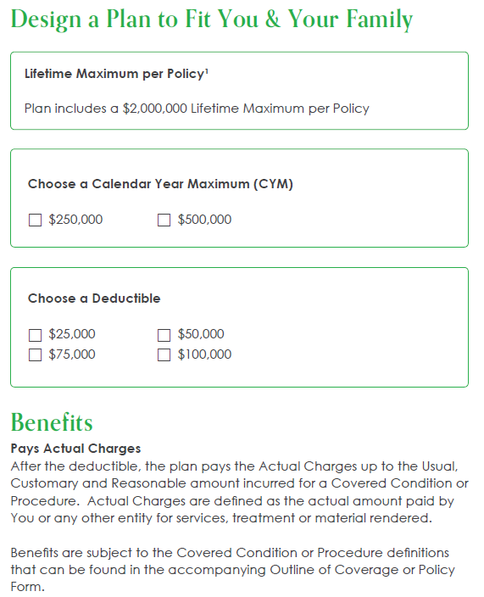
Specified Disease Policy
Major Illness Comprehensive Coverage
Why Specified Disease?
Pays actual charges for all eligible expenses as a result of a covered major illness/disease
Gives freedom to choose any doctor
Provides access to extended First Health network
Pays in addition to health policy
Coverage
Covers both inpatient and outpatient services
Covers prescription drugs
Specified Disease deductible must have a $5,000 spread from Critical Illness Rider benefit
Copyright © 2021 by Philadelphia American Life Insurance Company. All rights reserved.
Notes:
Kent

Slide 33
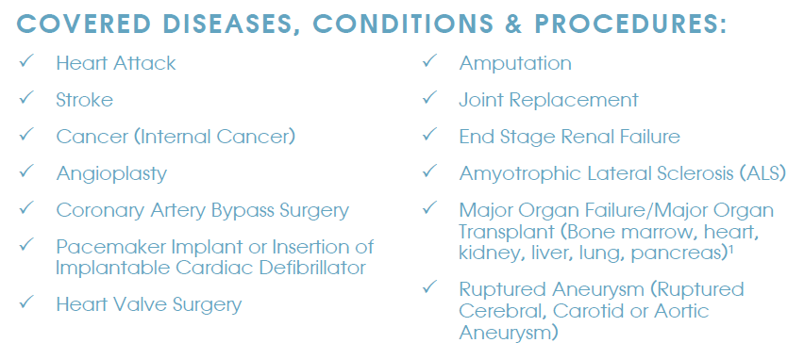

Slide 34
Specified Disease
Affordable rates for individuals and the entire family!
Sample Rates for Family of Four
Sample Rates for Individual
$250,000 CYM
Mother – 40 years old / non-smoker
Father – 40 years old / non-smoker
Two children
$250,000 CYM
Male – 38 years old / non-smoker
Calendar Year Deductible | Rate
$25,000 | $119.29
$50,000 | $71.58
$75,000 | $42.95
$100,000 | $25.77
Calendar Year Deductible | Rate
$50,000 | Less than $23

Slide 35
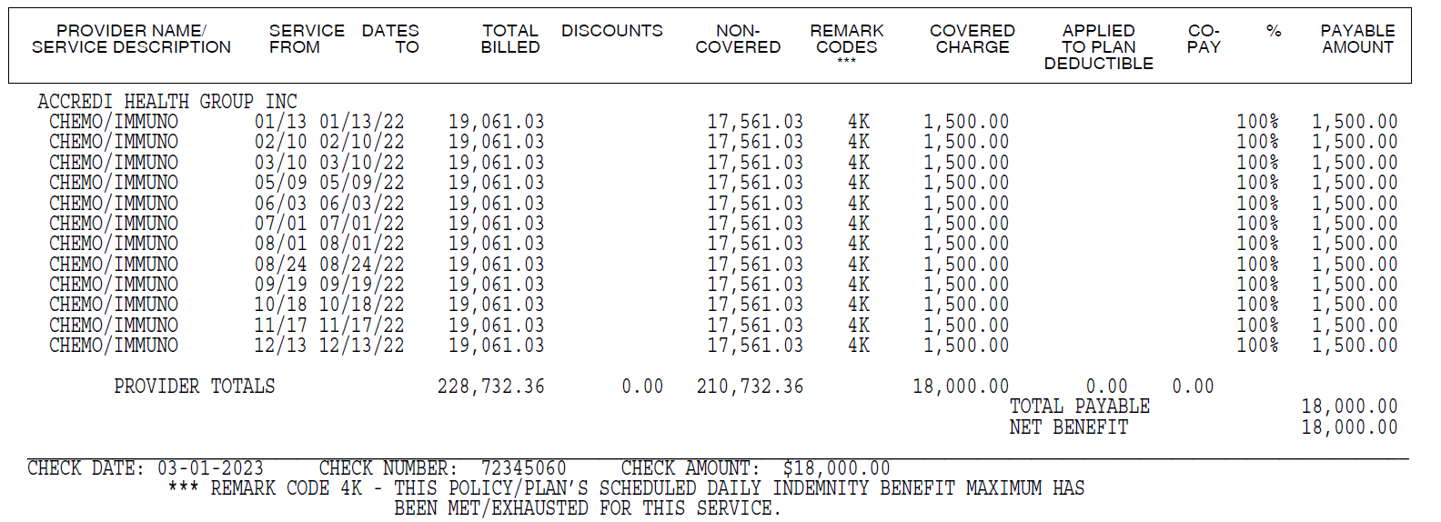
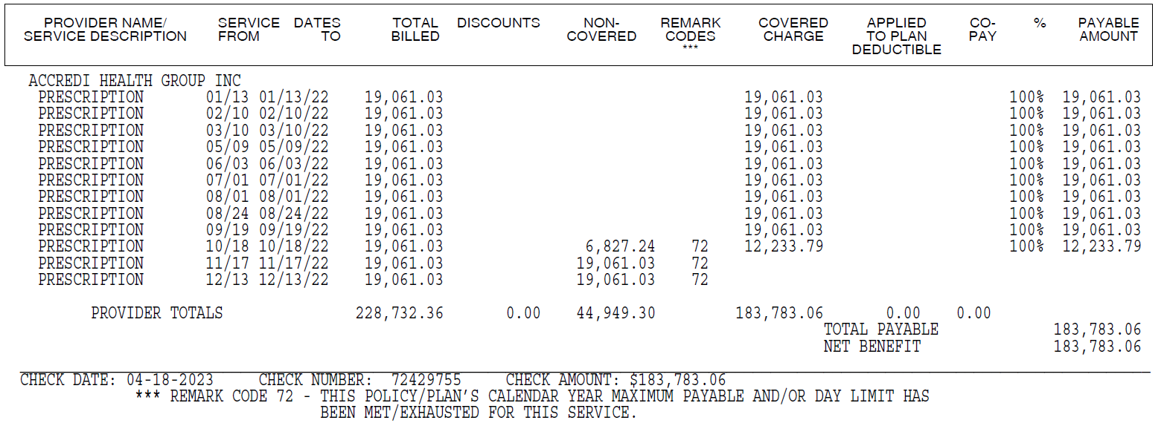
Bundling Example Two:
Oral Chemotherapy Treatment
HSPG
Plans
HSPG - Two Unit Plan; $2,500 deductible
Critical Illness Rider - $20,000 benefit
Specified Disease - $25,000 deductible; $250,000 CYM
Services
1 monthly dose of oral chemotherapy for 12 months
SPD
Provider/Facility/Hospital Charges
$228,732.36 billed ($19,061.03 per dose)

Slide 36
Benefits Payable
Example Two
Chemo Charges ($19,061.03 X 12 doses) | + $228,732.36
Network Discount (Not In-Network) | - $0
Actual Provider Charges | $228,732.36
HSPG Chemo Benefit ($1,500 X 12) | $18,000
HSPG Benefits Payable | $18,000
Critical Illness Rider ($20,000 X 25%)* | $5,000
Critical Illness Rider Benefits Payable | $5,000
HSPG Benefits Paid | Critical Illness Benefits Paid | Specified Disease Benefits Paid | Total Benefits Paid | Outcome
$18,000 | $5,000 | $183,783.06 | $206,783.06 | $21,949.30 Out-of-Pocket / Balance Bill
$18,000 | None | None | $18,000 | $210,732.36 Out-of-Pocket / Balance Bill
Specified Disease CYM | $250,000
Deductible to meet** | - $0
Previous CY Claims Paid | - $66,216.94
Remaining Specified Disease Benefits Available | $183,783.06
Specified Disease Benefits Payable | $183,783.06
*If diagnosed within first 90 days, CI benefits reduce to 25% of face value
**Deductible previously met

Slide 37
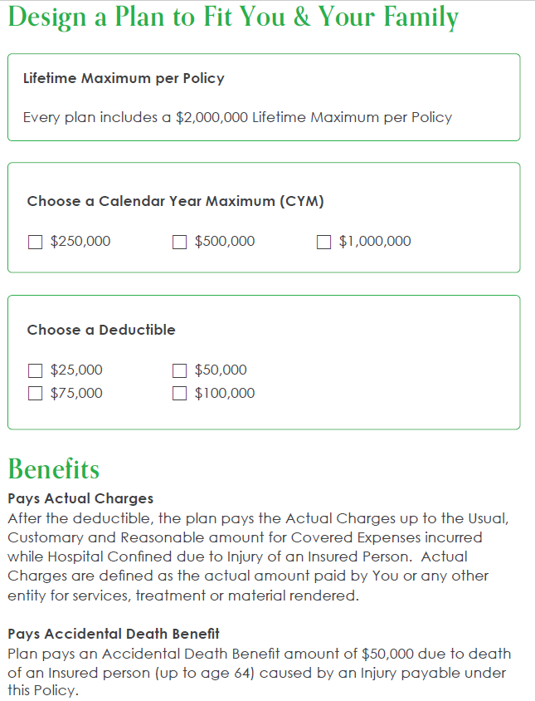
Catastrophic Accident
Catastrophic Accident
Expense
Why Catastrophic Accident?
Pays actual charges for all eligible expenses as a result of a covered accident causing injury
Gives freedom to choose any doctor
Pays in addition to health policy
Coverage
Covers both inpatient and outpatient services
Covers prescription drugs

Slide 38
Catastrophic ATV Accident Example
Provider/Hospital Charges
20 nights in ICU
2 nights in hospital room
Bundle: Two Unit HSP Gold with $5,000 CY Deductible; $100,000 Catastrophic Accident Deductible with $250,000 CYM
Actual Provider Charges | $278,000
HSP Gold ICU Benefit (injury) ($5,000 per day X 20 days) | $100,000
HSP Gold HC Benefit (injury) ($4,500 per day X 2 days) | $9,000
HSP Gold Admission Benefit | $2,000
HSP Gold Benefits Payable | $111,000 $5,000 = $106,000
Accident Charges | $278,000
Catastrophic Accident Deductible | - $100,000
Catastrophic Accident Benefits Payable | $168,000
Total Bundled Benefits Payable | $274,000
Total Provider Charges | - $278,000
Out-of-Pocket Owed by Insured | -$4,000
Actual Provider Charges | $278,000
HSP Gold ICU Benefit (injury) ($5,000 per day X 20 days) | $100,00
HSP Gold HC Benefit (injury) ($4,500 per day X 2 days) | $9,000
HSP Gold Admission Benefit | $2,000
HSP Gold Benefits Payable | $111,000 -$5,000 = $106,000
Total HSP Gold Benefits Payable | $106,000
Total Provider Charges | - $278,000
Out-of-Pocket Owed by Insured | -$172,000

Slide 39
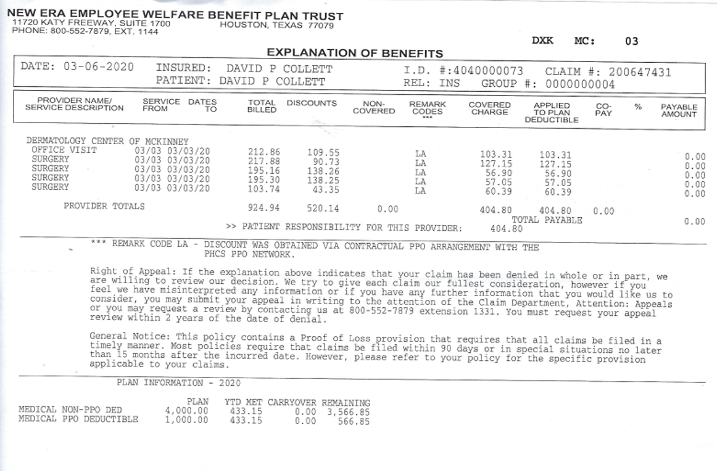
Major Medical Payout
Total Bill | $404.80
Major Medical PPO Deductible | $1,000.00
Out of Pocket Cost | $404.80
HSP Gold Payout
Physician Indemnity Benefit | $160.00
Surgery Benefit | $200.00
Total Benefit | $360.00
Out of Pocket Cost -$44.80

Slide 40
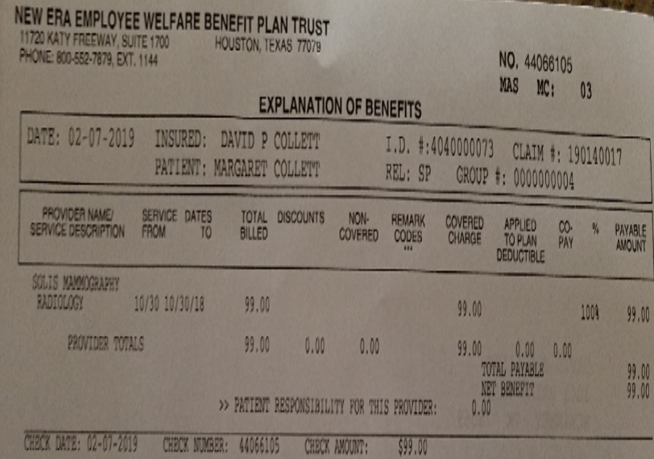
Solis Mammography
Cash Price
Self-Pay Price | $99.00
Cashier
Insurance Cost | $300.00
50% Network Discount | $150.00
Total Cost | $150.00

Slide 41
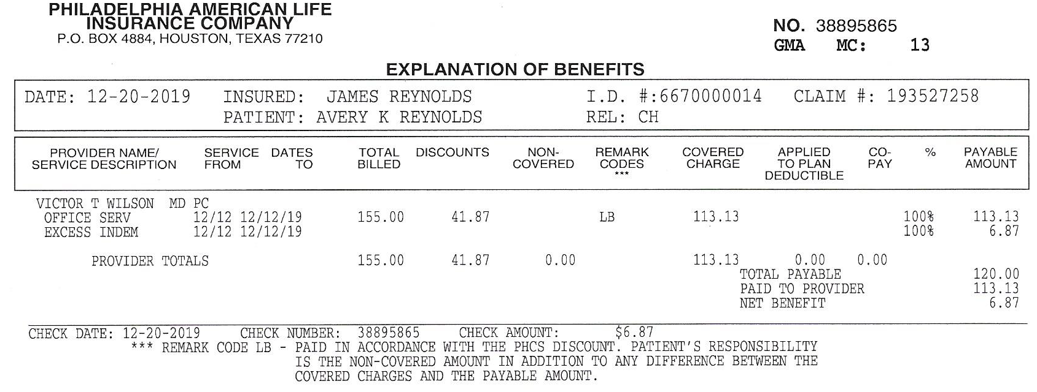
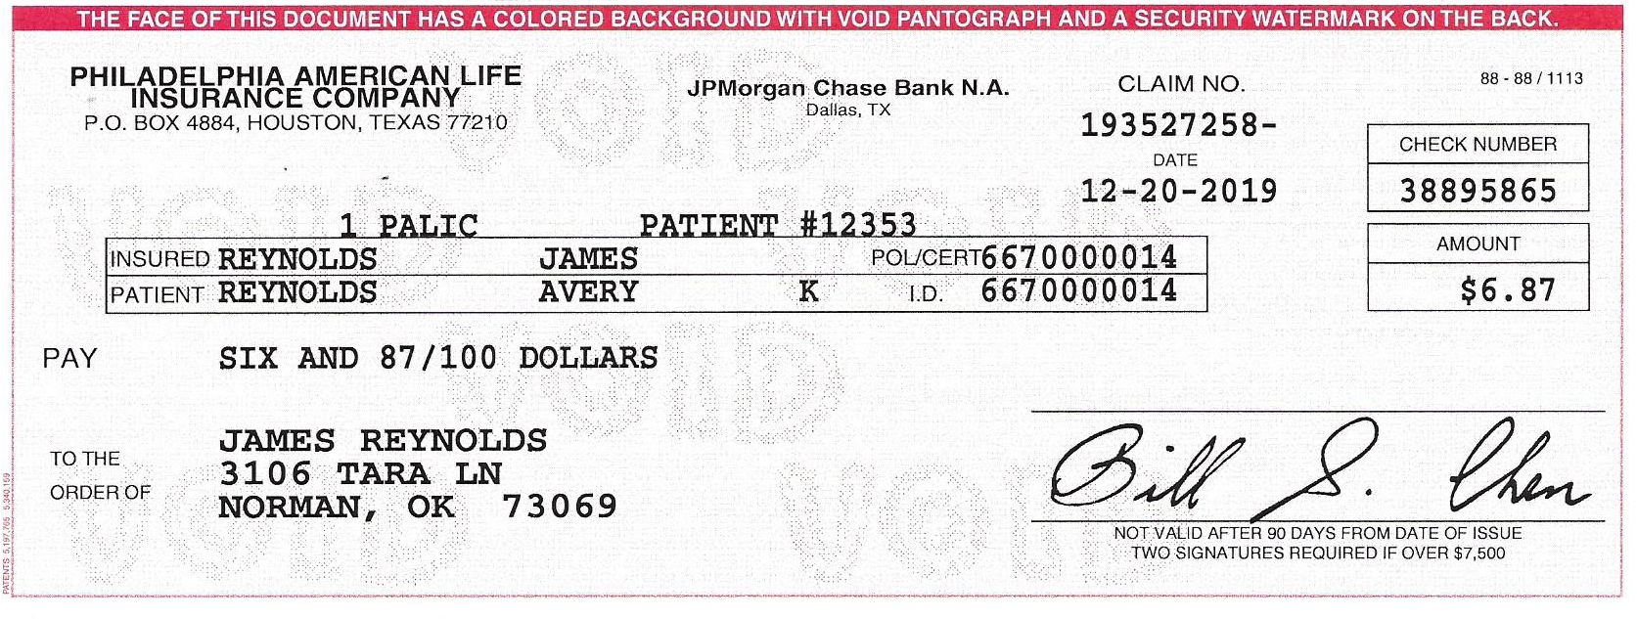

Physician Visit Example
Physician Indemnity Benefit | $120.00
Charges Paid to Provider | - $113.13
Excess Indemnity | $006.87

Slide 42
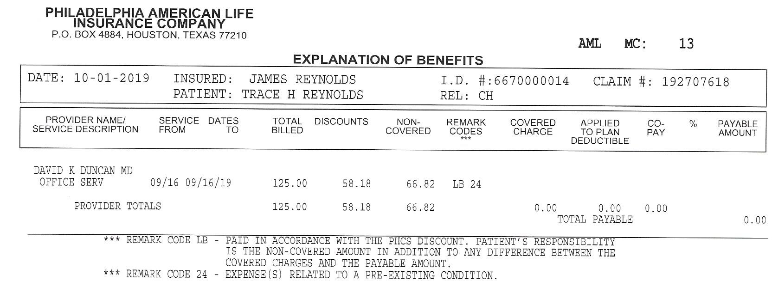
Pre-Existing Condition Example
Total Billed | $125.00
Network Discount Applied | - $ 58.18
Non-Covered Amount Owed | $066.82

Slide 43
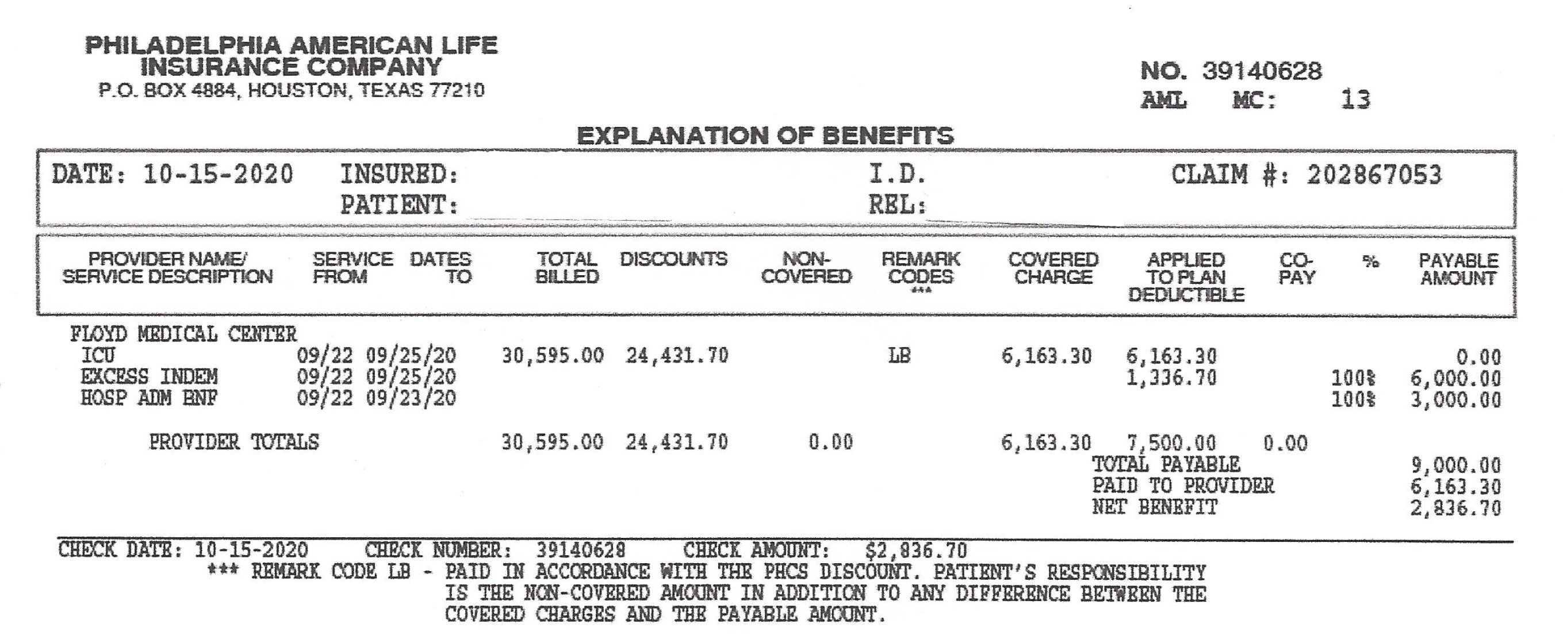
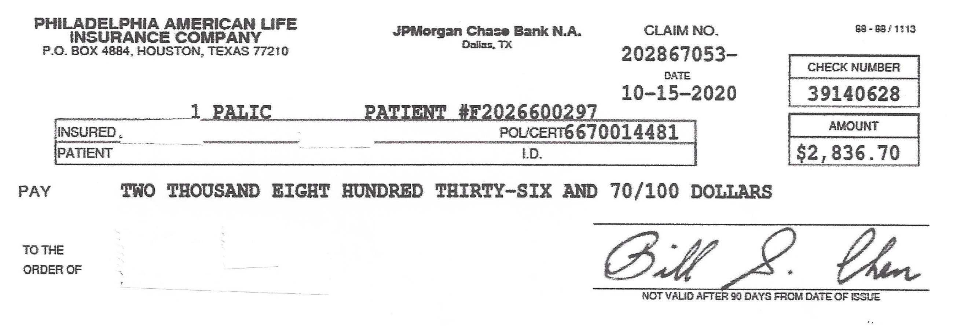
Deductible Example
Admitted to ICU Due to COVID
Coverage: HSP Gold 2 Units / $7,500 Deductible
Day 1 $4,500 + Day 2 $4,500 + Day 3 $4,500 + Deductible -$7,500 Admission Benefit $3,000
Benefits Payable | $9,000.00
Paid to Provider | - $6,163.30
Copyright © 2021 by Philadelphia American Life Insurance Company. All rights reserved.

