Slide 1


General Product Studies
Confidential and proprietary; redistribution, recording or copying is prohibited without written consent from Philadelphia American Life Insurance Co.
Copyright © 2025 by Philadelphia American Life Insurance Company. All rights reserved.
Notes:
Assistant Vice President in Marketing for U65 Products
Not an agent or sales man
21 years of experience
Attended over 1,000 agent sales presentations
Can’t pronounce all terms
You and I will be bffs for the next 3 days. Simply means you get to ask me any questions.

Slide 2

Marketing Overview
1990 | 2025
0 members | 250k+ members
$0 in AP¹ | $1.1 Billion + in AP¹
1 state license | 48 state licenses
48 states
Washington D.C.
Virgin Islands
¹Annualized Premium
Notes:
We are not a new company.

Slide 3
Marketing Outlook
Annuity
New Money Products
Medicare
Supplement Products
Under 65
Insurance Products
New Business Premium
(Issues and Paid)
New Business Premium
(Issues and Paid)
New Business Premium
(Issues and Paid)
2019 | $71 million
2020 | $71 million
2021 | $120 million
2022 | $52.7 million
2023 | $120.2 million
2024 (P) | $120 million
2025 (P) | $120 million
2026 (P) | $120 million
2019 | $34 million
2020 | $19 million
2021 | $19.4 million
2022 | $14.7 million
2023 | $8.3 million
2024 (P) | $9 million
2025 (P) | $10 million
2026 (P) | $11.5 million
2019 | $101.2 million
2020 | $114.5 million
2021 | $114.5 million
2022 | $89.7 million
2023 | $72.5 million
2024 | $70 million
2025 (P) | $80 million
2026 (P) | $90 million
Notes:
-reverse order
-change to 2019

Slide 4

PAL’s Alternative Approach to Health Insurance
Unique concept
Not a major medical
Brands healthcare and health insurance together
Pays set amounts regardless of the actual charges on the provider’s bill
Provides freedom of choice
Provides an incentive to shop smart
Creates a community of engaged healthcare consumers
Isn’t for everyone

Slide 5


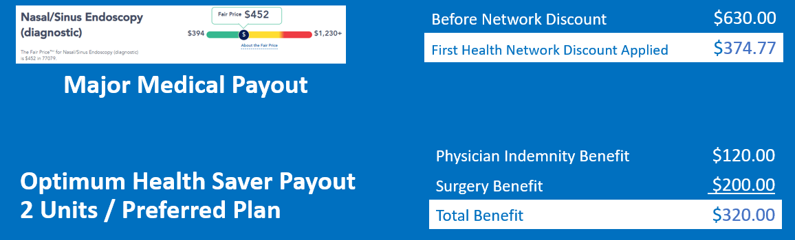
PAL’s Defined Benefit Plans
PAL Plans
No network restrictions = freedom of choice

Slide 6
Hospital Confinement
Preventive
Hospital Stay
Intensive Care Unit (ICU)
24 Hour Observation Stay
Mammogram
Colonoscopy
Annual Physical/Blood Work Labs
Doctor’s Office Visit
Imaging
Specialist
Chiropractor
MRI, X-Ray, PET/CAT Scan, etc. (Including FREE New Era Telehealth)
Unlimited
No charge
Emergency / Urgent Care
And more!

Slide 7


No carrier bundles quite like we do
Our bundling concept aims to provide an alternative solution to ACA or major medical coverage by addressing consumers’ top three healthcare concerns.

Slide 8






Health and Income Protection Series
Alternative Approach
Optimum Health Saver
Foundation Health Plan
PAL plans bundle together for robust coverage
Catastrophic Accident
Major Accident Comprehensive
Critical Illness
Major Illness Enhancement
24-Hour Enhanced
Accident Enhancement
Specified Disease
Major Illness Comprehensive

Slide 9


















Health Saving Tools paid for by PAL at no cost to insured¹
Fair Price partners
Healthcare PALS
Healthcare Bluebook
Concierge
Fair Pricing Tool
New Era Telehealth
Powered by Lyric
Benefit PAL Mobile App
¹ Valuable member services are for eligible plans only.

Slide 10
Your clients are backed by an AM Best A- (Excellent) Rated Company
Our A- (Excellent) Financial Rating comes from the most trusted and respected independent rating agency out there. AM Best has over 100 years of experience in rating insurance companies!

Slide 11
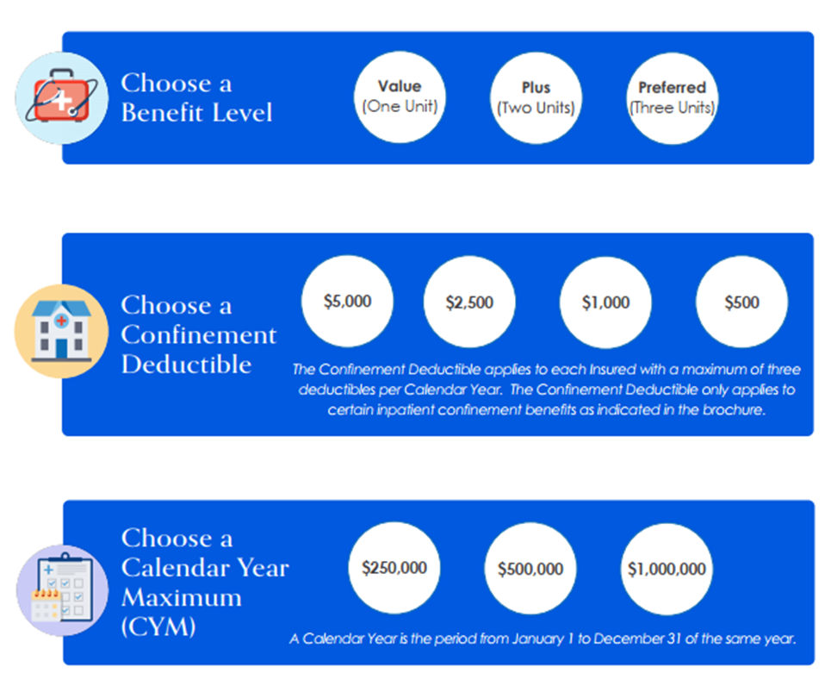
What is a calendar year maximum?
A calendar year maximum is the period from January 1 to December 31 of the same year.

Slide 12

How does PAL’s deductible work?
Formula:
First Inpatient Admission Benefit
Daily Hospital Confinement (Injury or Sickness)
Calendar Year Deductible
Three-Unit Coverage Example
First Inpatient Admission Benefit | $3,000
Daily Hospital Confinement for Injury | + $10,500
 | = $13,500
Calendar Year Deductible | - $5,000
One-day hospital benefit = $8,500

Slide 13
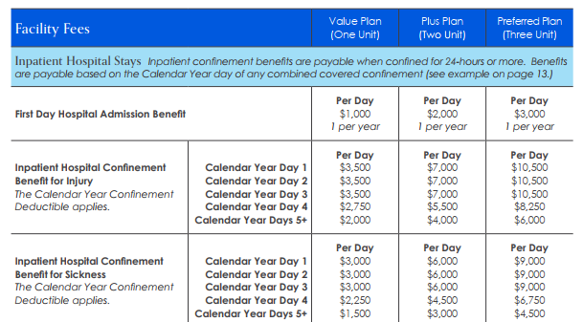
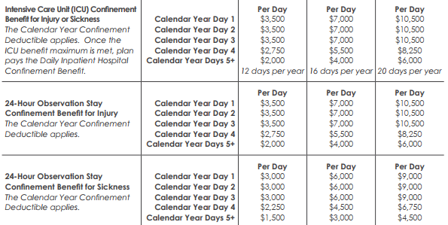
Hospital Stay Averages
Three Day Stay for Sickness Example
PAL Average Hospital Stay since 2011 is 3.5 days.
Deductible | National Avg. Hospital Stay per Day | One Unit Plan | Two Unit Plan | Three Unit Plan
$5,000 | $8,052 |  | $15,000 | $25,000
$2,500 | $8,052 | $7,500 | $17,500 | $27,500
(Day 1-3 Benefit x Days – Deductible) + Admission Benefit
Proprietary & Confidential 10.30.2023
National Average
Nonprofit Hospitals = $3,013
For-Profit Hospitals = $2,296
State/Local Government Hospitals = $2,742
Average: $2,684

Slide 14
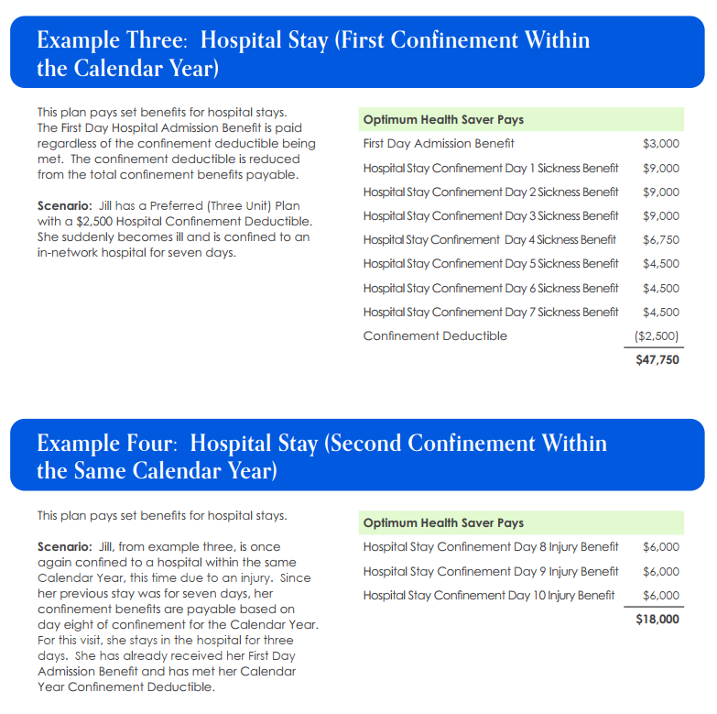
What is a hospital confinement benefit?
A hospital confinement benefit is based on the number of days you’ve stayed in a calendar year.

Slide 15
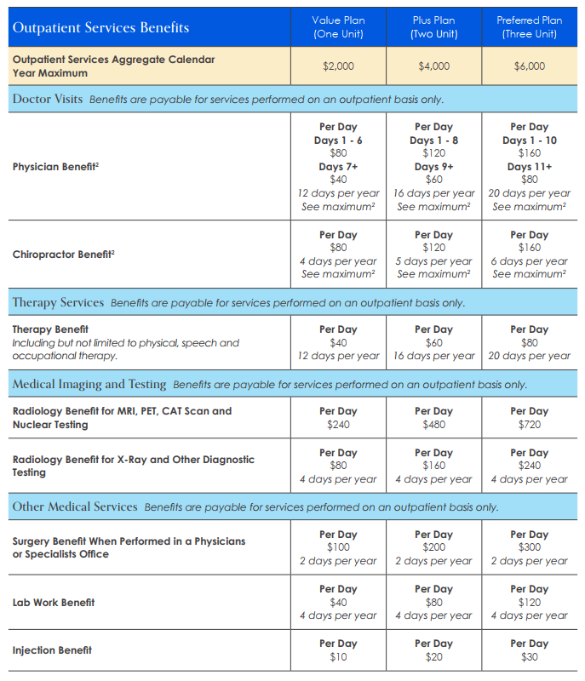
Outpatient Services
New benefit due to the popularity of therapy services
< 0.005% of policyholders reach their outpatient calendar year max per year*
6% of policyholders utilize more than six doctor visits per year*
*Based on PAL claims data for hospital indemnity plans
Benefit availability, exclusions and limitations may vary by state. Please refer to the policy in your state for more information.
¹There is a maximum of combined limit for the Physician and Chiropractor Benefits; includes up to 20 days for Three Unit Plans, up to 16 days for Two Unit Plans, and up to 12 days per One Unit Plan, per Calendar Year.
Proprietary & Confidential 10.27.2023

Slide 16
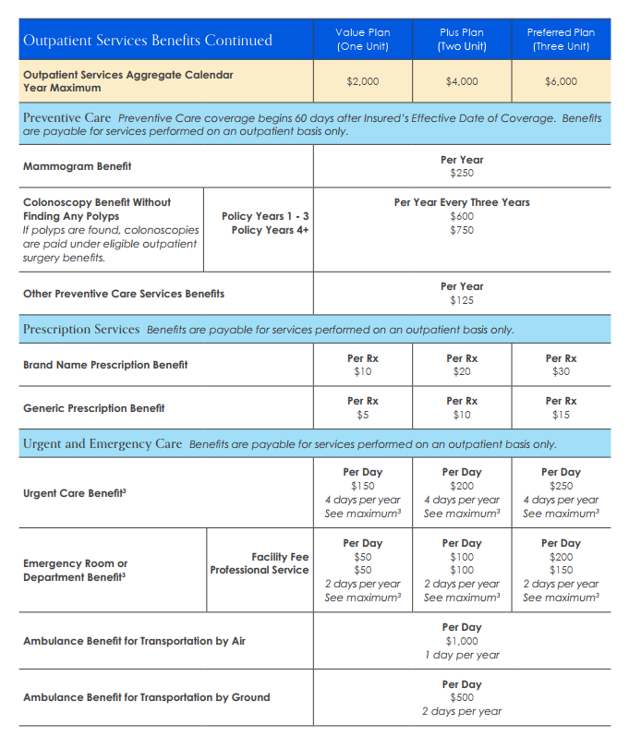
Outpatient Services
60-day waiting period
Benefit availability, exclusions and limitations may vary by state. Please refer to the policy in your state for more information.
²There is a maximum of combined limit for the Urgent Care and Emergency Department Benefits; includes up to 4 days per Calendar Year.
³The Calendar Year Maximum for Surgical Benefits is $50,000.
⁴The Surgical Schedule can be found in the Policy.
Proprietary & Confidential 10.30.2023

Slide 17
Bundling 101
Health & Income Protection Series by PAL
“When you need insurance the most, you need the most insurance.”
- A wise person

Slide 18
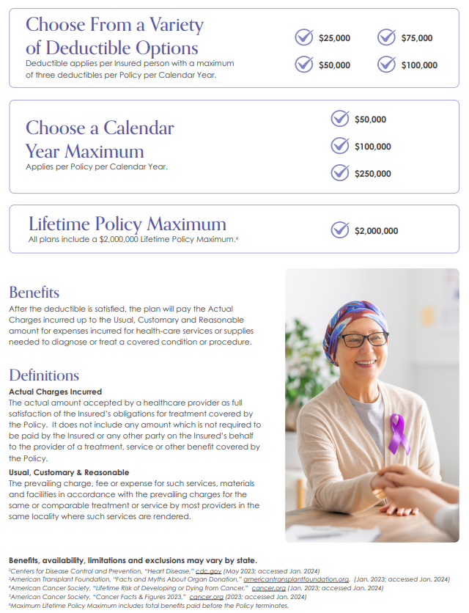
Specified Disease Policy
Major Illness Comprehensive Coverage
Why Specified Disease?
Pays actual charges for all eligible expenses as a result of a covered major illness/disease
Gives freedom to choose any doctor
Provides access to extended First Health network
Pays in addition to health policy
Coverage
Covers both inpatient and outpatient services
Covers prescription drugs
Specified Disease deductible must have a $5,000 spread from Critical Illness Rider benefit
Copyright © 2021 by Philadelphia American Life Insurance Company. All rights reserved.
Notes:
Kent

Slide 19
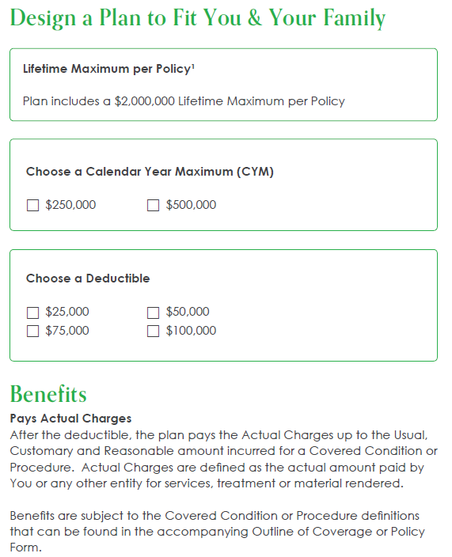
Specified Disease Policy
Major Illness Comprehensive Coverage
Covered Diseases, Conditions, & Procedures
Heart Attack
Stroke
Cancer (Internal Cancer)
Angioplasty
Coronary Artery Bypass Surgery
Pacemaker Implant or Insertion of Implantable Cardiac Defibrillator
Heart Valve Surgery
Amputation
Joint Replacement
End Stage Renal Failure
Major Organ Failure/Transplant (Bone marrow, heart, kidney, liver, lung, pancreas) ²
Ruptured Aneurysm (Ruptured Cerebral, Carotid or Aortic Aneurysm)
Copyright © 2021 by Philadelphia American Life Insurance Company. All rights reserved.
Notes:
Kent

Slide 20
Specified Disease
Affordable rates for individuals and the entire family!
Calendar Year Deductible | Rate
$25,000 | $119.29
$50,000 | $71.58
$75,000 | $42.95
$100,000 | $25.77
Sample Rates for Family of Four
$250,000 CYM
Father – 40 years old | Non-smoker
Mother – 40 years old | Non-smoker
Two children
Sample Rates for Individual
$250,000 CYM
Male – 38 years old | Non-smoker
Calendar Year Deductible | Rate
$50,000 | Less than $23

Slide 21

JET UNDERWRITING for QUICK ISSUE
How to avoid counter offers?
Don’t forget to rate up if they use tobacco in the last 2 years?

Slide 22
Underwriting Member Experience Tech Enhancements
DocuSign Like Applicant Signatures
Skip e-verification & TI by getting signature before submitting application
Jet Issue Underwriting
Same day issue for some clean applications
DocuSign for Counter Offers
Quicker process
Notes:
Kim – 5 min
Legal documents; must be accurate or

Slide 23
Underwriting Member Experience Tech Enhancements
Check status of application
Receive status updates via text message
Receive notifications for required actions
Direct message to home office
Early education on coverage
Applicant Portal
Notes:
Kim – 5 min
First of its kind

Slide 24



Give Your Clients The Power to Track Their Applications & Pending Action Items In Real Time
Opt to Have Your Client Sign Their Application Instantaneously
Save Time With a Streamlined Process for Counter Offers
Our new E-Sign feature will let you send your clients their application(s) for review and signature instantaneously, making it easier than ever to get those applications submitted right then and there during your appointment.
Just like checking the status of a pizza delivery, your clients will have the power to track their application status in real time!
Plus, the portal will let them know if any action is needed from them, allow for seamless document uploads, and give them a handy overview of the plans they applied for.
Sometimes underwriters need to issue a counter offer. No more of you needing to forward counter offers to your clients!
Our underwriters will send your clients an email directly (keeping you in the loop, of course!) with a DocuSign link for quick review and signature - making the counter offer process faster than ever before.

Slide 25
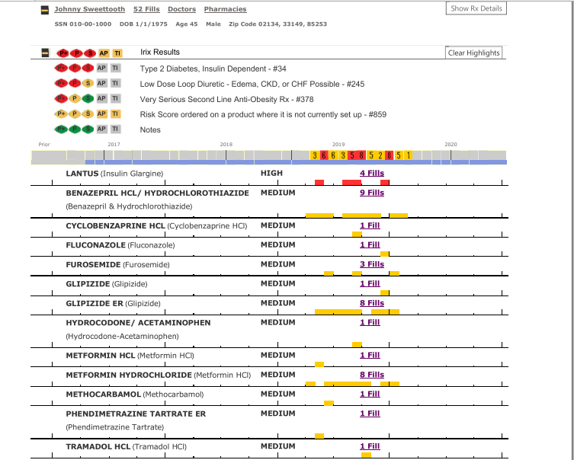
UW using Rx history? (Did you remind the client to think about their past prescription history when answering the medical questions? Because our underwriters are checking it out! This application and verification all were clean.

Slide 26
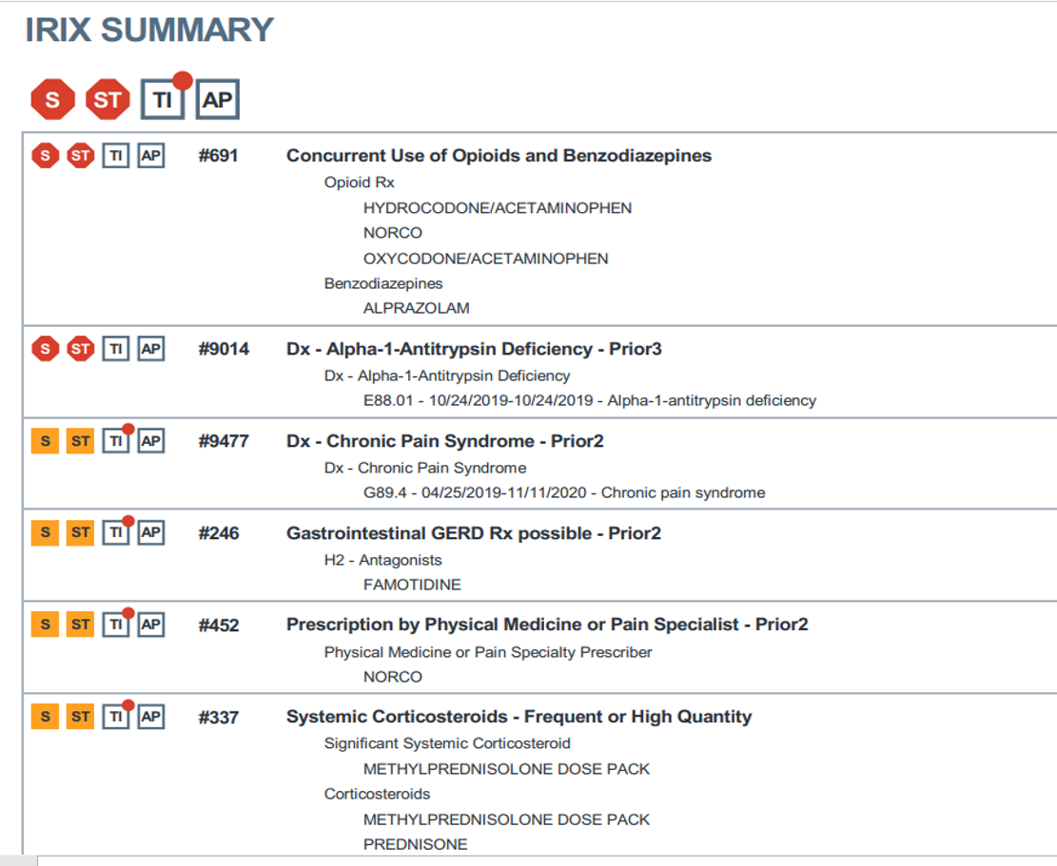

Slide 27
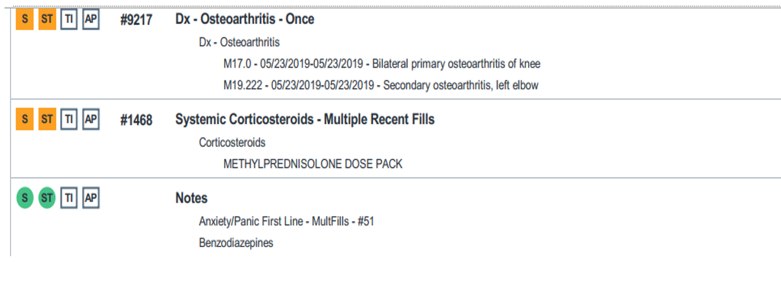

Slide 28
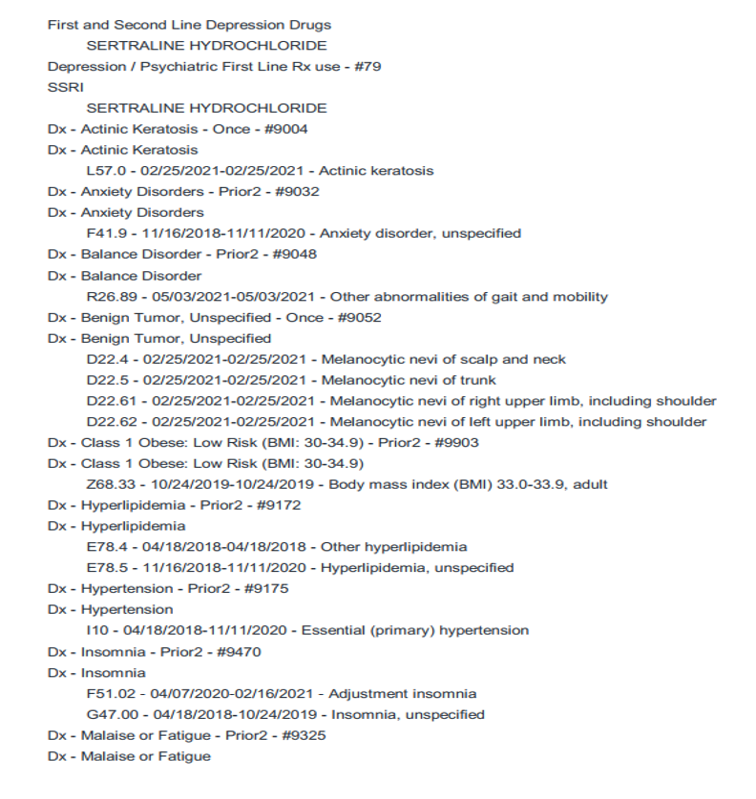

Slide 29
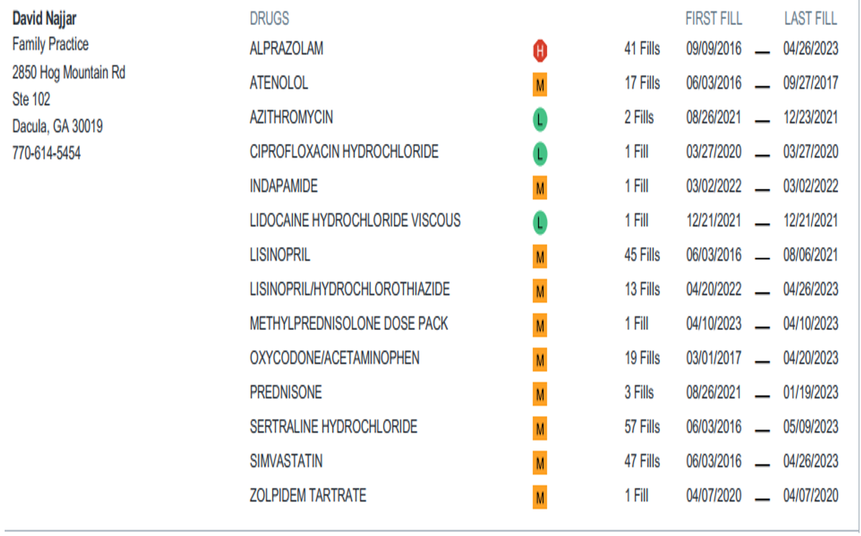

Slide 30
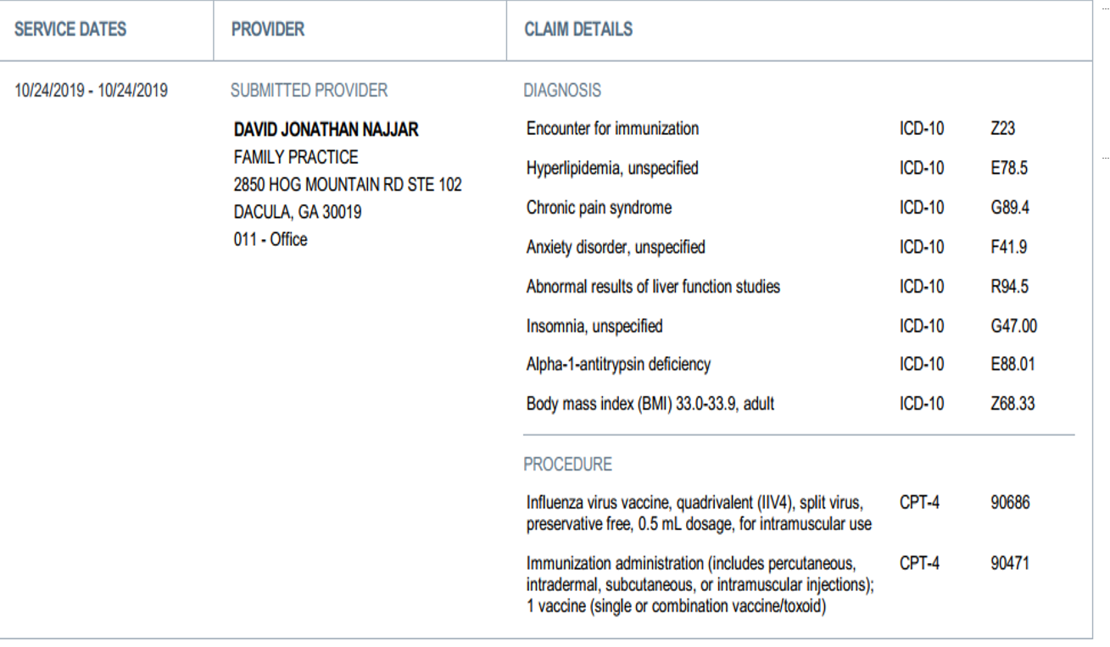

Slide 31
Questions?
Comments?
Contacts:
dcollett@neweralife.com
jurbano@neweralife.com
ckyle@neweralife.com
Confidential and proprietary; redistribution, recording or copying is prohibited without written consent from Philadelphia American Life Insurance Co.
Copyright © 2025 by Philadelphia American Life Insurance Company. All rights reserved.
Notes:
Assistant Vice President in Marketing for U65 Products
Not an agent or sales man
21 years of experience
Attended over 1,000 agent sales presentations
Can’t pronounce all terms
You and I will be bffs for the next 3 days. Simply means you get to ask me any questions.

