Slide 1



EXCLUSIVE SALES AND SUPPORT FOR DETEGO HEALTH,
POPULATION SCIENCE MANAGEMENT

Slide 2


We believe that
modern health coverage
should reflect the reality
of modern work.
Millions of Americans who make above average wages or above average health cannot access a plan customed designed to meet their needs, interests or how they wish to access the healthcare system.

Slide 3
1/1 Updates
What happened:
  A file error during enrollment processing on January 1, 2026 prevented household member IDs and ID cards from being generated for some members.
Why it happened:
  The error occurred during system file processing and was not immediately visible.
  We needed time to identify the root cause and confirm which members were affected.
Current status:
  The issue is being resolved and working toward all Digital IDs / cards to be available within the next few days.
  We are communicating directly with impacted members.
Acknowledgment:
  We recognize this caused frustration for members and challenges for you as our partner.
  We sincerely apologize for the disruption and the trust concerns this created.
Our promise:
  We have updated processes, added safeguards, and increased support resources to prevent recurrence.
  We remain committed to transparency and excellence in our partnership.

Slide 4


Who We Serve
Self-Employed & Working Owners
We serve individuals who don’t have access to a traditional employer-sponsored group health plan.
Our members are often independent contractors or gig economy workers looking for affordable,
flexible solutions to meet their unique needs.
Examples include:
Realtors & insurance agents
Rideshare drivers (Uber, Lyft, etc.)
The soon-to-be 25 million Americans who are
not eligible for subsidies on the exchange or
who do not receive coverage through an
employer

Slide 5




How We Serve Them
A New Way to Access Health Benefits
Working Owner Eligibility
Complete Surveys in Covered365 app
Earn Monthly Income
Group Health Benefit Access
Working Owner Eligibility:
Members qualify as working owners by participating as Consumer Data Respondents (CDRs), who complete surveys that provide valuable, de-identified insights.
Monthly Survey Income:
Earn money each month by completing surveys through the Covered360 mobile app.
K-1 Form:
At tax time, Working Owners of PSM receive a Schedule K-1 Form for reporting any income earned through surveys.
Administered by Detego Health:
A nationally licensed TPA and creator of High-Performance Health Benefit Plans.

Slide 6


Population Science Management
& the Working Owner Model
Why Population Science Management Working Owner Model?
Population Science Management (PSM) is a data research and analytics company with the mission of empowering
individuals to earn money by sharing their personal data and providing Working Owners access to Group Benefit Plans.
This Gold Standard for Working Owners, 1099 self-employed, and Gig Economy workers finally offers a solution with benefits unseen in the individual market.
PSM Employs Consumer Data Respondents (CDRs)
CDRs provide insights into their health and consumer habits.
As a CDR, each person is recognized as a Working Owner of PSM.
Gig Worker noun
plural gig workers
: a person who works temporary jobs typically in the service sector as
an independent contractor or freelancer : a worker in the gig economy
6

Slide 7




The Power of PSM:
Collecting Data from The Population
Significant Health Data:
Extensive data on disease states and chronic conditions in the market.
Rare & Highly Valuable Data:
Unlike general health surveys, PSM data is unique and highly valuable.
PSM’s Targeted Data Collection:
PSM gathers insights from a specific, defined population.
Beyond Health:
Surveys cover lifestyle, behavior, and consumer trends to drive innovation.
7
7

Slide 8
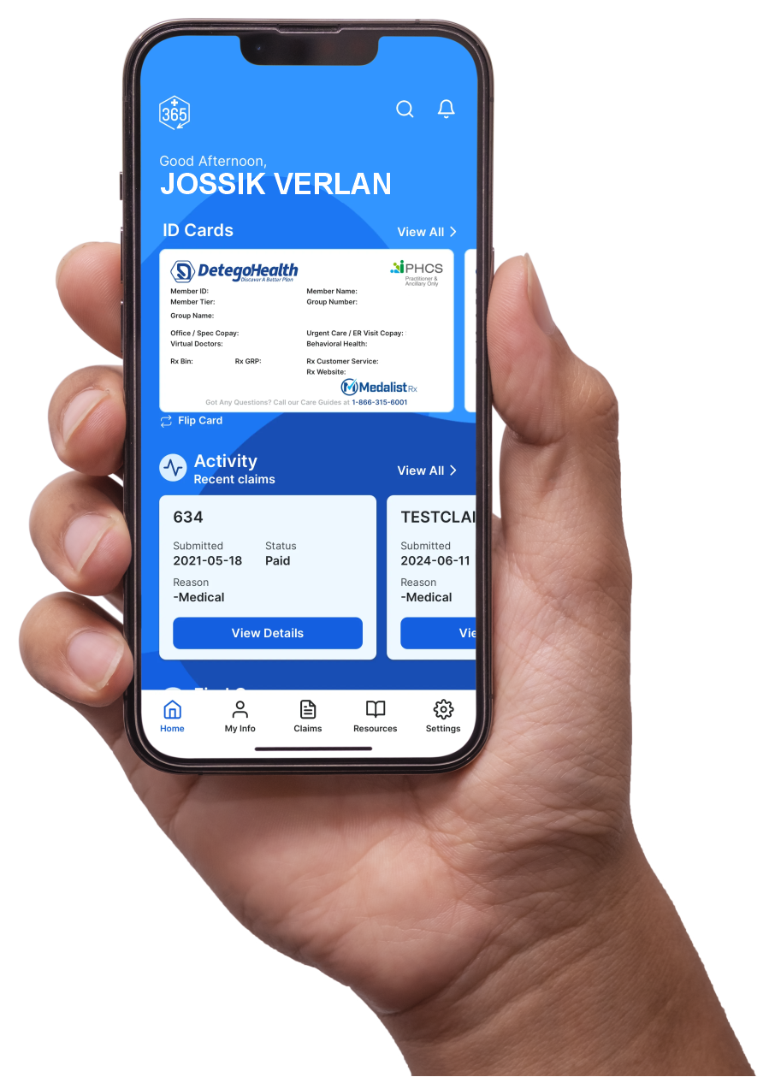
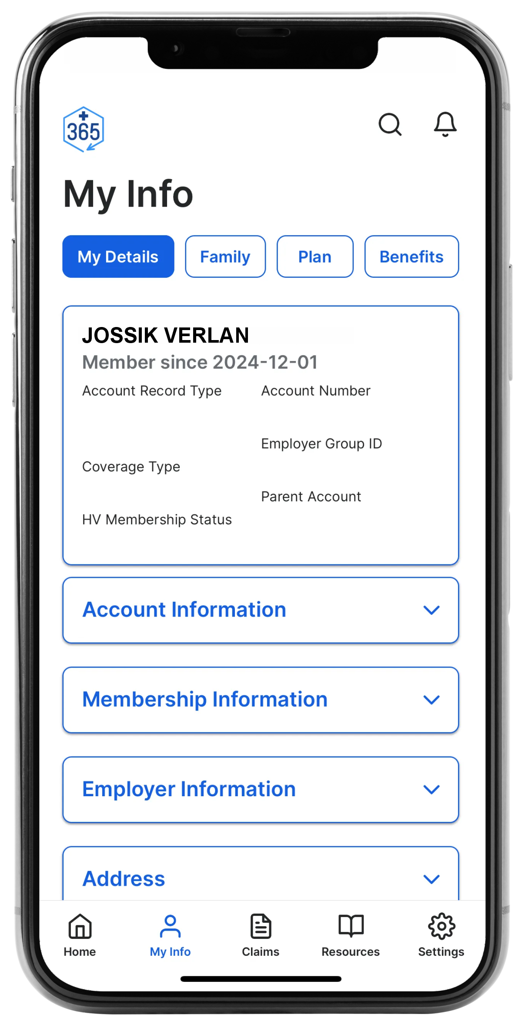
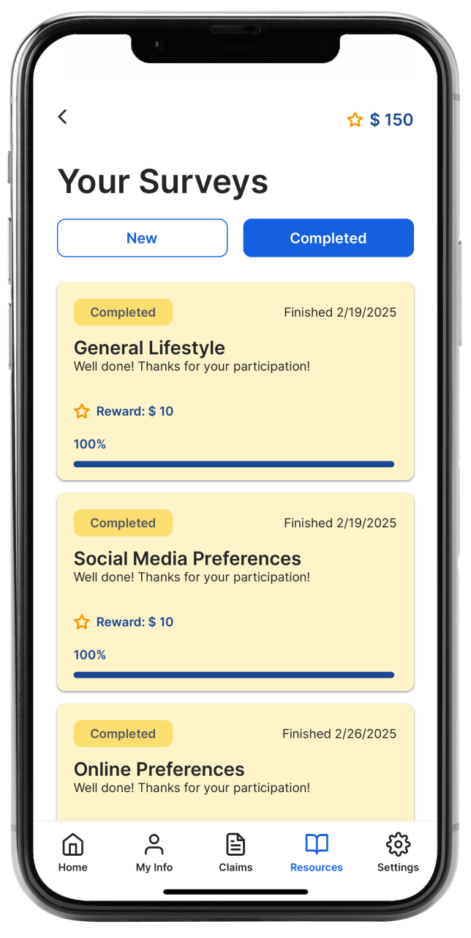

Working Owner Model
Job Requirements
To receive payment, you must actively participate as a Consumer Data Respondent (CDR) by completing surveys as requested.
Assigned surveys must be completed in the Covered365 app, available on the Apple App Store and Google Play.
Active CDRs who meet participation requirements and make monthly contributions are eligible for group medical benefits and other offerings.
Covered365 App
The Covered365 app provides you with convenient, 24/7 access to your organization’s Health Benefits Plan, all year round.
What’s Inside?
ID Card
EOBs
Claims
Consumer Data Respondent Surveys
Available on iPhone, iPad, and all Android devices.
** Covered365 is exclusively available to eligible Detego Health LLC users.

Slide 9
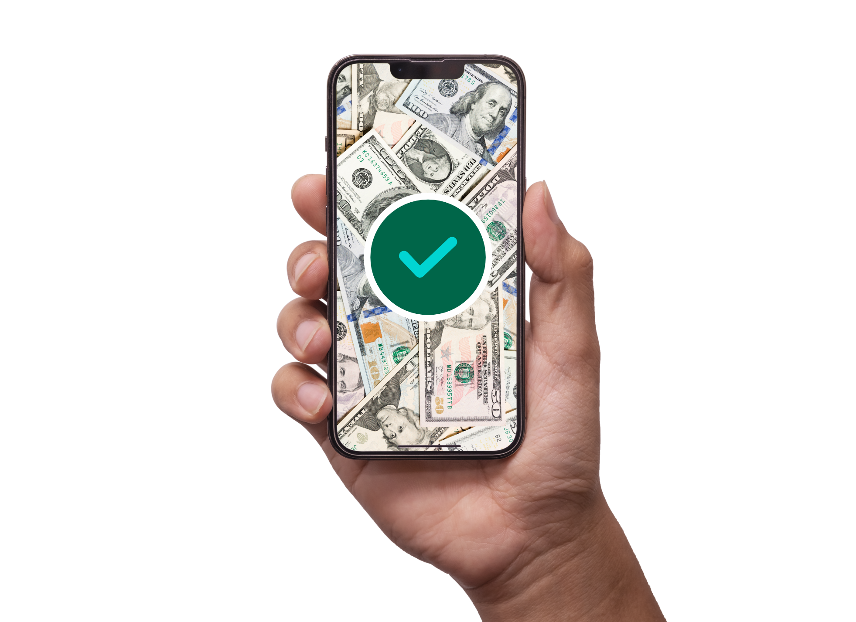
Working Owner Model
Payments
Payment amounts vary.
Payments are made through CommercePayments PreferPay
Verify Your Bank
You will receive a notification of payment through the email you provided.
The email should say it came from DoNotReply@commercebank.com.
Direct Deposit
After verifying your bank account, payments are processed
and may take 2-4 business days to show in your bank.
Available on iPhone, iPad, and all Android devices.
** Covered365 is exclusively available to eligible Detego Health LLC users.
Survey payments are only through ACH.

Slide 10
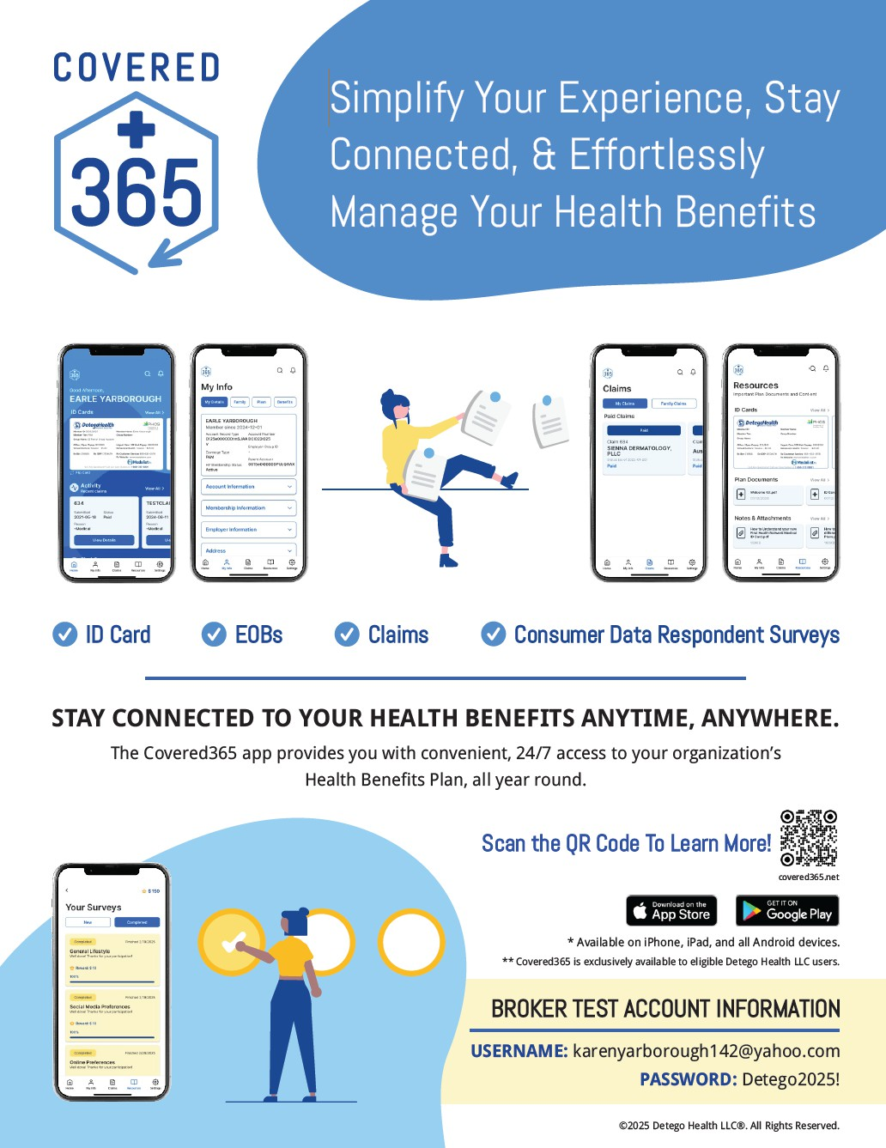



Broker Test Account
Username: detegotestuser1@detegohealth.com
Password: Detego2025!
Available on iPhone, iPad, and all Android devices.
** Covered365 is exclusively available to eligible Detego Health LLC users.
WWW.IRONHEALTHBENEFITS.COM
9

Slide 11





Recruiter / Enroller Roles to Remember
Step 1: Recruit, Not Sell
Recruit CDRs (Working Owners)
You are recruiting, not selling insurance
Step 2: CDR Suitability
Suitability Assessment Completed
Member is eligible for Benefit Plans
Step 3: Enroll in Health Benefit Plan
Enroll in Group Health Plan
Review plan options and materials with member

Slide 12


Milliman Suitability Tool Highlights
Digital Suitability Form:
PSM working owners will complete Milliman’s secure online suitability questionnaire to verify eligibility.
HIPAA-Compliant Process:
Captures members’ HIPAA release forms, ensuring privacy and compliance with federal health regulations.
Integrated Member Journey:
Accessible directly through your microsite, creating a seamless process from suitability assessment to plan enrollment.
Trusted Platform:
Milliman is a leading actuarial and technology firm with secure, data-driven tools used across healthcare and insurance industries.
Regulatory Alignment:
Designed to meet Department of Labor and state insurance guidelines, reducing compliance risks.

Slide 13
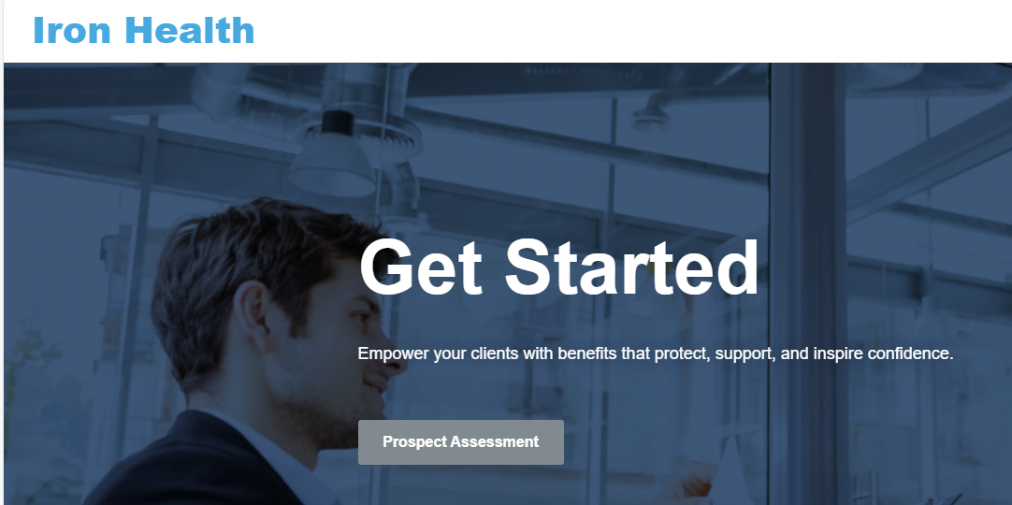
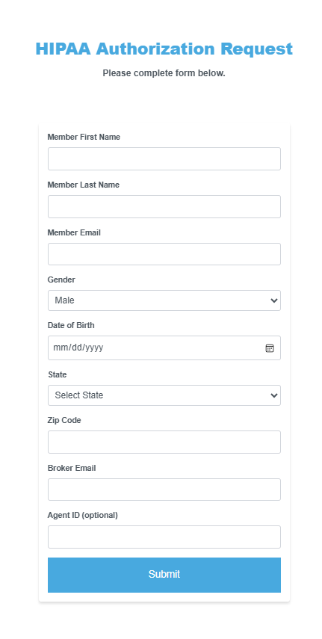
Milliman Suitability Tool Process
Step 1:
Access the submission form on Iron Health landing page, posted in your e123 back office.
Step 2:
Enter member’s information on the HIPAA Authorization Request form, as well as your email and 6-digit agent ID from e123.
.

Slide 14
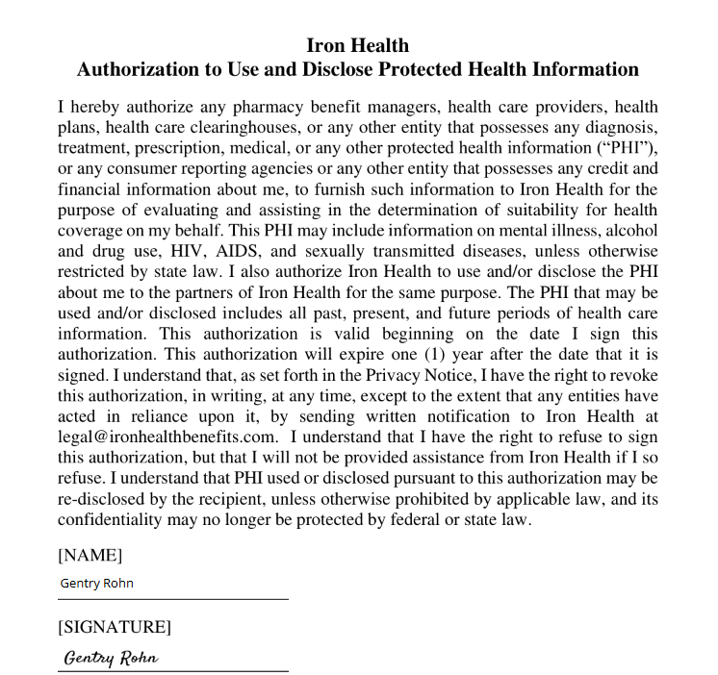
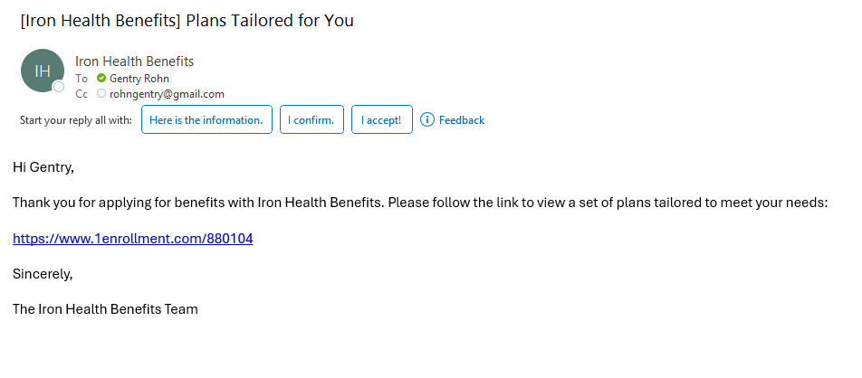
Milliman Suitability Tool Process
Step 3:
Member will receive an email to complete their HIPAA authorization through SignWell. Once signed, member’s information is automatically submitted to Milliman.
Step 4:
Both you and the member will receive an email with a link to available plans. Passing scores are directed to e123.

Slide 15
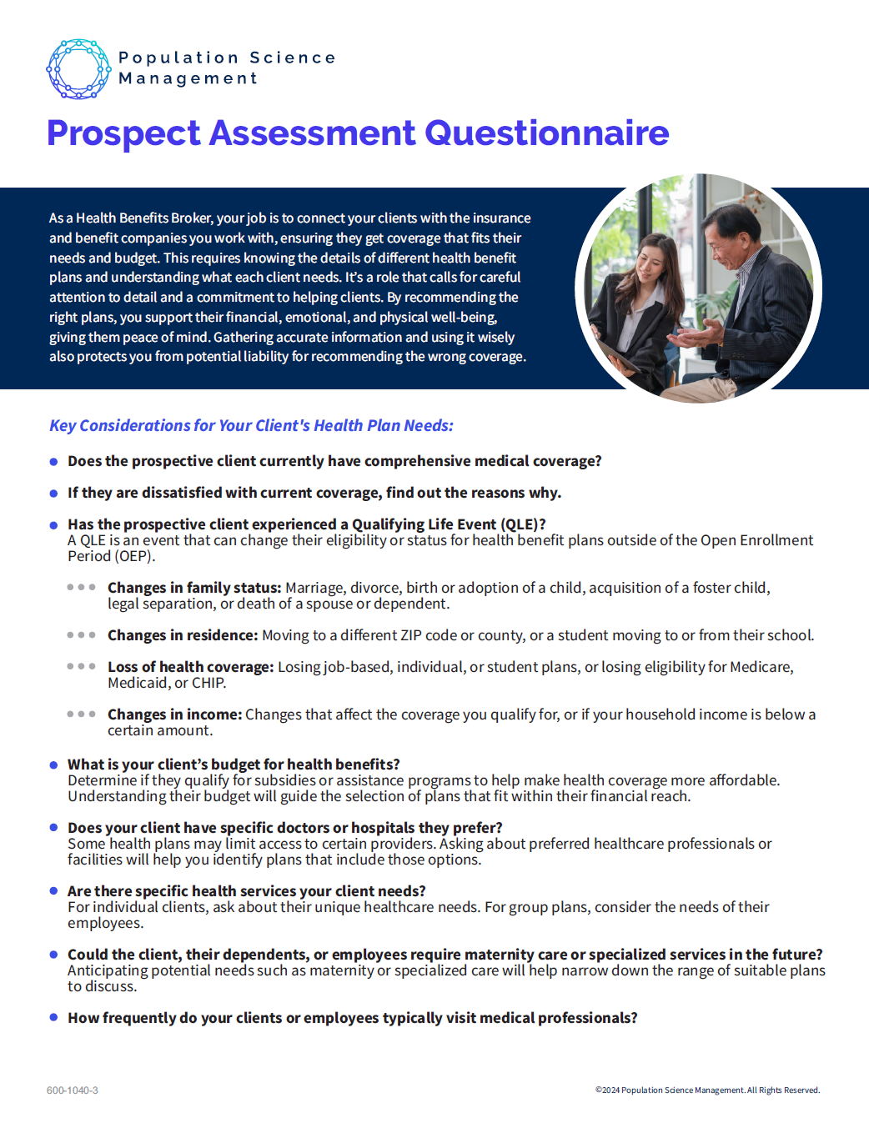

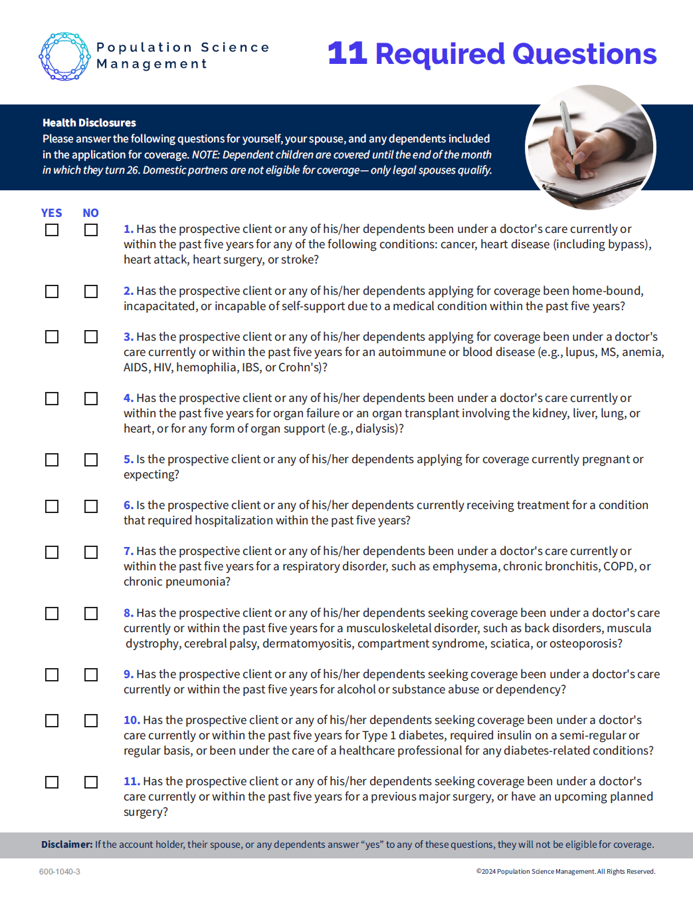
Working Owner PAQ
Please vet any dependents including spouses by utilizing the (PAQ).

Slide 16
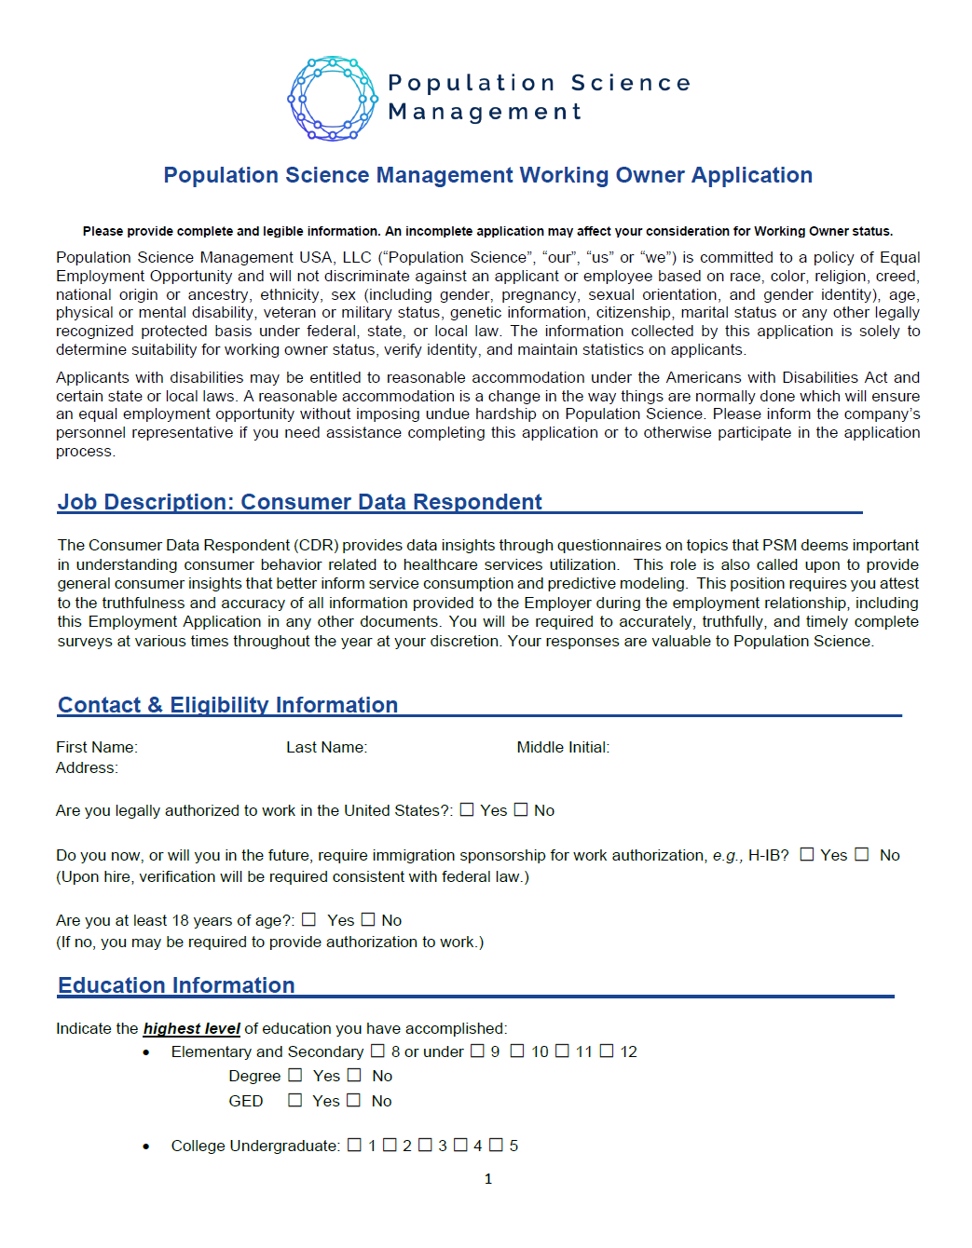
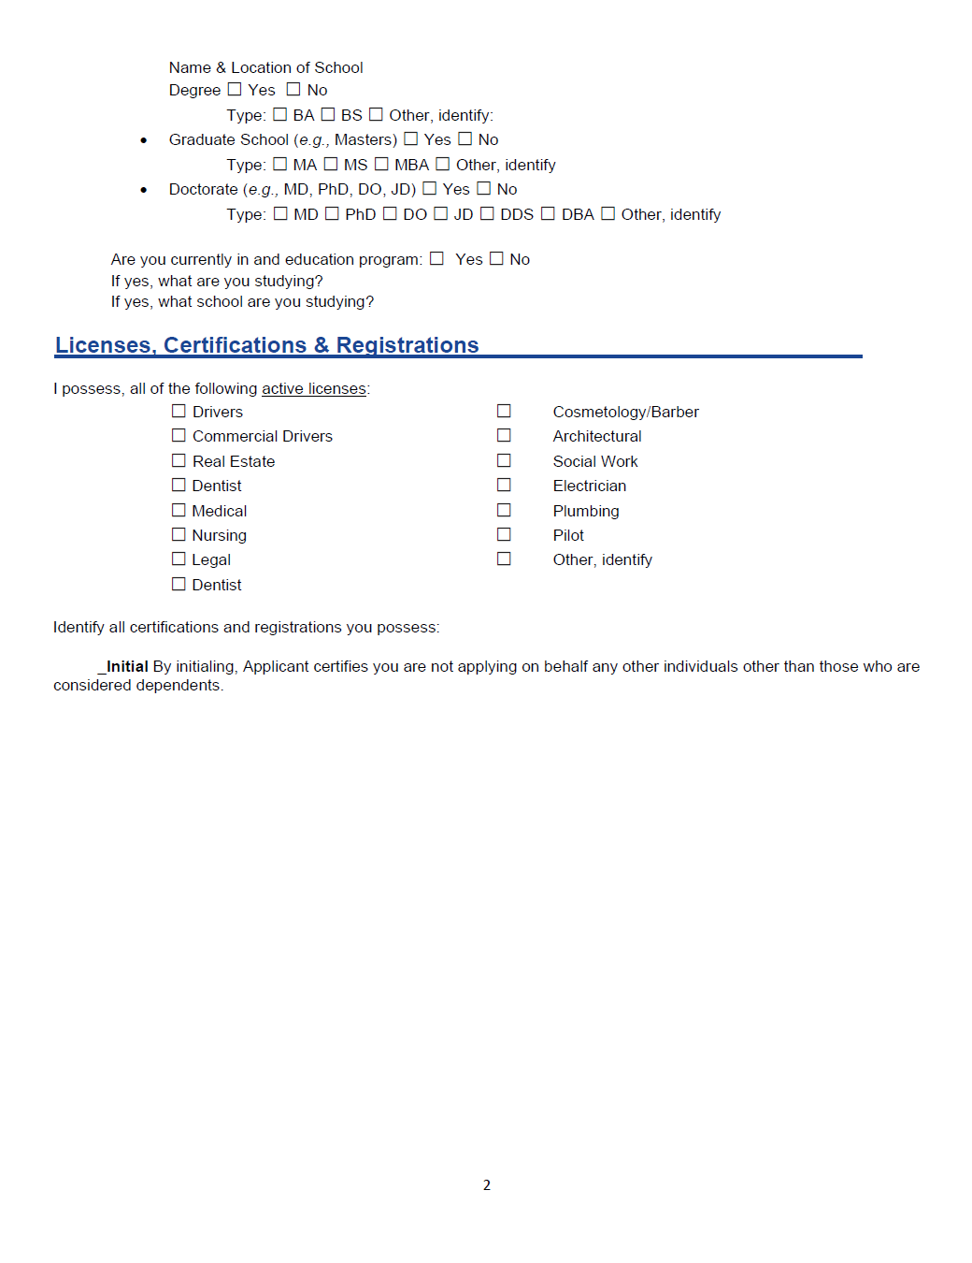
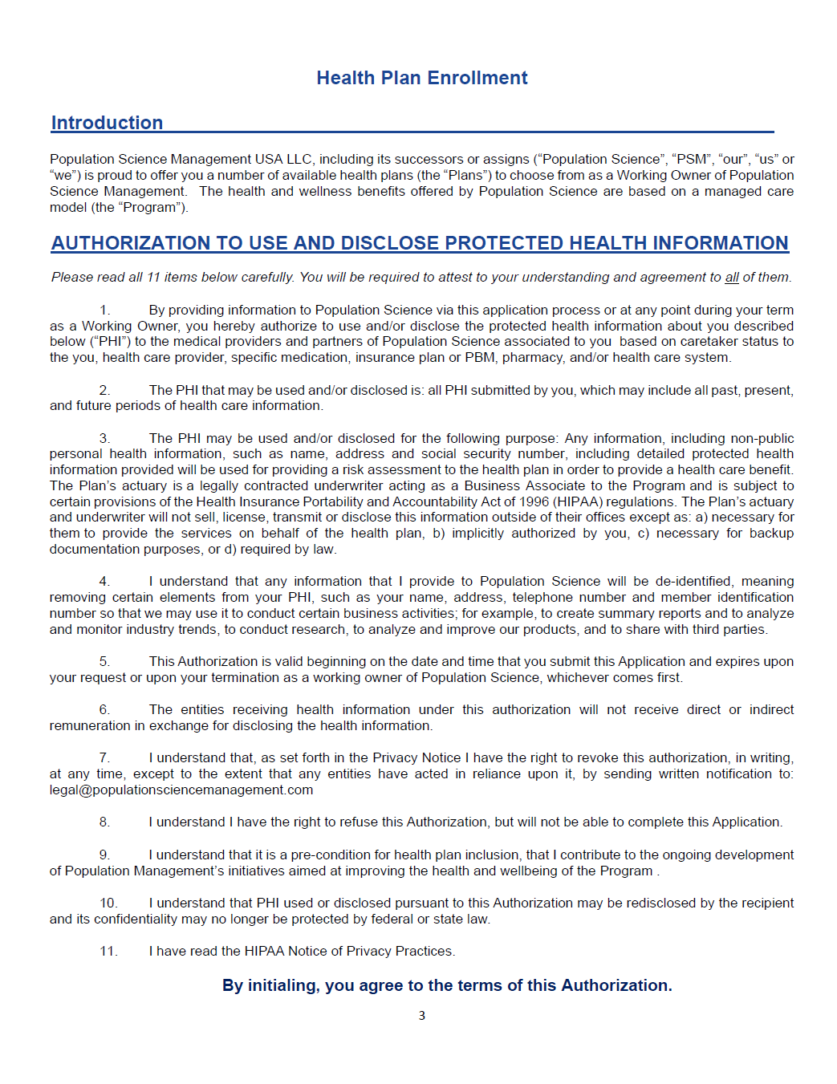
Working Owner Job Application

Slide 17
Recruiter vs Broker
Recruiter
Broker
Focuses on recruiting members to join PSM as fractional working owners (CDRs).
Not selling health benefits.
Step 1 in the process: Brings members into PSM by guiding them through the suitability process.
Discusses PSM membership, surveys, and working owner role only.
Builds trust by clearly explaining the PSM opportunity and compliance steps.
Compliance responsibility: Follow Department of Labor guidelines for recruitment.
Focuses on selling health plans and helping clients choose plan options.
Licensed to sell health benefit products.
Step 2 in the process: Helps members review health plan benefits and contributions after suitability is met.
Discusses health plan details, networks, and contribution options.
Builds trust by matching members to the right plan within the group health benefit options.
Compliance responsibility: Follow state regulations and licensing rules.
Key Takeaway:
Recruiters open the door by connecting people to PSM.
Brokers step in later to help members select their health benefits.
17

Slide 18
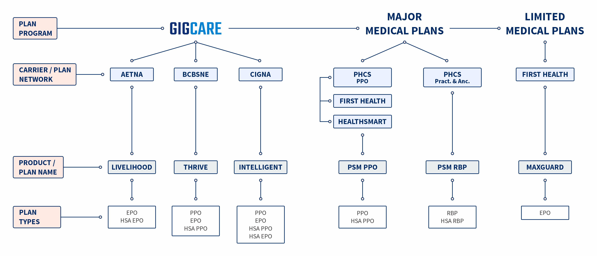

PSM Health Plan Offerings

Slide 19



GigCare
Plan Overview
Plan Qualifications
  4 Age Bands: 18-29, 30-44, 45-54, and 55-64
PPO & EPO Plan Types (including HSA)
Nationwide Networks
  Aetna
  BlueCross and Blue Shield of Nebraska
Price Range
19

Slide 20

GigCare Livelihood, Aetna Plans
Benefit Summary
Specialty Medications are not covered
 | $1,800 | $3,750 | $4,500 | $6,800 | $8,300 | $6,500 HSA
In Network Deductible Out of Network Deductible | $1,800 / $3,600 N/A | $3,750 / $7,500 N/A | $4,500 / $9,000 N/A | $6,800 / $13,600 N/A | $8,300 / $16,600 N/A | $6,500 / $13,000 N/A
In Network OOPM Out of Network OOPM | $9,200 / $18,400 N/A | $9,200 / $18,400 N/A | $9,200 / $18,400 N/A | $9,200 / $18,400 N/A | $9,200 / $18,400 N/A | $8,300 / $16,600 N/A
PCP Office Visits (deductible applies) Specialist Office Visits Urgent Care Copay | $40/visit $70/visit $85/visit | $40/visit $70/visit $85/visit | $40/visit $70/visit $85/visit | $40/visit $70/visit $85/visit | $40/visit $70/visit $85/visit | 25% after deductible
Emergency Room | 25% after deductible | 25% after deductible | 25% after deductible | 25% after deductible | 25% after deductible | 25% after deductible
Hospital Services (In and outpatient) | 25% after deductible | 25% after deductible | 25% after deductible | 25% after deductible | 25% after deductible | 25% after deductible
Nebraska is a NO SALE state for GIGCARE Livelihood plans due to our contract with BCBS of NE.

Slide 21

GigCare Intelligent, Cigna PPO Plans
Benefit Summary
Specialty Medications are not covered
 | $1,800 | $2,600 | $3,350 | $4,300 | $6,000 | $7,500 | $3,500 HDHP | $5,000 HDHP
In Network Deductible Out of Network Deductible | $1,800 / $3,600 $3,600 / $7,200 | $2,600 / $5,200 $5,200 / $10,400 | $3,350 / $6,700 $6,700 / $13,400 | $4,300 / $8,600 $8,600 / $17,200 | $6,000 / $12,000 $12,000 / $24,000 | $7,500 / $15,000 $15,000 / $30,000 | $3,500 / $7,000 $7,000 / $14,000 | $5,000 / $10,000 $10,000 / $20,000
In Network OOPM Out of Network OOPM | $10,000 / $20,000 $20,000 / $40,000 | $10,000 / $20,000 $20,000 / $40,000 | $10,000 / $20,000 $20,000 / $40,000 | $10,000 / $20,000 $20,000 / $40,000 | $10,000 / $20,000 $20,000 / $40,000 | $10,000 / $20,000 $20,000 / $40,000 | $8,300 / $16,600 $16,600 / $33,200 | $8,300 / $16,600 $16,600 / $33,200
PCP Office Visits Specialist Office Visits Urgent Care Copay | $25/visit $40/visit $60/visit | $25/visit $40/visit $60/visit | $25/visit $40/visit $60/visit | $25/visit $40/visit $60/visit | $25/visit $40/visit $60/visit | $25/visit $40/visit $60/visit | 20% after deductible | 20% after deductible
Emergency Room | 20% after deductible | 20% after deductible | 20% after deductible | 20% after deductible | 20% after deductible | 20% after deductible | 20% after deductible | 20% after deductible
Hospital Services (In and outpatient) | 20% after deductible | 20% after deductible | 20% after deductible | 20% after deductible | 20% after deductible | 20% after deductible | 20% after deductible | 20% after deductible
Nebraska is a NO SALE state for GIGCARE Intelligent plans due to our contract with BCBS of NE.

Slide 22


PSM Limited Medical
Plan Overview
Plan Qualifications
  4 Age Bands: 18-29, 30-44, 45-54, and 55-64
EPO Plan Type
Nationwide Networks
  First Health Network
Price Range
22

Slide 23

MaxGuard (Limited Medical Plans)
Benefit Summary
Specialty Medications are not covered
 | $300 | $600 | $900 | $1,500 | $2,000 | $2,500
Emergency Room Limited to 3 visits per benefit period. | $300 Copayment after Deductible | $300 Copayment after Deductible | $300 Copayment after Deductible | $300 Copayment after Deductible | $300 Copayment after Deductible | $300 Copayment after Deductible
Hospitalizations Combined 3 hospitalizations per benefit period. 5-day limit per hospitalization. | $850 Copayment per admission after Deductible | $850 Copayment per admission after Deductible | $850 Copayment per admission after Deductible | $850 Copayment per admission after Deductible | $850 Copayment per admission after Deductible | $850 Copayment per admission after Deductible
Maternity Services Routine Vaginal Delivery – 2 day limit Routine C-Section Delivery – 4 day limit | 100% after deductible | 100% after deductible | 100% after deductible | 100% after deductible | 100% after deductible | 100% after deductible

Slide 24
NEW – FULL NETWORK ACCESS
MaxGuard (Limited Medical Plans)
Benefit Summary
Specialty Medications are not covered
 | $300 | $600 | $900 | $1,500 | $2,000 | $2,500
In Network Deductible Out of Network Deductible | $300 / $600 N/A | $600 / $1,200 N/A | $900 / $1,800 N/A | $1,500 / $3,000 N/A | $2,000 / $4,000 N/A | $2,500 / $5,000 N/A
In Network OOPM Out of Network OOPM | N/A N/A | N/A N/A | N/A N/A | N/A N/A | N/A N/A | N/A N/A
PCP Office Visits (deductible applies) Specialist Office Visits Urgent Care Copay | $50/visit (10 per benefit period) $50/visit (10 per benefit period) $50/visit (10 per benefit period) | $50/visit (10 per benefit period) $50/visit (10 per benefit period) $50/visit (10 per benefit period) | $50/visit (10 per benefit period) $50/visit (10 per benefit period) $50/visit (10 per benefit period) | $50/visit (10 per benefit period) $50/visit (10 per benefit period) $50/visit (10 per benefit period) | $50/visit (10 per benefit period) $50/visit (10 per benefit period) $50/visit (10 per benefit period) | $50/visit (10 per benefit period) $50/visit (10 per benefit period) $50/visit (10 per benefit period)

Slide 25







All PSM Plans Highlights
Customer Care
Tele-Health
Member Portal &
Covered365 Mobile App
Diabetic Solutions
Pharmaceutical Advocacy Services
Imaging
25
25

Slide 26



Enrollment Cutoff
18th of the month
for GigCare Thrive (BCBSNE)
23rd of the month
all other PSM plans
26

Slide 27

No Sell States
There are currently 11 no sell states for PSM. They are CA, CT, HI, MD, MN, NH, OR, PA, VT, WA, WI
Nebraska is a No Sale State for PSM GIGCARE Liveliehood plans.

Slide 28

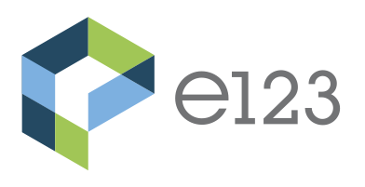
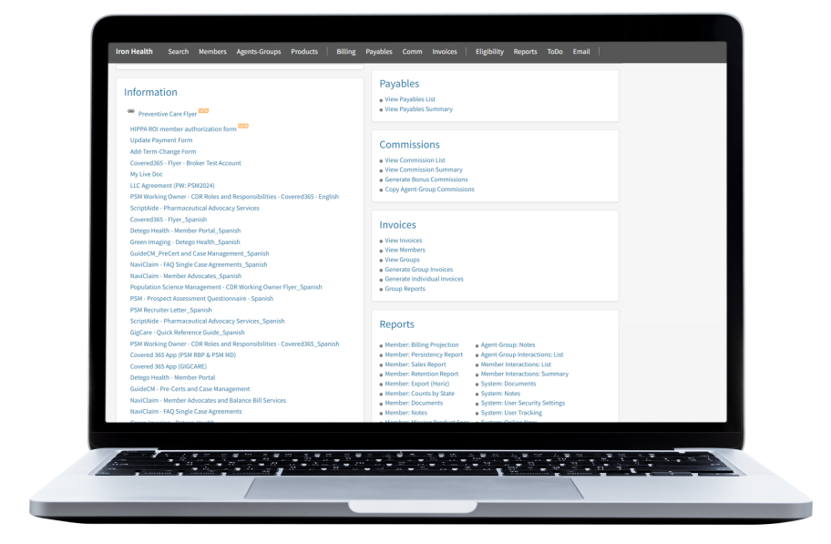
e123
Iron Health utilizes the e123 enrollment platform to provide you and your downline agents an exclusive back office to manage your business and simplify the sales process.
Access to up-to-date marketing materials and member facing flyers
Ability to manage hierarchy and downline agents
Access to real-time commission reporting
Easy to use sales platform
Product information including but not limited to current rates, summaries of benefits, formularies and provider access
Access to complete membership detail
28

Slide 29

Iron Health Benefits Broker Support Line
855-459-1113
Platform assistance: resending Working Owner application, uploading documents in the agent’s back office such as licenses, PSM Certificate, resend communication emails etc.
General plan information: enrollment cut-off dates, open enrollment periods, platform marketing materials assistance, recent updates
Billing inquiries for members enrolled in the Iron Health Platform
Broker Training Schedule: Broker Orientation & Platform Training
855-459-1113

Slide 30

Iron Health Benefits Broker Support Line
The Broker Support Line can’t provide support for the following:
Member ID cards
Claims Information
Member Portal issues or set up
Covered 365 issues or set up
Welcome emails sent by Detego Health
My Live Doc access
Detego Member Services is designed for members only

Slide 31



Phone: 855-459-1113
Website: ironhealthbenefits.com
General Questions: Info@IronHealthBenefits.com
Enrollment Platform Assistance: Support@IronHealthBenefits.com
Follow us on LinkedIn
31

Slide 32


Iron Health Benefits, is the exclusive access point for sales and support for Detego Health LLC.

Slide 33

Highlights
Customer Care (Detego Health)
PSM GIGCARE Thrive (BCBS) has Care Guides available at 866-200-2513 from 7:30AM - 6:00PM CST to support your every need.
PSM GIGCARE Livelihood (Aetna), PSM RBPs and PSM MaxGuard Limited Med plans have Care Guides available at 866-815-6001 from 7:30AM - 6:00PM CST to support your every need.
Member Portal via web (Detego Health)
When you are logged on, you can access your ID card, view EOB's and claims, download forms, access your plan documents and much more!
Covered365 mobile app (Detego Health)
When you are logged on, you can access your ID card, complete your required surveys, look-up providers and much more!
These services are handled by Detego Health TPA.
2020

Slide 34




Detego Health’s partnerships with outside vendors allow them to deliver specialized, high-quality services:
Telehealth
24/7 access to primary care, urgent care, and mental health triage.
Diabetic Solutions
Diathrive makes sure you're getting the best diabetic care.
Affordable Medical Imaging:
Make the most informed decision about MRIs, CTs and other imaging procedures.

Slide 35

Pharmaceutical Advocacy Services:
ScriptAide provides pharmaceutical advocacy services, reducing the financial burden using one of the 3 programs listed below. ***A valid prescription is required to participate in all 3 programs.
Detego Health is proud to have exclusive partners that enhance the member and employer experience:
Personal Importation Program (PIP): For covered medications, we compare pricing and import prescriptions from our Canadian pharmacies. For qualifying prescriptions, the co-pay is waived, making the medication free for the member.
Patient Assistance Program (PAP): PAP is designed for members in the United States who require non-covered medications and demonstrate qualifying financial need. Those who qualify will receive their medications for free, with no co-pays or shipping costs.
Self-Pay Importation Program (SPIP): SPIP is available to members in the United States who require non-covered medications. Through this program, individuals can import their prescribed medications at their own cost, typically saving 40- 45% compared to U.S. pharmacy prices.

Slide 36

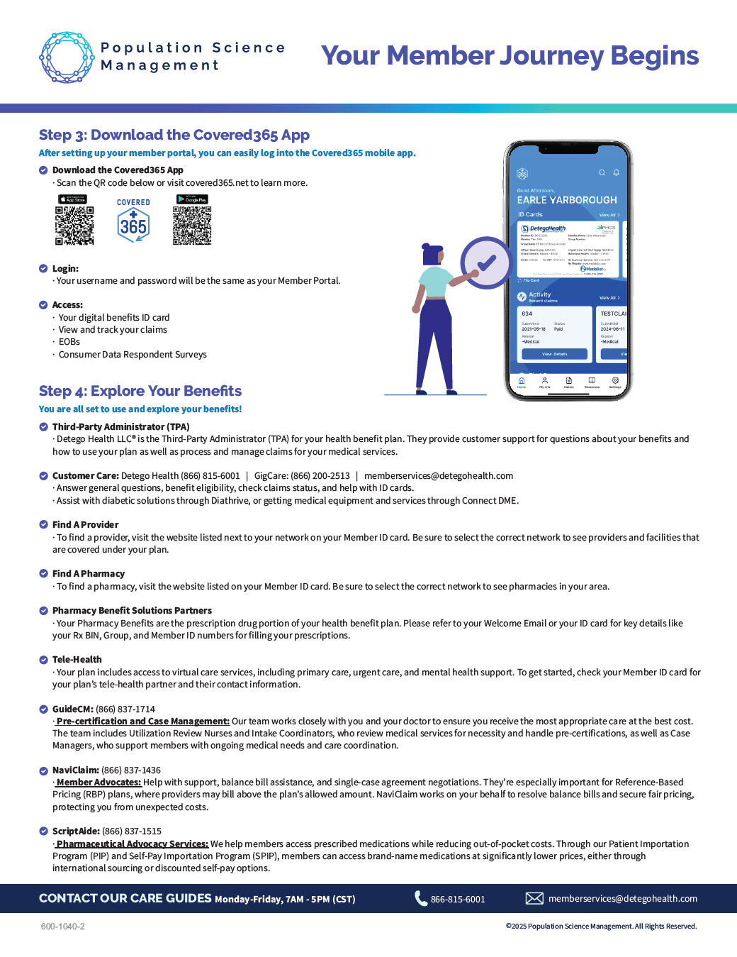
PSM MEMBERS SHOULD RECEIVE THE WELCOME EMAIL FROM DH MS 4-7 DAYS AFTER BEING ENROLLED.

Slide 37
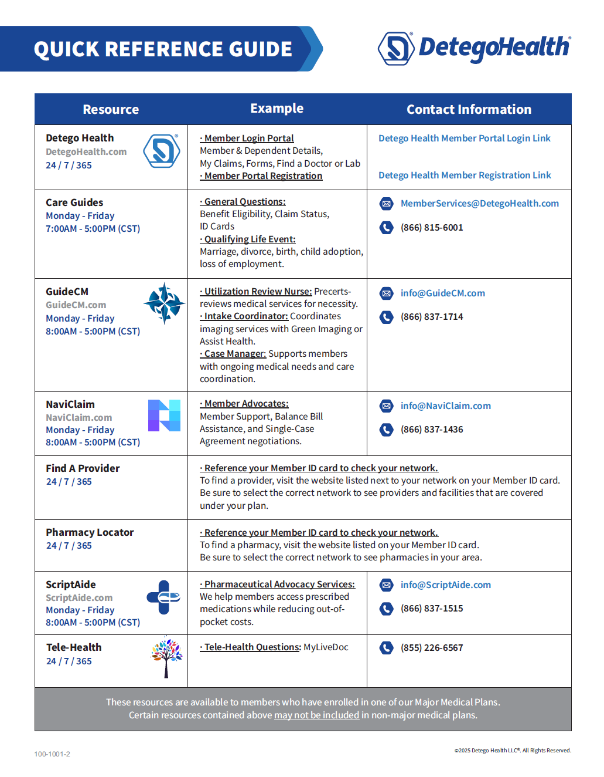
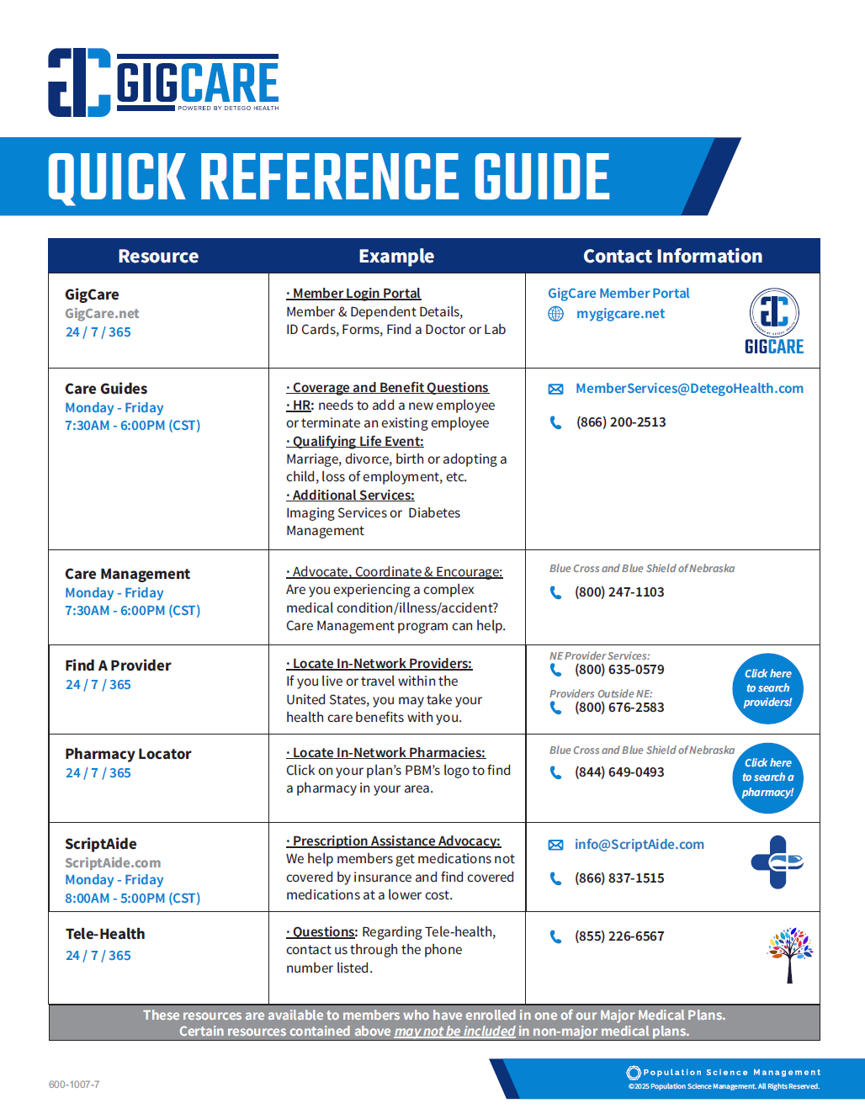
ONLY PSM GIGCARE THRIVE MEMBERS USE THE GIGCARE QRG.

Slide 38
EXCLUSIVE SALES AND SUPPORT FOR DETEGO HEALTH,
& POPULATION SCIENCE MANAGEMENT
Thank You

