Slide 1
A WARM HEARTED, HOLY SPIRIT INSPIRED CHURCH

Slide 2
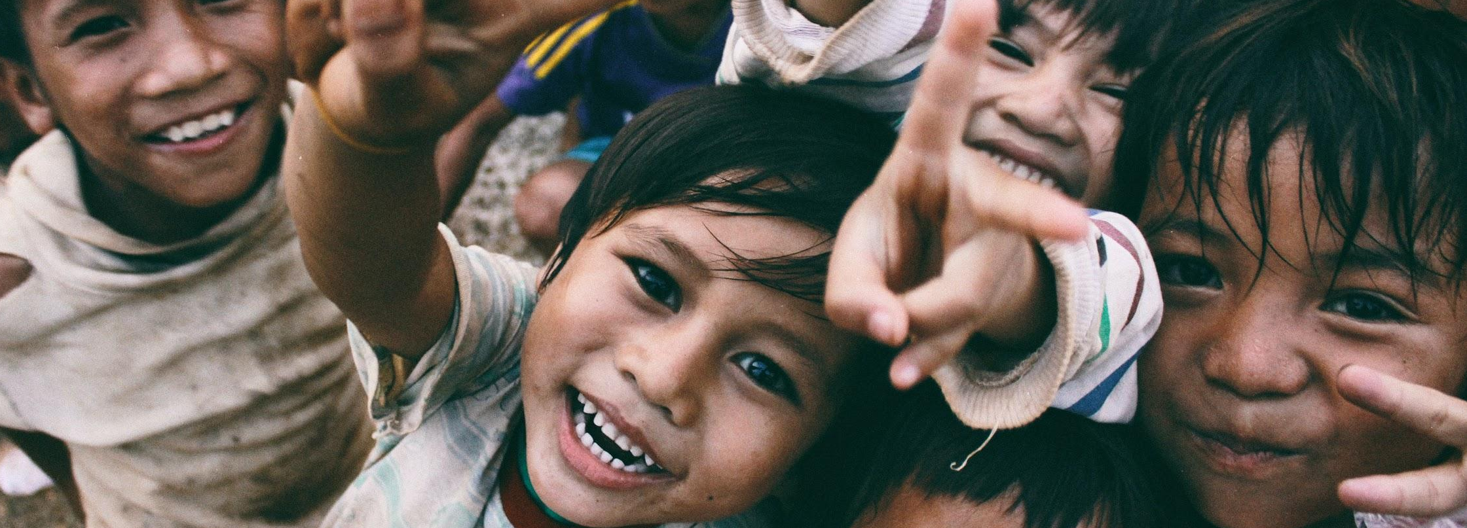
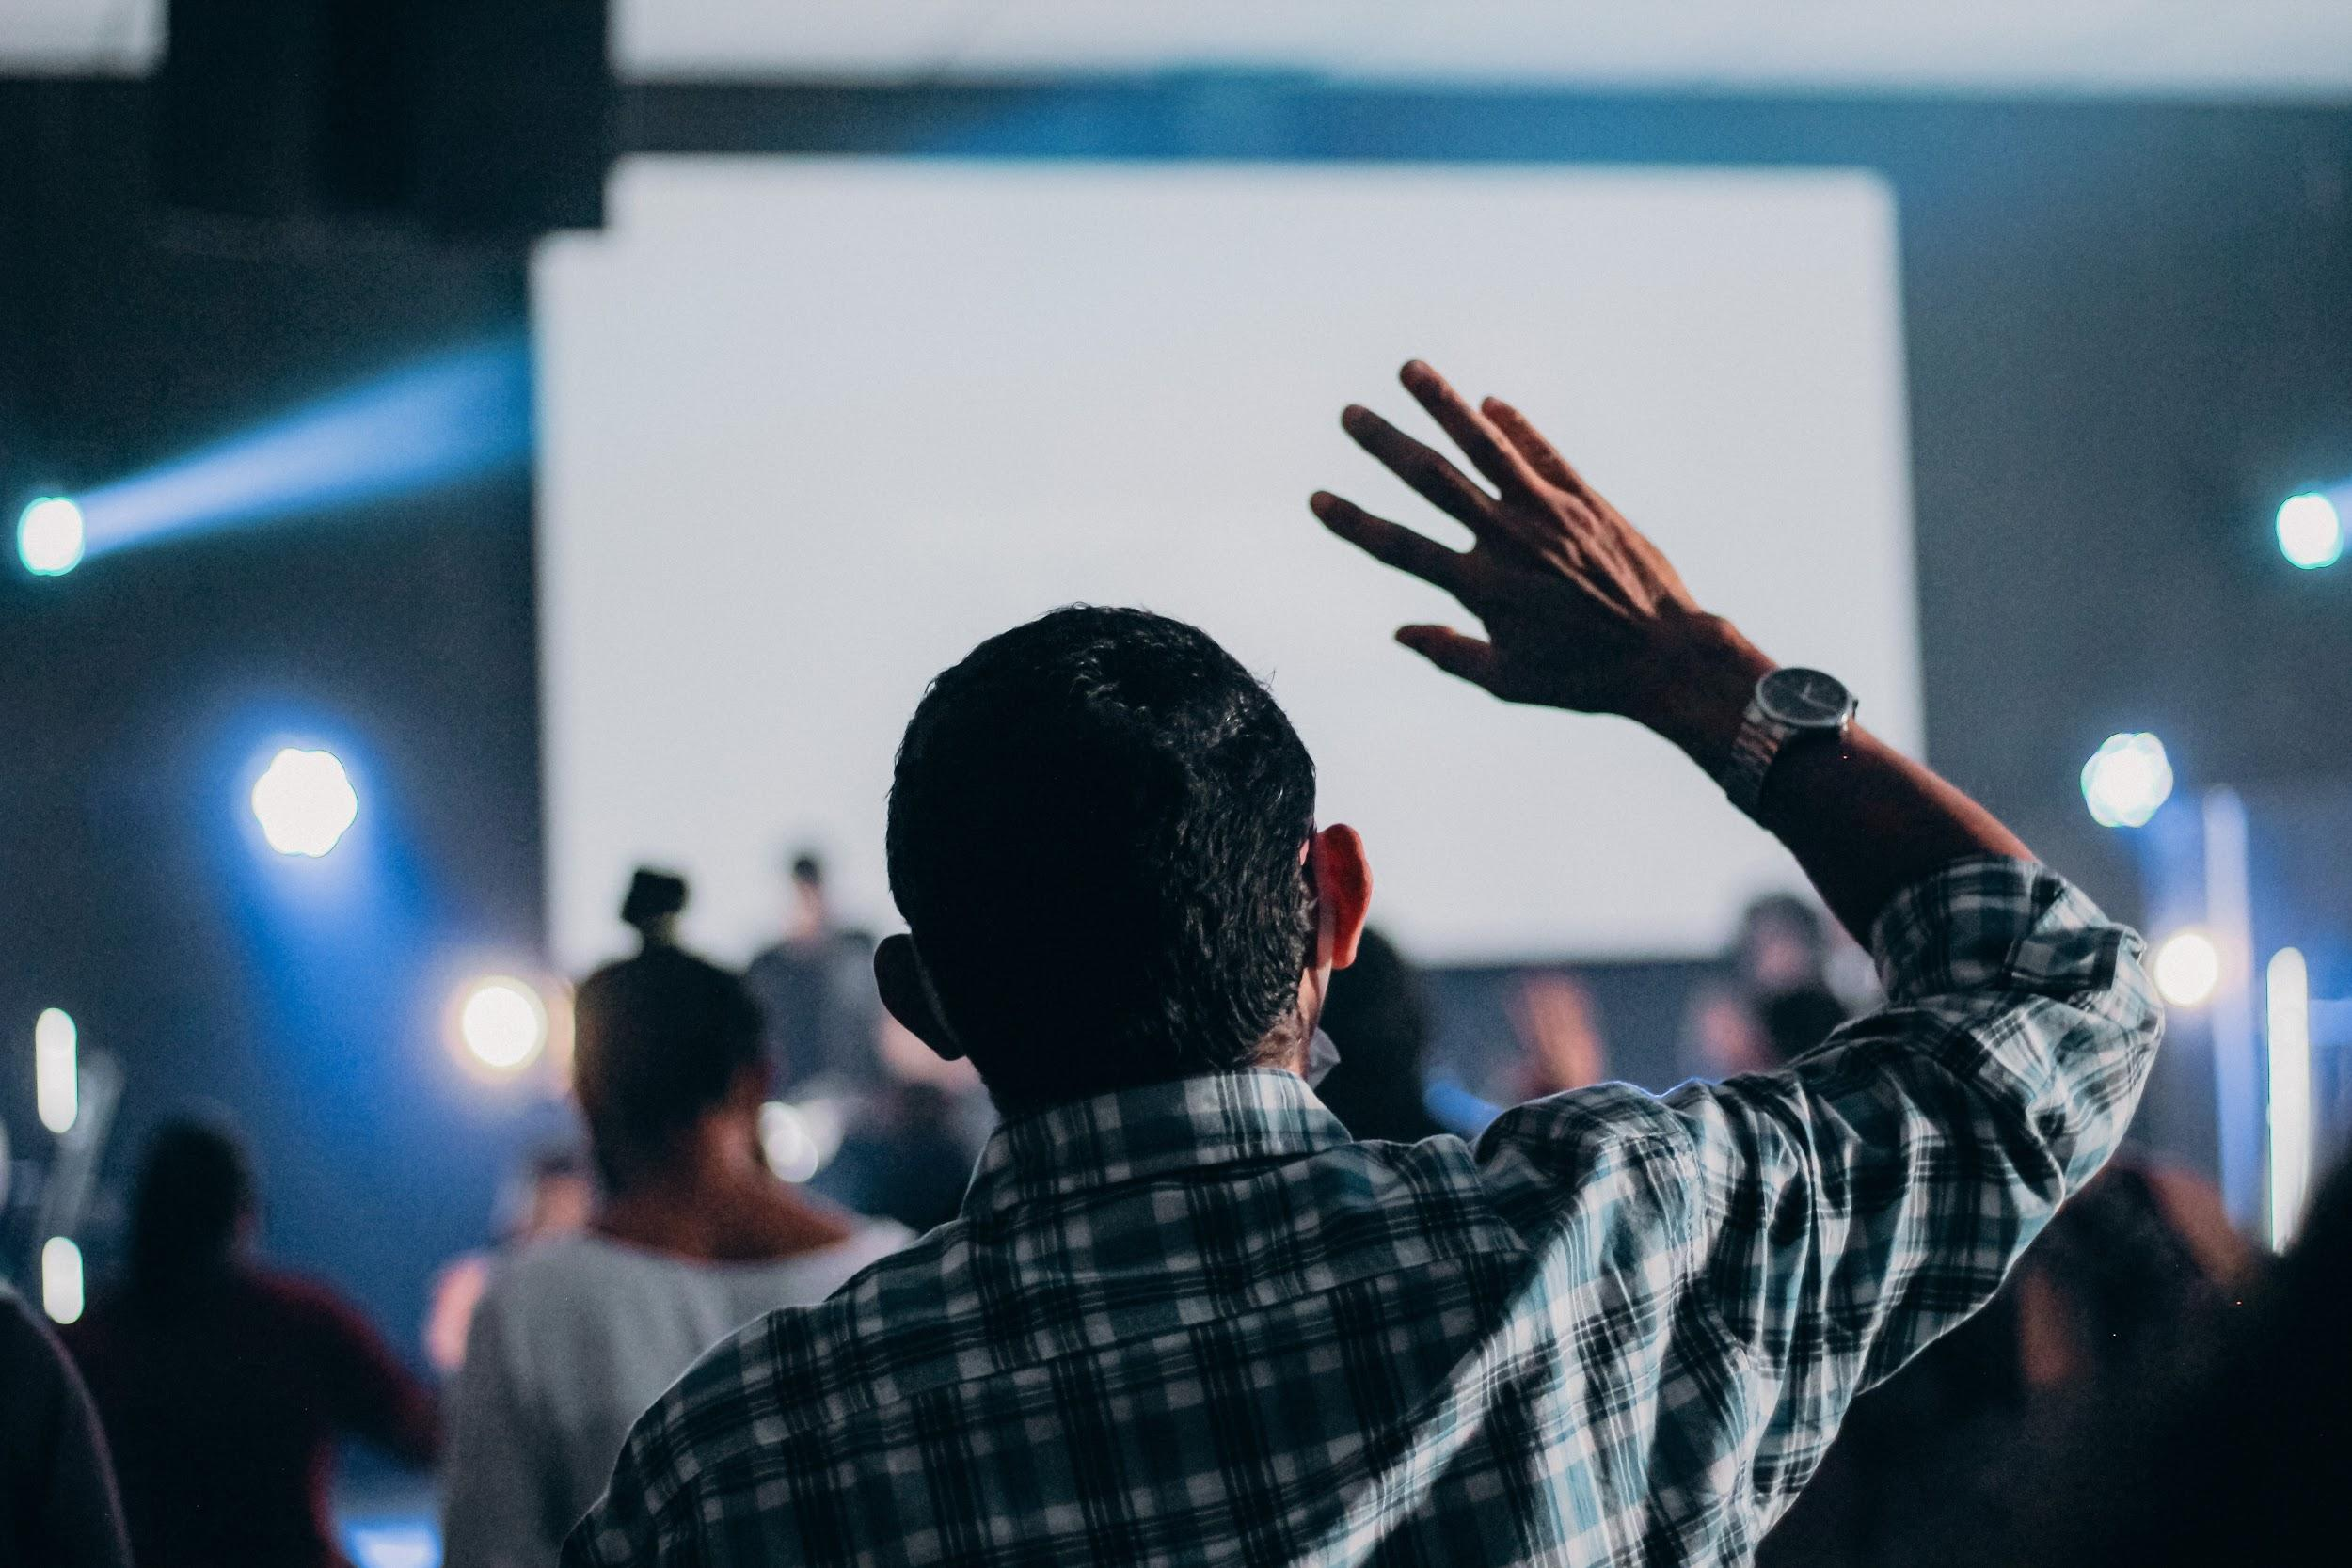
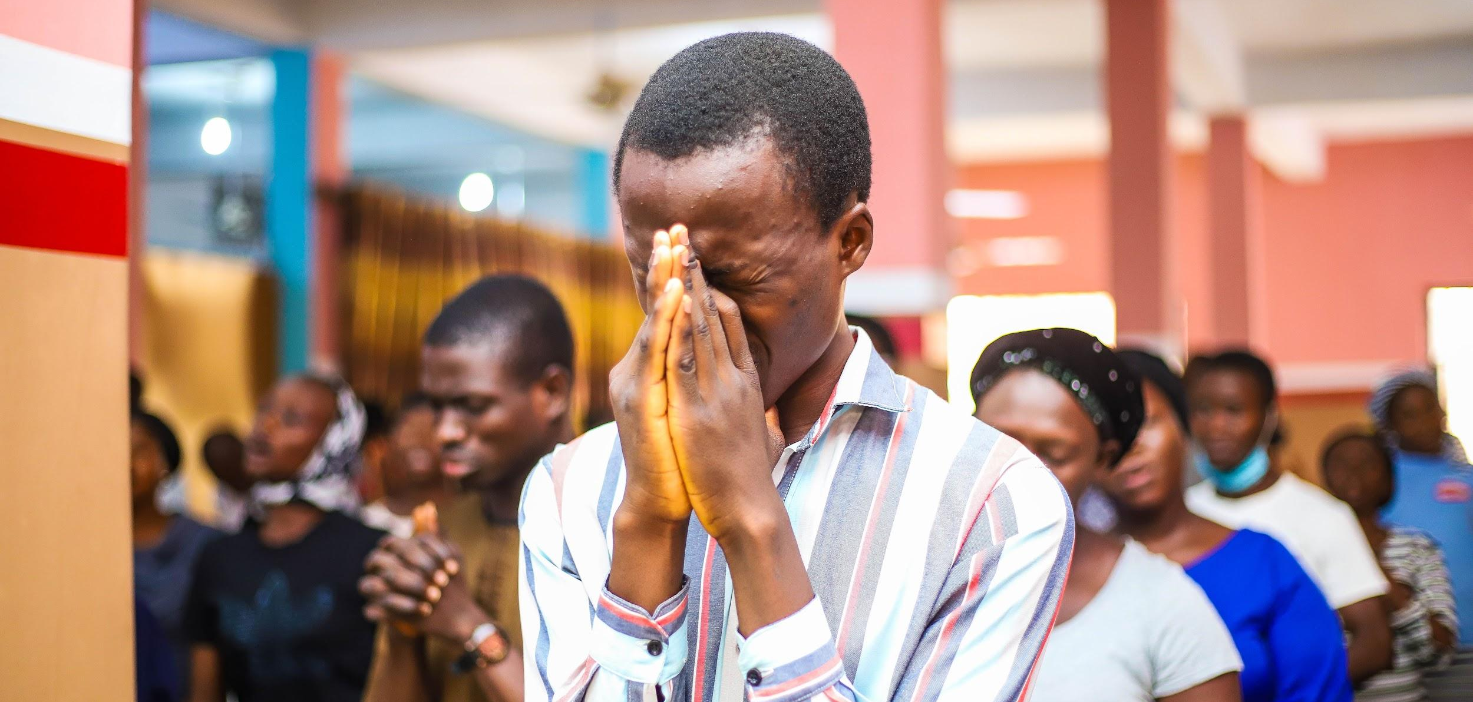


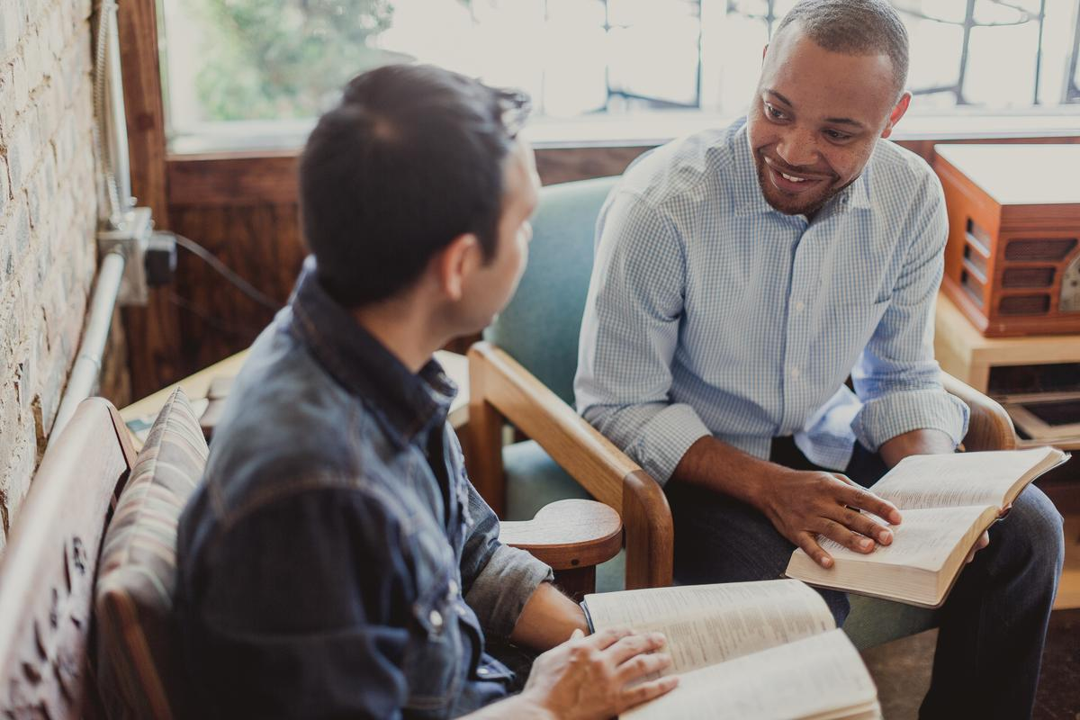
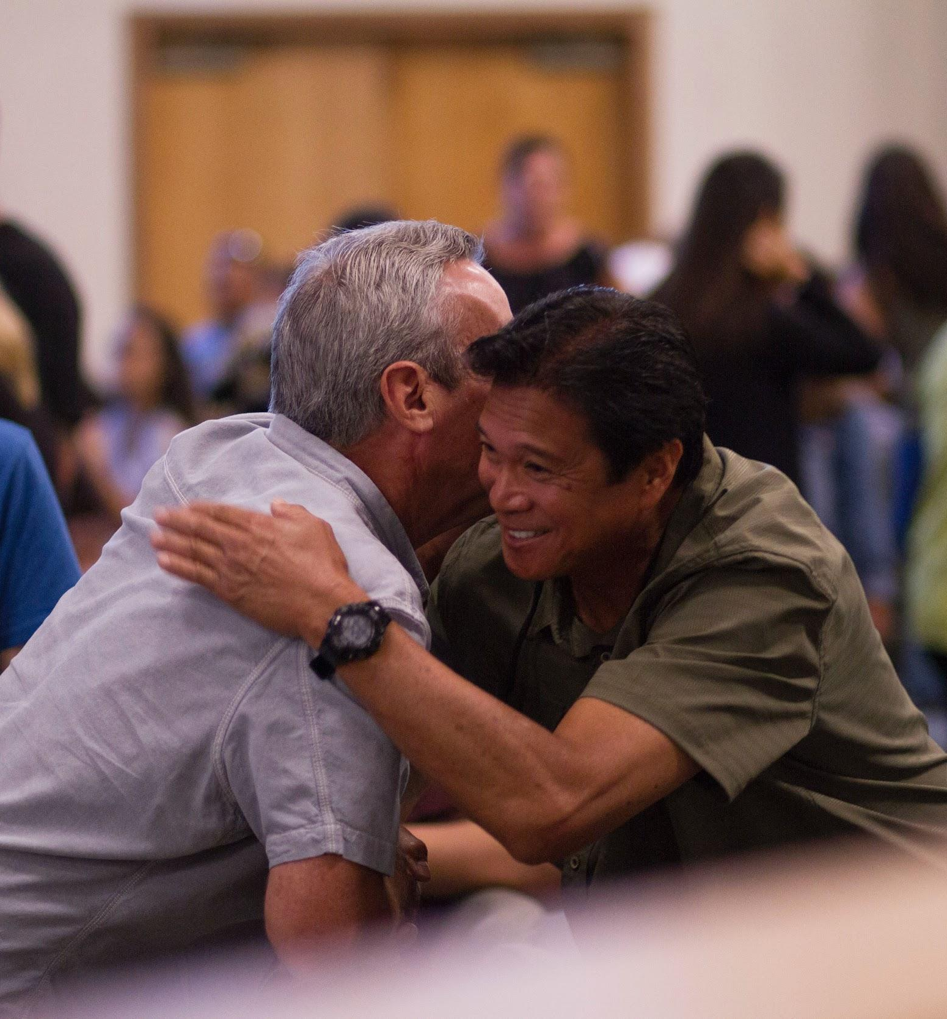

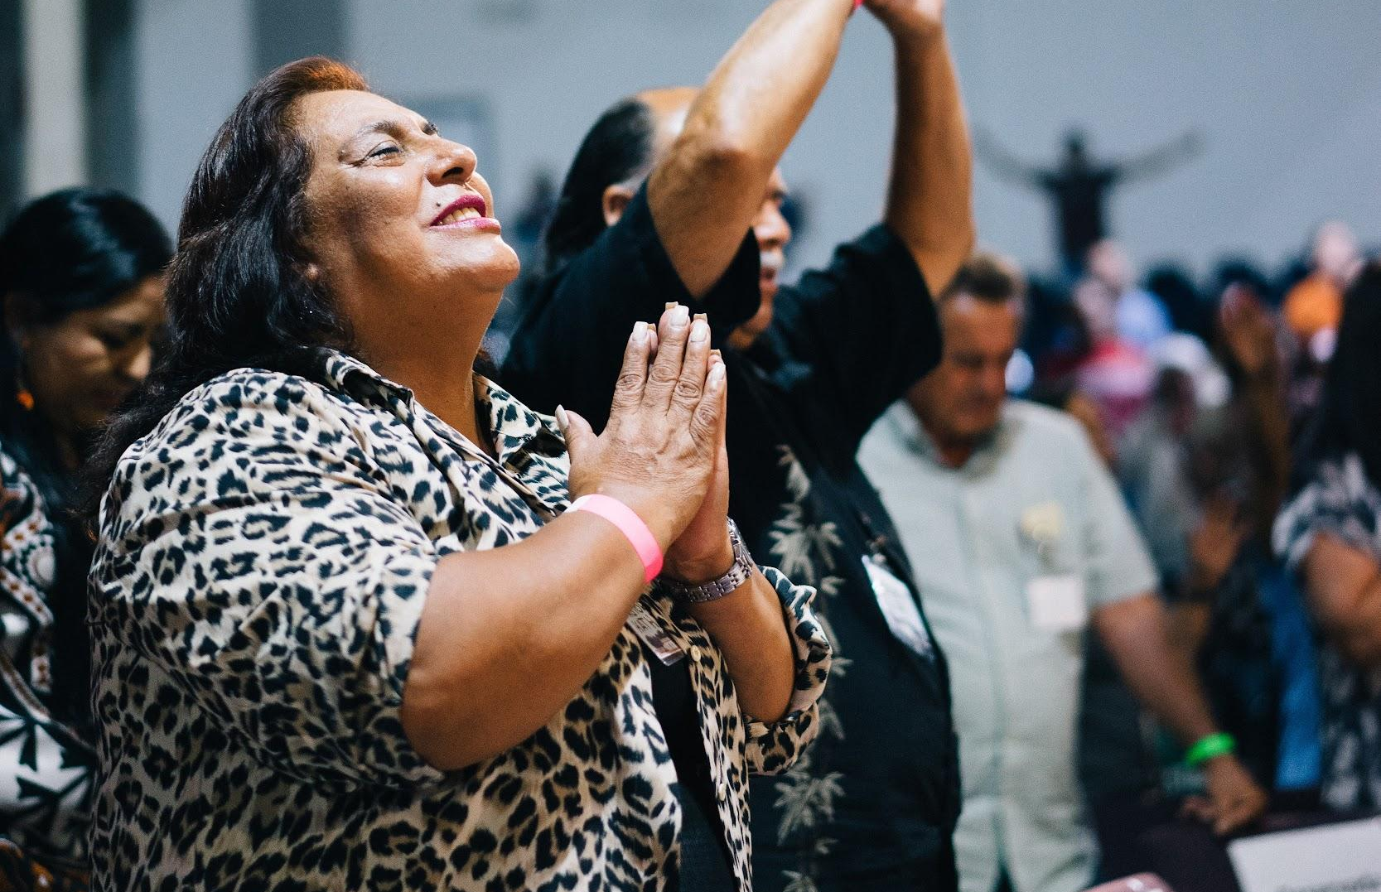
FOR ALL GOD’S PEOPLE

Slide 3
OUR MISSION
To make disciples of Jesus Christ who worship passionately, love extravagantly, and witness boldly.
Notes:
Worship -- surrender to and be fully devoted to one God—the Father, the Son, and the Holy Spirit. We are passionate about what is important to God.
Love -- love God wholeheartedly and love their neighbors as themselves. Our desire is to demonstrate to the world the extravagant love of God in the person of Jesus Christ.
Witness -- entrusted with a lifesaving and transforming message that we must share with others. Our witness is bold, compelling and fearless. Our mission advances when individuals become disciples of Jesus Christ and join God’s mission to make more disciples.

Slide 4
OUR VISION
To join God in a journey of bringing new life, reconciliation, and the presence of Christ to all people, and to helping each person reflect the character of Christ.

Slide 5
NEW BEGINNING
With humility, hope, and joy, the 17 member body known as the Transitional Leadership Council announced the official launch of the Global Methodist Church as of May 1, 2022.
Notes:
Thousands of Methodist clergy and laity from around the world worked together to lay the groundwork for a new, theologically conservative Methodist denomination steeped in the great ecumenical and evangelical confessions of the Christian faith. They envision a church fired by a warm hearted, Wesleyan expression of that faith that is dedicated to sharing the Good News of Jesus Christ in word and deed.
The Global Methodist Church is a church in transition as it prepares for its convening General Conference. During the transitional period, the Global Methodist Church will operate under a Transitional Book of Doctrines and Discipline and is governed by a Transitional Leadership Council. We anticipate holding the convening General Conference for the Global Methodist Church in the fall of 2023 or the spring of 2024.
Over time the Global Methodist Church firmly believes it will have local churches in countries all around the world.

Slide 6
CORE CONFESSIONS
The Global Methodist Church professes the Christian faith, established on the confession of Jesus as Messiah, the Son of God, and resurrected Lord of heaven and earth.
Notes:
This confession, expressed by Simon Peter in Matthew 16:16-19 and Acts 2:32, is foundational. It declares Jesus is the unique incarnate Word of God, and He lives today, calling all to receive Him as savior, and as the one to whom all authority has been given.
This faith has been tested and proved since its proclamation by Mary Magdalene, the first witness to the resurrection. It was defended by the women and men of the early church, many of whom gave their lives as testimony. Their labor, enabled and inspired by the Holy Spirit, resulted in the canon of scripture as the sufficient rule both for faith and practice (the Greek word kanon means rule). It formulated creeds such as the Apostles’ Creed, the Nicene Creed and the Chalcedonian definition as accurate expressions of this faith.
The GMC is committed to theological alignment grounded in the tenets of the historic Christian Faith in the Wesleyan tradition. We are submitted to the Lordship of Jesus Christ and the primacy and authority of Scripture. We are invested in a bold proclamation of the historic distinctives of Methodism.

Slide 7
ALL GOD’S PEOPLE
By virtue of its very name, the Global Methodist Church is a diverse church where all God’s people – whatever their color, culture, ethnicity, or nationality – are warmly welcomed to join with others to make disciples of Jesus Christ who worship passionately, love extravagantly, and witness boldly.
Notes:
It is a body that recognizes and deploys the gifts and contributions of each part of the church, working as partners in the Gospel with equal voice and leadership.
The Global Methodist Church’s witness to the world is marked by mutual love, concern, sharing, and a focus on those who are most vulnerable.
Its members watch over one another in love and bear witness to the transforming power of the Gospel as we humbly, but boldly, strive to serve others as ambassadors of Christ!
Committed to Gender and Ethnic equality. Women are joyfully received as members in local churches where they serve as trustees, lay leaders, Sunday school teachers, among many other roles. They are also joyfully ordained as elders and deacons, and consecrated as bishops.
The Global Methodist Church believes Scripture and Christian tradition bear witness to the importance of women and men sharing the responsibility and joy of serving the church as its leaders.

Slide 8
Key Ministry Commitments
Local Church as the Missional Center
Global, Multicultural, and Multiethnic
Long-Term, Enduring Global Missional Partnerships
Fulfilling the Great Commission
Notes:
Organized organically from the bottom up rather than from the top down – leaner general church structure. Movemental – organized for growth, not micromanaging. Cultivating a permission giving environment.
Empowerment of the Laity

Slide 9
METHODIST DISTINCTIVES
The Global Methodist Church is for all people who wish to join in a “methodical,” practical, and warm-hearted pursuit of loving God and serving others as Jesus’ disciples in the world.
Notes:
Through the organization and published works of John and Charles Wesley, the Methodist movement’s founders, a distinctly Methodist articulation of Christian faith and life was developed. Methodism placed particular emphasis on the universal work of grace, the new birth, and the fullness of salvation. The movement set as its mission: “to reform the nation, especially the church, and spread scriptural holiness over the land.”

Slide 10
ORGANIZATIONAL DISTINCTIVE
The Global Methodist Church is a connection of the willing not the constrained. In short, there is no “trust clause” as there is in some other denominations stating that a local church merely holds property and assets in trust for a general church. Instead, local Global Methodist congregations own all of their property and assets in perpetuity.
Notes:
As long as a local church wants to be part of connection dedicated to making disciples of Jesus Christ who worship passionately, love extravagantly, and witness boldly it is welcome in the Global Methodist Church.
The Global Methodist Church encourages congregations to be innovative and nimble as they work to fulfill the church’s mission at the grassroots level. They are not asked to serve a large bureaucratic general church with multiple boards and agencies. Rather, a light general church is structured so it serves and resources local churches. The whole church focuses on creative ways to share the timeless message of the Gospel for the world we all live in today.

Slide 11
BISHOPS LEADERSHIP
From apostolic times, certain ordained persons have been set apart and entrusted with the task of defending the Apostolic faith and overseeing and leading the church in its mission to make disciples of Jesus Christ and to spread scriptural holiness around the world. The role of a bishop is a sacred trust held for a defined period of time; it is not a lifelong office.
Notes:
The Global Methodist Church is equipped and supervised by an episcopacy modeled after that of the early centuries of Christianity and stemming from the historic line of Methodist bishops.
We share John Wesley’s conviction that bishops and elders are part of the same New Testament order. Therefore, bishops in the Global Methodist Church represent a specialized ministry rather than a separate order and are consecrated rather than ordained to their office.
The GMC provides for greater accountability for bishops, clergy, and local churches.

Slide 12
JOYFUL DISCIPLESHIP
The Global Methodist Church believes people have a deep desire to know the truth, and to devote themselves to it wholeheartedly. Our Church believes Jesus is the Truth, and he calls us to be his disciples.

Slide 13
ACCOUNTABLE DISCIPLESHIP
From its inception, the Methodist movement embraced the importance and power of small groups where people gave themselves over to accountable discipleship. The Global Methodist Church is strongly committed to recapturing this method for growing faithful disciples.
Notes:
The Church calls all its members to robust, life-long faith formation; faith formation that involves participation in small groups where disciples hold one another accountable with truth and grace as they continue to grow as Jesus’ joyful and obedient disciples.

Slide 14
MISSIONAL PRIORITIES

Slide 15
BIBLICAL TEACHING
We share with all people the whole counsel of God grounded in Scripture, and we advance the presence and fulfillment of the Kingdom of God in every part of the world and at all levels of societies and cultures.

Slide 16
TRANSFORMATIONAL DISCIPLESHIP
We are intentional about making, developing, nurturing, and deploying disciples of Jesus Christ through small groups where each person is invited, challenged, supported, and held accountable in living lives that reflect the character and mission of Christ.
Notes:
Through Christ’s infinite grace and by the power of the Holy Spirit, we are free to embark on a path of joyful obedience to God’s calling on our lives.
Fortunately, we walk together as Jesus’ disciples. And in doing so we challenge one another to give our hearts, minds, souls, and bodies to the endeavor of growing in the faith. Every Global Methodist church calls all its members – from the very young to the very old – to participate in classes to study Scripture, to learn about the richness of the Christian faith, and how to winsomely share it with others.

Slide 17
MULTIPLICATION
We are committed to seeing the life of Jesus reproduced in each person who chooses to follow him. Disciples are called to make disciples, who in turn make more disciples. And churches plant churches, that in turn plant new ones. Every disciple and every church is challenged to multiply disciples in God’s kingdom!

Slide 18
MINISTRY TO ALL PEOPLE
We are a movement called to serve others so they may know the grace and love of Jesus in their lives. We see the hurts that break the heart of God. Our hearts are broken too. We desire to be poured out so that others can experience the presence and power of God in their lives.

Slide 19
GLOBAL PARTNERS
We are a global church recognizing and deploying the gifts and contributions of each part of the church, working as partners in the Gospel with equal voice and leadership. We intentionally connect churches from different regions of the world who develop mutually rewarding relationships to share the Gospel and to grow His Kingdom globally.

Slide 20
CONNECTIONAL FUNDING
Each local church of the Global Methodist Church contributes financially to the ministry of the Church beyond the local church through connectional funding.

Slide 21
CONNECTIONAL FUNDING
The local church pays up to 1.5% of its operating income for general church connectional funding. The amount set can be less than the ceiling. The Transitional Leadership Council has set general church connectional funding at 1% of operating income initially.

Slide 22
CONNECTIONAL FUNDING
The local church pays up to 5% of its operating income for annual conference connectional funding. The amount set can be less than the ceiling. The Transitional Leadership Council has set annual conference connectional funding at 1% of operational income during this initial period. Once annual conferences are formed, they will each set their own respective percentages.

Slide 23
CONNECTIONAL FUNDING
Once a provisional annual conference is formed in an area, the provisional annual conference will determine the percentage of operating income that is to be paid as annual conference connectional funding. However, the percentage cannot exceed the 5% ceiling unless 2/3 of the provisional annual conference delegates vote to raise the ceiling.

Slide 24
JOINING THE GLOBAL METHODIST CHURCH
New beginnings are rarely easy. We know some local churches will face obstacles to joining the Global Methodist Church. For others, the transition will be fairly simple. Whatever the case, the Global Methodist Church will do all in its power to assist local churches that want to join!
Notes:
The Global Methodist Church work to assist in the formation of new congregations for people who want to leave their local UM church in order to plant a local GM church.
We strongly encourage pastors and lay people who want to join the Global Methodist Church to visit globalmethodist.org to learn the actions necessary to become a member congregation. Pastors and lay leaders should also familiarize themselves with the Global Methodist Church’s Transitional Book of Doctrines and Discipline, giving particular attention to Part Three. The book can be found online and downloaded by visiting globalmethodist.org/what-we-believe/.

Slide 25
MEMBERS JOIN US!
Many people will become a member of the Global Methodist Church when their local church becomes a member congregation. However, we know many people will not immediately have a congregation to join. We believe steadfast faithfulness, prayer, patience, and sacrificial giving will lead to new local churches that will flourish and grow. We should never forget that every local congregation in Christian history started where two or three were gathered in His name.
Notes:
The Church is creating pathways for people to join as associate members of local GM churches in other communities while they discern their options for forming a congregation in their own community.

Slide 26
www.globalmethodist.org

