Slide 1


CareerSource Pasco Hernando Education & Industry Consortium Committee Q3 Meeting February 23, 2026

Slide 2

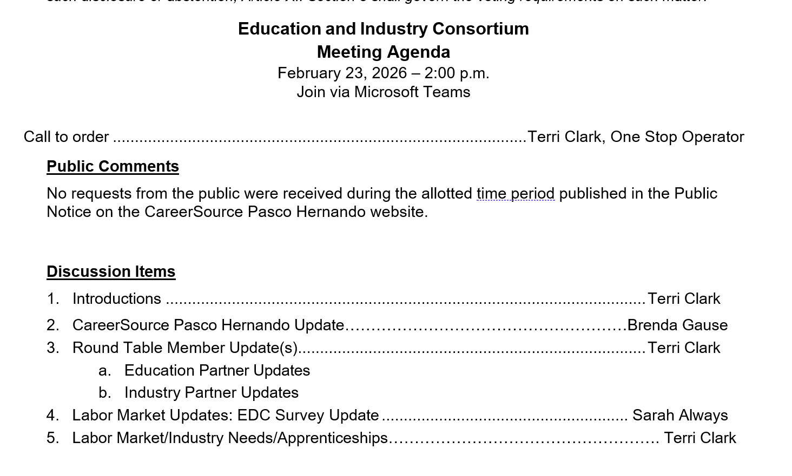
Welcome!
Notes:
Terri

Slide 3

Notes:
Every February, the Career Technical Education (CTE) community celebrates CTE Month® to raise awareness of the role that CTE has in readying learners for college and career success. CTE Month is also a time to recognize and celebrate the achievements and accomplishments of our CTE partners

Slide 4
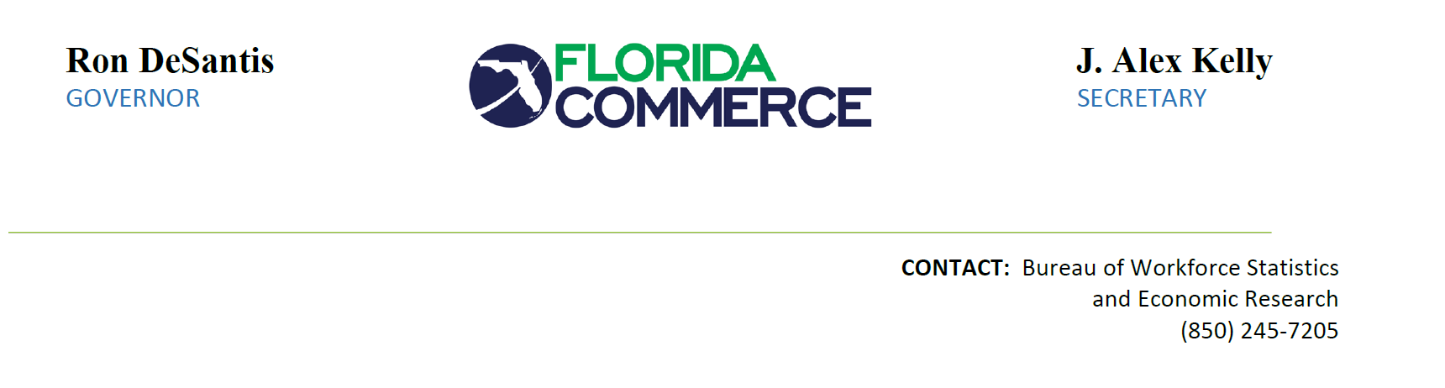
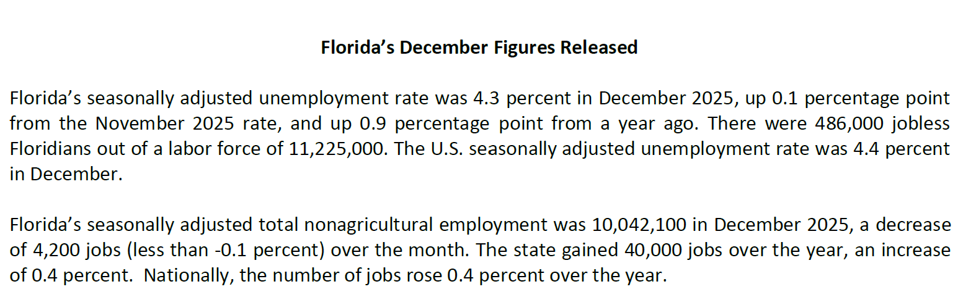

Slide 5
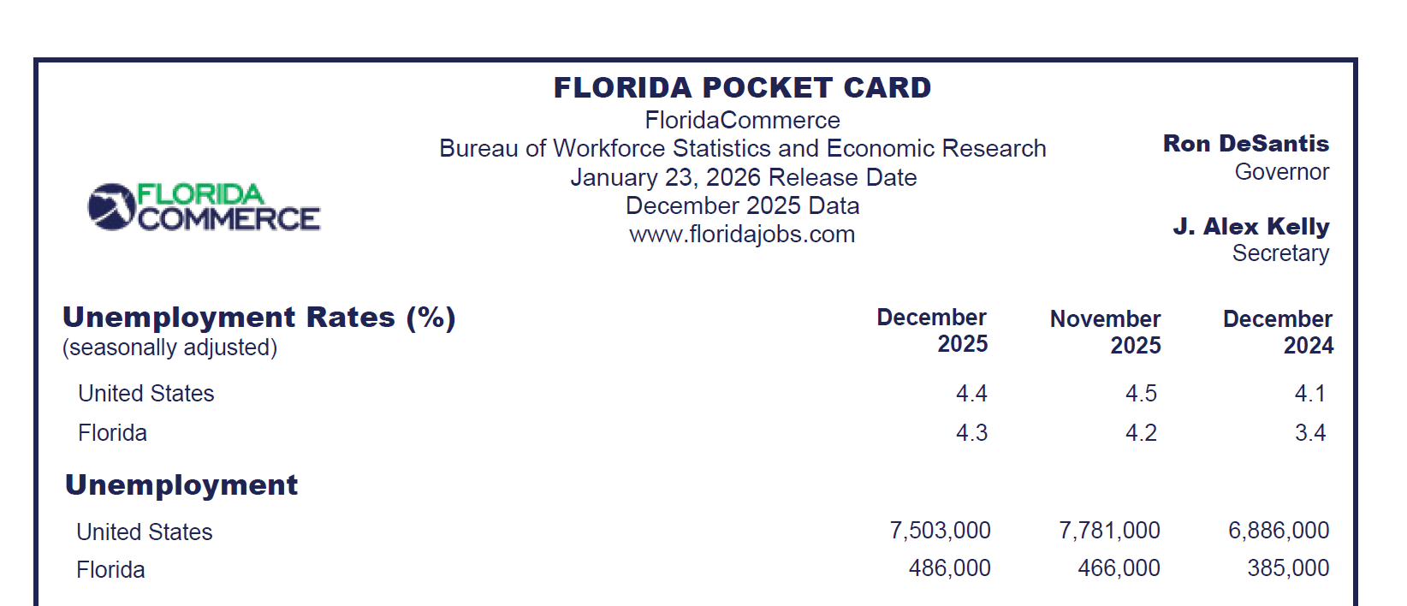

Slide 6
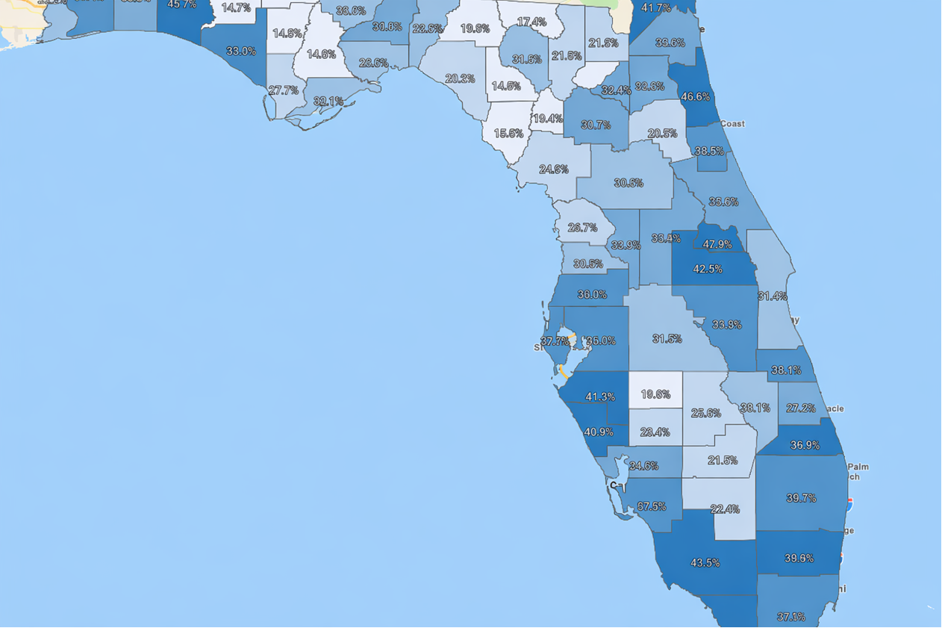
Underemployed Stats
December 2026
Hernando: 30.6%
Pasco: 36.0%
Thank you, Sarah for the data!
Source: JobsEQ

Slide 7

CareerSource Pasco Hernando Updates Brenda Gause and Terri Clark Education and Industry Partner Updates
Apprenticeship Introduction: Andrea Altman Program Coordinator, Workforce Pathways
Notes:
Terri

Slide 8


Public Comment Closing Remarks Q4 Meeting Options: Monday, June 1st or June 8th 2pm via Teams

