Slide 1


CareerSource
Pasco Hernando
Education & Industry
Consortium Committee
Q2 Meeting
November 17, 2025

Slide 2

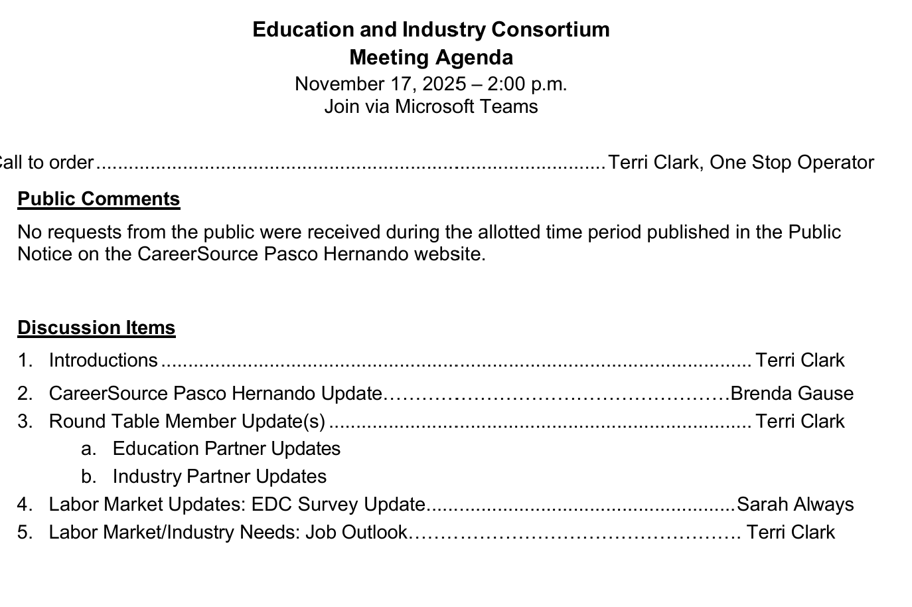
Welcome!
Notes:
Terri

Slide 3
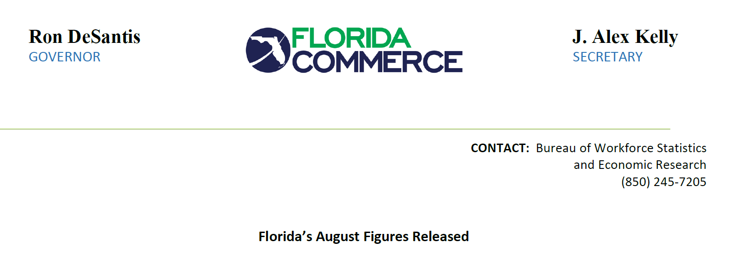
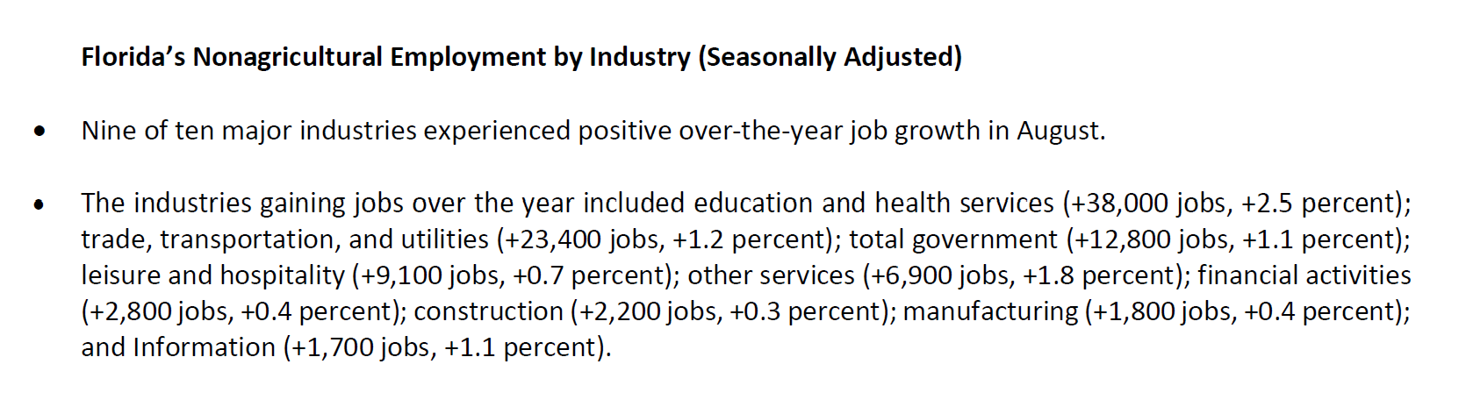

Slide 4
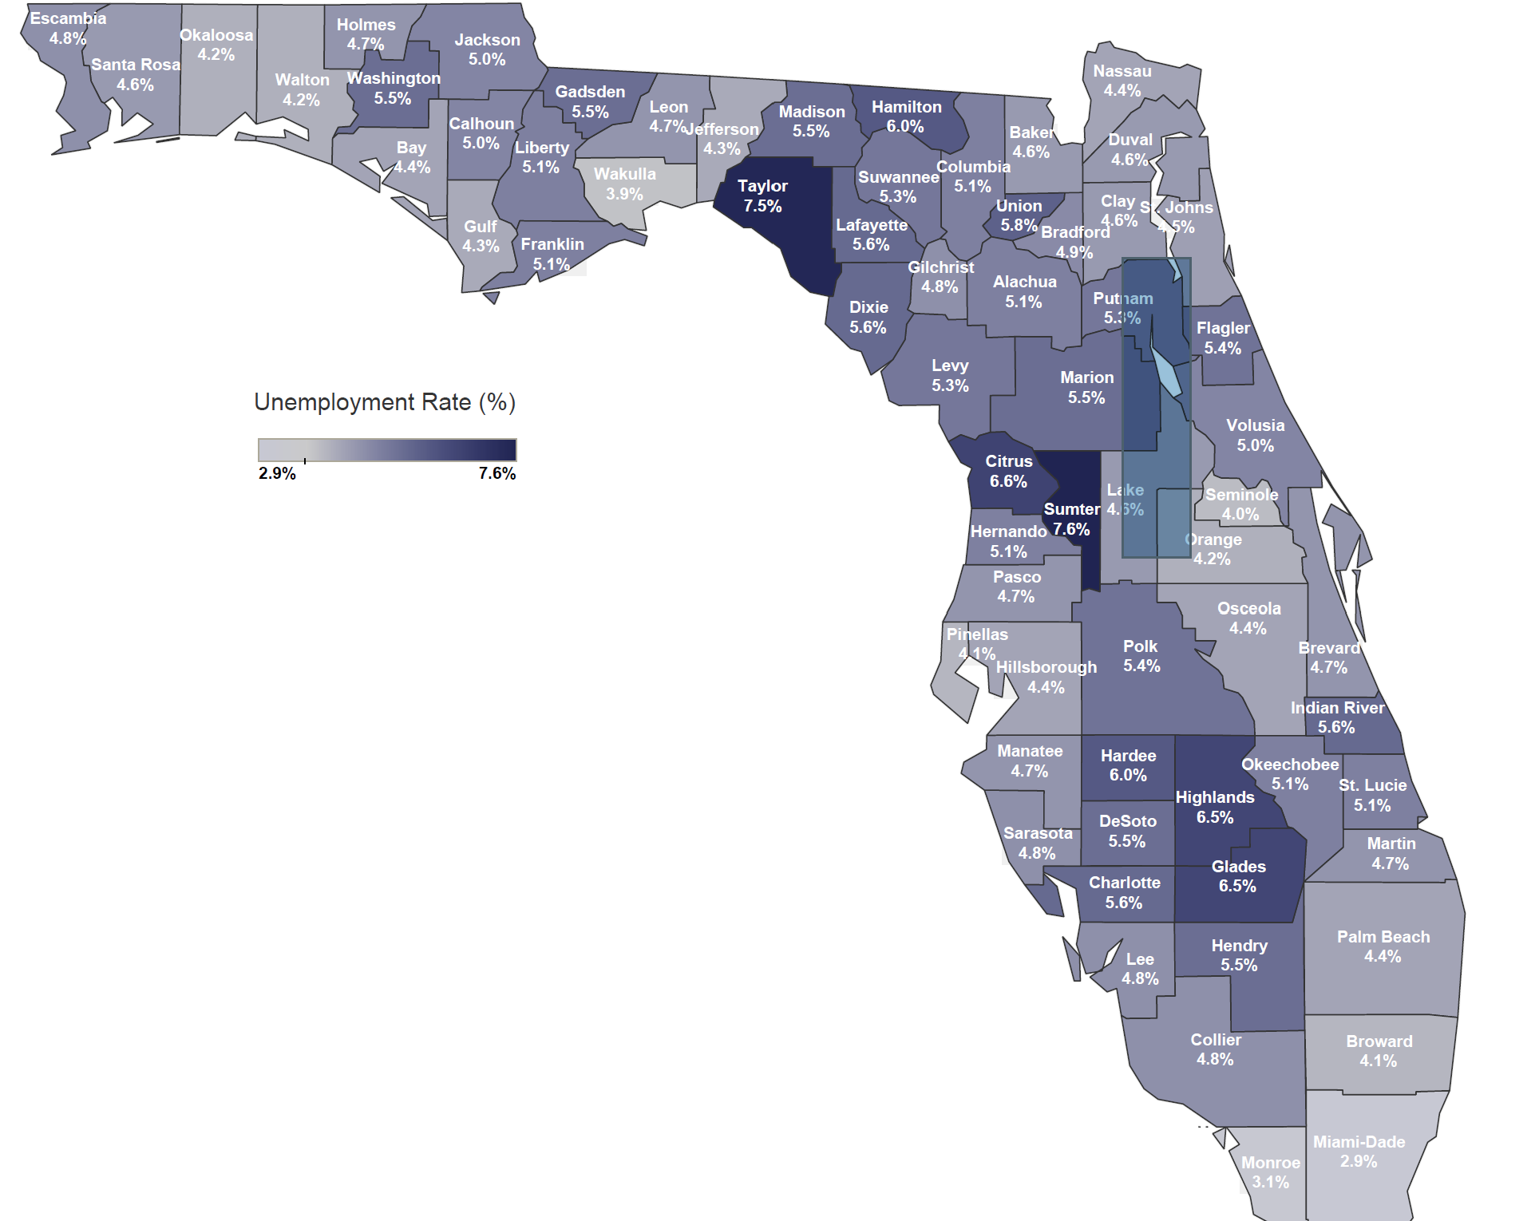
Florida Unemployment Rate: 3.8%
United States: 4.4%
Hernando: 24th out of 67 counties @ 5.1 %
Pasco: 40th out of 67 counties @ 4.7%
Highest Unemployed County: Sumter @ 7.6%
Lowest Unemployed County: Miami-Date @2.9%

Slide 5
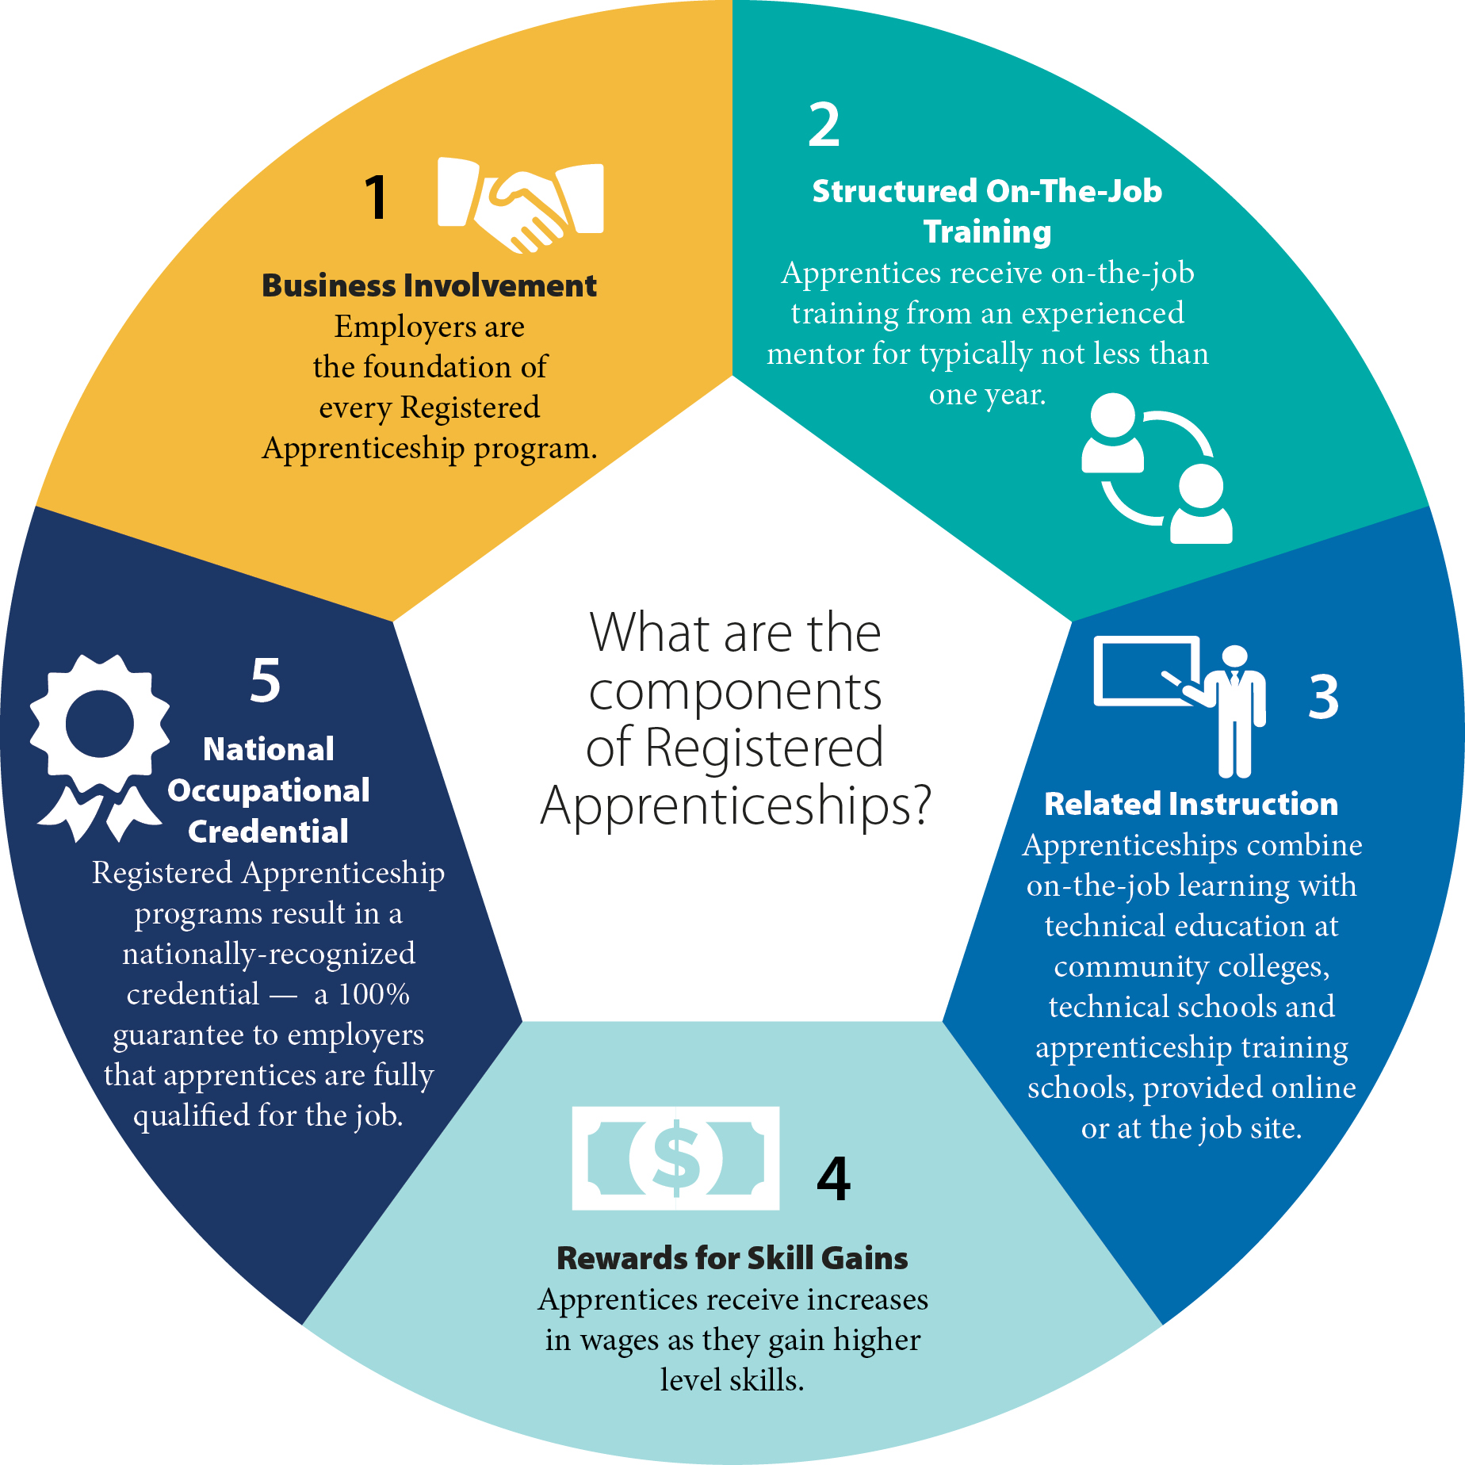

Slide 6
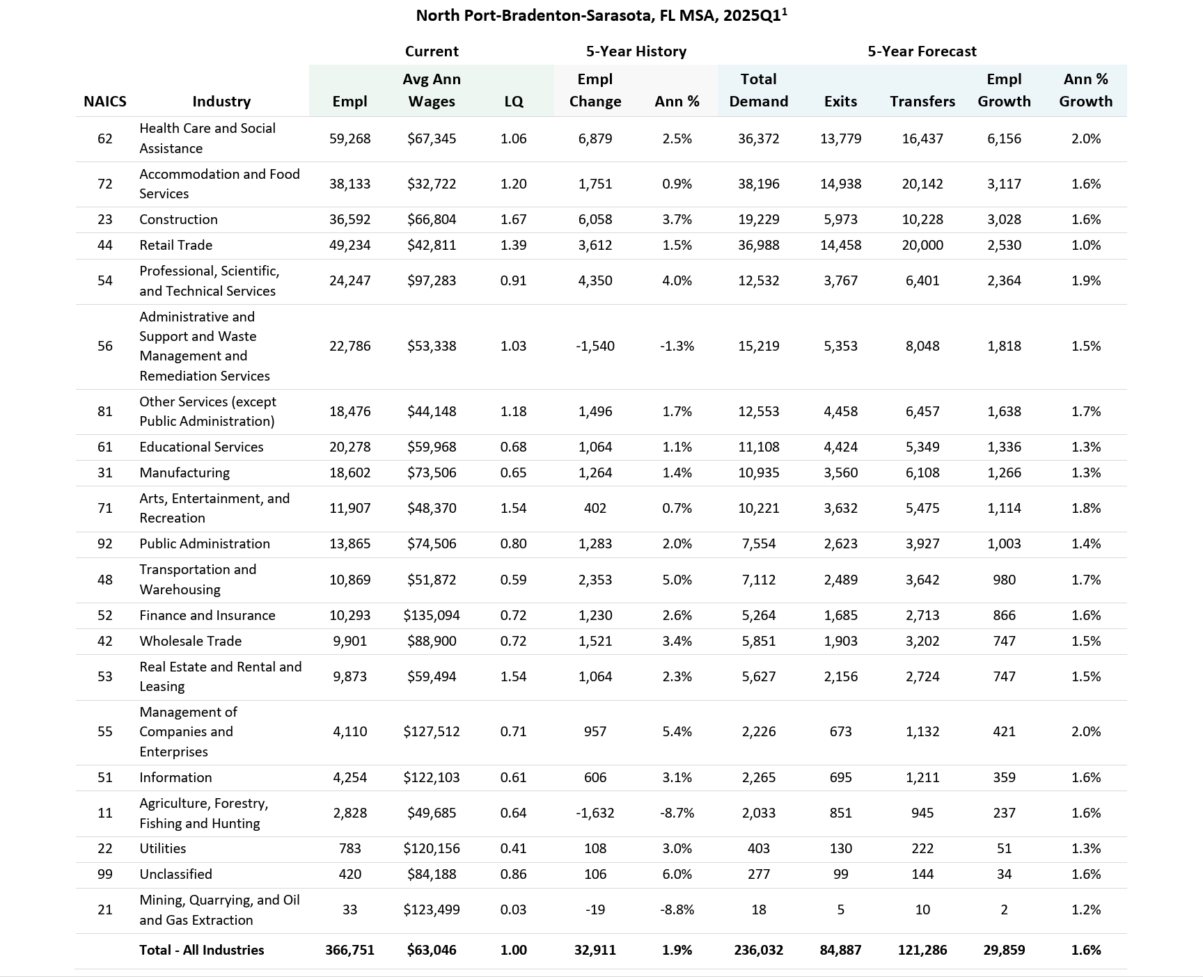

Slide 7
CareerSource Pasco Hernando Updates
Brenda Gause
Terri Clark (EIC term updates)
Education and Industry Partner Updates
Public Comment
Discussion
Closing Remarks
Q3 Meeting Options:
Monday, February 16 or 23
1pm via Teams
Notes:
Terri

Slide 8

Terri Clark
TClark Workforce Solutions, LLC
2722 Sapphire Blue Lane
Bradenton, FL 34211 tclark@careersourcepascohernando.com terri@tclarkworkforcesolutions.com www.tclarkworkforcesolutions.com

