Slide 1
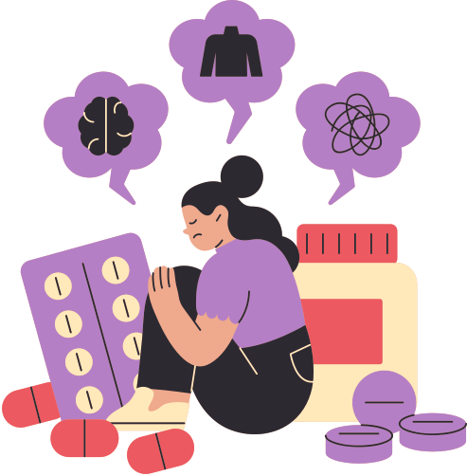
Presented By Sidra Zamir
Say Yes Foundation
THE DANGERS
OF DRUGS

Slide 2
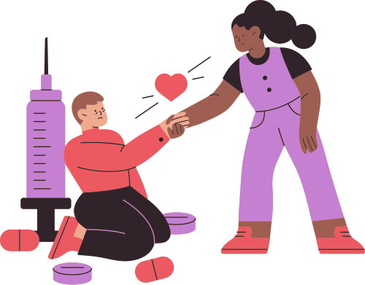
INTRODUCTION
Drug abuse happens when someone uses illegal drugs or misuses medicine. Many young people become victims of drugs because of curiosity, peer pressure, or stress. Unfortunately, drugs can quickly become addictive and very difficult to stop.

Slide 3
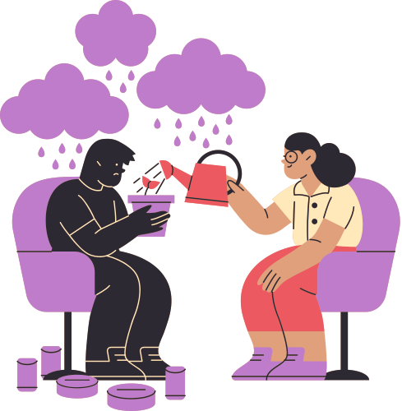
WHAT ARE
DRUGS?
Drugs are substances that change how the body and brain function. Some drugs are prescribed by doctors to treat illnesses. However, illegal drugs or the misuse of medicines can damage the brain, affect behavior, and create serious health problems.

Slide 4
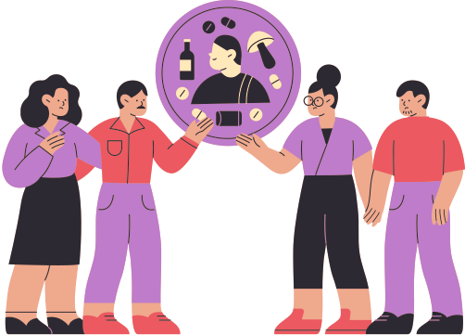
TYPES OF DANGEROUS
DRUGS
There are many types of illegal and dangerous drugs. Some common examples include cocaine, heroin, methamphetamine, and ecstasy. These drugs can cause addiction, meaning users feel a strong need to keep using them even when they know the risks.

Slide 5
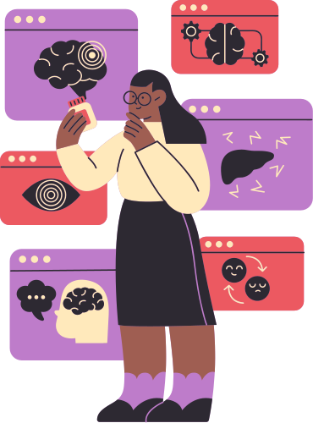
HEALTH
EFFECTS
Addiction is caused by a surge of dopamine. Dopamine is a chemical messenger in the brain that helps control motivation, pleasure, and reward; in turn, the feel-good hormone encourages us to repeat that behavior, leading to addiction. Drug abuse can seriously damage the body. It may harm important organs such as the brain, heart, lungs, and liver. Long-term drug use can cause diseases, weaken the immune system, and, in severe cases, lead to overdose or death.

Slide 6
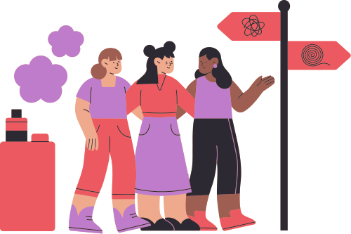
MENTAL AND
EMOTIONAL EFFECTS
Drugs can strongly affect mental health. Users may experience anxiety, depression, confusion, hallucinations, or paranoia. Over time, drug abuse can change the brain and make it difficult for people to think clearly or control their emotions.

Slide 7
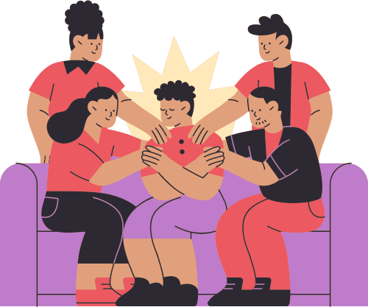
SOCIAL AND
FAMILY PROBLEMS
Drug addiction often causes serious social problems. People who abuse drugs may lose trust or get distanced from family and friends. It can lead to conflict at home, broken relationships, and social isolation.

Slide 8
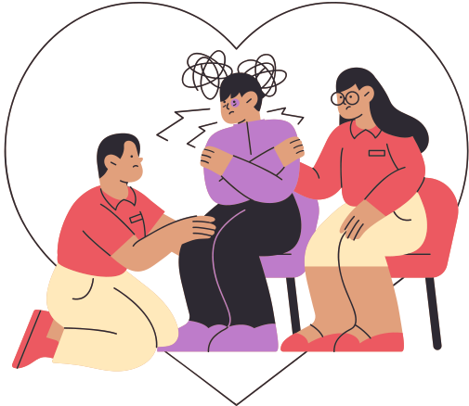
GET HELP!
Getting help for drug addiction can start by talking to a trusted adult, doctor, counselor, or addiction specialist. Treatment may include therapy, support groups, medication, or rehabilitation programs. In the U.S., SAMHSA’s helpline (1-800-662-4357) can connect people with confidential treatment and support.

Slide 9

PREVENTION
Preventing drug abuse starts with understanding the risks and making healthy choices. Building healthy ways to manage stress, surrounding yourself with supportive people, participating in positive activities, and learning to say no to peer pressure can help reduce the risk of drug use. It is also important to ask for help from a trusted adult, counselor, or doctor when problems become difficult to manage.

Slide 10
Say Yes foundation
THANK YOU
“Addiction is a health issue, not a moral failure. Asking for help is a strength.”

