Slide 1
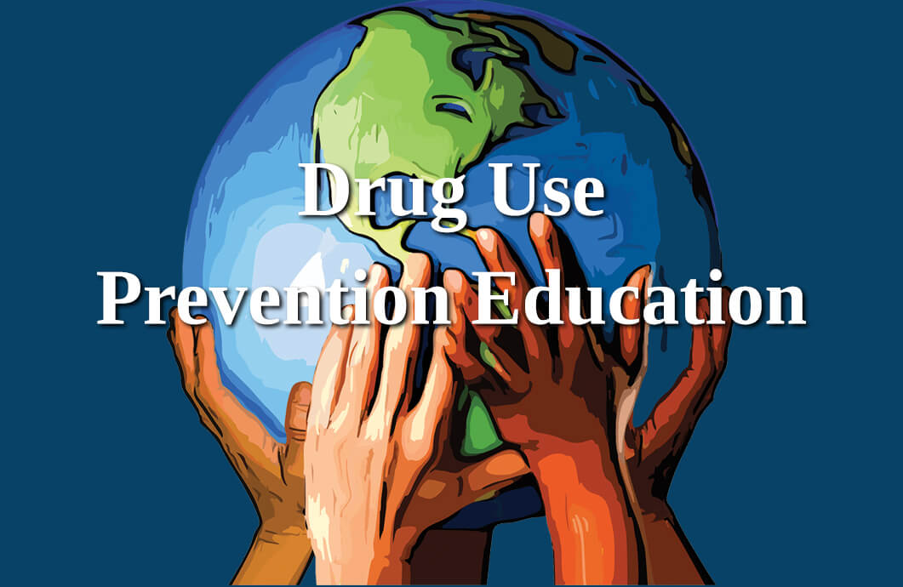
Fentanyl Prevention and Awareness
Exceptionally powerful narcotic / pain medication
It is utilized in surgical procedures to induce anesthesia and pain control
It is an opioid that is 100 times stronger than morphine and 30 to 50 times stronger than heroin
Schedule II Narcotic
High Risk for Dependency
Increasingly found in illicit drug supply
Odorless and tasteless
https://www.sandiegocounty.gov/
William Perno, SAY San Diego Senior Prevention Specialist

Slide 2

Can Fentanyl use lead to addiction?
Fentanyl is an addictive drug because of its potency. Persons taking prescription fentanyl prescribed by a doctor can experience dependence, which can lead to withdrawal symptoms after the patient stops taking the drug. Dependence can sometimes lead to addiction.
Fentanyl overdose symptoms may include extreme drowsiness, weak pulse, fainting, and slow breathing (breathing may stop). Seek emergency medical attention immediately or call the Poison Help line at 1-800-222-1222. A fentanyl overdose can be fatal, especially in a child or other person using the medicine without a prescription.
www.drugs.com

Slide 3

How can a fentanyl overdose be treated?
Drug dealers mix the cheaper fentanyl with other drugs like heroin, cocaine, MDMA and methamphetamine to increase their profits, making it often difficult to know which drug is causing the overdose. Naloxone is a medicine that can treat a fentanyl overdose when given right away. It works by rapidly binding to opioid receptors and blocking the effects of opioid drugs. But fentanyl is stronger than other opioid drugs like morphine and might require multiple doses of naloxone.
Because of this, if you suspect someone has overdosed, the most important step to take is to call 911 so they can receive immediate medical attention. Once medical personnel arrive, they will administer naloxone if they suspect an opioid drug is involved.
Naloxone is available as an injectable (needle) solution and nasal sprays (NARCAN® and KLOXXADO®)
nida.nih.gov

Slide 4
Fentanyl and Deaths: The Hard Reality
In the U.S. alone, fentanyl is now the leading cause of drug overdose deaths.
In recent years, over 70,000 overdose deaths annually have involved synthetic opioids—mainly fentanyl.
Most of these deaths are unintentional: people often don’t know fentanyl is in what they’re taking.
The opioid crisis has evolved over several decades, going through several phases since 1999, and killing over 564,000 people in the United States from overdose deaths alone. Fentanyl began to grow more popular in 2013, due to its potency and relative cheapness – which sent overdose deaths skyrocketing. Over 150 people die every day because of synthetic opioids like fentanyl.
Extremely potent: Just 2 milligrams can be fatal.

Slide 5
Fentanyl Crisis
The crisis has been exacerbated by the ease of producing and distributing synthetic fentanyl, often sourced from international suppliers. Its high potency and low production cost make it a preferred choice for drug traffickers, but this has led to a dramatic rise in overdose deaths.
Global Supply Chains: Chemical precursors for fentanyl are often sourced from countries like China and shipped to Mexico, where cartels manufacture and distribute the drug.
Overdose Epidemic: In the U.S., fentanyl-related overdoses have claimed tens of thousands of lives annually, with synthetic opioids being a leading cause of drug-related deaths.

Slide 6
How is fentanyl addiction treated?
Medication with behavioral therapies has been shown to be effective in treating people with a fentanyl addiction.
Medications for opioid use disorders—including fentanyl use disorder—are safe, effective, and save lives. These medicines interact with the same opioid receptors in the brain on which fentanyl acts, but they do not produce the same effects.
Methadone, an opioid receptor, attaches to and activates opioid receptors to ease withdrawal symptoms and cravings.
Buprenorphine, an opioid receptor, attaches to and partially activates opioid receptors to ease withdrawal symptoms and cravings.
Naltrexone, an opioid receptor, prevents fentanyl from attaching to opioid receptors, thus blocking its effects.
nida.nih.gov

Slide 7

CDPH Launches First Phase of Opioid Prevention ​​and Education Campaign ​
The California Department of Public Health is launching the first phase of an opioid and fentanyl prevention and education campaign today. Advertisements developed by federal partners will launch on social media, radio, television, billboards and bus stops next week.
https://www.cdph.ca.gov/
SACRAMENTO – To help address the opioid overdose crisis, today the California Department of Public Health (CDPH) is launching the first phase of a statewide opioid and fentanyl overdose prevention and education campaign. This effort is part of Governor Gavin Newsom's March 2023 Master Plan to tackle the fentanyl and opioid crisis. Due to the urgency of the fentanyl crisis, initial messaging for the campaign launches in September, followed by an expansive campaign in Summer 2024. The campaign is anticipated to continue through 2025.

Slide 8
Treatment for Fentanyl Addiction
Professional addiction treatment can help you safely withdraw from fentanyl use. Treatment involves medication to help you manage cravings and a variety of therapy to help you succeed in recovery.
Detox
Commonly referred to as detox, opiate withdrawal management includes services to help a person safely clear toxic substances from their body.
Inpatient Rehab
Inpatient hospitalization for fentanyl rehab provides the highest level of care for individuals with the greatest needs in recovery.⁷ This level of care can help individuals facing severe psychological conditions, especially those which may lead a person to harm themselves or others.
https://www.narcotics.com/

