Slide 1

Drug Identification & What you NEED to Know about Drugs
Presenter: Michael Jordan

Slide 2
Marijuana & Spice
Commom Drug & Designer Drug

Slide 3
What does marijuana look like?
Marijuana comes from the leaves and flowering tops of the Cannabis sativa plant, that appear greenish-gray when dried.
It also comes in a more concentrated, resinous form, hashish or hash, and as a sticky black liquid known as hash oil.

Slide 4
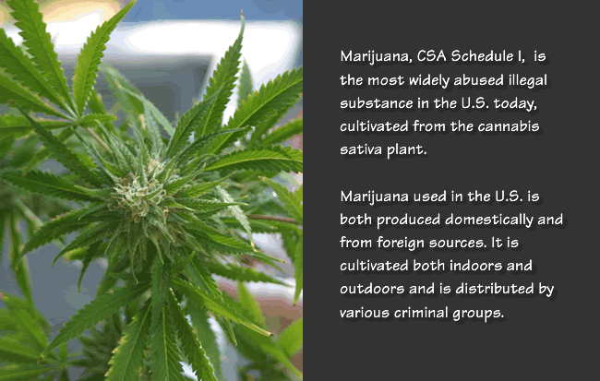
Marijuana Plant

Slide 5
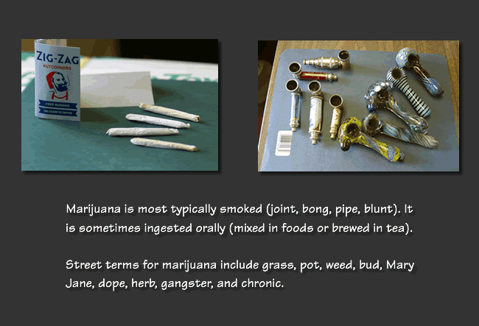
Street names

Slide 6
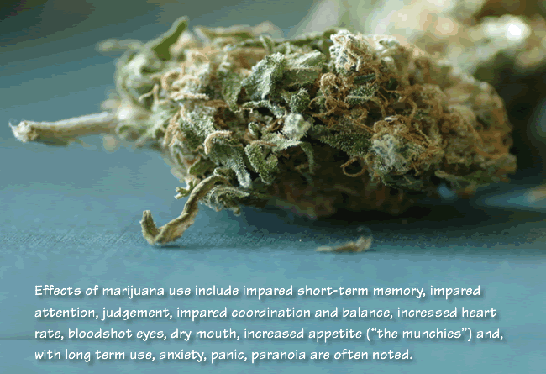
“mj”

Slide 7
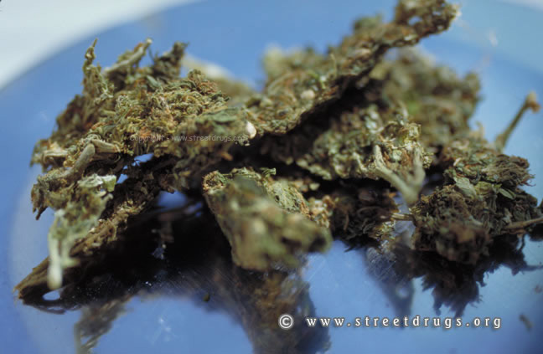
Marijuana Bud

Slide 8
Marijuana Stimulant or Depressant?
Sometimes marijuana seem to act like a stimulant , makes the heart race and give you panicky feelings and feelings of paranoia.
While other times it chills you out and makes you sleepy like a depressant. Is it a depressant or a stimulant ? In Cannabis, the main active ingredient is tetrahydrocannabinol (delta-9-tetrahydrocannabinol, THC).
Marijuana's effects are on human cognitive functions, psychomotor functions, and personality.

Slide 9
Marijuana (Con’t)
Marijuana is complex chemically, but it is not a narcotic. Like alcohol, marijuana acts as both stimulant and depressant, but it lingers in body organs longer than alcohol. Smoking marijuana can injure mucosal tissue and may have more carcinogenic potential than tobacco.
Research has indicated that marijuana intoxication definitely hinders attention, long-term memory storage, and psychomotor skills involved in driving a car or flying a plane. Expectations and past experience with marijuana have often influenced results more than pharmacological aspects have.
Marijuana has triggered psychotic episodes in those more vulnerable. Psychological and some instances of physiological dependence on marijuana have been demonstrated. As a psychoactive drug, marijuana surely alters mental functioning. Although it is possible that chronic use of marijuana produces irreversible damage to mind or brain areas.

Slide 10
Profile: Marijuana
What is marijuana?
Its main psychoactive chemical is THC. Due to the variety of effects it can produce, marijuana can be categorized as a stimulant, depressant, or hallucinogen.
How is marijuana used?
The most common way users ingest marijuana is by smoking it in joints (marijuana cigarettes), blunts (marijuana put into a hollowed-out cigar), pipes or bongs (water pipes). It is also eaten alone or cooked into food, most notoriously in hash or pot brownies. Also, it can be brewed into tea.

Slide 11
What are some street terms for marijuana?
Weed, Pot, Bud, Herb, Grass, Reefer, Ganja, Green, Mary Jane, Cheeba
Potency-related slang
­Low-grade: Schwag Dirtweed
­
Mid-grade:
Middies Skunk
­
High-grade:
Kindbud KB, Hydro Trees, Dank
PCP:
Dippers, Boat, Loveboat, Killer Weed, Fry, Frios, Wet, Water.
­
Powder or Crack Cocaine:
Chronic
Turbo
Bazooka
Crack Back
Fry Daddy
Woolies

Slide 12
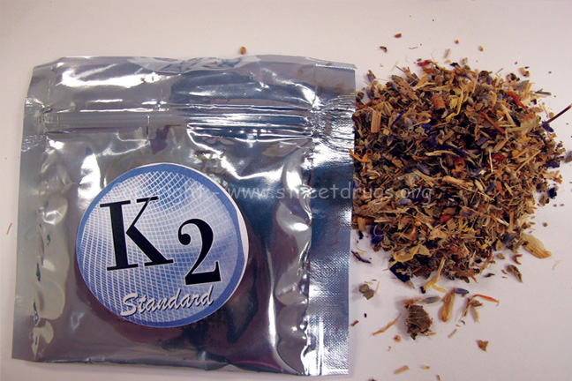
K2-Spice Synthetic marijuana

Slide 13
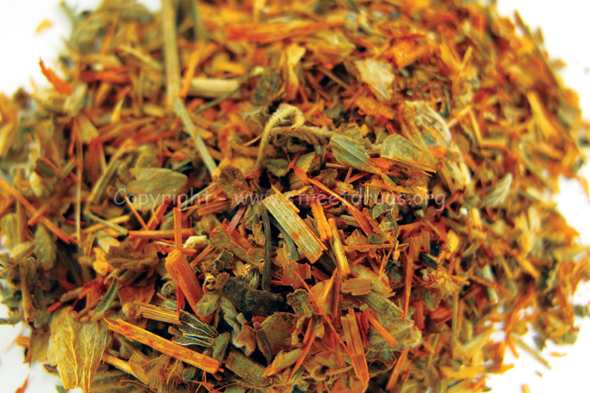
Dried leaves (variation of colors)

Slide 14
K2-Spice
Over the past couple of years, smokeable herbal products marketed as being “legal” and as providing a marijuana-like high, have become increasingly popular, particularly among teens and young adults.
These products consist of plant material that has been coated with research chemicals that claim to mimic THC, the active ingredient in marijuana, and are sold at a variety of retail outlets, coffee shops, head shops, and over the Internet.
These chemicals, however, have not been approved by the FDA for human consumption, and there is no oversight of the manufacturing process. K2 and others are typically sold in small, silvery plastic bags of dried leaves and marketed as incense that can be smoked. It is said to resemble potpourri. The leaf products are usually smoked in joints or pipes, however, some users make it into a tea.

Slide 15
K2-Spice
Herbal products have brand names such as “Spice,” “Spice Gold,” “Spice Silver,” “Spice Diamond,” “Spice 99,” “K2,” “K2 Strawberry,” “Blaze,” “Genie,” “Yucatan Fire,” “Skunk,” “Sence,” “Bliss,” “Black Mamba,” “Bombay Blue,” “Fake Weed,” “Genie,” “Zohai,” “Organic Mint Magic,” and “Red X Dawn” are labelled as herbal incense to mask their intended purpose.
“Synthetic cannabinoids” are a large family of compounds that are functionally (biologically) similar to THC, the main active ingredient in marijuana. Synthetic cannabinoids, however, are not organic but are chemicals created in a laboratory.

Slide 16
How can I tell if someone has taken marijuana?
See Hand-out Sheet

Slide 17
Meth & Bath Salt
Common Drug & Designer Drug

Slide 18
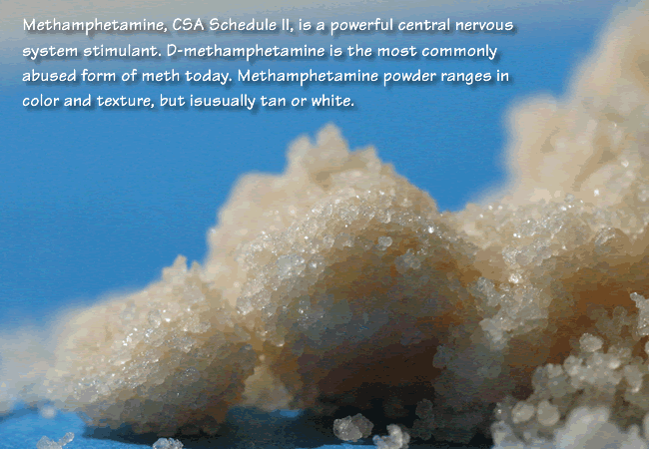
Meth

Slide 19
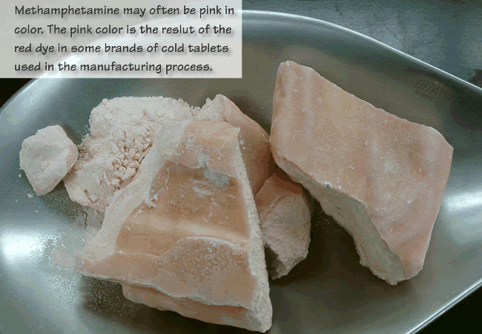
Meth

Slide 20
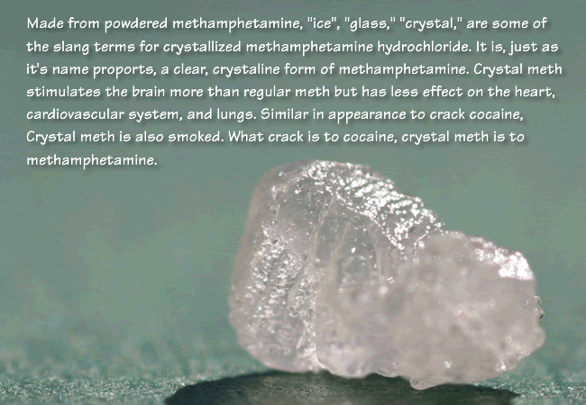
Meth

Slide 21
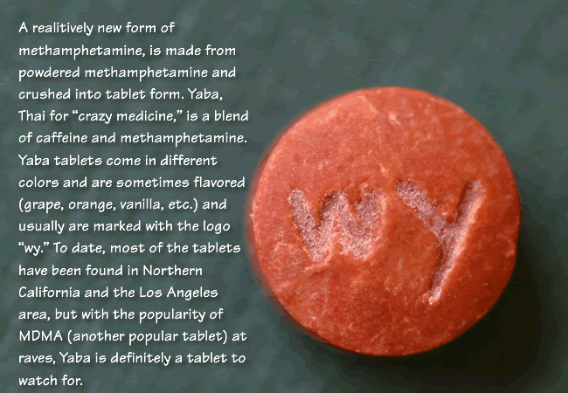
Meth-Yaba

Slide 22
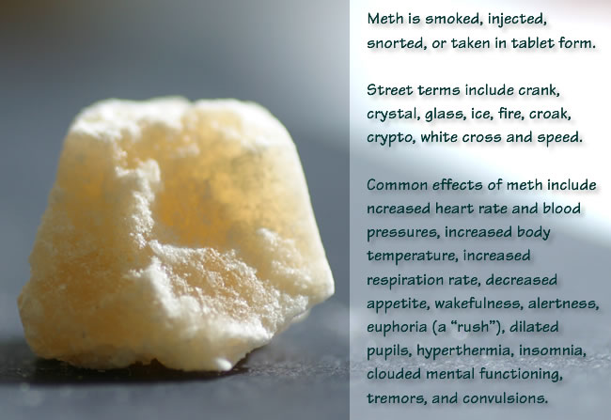
Meth

Slide 23
Meth use signs
There are many warning signs that a person may be addicted to methamphetamine. The physical appearance of a person using methamphetamines may provide several key clues:
Skin picking: methamphetamine addicts are known to obsessively pick at their skin. The marks left by this picking may look similar to an extreme case of acne, often leaving open sores on the face.
Skin crawling: meth addicts also often complain about having crawling skin, a disorder known as formication.
Tooth decay: Another common sign is tooth loss or tooth decay, referred to as meth mouth.
Hair loss: due to the lack of nutrients in an addict's body as well as the dangerous chemicals they ingest, hair breakage frequently occurs as well.

Slide 24
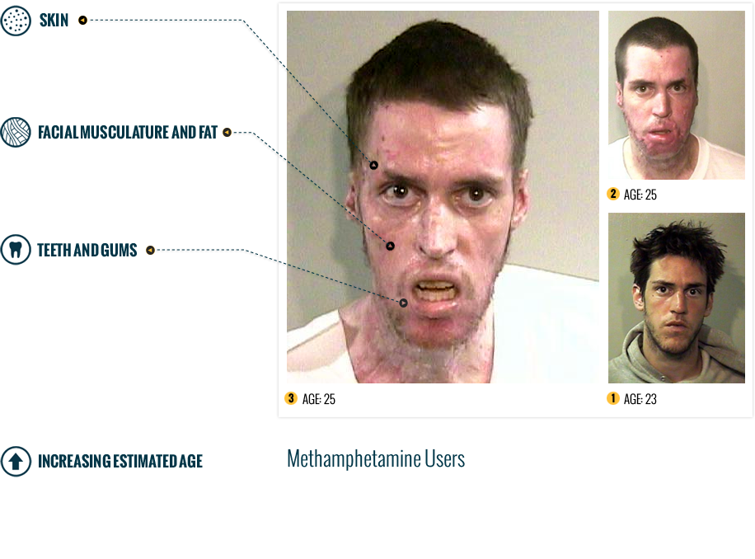
Horrors of Meth

Slide 25
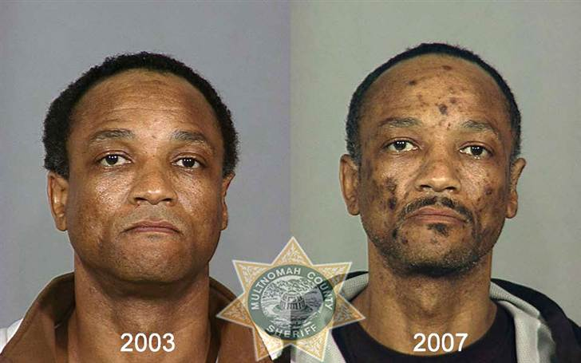
Horrors of Meth (con’t)

Slide 26
Bath Salt-Synthetic Meth
There's a variety of chemicals making up bath salts. These include cathinones and others.
The most serious results come from snorting or injecting, there are dozens of other chemicals that may be used. This makes treatment in the case of overdose or adverse affect very difficult.
They act as strong stimulants and may be sought by a person who normally uses cocaine or methamphetamine. They are strongly addictive and trigger intense cravings. Therefore even a person who sees that they are experiencing harm from abuse of these drugs may not be able to stop himself.

Slide 27
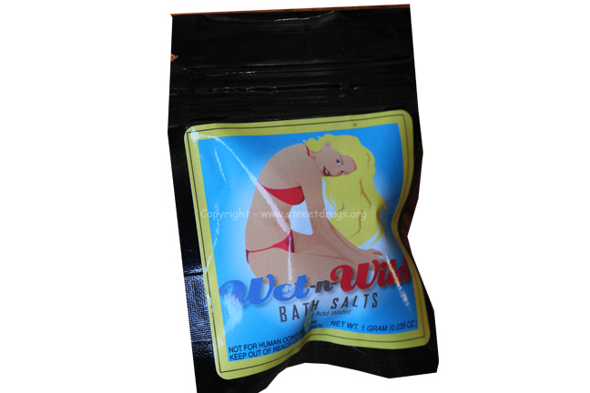
Bath Salt

Slide 28
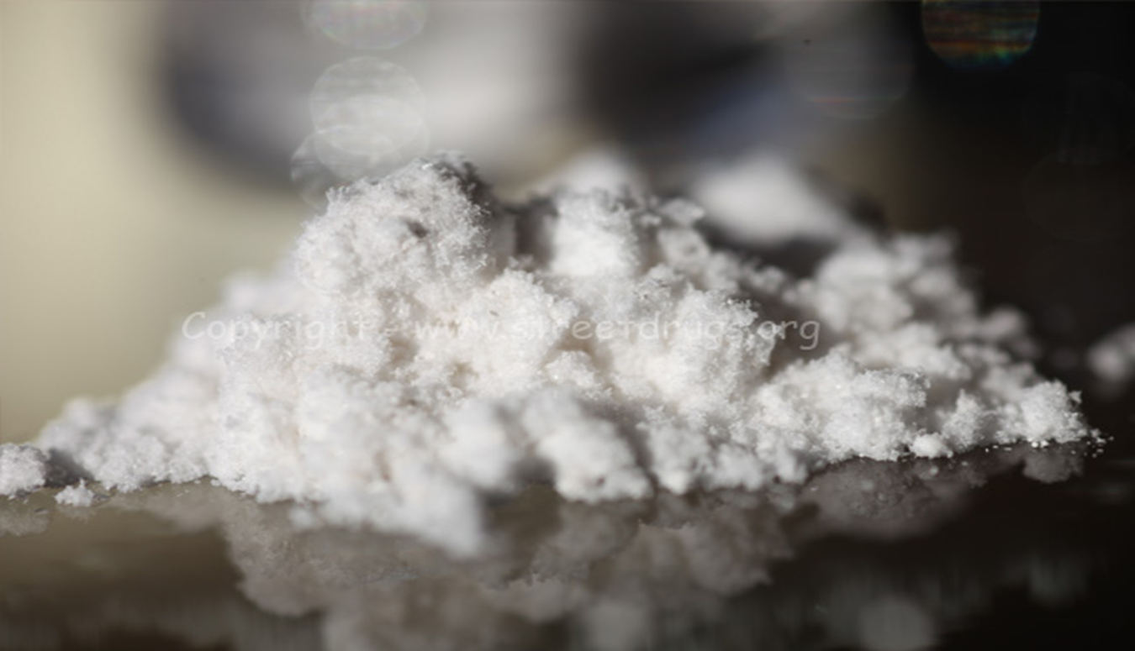
Bath Salt

Slide 29
Bath Salt
These products are sold under a variety of brand names including “Ivory Wave”, “Vanilla Sky”, “Energy-1” (NRG-1), “Ocean Snow”, “Hurricane Charlie”, “White Lightening”, “Red Dove”, “Cloud-9”, “White Dove”, “White Girl” and many others. They are indirectly marketed as “legal” alternatives to the controlled substances cocaine, amphetamine, and Ecstasy.
Bath salts are typically swallowed, inhaled, or injected, with the worst dangers being associated with snorting or needle injection

Slide 30
These signs of Bath Salt use include:
Increased blood pressure
Chest pains
Increased heart rate
Agitation
Hallucinations
Kidney pain
Increased body temperature or chills
Muscle tension
Nausea
Confusion
Reduced need for food or sleep
Paranoia
Suicidal ideas

Slide 31
These signs of bath salts use include
A person using bath salts may overheat and therefore tear his clothes off. His paranoia may drive him to aggressive, uncontrolled attacks on others, or self-destruction. He will probably not respond to any commands to stop his actions, and pepper spray or Tasers may have no effect.

Slide 32
How you can tell if someone is using Meth
See Hand-Out Sheet

Slide 33
Break Time

Slide 34
Cocaine & Crack Cocaine
Common Drug & Designer Drug

Slide 35
Cocaine & Crack Cocaine
It is a powerfully addictive central nervous system stimulant with detrimental effects on the user and on society as a whole. Crack, CSA Schedule II, is also a powerful stimulant derived from Cocaine that emerged in the mid-1980's.
Cocaine is a white powder derived from the leaves of the coca plant. The majority of coca plants used to process cocaine are grown in South America, of which ¾ of the plants are grown in Colombia. Cocaine is primarily smuggled through entry points in Southern California and South Texas.
Crack cocaine is derived from cocaine and is similar to cocaine, but it is not a powder---it is a solid that is broken and sold in “rocks.” Crack is produced by dissolving powdered cocaine in a mixture of water and ammonia or sodium bicarbonate. The mixture is boiled until a solid substance forms. The solid is removed from the liquid, dried, and then broken into the "rocks'" that are sold as crack. Crack cocaine is not smuggled into the United States—it is made from cocaine powder already in the U.S.

Slide 36
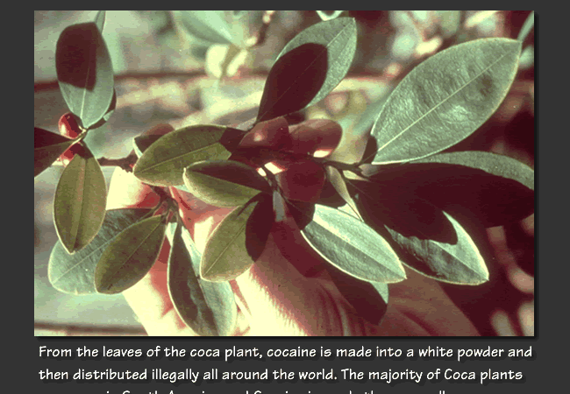
The Beginning Process

Slide 37
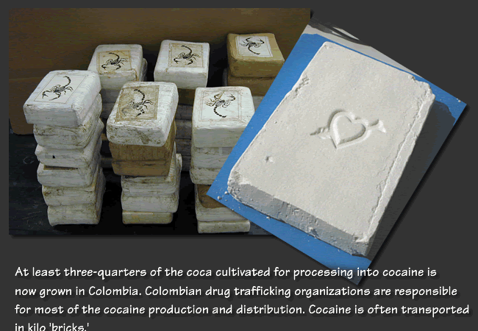

Slide 38
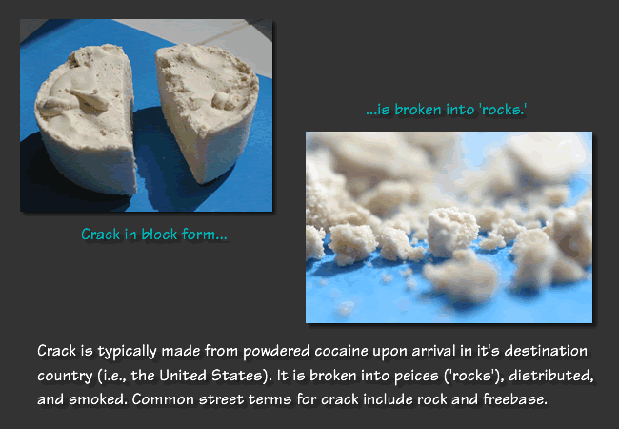

Slide 39
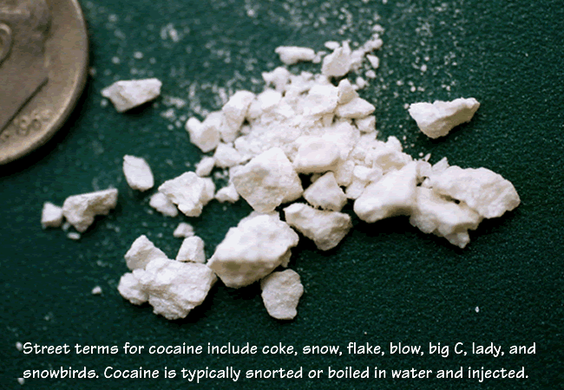

Slide 40
Short & Long Term effects
Short-term effects include increased heart rate, blood pressure, and body temperature as well as tremors, vertigo (dizzy confused state of mind), muscle twitches, and paranoia. Other less common consequences of use include chaotic heart rhythms, seizures, and strokes.
Long-term use, especially via intranasal (nasal passage) administration, may lead to loss of sense of smell, nosebleeds, throat irritation, and deterioration of the nasal septum, while prolonged use via ingestion can cause bowel gangrene resulting from decreased blood flow. Long-term use also can cause aortic dissection (a tearing in the lining of, or rupturing of, the aorta), a condition that may result in death.
High doses of cocaine and/or prolonged use can trigger paranoia. Smoking crack cocaine can produce a particularly aggressive paranoid behavior in users. When addicted individuals stop using cocaine, they often become depressed. This also may lead to further cocaine use to alleviate depression. Prolonged cocaine snorting can result in ulceration of the mucous membrane of the nose and can damage the nasal septum enough to cause it to collapse.
Cocaine-related deaths are often a result of cardiac arrest or seizures followed by respiratory arrest.

Slide 41
How you can tell if someone is smoking crack cocaine.
See Hand-out sheet

Slide 42
Heroin & Krocodil
Common Drug & Designer Drug

Slide 43
Heroin
Heroin and its precursor, opium, have been plagues in this country for more than a hundred years. It is thought that the Chinese working on the first transcontinental railroads brought opium from the East with them. Heroin was being used medically as a remedy for a wide variety of complaints, from pain to insomnia to "women's complaints."
In the US, heroin addiction was epidemic in the mid-twentieth century, and methadone was developed as a way to reduce overdoses and the spread of disease. While it did reduce some of the harm being done by heroin addiction, it was always known that it was not a complete solution.

Slide 44
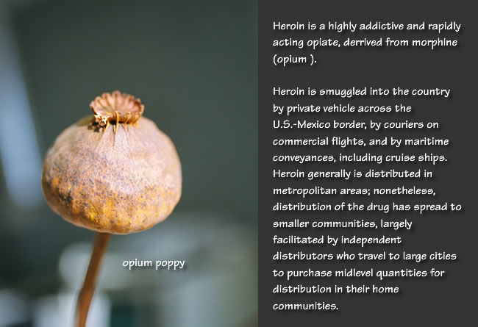
Heroin

Slide 45
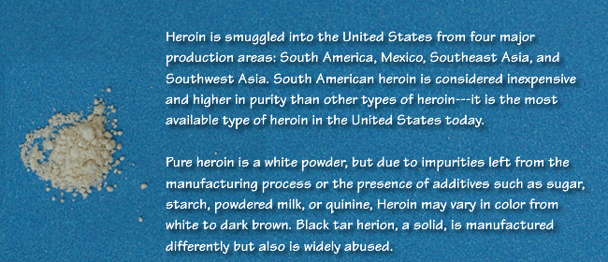
Heroin

Slide 46
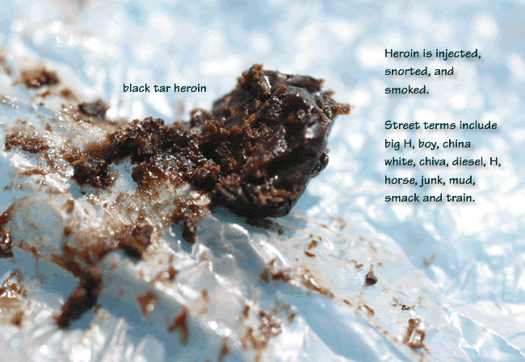
Heroin

Slide 47
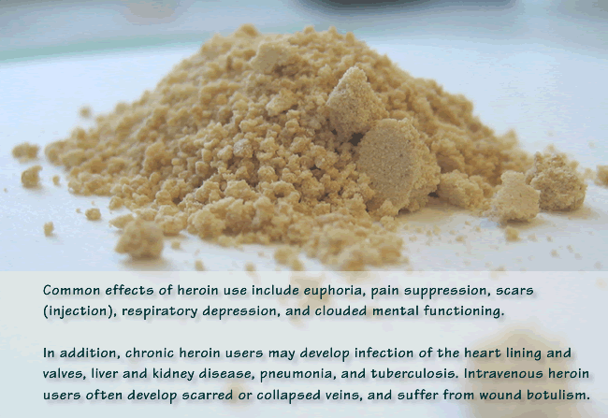
Heroin

Slide 48
Heroin
Injection ("shooting up" or "mainlining") provides the most intense and most rapid high.
Injection also provides the highest risk for contracting infectious diseases such as HIV and hepatitis.

Slide 49
The new Synthetic Heroin : “Krocodil”
Krokodil – the cheap heroin substitute that rots the flesh of addicts, usually killing them within two years – is believed to have made the switch to the US after a number of cases were reported in Arizona.
Officials in the state fear they may be seeing the beginning of an epidemic after two people in just one week attended hospitals suffering the devastating symptoms of the drug.
Krokodil – real name desomorphine - is an ultra-cheap heroin substitute that counts crushed codeine pills, gasoline, cooking oil, iodine, paint thinner and lighter fluid among its toxic ingredients.

Slide 50
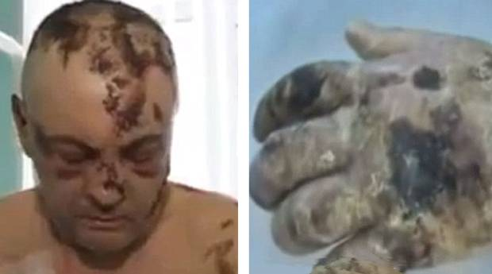
Krocodil
The drug, which has become extremely popular in Russia in recent years, gets its name from the stench and reptilian texture it gives to an addict’s skin before it eventually eats it away completely, often leaving a user's bones exposed.

Slide 51
Krocodil
The drug is called Krokodil because it leaves users with scaly skin like a crocodile. Although it has the same mental effects as heroin, krokodil’s incredibly cheap ingredients cause dramatic and devastating consequences in a user’s body.
Many addicts suffer brain damage and speech impediments from the drug, but it is from the fact it often causes blood vessels to burst - leaving strong-smelling gangrenous wounds to fester on the body - that krokodil acquired its sinister name and reputation.
The Krokodil eats the internal human organs
The average krokodil user has a life expectancy of just two to three years after they start taking the drug, and in that time they can expect their skin to turn green, scaly and fall-off as a kind of pre-death decomposition sets in.

Slide 52
Get informed
This is the reality of what we’re faced with daily that’s lurking in our communities, schools, neighborhoods, and homes.
We urge you to get informed about these facts and inform others so that we can preserve and spare the lives of our Loved ones, especially the youths, our Future!!!

Slide 53
“7 Ways to Tell if Someone is Using Heroin”
See Hand-out sheet

