Slide 1


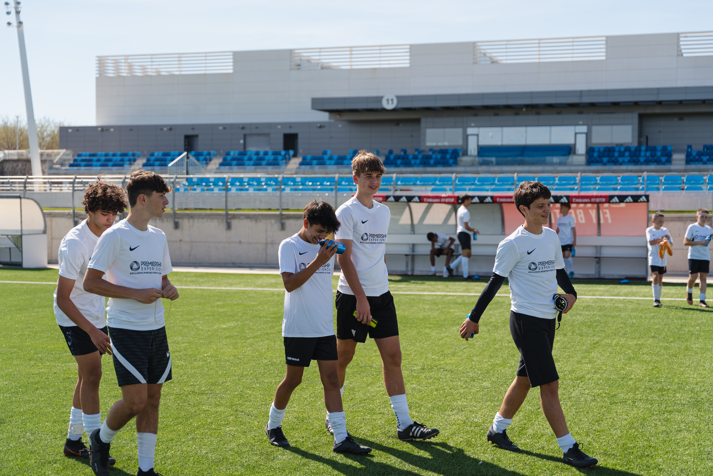


Bloomingdale Lightning FC
Elite Madrid Football Experience
7th – 12th April 2027

Slide 2


Who are we ?
Award Winning Global Sports Tour Operator
Specialise in providing bespoke experiences in partnership with the biggest names in world sport & entertainment
Offices in UK, China, Australia and UAE
Since 2010 we have arranged experiences for over 250,000+ people
97% of all our groups book again over an 18 month period – testament to the hard work of our team in providing the highest quality of experience.

Slide 3












Our Academy & School Partners
Plus, many more…

Slide 4

What is included?
Accommodation at a 4* Partner Hotel on a half board basis
3 x Training Development Sessions with professional Real Madrid coaches at official training complex
Three Challenge matches vs local opposition for each travelling team
Behind the Scenes Tours of both the Atletico Madrid Stadium and the Bernabeu Stadium
Tickets to a Live La Liga Fixture
Entry to Warner Bros. Theme Park
Evening entertainment x 1 night (e.g. bowling)
Private executive coach transportation throughout the experience
Free time to explore the culture, history and key shopping & entertainment destinations in Madrid
A 24/7 Premiership Experience tour manager with you for the duration of the experience

Slide 5

Madrid Trip Overview
All details of the Elite Madrid Football Experience can be found on the following link:
Bloomingdale Elite Madrid Experience

Slide 6
Considerations
Travel Window / Dates – This is a 6 day/5 night experience. The travel dates for the trip are 7th – 12th April 2027 (travelling on 6th April overnight to arrive on 7th April)
Passport – At least 6 months validity from return date of travel is required
Visas – It is the responsibility of each individual to ensure they have a valid visa in advance of travel.
Travel Insurance – Each traveller must have fully comprehensive travel insurance prior to departure. It must cover full medical & repatriation needs as a minimum. A copy of each players insurance policy must be submitted to Real/Atletico Madrid for training sessions to be permitted.

Slide 7
Considerations
Dietary/Medical- If you have any dietary/nutritional requirements or medical conditions please make sure this is communicated in advance of the trip.
Lunch – The package does not include lunch as the itinerary does not permit time each day for a reserved sit-down meal at a restaurant. There will of course be an opportunity for the group to purchase lunch on each day of their experience. It will mostly likely be grab and go lunch based on the schedule to maximise time. The tour manager from Premiership Experience will advise of different food options to choose from on each day of the experience.
Rooms – Players travelling independently will share with teammates in triple or twin rooms. Any parents accompanying their child will share a twin room as part of the same family.

Slide 8
Considerations
Flights – Flights are not included to allow those who may wish to add some time before/after the trip to do so – or for those who wish to use points to purchase their airfare. All participants must ensure they are in destination for by lunchtime on 7th April 2027 to allow the programme to commence.
Potential Flight (Trip Dates only) – Both American Airlines and United fly direct to Madrid with flights leaving on the evening of 6th April and arriving in the morning on 7th April.
Total Cost – Parent Price - $1999 per person / Player Price - $2499 per person
Deposit – $400pp required by Friday 28th August to secure your place. First come first serve due to demand.
Payment Plan – Bloomingdale LFC to confirm. Suggested monthly payment plan to ensure affordable for all families with last payment to be made 4 weeks out from departure.

Slide 9
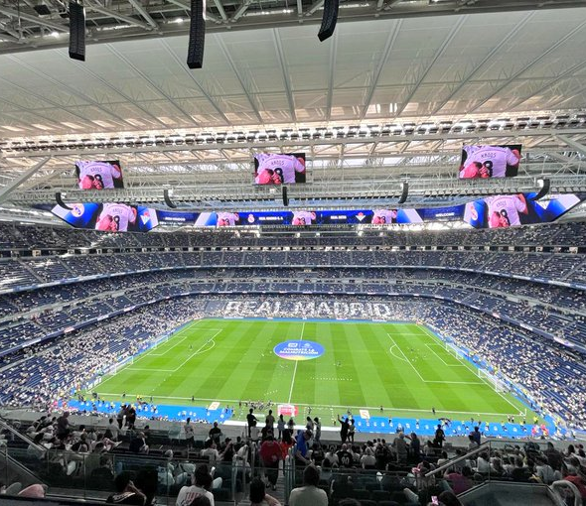
Any Questions ?

