Slide 1
Retinal Findings with Systemic Disease
Jeffry D. Gerson, O.D., F.A.A.O.
Jgerson@hotmail.com
Notes:
For full 2 hours, unhid e slides

Slide 2
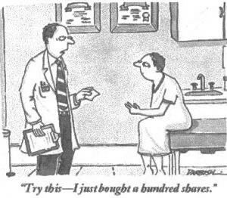
Disclosure
I have been on advisory boards/a consultant to/received honoraria from/ or been on speakers bureau list of the following:
  Allergan, Apellis, Astellas, Bausch & Lomb, Essilor, iCare, Lenz, Luneau Technologies, MDA, Notal Vision, Novartis, Optos, Viatris, ZeaVision
These affiliations will have no affect on the content of this lecture

Slide 3

Antioxidants
Do you drink coffee?
  Over 50% of Americans drink coffee
Is this important?
  Coffee is leading source (by far) for antioxidant intake in the US diet!!¹
Neither coffee nor caffeine intake were associated with early AMD per BDES
Beware:
  COFFEE and DOUGHNUT Maculopathy²
As reported by American Chemical Society 8/05
Kerrison J.B. et.al. Coffee and Doughnut Maculopathy: Acute Ring Scotomas. BJO.2000 Feb;84(2):158-64.

Slide 4
The Relationship of Coffee Consumption with Mortality Ann Intern Med 2008:148:904-14
2 Cohorts
  41,736 men Hx Professionals FUp Study – 18 years
  86,214 women Nurse’s Hx Study - 24 years
Results
  After adjustment for age, smoking, other CVDz and CA risk factors
 | Men
<1 cup / month | 1.07
1 c/m – 4 cups/w | 1.02
5-7 cups / week | 0.97
2-3 cups / day | 0.93
4-5 cups / day | 0.80
> 6 cups / day | 0.74
P<0.001 for trend and independent of caffeine intake

Slide 5
How much can diet affect vision?
Junk food can cause blindness!
  French fries, potato chips, white bread, processed ham and sausage
Complaints at age 14 of tiredness
  Normal BMI, no signs of malnutrition
    Low B12 and anemia treated and given dietary advice
Age 15: hearing and vision loss
Age 17: Blindness
  Low B12, Vit D, bone density and high Zinc
Optic neuropathy caused by junk food diet!
  Some controversy as to possibility of other cause…..
  BMI isn’t everything (as seen in this case)
Harrison et al. Blindness by Junk Food. Annals of Int Med. 9/19

Slide 6
Course Objectives
Discuss Ophthalmic tests for evaluating retina
Discuss systemic conditions that affect retina, and how we factor into patient care
Discuss findings associated with systemic diseases, both common and uncommon
Know when to refer, and to whom

Slide 7
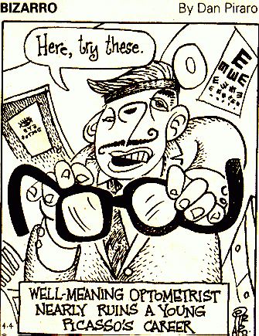
Medical optometry: A different kind of “liability”

Slide 8
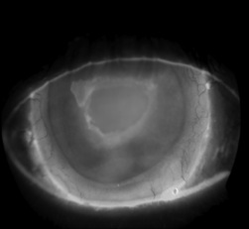
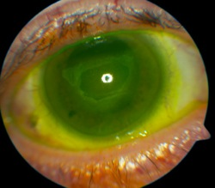
More Than Meets the Eye
Macula off retinal detachment OD
LP vision
Systemic health: good?
Meds: Valium, Oxycodone, Methadone, Elavil
Tx: Vitrectomy and Scleral Buckle
Post op: Corneal Abrasion and HM
How did the abrasion happen???
Bottle Top

Slide 9
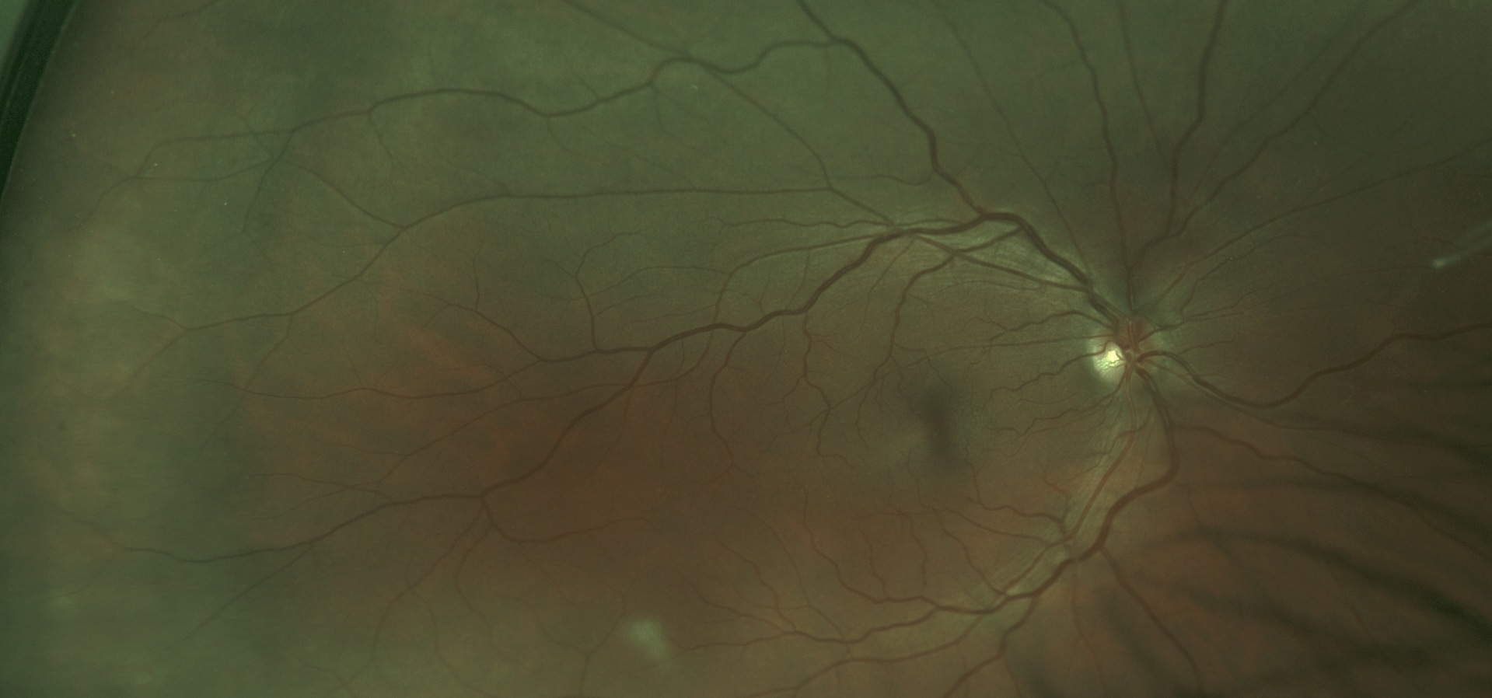
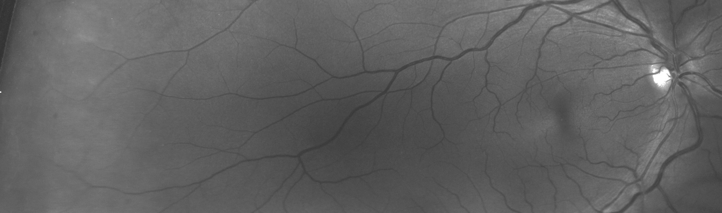
What does this mean to you?

Slide 10
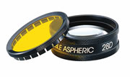

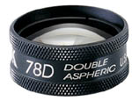

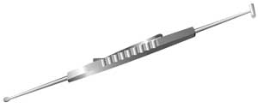
Clinical exam
**BIO best for clinical exam of peripheral retina
Condensing lens at slit lamp ideal for magnified posterior pole views
Dynamic clinical exam
Require examiner to document
Some things best seen clinically, and unable to be seen with imaging devices

Slide 11
Healthy patient??...
32 yo male
2-3 month history of cough, dyspnea, chills, malaise
Recently returned from International travel
Lives in Midwest
Health care professional
No improvement with antibiotics and PO prednisone
Abnormal chest x-ray
Good vision
Referred to Pulmonologist

Slide 12
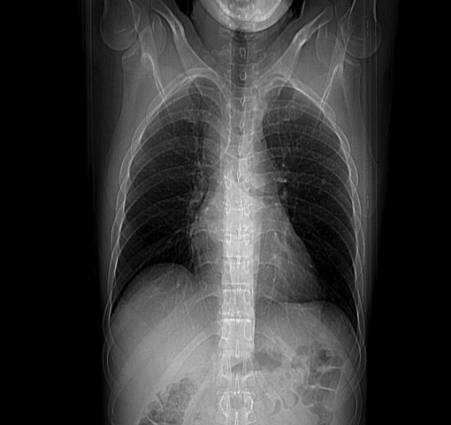
Chest X-ray
Calcified Granulomas
Differentials?
  TB
  Sarcoid
  Histoplasmosis
  Lymphoma

Slide 13
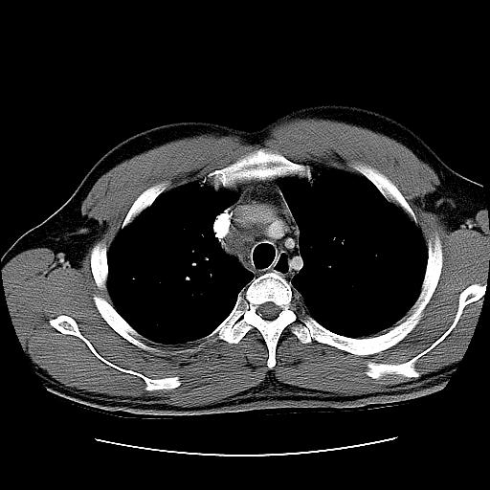
Case continued
CT ordered with contrast
Labs ordered
  CBC Normal
  Normal Liver function
  ESR 46 mm/hr
  Negative TB skin test
  ACE 44 U/L (7-46)
  Histo Mycelial Ab Normal
  Histo Anti H Ab 1:32

Slide 14

Histoplasmosis
Treatment:
  Sporanox (Itraconazole) 200mg BID x 1 mo
  100mg BID x 2 mo
Aside:
  Value of prescription drug coverage!
  Importance of good doctor patient relationship!!!
  In case you were wondering, Histo has remained quiet, with no radiologic changes as of 4/06

Slide 15
Systemic Histoplasmosis
Caused by Histoplasma capsulatum, a dimorphic fungus, that turns into a yeast at body temperature
Endemic to Ohio, Mississippi, and Missouri River valleys
Aerosolized fragments result in alveolar deposition
Most infected people are asymptomatic
Can involve CNS, liver, spleen, eyes, rheumatologic system, and hematologic system

Slide 16
Histoplasmosis cont.
Symptoms can occur 3-14 days after exposure
Approximately 250,000 infected annually
Clinical manifestations in less than 5%
About 90% with acute pulmonary histo are asymptomatic
Enlarged hilar and mediastinal lymph nodes in 5-10% of patients
Affects males 4:1
Progressive disseminated histo mostly occurs in immunocompromised patients ex: AIDS
Good summary article: Trevino & Salvat:Preventing Reactivation of OHS. Optometry 1/06
Notes:
So, about 1250 become symptomatic

Slide 17
Testing
CBC generally normal
Sputum cultures yield positive results in only 10-15% of acute pulmonary histo
Complement fixing antibodies
  Greater than 1:32 suggests active
    Positive 5-15% of within 3 wks of exposure
    Positive 75-95% at 6wks
Immunoprecipitating antibodies
    Anti-M detected in 50-80%, and remains elevated for years
    Anti-H detected in 10-20% and becomes undetectable after 6mos. This antibody is most specific for active histo
Imaging studies
  Chest X-ray
  CT scan
HLA-B7, HLA-DR2 and may be elevated more in people with CNVM
Notes:
HLA DR2: Meredith et al. Assoc of HLA-DR2….AJO 1980.89:70-6
HLA B7 Meredith et al. Prevelance of HLA B7….AJO 1978:86:325-8
HLA DR15/HLA DQ6 haplotype..Dabil et al. Assoc of…… Hum Immunol 2003;64:960-4

Slide 18
Treatment
No treatment needed if asymptomatic
Treatment if symptomatic, or progressive
Treatments
  Amphotericin B: drug of choice for overwhelming active histo, administered by IV
  Itraconazole: Fungistatic, very active against Histo, minimal side affects
    Liver functions must be monitored
    Approximately 86% success when treating > 2mos
  Ketoconazole: Fungistatic, well tolerated, does not cross blood/brain barrier

Slide 19
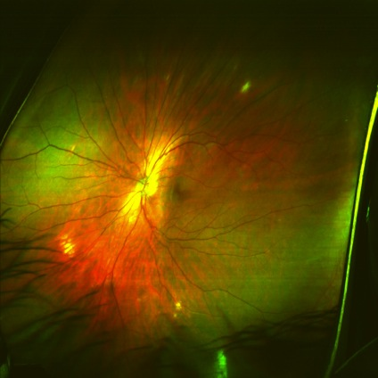
(P)OHS
(Presumed) ocular histoplasmosis syndrome
Not previously found post-ennucleation in patients with typical POHS
Has been found in eye of patients with known Histo
Approx 1-10% pts. In endemic areas have ocular involvement, usually asymptomatic
10% will be bilateral

Slide 20
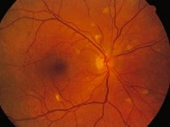
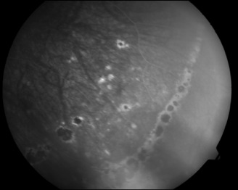
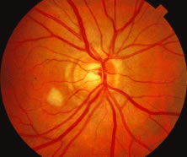
OHS
  Histo Spots
    Atrophic yellowish white scars from previous multifocal or disseminated choroiditis
    Can form streaks
  Peripapillary Atrophy
    May represent atrophied granulomas that formed during active infective stage of
    Neovascular membranes can form here, and involve macula

Slide 21
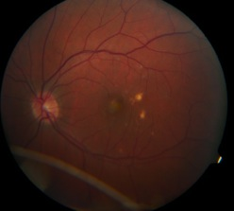
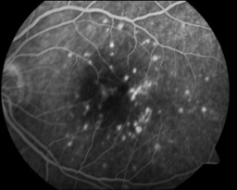
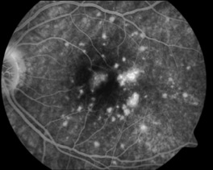
OHS
Macular Involvement
  CNVM tend to form in area of pre-existing histo spot
  May be immune reaction against H. capsulatum
  May be due to weakened Bruch’s membrane
  10% become bilateral at 5 yrs, and 20% at 10yrs
  81% with disciform macular scarring have pulmonary calcifications

Slide 22
Treating CNVM from Histo
MPS
  Argon laser to entire lesion effective if extrafoveal with 8% recurrence
  Krypton laser if juxtafoveal with 23% recurrence
Submacular Surgery (SST)
  Benefit seen in surgical group if entering acuity worse than 20/100 (76% vs 50% same or better)
  More recently shown beneficial with PPCNVM¹: different histopath
  Pt experience no better with surg in any group²
PDT
  >50% remain equal or show improvement
  No cases of severe vision loss as has been reported as has been with AMD patients
Anti-VEGF Therapy
1. Thomas, Matt at Barnes Retina in St. Louis 3/2008 2. Surg vs observ with POHS CNVM. SST group. Arch Ophth 12/08
Notes:
SST: 2008 paper by Matt Thomas at Barnes in St. Louis: success with PPCNVM, likely different histopath and prognosis than foveal lesions

Slide 23
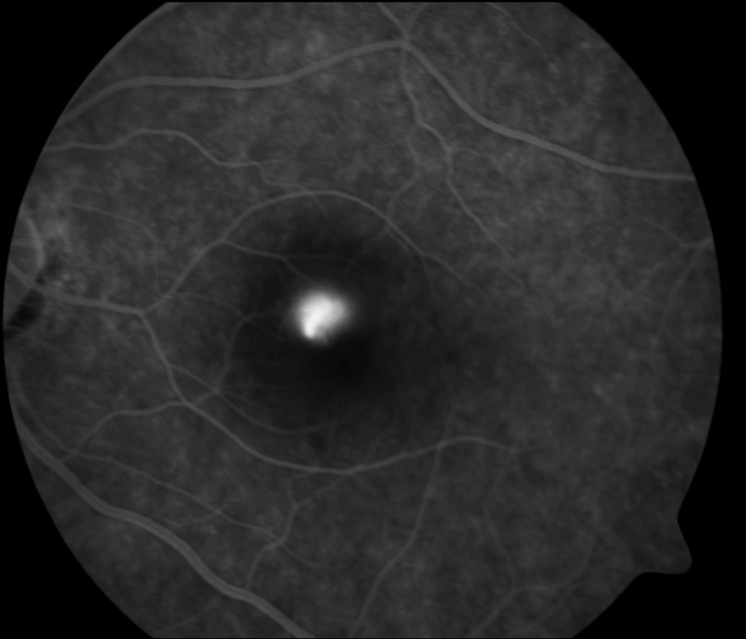
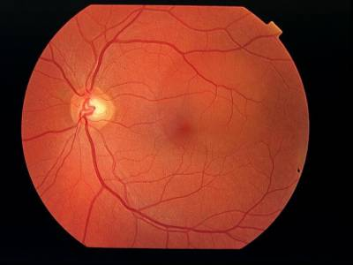
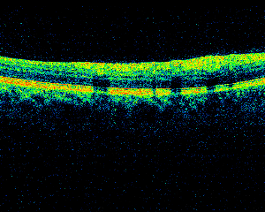

Central “Spot”
50yo female referred in with a “spot” in the center of her vision
Present for 1-2 wks
Referring OD noticed abnormality
VA 20/20 OU
Denies High stress or type “A” personality

Slide 24
Central Serous Choroidopathy
Characterized by breakdown of the outer retinal barrier, with leakage of fluid through a defect in the RPE into the subretinal space, resulting in a neurosensory detachment
Often times associated with high stress +/-
  ED (Emotional Distress) may be related¹
FA or OCT must be done to rule out CNVM
Other systemic associations
  Use of corticosteroids* (Well documented in literature), pregnancy, increased adrenaline level, hemodialysis, collagen vascular disease, and hypertension
Treatment?
Letter of diagnosis to PCP to make aware
1. Conrad et al. Alexithymia and emotional distress in ICSC. Psychosomatics. 2007 Nov-Dec;48(6):489-95

Slide 25
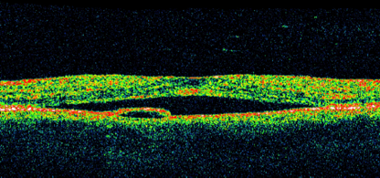
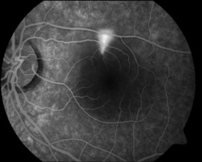
ICSC
Treatments proposed:
  PDT
    Success in multiple studies¹
  IVTA
    May prevent leakage
    Not study proven and counterintuitive
  Anti-VEGF
Is it too easy to be successful with new treatments??
PDT for RPE leaks in CSC. Ober, M et al. Ophthalmology. Dec. 2005.

Slide 26
Central Serous and Steroids
How would you know about steroid use?
What kinds of steroids
  I have had cases of cream/ointment, oral
Could hormones have same affect?
  Patient on Androgel for “Low T”

Slide 27
ICSC
Steroids react with mineralocorticoid receptors
Mineralocorticoid antagonists (counteract or prevent effect steroids)
Significant reduction in RPE detachment and in choroid thickness in treatment groups vs. placebo groups after 1 month of treatment
Improved VA in patients with prolonged CSCR after 1 month of treatment versus placebo or eplerenone. Also improved CRF/CRT

Slide 28
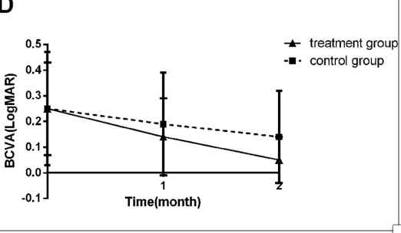
ICSC continued
Placebo controlled 40mg BID Spironolactone vs control x 2 mos¹
  Complete of SRF in 56 vs 8% at 2 mos
  Statistically significant improvement in central thickness: 75 vs 15 microns
  VA improved in both; more in Tx, but not stat statist.
Practical guidelines:
  Sprionolactone 25-50mg BID
  Consider K supplementation and kidney function testing
1. Sun et al. BJO. Spironolactone in ICSC. 8/2017.

Slide 29
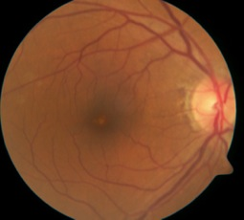
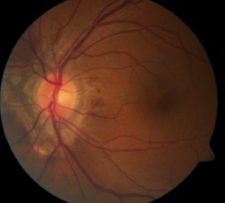
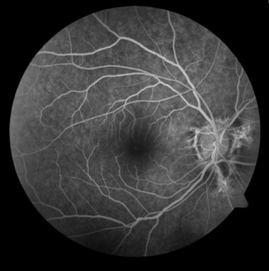
Case Study
44 yo native-american male
Recent awareness of central blind spot
20/25 OU
Diagnosis?
  Solar Maculopathy
Systemic assoc???

Slide 30

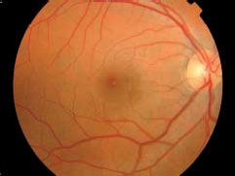
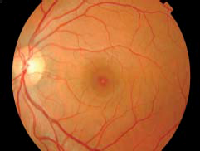
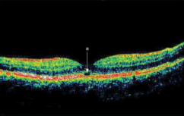
Solar Maculopathy
Bilateral yellowish spot in fovea with surrounding hyperpigmentation and OCT shows loss of cells at RPE layer
Retinal phototoxicity vs photocoagulation
Often happens in patients who use drugs or are on psychotropic meds
  Sun gazing while “on drugs” or brief exposure with pharm. Dilated pupils
  No other systemic associations
Notes:
A 7mm pupil with solar observation causes a 22degreeC increase in retinal temperature, well above the 10degree threshold to cuase photocoagulation

Slide 31
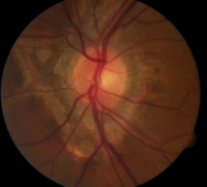
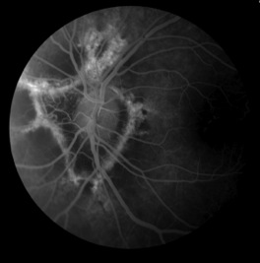
Case Study cont.
Take a closer look at the ONH
What is this?
No PEPS
Idiopathic
Warned of possibility of future CNVM
Notes:
PT: d. Bread
P:Pseudoxanthoma Elasticum
E: Ehlers danlos
P: Paget’s
S: Sickle Cell

Slide 32
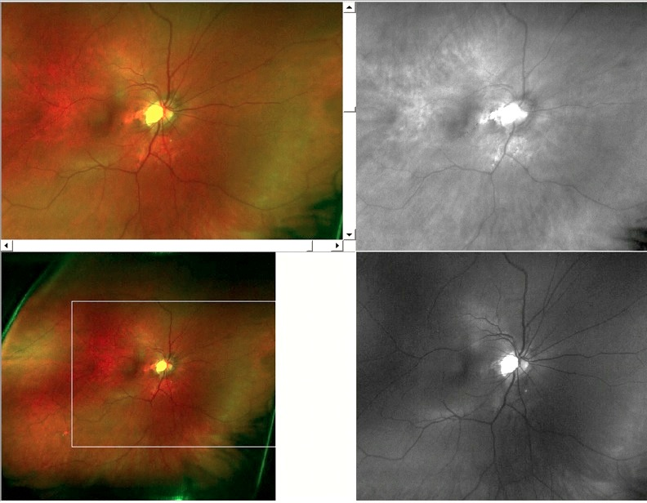
Case study
32yo female
Good health
20/20 OU
“retinal changes”

Slide 33
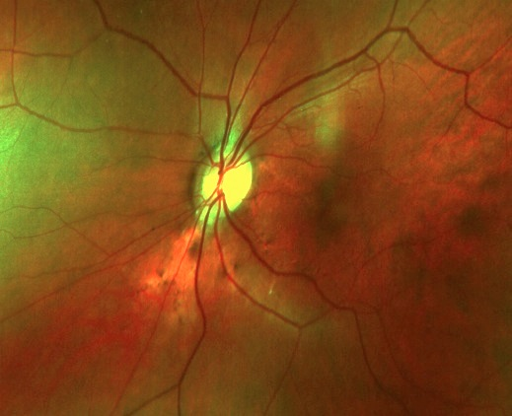
Angiod Streaks
Diagnosis: Angioid Streaks
Treatment: yearly exams, and home monitor with Amsler grid
Note: proximity of Angioid streak to fovea
Over 50% of Angioid streak patients have associated systemic disorders

Slide 34
Angioid Streaks
Represent breaks in an abnormal Bruch’s Membrane that may present spontaneously or as result of trauma
Eventual RPE and choriocapillaris degeneration
Generally radiate out from ONH, bilateral
Color depends on fundus color and degree of RPE atrophy
  Red: Lightly colored fundi, reflect underlying choroid
  Brown: Darker pigmented fundi
  Orange: Specific type of RPE mottling

Slide 35
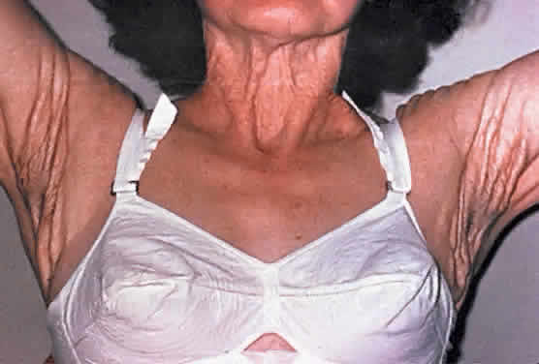
Angioid Streaks: associated systemic conditions
Pseudoxanthoma Elasticum
  80-90% have angioid streaks
  Degeneration of collagen
  Most common systemic
Paget’s Disease
  8-15% have angioid streaks
  Metabolic bone disease
Sickle Cell Disease
  <6% have angioid streaks
Ehler’s-Danlos Syndrome
  Skin fragility, joint hyperextensibility
Diabetes
Others: maybe coincidental
PEPSI
Notes:
PXE: Disorder of skin elasticity, usually autosomal recessive, shows by age 30, often have cardiovascular dz, and GI bleeding, women 2:1, peau d'orange retina, degeneration of elastic fibers: that is why affects skin, vessels, bruch’s membrane
Paget’s: due to abnormal osseous tissue thererfore mostly affect bones, but also other structures, usually about 50yo, and rarely before 20yo, causes bowing of bones, aften skull (leading to neuro problems and CN palsies), legs, and vertebrae
Ehler’s Danlos: a grouping of diseases, hyperextensibility of joints, skin fragility. Can result in gaping wounds. Autosomal dominant. May have varicose veins. Defect of collagen elasticity. No defnitive tx, except for treating symptoms

Slide 36
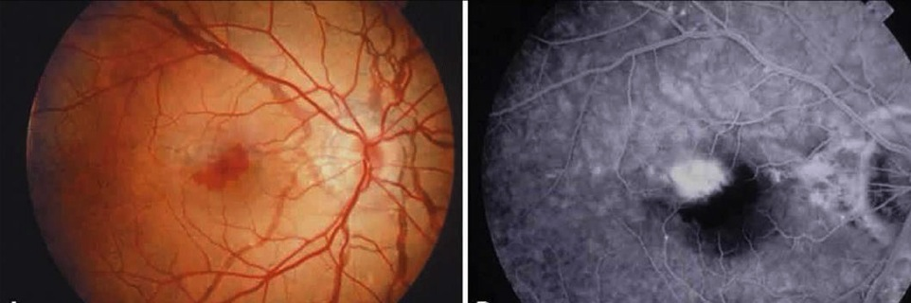
Angioid Streaks
Not problematic unless get CNVM
If CNVM, standard is thermal laser, but >75% recur
Monitor with Amsler grid

Slide 37
Case of Missing Labs
RM is a 46 year old Caucasian male
Referred for retinal changes, questionable macular edema
Last physical 2-3 years prior
“No systemic health problems”, no medications
Paramedic
Note: Not a very healthy looking patient

Slide 38
“Healthy” Paramedic cont.
Visual acuity: OD: 20/100 OS: 20/30
Pupils, CVF, Amsler all normal
Anterior segment: Normal, no iris changes
Fundus exam:
  Widespread microaneurysms, several cotton wool spots, vascular engorgement and crossings, dot and flame hemorrhages in post-pole and equatorially
  Macular edema present OD, and possibly OS
Fluorescein Angiogram ordered
  Above changes noted, significant leakage in OD macula. Limited change to macula OS
TX: Focal laser recommended
TX Cont: Letter sent to PCP telling of findings, recommend blood workup for DM and other vascular problems

Slide 39
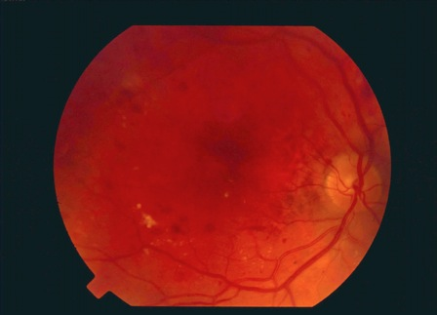
Unhealthy Paramedic
Vision after focal: OD: 20/70
Retinal changes: worse
Pt notes that has been to doctor, and now on meds for DM
BP checked at visit and was 184/102

Slide 40
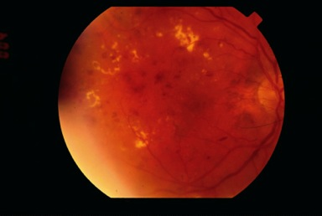
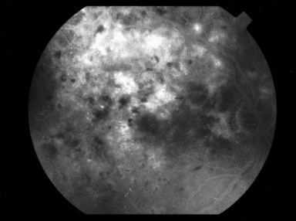
Paramedic
2 mos later he notes vision may be a little worse: OD: 20/200 OS: 20/40
BS poorly controlled
BP: 156/94
We called PCP for lab results…….

Slide 41

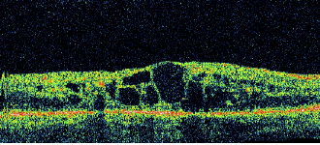
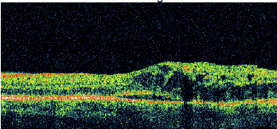
Case of Missing Labs
MD office had no records of any lab work done!
Pt self tested while on job, and treatment based on that
Fairly non-compliant patient
? Compliant PCP
Needs Endocrinologist consult…
**This patient not only has diabetes, but also hypertension!
Notes:
OD: 20/200 to20/50 and 780 to 226 microns with laser
OS: 2050 to 20/25 and 390 to 304 microns with focal

Slide 42
Diabetes
Approximately 9.3% of US Adults!
2 types
  Type 1 (previously insulin dependent)
    Beta cell destruction leading to absolute insulin deficiency
    Glucose stays in blood since can not enter insulin dependent tissues
  Type 2 (previously non-insulin dependent)
    Peripheral insulin resistance, maybe relative insulin deficiency or secretory defect
    Treatment to decrease hepatic glucose production &/or decrease peripheral insulin resistance
    May become insulin dependent

Slide 43
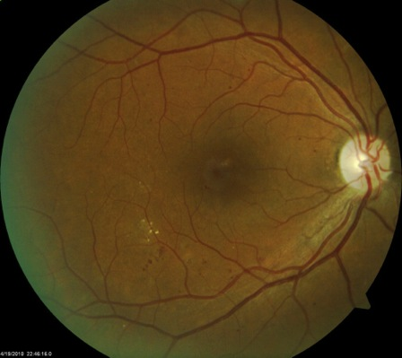
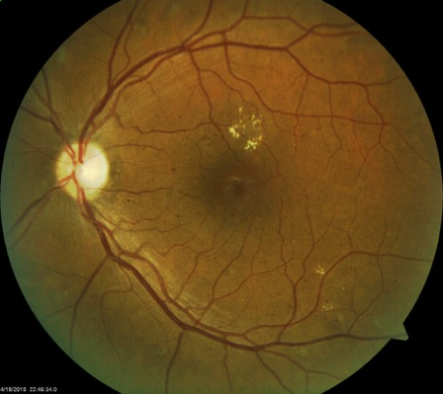
Diabetes
Lifetime risk of DM for Caucasian individuals born in 2000 is 32.8% for males and 38.5% for women (approx 20% more for hispanic)
DM affects approximately 1:16 Americans, and approx 1/3- 1/2 unaware they have DM
NPDR may predate diagnosis of Type 2 DM by 6 years and detected in >20% at diagnosis
BMI and weight are major risk factors: for every increase in wt by 1kg, increase risk by 4.5%
Obesity by BMI is well over 20%

Slide 44
Diabetes
Testing
  Should be more frequent if obese, family history, birth to large baby, hypertensive or dyslipidemia
Diagnosis
  Fasting BG >125mg/dl
  Symptoms of DM plus casual BG >200mg/dl
  2 hour BG >200mg/dl during OGTT
  Repeat test to confirm
  ***A1c over 6.5

Slide 45
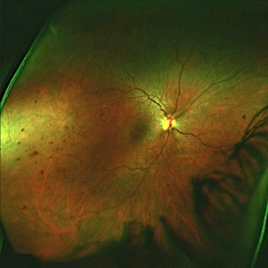
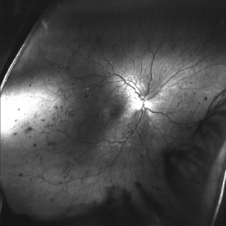
NPDR
Mild
  At least 1 ma
Moderate
  Hemorhages &/or ma’s (2A), CWS, or VB(< 6B) or IRMA (<8A)
Severe
  4/2/1
  15% to PDR in 1yr¹
Very Severe
  2 or severe findings without neo.
  45% to PDR in 1 yr¹
1. As reported by ETDRS

Slide 46
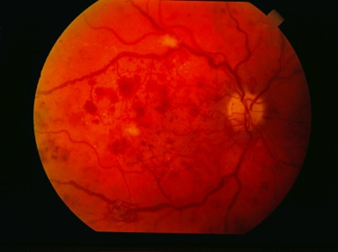
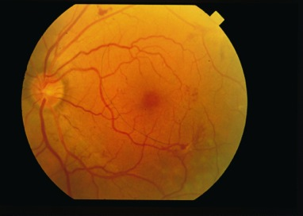
Proliferative Diabetic Retinopathy
NVD or NVE
High risk
  NVD >1/2 disk area
  NVD and VH/PRH
  NVE >1/2 disk area +VH/PRH
Untreated, can lead to VH or tractional RD
Without tx, 50% blind in 5 years
Current treatment: PRP when High Risk, may need vitrectomy

Slide 47
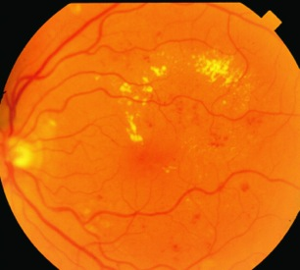
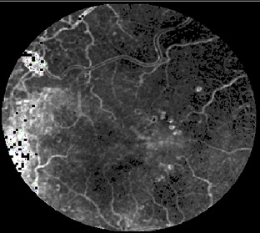
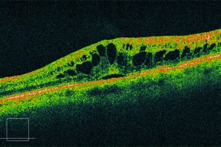
Macular Edema
Today’s categories of DME
CI-DME: Central subfield involving central 1mm of fovea
Non-CI: Not involving central subfield (1mm of fovea)
CSME not really “used” anymore
Does Vision matter?

Slide 48
Diabetic Retinopathy Study
Randomized, prospective to evaluate PRP
Primary outcome was severe vision loss defined as 5/200
Demonstrated 50% decrease in SVL in PRP group
Recommendation: PRP
Complication: 11% lost 1 or more lines of acuity, and 5% had visual field loss

Slide 49
Early Treatment for Diabetic Retinopathy Study
Evaluated PRP and aspirin in pts with less than HR PDR OU, laser for DME
Outcome was Moderate VL (doubling of visual angle)
Results of 3 areas of interest:
  >50% less MVL with laser for CSME
  PRP for PDR, not needed earlier, but may be beneficial for Type 2
  ASA 650mg did not alter retinopathy, VA or VH, or rates of vitrectomy

Slide 50

Diabetic Retinopathy Vitrectomy Study
Is early vitrectomy beneficial?
  20/40 was more common in early-vitrectomy group (1-6 mos.)
  Benefit seen in eyes with most severe disease
  In regards to VH, clear benefit to type 1, but not to type 2
Today: 25g vitrectomy

Slide 51
Lucentis
DRCR.net investigated Lucentis vs laser and/or steroid n= 691 people (~850 eyes).
  Grps (success is 20/20 or <250microns @ 1yr)
    1: sham injection + prompt laser treatment
    2: Lucentis + prompt laser (8/13)
    3: Lucentis + deferred laser treatment (≥24 weeks (9/13)
    4: IVK + prompt laser (3/4)
    Success: 32%, 64%, 52%, 56%
    Lucentis gained 9 letters vs 3 in laser v 4 w steriod
    Steroid better than laser for OCT, but not VA
    Approx 30% Lucentis + 3 lines vs 15% w laser
Elman et al. Lucentis in DME. Ophthal 4/10
Notes:
Neil Bressler calls this study “definitive proof” that Lucentis is better than laser alone
Lucentis was monthly “at doctor’s discretion”.
The number in parenthesis is the number of injections given vs total possible if given every opportunity

Slide 52
DRCR
Protocol T: Any Anti-VEGF will do
Protocol S: Lucentis not worse than PRP
Protocol V: NO tx needed for 20/25 mild DME!
Ongoing studies

Slide 53
Diabetes Control and Complications Trial & UK Prospective Diabetes Study
Pts randomized to conventional or intense control
Showed slower progression for intense control group
For those with no NPDR at start, if intense, then 76% less devel. of retinopathy
If A1c down by 2%, PDR would decrease by 50%
Decrease in A1C by 1 %:
  14% decrease in MI
  12% decrease in stroke
  37% decrease in microvascular dz
  21% decrease in any DM endpoint
DCCT reported relationship of A1C and avg. Glucose
%HbA1C Avg. Glucose (mg/dL)
4.0 60
5.0 90
6.0 120
7.0 150
8.0 180
9.0 210
10.0 240
11.0 270
Control group in DCCT: 9-10%
Strict control group: 7%
Sources: NEJM 329:977-986 1993 UKPDS: Lancet 352:837-853,1998

Slide 54
10 years after DCCT¹
10 yrs later A1c was 8.07% vs 7.98% in the groups
Prevalence of retinopathy progression or PDR less in intensive group after 10 yrs (24 vs 41% & 6.5 vs 19%)
Other studies have confirmed retinopathy linked to initial BS control²
Similar effect seen in neuropathy and albuminuria
Metabolic memory appears to last 10 years, but may wane at some time
1. Prolonged Effect of Intensive Therapy with T1DM. DCCT group. Arch Ophth 12/08. 2. Reichard P. Glycemic thresholds for complications. J Diab Complic. 199:9(1);25-30.

Slide 55


What We Need to Know
The DPP Ten Years Out :
38% reduced risk of with lifestyle modification
17% reduced risk with metformin
The Diabetes Prevention Program (DPP) showed that lifestyle modification lowers the risk of developing T2DM in high-risk patients by 58% over 4 yrs.
Walking 150 minutes per week
Metformin reduced the risk by 30%
  Exercise was twice as
  effective as drug
Diabetes Prevention Program

Slide 56


Hemoblobin A₁c
Importance of A1c monitoring
Critical to disease control and prevention of problems
Does a patient know their last reading?
  Good, bad, or worse response
In office testing
  www.a1cnow.com

Slide 57



WAY more important than A1c
TIR w CGM
70% TIR dramatically reduces risk of DR or DR progression

Slide 58

Intravitreal Steroid

Slide 59

The Challenge for OD’s in Diabetes Care….

Slide 60

Those Who Aren’t What We Call Them
Calling someone “a diabetic” is existentially diminutive
Few people want to be known AS or even BY their health status
Why don’t we say ‘he is a macular degenerate,’ or ‘she is cancerous’?
Don’t Substitute a Part
Of Any Person
For the Whole Person

Slide 61




You never know..
Diagnosed with T2DM 2 wks ago
Vision not good, Endo said due to BS fluctuation
20/50

Slide 62



And today….

Slide 63
My favorite student

Slide 64
“Paramedic’s Friend”
65yo male
Occupation: retired, but used to be field medic in military
“My optometrist referred me because of my right eye, I am not sure what is wrong”
“Good general health, my blood pressure runs low”
My exam…
Notes:
Based on gary alvested

Slide 65



Hypertension??
Vision: 20/400 OD
Anterior Segment: normal
Blood Pressure: 196/120
What next….
Sent to PCP directly from office
Started on HTN meds

Slide 66
Hypertension
50-60 million Americans have systemic HTN (by today’s standards)
Usually asymptomatic, but can lead to MI, PVD, CVA, renal disease, retinopathy
Significant CVD risk at 140/90, and risk doubles with every increase of 20/10mmHg
Risk factors include smoking, dyslipidemia, DM, age, family history, race, sedentary, obese, sodium…

Slide 67

Hypertension
Refer to PCP in timely manner
Goal of BP reduction to as low as tolerated
Most patients will require 2 medications
Lifestyle modification
  30 minutes of physical activity >4 days/wk can lower SBP by up to 9mmHg
  Weight loss of 10kg can lower SBP by 5-20mmHg
Category* |  | Systolic | Diastolic
Normal |  | <120 | <80
Pre-HTN |  | 120-139 | 80-89
HTN
Stage 1 |  | 140-159 | 90-99
Stage 2 |  | >160 | >100
Malignant |  |  | >120
*The Seventh Report of the Joint National Committee on Prevention, Detection, Evaluation, and Treatment of High Blood Pressure, NIH

Slide 68


ME and 20/25-…What would you have done in 2012 and now in 2022?

Slide 69



So pt presents with VO & ME
First and foremost: Any ME from VO is no longer an “optometric” management: There is proven benefit to Tx that are implemented earlier than before
Which treatment is best?
  Not exactly up to us…But sort of
  ….you choose!

Slide 70


Hemorrhage everywhere!
68 yo female
Dramatic decrease in vision 1 wk prior due to Vitreous Heme
Exam as seen after VH resolution
Diagnosis and Treatment?
Hint: Size matters: 100 microns

Slide 71


Macroaneurysm
1mo and 5 mo s/p focal laser
VA returned to 20/20
Blood Pressure at initial visit:
  186/98
Hypertension is prime concern if macro-a seen, secondary concern of diabetes

Slide 72

RAM
Most commonly in 6th or 7th decade of life
Usually women, and only 10% bilateral
Hypertension is prime systemic assoc. (2/3)
Must also rule out cardiovascular disease, including increased cholesterol/lipid levels, and diabetes
Communication to PCP

Slide 73

Dangers of Addiction
38 yo male
Healthy
No meds, but…
  Viagra PRN
  Frequent Alcohol
20/20 OD, 20/30 OS
Ant Seg healthy
Retina OS as seen
Diagnosis?

Slide 74


Valsalva Maculopathy
“Drunken Pumpkin”
Common causes:
  Vomit, cough, sneeze, constipation, exertion
  Often seen with alcoholism, bulemia and GI problems
Tend to resolve on own
No long lasting damage
What caused condition in this patient?

Slide 75


What do you think when you see this clinical image?
OD Macula
OS Macula

Slide 76


How about this Visual Field??

Slide 77
Pt. AM exam findings
Pt AM is a 47yo female that has been on Plaquenil 200mg BID x 1 yr, weights approx 120lbs
Being seen by request of her rheumatologist for screening for Plaquenil toxicity
Vision corrects to 20/20 in both eyes
Pupils and screening Matrix VF are normal
Contrast is normal at 1.25% OU and color is normal
MPOD is .31 OD and .38 OS
IOP 18/17mmHg
Schirmer is 0mm in both eyes w/ dry eye sx

Slide 78


Further findings: Cross Hair OCT: Worried yet??
OD
OS
No apparent PIL degredation seen

Slide 79


Inner Retinal Thickness: Still all normal

Slide 80


GCC and RNFL
GCC Comparison
RNFL Comparison

Slide 81

Full Retina Significance OD and OS
Note: significantly ring thinning around OD macula

Slide 82

New Guidelines per AAO (the other one)
Risk increases sharply to 1% at 5-7yrs or cumulative dose of 1000g (usual dose 400mg/d HCQ or 250mg/d CQ)
New screening guidelines include baseline exam and then annually at 5yrs
Objective tests: mfERG or FAF or SDOCT
Subjective test: 10-2
Fundus exam still important, but findings are generally late stage
Recommendations screening for CQ and HCQ Retinop.Marmor et al. Ophthalmology 2/11

Slide 83
Revision to SOC
Published in Ophthalmology in 2016 again by Marmour
Main changes:
  OCT and 10-2 are main tests
  MfERG and FAF in Asians
  Goal of <5mg/kg of real body weight
  Risk of toxicity at 5/10/20yrs is 1/2/20%

Slide 84
This is the question
When looking at the scans for this patient, can we tell if this is Plaquenil toxicity vs other macular abnormality?
Is it likely to see such asymmetric changes due to Plaquenil?
Cumulative dose is low, at only approximately 150,000mg (well below hypothesized “tipping point” of 1,000,000mg)

Slide 85




An obvious example of loss of PIL
Normal
PIL Present
ELM Present
Patient
PIL Present
ELM Present
PIL Missing
A horizontal section through the fovea of the left eye reveals similar findings as displayed previously in the right eye.
A small, but intact, PIL is present under the fovea and a perifoveal absence of the PIL is documented. With loss of the PIL, the intact external limiting membrane (ELM) appears to drape over the missing tissue.

Slide 86
Importance of VF
VF should be 10-2 and performed along with objective test
Even though SDOCT is objective and more specific: 10% w early toxicity will show significant VF defect and “normal” OCT (in patients w 1000g cumulative)
Compared VF to OCT profile and thickness….no GCC measurement
Marmor M, Melles R. Disparity btwn VF and OCT w Hydroxychlorouine. Ophth. 6/14

Slide 87


Why is baseline so important
43yo female w Rx for Plaquenil
Wants eyes checked before staring
h/o autoimmune and neurologic disorders w multiple meds

Slide 88

Drug Induced Maculopathies
Tamoxifen
1-6% incidence
Related to total dose (10g) or daily dose
Can happen very acutely
Often improve after discontinue drug

Slide 89




62yo Female 20/20 OU
20/20 OU
Anterior seg normal
IOP, VF, pupils WNL
No current meds
???What is this

Slide 90

Nevus
Usually flat lesions of choroid, may have minimal elevation
May develop drusen
Estimated to be in 6-10% by Blue Mountain Eye Study
Recent pub. stating 2.1%¹
May be pigmented or amelanotic
Observation for growth critical
Ophthalmology Oct 2005 Singh et al
  Estimate 8.64 million in US with nevus
  Estimate conversion to melanoma to be 1/8845
1. Greenstein et al. Prevalence of nevi. Ophthal. 12/11.

Slide 91

Metastatic Disease
Cancer is 2nd leading cause of death in US
Choroidal met is most common ocular malignancy
As high as 34% with choroidal met, have no previous dx of cancer
Most common primary site is lung, followed by breast
Despite rise in dermal melanoma, no rise in choroidal melanoma seen
PET/CT scans most effective for detecting systemic met. BJO Sept. 2005

Slide 92




Metastatic
Most common primary sites:
  Men
    Lung 26-50%
    Unknown 6-29%
    GI 3.5-12%
    Prostate 3-12%
  Women
    Breast 68-85%
    Lung 8-12%
    Unknown 4-12%
Info_B:HMHMASS G=79dB DYN=60dB
+Dist~11.4mm <>Dist Off
Info_B:VMAPMASS G=79dB
+Dist~3.3mm <>Dist Off
Notes:
Pt in slide: Lynn Patty 20/100 OD lesion can see tumor flush/circulation ??Metastatic approx 11.4mm x 3.3mm by Bscan
Possible: Barbara Pachter in caves metastatic breast

Slide 93


Metastatic Disease
Most common sites of Choroidal Metastasis
  Breast 39.7 – 65%
  Lung 14-29.5%
  GI 2.6-6.3%
  Skin 2.0-4.5%
  Prostate 1.3-3.6%
  Kidney .9-4.0%
  Unknown 4-18.3%
Thorough systemic work-up needed in cases of ocular malignancies

Slide 94

Ocular Melanoma
Early recognition of signs of small lesions likely to prove to be melanomas: symptoms, tumor margin touching disc, thickness > 2.0 mm, subretinal fluid, orange pigment
Notes:
94

Slide 95

Percentage of Small Tumors that Grew
C Shields et al. Arch Ophthalmol 2000; 118: 360-364

Slide 96




Easier Plaque Design Low Profile

Slide 97



Choroidal Melanoma
53yo caucasian female
  HTN and hypecholest.
Referred by OD
20/20 OD 20/25 OS
Suspicious lesion OD
Sent for systemic w/u

Slide 98


Post treatment
Systemic workup negative for metastasis or other ca
Brachyplaque therapy
Vision to 20/50 post tx
CE and vision to 20/40
Spread/mortality
  Tumor configuration
  Histology
    Spindle
    Mixed
    Epithelioid
Notes:
Mortality: SME 15, 50, 85
Melonama 4.3 per million

Slide 99
Life Expectancy
High likelyhood of metastatic disease
  25% at 5 yr and 34% at 10yr
  If metastasize, poor prognosis
    Death rate of:
      80% at 1 yr
      92% at 2 yrs
      Approx. 1% survive 5 yrs
Difficult to predict survival
  Not related to tumor size or treatment modality
COMS group. Devel. Of Metastatic Dz in COMS. Arch Ophth 12/05

Slide 100


Routine exam finding
54yo male in for routine exam
20/20 vision
h/o Melanoma

Slide 101

Drug induced retinopathy
Interferon treatment for 5 mos
  Infusions 1/mo and injections 3/wk
Typical onset 1-5 mos
Often resolves w d/c Tx
More common w HTN

Slide 102

Quality of Life after Tx
Significant difference in vision for 1st year (plaque > enucleation), fading after 5 yrs
  Most notably driving and peripheral vision
Patients treated with plaque had increased psychological distress following therapy
  This faded after survival rates announced
  Still distress in both groups
Melia et al. Quality of Life: 5 yrs after Tx in COMS. Arch Ophth 2/06

Slide 103


Slide 104


Familial Adenomatous Polyposis (FAP)
Rare: 2.3-3.2/100,000
Avg onset at 16yo
Without Colectomy, colon cancer inevitable
Autosomal dominant 75-80% have affected parent
78-88% have 4 or more fundus lesions

Slide 105

Retinal Consult
37 year old female
Vision 20/40 OS
No pain or pain with movements
No APD
Normal Anterior segment exam
Recent ER visit for LOV
  Then went to Ophthal.
    Either MS, Diabetes or nothing…wait and see
Further History:
Previous episodes of vision “Graying”
Unable to take hot showers
Electric like impulses through arms/back
Numbness in fingers
Clumsy walking
Decreased contrast/color OS

Slide 106

Optic Neuritis
What is the normal visual outcome?
Will this recur?
What is risk of MS?
What is eye treatment?
What is Systemic Treatment?
What tests are needed?

Slide 107

ONTT, CHAMPS and ETOMS
All 3 agree, and confirm likelyhood of progression to further demyelinization
Recurrence of Optic Neuritis:
  28% at 5 yrs
  35% at 10 yrs
      Recurrence more frequent in those that eventually developed MS
      Single occurrence not associated with poor vision
      Multiple occurrence associated with worse vision, approx. 25% were 20/400 at 5 years
Notes:
ONTT: Optic Neuritis Treatment Trial
CHAMPS: Controlled High Risk Subjects Avonex Multiple Sclerosis Prevention Study
ETOMS: Early Treatment of Multiple Sclerosis

Slide 108

Optic Neuritis and MS
15-20% of MS present with ON
38-50% of MS will develop ON
Most predictive factor in who will develop MS is presence of white matter abnormalities (demyelinating lesions) on brain MRI
*Overall 10-year risk of MS 38%
  no baseline MRI lesions 22%
  > 1 baseline MRI lesions 56%*

Slide 109

Treatment?
Oral steroids alone not affective
At 3 years, MS risk for IV vs PO vs Placebo 17% vs 21% vs 25%
IV methylprednisilone x 3 days followed by 11 days of oral pred.
Treatment with IMA?
  12,000/yr with wkly/daily injections and side effects
  Interferon Retinopathy¹
  *NEW ORAL TX!!!**
Retinopathy of MS on Interferon. Saito.et al. MS: April 07
Notes:
IMA = Immunomodulation agents

Slide 110
ON predictive factors
When no brain lesions were found, the following were not present in any cases of CDMS (clinically definite MS)
  Severe disc swelling, painless, NLP, retinal exudates, disc or peripapillary hemorrhage

Slide 111
OCT: Predictive value
RNFL thickness may be able to be predictive as to MS or level of vision loss
RNFL thickness signif. reduced in MS eyes
Disease free thickness>MS = fellow of ON > MS w ON
Lower visual function with less RNFL
Avg. RNFL thickness declined with increased neuro. impair. and disability
Fisher et al. RNFL in MS. Ophthal 2/06

Slide 112
Lattice Degeneration…
30 year old male referred for evaluation of lattice degeneration and atrophic holes
Very healthy athlete, no medications
Exam findings:
  VA: 20/20 OU
  Anterior segment healthy
  Peripheral retina: Lattice with holes
  Posterior pole..

Slide 113

Plaques
Several Hollenhorst Plaques
Further questioning: No cardiovascular or carotid disease
Treatment: Laser to lattice and holes
Referral: To PCP for cardio and carotid work-up
Pt lost to follow up
Notes:
??Sousack Disease? Askm whitaker: Encephalopathy, pseudo plaques, deafness

Slide 114



Hollenhorst Plaques
Landmark article in AJO January 1973
  Carotid disease and heart disease about same incidence at time of plaque seen
  Patients 4x more likely to die of MI than CVA
Referral to PCP or internist
Notes:
Note: Recent patient that HH Plaque noted on exam, and scheduled f/u for 1 month, had stroke 1 day before f/u appt scheduled

Slide 115

Artery Occlusion
Historically felt than 5% develop NV
  Duker et al 1991: 18.2% NVI, 15.2% NVG
  Hayreh: mean to NVI 5.5 weeks
    Can develop NVI without carotid disease
  Inner retinal cell death, but outer layers spared, and have high O₂ demand
Treatment
  PRP when NVI
  Acute treatment
    AC paracentesis, massage, carbogen…
    Accupunture¹: marked visual improvement in 25%
    TPA (EAGLE study in Europe)
  Referral to PCP or internist for treatment of underlying systemic disease
Article in Sept 06 AJO by S.S. Hayreh
1. Zheng J, Chen Z, Wang W, Xia S: Acupuncture in retinal arterial occlusion. Chin Med J (Engl) 94: 175, 1981

Slide 116

Recent patient
64yo Hispanic female
Sudden LOV 5 hrs ago
Good health
OD: NLP OS: 20/20
What else do you want to know?
260/150

Slide 117
What’s the most important thing to do with an acute artery occlusion?
HINT: Not eye related!!
THESE ARE SICK EYES IN SICK PEOPLE
Study of 103 pts screened after CRAO
  37% critical carotid disease and acute stroke
  33% HTN emergency, 20% MI,
  25% surgical intervention, 93% medicine change¹
Immediate referral to ER/Stroke center and Diffusion weighted MRI
1. Lavin et al: Stroke risk and risk factors in AO. AJO in press 9/18

Slide 118

Is AMD strictly an ocular disease with no systemic associations?
NO
Several different theories and factors that point to AMD being systemically related
“Systemic” treatments may be beneficial
Nutrition modification is an easy way to treat systemically

Slide 119
CVD and AMD share many common risk factors
"sick eyes may occur in sick bodies related to smoking, obesity, inadequate nutrient intake, and other unhealthy behaviors".
Seddon JM et al. C-reactive protein and homocysteine are associated with dietary and behavioral risk factors for age-related macular degeneration. Nutrition 22:441-43, 2006.
Seddon JM et al. Evaluation of homocysteine and risk of age-related macular degeneration. Am J Ophthalmol 141:201-3, 2006.
Seddon JM et al. Progression of age-related macular
degeneration: prospective assessment of C-reactive protein, interleukin-6, and other cardiovascular biomarkers.Arch Ophthalmol 123:774-82, 2005.

Slide 120
Remember Pablo….Vision is important
Can we allow our patients to see like this…regardless of ocular pathology?

Slide 121
So now you are ready to “treat” systemic disease, but…..
What is the most important thing we can do for our patients (in their “eyes”)
CORRECT VISION!
  That is why they come to us
    Majority of vision impairment in diabetes is from lack of refraction!^{1,2}
Practice the “Optometric Model”
  Combining medical and optical “treatment”
1. Klein et al. VI Prevalence (WESDR) Ophth. 10/09. 2. Zhang et al. DM and VI. Arch of Ophth. 10/09.

Slide 122
Thank You
jgerson@Hotmail.com

Slide 123
Thank You jgerson@hotmail.com
Online Resources
www.retinalphysician.com
www.pubmed.com
www.optometricretinasociety.org
www.optos.com

