Slide 1
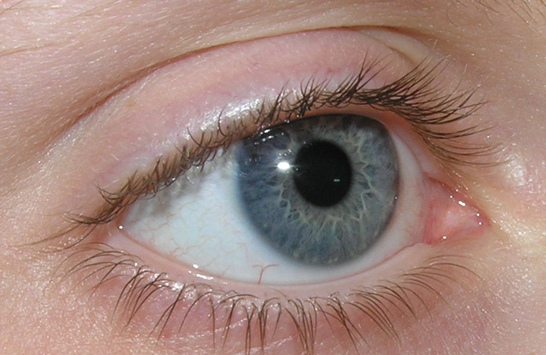
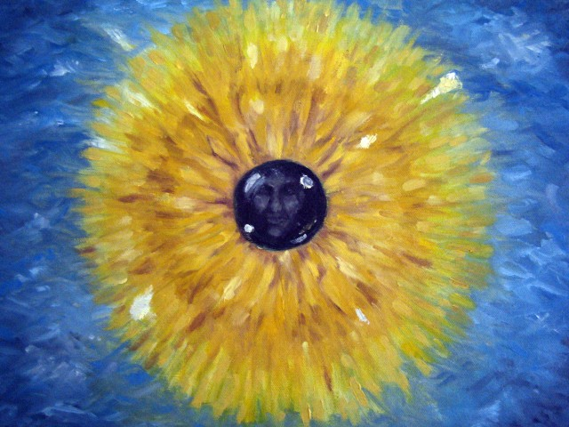
The Art of Optometry
Jeffry D. Gerson, O.D., F.A.A.O.
Olathe, KS
jgerson@hotmail.com

Slide 2
Story/joke
A doctor gives a pateint a long list of don’ts, including nearly everything he enjoys in order to try to prevent more problems. The dismayed patient asks if he denies himself of all of those things, which make his life worth living, will he live longer?.. The doctors answers quickly, No, but it will seem that way.

Slide 3
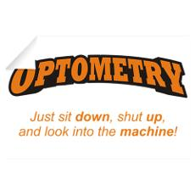
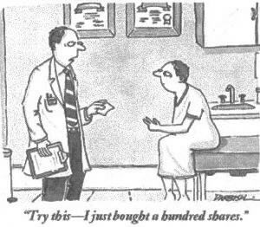
Disclosure
I have been on advisory boards/a consultant to/received honoraria from/ or been on speakers bureau list of the following:
  Well…for this course, it just doesn’t matter. This is all about how to do and if I am biased in any way, call me out on it!

Slide 4

Antioxidants
Do you drink coffee?
  Over 50% of Americans drink coffee
Is this important?
  Coffee is leading source (by far) for antioxidant intake in the US diet!!¹
Neither coffee nor caffeine intake were associated with early AMD per BDES
Beware:
  COFFEE and DOUGHNUT Maculopathy²
As reported by American Chemical Society 8/05
Kerrison J.B. et.al. Coffee and Doughnut Maculopathy: Acute Ring Scotomas. BJO.2000 Feb;84(2):158-64.

Slide 5
Start to look at things from a different perspective…

Slide 6
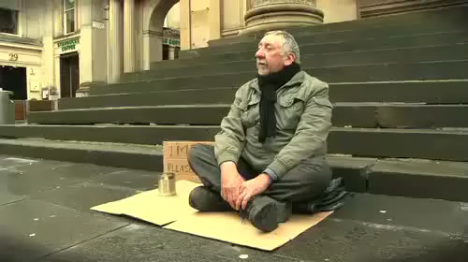
Start to look at things from a different perspective…

Slide 7
Antioxidants
Do you drink coffee?
  Over 50% of Americans drink coffee
Is this important?
  Coffee is leading source (by far) for antioxidant intake in the US diet!!¹
Neither coffee nor caffeine intake were associated with early AMD per BDES
Beware:
  COFFEE and DOUGHNUT Maculopathy²
As reported by American Chemical Society 8/05
Kerrison J.B. et.al. Coffee and Doughnut Maculopathy: Acute Ring Scotomas. BJO.2000 Feb;84(2):158-64.

Slide 8
The Relationship of Coffee Consumption with Mortality Ann Intern Med 2008:148:904-14
2 Cohorts
  41,736 men Hx Professionals FUp Study – 18 years
  86,214 women Nurse’s Hx Study - 24 years
Results
  After adjustment for age, smoking, other CVDz and CA risk factors
 | Men
<1 cup / month | 1.07
1 c/m – 4 cups/w | 1.02
5-7 cups / week | 0.97
2-3 cups / day | 0.93
4-5 cups / day | 0.80
> 6 cups / day | 0.74
P<0.001 for trend and independent of caffeine intake

Slide 9
Throughout the lecture, I will have some quotes by different philosophers and other “thinkers”
Feel free to interject your own thoughts and ideas

Slide 10
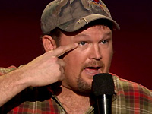
“How much deeper would the ocean be without sponges?”
Larry the Cable Guy

Slide 11
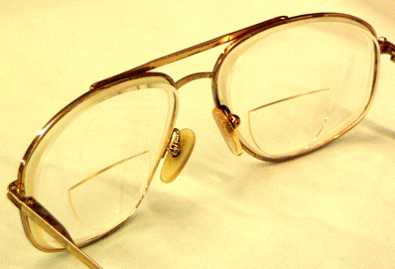
Most people think that they are going to live forever ….until they develop a cold.
How does this relate to optometry?

Slide 12
Why the title “Art of Optometry”
Medicine in general includes two “cultures”
We are all familiar with the science of optometry,
  Opportunity for learning and discussion
The art: needed to promote success within the science…
  Rare opportunity for discussion and reflection
Notes:
Bring up sessions during residency: weekly readings and discussions. Most informative of residency, and most reflective.

Slide 13
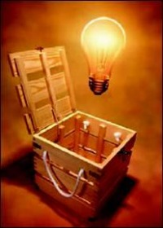
Course Objectives
Begin to think differently about our patients and profession
  More than Meets the Eye
See optometry as a science and an art
Think about and realize the impact we have on our patients
“It is difficult to make an asymptomatic patient feel better” Sir William Osler
Notes:
Things are not always as they seem: More to it than meets the eye
Objectives don’t mention eye disease, eyes, or any other typical objectives we think of

Slide 14
A different way to think…

Slide 15


Slide 16
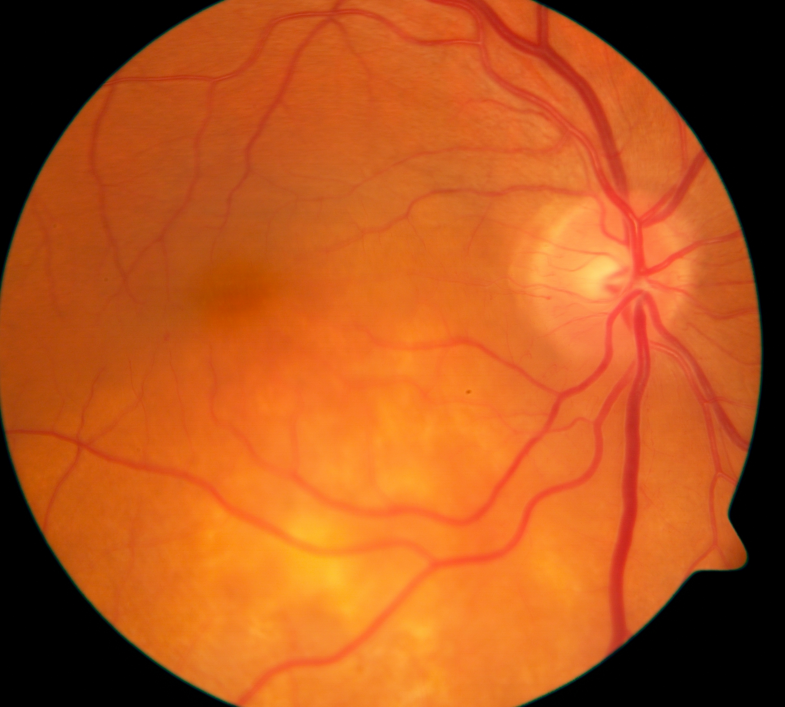
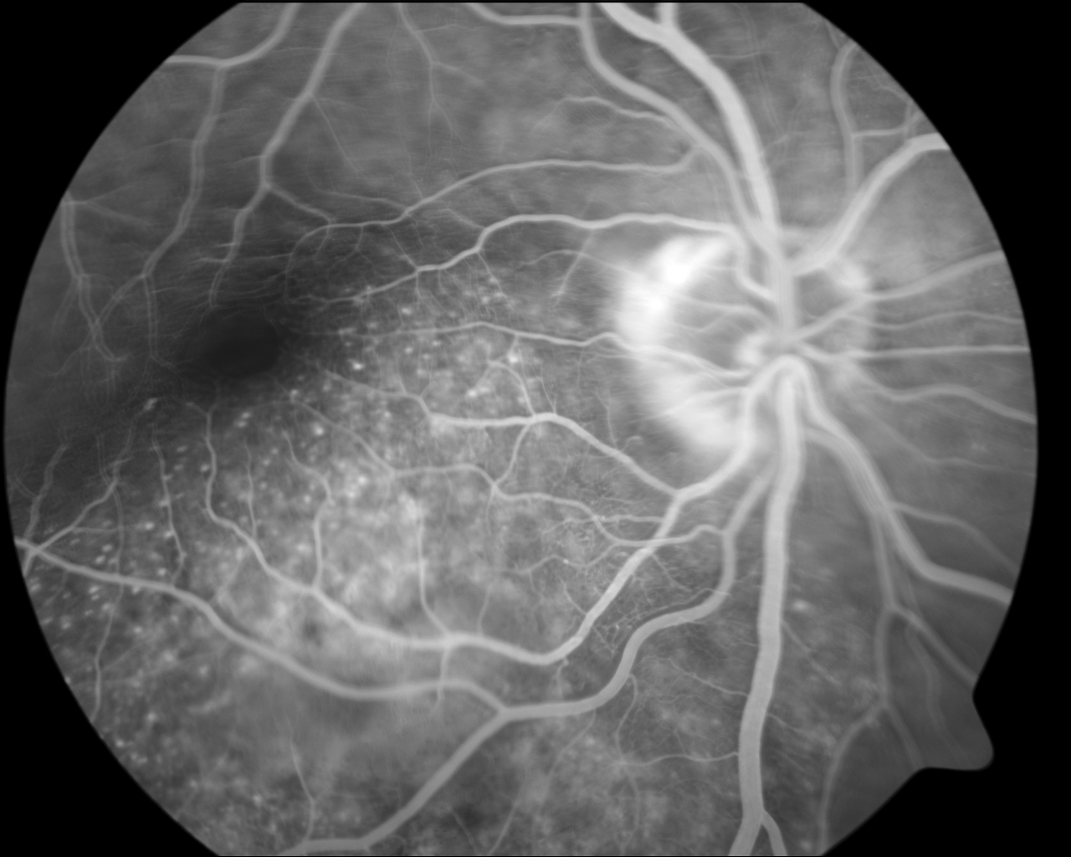
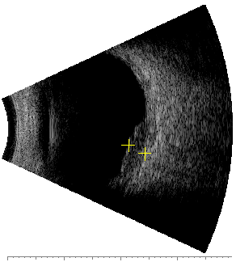
What is this?
A. Choroidal Melanoma
B. Metastatic Carcinoma
C. Retinal Detachment
D. None of the Above
E. Combination of 2 of the above

Slide 17
Quote by Maimonides
“May I never forget that the patient is a fellow creature in pain. May I never consider him merely a vessel of disease.”
How does this pertain to the previous slide? (and to the rest of what we do as optometrists)
Notes:
Maimonides was a mid evil jewish scholar,philosopher and physician who was also well known in non-religious medical society
Some doctors take oath of Maimonides instead of hippocratic oath
When we first see a patient with such pathology, we often think “that’s cool”, and that is paying attention only to our selfish thoughts and the eye, not the person that the eye belongs to.

Slide 18
Lets Try Again: What was this?
A. Incidental finding: At a routine exam by O.D.
B. Bad news: For a calm Husband
C. Life Changing Diagnosis: For a family
D. Mortality: For a person
E. All of the Above
Notes:
Also, from initial slide with photo and multiple choices, was 2 of the above: Metastatic carcinoma and none of the above..as evidenced here

Slide 19
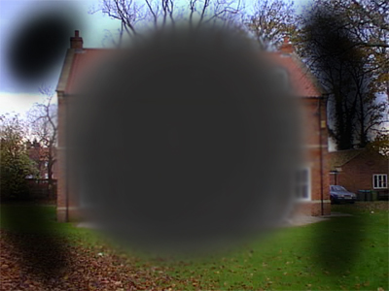
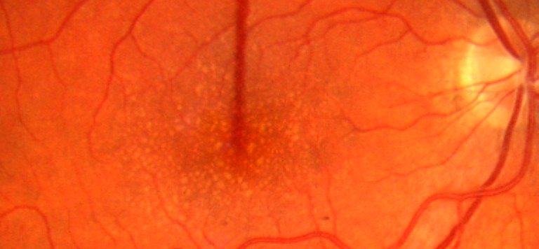
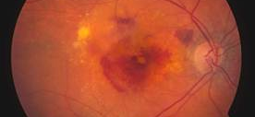
Now…what are these?
AMD?
Threat to vision?
Change in outlook on life?
Have I changed your outlook?

Slide 20
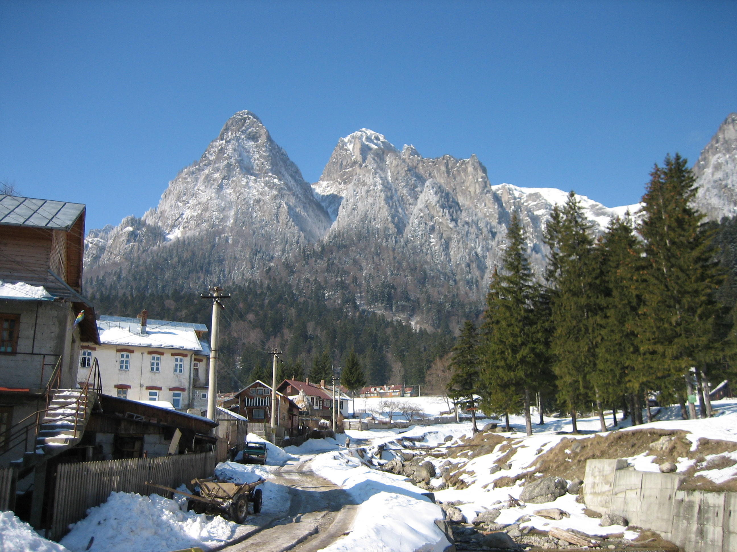
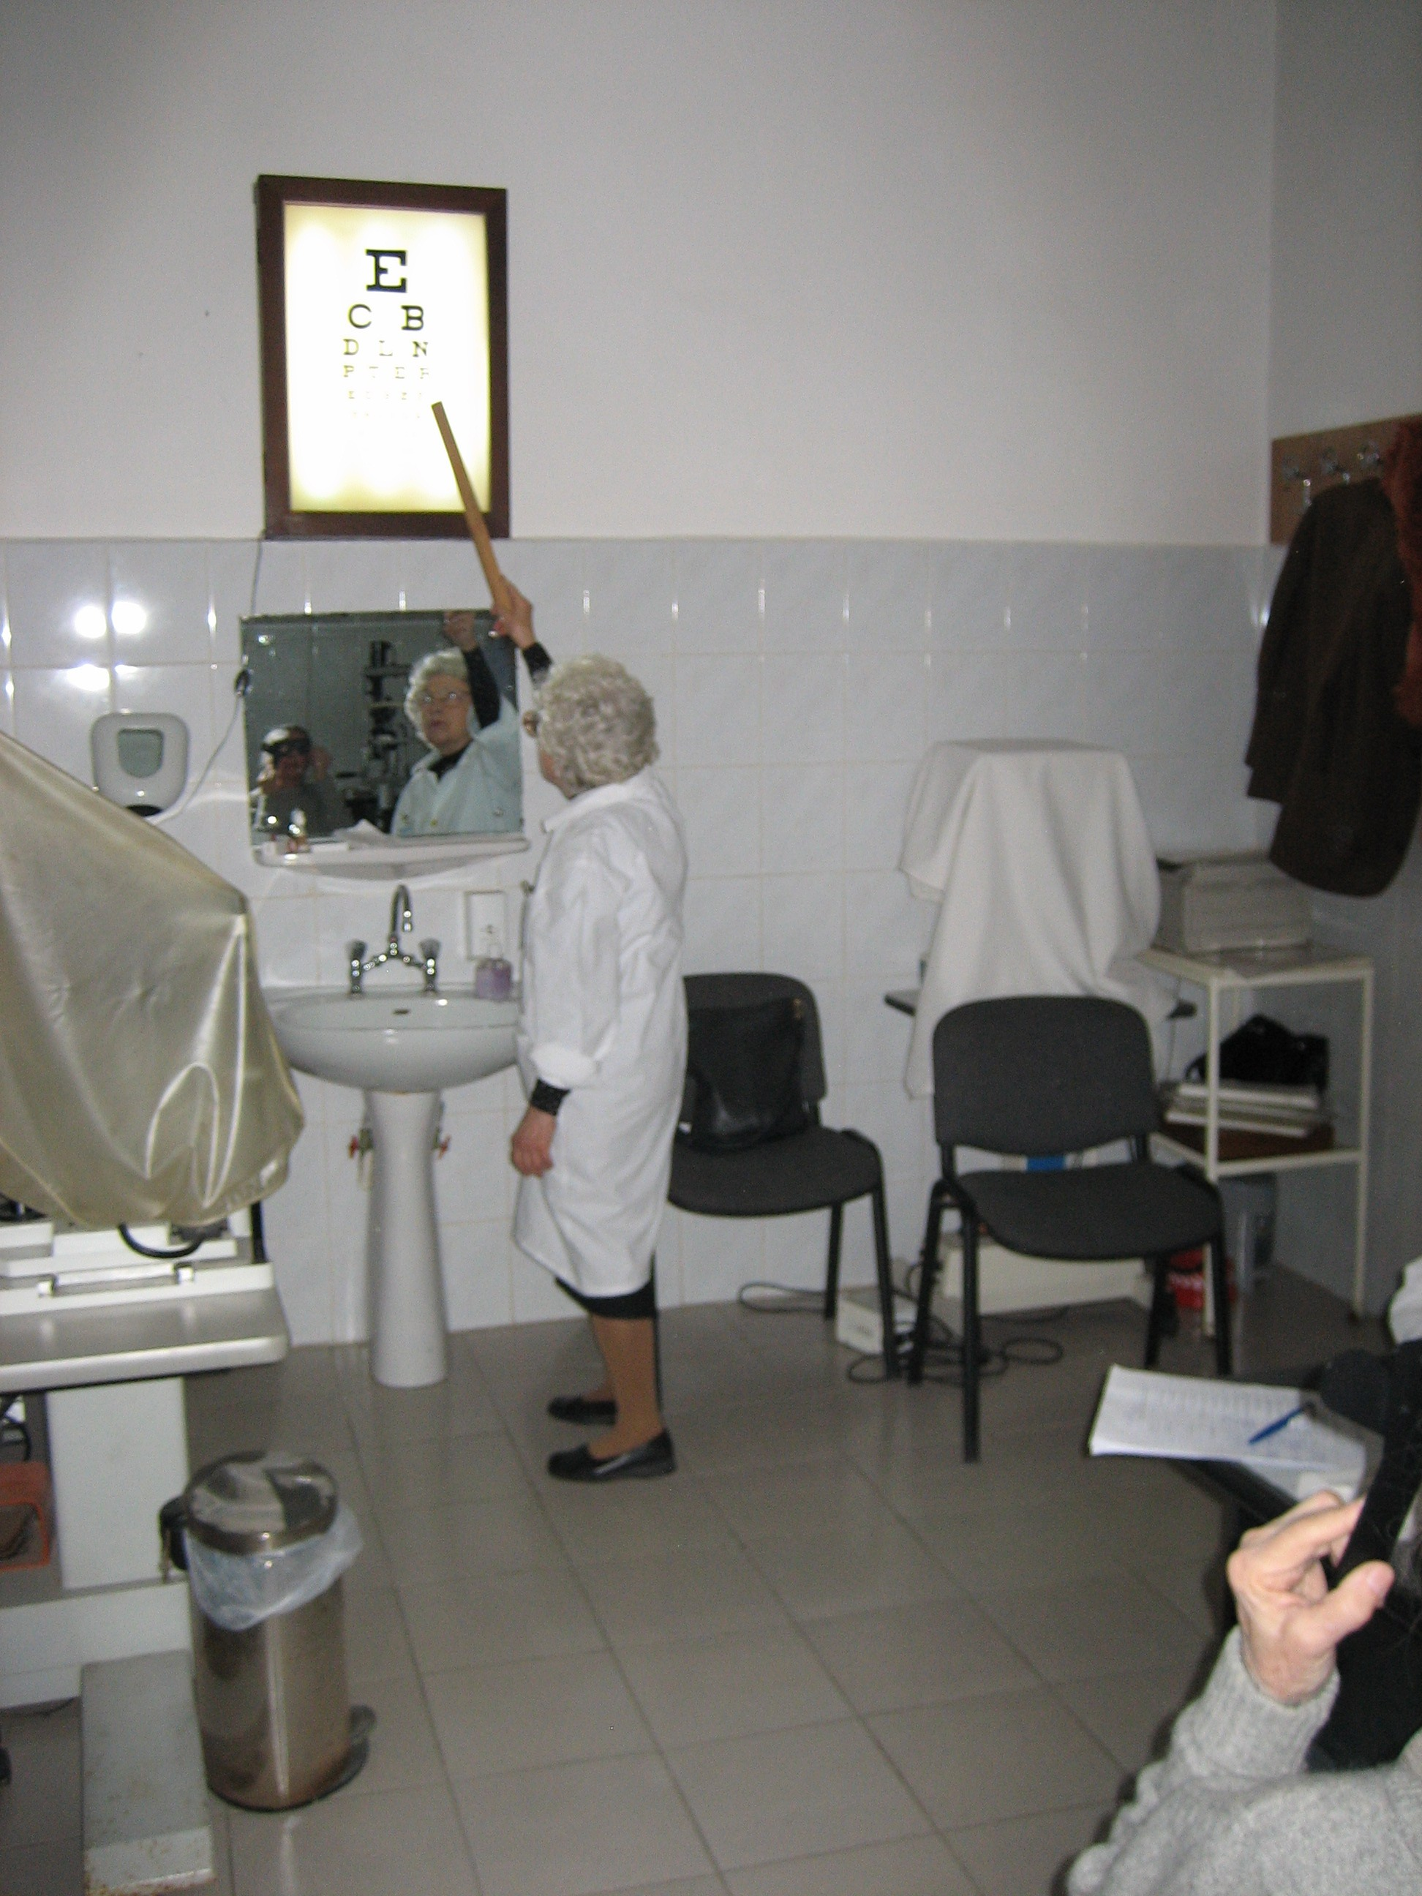
My trip to Romania

Slide 21
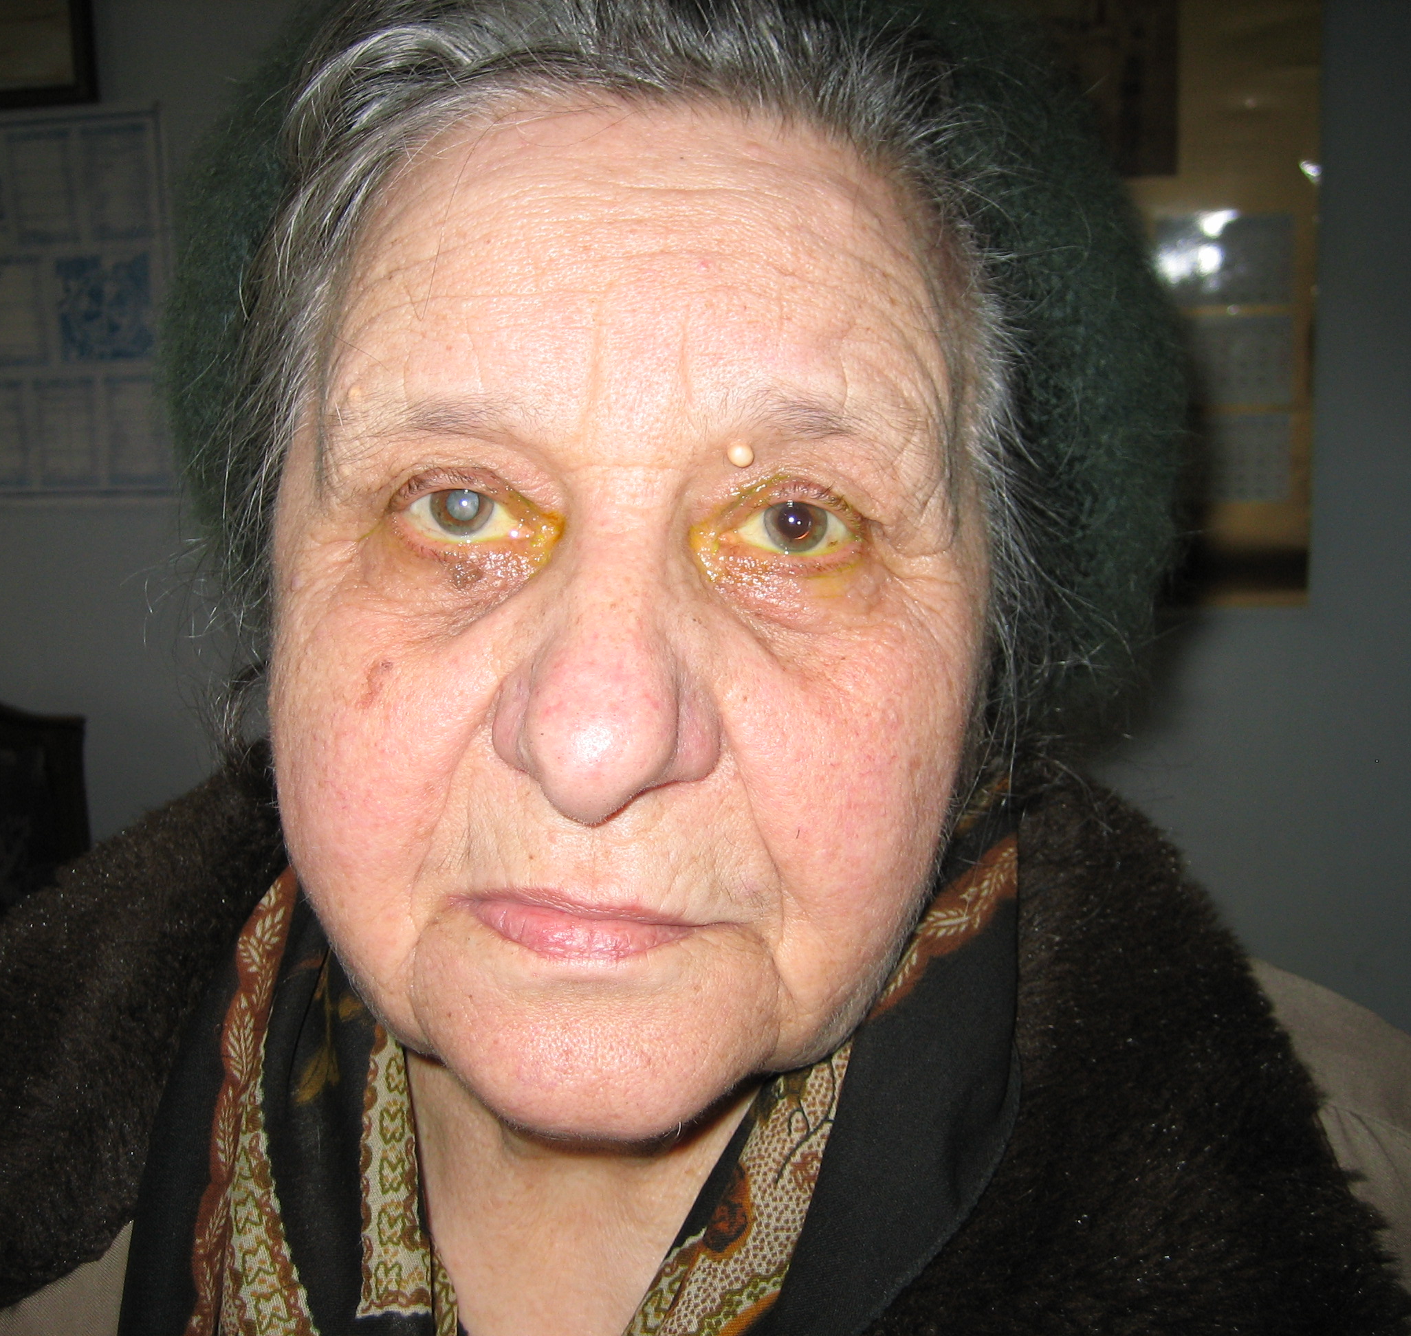
A Matter of Perspective
Which eye needs cataract surgery??
Notes:
Immediate answer is OD, but is it really? With 20/30 in OS, is there a need for surgery OD when it is expensive and no perceived decrease in function at this time?

Slide 22
Which eye needs cataract surgery?
OD
OS
Neither

Slide 23
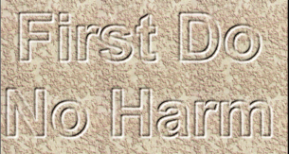
What is YOUR job? (as an O.D.)
Is it to examine eyes and diagnose eye conditions?
Help people see better?
Explain conditions and help treat them?
“Every time a patient see’s a doctor, they should feel better as a result.”

Slide 24
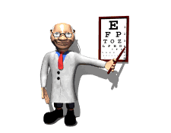
Our Job
To put things into perspective
Patients want a recommendation based on knowledge and compassion
“To cure sometimes, to relieve often, to comfort always” Edward Trudeau
Notes:
Trudeau: 1848-1915 Physician that contracted TB, founded sanatorium for tx of TB and lab for infect. disease

Slide 25
First Do No Harm…but it’s ok to make mistakes
“The objective of medical science is not to open a door to infinite wisdom, but to set a limit on infinite error” Berthold Brecht paraphrase
Can you admit mistake?
  Mistakes are inevitable as medicine is part art and every patient is different
  An apology will often “clear the air” and prevent any further action

Slide 26
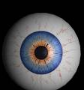
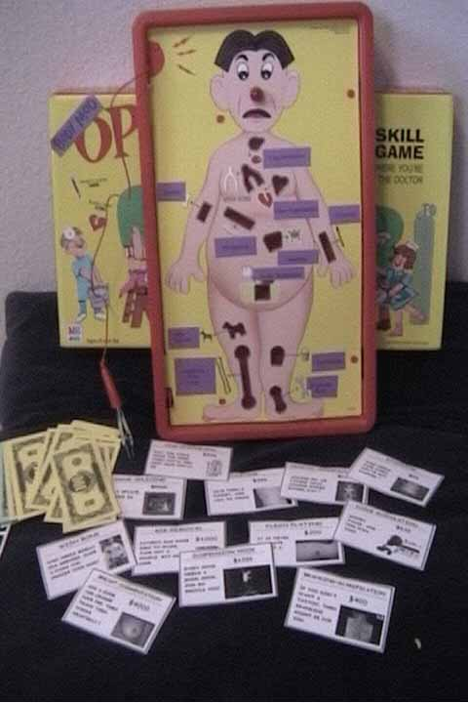
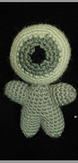
Sum is greater than its parts
We often learn how eyes affect vision
We often learn how systemic disease affects the body
Occasionally we discuss how eyes affect the body
But how do eyes affect person?

Slide 27
Treating vs. Healing
A disease entity is treated
A person is healed
Can we do both?
Often times the goal shifts to treating without regard to healing
  Less regard to comprehensive history taking, chairside manner and overall interaction

Slide 28
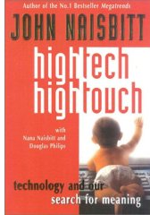
Treating People, (Not Legal Entities)
What are people’s expectations?
High Tech or High Touch
  BOTH: People want a hands on approach while incorporating the latest technological advances
The right answer
  People value no answer more than one that is contrived and false

Slide 29
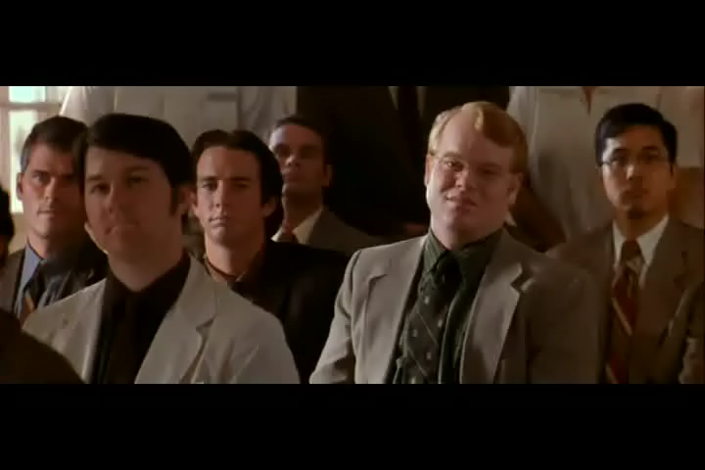
A different way to think…
Robin Williams as Patch Adams, M.D.

Slide 30
Malpractice
Medicine in general acquired a “halo” in the early 20th century, when doctors, especially rural, made house calls, cared for people, and hospitalization was rare
Now, less time is spent, and more emphasis is put on technologically driven tests, and less on history and clinical exam, and the halo has been removed
Avoidance of lawsuits drives medicine..including optometry

Slide 31
According to a 1991 NEJM article, what percentage of patients harmed by medical treatment file suit?
a. 1.53%
b. 12.3%
c. 22.1%
d. I don’t know, I’ve never been sued
Notes:
1.53

Slide 32
“42% OF ALL STATISTICS ARE MADE UP ON THE SPOT”
Larry the cable guy

Slide 33
Malpractice suits
Why do people sue Doctors?
  Perceived lack of caring followed by lack of availability and lack of listening
  It is usually not due to injury, but due to:
    -Sense of altruism: Prevent others from same fate
    -To expose the truth
    -Monetary reward¹
Usually, could be avoided with proper communication. Absence of explanation leads to distrust and feeling dismissed.
The focus of medicine has shifted from healing (which begins by listening to the patient) to curing
1. Vincent et al, “Why Do People Sue Doctors?” Lancet June 25, 1994
Notes:
OD’s rarely sued, we spend more time with patients than many other doctors
Have established relationships, and often “friendships”
Many people see as only first line, and not ultimately responsible
Not perceived to make as much money, so less contempt

Slide 34
Who has been sued by a patient?
ME
Not me
I won’t answer, I’m afraid to jinx myself

Slide 35
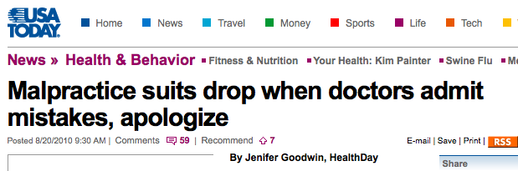

Slide 36
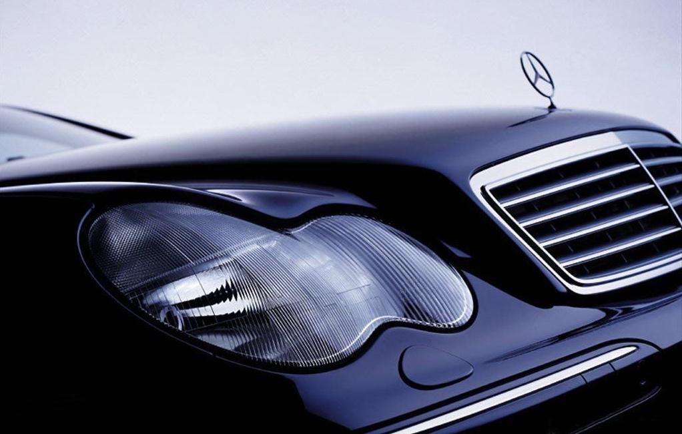
Cost of Malpractice
    Is malpractice really a leading cause in increase of healthcare cost?
      Approximately 2.9% of annual gross income spent on insurance, while 2.3% spent on “professional car upkeep.”
Real cause of increase in cost of medicine:
  Defensive practice of medicine to prevent lawsuits
How has this affected our patients?

Slide 37
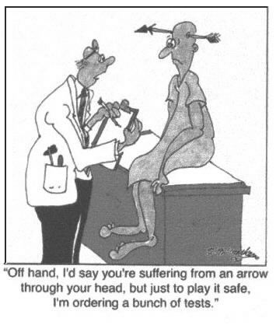
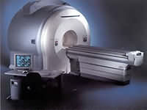
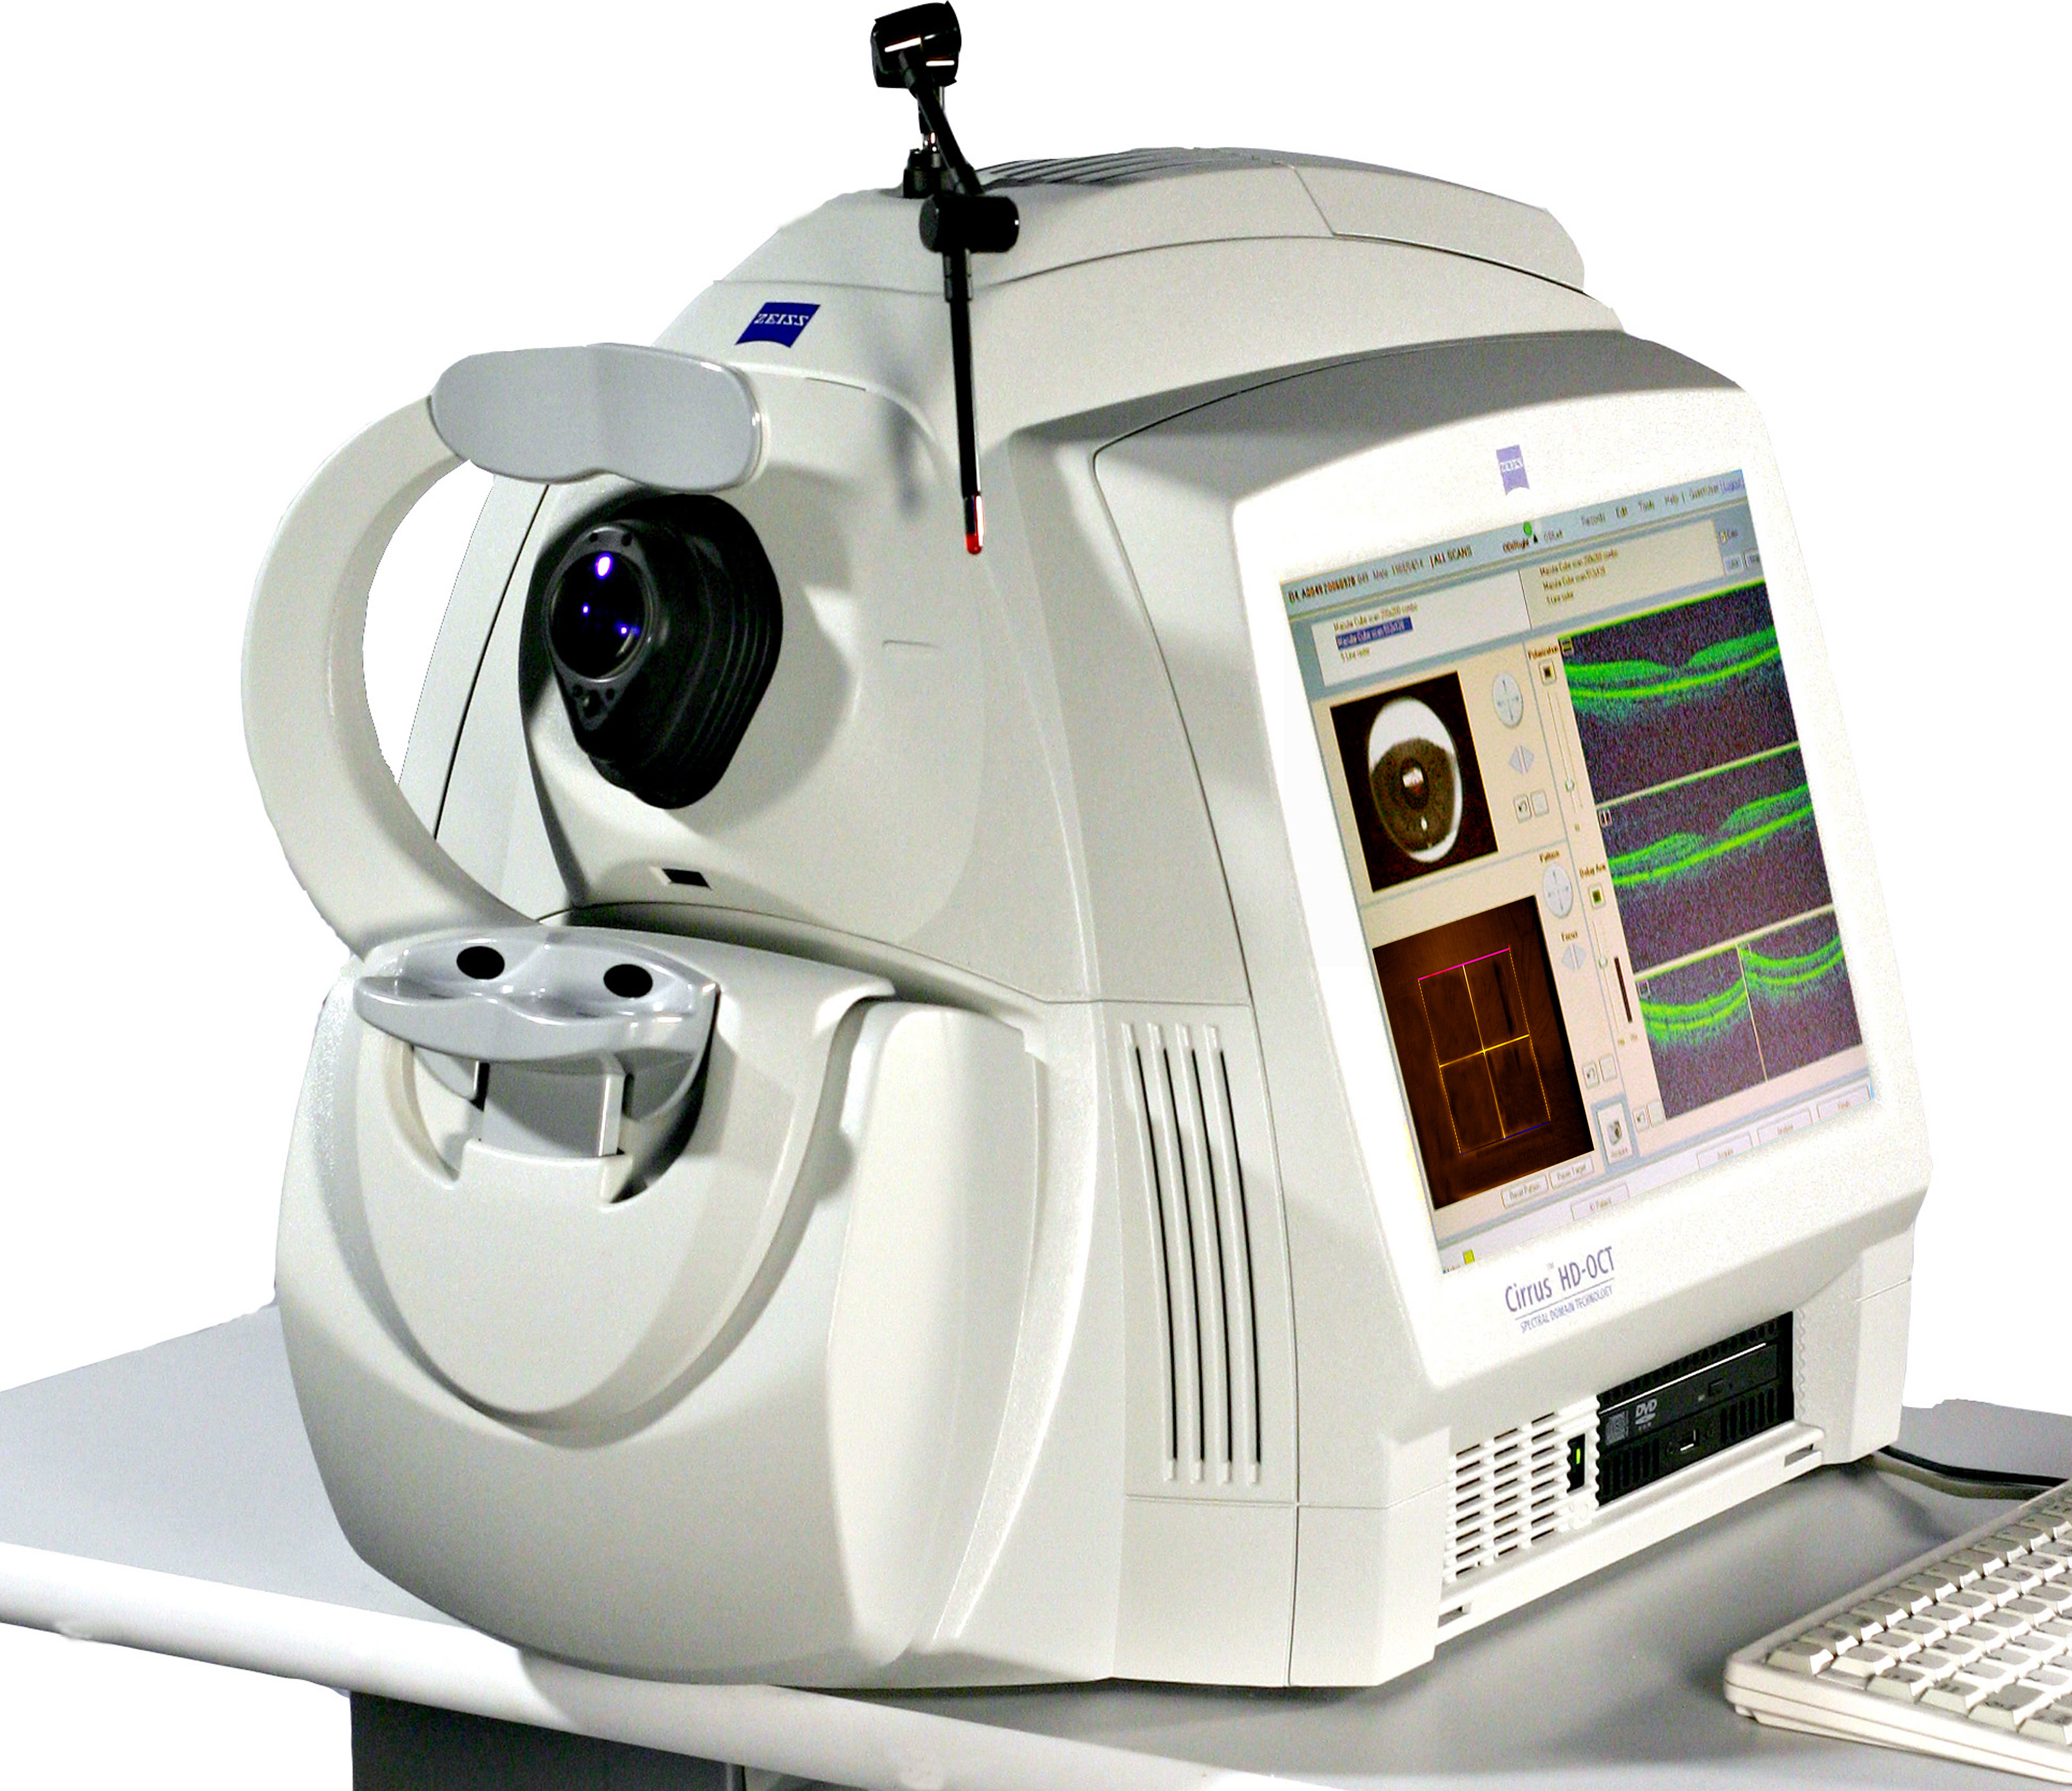
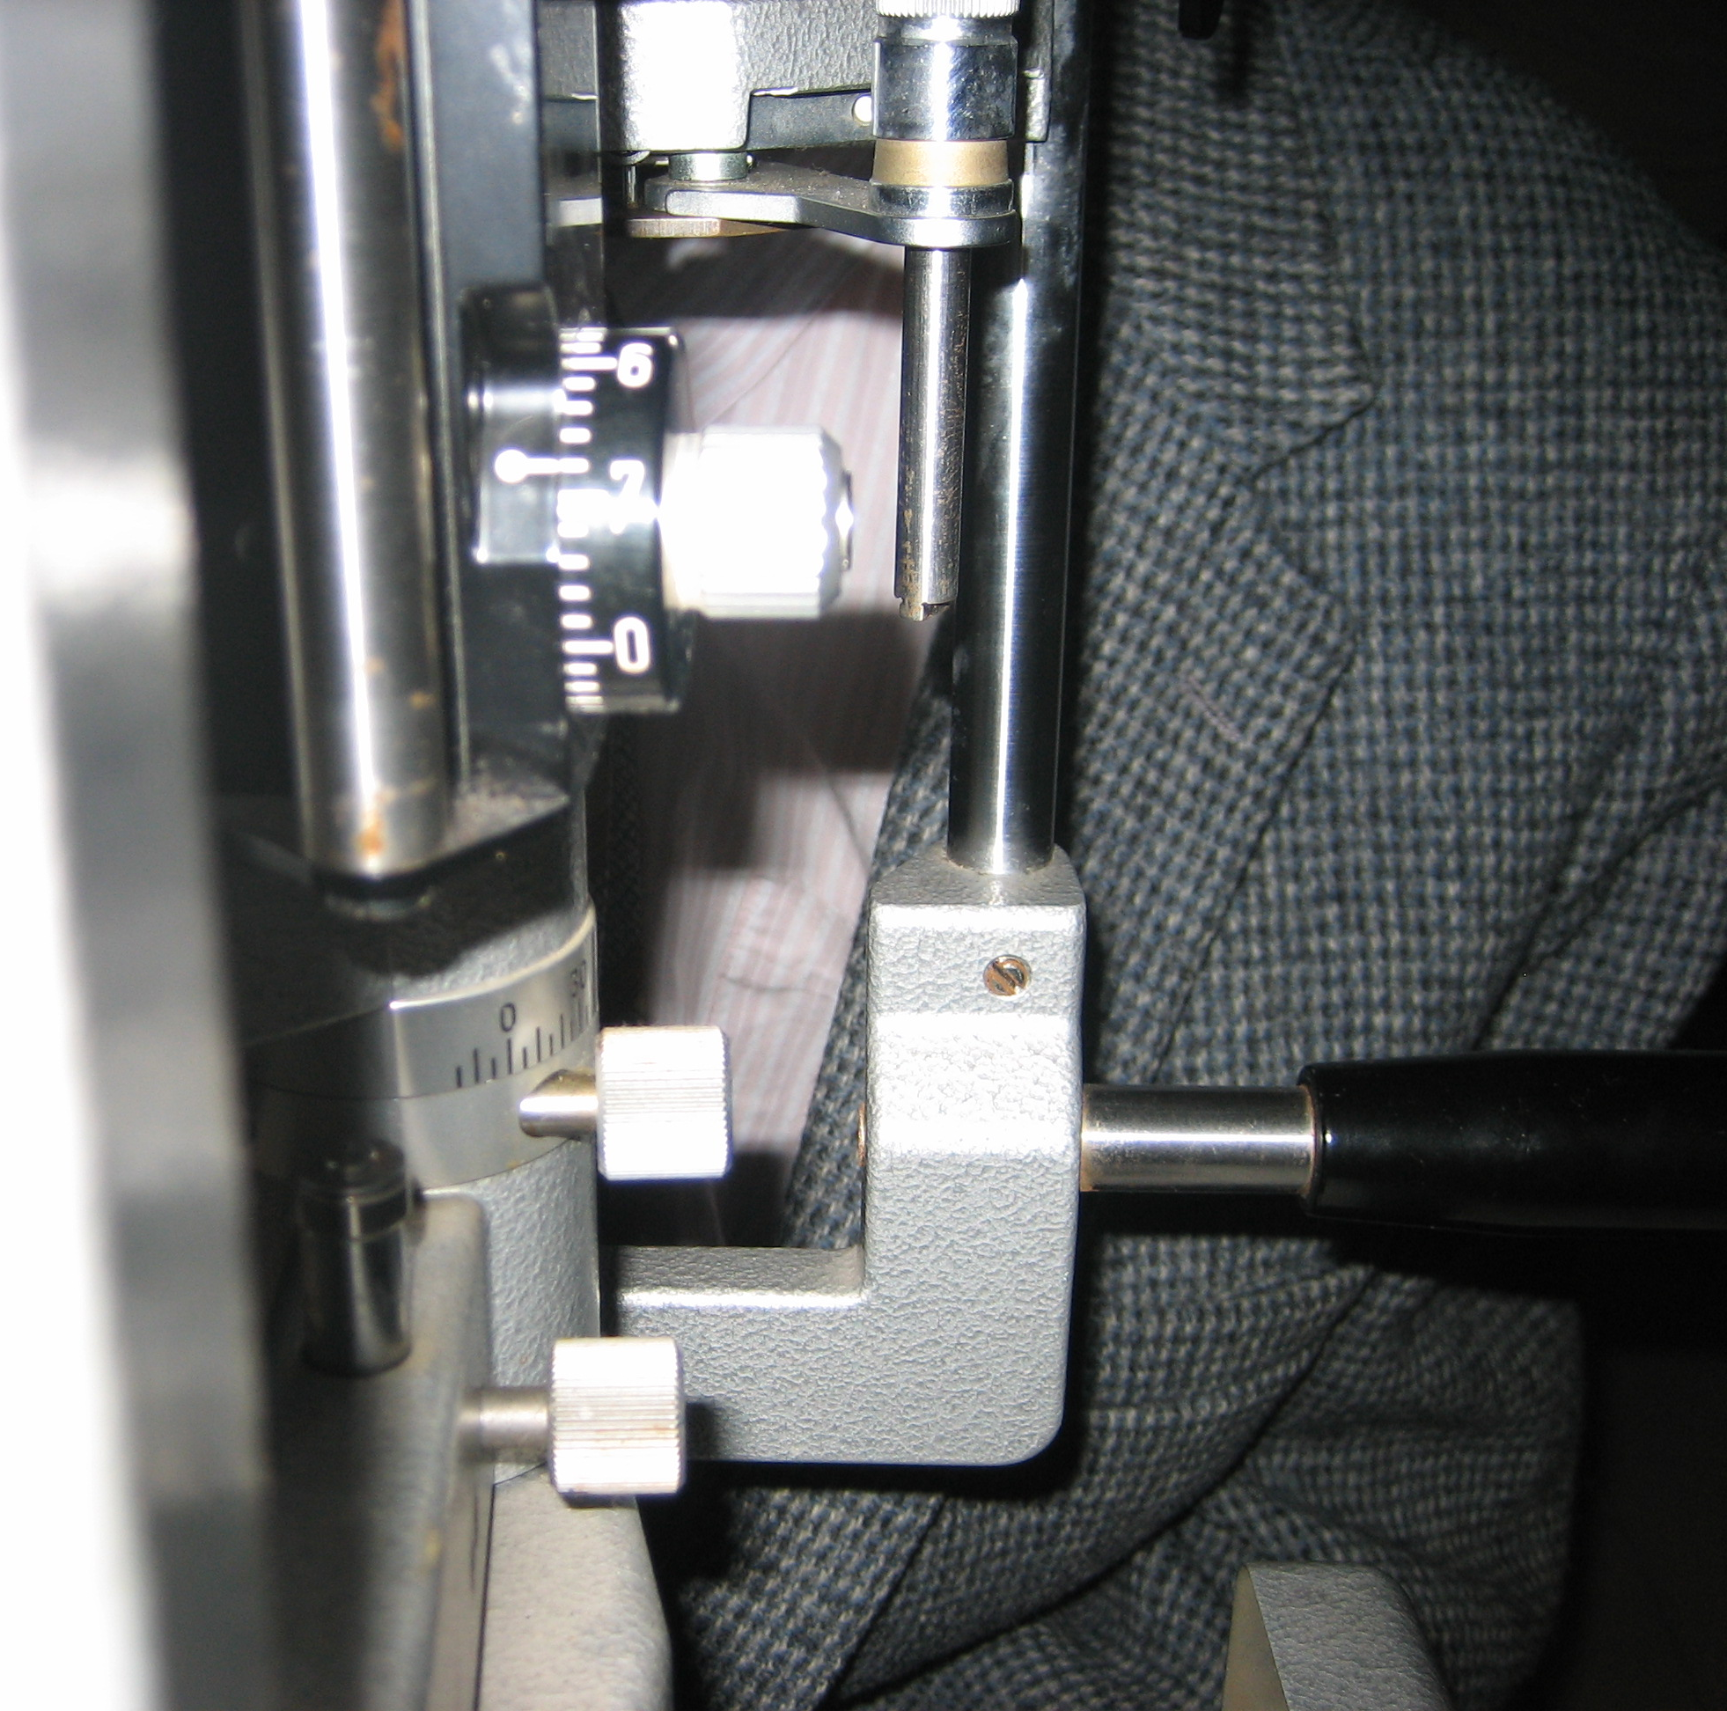
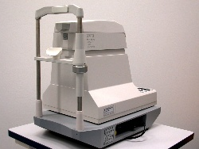
Cost of Malpractice
More traditional exam techniques are replaced by more technical (and expensive) tests
  These techniques are often less personal and not communicated to patients
        Leading to feelings of lack of care, and viscious circle of “malpractice”
VS

Slide 38
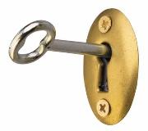
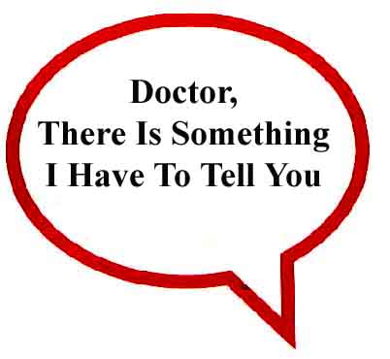
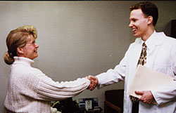
Communication
Crucial part of every doctor-patient encounter
Two way street
Use appropriate terms and tone
  Authority without being dogmatic
  Use understandable terms

Slide 39
When you ask your patient about their chief complaint, how long do you let them speak?
A. 2 seconds
B. 18 seconds
C. 55 seconds
D. 2 ½ minutes
E. As long as they need

Slide 40
“Light travels faster than sound. That’s why some people appear bright until you hear them speak.”
Larry the Cable Guy

Slide 41
Let the patient speak!
Good communication starts with listening…
How long is the average patient allowed to talk when asked of their chief complaint?
  18 seconds
  77% never get to complete their opening statement!
  If left uninterrupted, avg. patient would talk 150 sec.
  Avg patient at PCP has 1.2 to 4.9 “chief complaints”

Slide 42
Have you “faked” an answer in the last week?
a. Yes
b. No
c. No, I’ve never done that
d. Oops, I just did it again

Slide 43
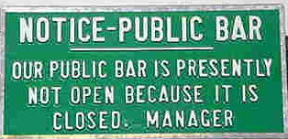
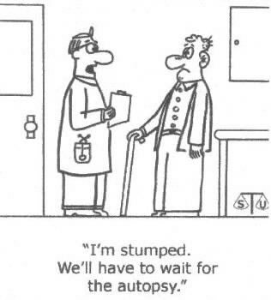
Don’t…
Use scare tactics
Knock another doctor
Fake an answer
Hide the truth
Think that everything always can and needs to be fixed.
Be afraid to admit mistakes or lack of knowledge
Cartoon compliments of Wisconsin Health Freedom Coalition
Notes:
For “ Don’t think that everything can and needs to be fixed: a good example is what we now see with OCT. VMT and the average ERM : These are not new entities, and weren’t treated in the past and people did fine, so maybe don’t always need “treatment” now. Sometices technology tells us too much

Slide 44
Words that maim vs words that heal
It’s not what you say, but how you say it
Language doesn’t carry ideas, it shapes them
Avoid jargon
We should never instill uncertainty and dread
  Simple mention of cataract can do this!
Worst case scenario often presented to avoid malpractice (opposite affect)
“Your eye pressure is 25, and you may go blind from glaucoma if we don’t do something about it quickly”
Bedell et al. Words that Harm, words that heal. Arch Intern Med. 2004 Jul 12;164(13).
Notes:
Another clinical example of words:
With your family history and poor diet, I am afraid that without following my advise, you are very likely to develop macular degenerton and go blind.

Slide 45
“What Happens if you get scared half to death….twice?”
Larry the cable guy

Slide 46
Words that heal
Healing words set stage for collaborative decision making
Verbal and non-verbal language
Positive “spin”, avoid negativity
Persuading a patient that nothing is wrong is often a thankless task, if not impossible
“Your eye pressure is slightly elevated, so I’d like to do a few extra tests to insure that everything is just fine”
Notes:
Cont of other example:
You have some mild aging changes in your eyes and I’d like ot recommend that you take this nutritional supplement in order to prevent any further change

Slide 47
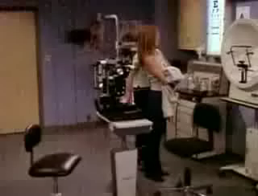
Speaking of being scared….

Slide 48
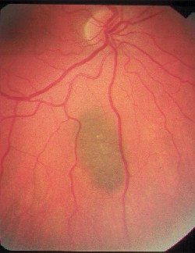
Maim or Heal?
How do you describe a choroidal nevus to a patient?
  Do you mention the chance of conversion to melanoma?
  Do you compare to freckle?
  Do you correlate to skin cancer?
  Do you not mention it to patient?

Slide 49
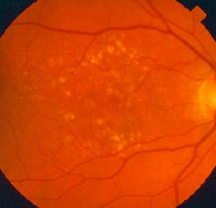
Maim or heal?
How do you describe drusen to a patient?
Is this AMD?
Will it cause blindness or vision loss?
Is it treatable?

Slide 50
Building relationships
“…For some patients, though conscious that their position is perilous, recover their health simply through their contentment with the physician” Hippocrates
  Placebo affect
Less lawsuits in optometry due to relationships
Good relationships are built on trust, communication and confidence (by following principles mentioned up until this point)

Slide 51
Breaking Bad News
How many classes in school discussed this?
But it comes up every day
ZERO!
Notes:
Because we weren’t taught, we are afraid to do, or to do right
Give example: Annie is a great doctor, but hates to give ba news because doesn’t like to be bearer of bad news…has me do it sometimes….just a comfort issue

Slide 52
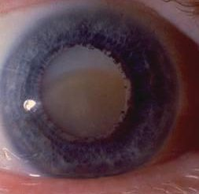
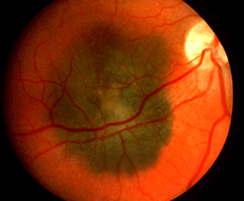
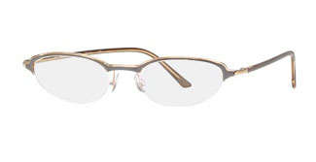
Bad News: A matter of perspective
Diagnosis of myopia vs cataracts vs melanoma

Slide 53
Bad News
Definition?
  Anything that drastically and/or negatively affects a patient’s view of their future
  The difference between what a patient expects and what we tell them
Who needs to break bad news?
  We do
Do we have an ethical obligation to tell truth?
  Yes
Can this “art” be learned?
  Yes by experience and researching and understanding

Slide 54
Steps to telling bad news
1. Start off well
Who, where, how
2. What does your patient already know
3. What do they want to know
4. Share information
5. Respond
6. Follow through: next steps

Slide 55
OK, but why do we care?
It's a matter of perspective

Slide 56

Impact of AMD on Quality of Life
 | Quality of Life Decrement | Comparison
MILD AMD | 17% | symptomatic HIV moderate cardiac angina
MODERATE AMD | 40% | permanent renal dialysis severe cardiac angina
SEVERE AMD | 63% | advanced prostrate cancer severe stroke requiring constant nursing care
Note: patients have a perceived impairment
that is 96% to 750% greater than the impairment estimated by treating physicians
Brown, Brown, Sharma; Age-related macular degeneration: economic burden and value-based medicine analysis. CJO vlume 40, No.3 / June 2005
Notes:
RHEO procedure targets mild & moderate AMD (yellow highlights)

Slide 57
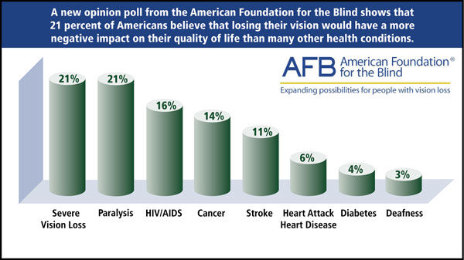
American Foundation for the Blind Headlines
Notes:
<Add USA today headline/article>
Many sources, including a recent clip in USA Today, have found the greatest fear people have is going blind.

Slide 58
Stages
Denial
Anger
Bargain
Depression
Acceptance
Initial
  Facing the problem
Chronic
  Having the condition
Final
  Accepting condition

Slide 59
Bad News: Pearls
KISS
Don’t assume how a patient will react to any news
Bluffing may have worked in school, but won’t in an exam with a patient
Patients remember less than 50% of what we say: so go slow, and speak in English (That Larry could understand)
Make sure that your patient understands:
  Ask them!
Notes:
Ask patients: Are you following me? Am I making sense? Does this sound sensible/reasonable?

Slide 60
Have you ever made a patient cry
a. Yes
b. No
c. Yep, every time I put in tropicamide

Slide 61
What to do if your patient starts crying
Move closer
Offer tissue
Touch
Identify what is causing
Stay with them until they can become calm

Slide 62
Resources
The Lost Art of Healing by Bernard Lown, M.D.
How To Break Bad News: A Guide for Health Care Professionals by Robert Buckman, M.D.
Diabetic Eye Disease by A. Paul Chous, O.D.
Driving with Confidence by Eli Peli, O.D.
How Doctors Think by Jerome Groupman, MD.
Survival of the Sickest by Sharon Moalem, M.D.
The Creative Destruction of Medicine by Eric Topol, MD
Freakonomics by Steven Levitt and Stephen Dubner
You Don’t have to be Wrong for me to be Right

Slide 63
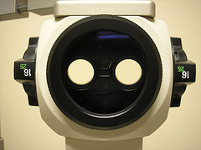
Thank You
Jeffry Gerson, O.D., F.A.A.O
jgerson@hotmail.com
Notes:
Read: In search of my Husbands Mind

Slide 64
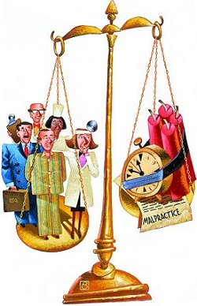
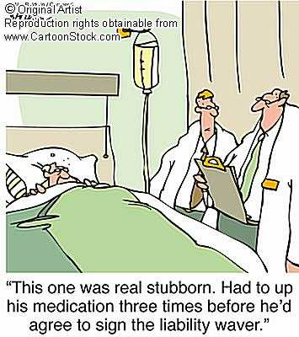
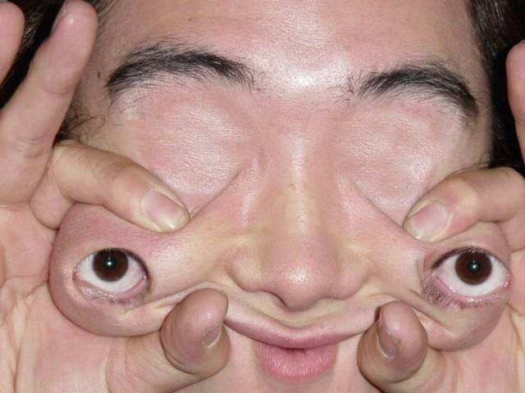
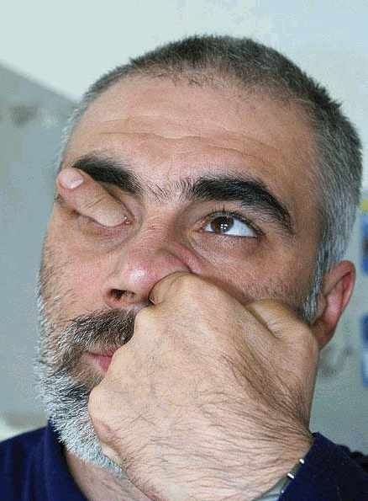
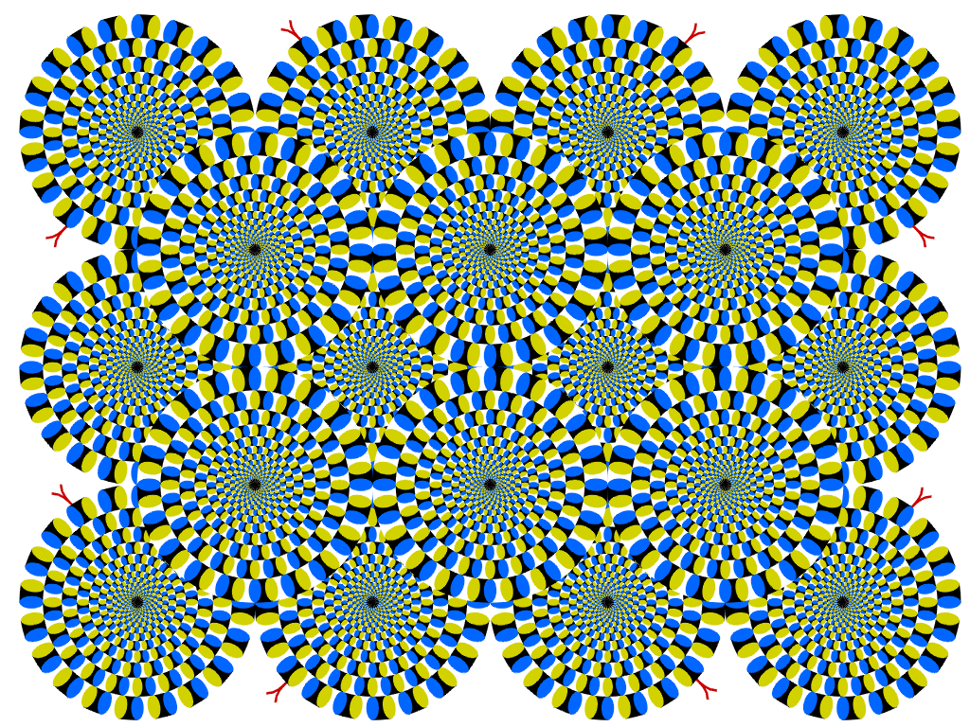

Slide 65
“Light travels faster than sound. That’s why some people appear bright until you hear them speak.”
Larry the Cable Guy

Slide 66
“How much deeper would the ocean be without sponges?”
Larry the Cable Guy

Slide 67
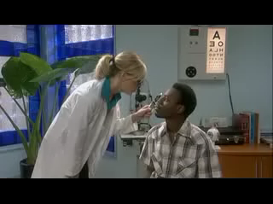
Although technology can be important to avoid image problems..

Slide 68
“What Happens if you get scared half to death….twice?”
Larry the cable guy

