Slide 1


The Untamed Cost Center
Why CFOs Must Lead Healthcare Strategy
Notes:
By a show of hands...
Who feels confident that you are PROACTIVELY managing your medical/benefits spend as much as possible?

Slide 2






Healthcare is not a Benefit. It’s a Financial System.
“Healthcare is often the second or third largest controllable expense—yet managed with less rigor than revenue.”
Notes:
CONTROLLABLE EXPENSE...
Do you know what I believe to be the biggest lie we're told in business? That we can't control the cost of healthcare.
I heard that on a documentary recently and it hit home.
It's not that we CAN'T.. it's a matter of not understanding how all the pieces work together, where to start, or just wanting to do the EASY thing and get it off your plate until next year...
but that's not going to work anymore.
Our goal today is to...

Slide 3

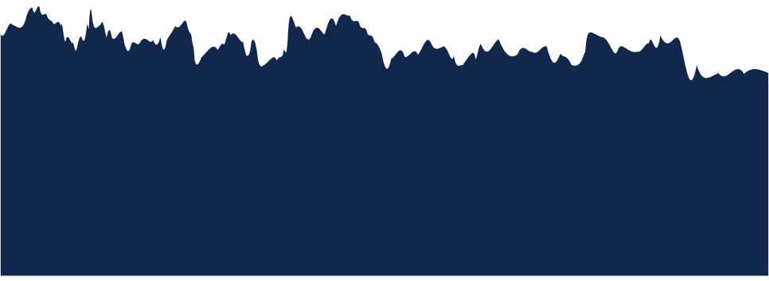
Why This Matters to Finance Now
What’s changed:
Healthcare trend > revenue growth
Pharmacy now the fastest-growing cost driver
Specialty & GLP-1s introduce budget shock
Fiduciary scrutiny is increasing
This is no longer a renewal problem—it’s a forecasting and risk problem.
Notes:
Medical cost trend is growing faster than revenue growth, inflation, and wages.
Why?
- rising pharmacy costs, including biologics, Cell and gene therapies and the high cost and high usage of GLP-1s,
-health care labor costs and workforce shortage.
- Aging population
- Increasing chronic health conditions- accounts for 90% of the country's $5 Trillion healthcare spend. -- 6 in 10 adults have at least 1 chronic condition.
Another important factor to keep in mind is the fiduciary responsibility.
about 10-15 years ago, we started to see more litigation around retirement plan sponsors along with additional compliance requirements and recommendations. We're now seeing this same shift related to employer-sponsored benefits.
With so many misaligned incentives built into the systems in place today, we have to be diligent in our practices to ensure we're doing what's best for the employees and members.

Slide 4


The Real Cost of Healthcare
Move beyond premiums.
Total Cost of Risk Includes:
Medical + pharmacy claims
Employer HSA/FSA contributions
Payroll tax implications
Absenteeism & presenteeism
Turnover & replacement costs
Disability & workers’ comp overlap
Administrative + compliance costs
Notes:
These dynamics create pricing inefficiencies — and that’s where alternative funding becomes relevant.

Slide 5
Funding Strategy & Financial Levers
Fully Insured vs Self-Funded: When the Math Works
Finance-relevant differences:
Cash flow timing
Balance-sheet predictability
Risk corridors & stop-loss
Data access & transparency
Long-term cost control optionality
Self-funding = risk management, not risk taking
Notes:
I'm not here to get get in the weeds on the differences between fully insured and self-funded medical plans. But i do want to point out a few financial relevent differences to keep in mind. And hopefully, if you're not self-funded, you're having these discussions and evaluations every year or two.
The question isn’t whether risk exists—it’s whether you’re paying to manage it or paying blindly for it.
For many years self-funding has been looked at as a financial risk. But when you have the right systems, tools, partners in place it becomes the best way to manage healthcare/benefits related risk.
I had a conversation with someone recently who currently isn't getting data outside of renewal time. They said why does it matter, we can't change things mid year any ways... True, when you're fully insured. When you're self funded and you see in February that someone just filled a $6k/mo script.. there are ways to mitigate that the remainder of the year. Stacey will talk more about that shortly. Or maybe it's a diabetes diagnosis and we see they already have hypertension as well. providing health coaches and programming to ensure those employees are being proactive and in compliance with their treatment plan.

Slide 6
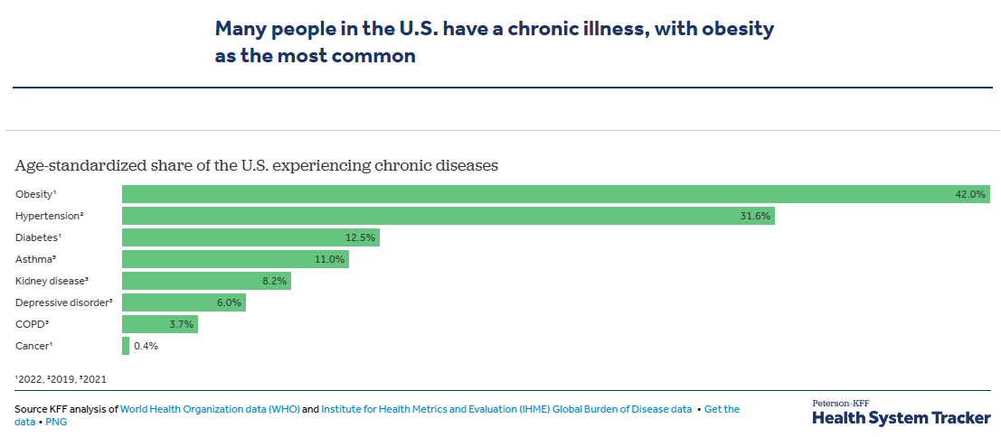
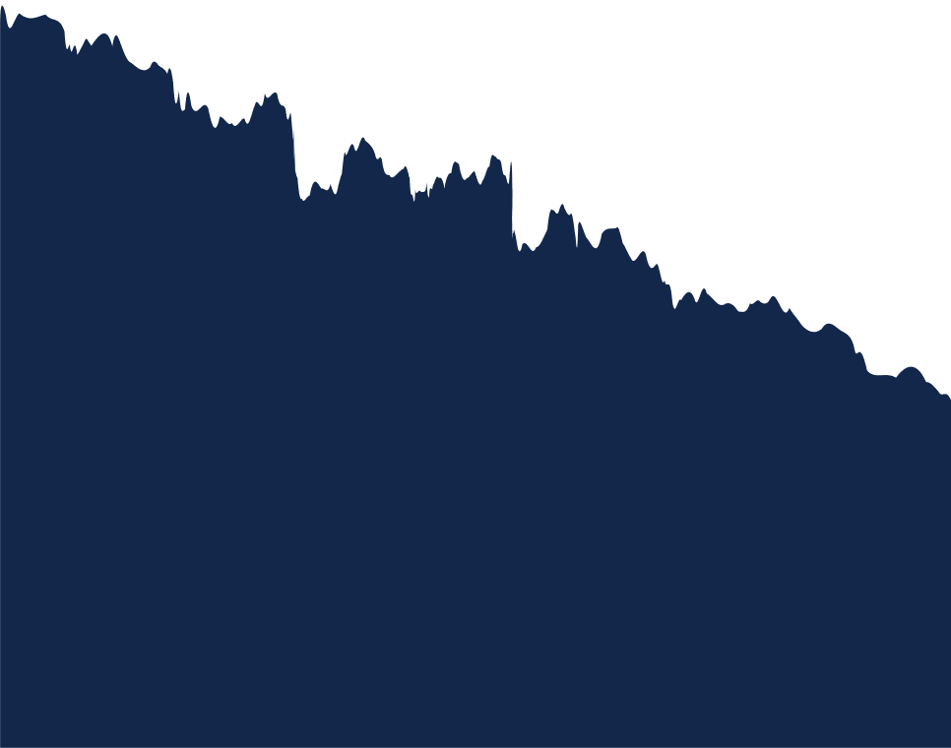
US Healthcare Spending by Health Condition
Many people in the U.S. have a chronic illness, with obesity as the most common
More than 40% of adults—more than 100 million people—are obese.
Obesity costs the US healthcare system almost $173 billion a year.
Nearly half of U.S. adults (119.9 million) have high blood pressure.
Annual costs associated with high blood pressure were an estimated $219 billion in the United States in 2019.
More than 38 million Americans of all ages have diabetes, and 98 million adults are at high risk.
$307 billion is spent each year on direct medical costs and another $106 billion on reduced productivity.
Notes:
References:
https://www.cdc.gov/obesity/php/about/index.html
https://www.cdc.gov/nccdphp/priorities/high-blood-pressure.html
https://www.cdc.gov/chronic-disease/data-research/facts-stats/index.html
https://www.cdc.gov/nccdphp/priorities/diabetes-interventions.html

Slide 7
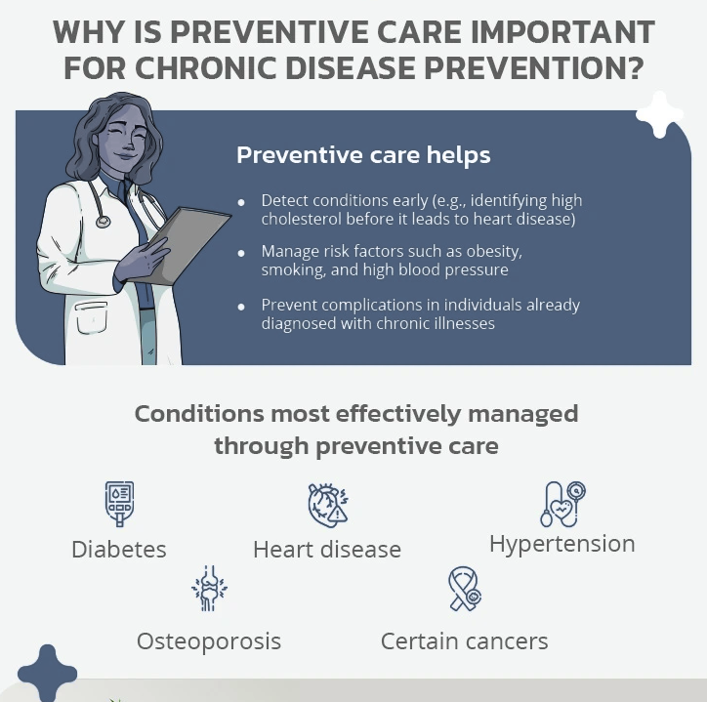
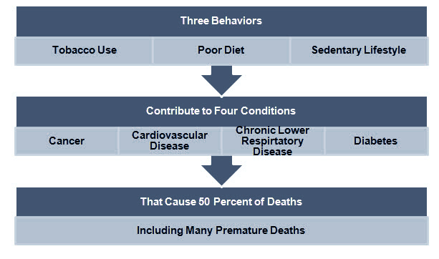
Why is preventive care important for chronic disease prevention?
Preventive care helps
Detect conditions early (e.g., identifying high cholesterol before it leads to heart disease)
Manage risk factors such as obesity, smoking, and high blood pressure
Prevent complications in individuals already diagnosed with chronic illness
Notes:
It is more important than ever for individuals to take an active role in understanding how their insurance plans work and how to advocate for themselves.
https://www.cdc.gov/chronic-disease/data-research/facts-stats/index.html

Slide 8
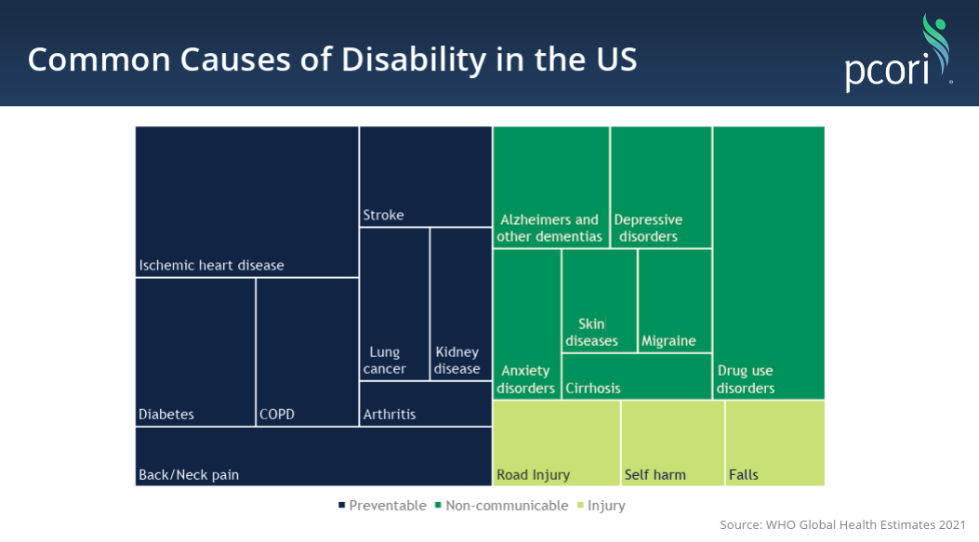
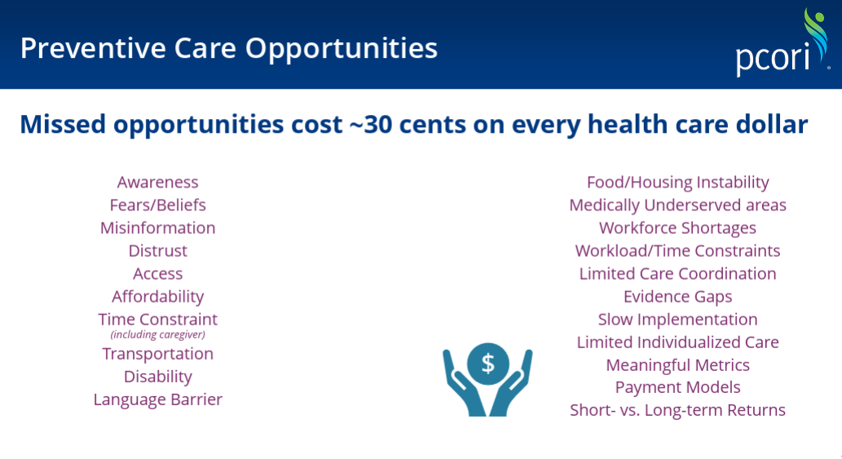
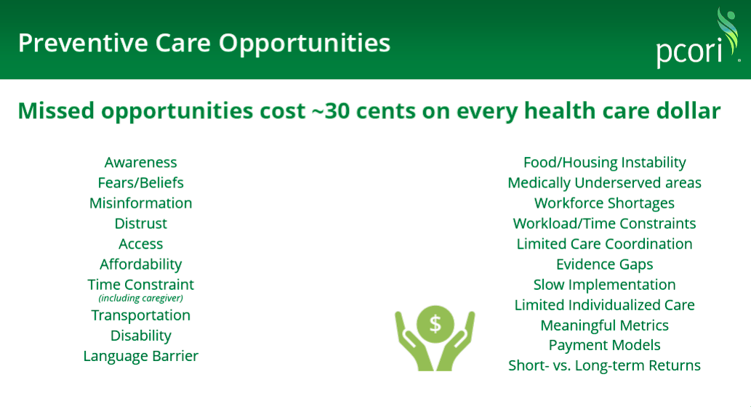
Common Causes of Disability in the US
Preventive Care Opportunities
Notes:
I'm not trying to say employers are causing this rise in chronic conditions or that they should shoulder the responsibility for reversing it all.. BUT I think Employers have the ability to make a significant impact.
The average person in the US spends 1/3 of their life at work. What can we start doing to shift employee's mindset around their health and wellbeing, and how can we provide them the tools and resources to live healthier lives which will ultimately lower your financial risk.
Switching gears, lets jump into one of the main factors contributing to the rising costs we're seeing in healthcare.

Slide 9

Pharmacy as a Financial Cost Driver
Pharmacy Is the Fastest-Growing Variable Expense
Specialty drugs driving disproportionate spend
Top 3 Cost Drivers - Inflammatory Conditions, Oncology & MS
Fewer members, more dollars
6% of population utilized at least 1 specialty drug
Future Outlook
Speciality spend could reach $1 Trillion by 2030, driven by a 40% annual growth rate
Not managing pharmacy is equivalent to leaving a major spend category unmanaged on the P&L.
Notes:
STACEY
Specialty drugs account for over 50% of total U.S. prescription drug spend despite being used by only about 2-3% of the population. In 2024, U.S. specialty drug spending reached approximately $416.8 billion, a 11.9% increase from 2023. Costs are driven by high-cost treatments for complex, chronic conditions such as oncology and immunology

Slide 10
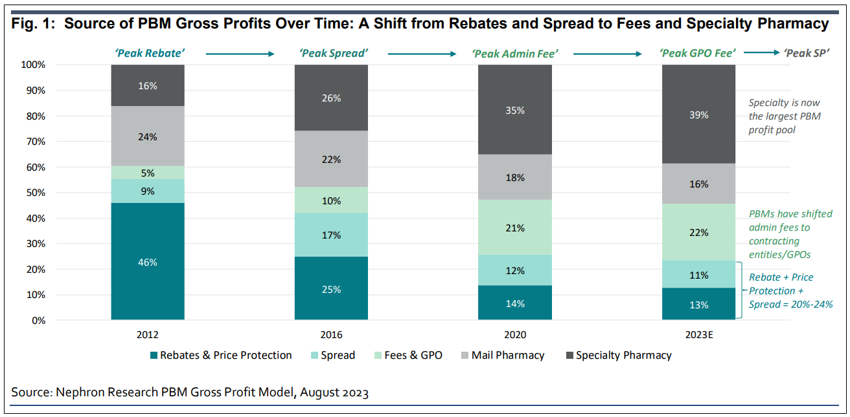
Pharmacy as a Financial Cost Driver
Drug Prices Aren’t the Real Problem
What actually drives cost:
PBM pricing mechanics
Rebate dependency
Spread pricing
Site-of-care decisions
Formulary design incentives
Two employers with the same drug can have wildly different net costs.
Notes:
Many employers don’t realize lower-cost options exist outside traditional PBM pricing.

Slide 11
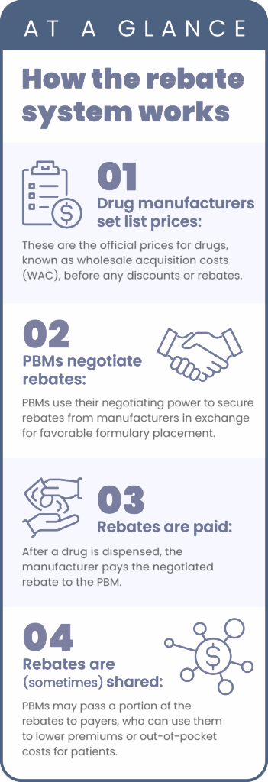
Pharmacy as a Financial Cost Driver
PBM Models:
Where Incentives Break
How the Rebate System Works
Rebate vs pass-through
“Pharmacy spend is one of the few areas where the buyer often doesn’t know the true net price.”
Notes:
Many employers don’t realize lower-cost options exist outside traditional PBM pricing.

Slide 12
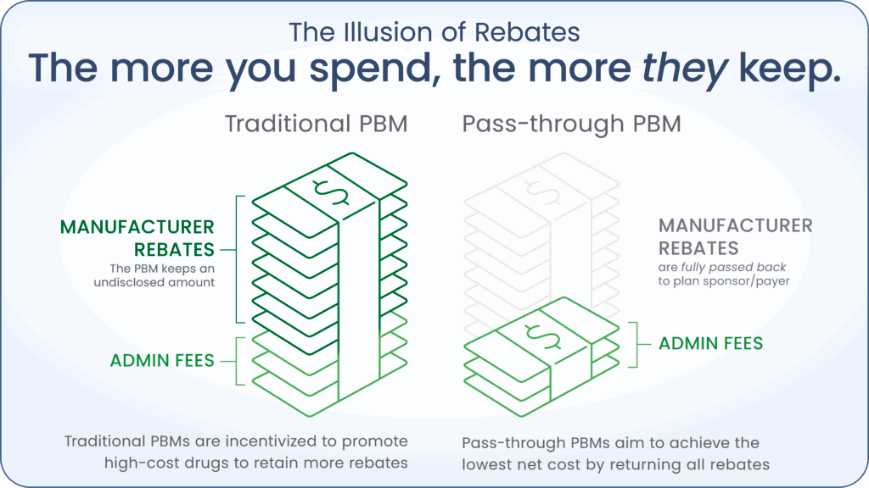
Pharmacy as a Financial Cost Driver
PBM Models:
Where Incentives Break
Rebate vs pass-through
“Pharmacy spend is one of the few areas where the buyer often doesn’t know the true net price.”
Notes:
Many employers don’t realize lower-cost options exist outside traditional PBM pricing.

Slide 13
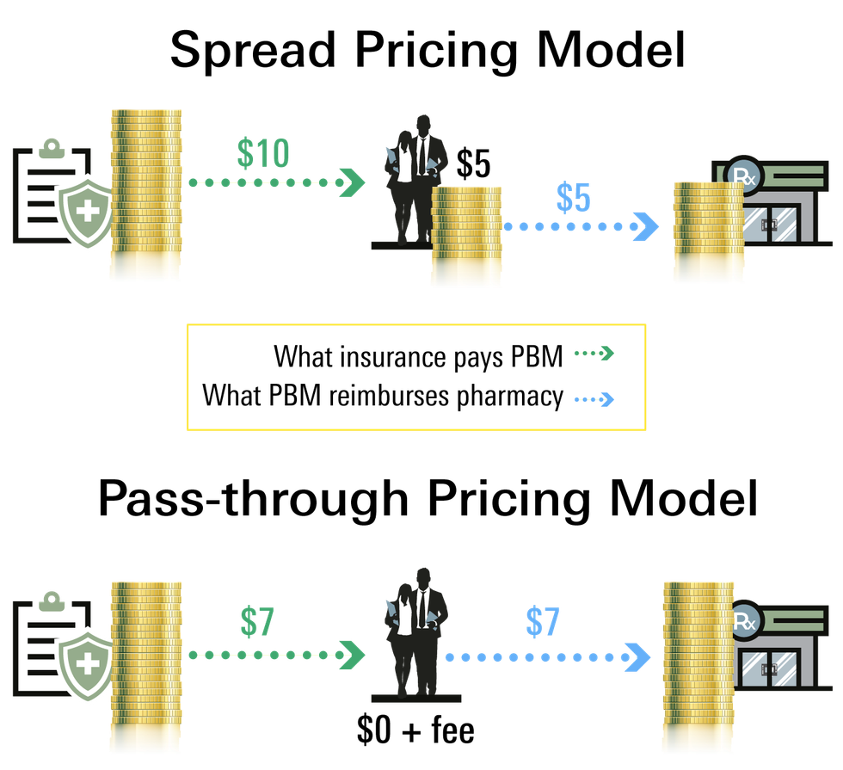
Pharmacy as a Financial Cost Driver
PBM Models:
Where Incentives Break
Spread vs transparent pricing
“Pharmacy spend is one of the few areas where the buyer often doesn’t know the true net price.”
Notes:
Many employers don’t realize lower-cost options exist outside traditional PBM pricing.

Slide 14
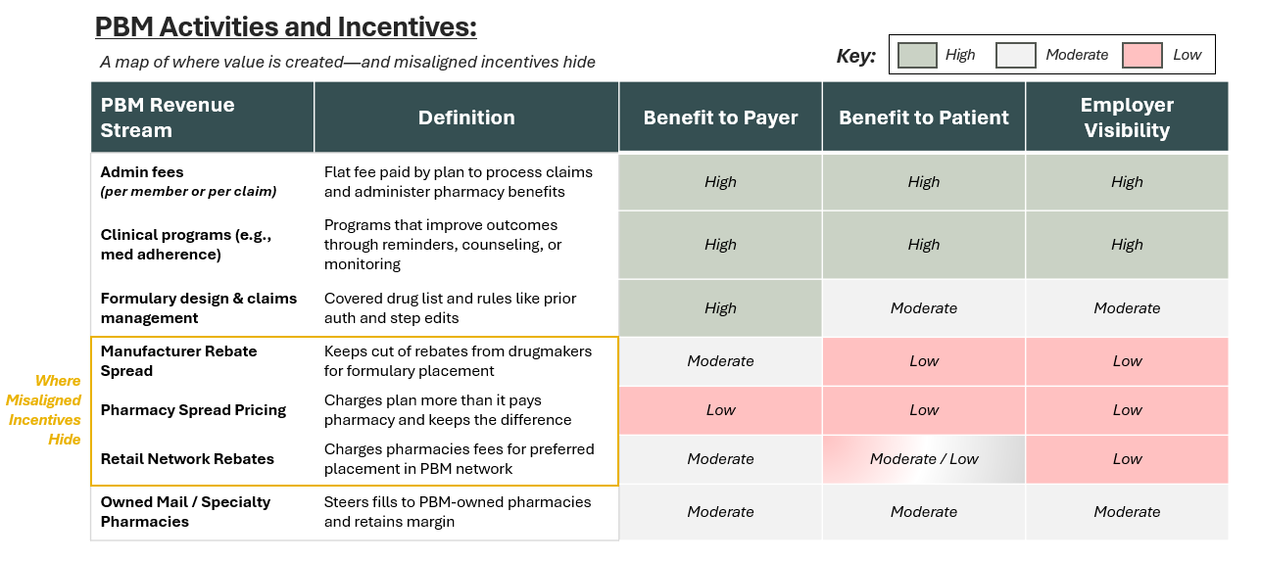
Pharmacy as a Financial Cost Driver
PBM Models: Where Incentives Break
Why lowest list price ≠ lowest net cost
“Pharmacy spend is one of the few areas where the buyer often doesn’t know the true net price.”
Notes:
Many employers don’t realize lower-cost options exist outside traditional PBM pricing.

Slide 15
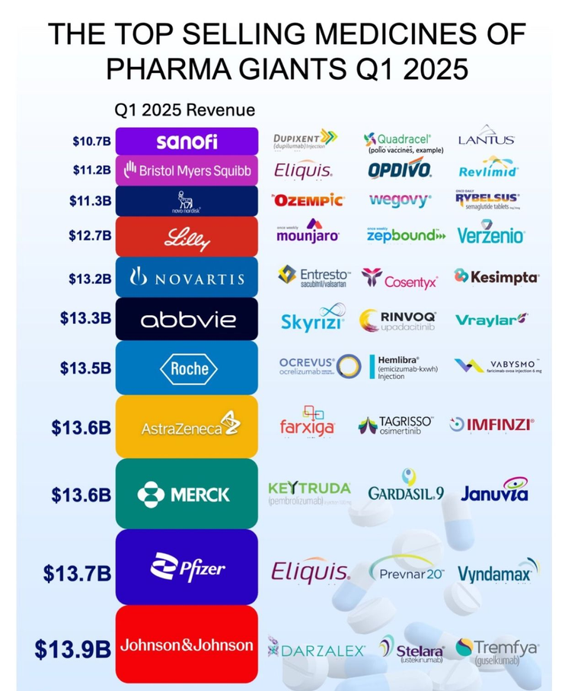
Pharmacy as a Financial Cost Driver
Specialty Drugs = Catastrophic Financial Events
Oncology, autoimmune, rare disease
One claimant = six-figure exposure
Poor forecasting without oversight
Notes:
Many employers don’t realize lower-cost options exist outside traditional PBM pricing.

Slide 16
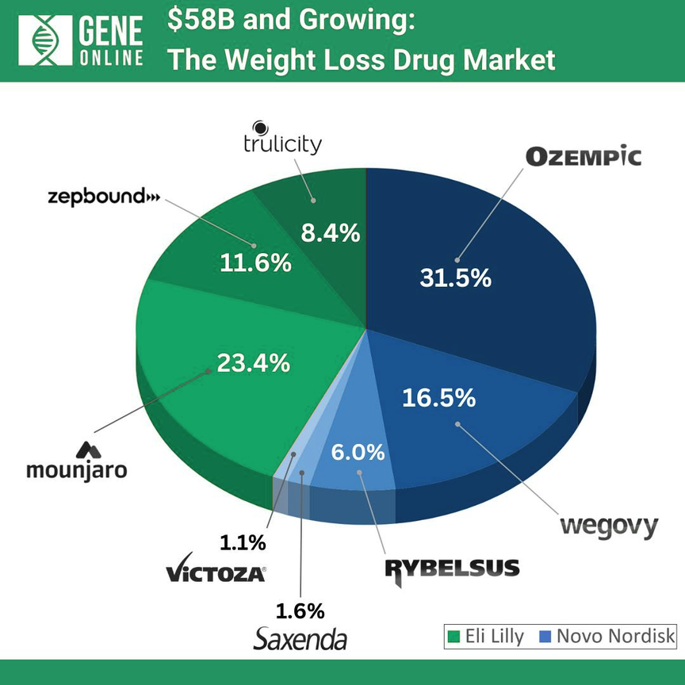
Pharmacy as a Financial Cost Driver
GLP-1s: Budget Shock
Balanced, clinical framing:
Rapid adoption
Multiple indications
Long-term utilization uncertainty
Requires financial policy, not reaction
Notes:
Many employers don’t realize lower-cost options exist outside traditional PBM pricing.

Slide 17
Data Transparency & Fiduciary Risk
Why CFOs Hate the Healthcare Black Box
What Employers Should Demand (But Often Don’t)
Common gaps:
Incomplete claims data
No true net cost visibility
Vendor-owned data
Limited audit rights
Data ownership clarity
Audit rights (medical + Rx)
Transparent contract terms
Independent benchmarking
“If you can’t measure it, you can’t manage it.”
Notes:
Many employers don’t realize lower-cost options exist outside traditional PBM pricing.

Slide 18
Data Transparency & Fiduciary Risk
ERISA & Fiduciary Exposure
Why this matters now:
Increased litigation
PBM fee scrutiny
Duty to act in plan participants’ best interest
Healthcare is no longer just HR’s responsibility—it’s a fiduciary risk issue.
Notes:
Many employers don’t realize lower-cost options exist outside traditional PBM pricing.

Slide 19
Federal PBM Reform - CAA
Mandatory PBM Transparency - Aug 2028
PBM detail drug spend reports twice annually
Civil penalties for noncompliance
100% Rebate & Remuneration Pass Through
PBMs must pass through 100% of rebates, fees, and alternative discounts to plans
Rebates must be fully disclosed and paid at least quarterly
PBMs defined as ERISA covered service providers
PBM Fee Disclosure Rule (self funded focus)
PBMs must disclose rebates, spread compensation, and pharmacy recoupments
Fiduciaries granted audit rights over PBM compensation
Healthcare is no longer just HR’s responsibility—it’s a fiduciary risk issue.
Notes:
• This is the most significant federal PBM reform to date.
• Transparency alone does not equal savings — governance and oversight matter.
• Fully insured groups will still depend on carrier compliance.
• Self-funded plans gain leverage — but also fiduciary responsibility.
• Now is the time to evaluate rebate structure, spread pricing exposure, and contract alignment before 2028.

Slide 20
What High-Performing Employers Do Differently
Finance + HR Collaboration Wins
Clear ownership:
Finance: strategy, risk, modeling
HR: engagement, adoption, communication
Finance sets the guardrails. HR drives the outcomes.
Notes:
Many employers don’t realize lower-cost options exist outside traditional PBM pricing.

Slide 21
What High-Performing Employers Do Differently
Benefits Design Drives Claims
What works (and what doesn’t):
Incentives vs confusion
HDHPs: when they help vs backfire
Navigation tools that reduce waste
Mental health access & productivity
And they do this consistently:
Quarterly claims reviews
Multi-year forecasting
Active Rx strategy
Vendor accountability
Defined decision rights
Employee Behavior = Financial Outcomes
Notes:
There is way too much medical waste and abuse. 21% of medical care is unnecessary. Navigation tools help to cut the waste but also provide more value and peace of mind to members.

Slide 22

Bringing It Together
The Levers CFOs Can Actually Control
Funding strategy
Pharmacy oversight
Vendor contracts
Data transparency
Employee behavior levers
Doing nothing is still a decision—with financial consequences.
Notes:
QUESTIONS??

Slide 23
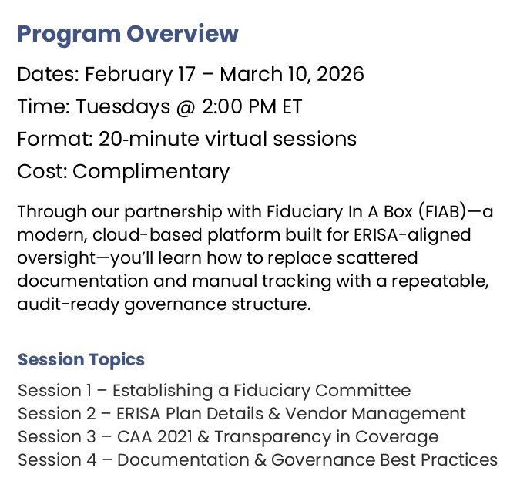

Building a Fiduciary Process
HIG is offering FEI members a complimentary 4-week educational series. Please reach out to Jamie Johnson for the link to register.

Slide 24


Thank you

