Slide 1
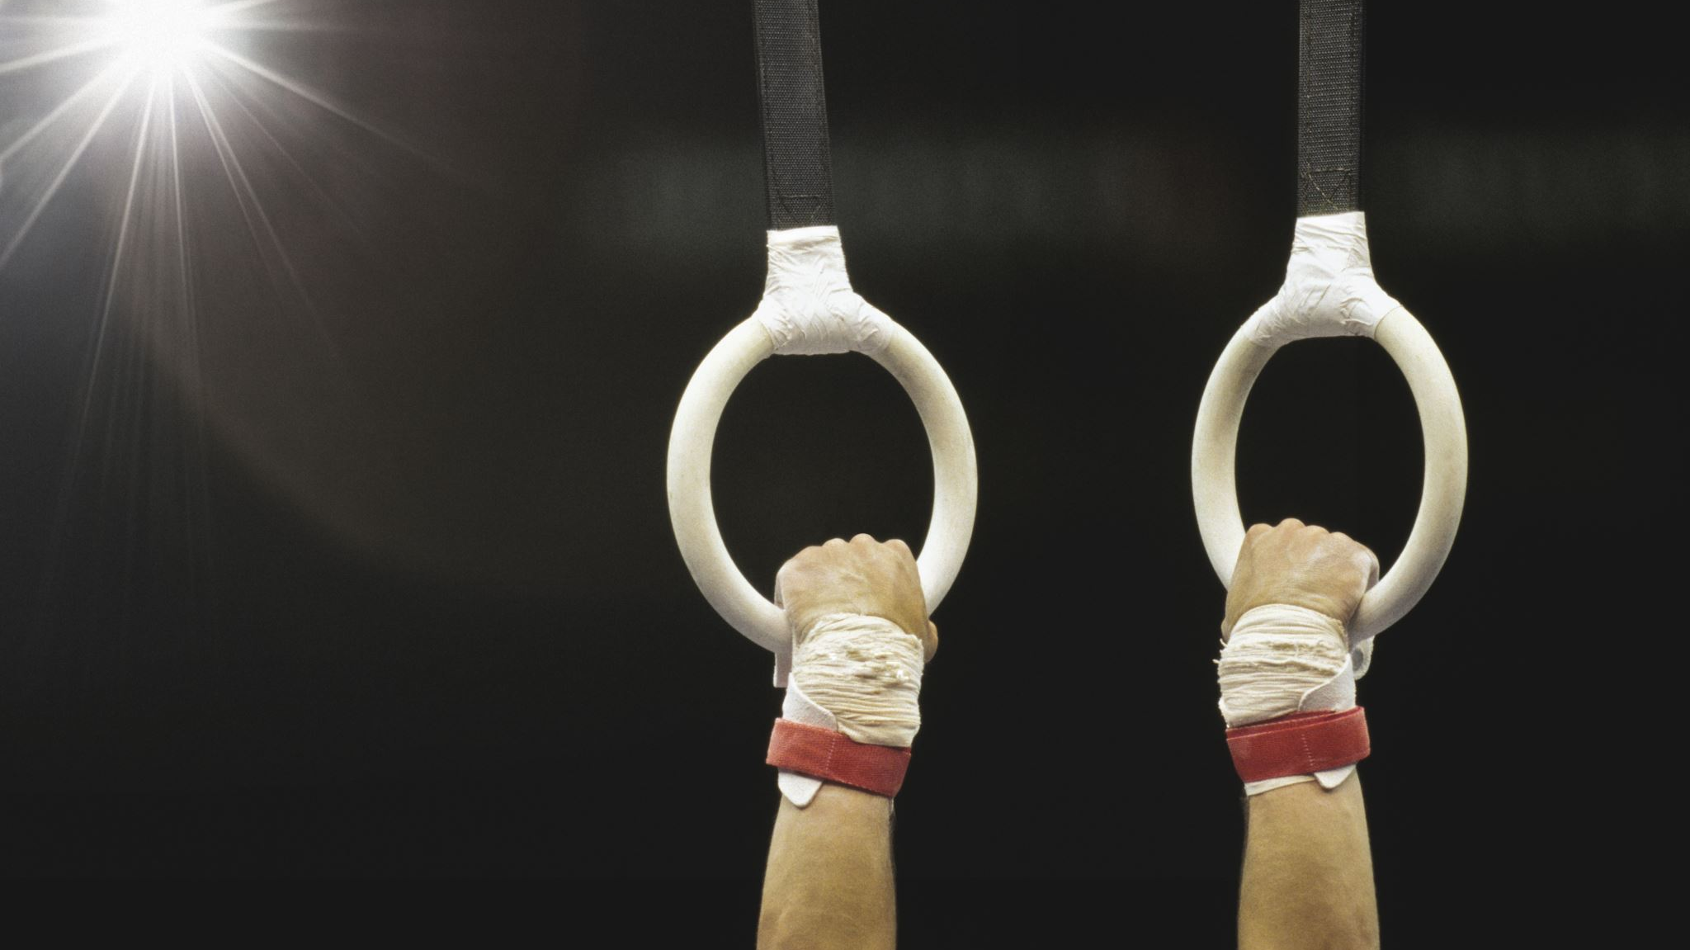
British Gymnastics Apprenticeships
With GymForce!!!

Slide 2
Pre Application Information
No Maths or English GCSEs needed
Karl is happy to accommodate any learners’ individual needs and put extra adjustments/support in place if you would like
Course Lead: Karl
Karl has run a very large amount of apprenticeship courses, works as an independent apprenticeship assessor and has a prebuilt professional relationship with Bethan and GymForce
Pre Application Call
Ahead of applying, we can arrange a call with Karl, and ourselves, and he will endeavour any questions you may have about any element of the apprenticeship
Next intake is September & applications are open

Slide 3
Course structure
Full duration of the course is 12-14 months
The course is full time – 30 hours per week
20% of the course is off the job training
A 2 hour online lesson, fortnightly
6 hours per week dedicated to training; this could be shadowing in the gym, developing session plans, office support, reception work etc
80% of the course is hands-on in the gym (these are paid shifts!)

Slide 4
Support throughout the Course
Mentorship within GymForce
Progress Review every 8 weeks
Email Support from Karl
30 min call for extra support, on alterate weeks to your online classes with Karl and/or Kacey. This will be individualised support to get you through the course.

Slide 5
Qualifications & Learning
Fully funded Level 1
Funded Access to exclusive BG Webinars for professional development
Funded Trips
Skills development beyond coaching if desired; lesson planning, safeguarding, club operations etc
This will be very different to the ‘school experience’
Karl loves to work with individualised support plans and is well experienced to adapting and accommodating learner needs

Slide 6
Trips, Events & Experiences
Lileshall Residential – includes tickets to the BG Championships
travel down to lileshall with your cohort and complete preplanned activities, then spend the whole weekend at the championships!
Opportunities to assist with events; national competitions, events, festivals and displays

Slide 7
Financial Benefits
Earn whilst you learn!!
No tuition or course fees
Provides you with training & experience to be on a direct pathway to Level2
The college are rated Outstanding by Ofsted!

Slide 8
Portfolio Assesment
The portfolio assessment is made up of ten pieces of evidence
These pieces of evidence support your independent learning
As an example, there is a module on policies & procedures. You could submit an updated club procedures document you have supported with or learnt from. This one piece of evidence.

Slide 9
End Point Assessment
1. Coaching Observation
(this will be with an Independent Assesor)
This will be on one of many topics, that the apprentice will chose for themselves
2. Discussion
This will be 45 minutes long and the discussion will center around the apprenticeship and experiences throughout this time.

