Slide 1
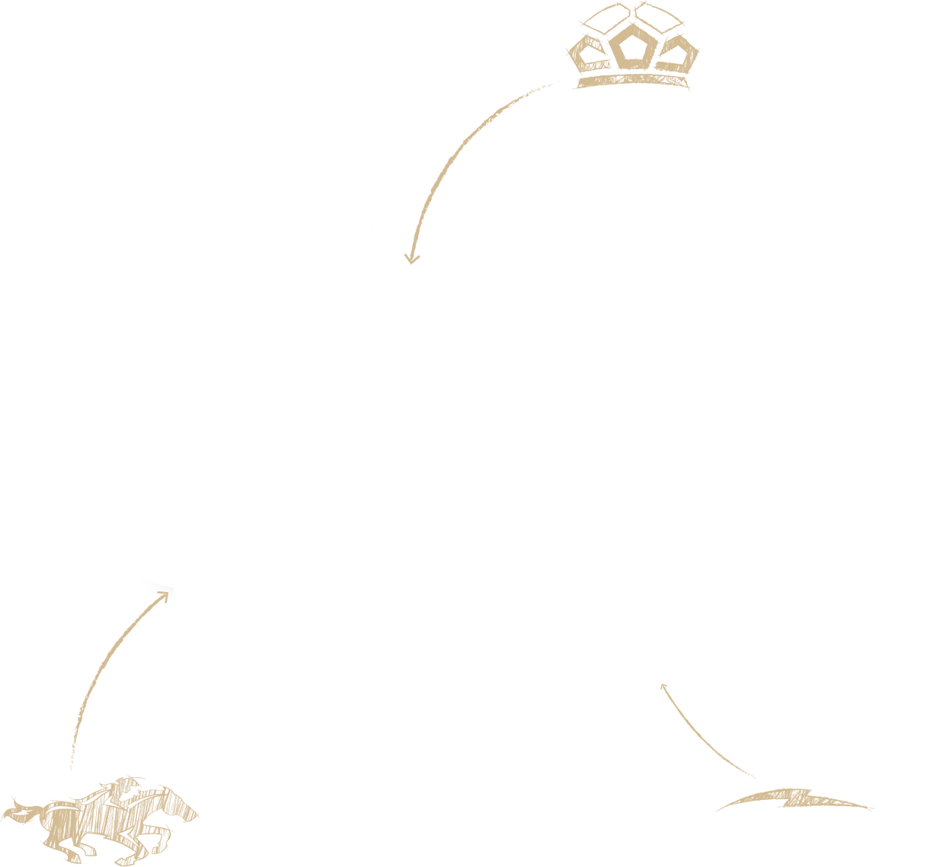

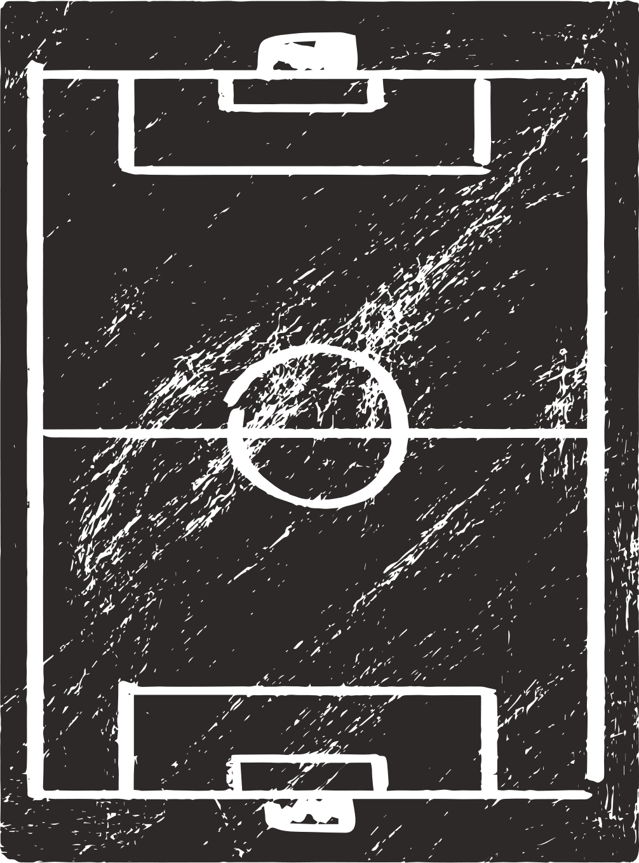
THE
INDEPENDENCE
WAY
2025-2026
CHARLOTTE INDEPENDENCE SOCCER CLUB
www.independencesoccer.club

Slide 2


03
INTRO
12
METHODOLOGY/HOW
06
CULTURE + VALUES
13
DEVELOPMENT
07
PURPOSE + IDENTITY
19
EDUCATION
09
STYLE + PHASES + PRINCIPLES
26
PLAYER PATHWAYS
TIW

Slide 3

TIW

Slide 4
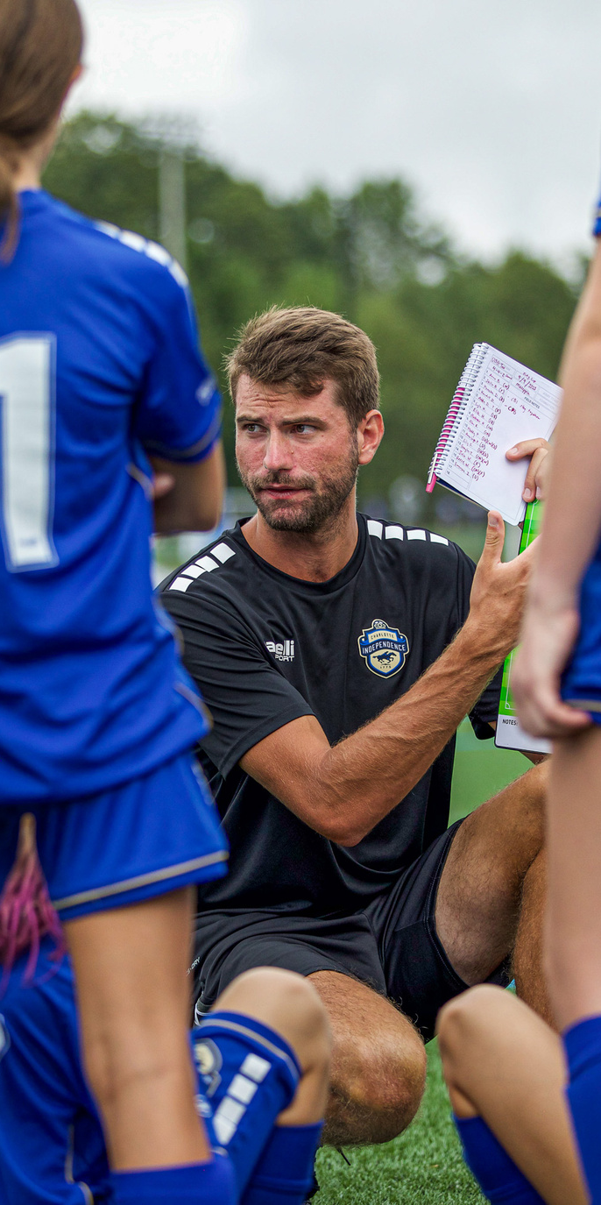
INTRODUCTION
Rich in Experience, Grounded in Delivering Success
The Independence Way (TIW) is a tested and proven soccer development platform that incorporates hundreds of years of collective experience in youth, collegiate, and professional levels. It successfully guides the soccer journeys of thousands of children and families each year.
The Independence Way includes proprietary components that we will cover in this presentation. These components ensure the success of your child's soccer journey, whether they are starting out as recreational players or aiming to compete at collegiate or professional levels.
The results are unquestionable, all thanks to The Independence Way!
800+
24
Collegiate Soccer Players Committed
US National Team and Professional Players
1000'S
75,000+
Varsity HS Players
Recreational Players Introduced to the Sport

Slide 5
CULTURE + VALUES
OUR BELIEFES AND NORMS
COMMUNITY
CHARACTER
COMMUNICATION
COMMITMENT
COMPETITION
WHAT IS TIW?
THE INDEPENDENCE WAY...
PURPOSE + IDENTITY
OUR WHAT AND WHY
ORGANIZATIONAL PURPOSE
PLAYING W/PASSION
INDIVIDUAL CREATIVITY
HARDWORKING + RELENTLESS
FORWARD THINKING
LOVE OF THE GAME
APPROACH
OUR HOW
HOLISTIC PLAYER DEVELOPMENT
TRAINING PHILOSOPHY
PERFORMANCE ANALYSIS + PLAYER FEEDBACK
COACHING METHODOLOGY
EDUCATION FOR ALL
PROVEN CURRICULUM
TIW

Slide 6
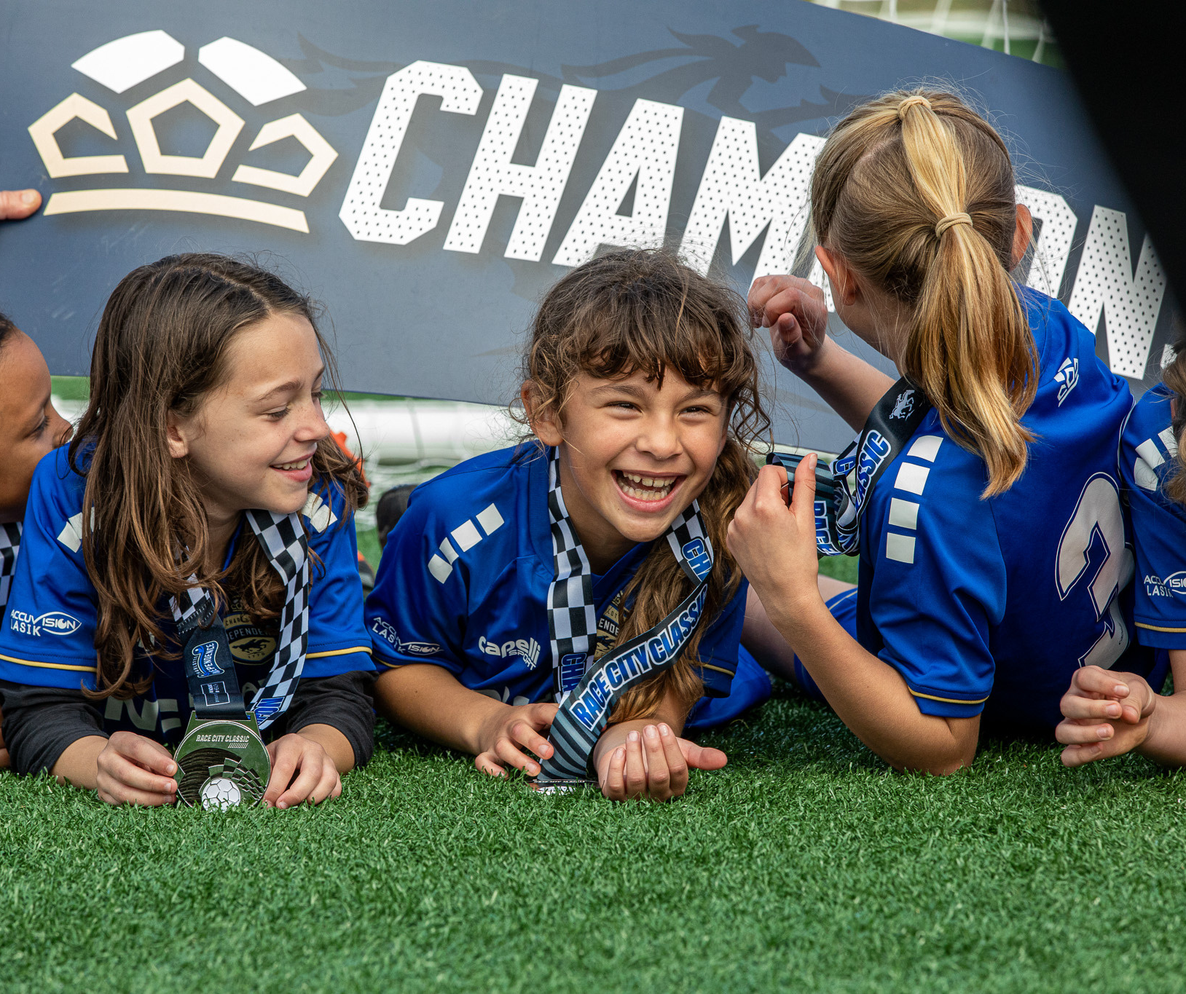
“THEY FORGET WHAT YOU SAY TO THEM.
THEY FORGET WHAT YOU DO WITH THEM.
BUT THEY NEVER FORGET HOW YOU MADE THEM FEEL.”
THE
INDEPENDENCE
WAY

Slide 7

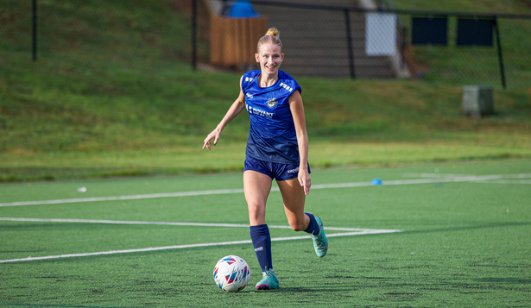

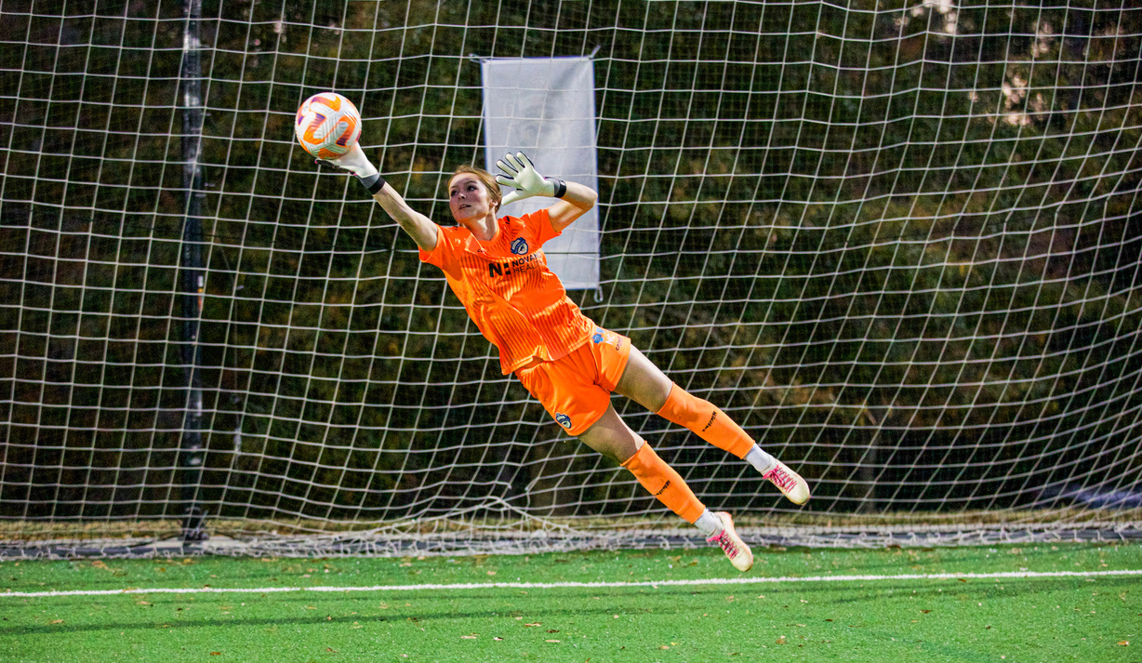
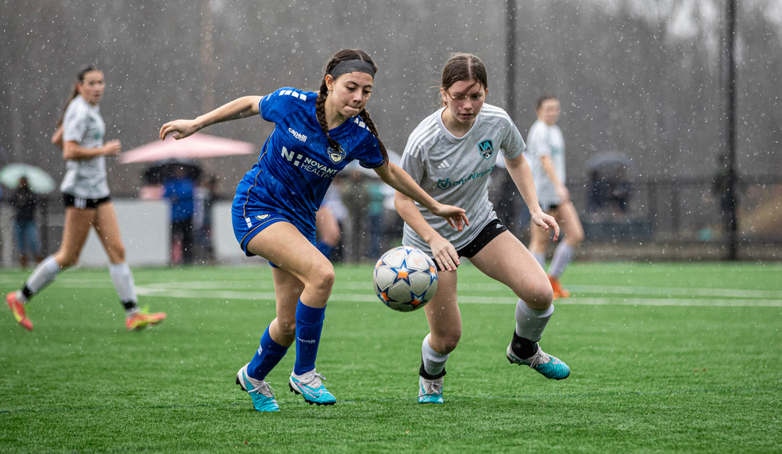
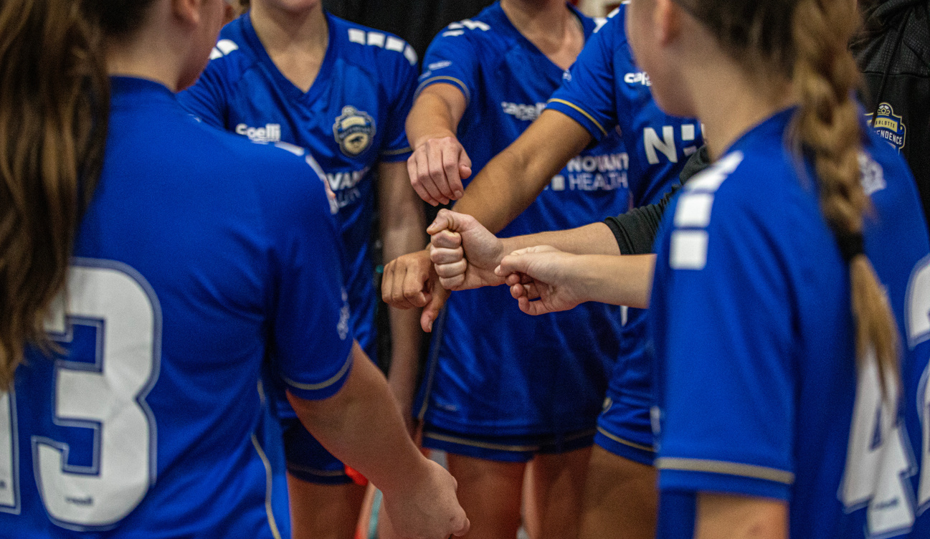
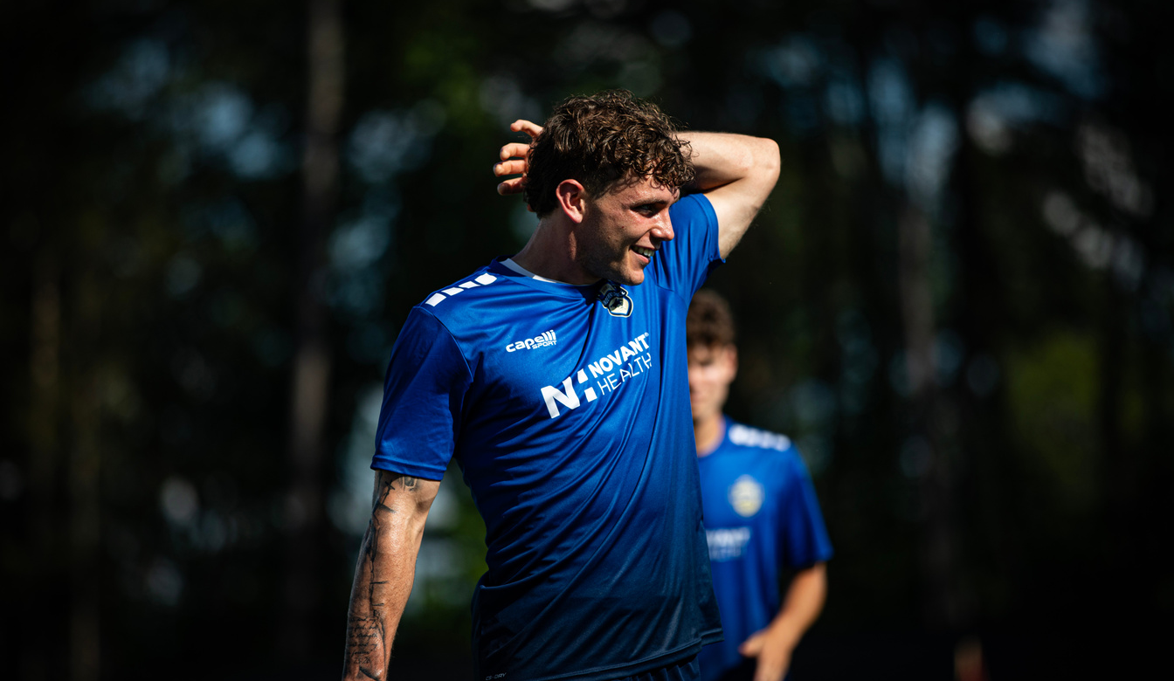
TIW OUR VALUES
CHARACTER
POSITIVE, HONEST, LEADERSHIP, INTEGRITY, CONFIDENCE, GROWTH MINDSET, TEAMWORK
COMMITMENT
PASSION, DRIVE, OWNERSHIP, ACCOUNTABILITY, SACRIFICE
COMPETITION
MENTALITY, WINNING CULTURE, TRAIN TO COMPETE, LIFE LESSONS
COMMUNITY
TOGETHER, COLLECTIVE, WE MENTALITY
COMMUNICATION
TRANSPARENT, HONEST, APPROPRIATE, EVALUATE, RESPECTFUL

Slide 8
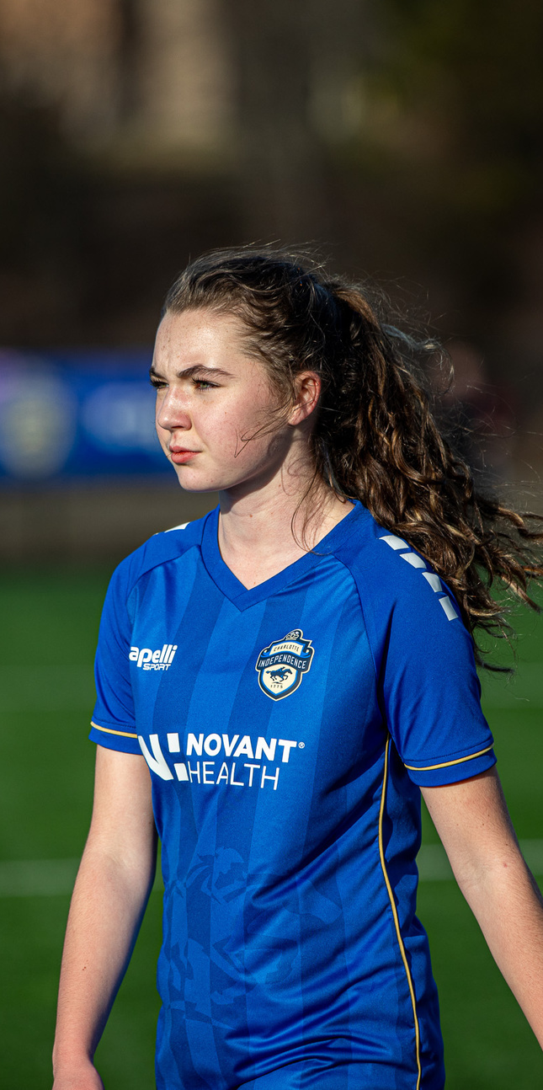
TIW OUR PURPOSE
Our purpose is to teach and develop players in an environment that promotes both individual and team growth. Our players are continually challenged and experience success, resulting in increased self-confidence, self-esteem, soccer ability, and personal potential.
Our environment places players in a competitive setting that ensures success today, tomorrow, and in the future, both on and off the field.

Slide 9
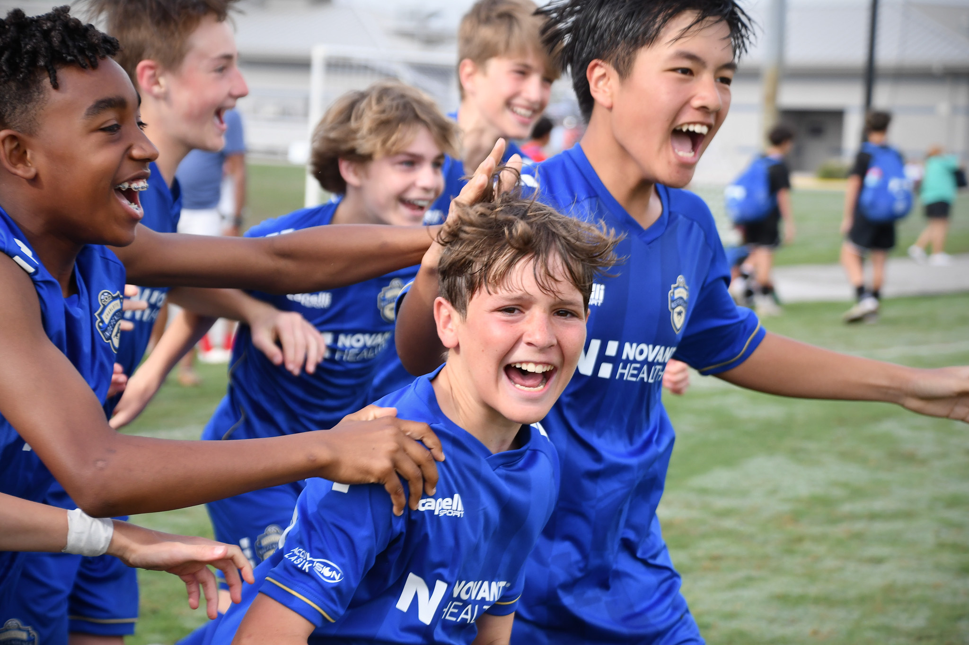
TIW OUR IDENTITY
Our players and teams should reflect a PASSION, hunger, and desire to succeed on the field. Our players are expected to support and play for the team with mutual respect and competitiveness.
When we do not have the ball, we should be HARDWORKING to win it back. When we have the ball, we should be positive, FORWARD-THINKING, and CREATIVE. We should play effective soccer, increasing our chances of scoring with each possession.
Our players will be encouraged to display their individual soccer personalities and express themselves as we learn to play for fun, for the LOVE OF THE GAME, and with the competitive spirit that comes from rigorous competition on the soccer field.

Slide 10
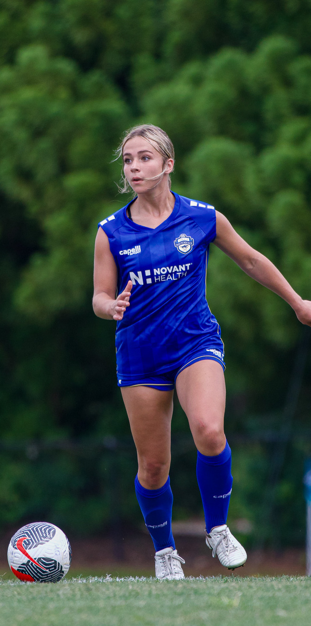
TIW STYLE OF PLAY
In possession we want to be forward thinking, passing forward, and moving forward effectively, breaking opponents lines, and forcing them to defend as we encourage intensity and creativity in our attacking play.
When we lose the ball we want to prevent counter attacks by applying immediate pressure and disrupting any rhythm in our opponents play.
When defending we want to apply planned pressure as far away from our goal as possible, keeping our lines close together, both vertically and horizontally, forcing predictability from our opponents, where wecan set traps and recover possession.
When we win the ball, if no forward pass is available, we look to secure possession to regain control of tempo and to rebuild our attack.

Slide 11
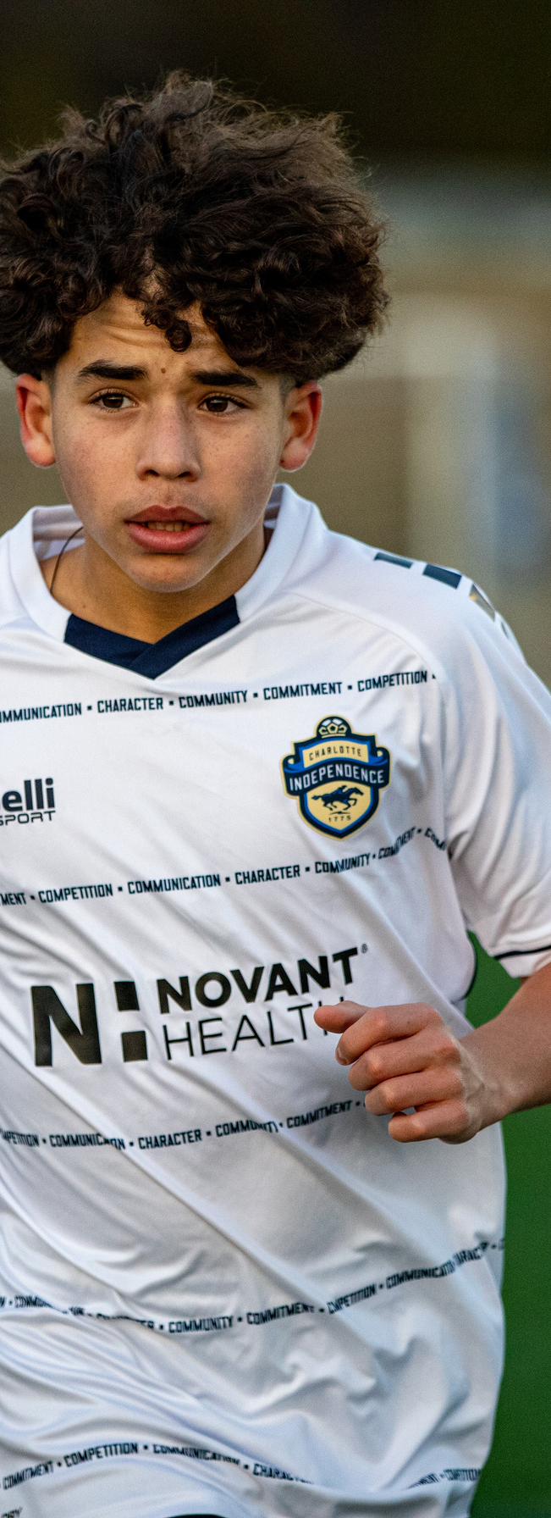
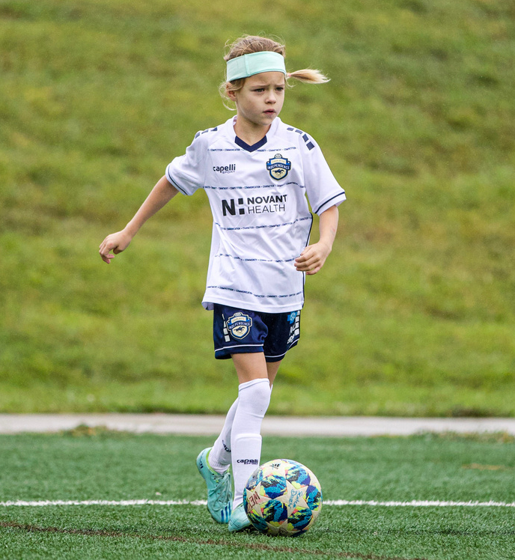
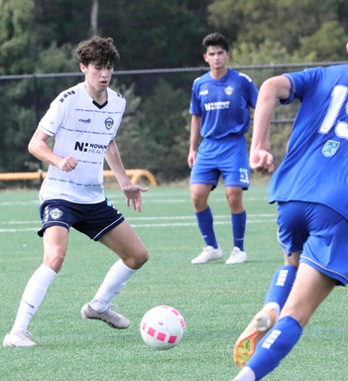
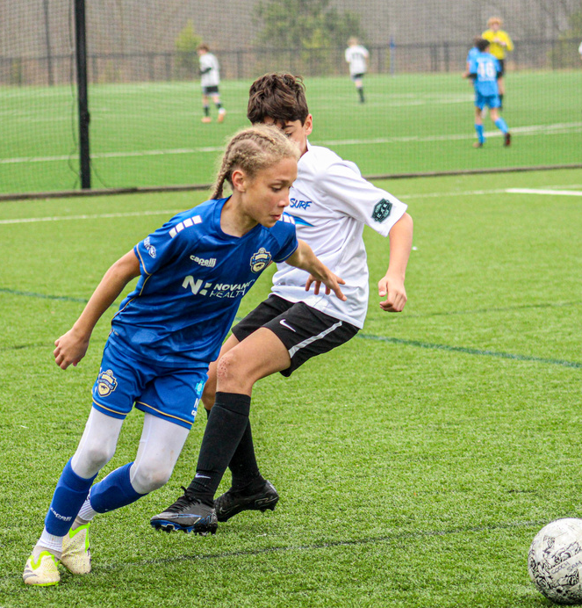
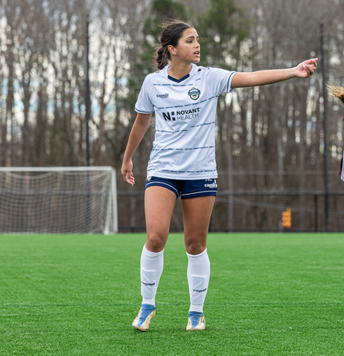
FOUR OPPORTUNITIES
TRANSITION
ATTACKING TO DEFENDING
ATTACKING
Forward thinking, can we go forward with the ball?
Movement on and off the ball
Intensity, Desire
Creativeness
Effective Soccer
Immediate pressure on the ball
Recover - Positional play behind the ball
Slow down opponent and reorganize the lines - Balance and Compact
TRANSITION
DEFENDING TO
ATTACKING
TIW
DEFENDING
Keep the ball, connect 1st pass and secure the ball
Immediate creation and use of space
Counter attacking/vertical play
Compact Shape
Organized lines behind the ball
Set up trap areas to recover the ball. Can we create numbers up?
Talk, communicate

Slide 12
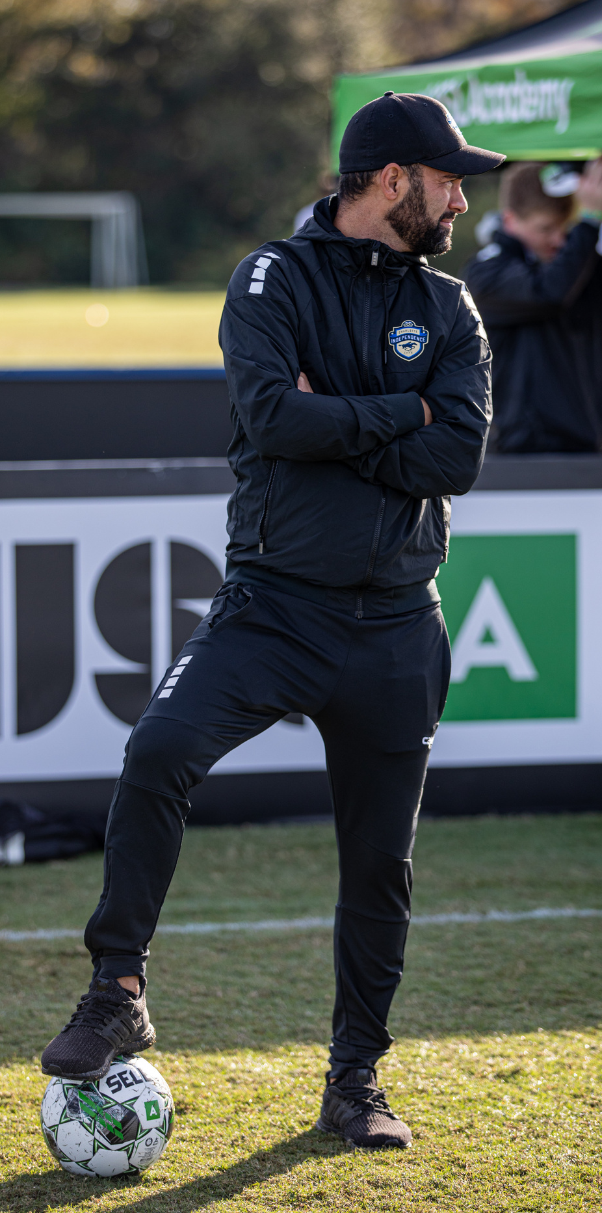
GAME PHASES + PRINCIPLES
IN POSESSION | DEFENSIVE TRANSITION | OUT OF POSSESSION | ATTACKING TRANSITION
PASS FORWARD - RUN FORWARD | COUNTER PRESS | ORGANIZED PRESSURE | SECURE THE BALL
BUILD UP PROGRESS TO PENETRATE CREATE AND SCORE GOALS | IMMEDIATE PRESSURE, PREVENT COUNTER RECOVER BEHIND THE BALL - REORGANIZE THE LINES | DISRUPT BUILD UP REGAIN THE BALL PROTECT THE GOAL | 1ST OPTION - VERTICAL PLAY, LOOK TO COUNTER 2ND OPTION - SECURE THE BALL

Slide 13


METHODOLOGY
HOW WE COACH
HOW WE PRACTICE
COACHING
DNA
SESSION
DNA
Our soccer methodology is a system of methods used to implement, enact and realize our philosophy.
HOW WE TEACH
GAME
DNA
EXERCISE
DNA
THE
INDEPENDENCE
WAY
HOW WE PLAY
HOW WE TRAIN

Slide 14
HOLISTIC PLAYER
DEVELOPMENT
PLAYER DEVELOPMENT IS...
how we train, using our deliberate curriculum to guide our coaching staff in designing sessions that train, develop, and grow each player. We train to get better. We want our players to continuously improve and reach new levels of ability. This approach is fun and motivating for each of our soccer players.
At Independence, the appropriate training session is created and designed according to our rigorous standards. We expect our staff to apply their knowledge in a way that fosters player development and improvement.
During this process, one thing is certain: players will achieve success and face setbacks. This is the essence of player development, and these are valuable life lessons. We work through both setbacks and successes with each of our players on their path to individual improvement and achievement.

Slide 15
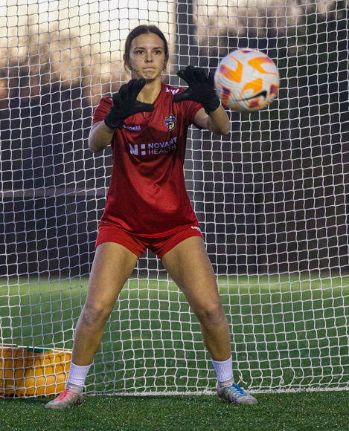

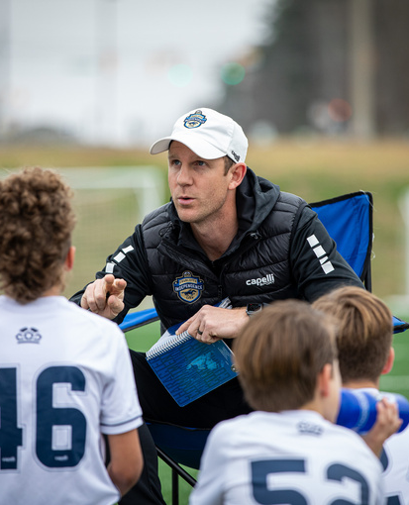

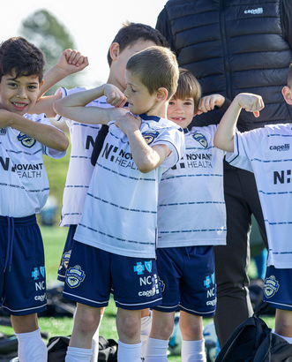
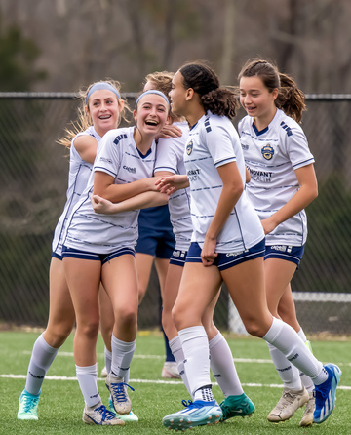
TECHNIQUE
TACTICS
DEVELOP
TOGETHER
PHYSICAL
PSYCHOSOCIAL

Slide 16
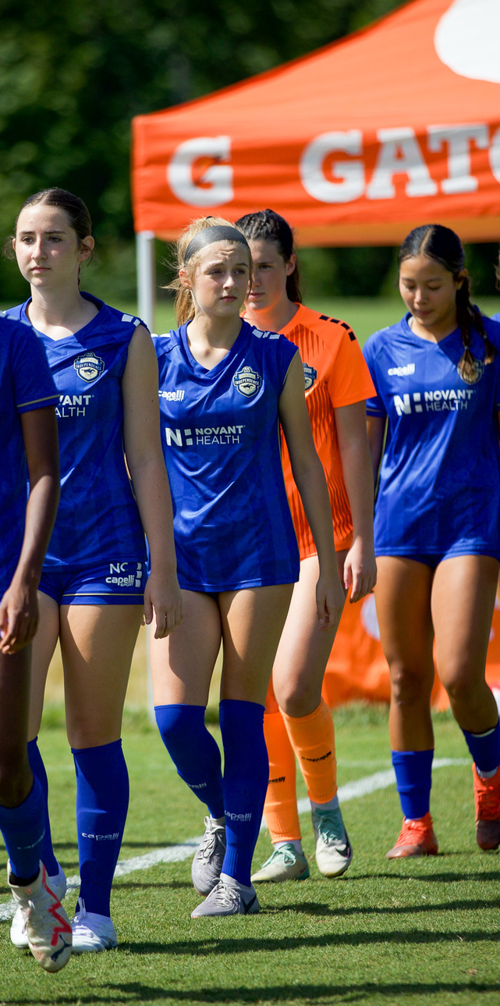
TIW DEVELOPMENT
TECHNIQUE
The mechanics necessary to execute an action or skill.
TACTICS
Performance of decision-making in the game. When, Why, Where elements of the execution of technique.
PHYSICAL
Soccer specific development of speed, agility, balance, strength, endurance, diet and nutrition. All the elements of physiological performance related to soccer.
PSYCHOSOCIAL
Psycho-Social - A player’s approach to the game from a psychological and social perspective. Ability to relate to peers, accept responsibility, handle setbacks, build and maintain confidence, respect themselves and others, and to always know the difference between right and wrong. Attitude is everything.

Slide 17
TRAINING
PHILOSOPHY
INDIVIDUAL VS TEAM
TEAM TRAINING is a player's opportunity to grow in a competitive and dynamic group environment, cultivated by the coach and teammates. It provides the technical, tactical, physical, and psychosocial components essential to a player's experience.
INDIVIDUAL TRAINING is a player’s chance to develop and sharpen techniques and skills. It is necessary for the development of a player, as it allows for the isolation of specific elements of the game in a deliberate and targeted setting. This is a part of an Individual Development Plan for each player.
The amount of individual training a player is willing to undertake can be the differentiating factor in performance, helping to realize the player's potential and achieve their personal goals.
TIW

Slide 18
PERFORMANCE
ANALYSIS +
PLAYER FEEDBACK
We implement a technology-driven approach using sports science to record, analyze, and store performance-related data relevant to the ongoing development of each individual player.
This is a critical part of what we call the INDIVIDUAL DEVELOPMENT PLAN (IDP)

Slide 19
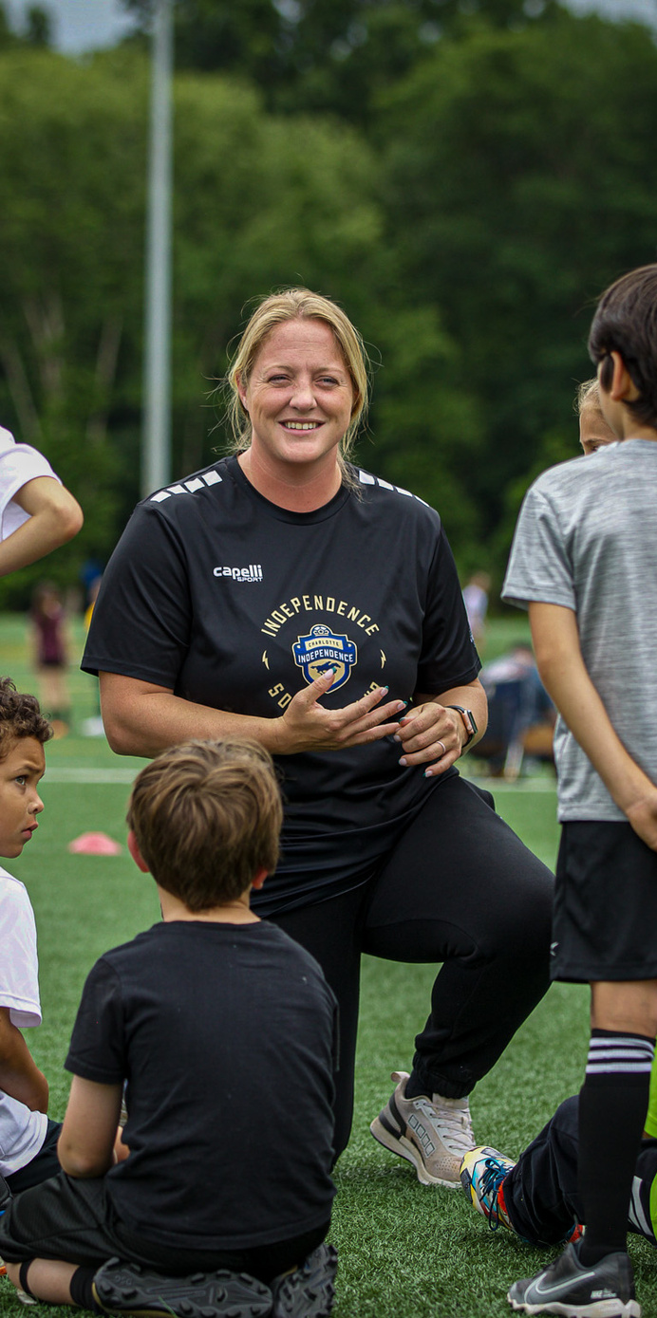
MENTORSHIP PROGRAMS
Mentorship is key to development. At Independence, we believe that mentorship between players and coaches is a crucial factor in our culture, environment, and overall development.
We will utilize the resources within our club to foster a positive mentorship program that impacts and influences the next generation.
TIW

Slide 20


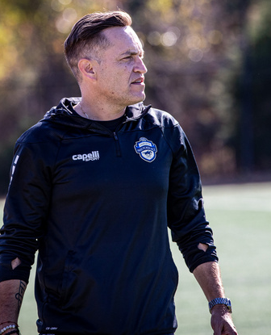

PLAYER
COACH
EDUCATION
TOGETHER
PARENT

Slide 21
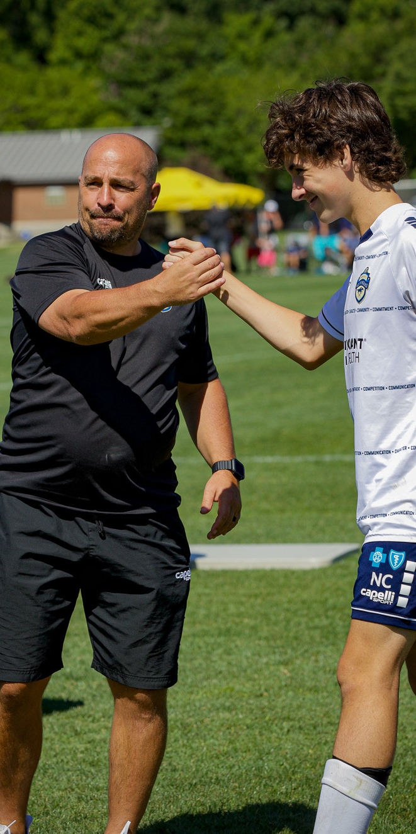
COACHING METHODOLOGY
Our teaching pedagogy is designed to maximize our players' potential and achieve individual and team success without sacrificing individual player development.
Our instruction is question-based so the player owns the outcome, not the coach. Our coaching staff are teachers and EDUCATORS of the game.
We have a growth mindset. We solve problems the same way we ask our players to. We encourage decision-making in training as early as possible. To create problem-solving players, our aim as EDUCATORS is to stimulate, not simply instruct.
Our coaching staff instruct and EDUCATE on best practices while also encouraging our players to use their personal experiences to influence player and team development.

Slide 22
PLAYER EDUCATION
The education of the player is an important part of player development, and it is ultimately the player's responsibility. Each player chooses their attitude and effort in everything they do. It is their attitude, not that of their parents or the coaching staff, that will enhance their development. Players should love the game; the enjoyment derived from it means that soccer shouldn’t just take place during training sessions. Players will be guided on how their development can take place at home through self-training and playing, utilizing Individual Development Plans (IDPs), evaluations, video analysis, being a soccer fan, and taking ownership of their development.

Slide 23

PROVEN CURRICULUM
Our club curriculum is a compilation of HIGHLY ACCOMPLISHED & PROVEN program curricula that encompass our player pathways.
Our curriculum defines key principles specifically designed for each program's age and ability level within the club.
These are organized in a specific way through a competitive calendar that captures our seasonal periodization plans.

Slide 24
PARENT EDUCATION
The education and inclusiveness of parents at CISC are equally important for player development to be successful.
We want all members to understand what The Independence Way is.
It is our goal to be transparent with parents about the development process and pathways. Our coaching staff will communicate with parents throughout the year.
The content will vary based on the player's age and expected responsibilities. Our coaching staff will not report to parents but will instead keep them informed of progress and milestones along the way.

Slide 25
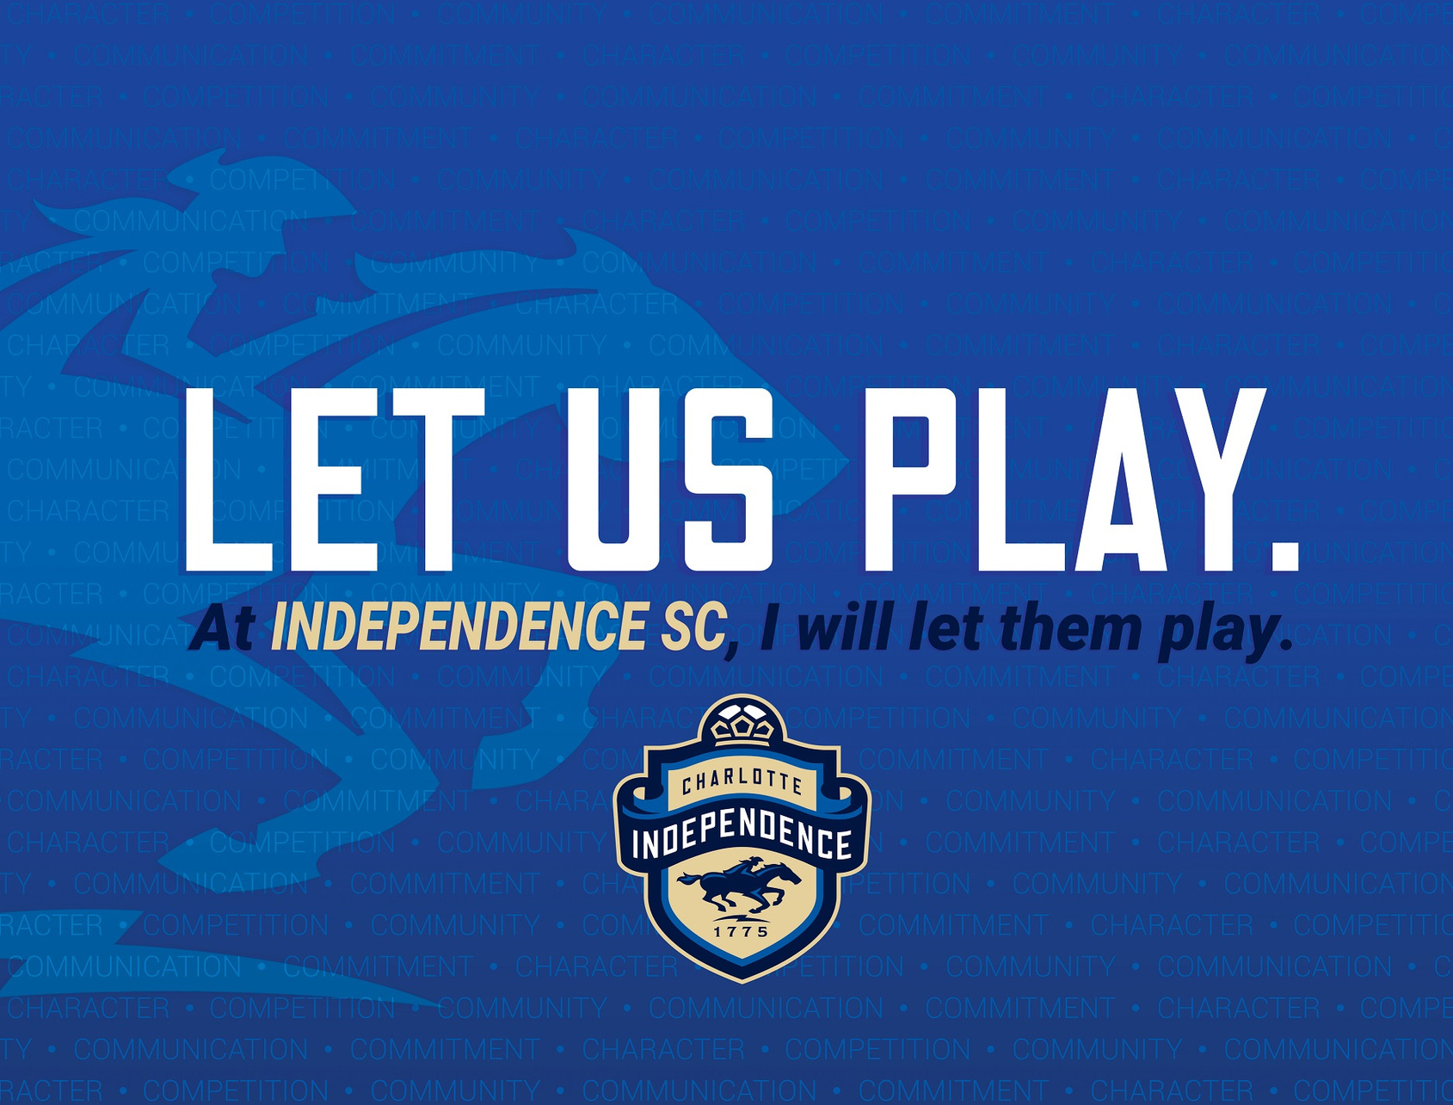


Slide 26
COACHES
CONTINUING EDUCATION
The program is based on a culture that fosters a deep desire to improve, learn, share, and develop as a soccer EDUCATOR. This is cultivated through daily interactions, structured meetings and sessions, video analysis, technology, and one-on-one interactions.
Our coach mentorship program thrives on one-on-one interactions.
The culture promotes a growth mindset and emphasizes 'information sharing' to deliver best practices to our players. We are constantly asking the 'why' behind what we do.

Slide 27

PLAYER PATHWAYS
TIW

Slide 28

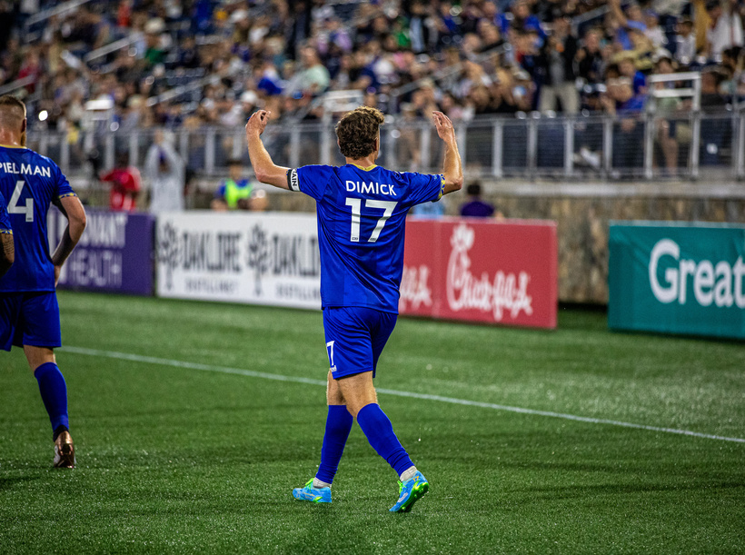
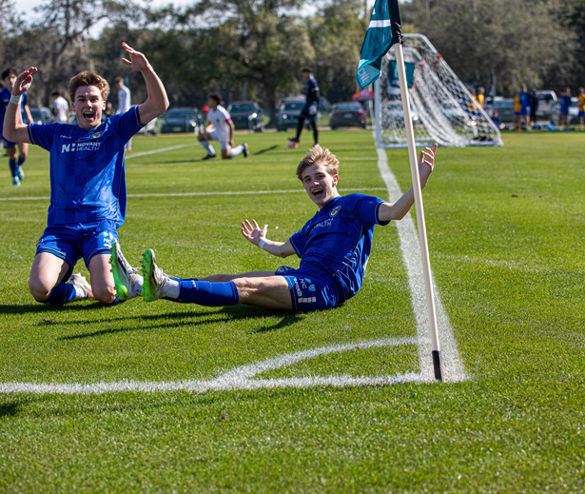
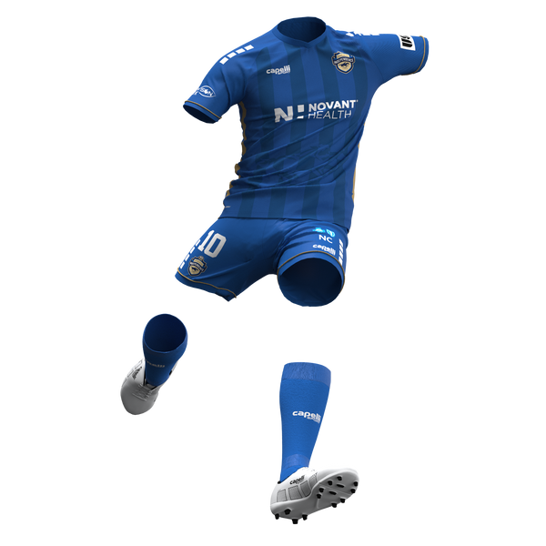



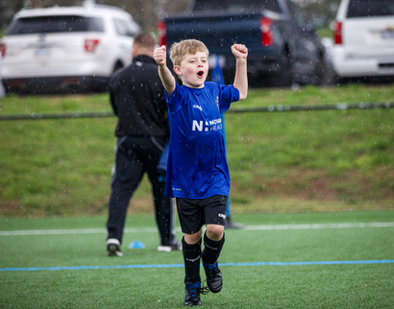
PLAYER GROWTH
PROFESSIONAL
PERFORM TO SUCCEED, EXCEL IN TACTICAL AWARENESS,
PHYSICAL AND MENTAL PREPARATION
ACADEMY
FINE TUNE ALL TECHNIQUES, DEVELOP TEAM TACTICS AND INTELLIGENCE, PHYSICAL PREPARATION AND NUTRITION
COMPETITIVE
SKILL ACQUISITIONS, PLAYER DEVELOPMENT, TACTICAL UNDERSTANDING, POSITIVE SOCIAL INTERACTION, PHYSICAL PERFORMANCE DEVELOPMENT
RECREATION
INTRO TO SOCCER, FUN, SOCIAL, HEALTH AND WELLNESS

Slide 29
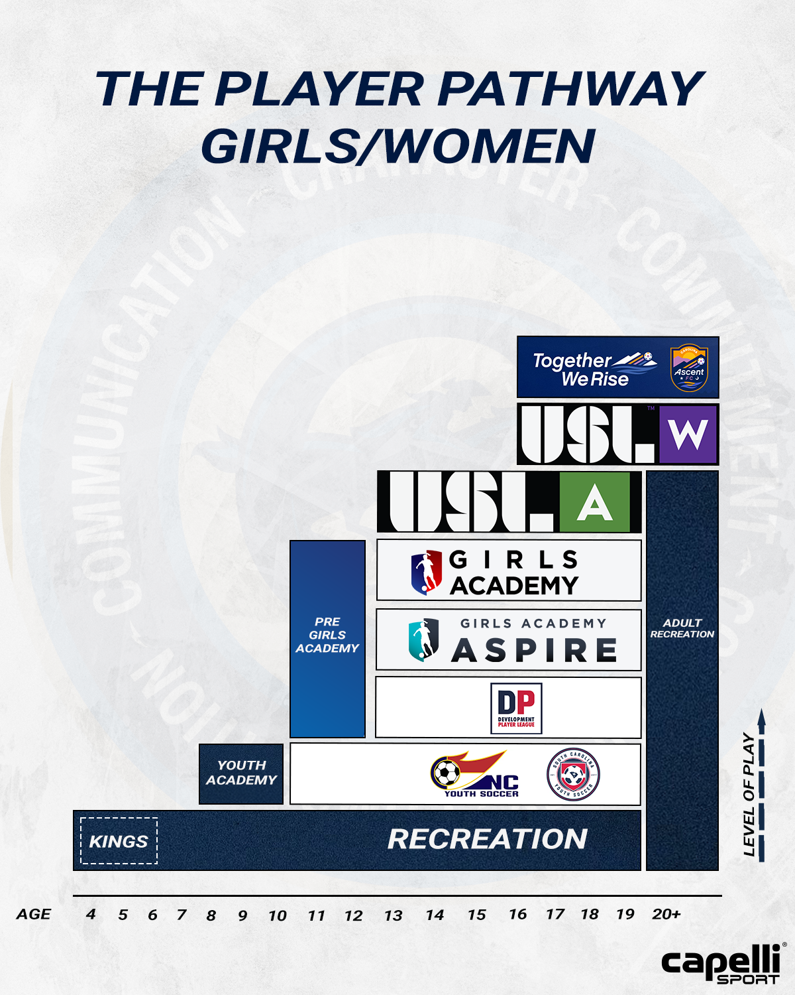
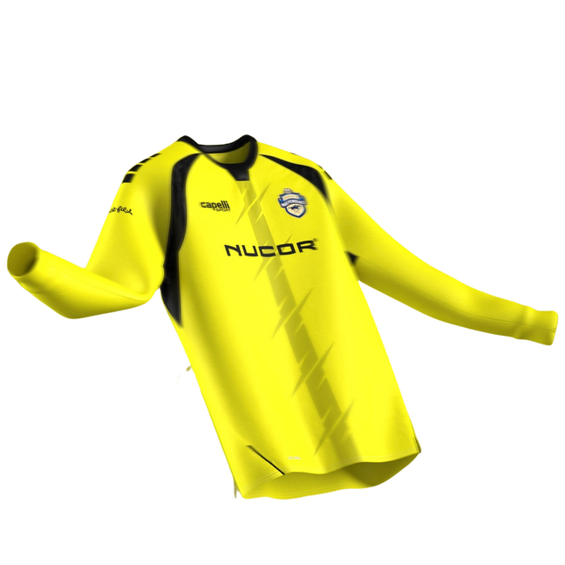
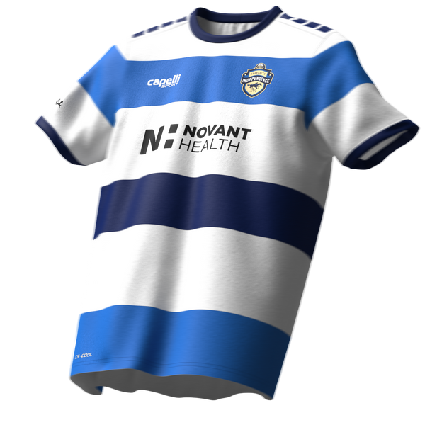
GIRLS/WOMEN
pathway

Slide 30
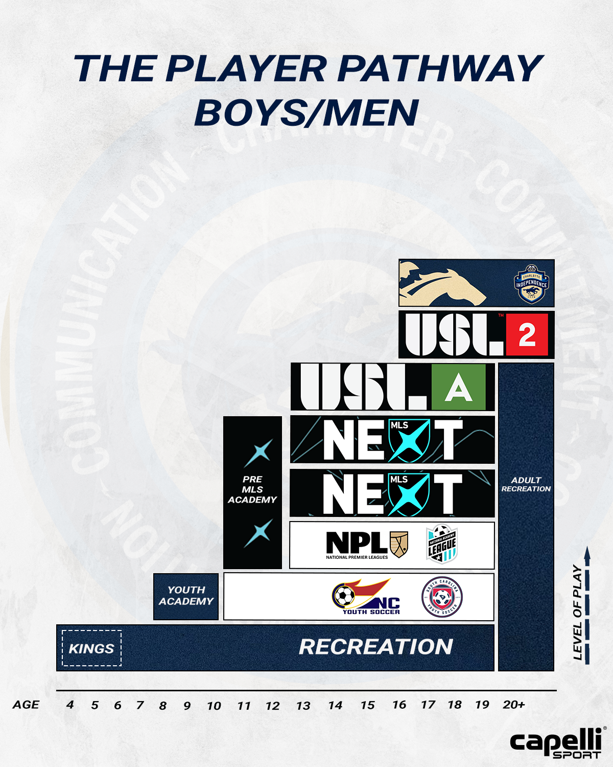
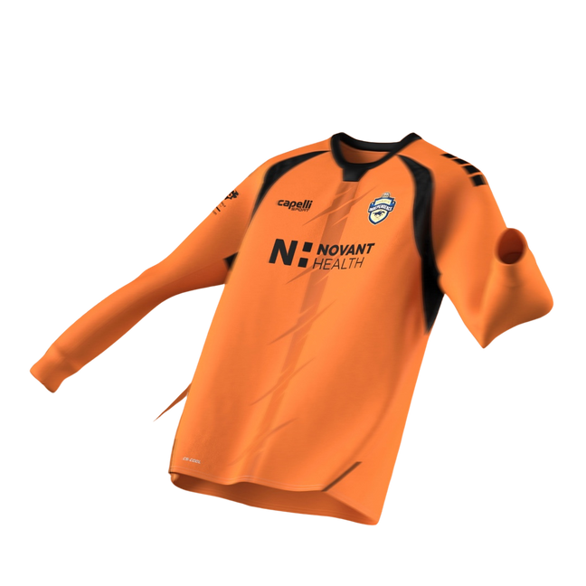
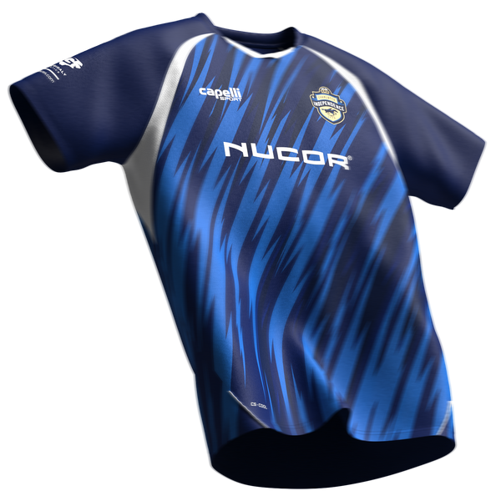
BOYS/MEN
pathway

Slide 31


THE INDEPENDENCE WAY
A POSITIVE CULTURE
FOUNDATIONAL VALUES
ORGANIZATIONAL PURPOSE
AN IDENTITY, STYLE + CHARACTERISTICS
HOLISTIC PLAYER DEVELOPMENT
TRAINING PHILOSOPHY
PERFORMANCE ANALYSIS + FEEDBACK
MENTORING
COACHING METHODOLOGY
EDUCATION FOR ALL
PROVEN CURRICULUM
PLAYER IMPROVEMENTS + COMPETITIVE
PLAYER PATHWAYS
TIW

Slide 32
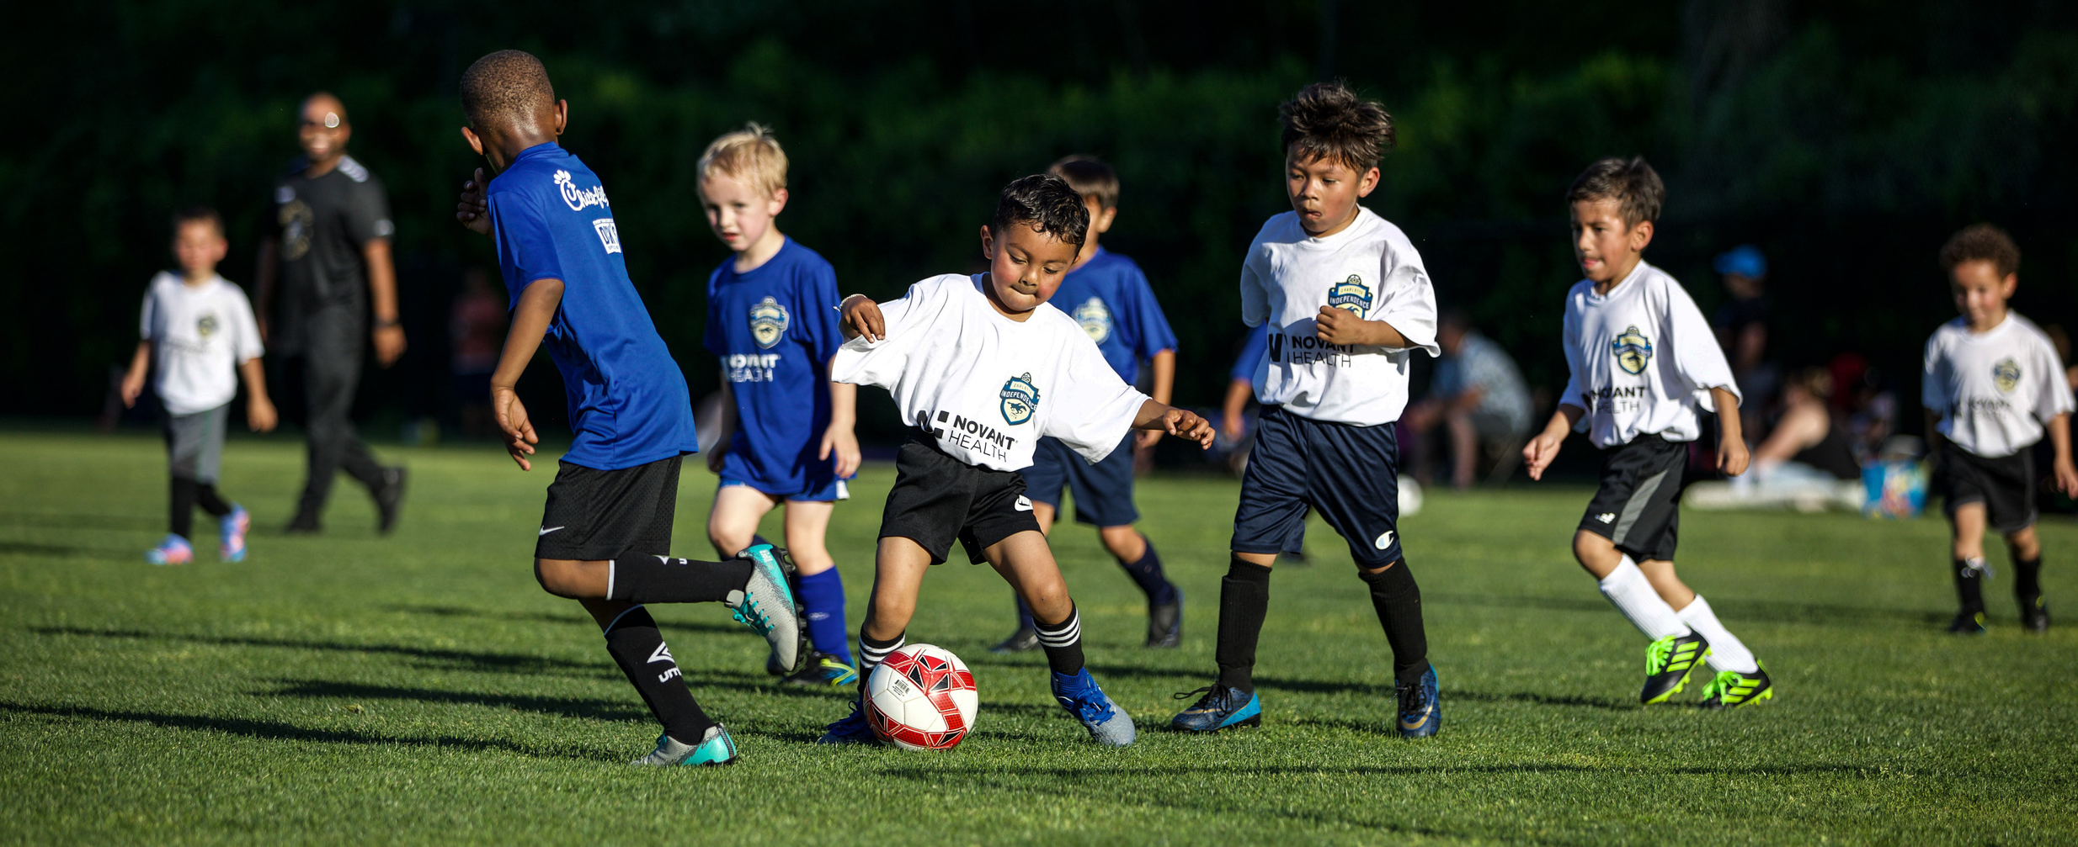
THE
INDEPENDENCE
WAY
THANK YOU
www.independencesoccer.club

