Slide 1

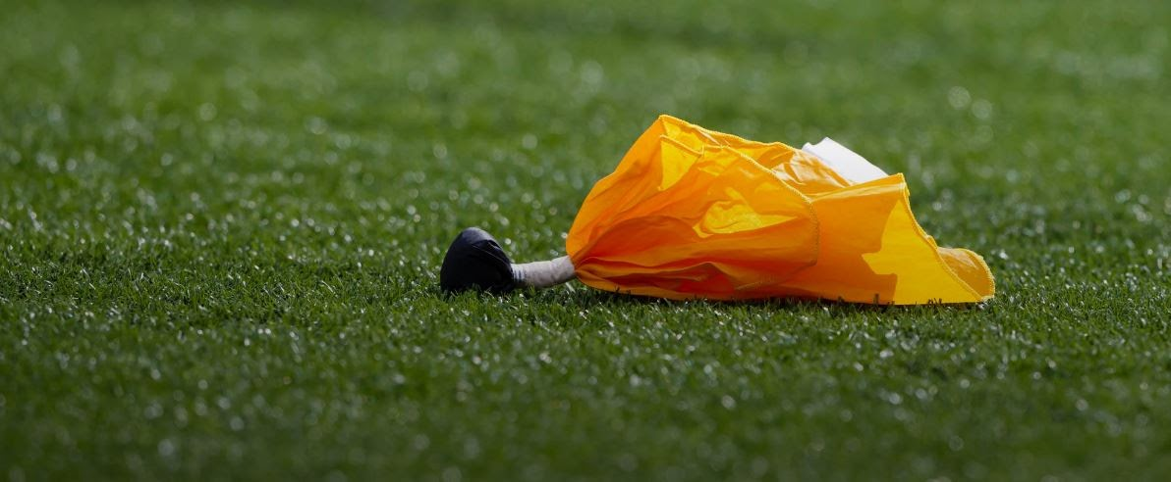
General Meeting
July 7, 2025

Slide 2
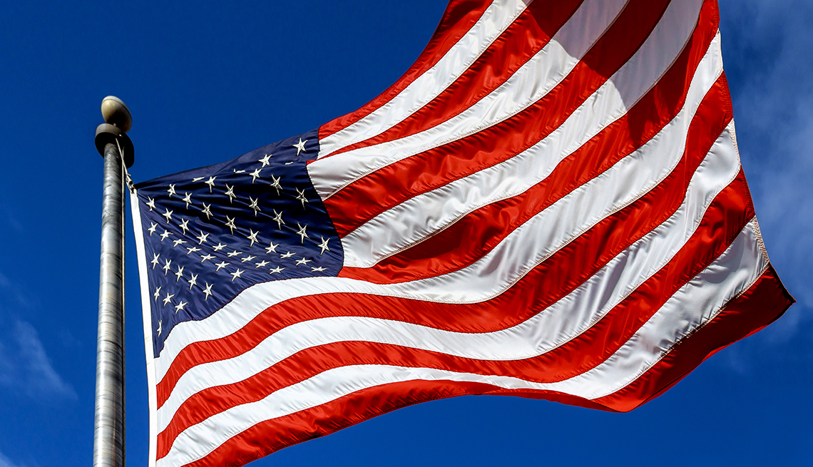


Slide 3

Agenda
PRESIDENT’S REPORT - GELLER
SECRETARY’S REPORT - LENEHAN
FINANCES – TRACH
ASSIGNOR – McLANE
SCHOOL DISTRICT UPDATE - GREENE
TRAINING - DEI
NEXT MEETING
Notes:
NOTE: NCHSAA Guidelines – Running clock when 42 point differential is reached in 2nd half

Slide 4
secretary Report
Secretary's Report
meeting Attendance
Must attend Five (5) meetings to be on crew
5 meetings is required for 2026 varsity CREWs
You are responsible for signing yourself in

Slide 5
Financial Report
Treasurer Report
June 16th
Financial Statement
Truist Balance as of July $14,832.42
Balance of All Accounts $14,832.42
2025 Dues
Tackle Only - $40.00
Tackle & Flag - $50.00
Flag Only - $20.00
* Tackle and flag discount If Paid when registering for Tackle

Slide 6
ASSIGNOR
arbiter
All games for ECFOA will be assigned
Through arbiter by bob mclane
If you know of dates not available, please block yourself out
Install Arbiter App on your smartphone
NOTE: ECFOA DOES NOT assign youth league football

Slide 7
School District update
school district update
If new OR Transfer official, see Yetta to complete the following
  W-9 Form
  INFORMATION SHEET
Jessica Lunsford – Badging
  Process is changing
  If badge is expiring, prior to or during 2025 season, wait until Yetta provides updated process to renew badge

Slide 8
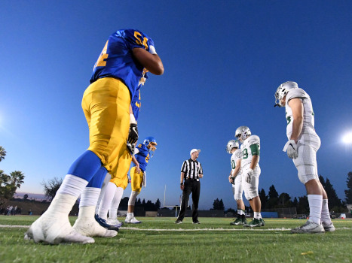
Training
NON – FHSAA SCHOOLS - REVISED
RULE 3
Notes:
Each half starts with a kickoff. Be sure captains understand their options.

Slide 9
non – fhsaa schools - Revised
AMERICAN HERITAGE - DELRAY
BOCA CHRISTIAN
CLEWISTON
GLADES DAY
JUPITER CHRISTIAN
OXBRIDGE

Slide 10
Rule 3
Periods, Time Factors and Substitutions

Slide 11
Length of Periods
PERIOD OF TIMING | CLOCK TIME
1st Half: 1st Period Intermission Between Periods 2nd Period | 12 minutes 1 minute 12 minutes
Halftime: When teams leave the field. 17 minutes is normal. May be increased to a maximum of 20 minutes provided opponents are notified prior to game. Minimum halftime is 10 minutes, plus mandatory 3-minute warm up period, not 7 minutes and 3-minute mandatory warm up period | 10 to 20 minutes
Modified Halftime: Games interrupted due to weather during the last 3 minutes of the 2nd period. Coaches can mutually agree to shorten halftime to 1 minute. | 1 minute
Mandatory Warm-up: Game officials responsible for ensuring 3-minute warm-up period is posted on the game clock. Head coach is responsible for having their team on the field for warm-up period. Warm-up period also mandatory with a modified halftime. | 3 minutes
2nd Half: 3rd Period Intermission Between Periods 4th Period | 12 minutes 1 minute 12 minutes
Charged Team Timeouts | 1 minute
Notes:
NOTE: NCHSAA Guidelines – Running clock when 42 point differential is reached in 2nd half

Slide 12
Length of PeriodS
Clock running time for a high school game is 48 minutes with periods and intermissions indicated in previous table.
Games ending tied, may be resolved by overtime method approved by the FHSAA
Freshmen & Lower level – 8 minutes
JV – 10 minutes
Notes:
NOTE: Some counties use 10 minute periods for JV

Slide 13
Length of Periods
Period(s) may be shortened in any emergency by agreement of opposing coaches and referee.
By agreement of opposing coaches and referee any remaining period may be shortened or game terminated.
Crew of officials are authorized to delay or suspend the game if weather conditions are construed to be hazardous to participants.

Slide 14
Starting A Period/Half
COIN TOSS
  Conducted 3 minutes prior to game time
  No more than 4 team members in game uniform (captains) may be present
  All other team members must remain outside the field of play
  Visiting captain given choice of “heads” or “tails”
Notes:
Each half starts with a kickoff. Be sure captains understand their options.

Slide 15
Starting A Period/Half
COIN TOSS
  Winner first choice of options for 1st half or defer
  Loser choice of options for half that winner did not select
  Options for each half:
    Choose whether team will kick or receive
    Choose goal team will defend
    Do not allow a captain to choose the option to kick

Slide 16
Starting A Period/Half
CLOCK MALFUNCTION
  IF THE GAME CLOCK IS NOT FUNCTIONING, WITH 4:00 REMAINING BEFORE THE END OF EACH HALF, THE REFEREE SHALL:
    NOTIFY THE FIELD CAPTAINS AND THEIR HEAD COACHES OF THE TIME REMAINING
    IF THE TIME IS NOT STOPPED, REFEREE SHALL ORDER THE GAME CLOCK TO BE STOPPED

Slide 17
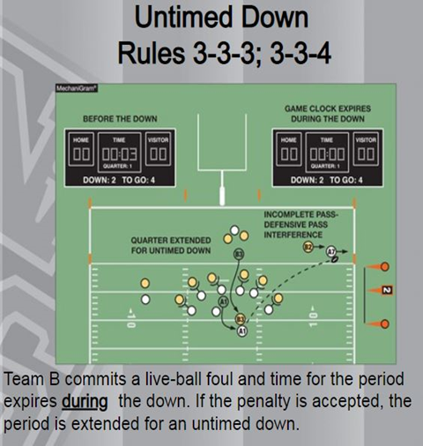
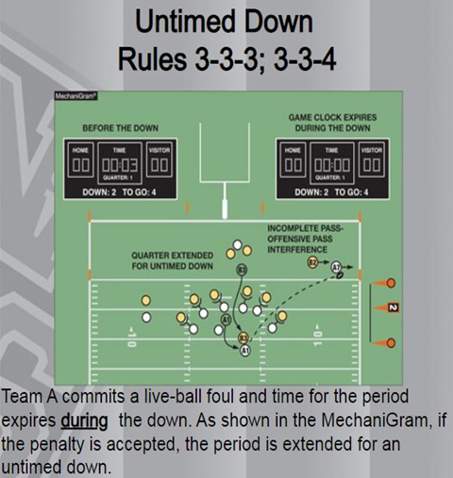
Ending A Period/Half
An untimed down extends a period if one of the following occurs during a down which time expires.
  Foul by either team and penalty is accepted (except fouls in 3-3-4b)

Slide 18
Ending A Period/Half
In addition, an untimed down extends a period if one of the following occurs during a down which time expires.
  Double foul
  Inadvertent whistle
  Touchdown scored, try is attempted
    Exception: TD is scored on last down of 4th period and points have no impact on the outcome of the game
  Note: If the above occurs during the untimed down, procedure is repeated

Slide 19
Ending A Period/Half
A period is not extended if one of the following occurs during a down which time expires
  Defense fouls during successful try/FG and offended team accepts results of the play with enforcement from the succeeding spot
  Foul by either team and penalty is accepted
    3-3-4b
Notes:
Next slide lists fouls

Slide 20
3-3-4b exception Fouls
Unsportsmanlike fouls
Non-player fouls
Loss of down fouls
Illegal Handing
Illegal Forward Pass
Intentional Grounding
Illegal Touching
Fouls enforced on subsequent kickoff
Rule 8-2-2, 8-2-3, 8-2-4 or 8-2-5
Enforcement by rule results in a safety
End zone is enforcement spot

Slide 21
Starting &
Stopping Game Clock
Game clock does not start on first touching by K
Referee has authority to correct obvious game clock timing errors if discovered prior to second live ball following the error
Referee also has authority to correct obvious play clock timing errors if discovered prior to the snap
Notes:
Exception: If period has officially ended, timing error cannot be corrected.

Slide 22
Starting &
Stopping Game Clock
When a foul is committed with less than 2 minutes remaining in either half, the offended team will have the option to start the clock on the snap
Rational: There are situations where a team may want to decline a penalty and still start the clock on the snap.
Prior to 2023 this option existed only if the penalty was accepted
Notes:
Exception: If period has officially ended, timing error cannot be corrected.

Slide 23
Charged and Official’s Timeouts
CHARGED TIMEOUTS
  Each team entitled to 3 charged timeouts each half
    player – head coach – designated representative
  Unused timeouts do not carry-over
    From 1st half to 2nd half
    2nd half to overtime
  Successive timeouts during the same dead ball period may be granted
Notes:
Request for timeout make be made by a player, head coach or designated representative.

Slide 24
Charged and Official’s Timeouts
Question
  The clock is running with 11 seconds to play in the 4th quarter. Team A is out of timeouts, but quarterback A1 runs up to the referee and requests a timeout.
    The request is granted, but Team A will be penalized 5 yards for delay of game
    The request is granted, but Team A will be penalized 15 yards for unsportsmanlike conduct
    The request is denied; there is no penalty
    The request is denied and Team A will be penalized 5 yards for delay of game
  Correct answer - C
Notes:
Request for timeout make be made by a player, head coach or designated representative.

Slide 25
Charged and Official’s Timeouts
OFFICIAL’S TIMEOUTS
  Apparently injured player
  Player shows signs or symptoms of concussion
  Player bleeding or blood on uniform
  Player who’s helmet comes completely off
  Player equipment missing/improperly worn
  Unusual heat or humidity (wet bulb readings)
  Refer to 3-5-7 for additional official’s timeouts

Slide 26
Play Clock, Ball Ready for Play and Delay
Event | Game Clock Starts | Referee’s Signal
Penalty Admin | Ready | Wind
Charged Timeout | Snap | Chop
Offensive Injury/Equipment | Ready | Wind
Measurement | Ready | Wind
Possession Change - B Snaps | Snap | Chop
Touchdown | N/A | Chop
Try/FG/Safety | Varies | Chop
Start a Period | Snap | Chop
Legal Kick | Snap | Chop
25 SECOND PLAY CLOCK
Notes:
3-5-7b – 1st down declared

Slide 27
Play Clock, Ball Ready for Play and Delay
Event | Game Clock Starts | Referee’s Signal
Penalty Admin - Defensive Foul | Running | Wind
Dead Ball Inbounds | Running | None
Dead Ball Out of Bounds | Snap | None
Incomplete Pass | Snap | None
Team A - Awarded 1st Down | Signal | Wind
Double Possession Change – A Snaps | Ready | Wind
Defensive Injury/Equipment | Ready | Wind
40 SECOND PLAY CLOCK
Notes:
3-5-7b – 1st down declared

Slide 28
Substitution
Between downs eligible substitutes may replace players.
Replaced players must begin to leave the field within 3 seconds.
  Must go directly to team box
Question - Breaking the huddle with more than 11 players. Legal or Illegal?
  Legal
During same dead ball interval, No substitute shall become a player and then withdraw.
During same dead ball interval, No player shall withdraw and then re-enter.

Slide 29
Substitution
Illegal Substitution:
  Replaced player/substitute attempts unsuccessfully to leave the field
  Does not participate or affect the play
  Can be Dead Ball or Live Ball penalty
Illegal Participation:
  Replaced player/substitute participates or affects the play
Notes:
Illegal Participation cover further in Rule 9

Slide 30
Next Meeting
JULY 14
  NEW & TRANSFER OFFICIALS
  6:30 P.M.
  JOHN I. LEONARD H.S.
JULY 28
  ALL MEMBERS
  6:30 P.M.
  JOHN I. LEONARD H.S.

Slide 31

THANK YOU - Questions?

