Slide 1

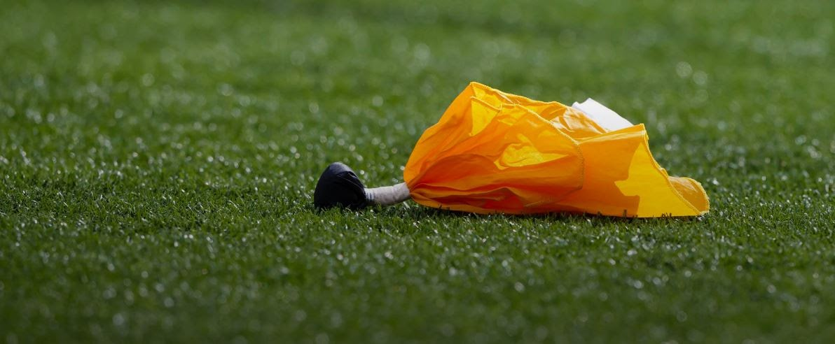
General Meeting
June 16, 2025

Slide 2
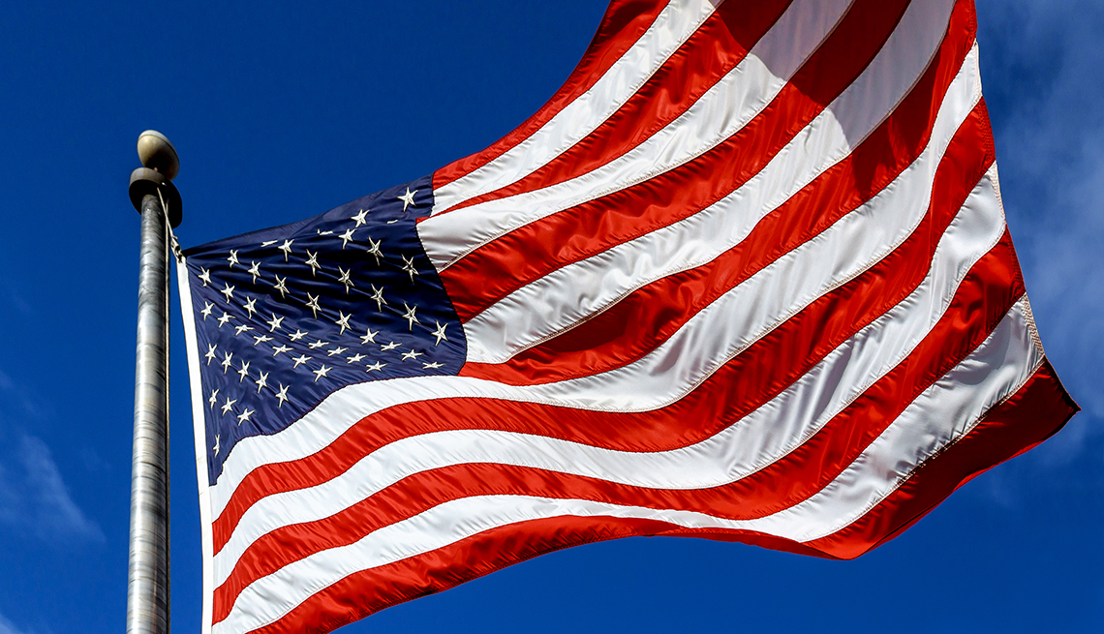
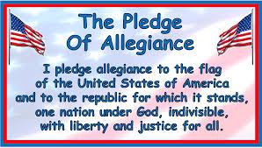

Slide 3

Agenda
2024 Season Recap – Geller
2025 Meeting Dates - Geller
2025 Crew Chiefs / Board Members – Geller
Finances – Trach
Secretary Report & Crew Eligibility - Lenehan
Arbiter – McLane
School District Update – Greene
Training – Dei
Notes:
NOTE: NCHSAA Guidelines – Running clock when 42 point differential is reached in 2nd half

Slide 4
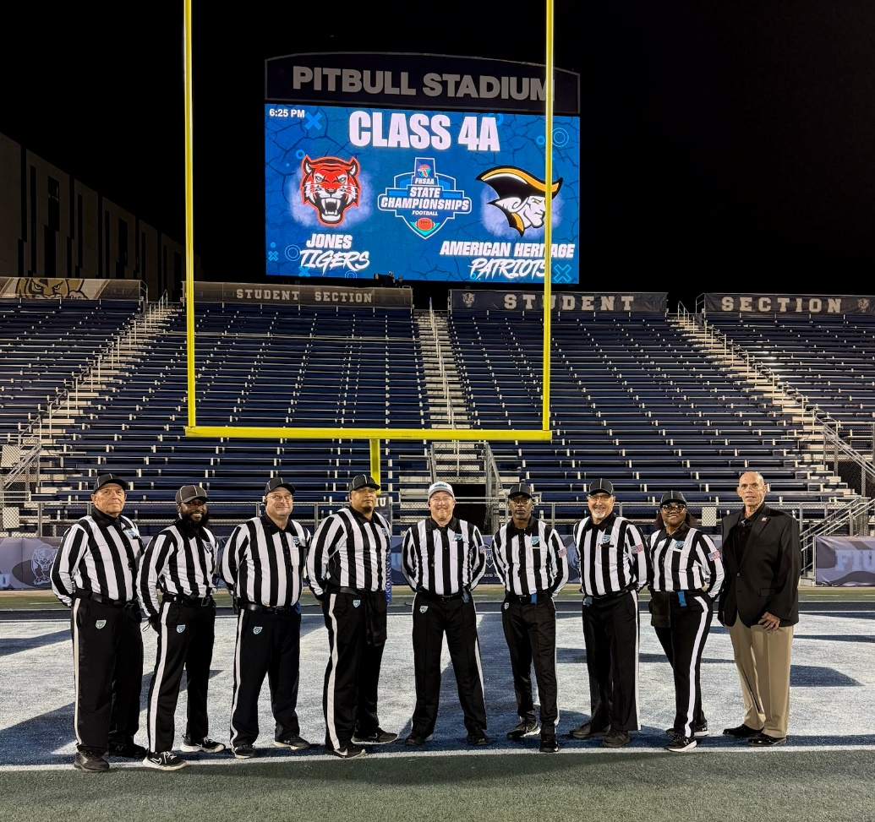
2024 SeaSON Recap
2024 #1 Playoff Crew – State Championship Game
Referee – Jeff Geller
Umpire – Steve Boyd
Head Linesman – Maria Jackson
Back Judge – Mayard Williams
Side Judge – Andrew “Rico” Joseph
Field Judge – Lance Bradford
Alternate – John Trach
ECO – Evan Ortiz
Notes:
NOTE: Some counties use 10 minute periods for JV

Slide 5
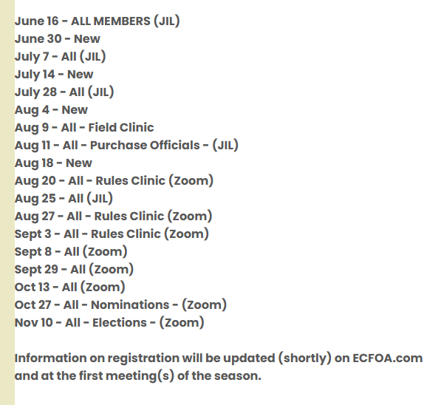
2025 Meeting Dates

Slide 6
2025 Board members
Jeff Geller – President
Vince Holmes – Vice President
John Trach – Treasurer
Sean Lenehan - Secretary
Steve Boyd – Member at Large
Sean Dei – Member at Large
Garrett Bell – Member at Large
Ronnie Wood – Training Coordinator
Travelle Northern – Past President
Bob McLane – Assignor*
* Assignor is a non-voting member of board

Slide 7
Financial Report
Treasurer Report
June 16th
Financial Statement
Truist Balance as of June 3rd $990.42
Balance of All Accounts $990.42
2025 Dues
Tackle Only - $40.00
Tackle & Flag - $50.00
Flag Only - $20.00
* Tackle and flag discount If Paid when registering for Tackle

Slide 8
secretary Report
Secretary's Report
meeting Attendance
Must attend Five (5) meetings to be on crew
5 meetings is required for 2026 varsity CREWs
You are responsible for signing yourself in

Slide 9
Arbiter
arbiter
All games for ECFOA will be assigned
Through arbiter by bob mclane
If you know of dates not available, please block yourself out
Install Arbiter App on your smartphone
NOTE: ECFOA DOES NOT assign youth league football

Slide 10
School District update
school district update
If new OR Transfer official, see Yetta to complete the following
  W-9 Form
  INFORMATION SHEET
Jessica Lunsford – Badging
  Process is changing
  If badge is expiring, prior to or during 2025 season, wait until Yetta provides updated process to renew badge

Slide 11
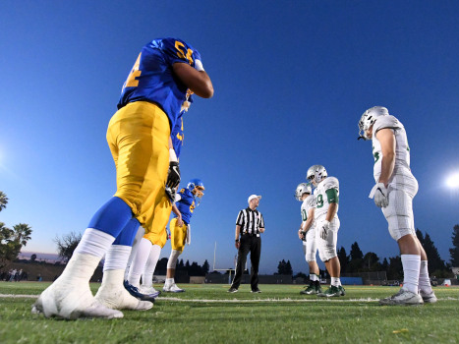
Training
CONFLICTS
APPEARANCE
FHSAA VS. NON – FHSAA SCHOOLS ATTIRE
2025 RULE CHANGES
Notes:
Each half starts with a kickoff. Be sure captains understand their options.

Slide 12
conflicts
YOU WORK AT A PARTICULAR SCHOOL
YOUR SPOUSE WORKS AT A PARTICULAR
YOUR CHILD / STEPCHILD ATTENDS A PARTICULAR SCHOOL
CONFLICT REMOVES WHEN:
  YOU OR SPOUSE LEAVES THE SCHOOL
  CHILD HAS BEEN OUT OF SCHOOL FOR 4 YEARS
    I.E. GRADUATED IN SPRING 2025, CAN’T WORK SCHOOL UNTIL FALL 2029
Notes:
Each half starts with a kickoff. Be sure captains understand their options.

Slide 13

Appearance
Sub-Varsity Game Appearance
Well Groomed
FHSAA Shirt & Stripped Shorts
Be on time & Crew Chief Communication
Black Socks
black shoes
Black & White Strip official's hat
Keep your cell phone in your car or bag!
Black Sunglasses are permitted
*This applies to any game assigned by ECFOA
Notes:
Each half starts with a kickoff. Be sure captains understand their options.

Slide 14
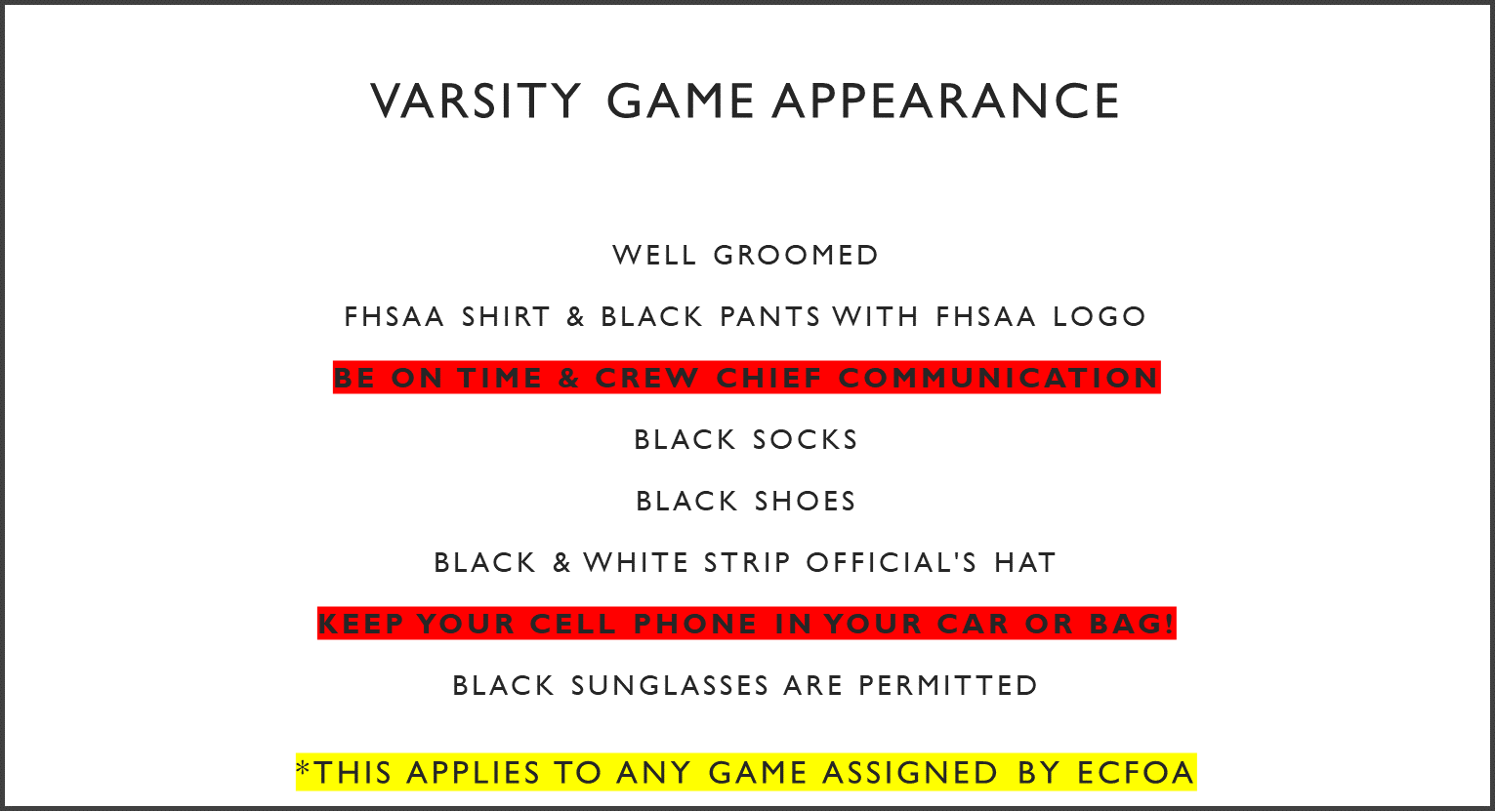
Appearance
Notes:
Each half starts with a kickoff. Be sure captains understand their options.

Slide 15
FHSAA vs. Non-FHSAA Schools
FHSAA VS. NON – FHSAA SCHOOLS ATTIRE
  IF AN FHSAA SCHOOL IS PLAYING A NON – FHSAA SCHOOL, NO MATTER THE HOME TEAM, FHSAA PATCHED SHIRT AND PANTS SHALL BE WORN FOR VARSITY GAMES
  IF AN FHSAA SCHOOL IS PLAYING A NON – FHSAA SCHOOL, NO MATTER THE HOME TEAM, FHSAA PATCHED SHIRT AND SHORTS SHALL BE WORN FOR SUB-VARSITY GAMES (JV ATTIRE)
  ANY QUESTIONS ON ATTIRE, CONTACT JEFF GELLER, SEAN DEI OR BOB MCCLANE

Slide 16
NON - FHSAA vs. Non-FHSAA Schools
NON - FHSAA VS. NON – FHSAA SCHOOLS ATTIRE
  IF BOTH TEAMS ARE NON- FHSAA SCHOOLS, BLACK AND WHITE 2” STRIPPED SHIRT WITH AMERICAN FLAG ON LEFT SLEEVE AND PANTS SHALL BE WORN FOR VARSITY GAMES, FHSAA PATCHED ATTIRE MUST NOT BE WORN!
  IF BOTH TEAMS ARE NON- FHSAA SCHOOLS, BLACK AND WHITE 2” STRIPPED SHIRT WITH AMERICAN FLAG ON LEFT SLEEVE AND SHORTS SHALL BE WORN FOR SUB - VARSITY GAMES, FHSAA PATCHED ATTIRE MUST NOT BE WORN!
  WEARING FHASS PATCHED ATTIRE WHEN TWO NON-FHSAA SCHOOLS ARE PLAYING, SUBJECT TO FINE AND / OR SUSPENSION FROM FHSAA
  ANY QUESTIONS ON ATTIRE, CONTACT JEFF GELLER, SEAN DEI OR BOB MCCLANE

Slide 17
non – fhsaa schools
BEREAN CHRISTIAN
BOCA CHRISTIAN
GLADES DAY
JUPITER CHRISTIAN
OXBRIDGE
AMERICAN HERTIAGE - DELRAY

Slide 18
2025 Rule changes
POINTS OF EMPHASIS
  ILLEGAL AND IMPROPERLY WORN PLAYER EQUIPMENT
  SPORTSMANSHIP
  DEFENSELESS PLAYER / TARGETING

Slide 19
2025 Rule changes
MOUTHPIECES – CLARITY ON ATTACHMENTS
  ITEMS THAT ARE ATTACHED TO THE TOOTH AND MOUTH PROTECTOR THAT DO NOT SERVE A PURPOSE AND FUNCTION IN PROTECTING THE TEETH OR MOUTH WILL BE ALLOWED.
  ITEMS THAT ARE A PART OF THE TOOTH AND MOUTH PROTECTOR THAT ARE HEALTH OR RISK TO THE PLAYER CAN POSE A DANAGER TO THEMSELVES OR OTHER PLAYERS, WILL NOT BE ALLOWED
  MORE CHANGES COMING TO MOUTHPIECES IN 2026
  ONLY ONE (1) MOUTHPIECE CAN BE ATTACHED TO THE FACE MASK (FHSAA ADVISORY LETTER IN 2023)

Slide 20
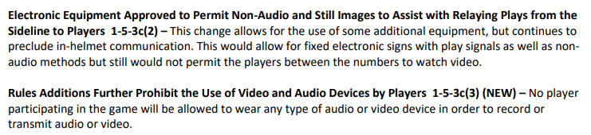
2025 Rule changes
ELECTRONIC EQUIPMENT

Slide 21
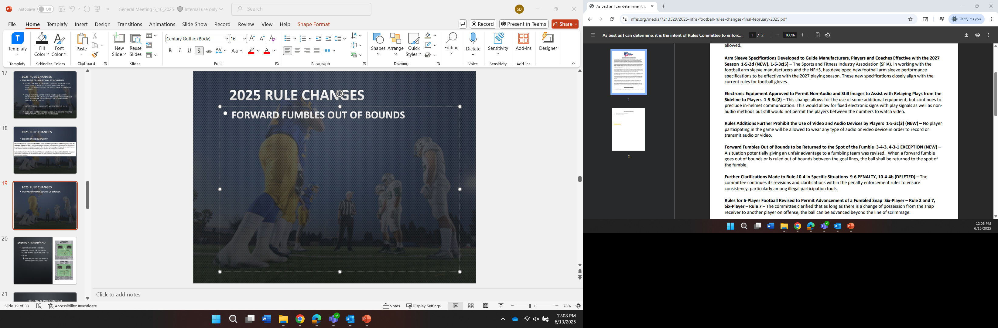
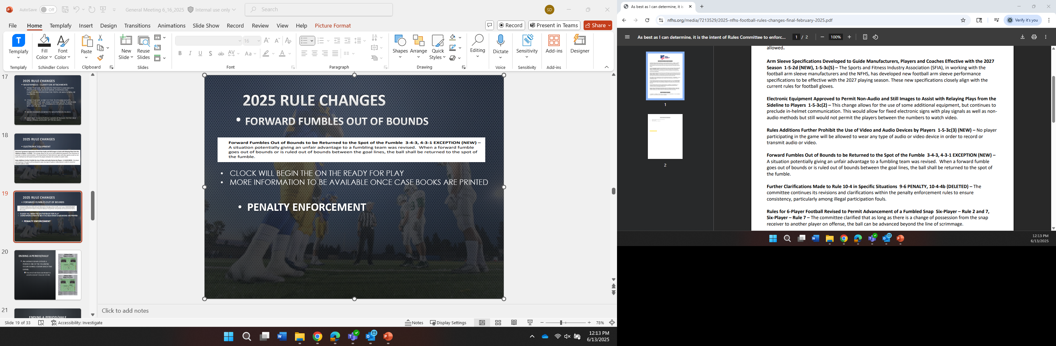
2025 Rule changes
FORWARD FUMBLES OUT OF BOUNDS
CLOCK WILL BEGIN THE ON THE READY FOR PLAY
MORE INFORMATION TO BE AVAILABLE ONCE CASE BOOKS ARE PRINTED
2025 Forward Fumble Out of Bounds Rule Change
PENALTY ENFORCEMENT

Slide 22
Next Meeting
JUNE 30
  NEW & TRANSFER OFFICIALS
  6:30 P.M.
  JOHN I. LEONARD H.S.
JULY 7
  ALL MEMBERS
  6:30 P.M.
  JOHN I. LEONARD H.S.

Slide 23

THANK YOU - Questions?

