Slide 1
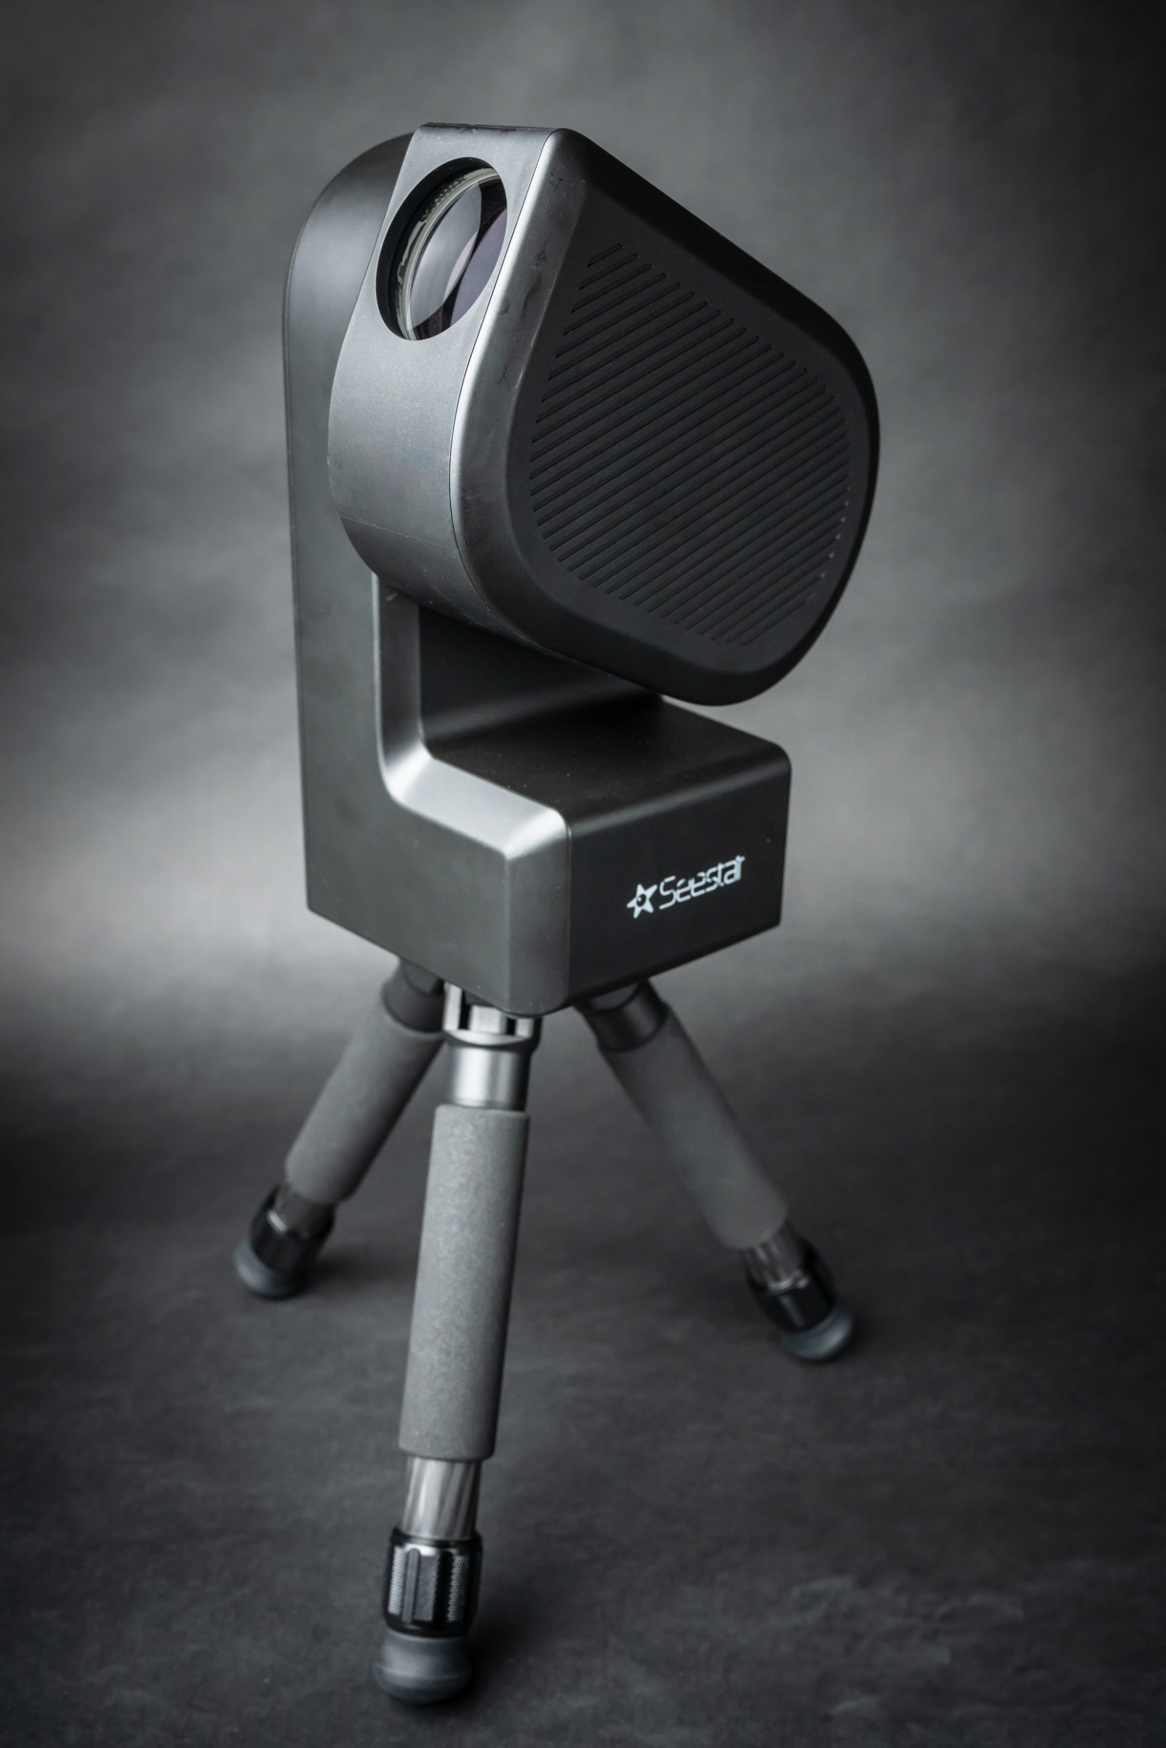
Seestar File Download

Slide 2
Automatic Image Calibration
The Seestar automatically takes and applies:
dark, flat, and bias frames to the image.
correcting for readout noise, sensor noise, and image train imperfections such was dust.

Slide 3
Seestar S50 delivers two kinds of output files:
High-resolution 2X and 4X JPEG files delivered to the controlling device
A FITS file (accompanied by a low-res .jpg thumbnail) stored in the S50. This can readily be extracted to a PC or laptop via a file browser.

Slide 4
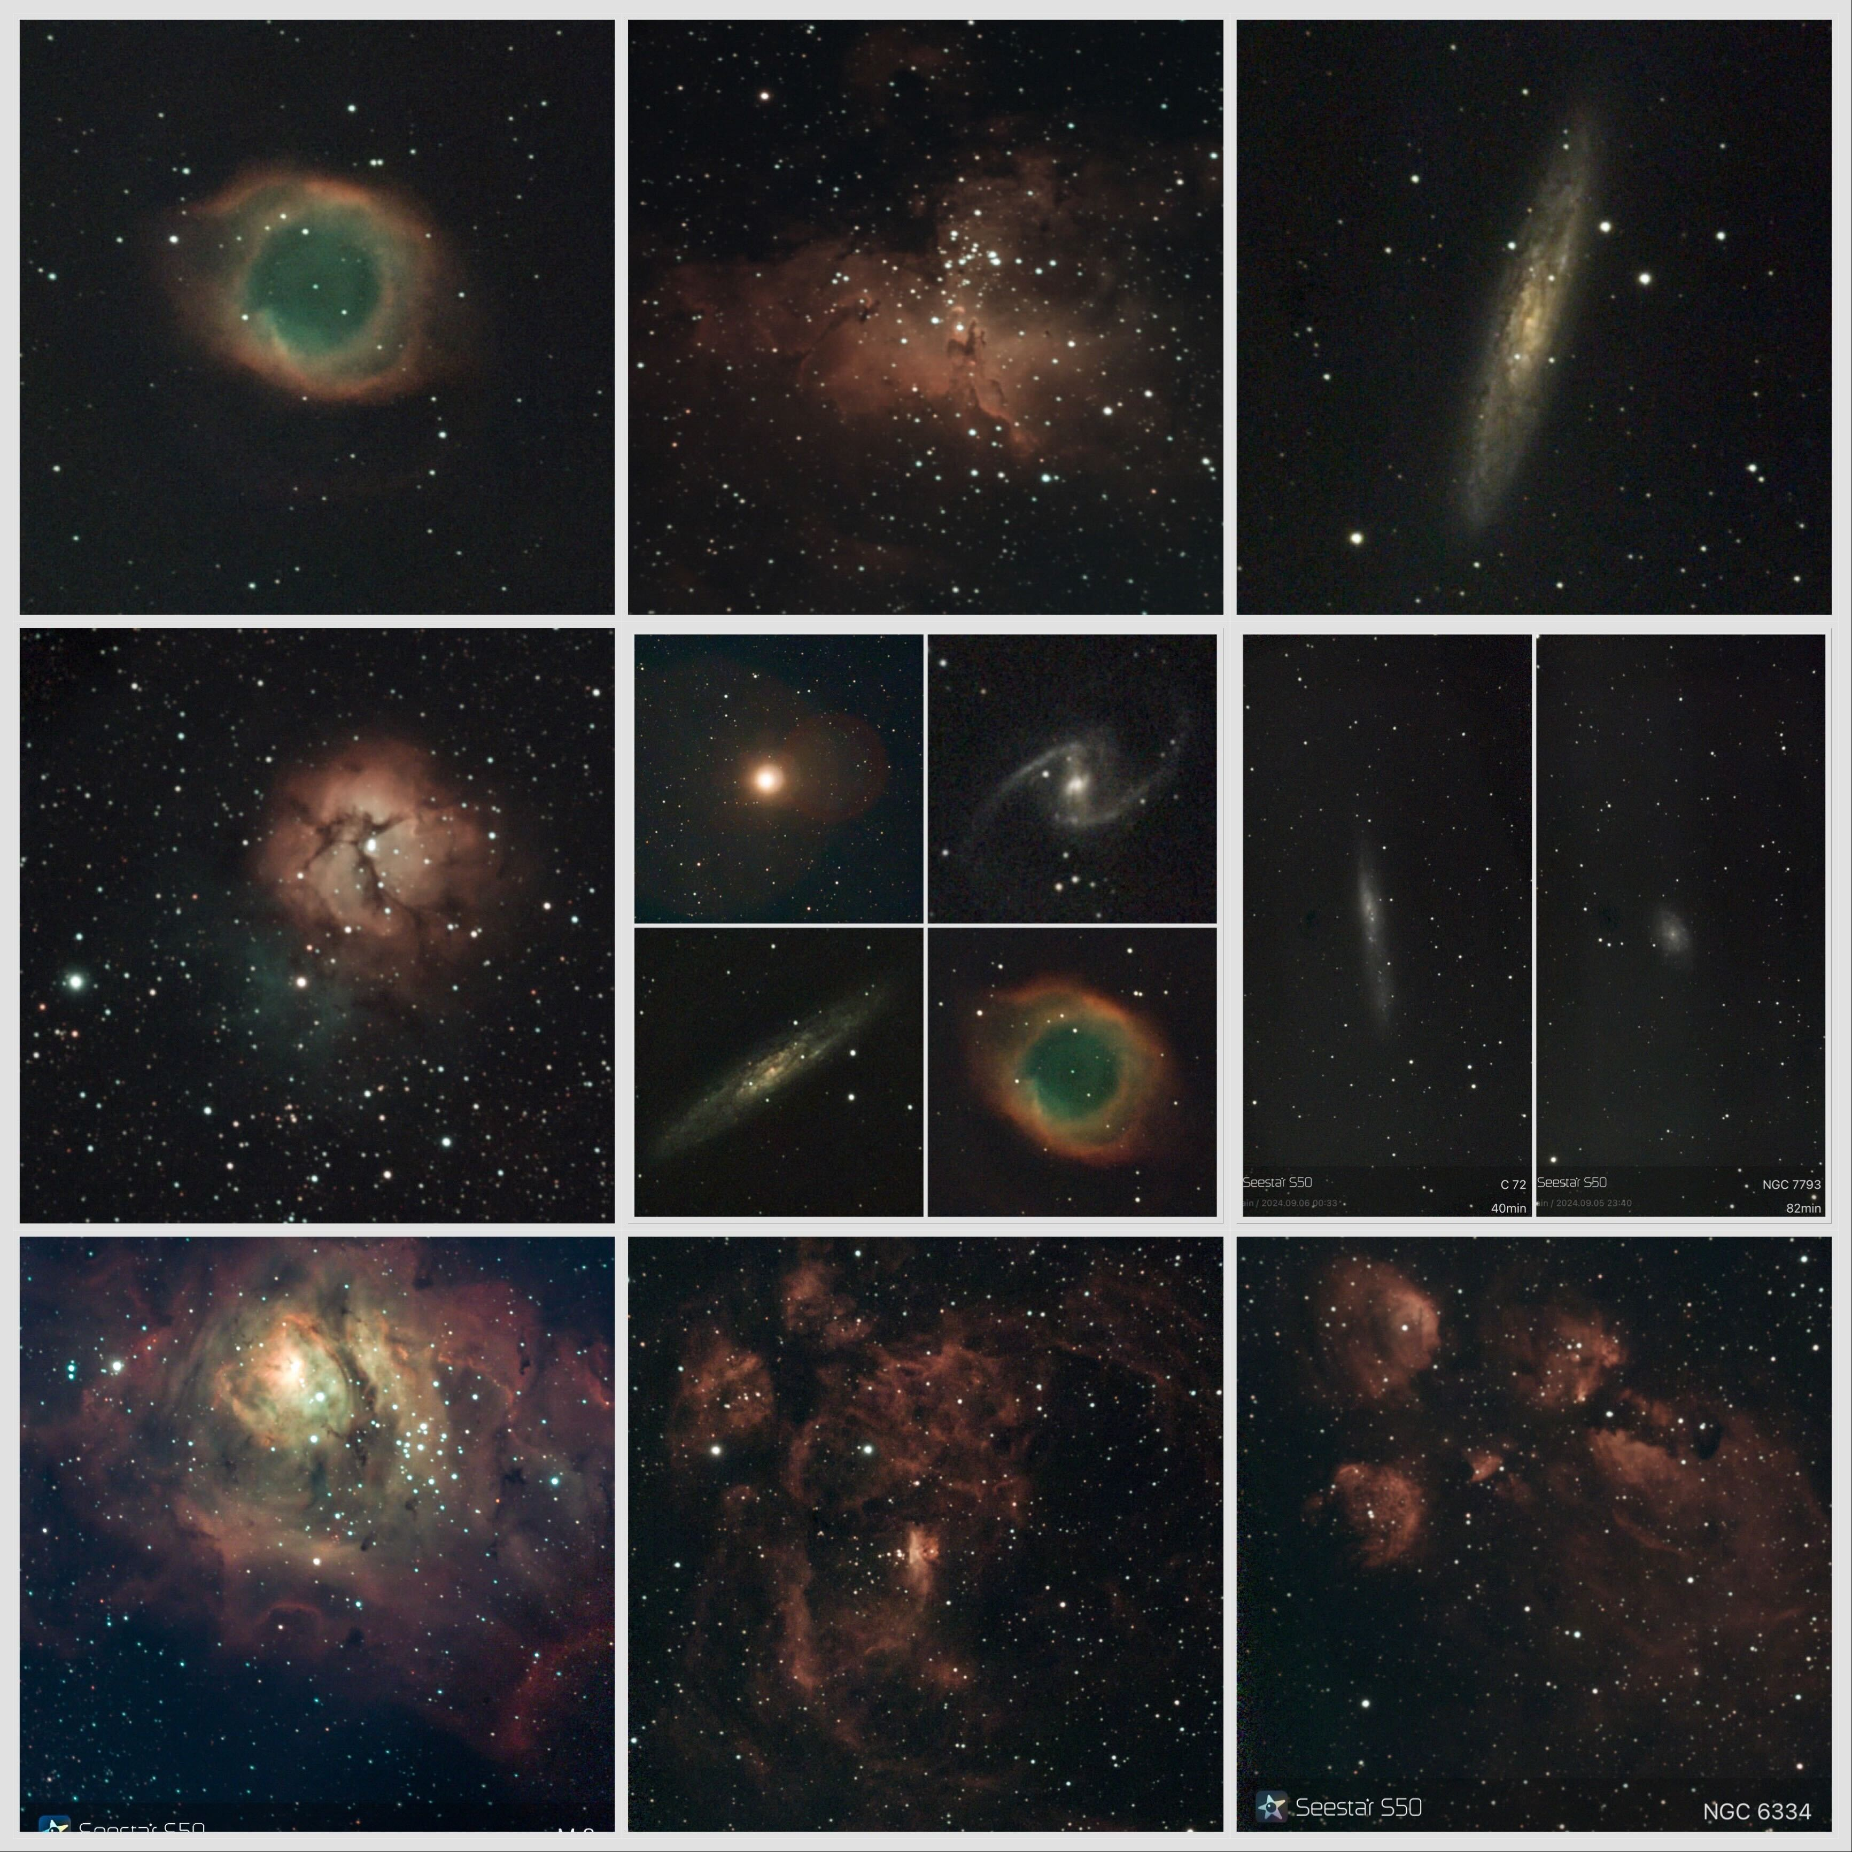
Album

Slide 5
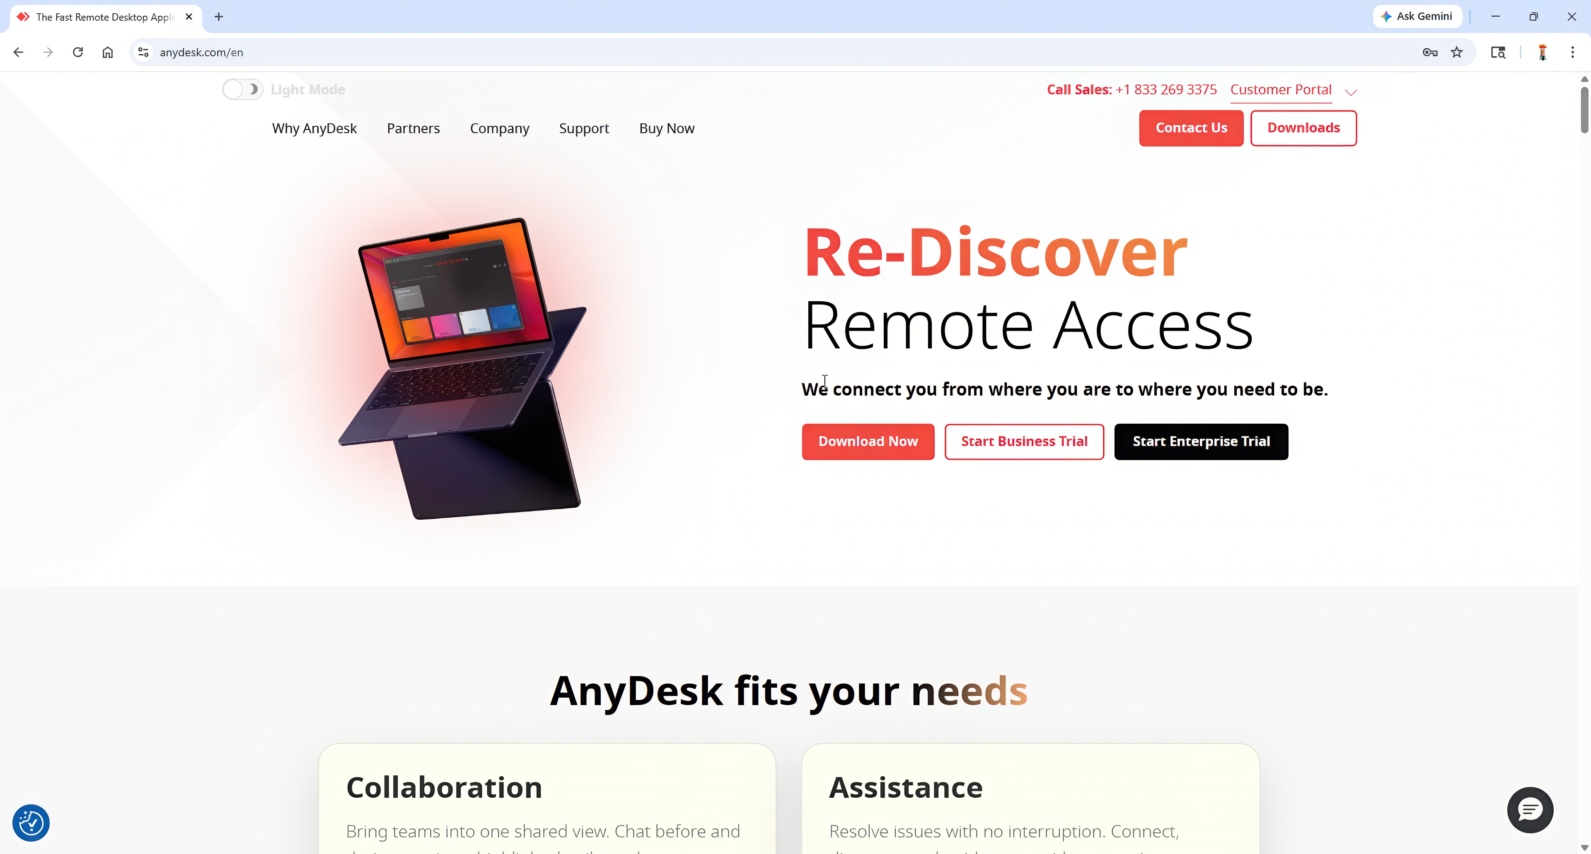

Slide 6
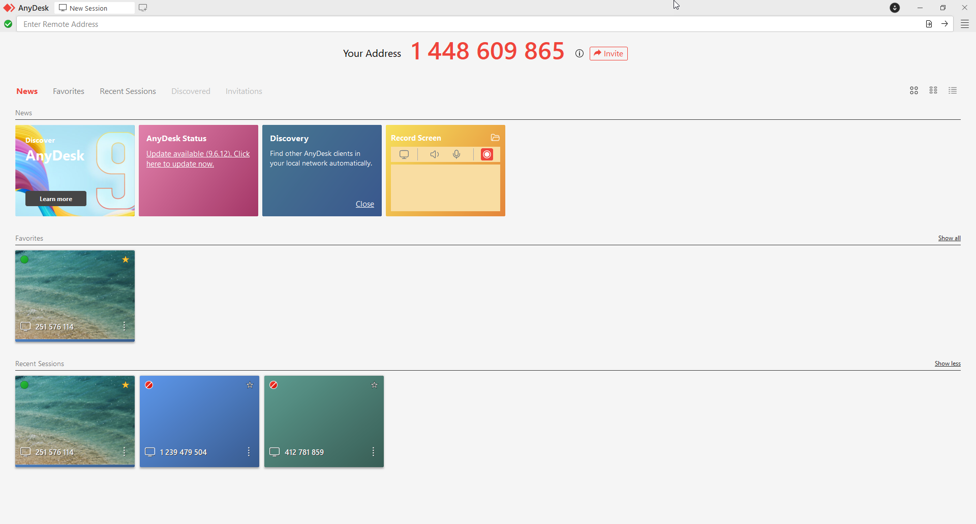

Slide 7
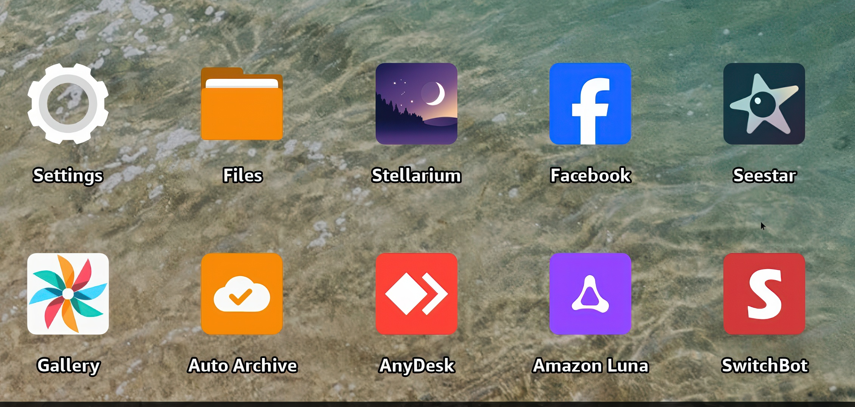

Slide 8
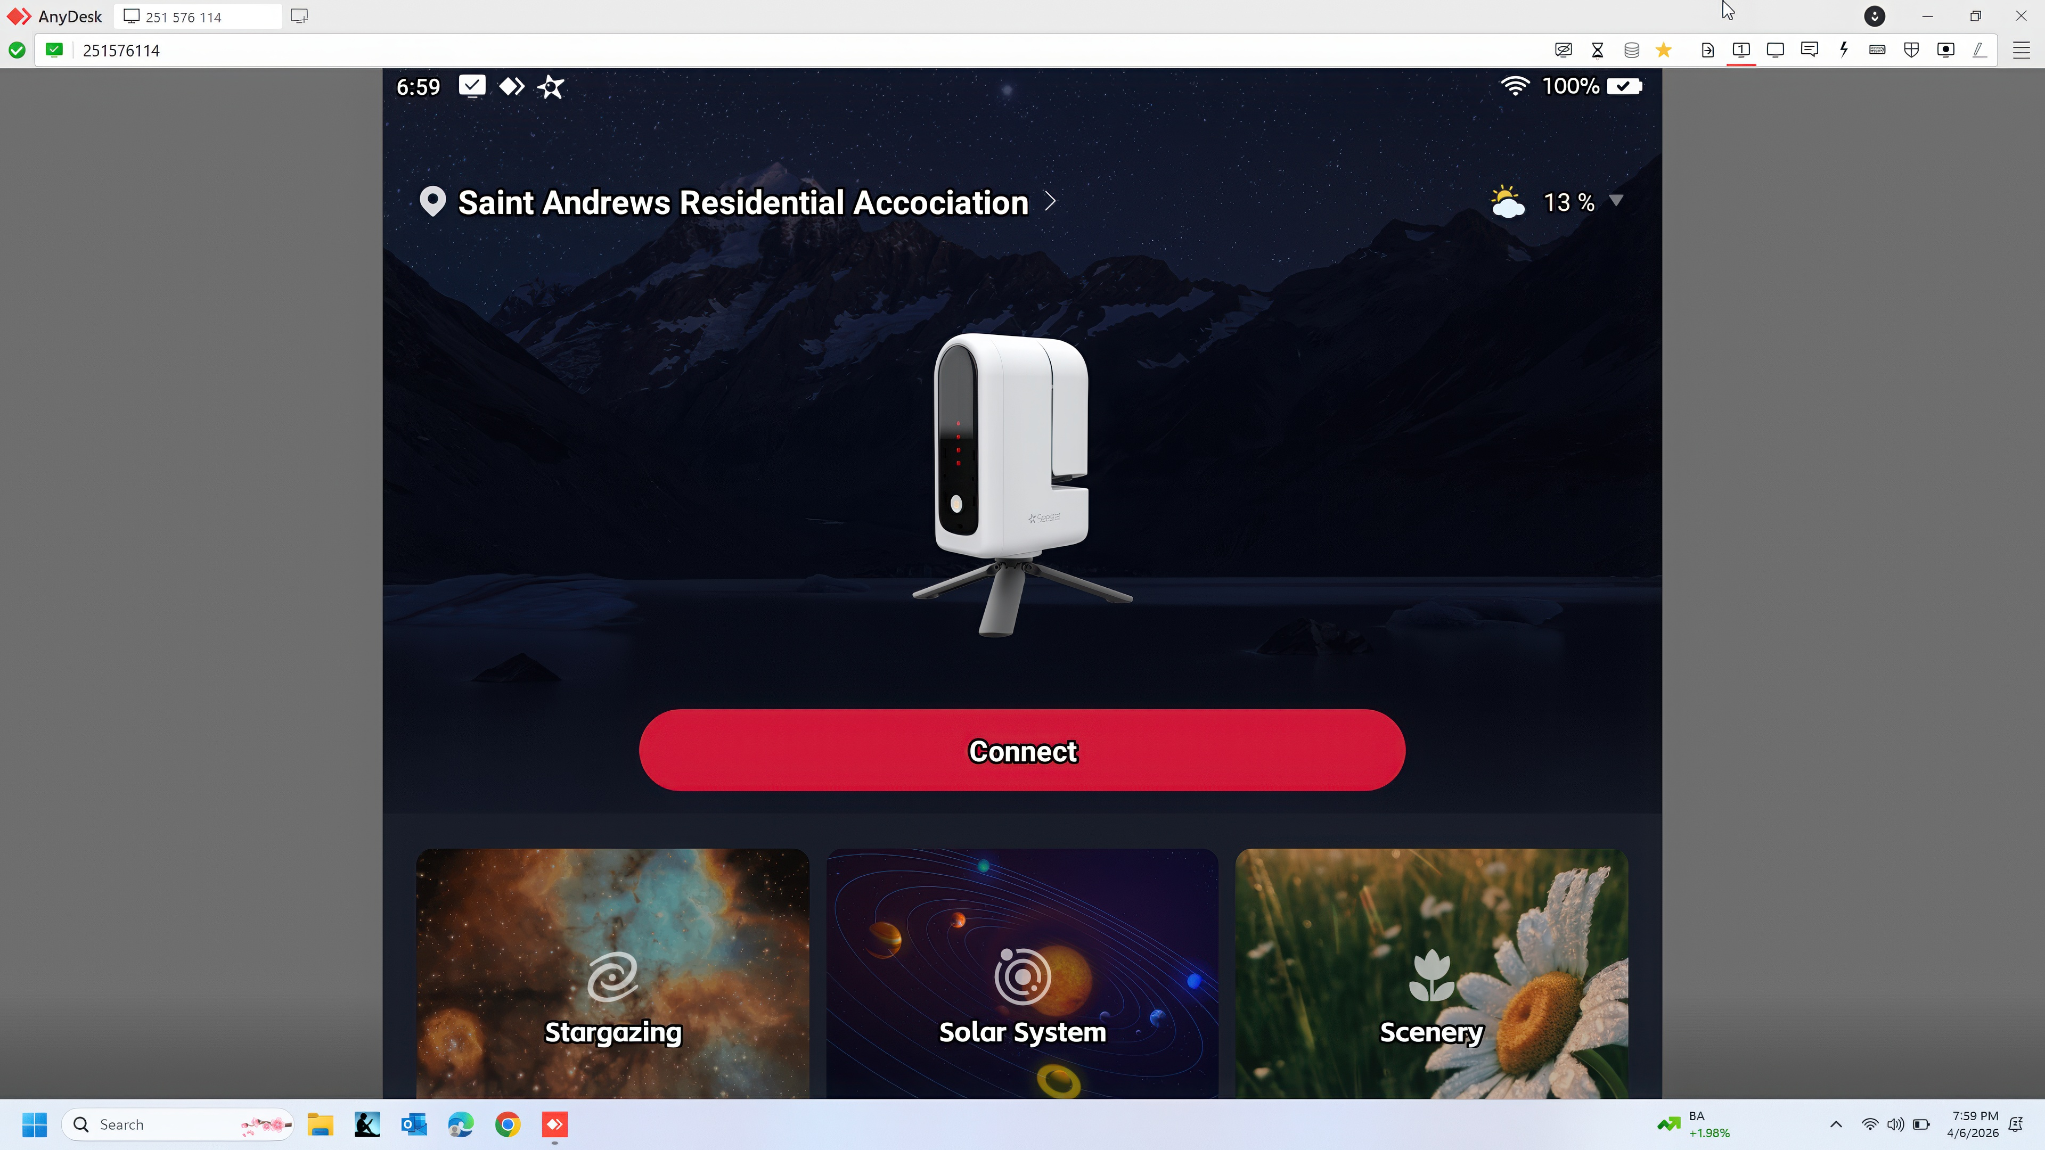

Slide 10
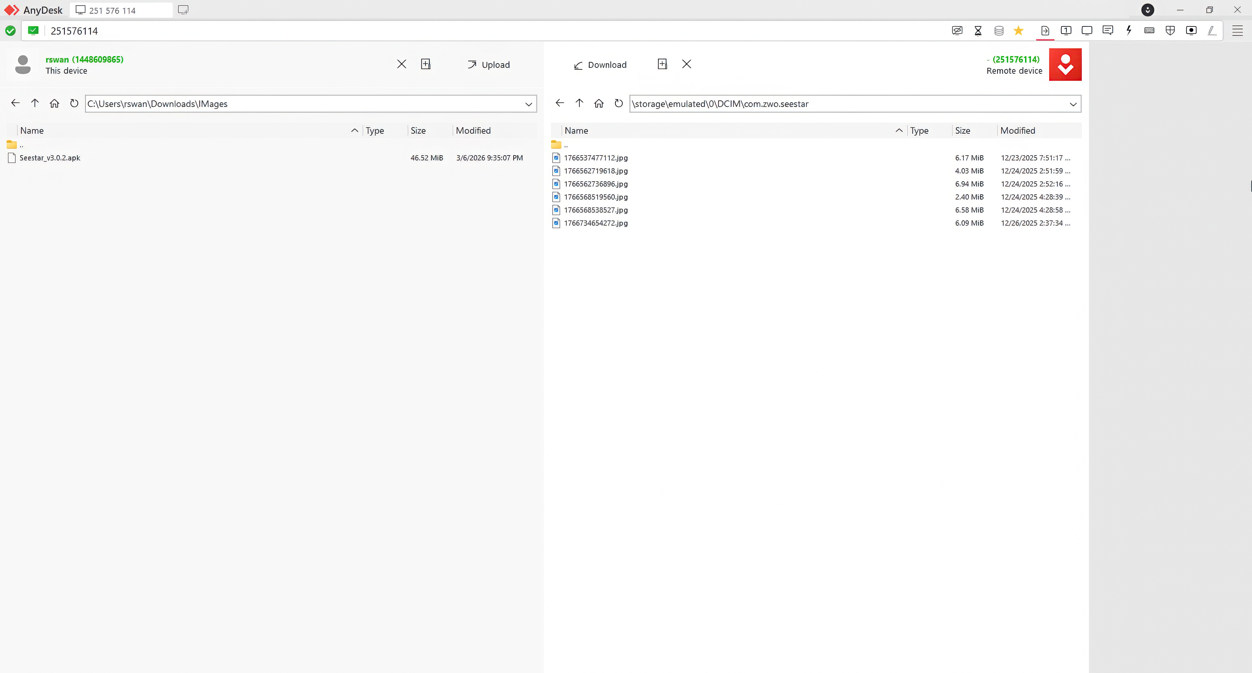

Slide 14
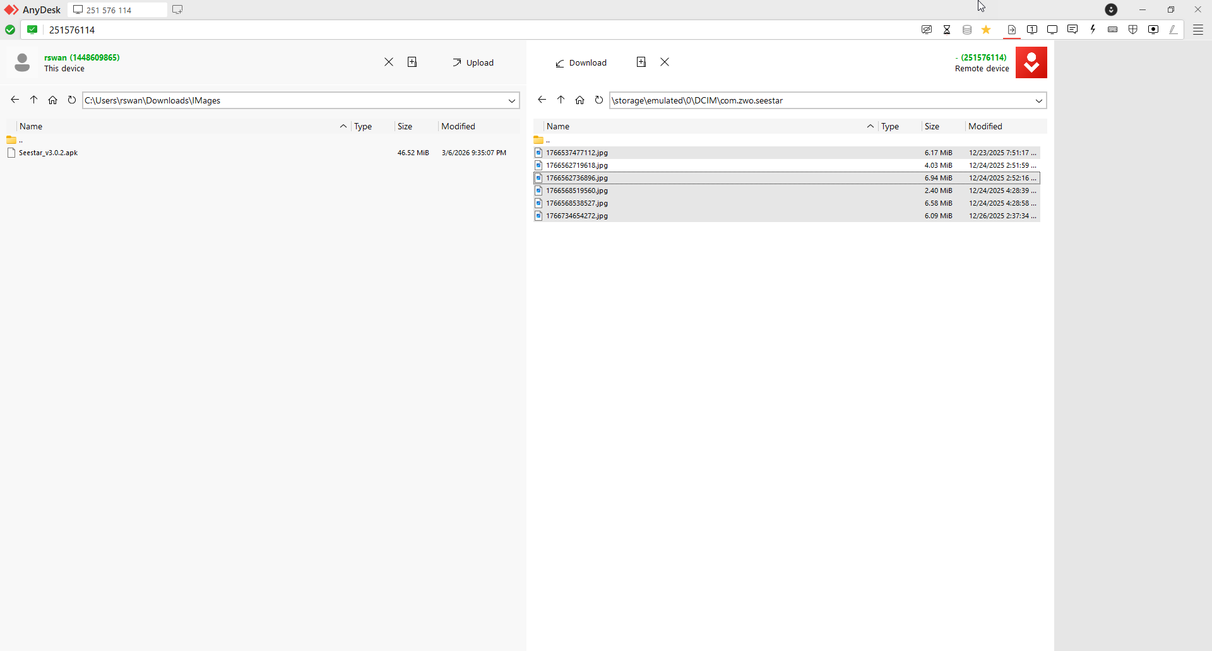

Slide 16
