Slide 1

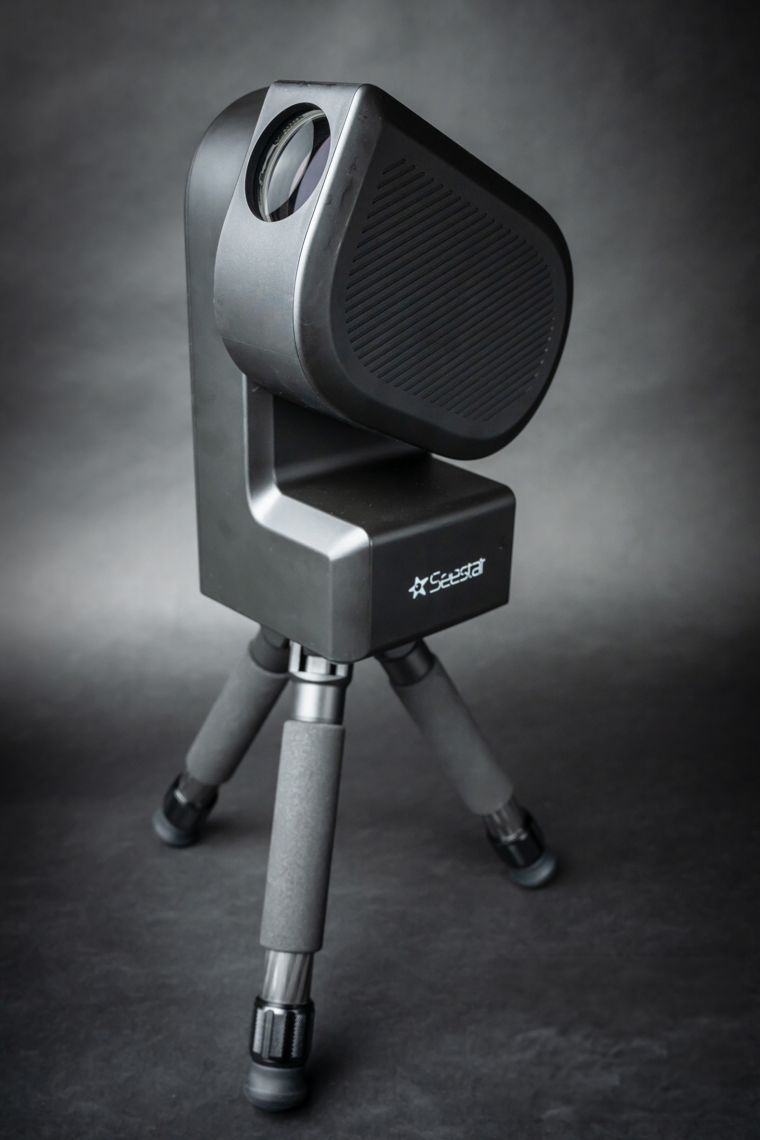
The Seestar S50
Notes:
Overview of Seestar Telescope Features, Purpose and Target Audience, Comparison with Traditional Telescopes

Slide 2
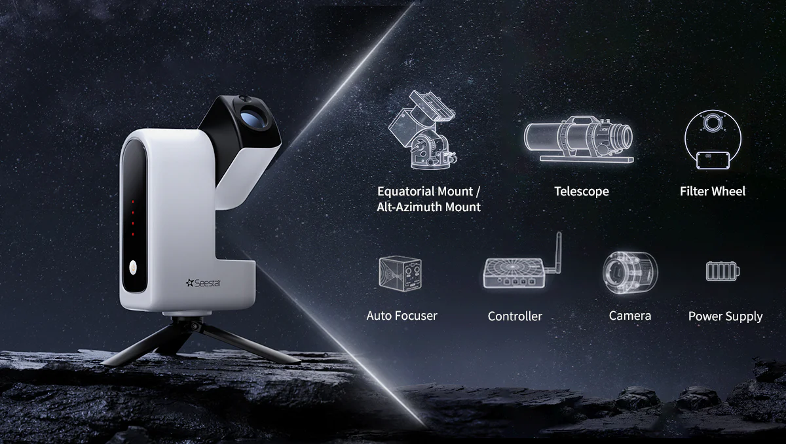
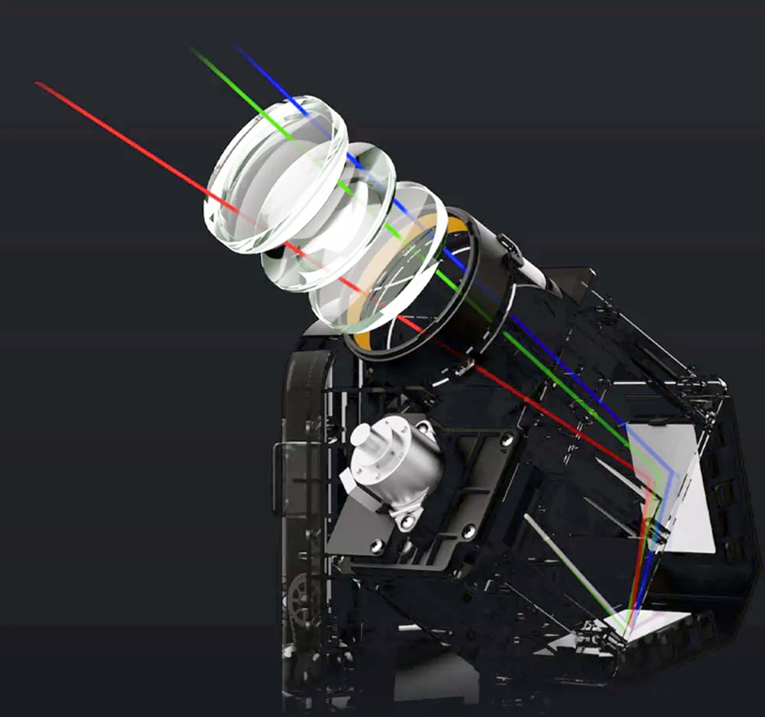
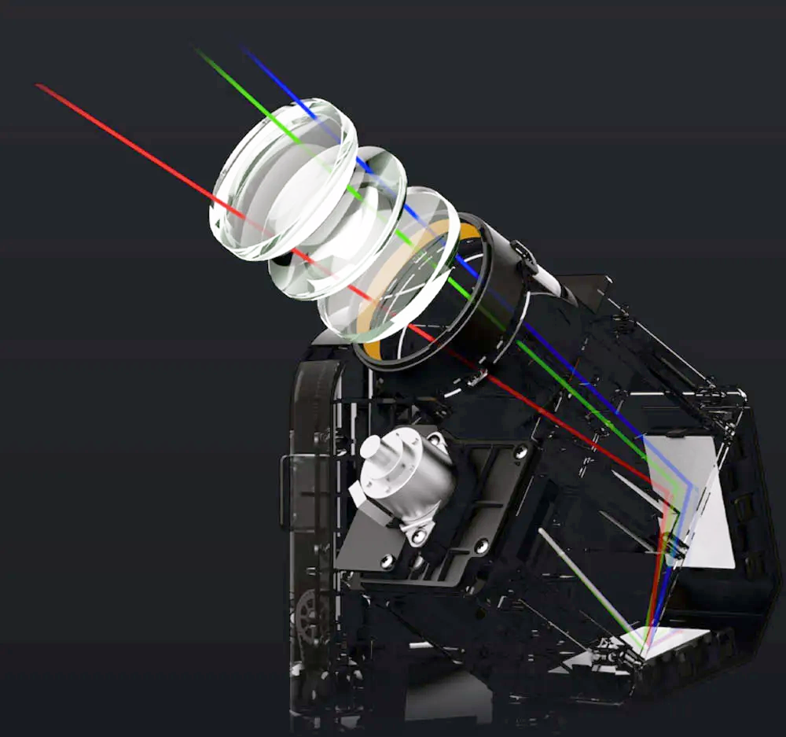
The Seestar
Notes:
Overview of Seestar Telescope Features, Purpose and Target Audience, Comparison with Traditional Telescopes

Slide 3
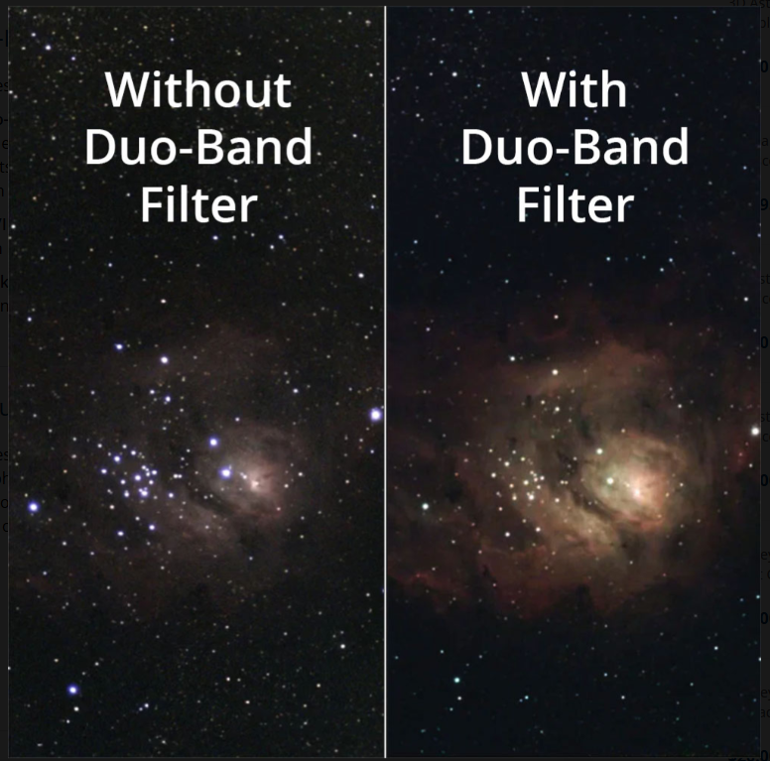
Photoelectric Intelligent Astronomical Telescope Theodolite
Smart Telescopes
Apochromatic triplet refractor
Plate solves and centers objects
Autofocuses
Auto Calibration frames
4K Images (drizzle)
Smart stacks
Auto dew heater
Internal filter wheel (dual band)
Smart mosaics
AI Denoising
$549
Notes:
Overview of Seestar Telescope Features, Purpose and Target Audience, Comparison with Traditional Telescopes

Slide 4
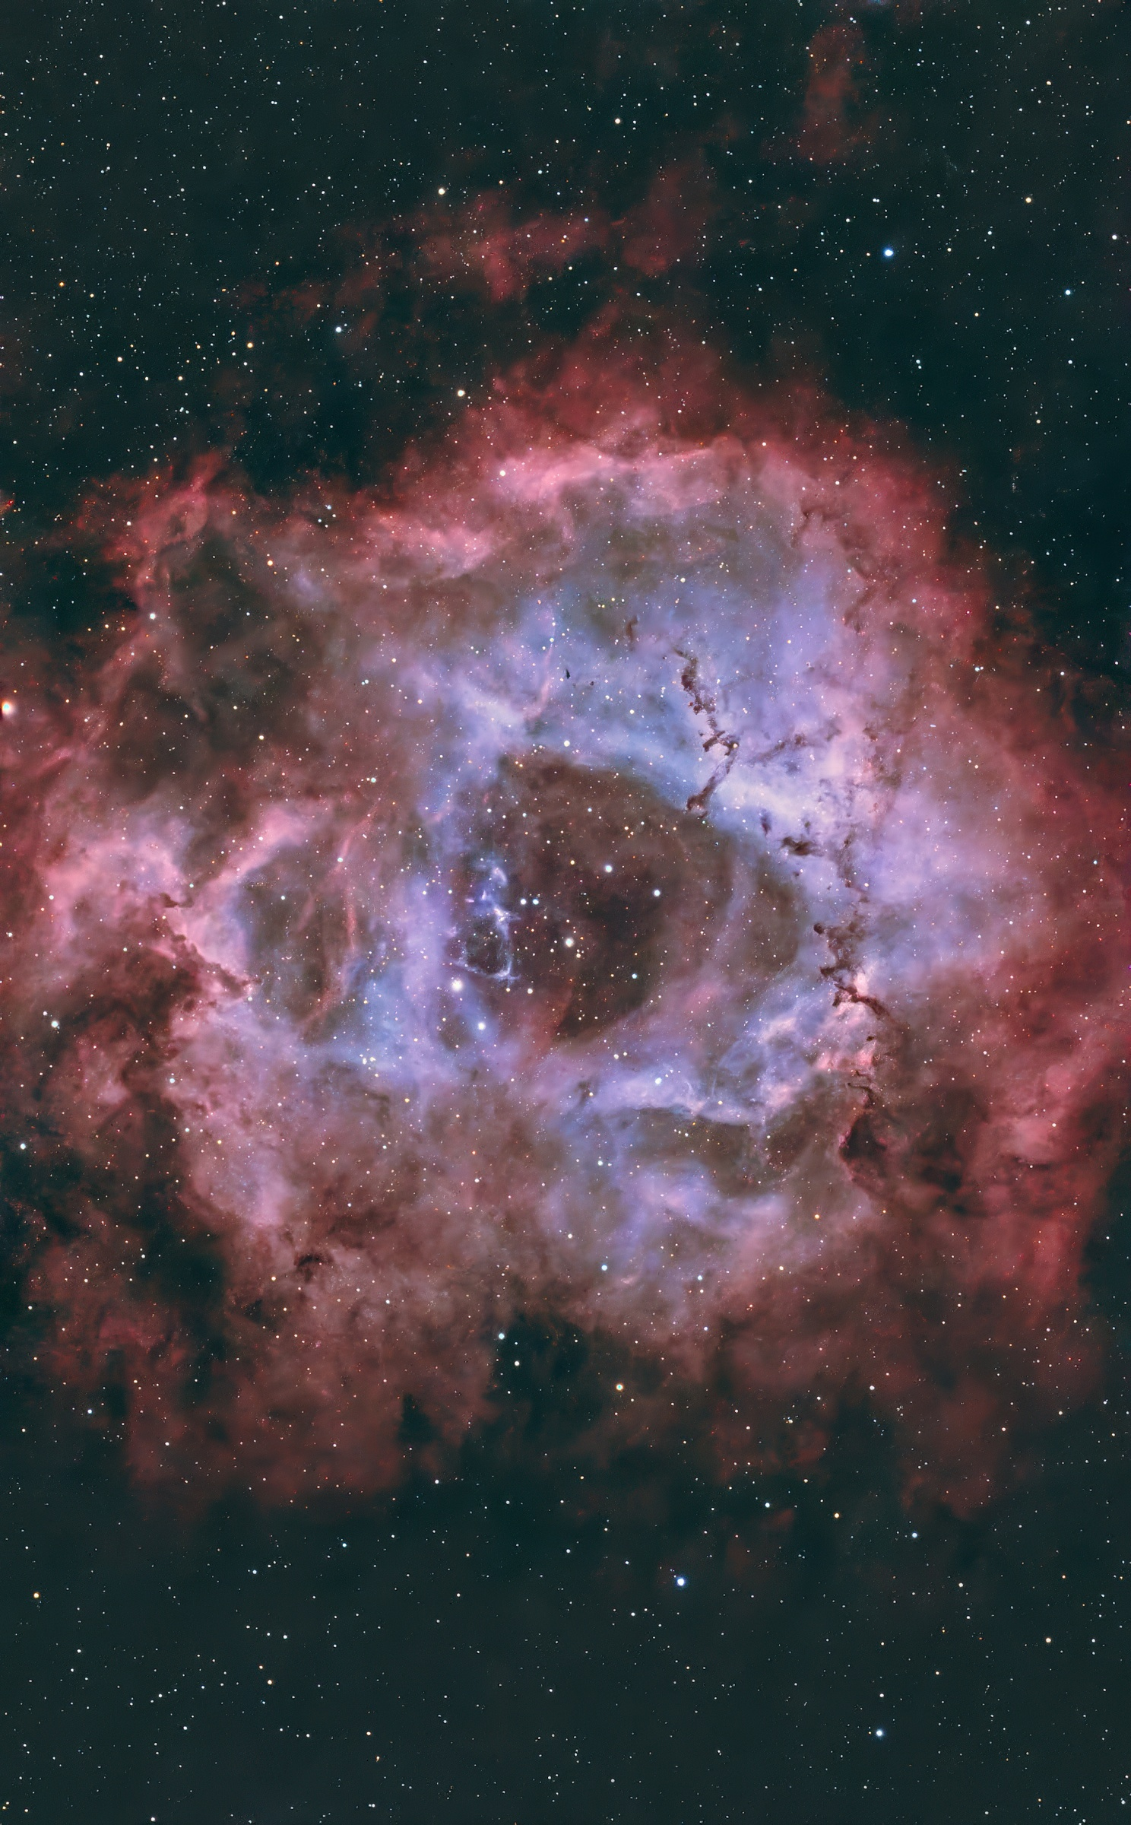
Notes:
Overview of Seestar Telescope Features, Purpose and Target Audience, Comparison with Traditional Telescopes

Slide 5
The App
Notes:
Overview of Seestar Telescope Features, Purpose and Target Audience, Comparison with Traditional Telescopes

Slide 6
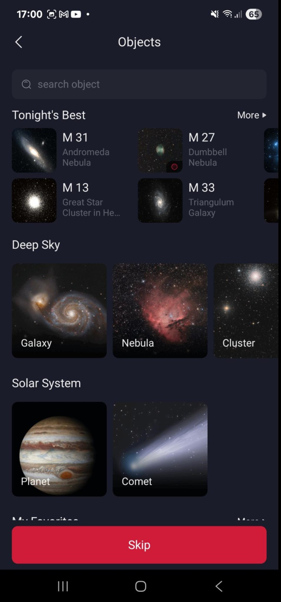

Notes:
Overview of Seestar Telescope Features, Purpose and Target Audience, Comparison with Traditional Telescopes

Slide 7
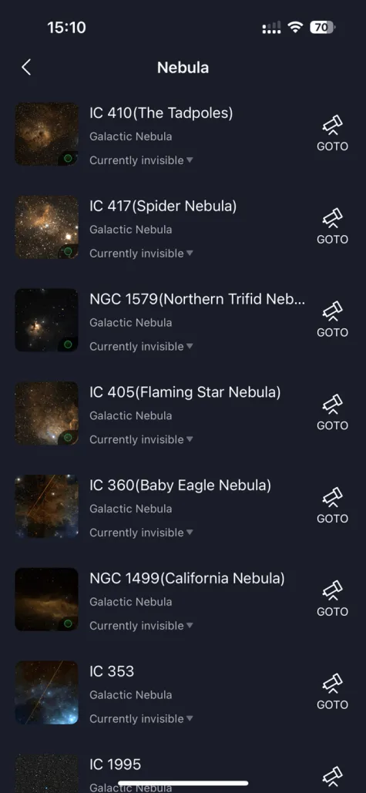
Notes:
Overview of Seestar Telescope Features, Purpose and Target Audience, Comparison with Traditional Telescopes

Slide 8
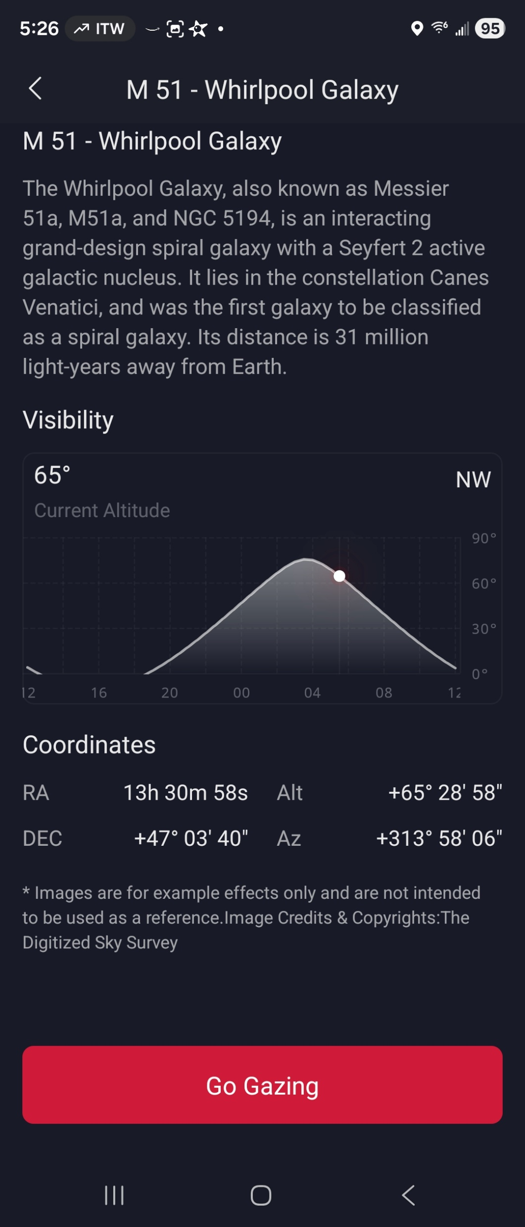
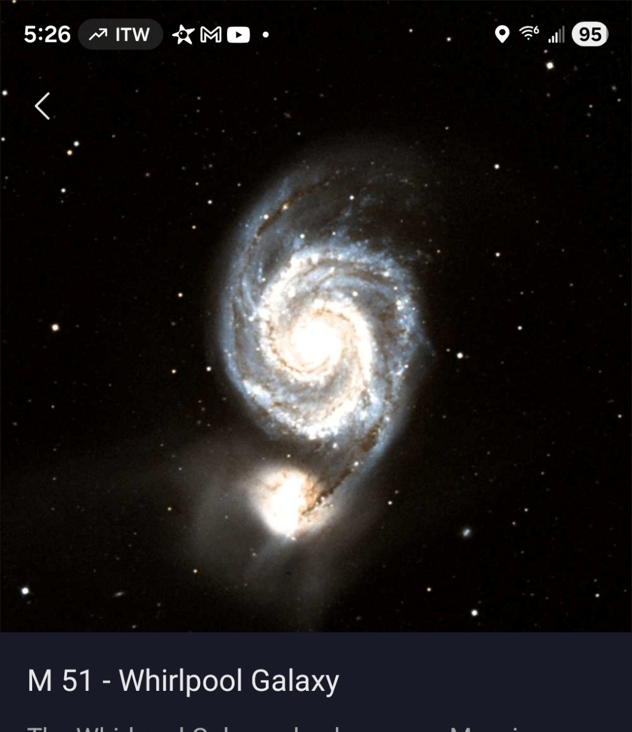

Notes:
Overview of Seestar Telescope Features, Purpose and Target Audience, Comparison with Traditional Telescopes

Slide 9
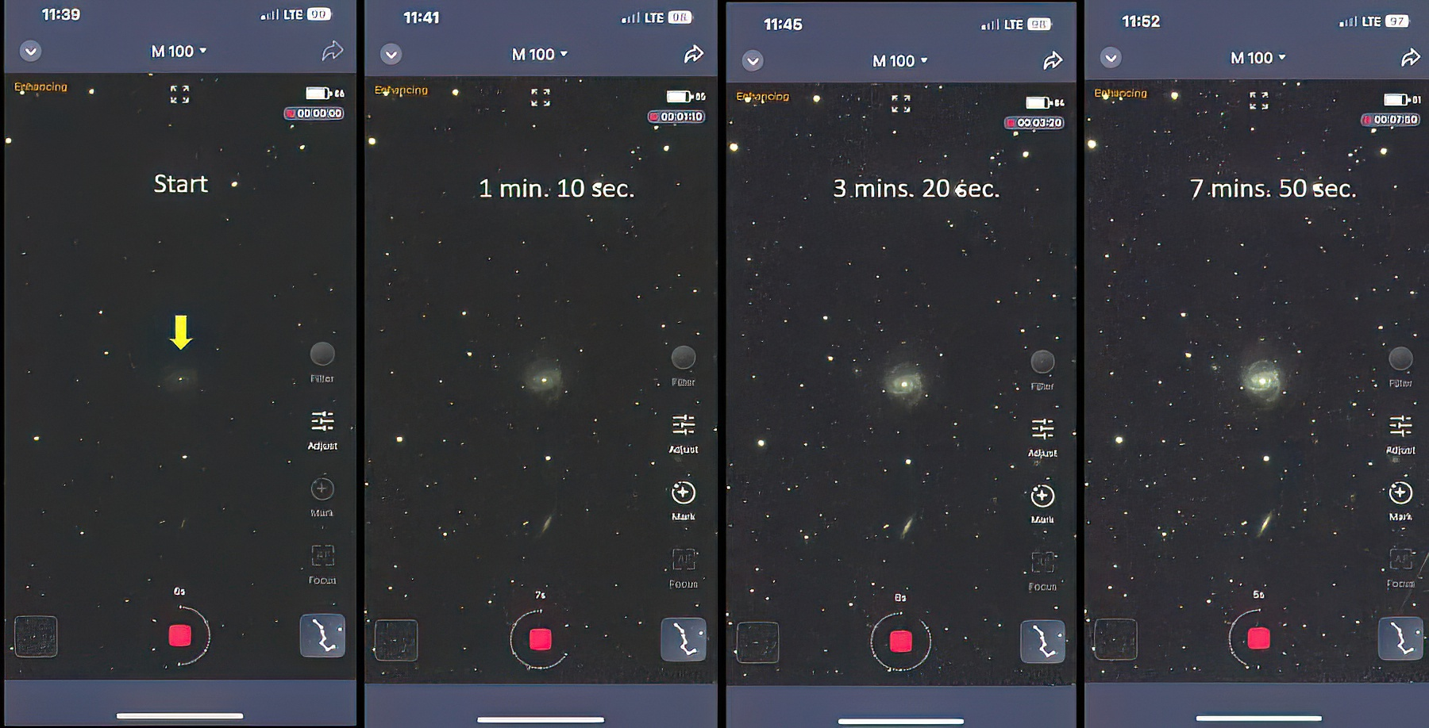
Live Stacking
Notes:
Overview of Seestar Telescope Features, Purpose and Target Audience, Comparison with Traditional Telescopes

Slide 10
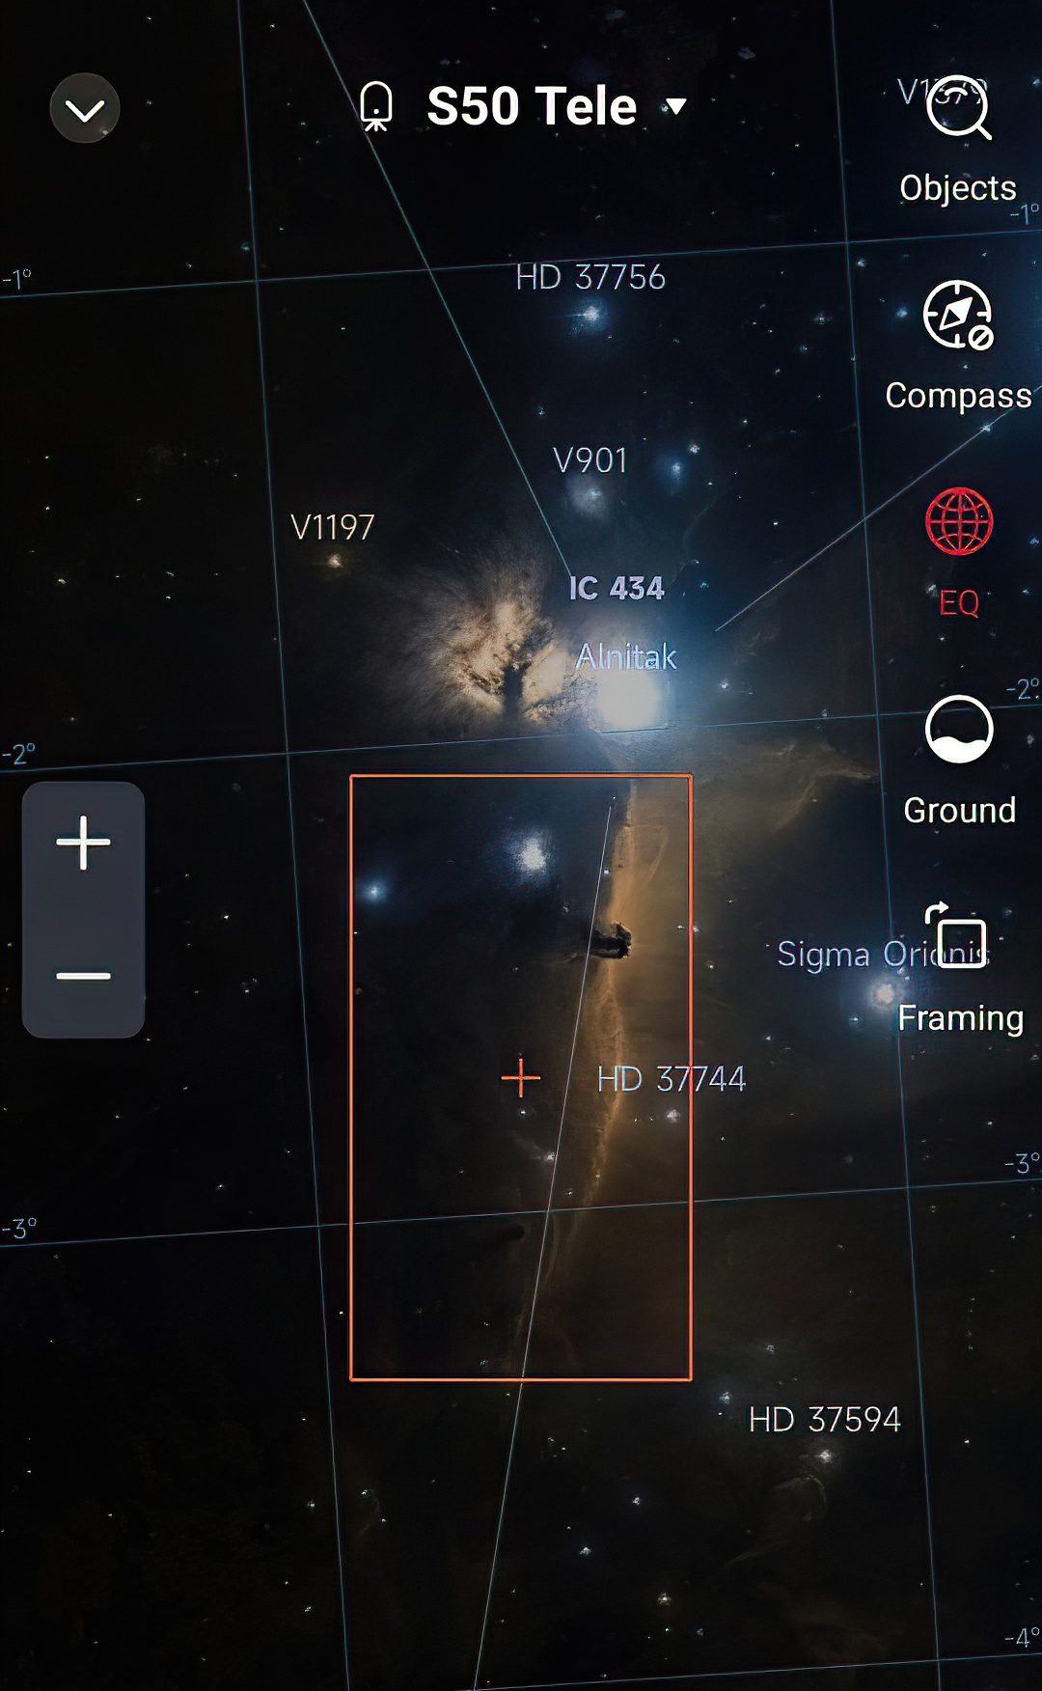
Sky Atlas
Notes:
Overview of Seestar Telescope Features, Purpose and Target Audience, Comparison with Traditional Telescopes

Slide 11
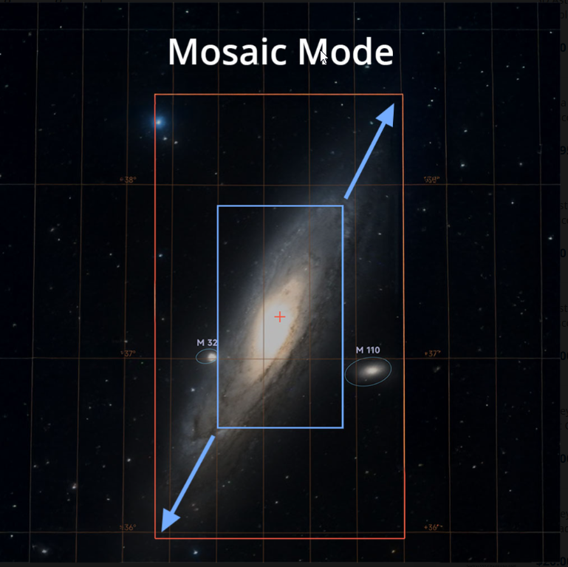
Notes:
Overview of Seestar Telescope Features, Purpose and Target Audience, Comparison with Traditional Telescopes

Slide 12
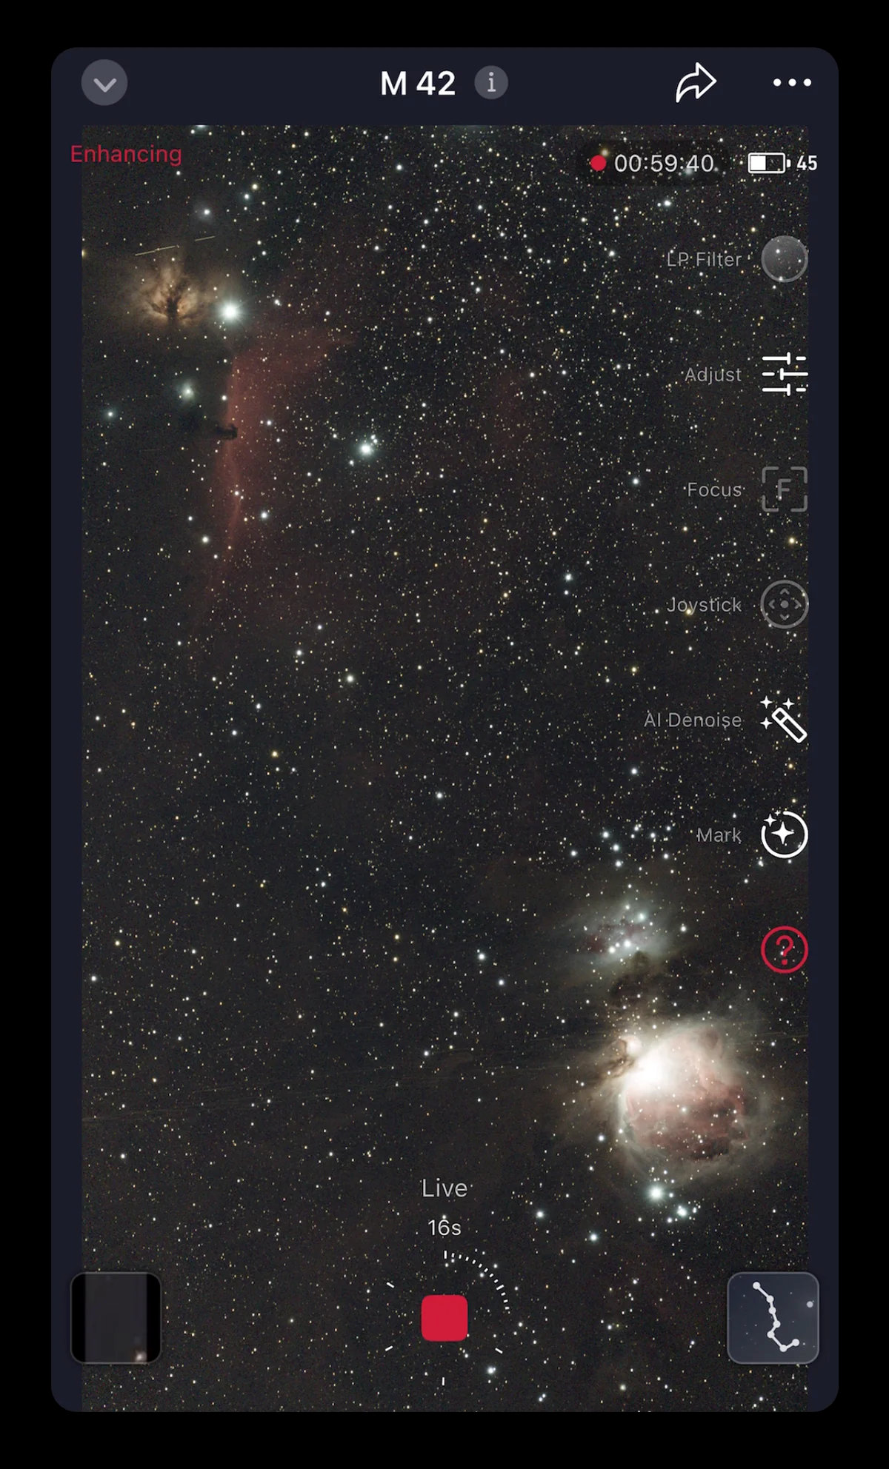
Live View
Notes:
Overview of Seestar Telescope Features, Purpose and Target Audience, Comparison with Traditional Telescopes

Slide 13
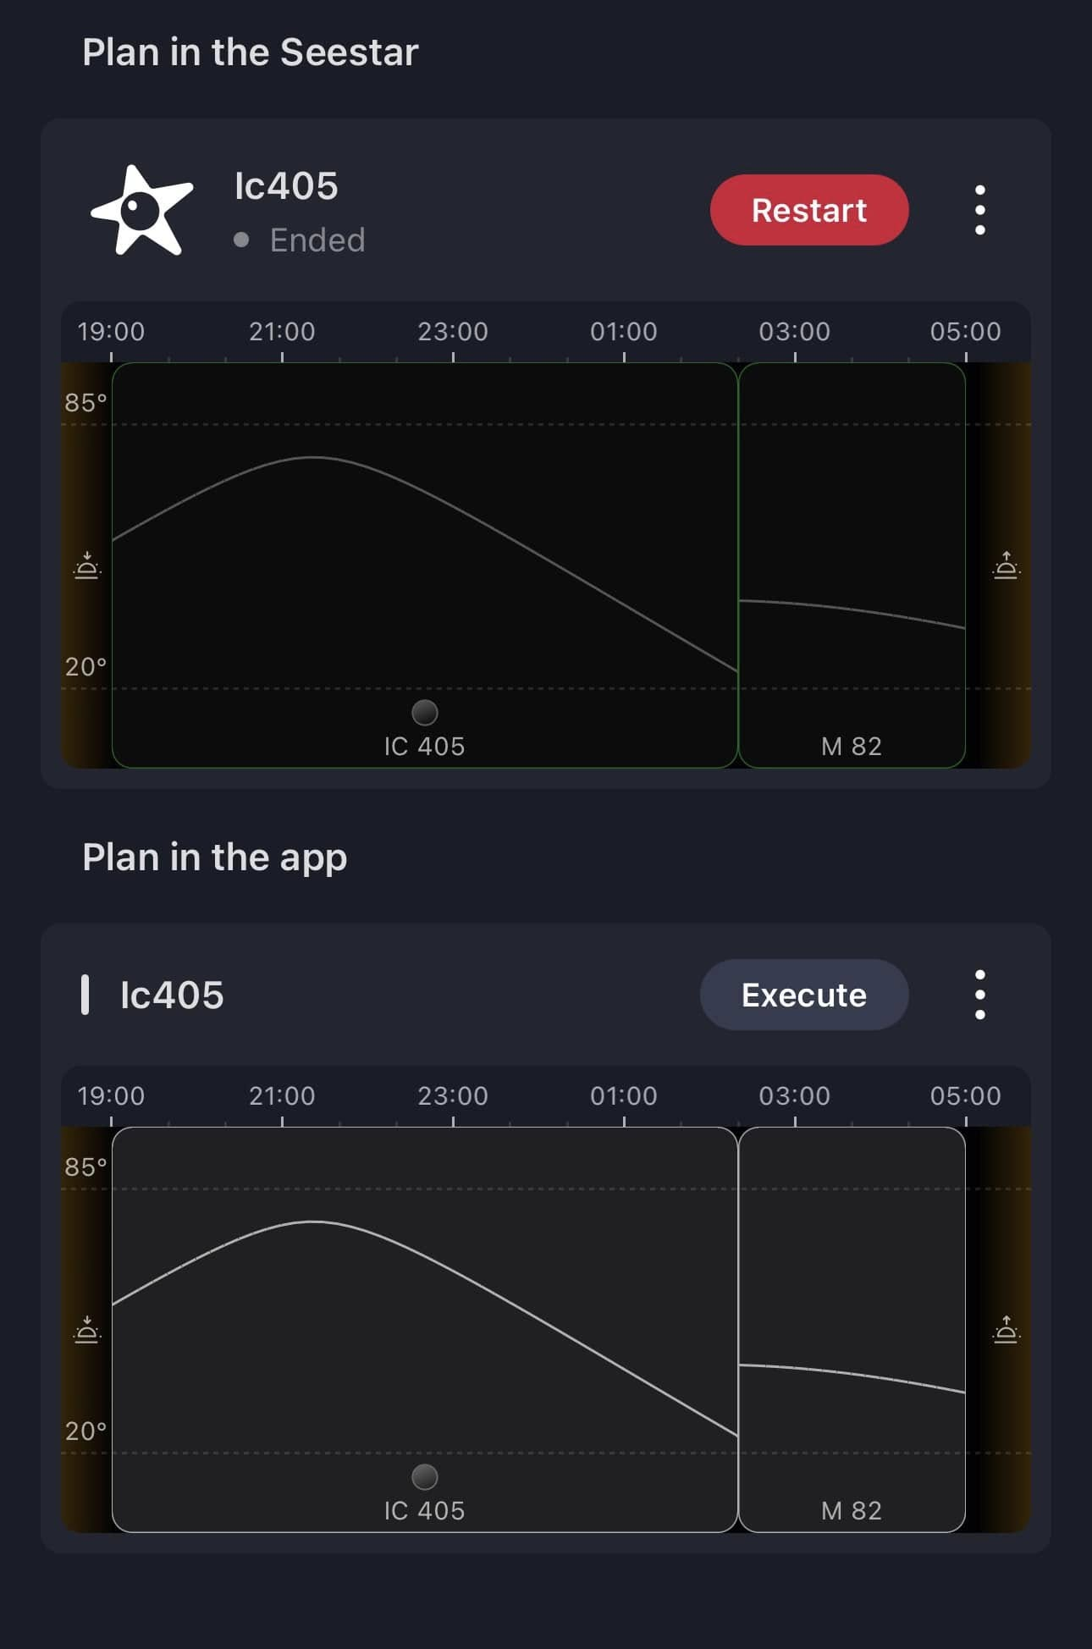
“Plan” mode
Notes:
Overview of Seestar Telescope Features, Purpose and Target Audience, Comparison with Traditional Telescopes

Slide 14
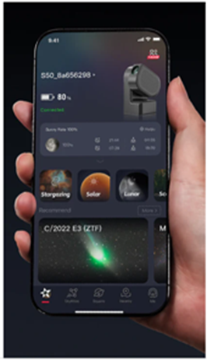


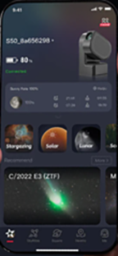

“Guest” Mode
Notes:
Overview of Seestar Telescope Features, Purpose and Target Audience, Comparison with Traditional Telescopes

Slide 15
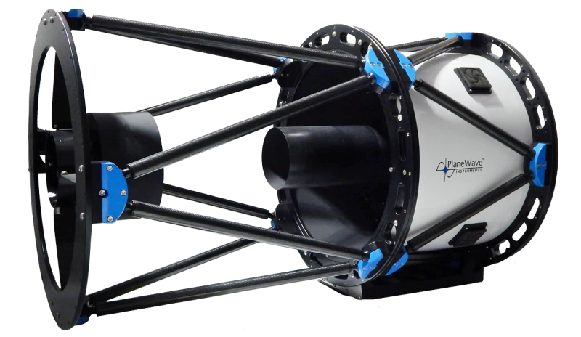
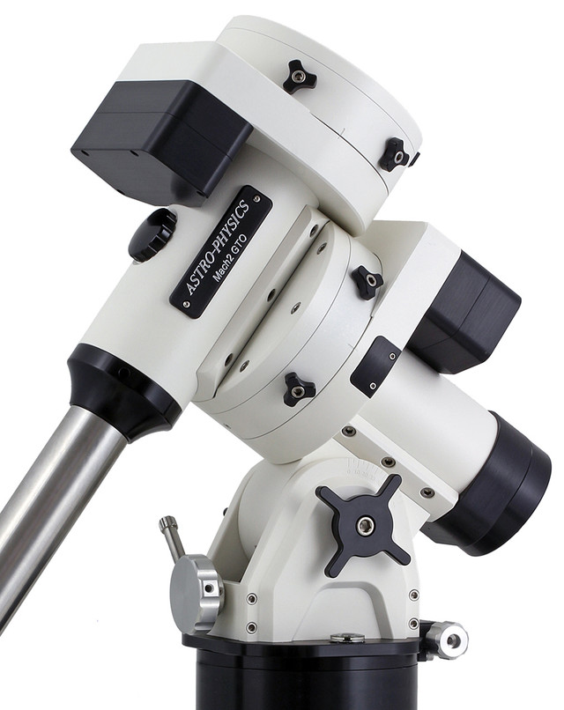
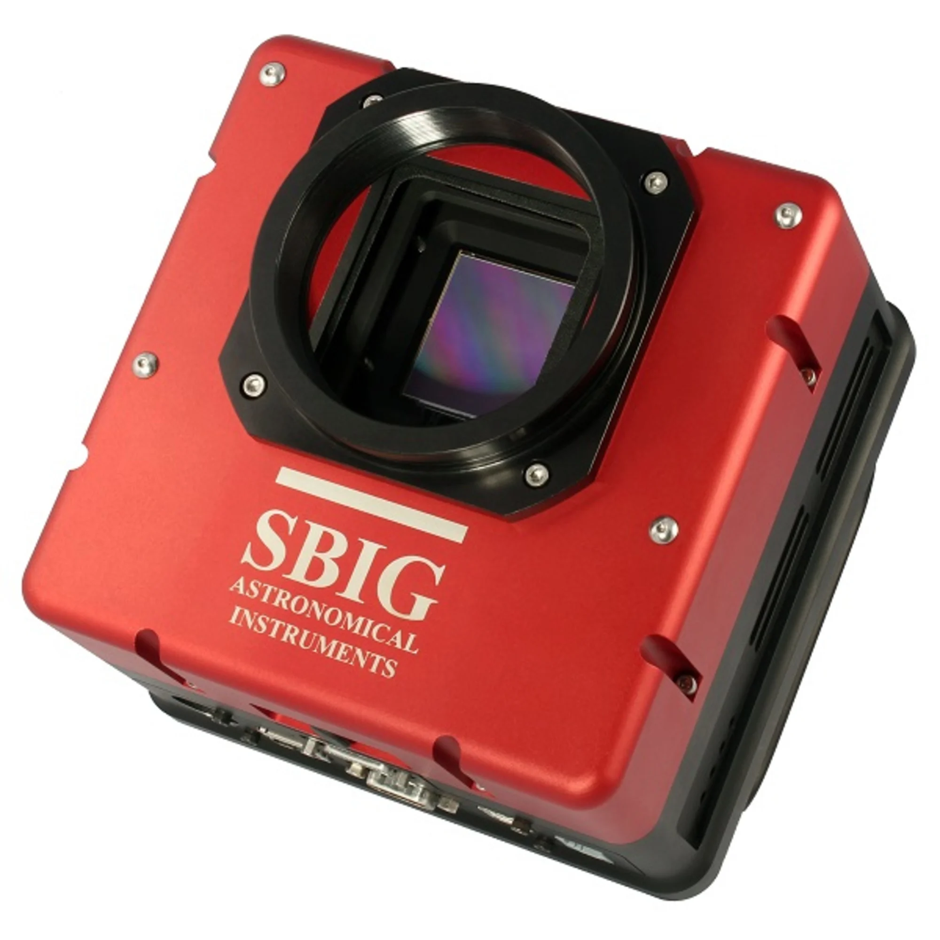
What the Seestar is NOT
$73,000
$21,000
$10,000
Notes:
Overview of Seestar Telescope Features, Purpose and Target Audience, Comparison with Traditional Telescopes

Slide 16
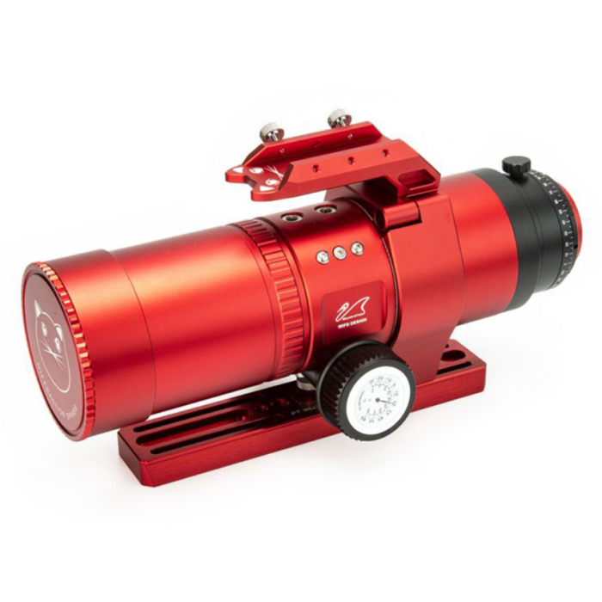
No Camera
No Mount
$900
Notes:
Overview of Seestar Telescope Features, Purpose and Target Audience, Comparison with Traditional Telescopes

Slide 17
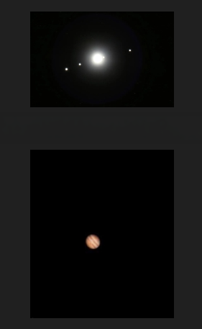
What you won’t be happy with
Notes:
Overview of Seestar Telescope Features, Purpose and Target Audience, Comparison with Traditional Telescopes

Slide 18

Why I moved my Seestar Telescope to Texas
Notes:
Overview of Seestar Telescope Features, Purpose and Target Audience, Comparison with Traditional Telescopes

Slide 19
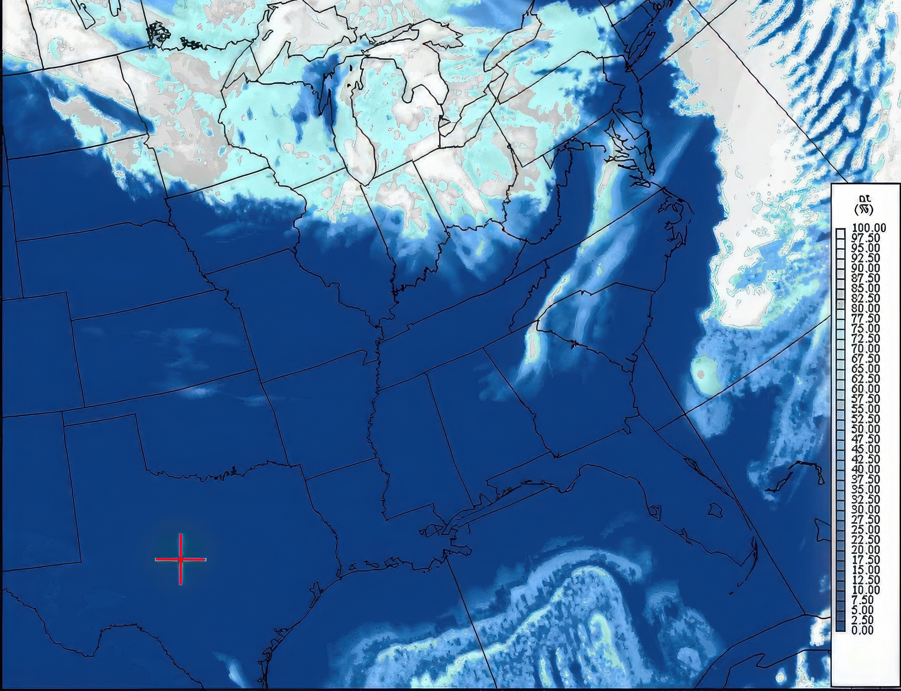
Notes:
Overview of Seestar Telescope Features, Purpose and Target Audience, Comparison with Traditional Telescopes

Slide 20

Notes:
Overview of Seestar Telescope Features, Purpose and Target Audience, Comparison with Traditional Telescopes

Slide 21
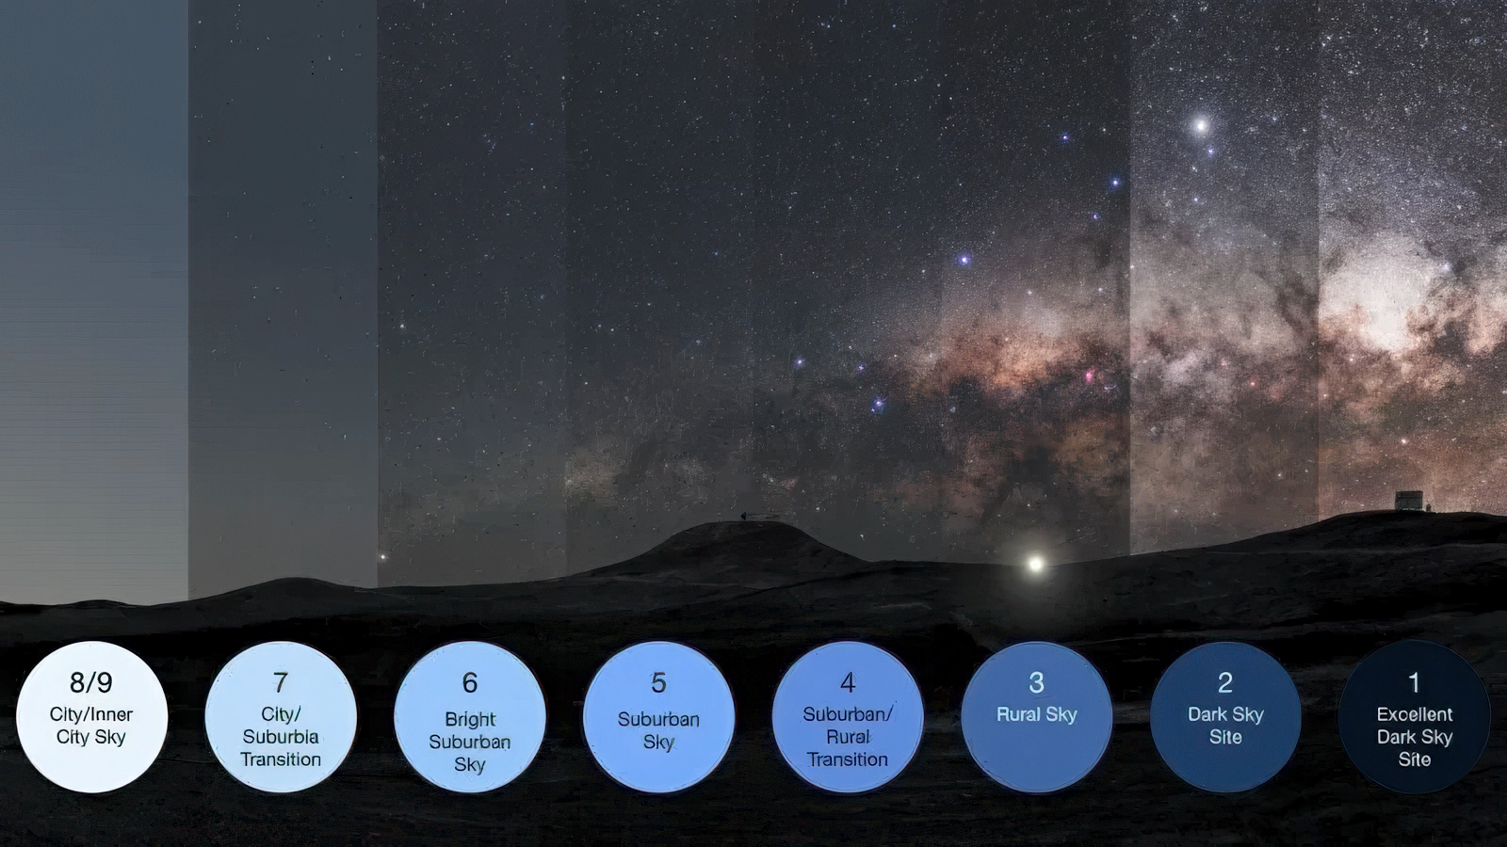
Bortle 1 skies
Notes:
Overview of Seestar Telescope Features, Purpose and Target Audience, Comparison with Traditional Telescopes

Slide 22
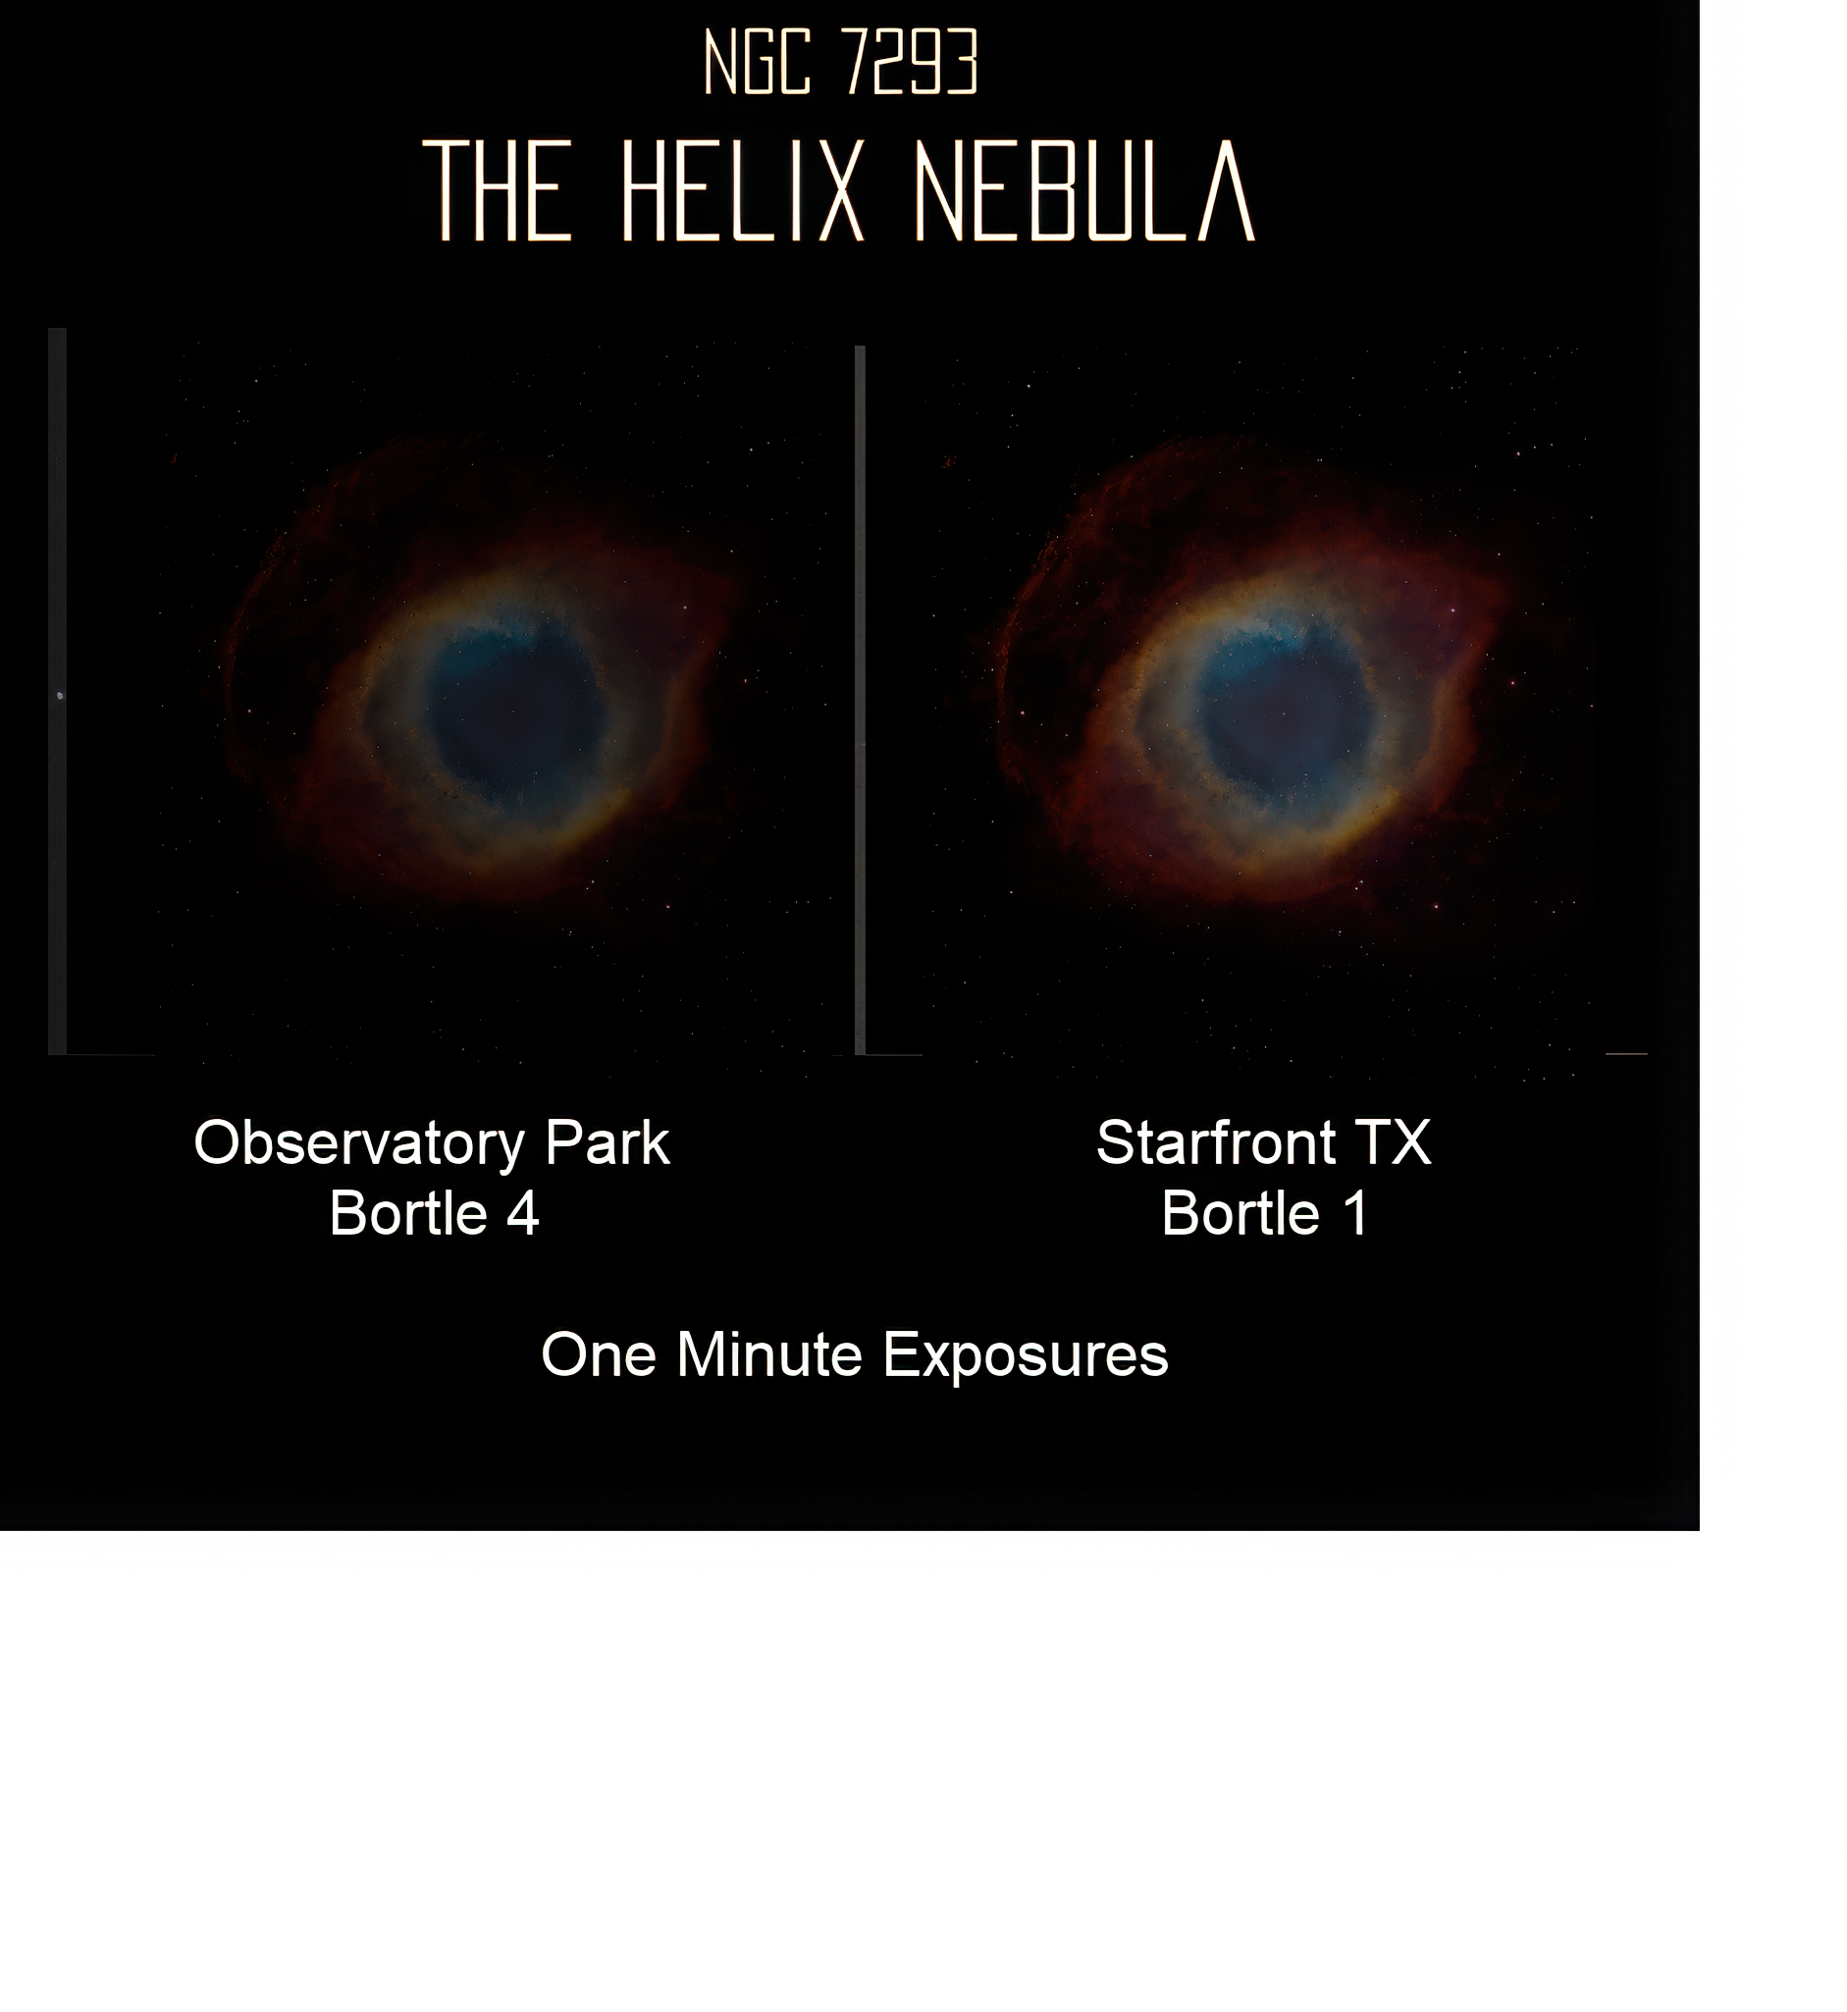
Bortle 1 skies
Notes:
Overview of Seestar Telescope Features, Purpose and Target Audience, Comparison with Traditional Telescopes

Slide 23
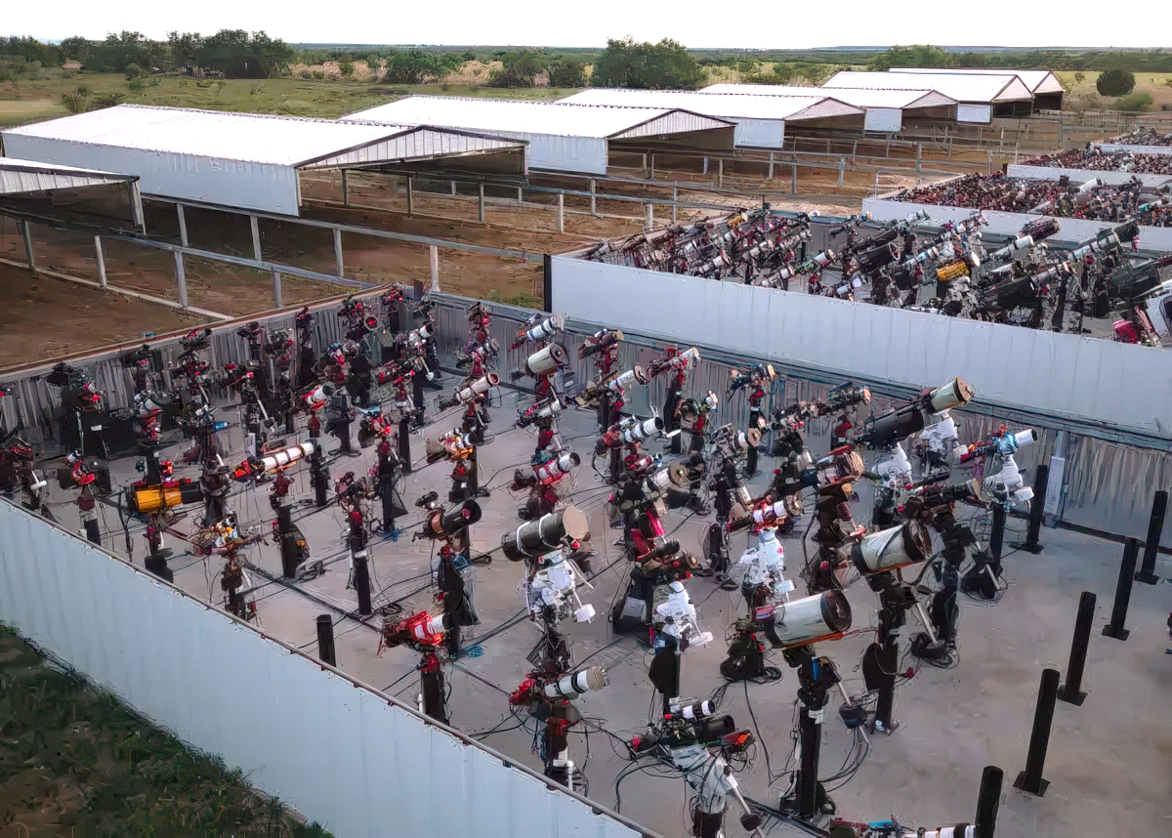
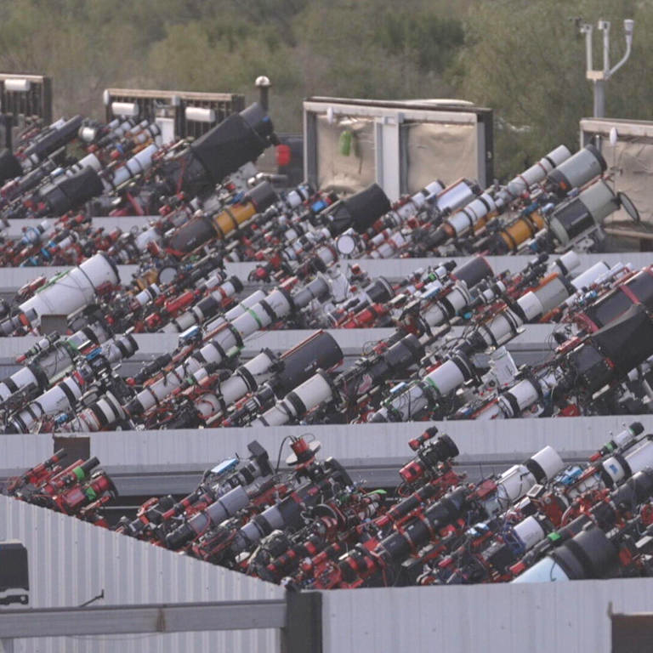
Starfront Observatories in rural central Texas
Average of 240
“clear” nights
Notes:
Overview of Seestar Telescope Features, Purpose and Target Audience, Comparison with Traditional Telescopes

Slide 24
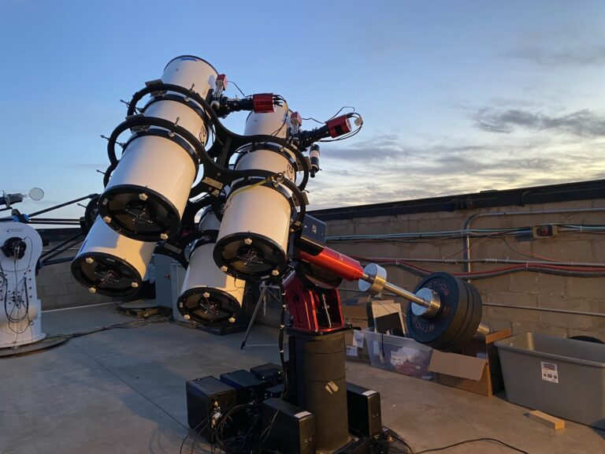
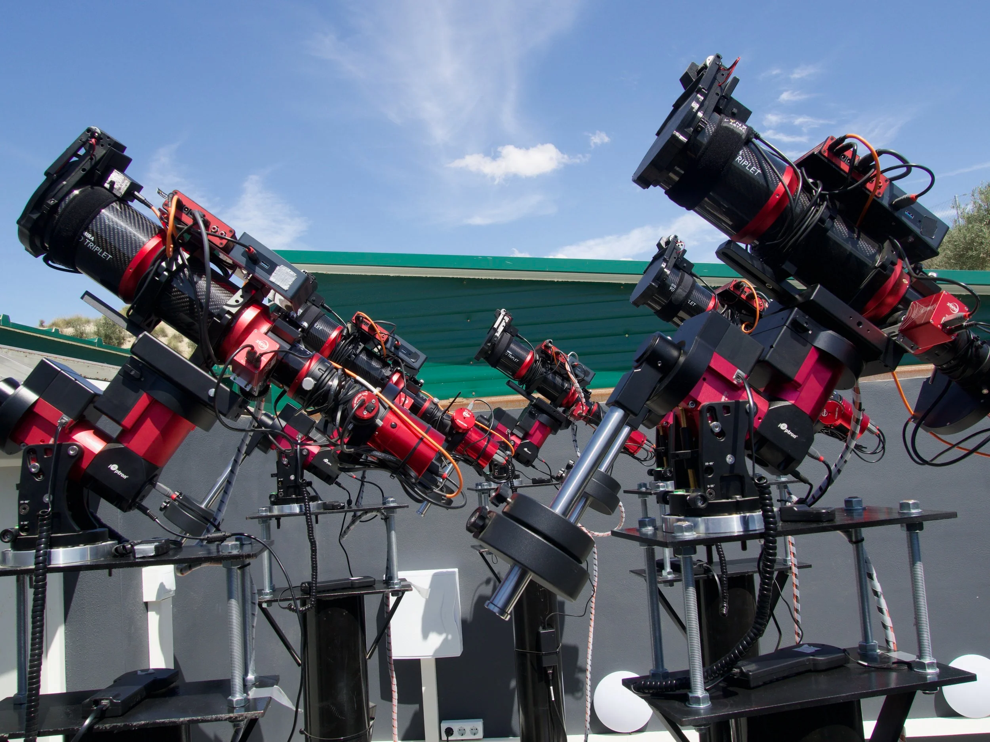
Notes:
Overview of Seestar Telescope Features, Purpose and Target Audience, Comparison with Traditional Telescopes

Slide 25
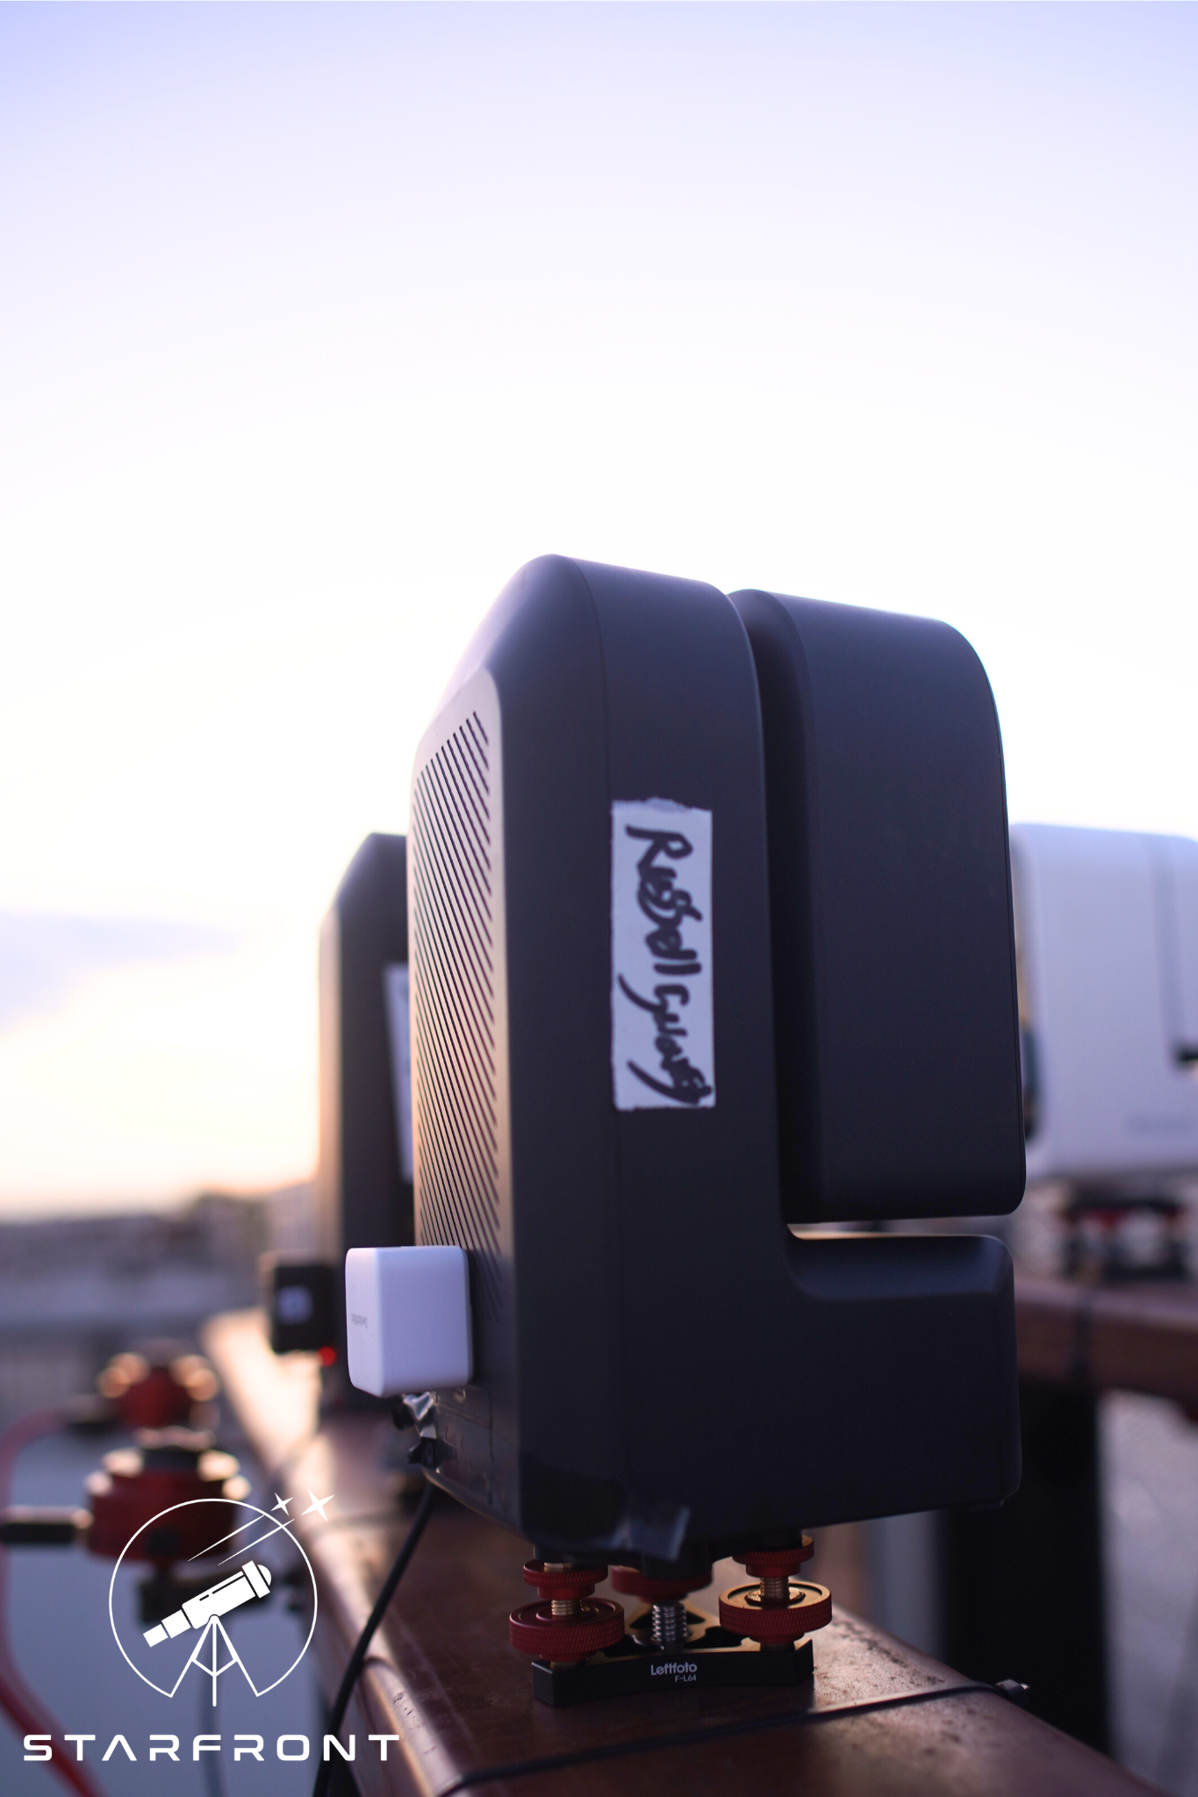
Notes:
Overview of Seestar Telescope Features, Purpose and Target Audience, Comparison with Traditional Telescopes

Slide 26
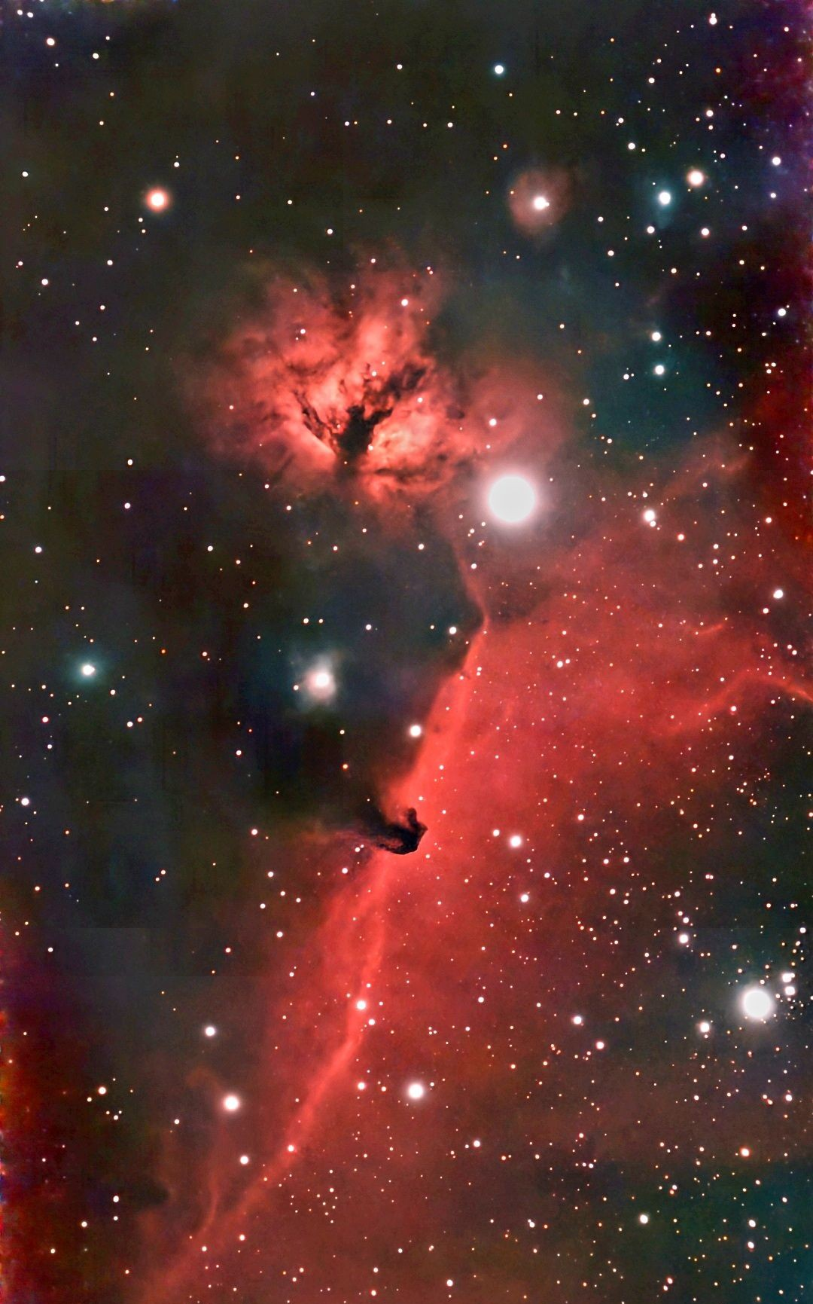
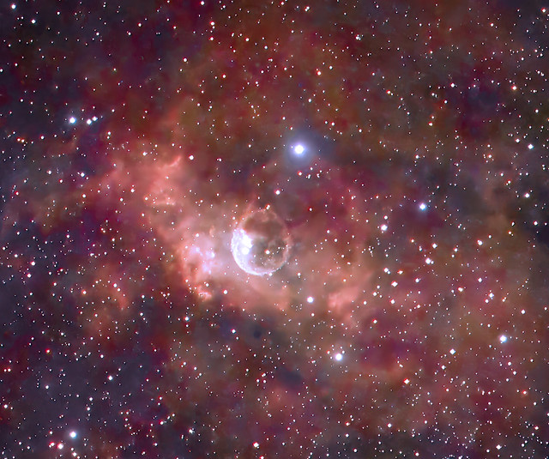
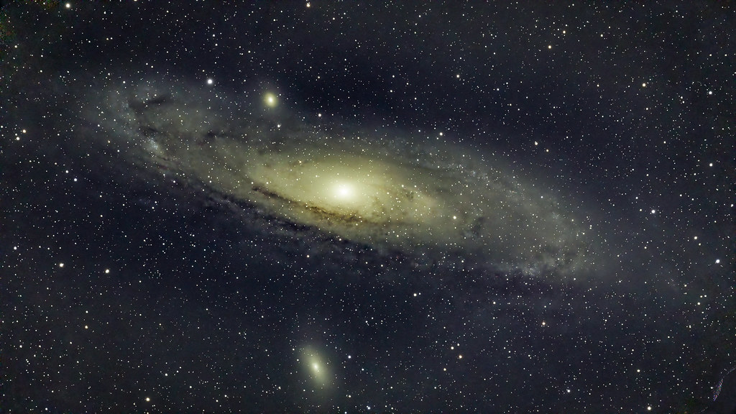
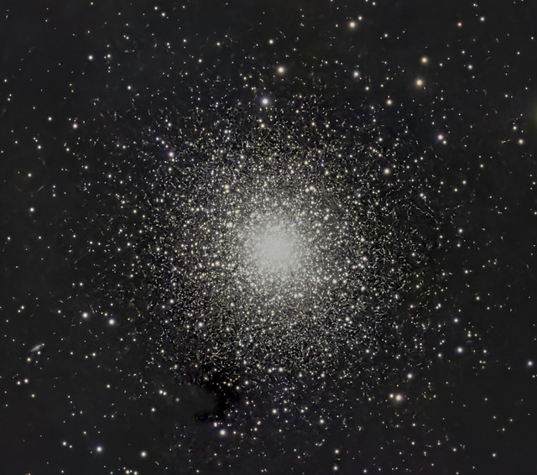
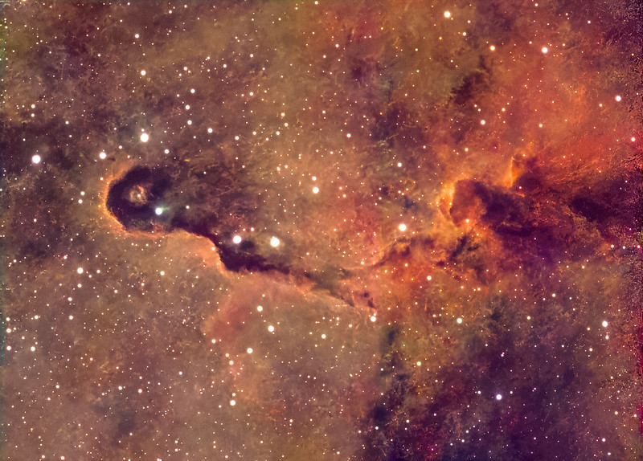
Notes:
Overview of Seestar Telescope Features, Purpose and Target Audience, Comparison with Traditional Telescopes

Slide 27
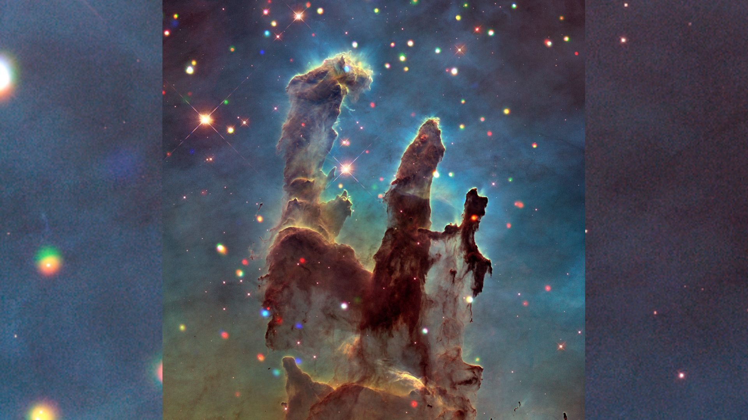
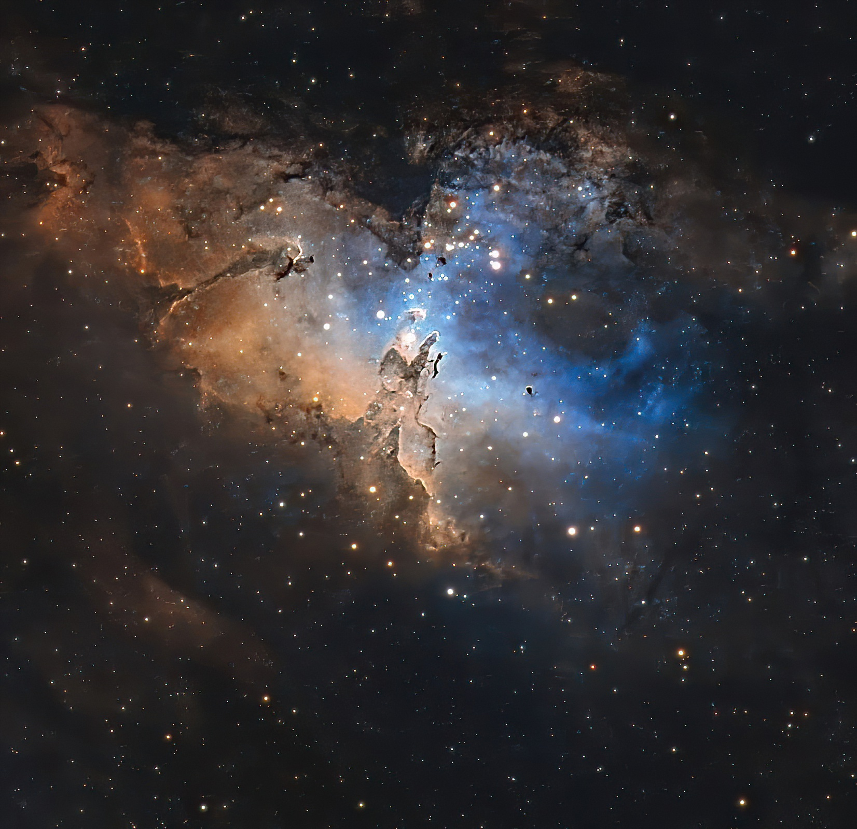
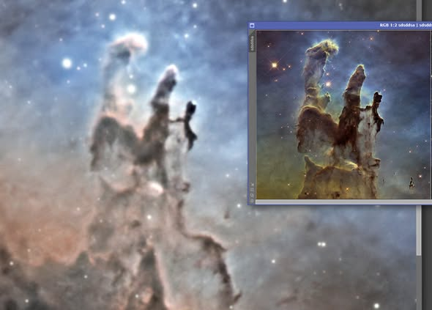
Hubble
Notes:
Overview of Seestar Telescope Features, Purpose and Target Audience, Comparison with Traditional Telescopes

Slide 29
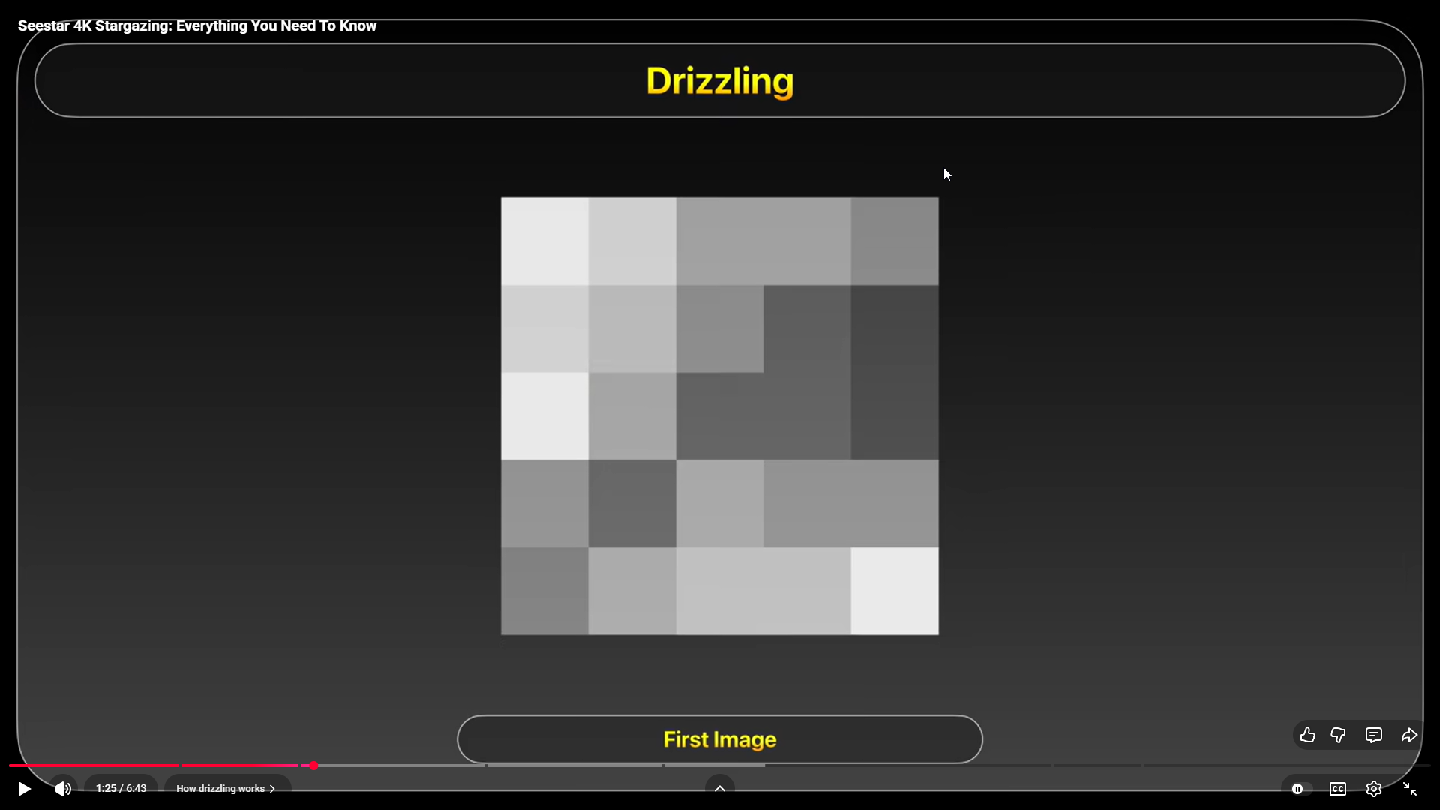
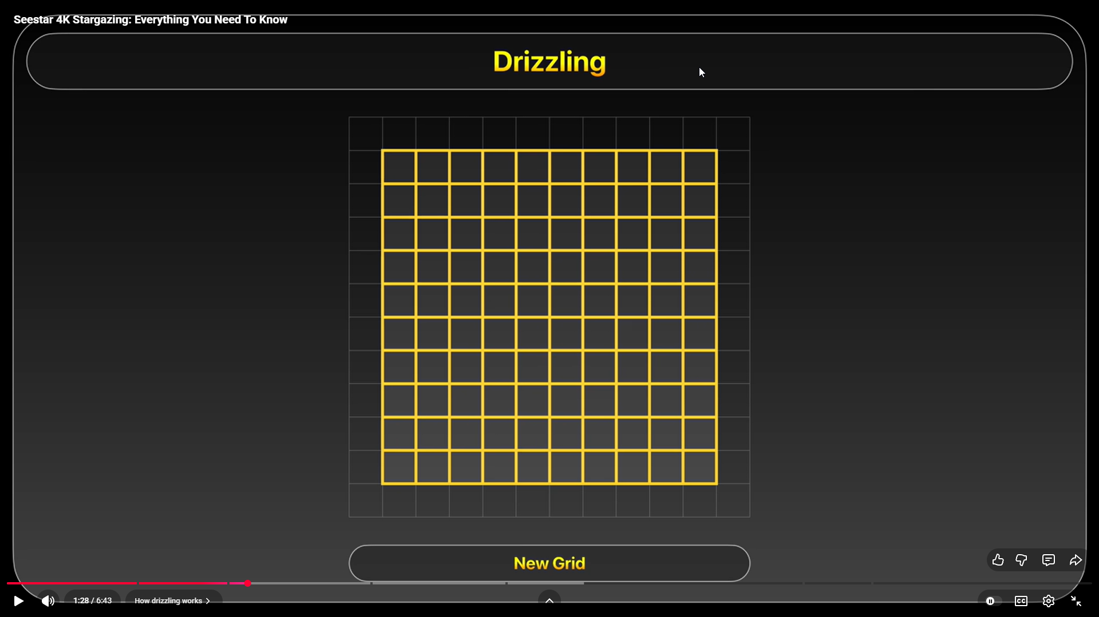
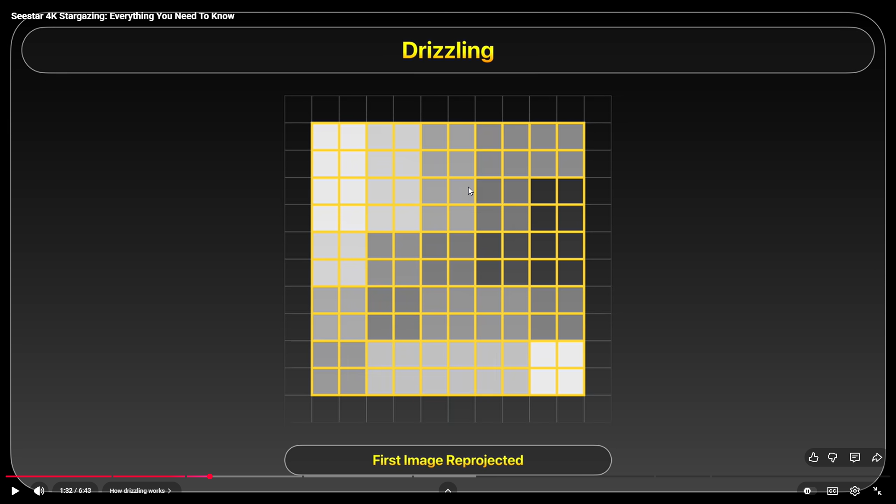
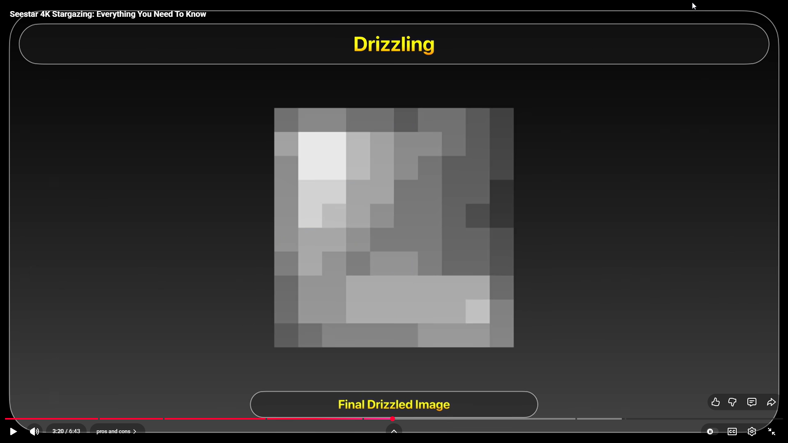

Slide 30
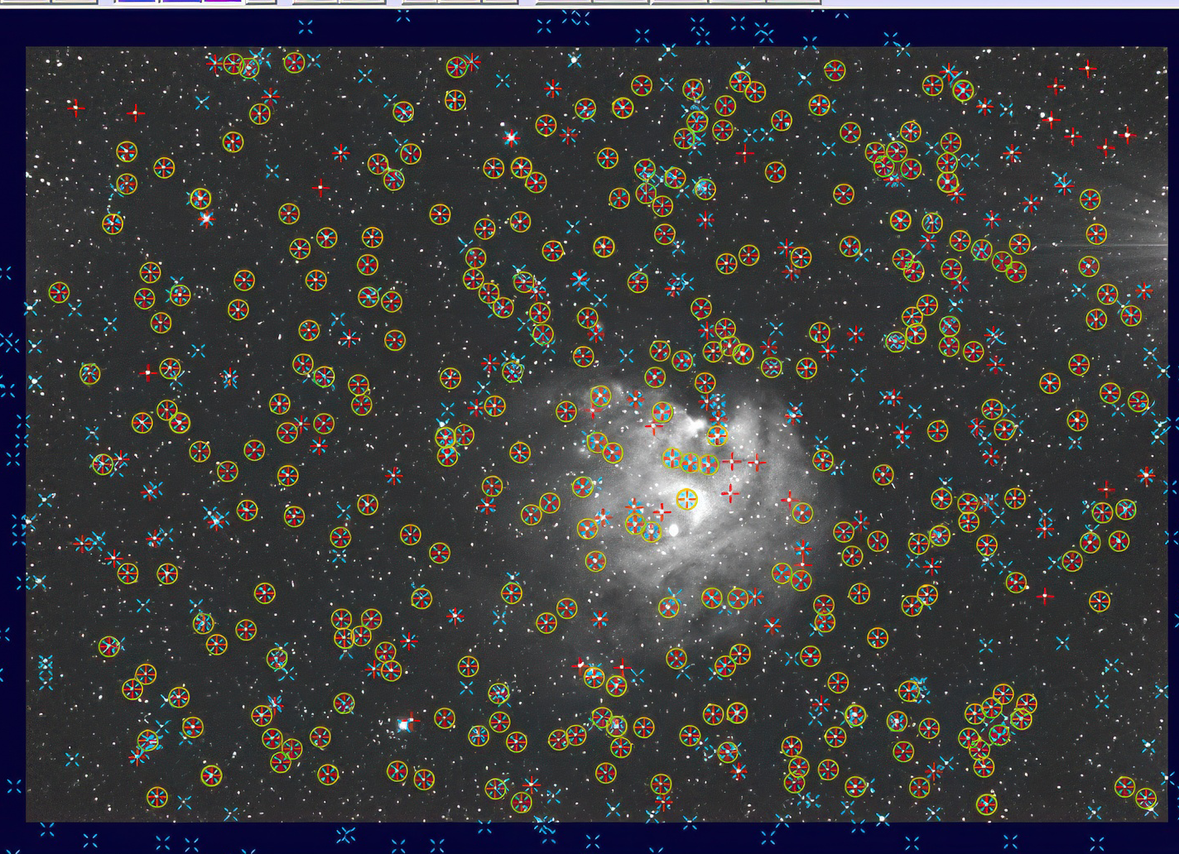
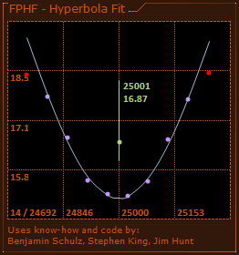
Notes:
Overview of Seestar Telescope Features, Purpose and Target Audience, Comparison with Traditional Telescopes

