Slide 1


Dose of Nature Volunteer Evening
December 2025
Notes:
All photos from Unsplash www.unsplash.co.uk

Slide 2
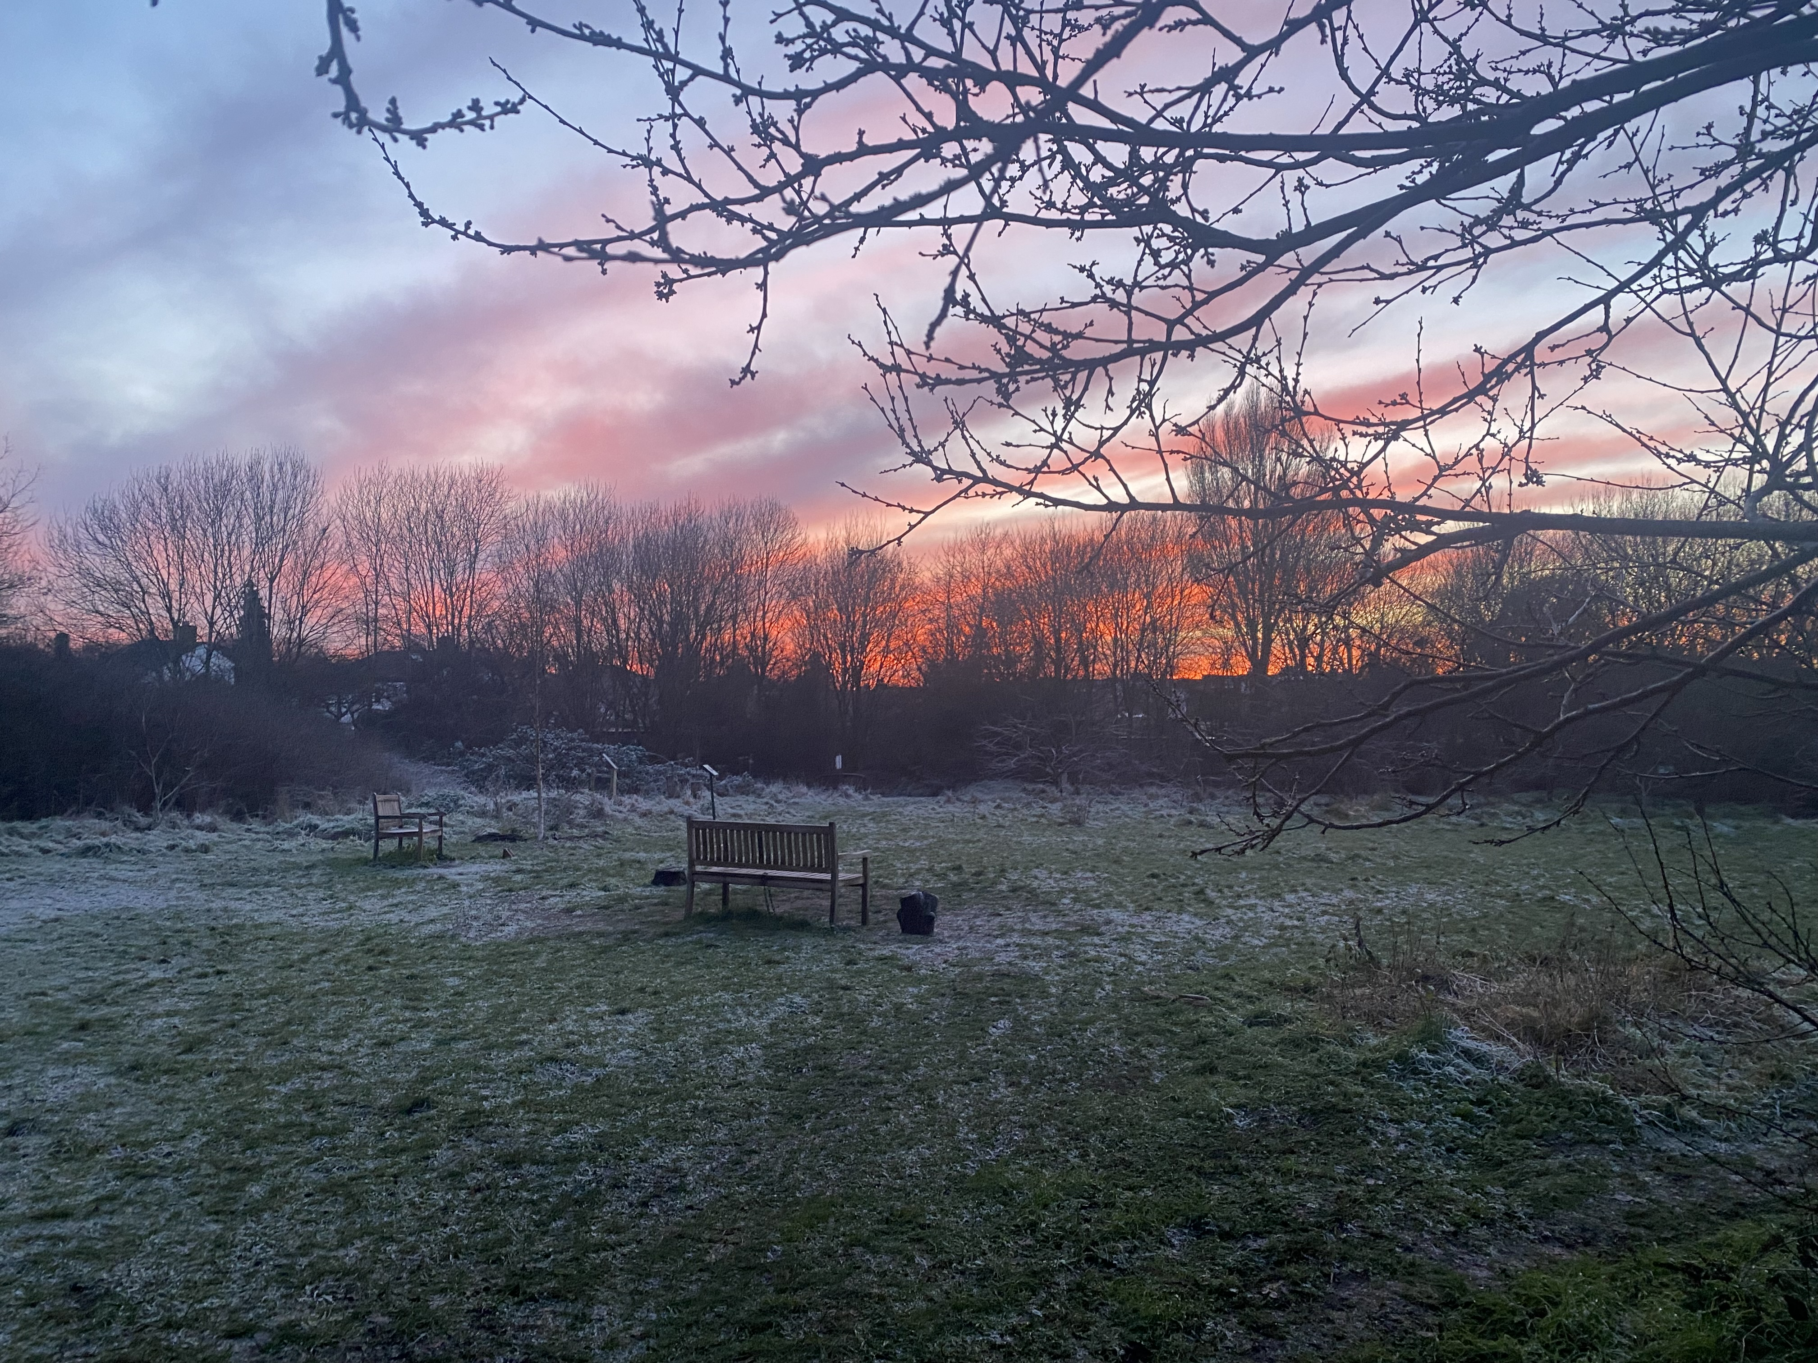
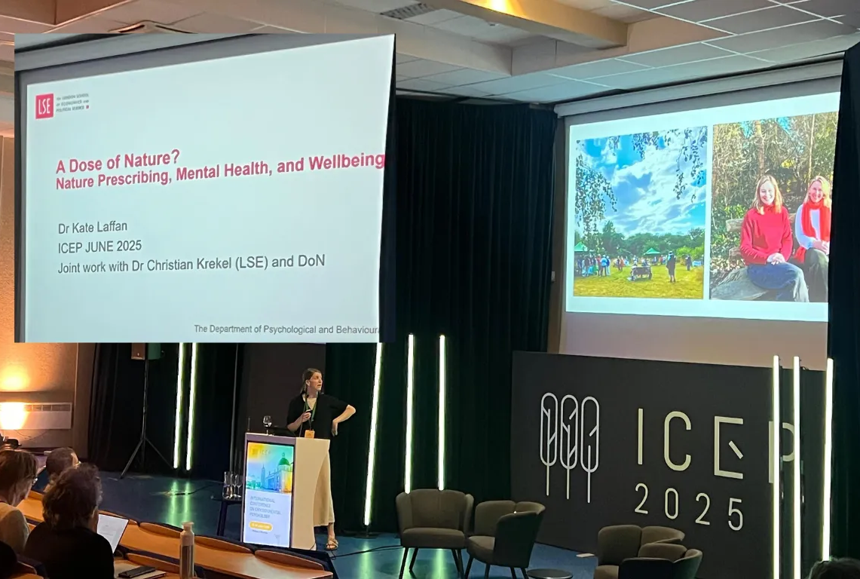
2025 Highlights

Slide 3
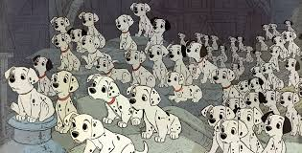
Our Dose of Nature Family
Since we began in 2019, we’ve supported over 1,500 individuals struggling with their mental health (referred to us from 133 GP practices).
We’ve trained 219 volunteer Guides (25 cohorts in Kew; 11 cohorts in Guildford)
2025: The Team
67 Active volunteer Guides in Kew (+ 38 in Guildford)
14 Employees (10 in Kew; 4 in Guildford):
- Psychologists: Alison, Georgina, Emma
- Operations: Katie, Debs, James, Natasha, Tom, Lindsey, Shaun
4 Doctoral Trainees
8 Trustees
8 Volunteers supporting with HR, finance, social media, website, newsletter, cakes

Slide 4
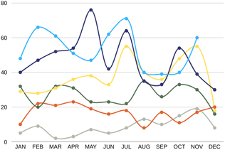

Referrals
586 Referrals to date: Demand for our service continues to grow

Slide 5
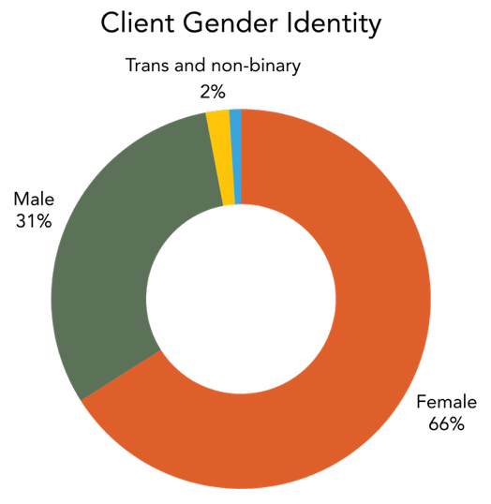
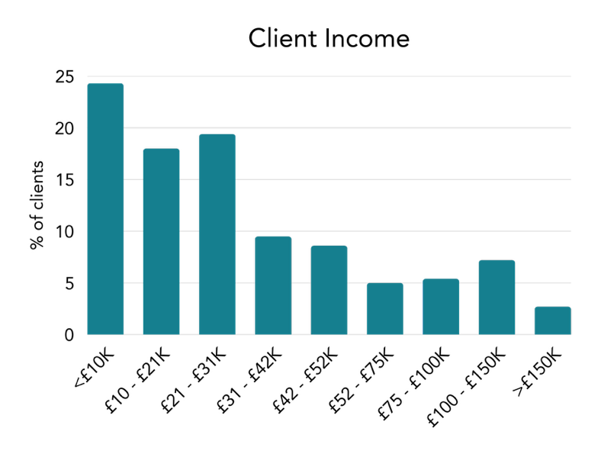
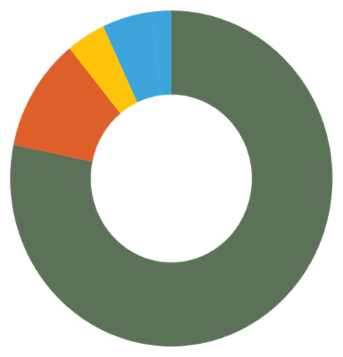
2024 - 2025 Demographics
Client Ethnicity
Black, Black British, Caribbean or African
4%
Mixed or Multiple Ethnic Groups
7%
Asian or Asian British
11%
White or White British
78%

Slide 6
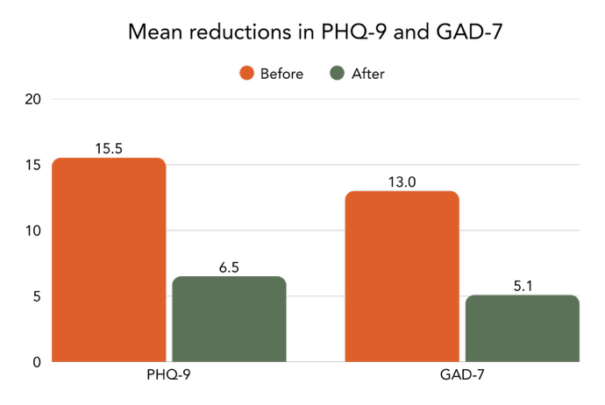
2024 – 2025 Performance
All adults | Recovery rate
Dose of Nature Prescription | 64%
NHS Talking Therapies³ | 50%
All adults | Reliable improvement
Dose of Nature Prescription | 86%
NHS Talking Therapies³ | 67%
All adults | PHQ-9 reduction | GAD-7 reduction
Nature Prescription | 9.0 | 7.9
NHS Talking Therapies¹ | 5.7 | 5.3
Clinical threshold
Clinical threshold

Slide 7
“After my experience with Dose of Nature, my confidence increased to such an extent that I went on to get a wonderful job - something I'm not sure I would have been able to do without my Nature Prescription.”
Alice, referred to DoN for anxiety and low mood
“I don't do well with endings and goodbyes. And often the way things work, like say counselling, or an 8-week programme, it had an inevitable ending, and it was hard for me to deal with that - it brings on things like rejection, abandonment.
But Dose of Nature is like ‘You don't have to go anywhere, you are allowed to go to our groups whenever you want’. I was like ‘Really?’
And it’s turned from me being the client into me volunteering and seeing both sides. I feel helpful when I speak to new clients that come to the groups, because I know how it feels to come to a group without knowing anyone.
So, it's reassuring just knowing that Dose of Nature are still going to be there for you and that it's a growing community, I'm like, I don't want this to stop.”
Adam, 43
“Out of every single mental health intervention I have ever received, what I have found at DoN has been the most effective at actually improving my quality of life and helping me to heal.”
Suki, 34, referred for anxiety and low mood
“I have been a doctor for 21 years and I can honestly say I have not come across a mental health initiative that has come close to being as useful as Dose of Nature has to my patients.”
Dr Lisa Wray, GP at Richmond Lock Surgery

Slide 8

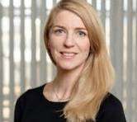
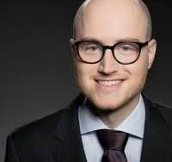
Research
London School of Economics
In Autumn 2022, approached by two Assistant Professors in Behavioural Science at LSE,
Dr Kate Laffan and Dr Chris Krekel, to undertake a Randomised Control Trial (RCT),
evaluating the impact of our nature prescriptions, on mental health, wellbeing, and
pro-environmental behaviours.
First RCT of its kind
Interim report presented in Feb 2025 in Vilnius, at International Conference on Psychology
“Early results are pointing to a robust and positive overall impact of the programme”, with improvements in wellbeing measures, reductions and loneliness, and for mental health, "estimates represent highly significant statistical differences as well as clinically substantive improvements”.
Completed data collection for 300 participants (150 matched pairs) in Nov 2025 (- 1432 referrals to get there!)
£3,850 of wellbeing benefit per participant; £8 - £12 of wellbeing benefit for every £1 spent

Slide 9






Other Research
King’s College, London Dr Cat Huckle co-authored a systematic review on nature-based interventions for neurological disorders
Evaluation of our Young Person’s programme by one of our previous Guides as part of her Master’s at Goldsmith’s, University of London, currently in peer review
Therapists’ experiences of delivering traditional therapy and nature prescriptions, Emily Alford, as part of MA in Integrative Counselling and Psychotherapy, University of Roehampton
Doctoral theses : Impact of nature prescriptions on loneliness; the experiences of volunteering as a Guide; a study on the demographics on who accesses nature prescriptions
A potential RCT on people who have experienced Psychosis with West London NHS Trust
Research with young people (LSE)

Slide 10
Young Person’s Programme
According to polling commissioned by YouGov, by UCL’s Grand Challenge of Mental health and Wellbeing (Sept 2025), the majority (64%) of young adults (aged 16 – 25) in Britain say they have experienced mental health difficulties, with a third (32%) expecting they will need support in the coming year.
People who had been helped by a private therapist (74%) were likely to find the support helpful, but the satisfaction ratings for NHS therapists (56%) or GPs (53%) were less favourable. Of those sufficiently unwell to have a referral to CAMHS, 69% found it unhelpful.
A study published this summer found that talking therapy offered by the NHS for people with depression or anxiety appears to be less effective for people aged 16 – 24 than those aged 25 – 65. This study highlights the need to find alternative treatments for young people.
Meanwhile, RSPB research suggests that only 21% of 8-12 year olds are “connected to nature”. The study identified the lowest recorded nature relatedness figures for 15- to 17-year-olds.
In other words, today’s young people have the poorest mental health of any age group in the UK and, at the same time, feel the least connected to nature.
Dose of Nature
90 referrals for young people in 2025 to date
Regular 4 – 6-week courses for young people who have engaged in the 1:1 prescription
Monthly drop-in group for young people who have completes the course

Slide 11
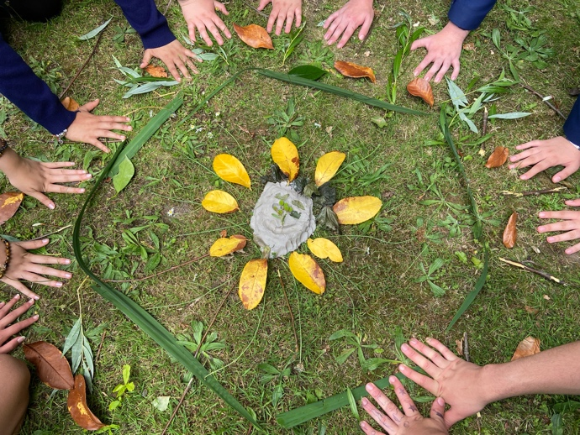
Young Person’s Programme
“I enjoyed being outside and noticing the colours and shapes, and my Guide helped me to really notice things. I didn’t expect it to be fun, but we laughed a lot and did silly things like lie on the grass and stare at the sky, even though it was raining! I really liked the creative stuff we did together too, we drew trees and wrote poems, but even though I’m not very good at either, I never felt it mattered. I also found it interesting learning about the science and how being outside really can affect your mental health. And it has worked for me. I feel so much less anxious now. I do still worry about lots of things, but now when I feel panicky, I just go outside and it really does help – like magic!”
Minna, 17
“My nature prescription gave me hope for the rest of the week.”
Jen, 16

Slide 12
Schools-Based Initiative
Rationale for the initiative: preventative, access large numbers of young people, influence the way in which we manage mental health / wellbeing from a young age.
Pilot: Two initiatives at a local secondary school
PHSE Programme
180 Year 8 students (aged 12-13) completed a four-week course during their regular PSHE lessons. Throughout the programme, students learned practical tools to manage stress, anxiety, and emotional challenges.
Week 1: https://vimeo.com/reviews/a5059905-fc54-418f-966b-f17499dc8c7e/videos/1093035761
Week 2: https://vimeo.com/reviews/a5059905-fc54-418f-966b-f17499dc8c7e/videos/1090113623
Week 3: https://vimeo.com/reviews/a5059905-fc54-418f-966b-f17499dc8c7e/videos/1090115524
Week 4: https://vimeo.com/reviews/a5059905-fc54-418f-966b-f17499dc8c7e/videos/1090118551
2. Six week ‘Nature for Wellbeing course’
85%
of students’ mental health improved
83%
felt more connected to nature
“I realised that I overthink things and now I use nature to ground me... I also use nature as a break from my work, and I then feel refreshed and produce better quality work”
Ali, 17
All students started spending more time in nature

Slide 13
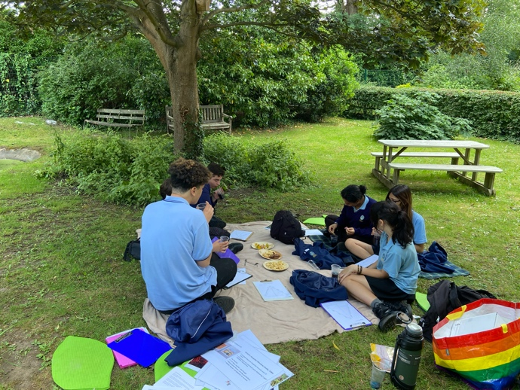
Young Person’s Programme: Next Steps
Keep calm and carry on!
Young Person’s Hub
Further research

Slide 14








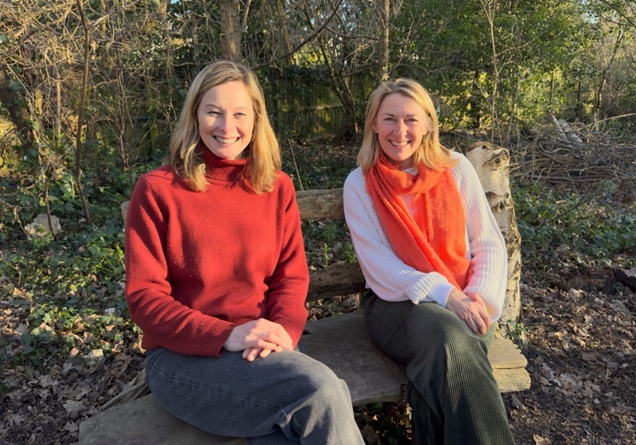
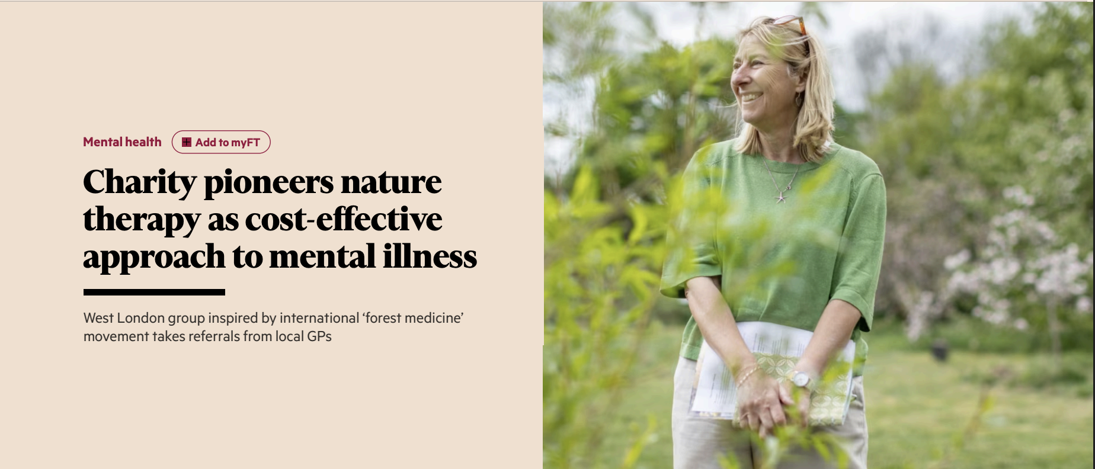
A Big Year for Media
Notes:
Wellbeing workshops – preventative work, leaving care team, GPs, support service for cancer patients, SPEAR – homeless charity
DoN Ambassadors – Chris, Katie, Tim,

Slide 15
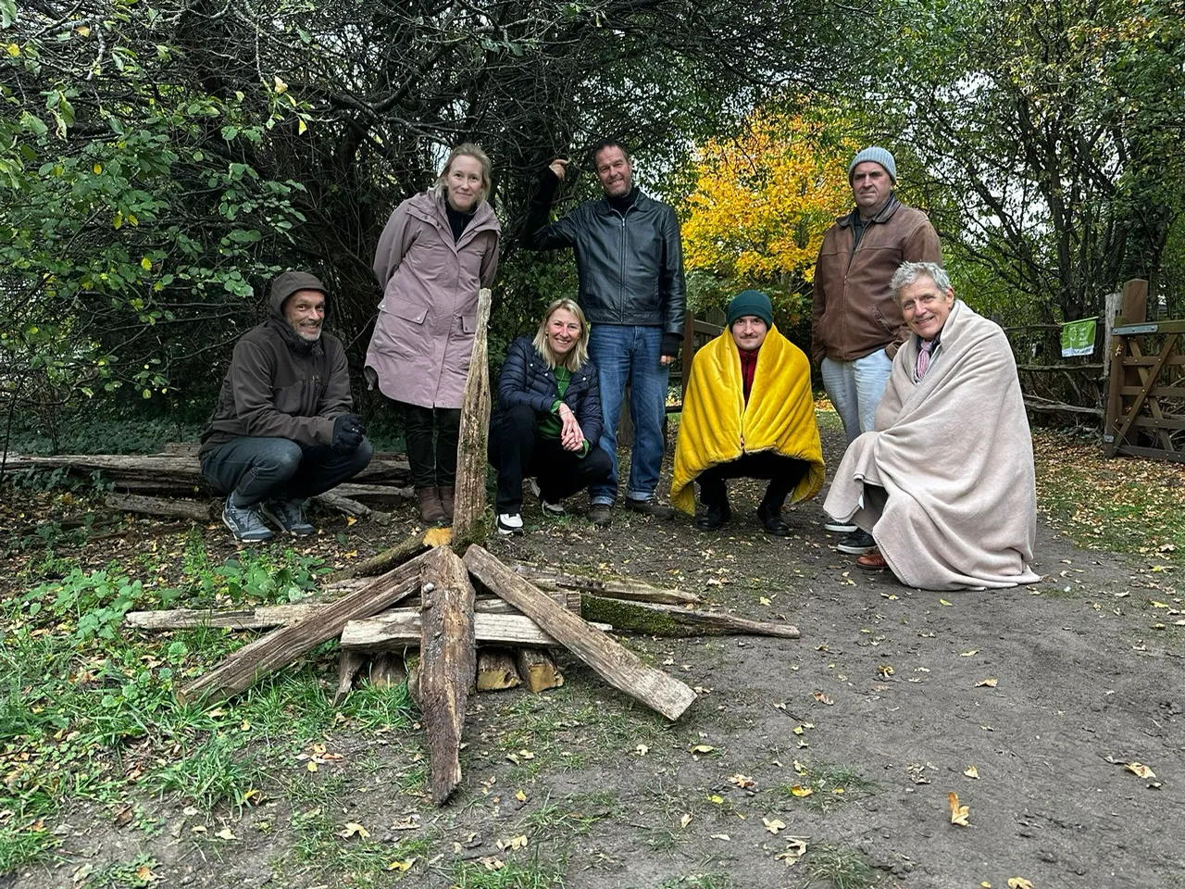
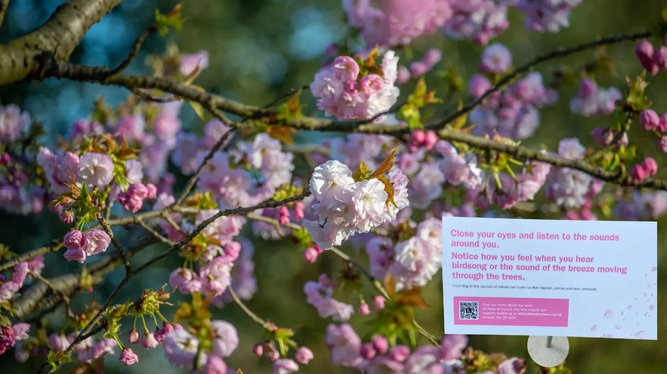
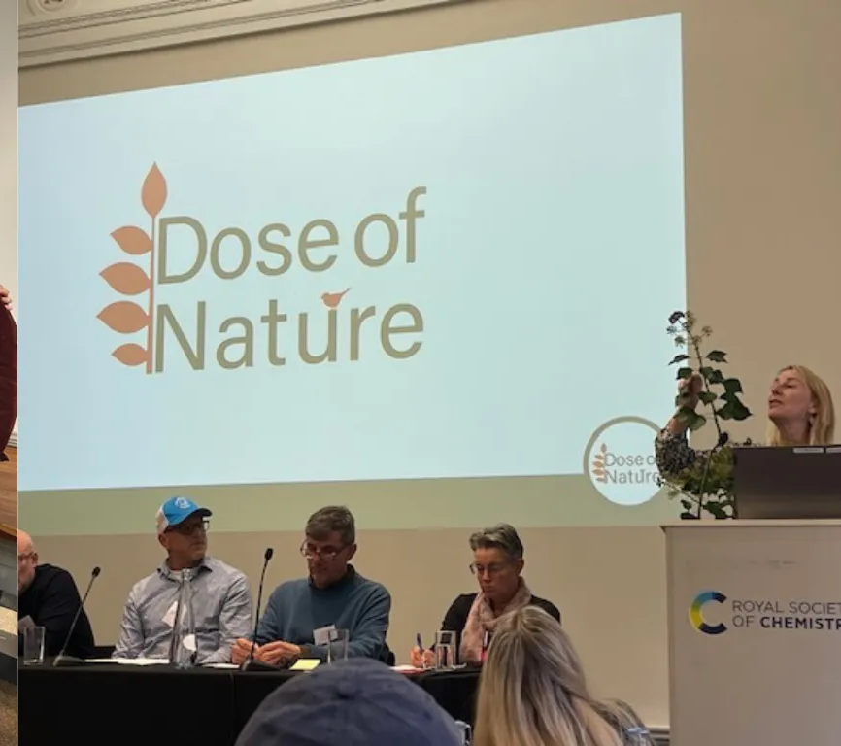
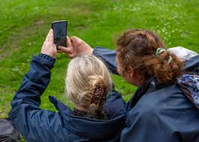
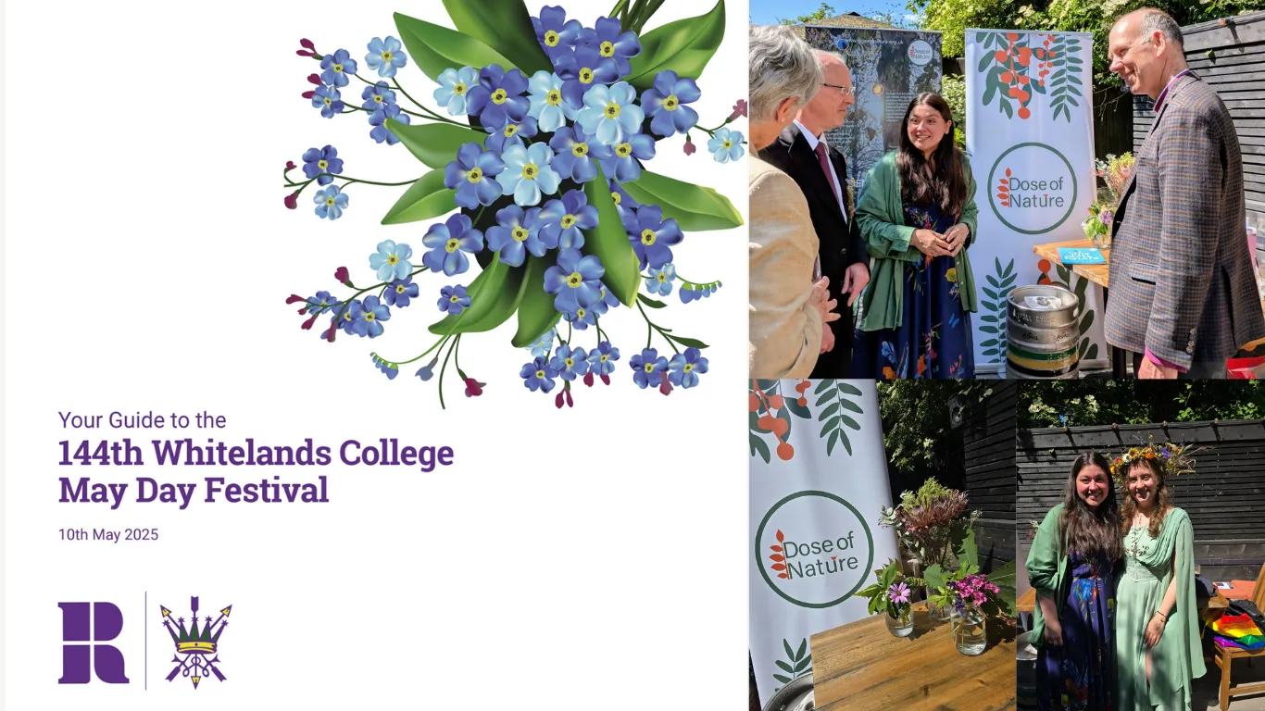
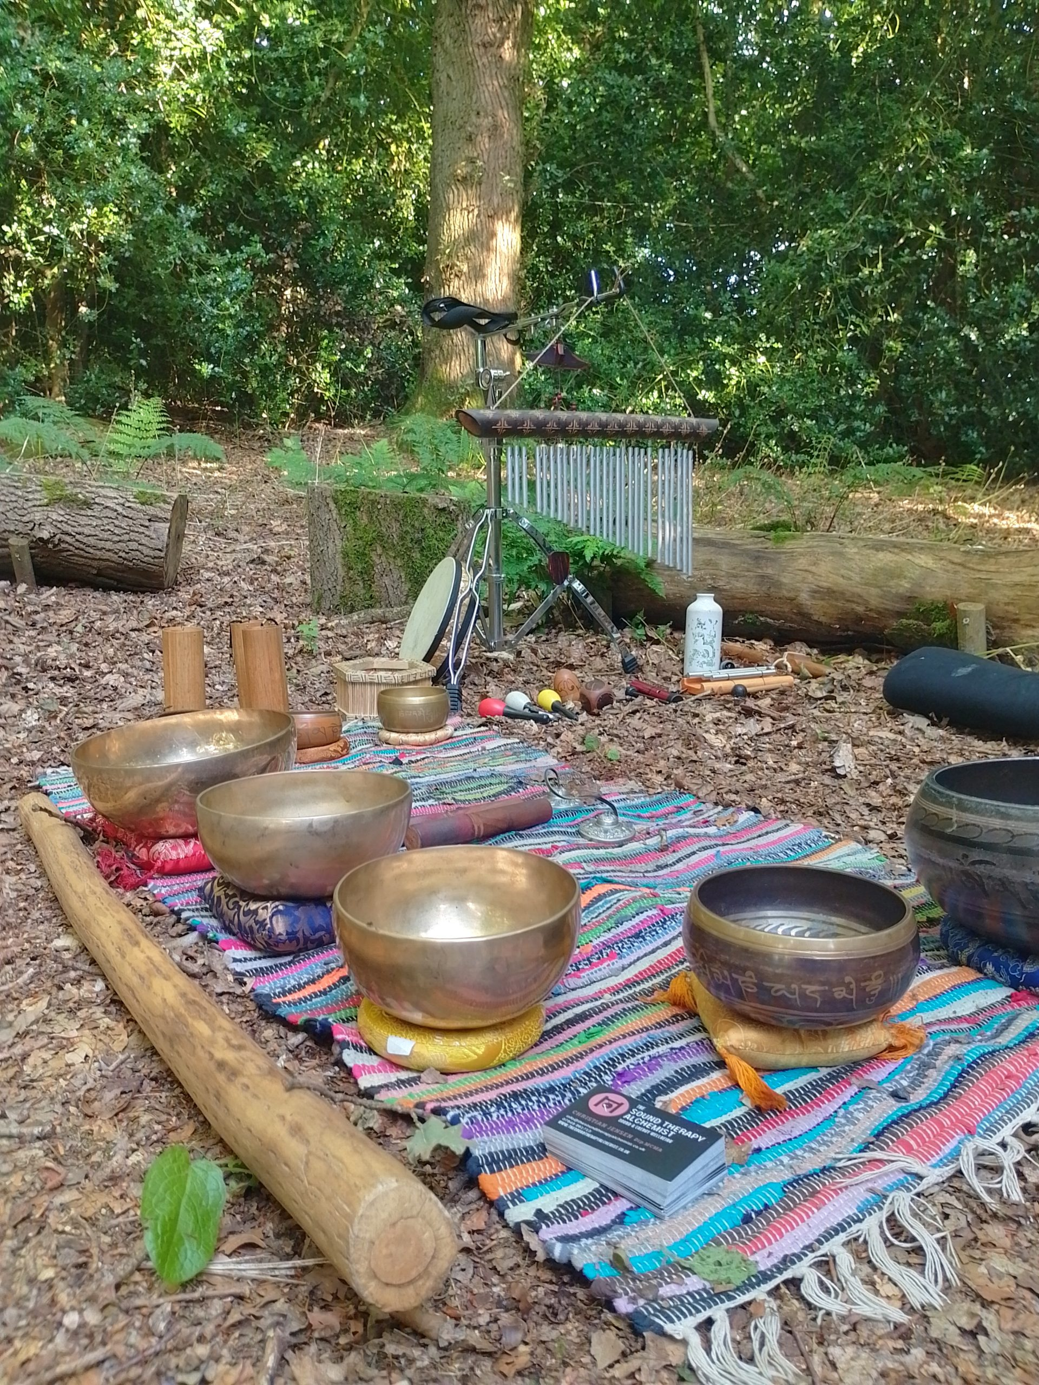
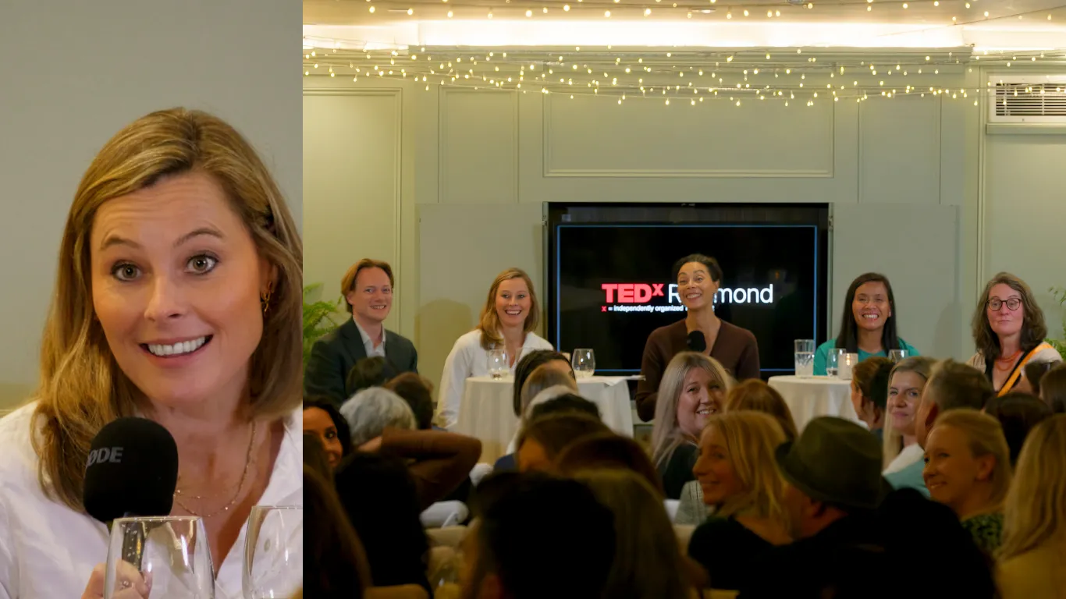
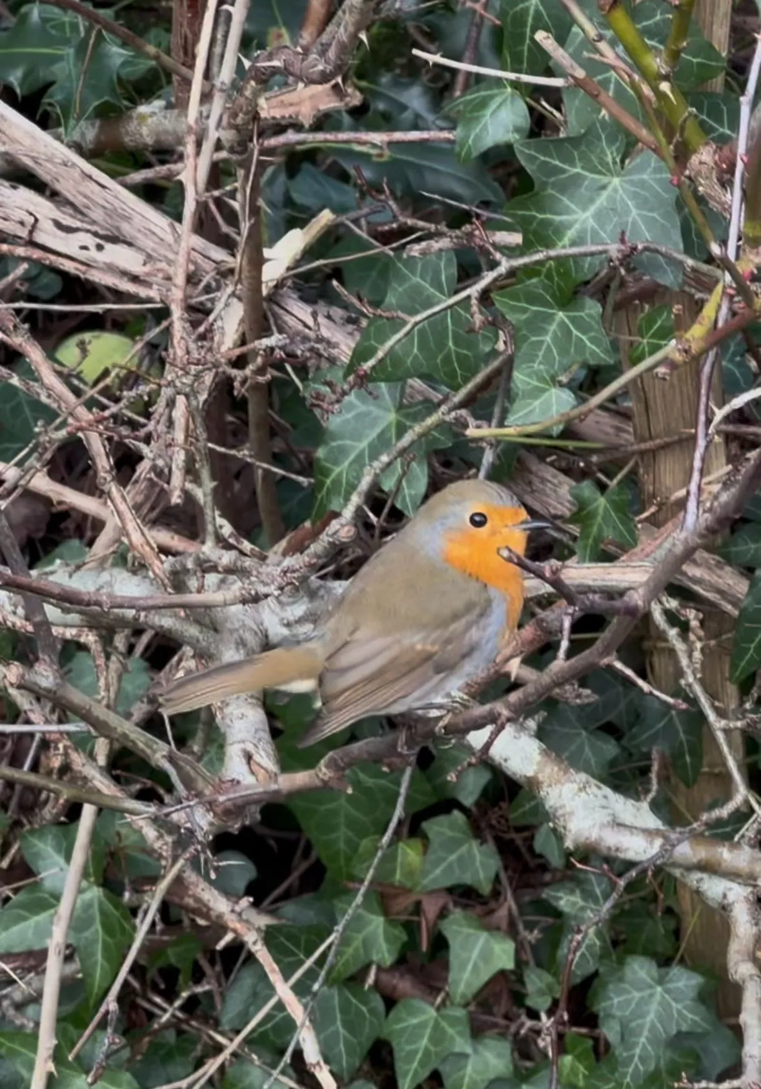
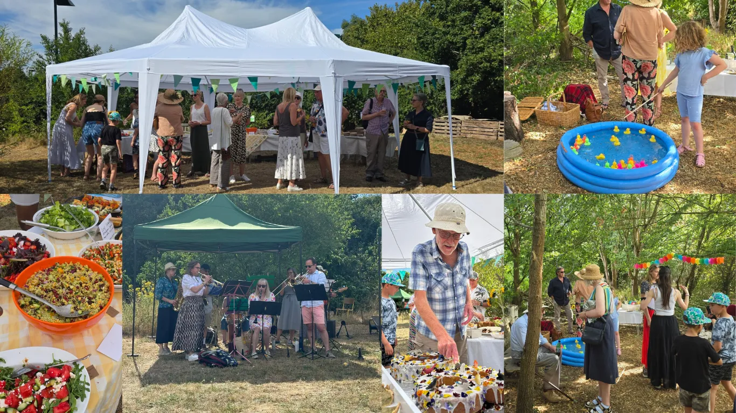
Other Highlights in Pictures

Slide 16
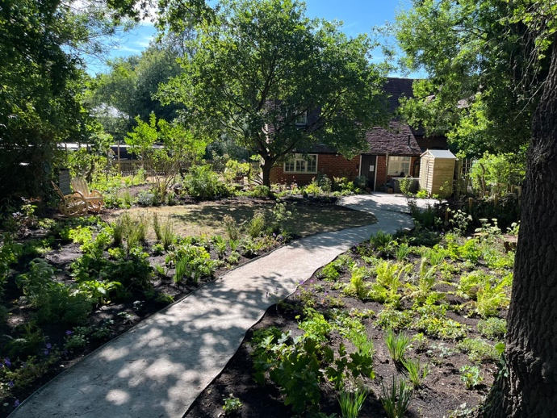
Guildford Highlights
Therapeutic garden collaboration with Wisley Gardens

Slide 17
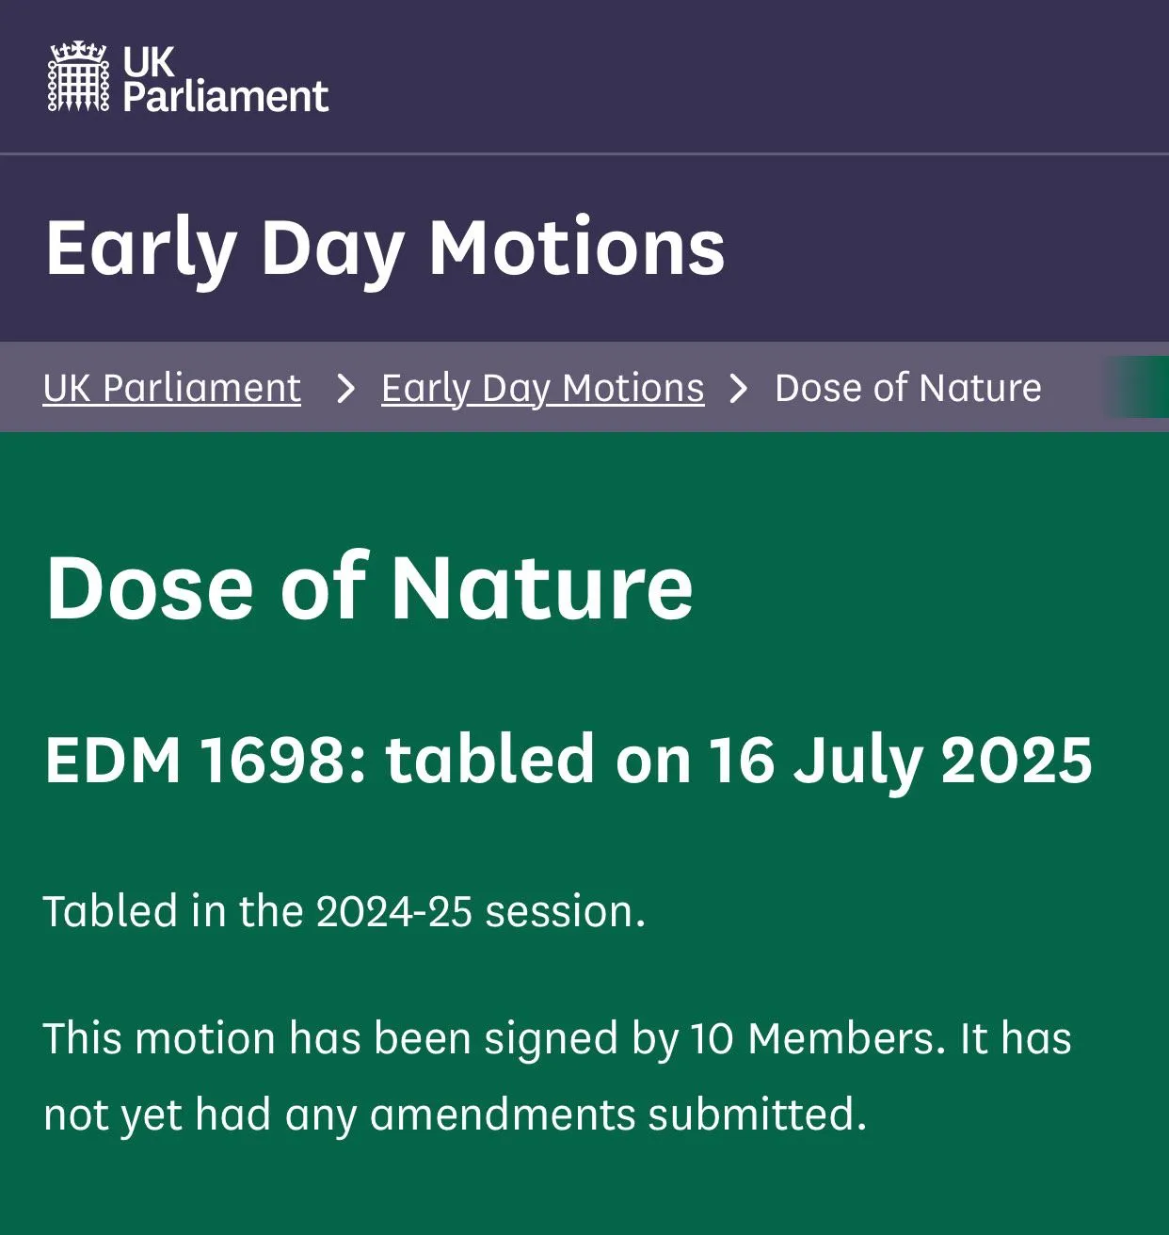

Guildford Highlights

Slide 18

Funding
50% Trust Funds
15% NHS
15% Private Donors
10% Local Authority
10% Local Community, Corporate, Earned Income

Slide 19
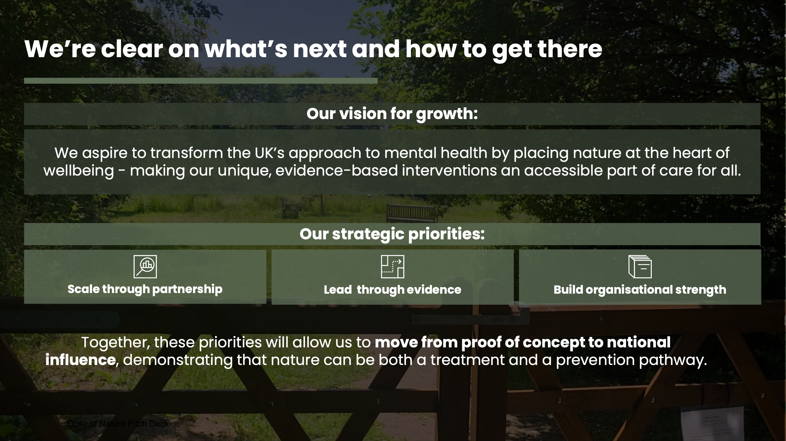

Slide 20
And this is why….
When I arrived at Dose, I was fresh out of two psychiatric hospitals. In honesty, I cannot remember much of my initial meeting, but I do remember that on the way there, I was scared. But on the journey home, I didn’t feel so scared anymore. My psychosis had made me a shell of my former self, but sitting in nature on that first day, proved to be a glimmer of hope. Something I could hold on to.
As the months passed, I met my volunteer at the charity. She read me poetry and made me feel safe. We talked for hours and shared our love of music and dance under the trees of various surrounding parks.
Connecting in nature with my personal guide, sitting together, talking and being gently listened to, was a unique and incredible experience.
I often think about people who are going through similar things that I did mentally and how they would feel so much better if they had the chance to have this opportunity too. It opened my world.
I was told in therapy to find something that I love - and to hold onto it. Often, with people experiencing mental health difficulties and challenges there is a block in feeling enjoyment and particularly forming connections and maintaining relationships.
Dose of Nature is a sheer gem in opening up people’s worlds and ensuring they have a true friend in the process. I know I found so much beauty there, and you know what’s the best thing? it’s beauty I can now see everywhere, having gained a renewed perspective on life, a new reason to live.

Slide 21
2024 Feedback
private area of website for volunteers - bios/resources
written feedback at the end - tips to improve
Lanyards/business cards for guides
training evenings not always on a Tuesday
improve processes re. matching - written confirmation, name, start/end dates
new resource book
change supervision set up – booking system, more options/ availability
better information for clients re. what’s involved in terms of commitment
grow and get NICE approval
consistency in processes, re, feedback, etc.
follow-up feedback on clients – how they’re doing after six months /one year
name badges for Guides at training sessions

