Slide 1
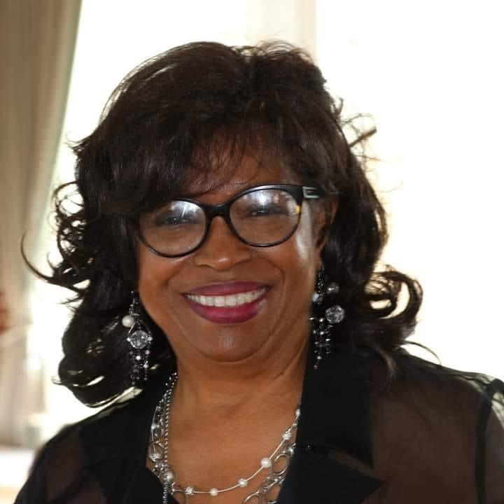
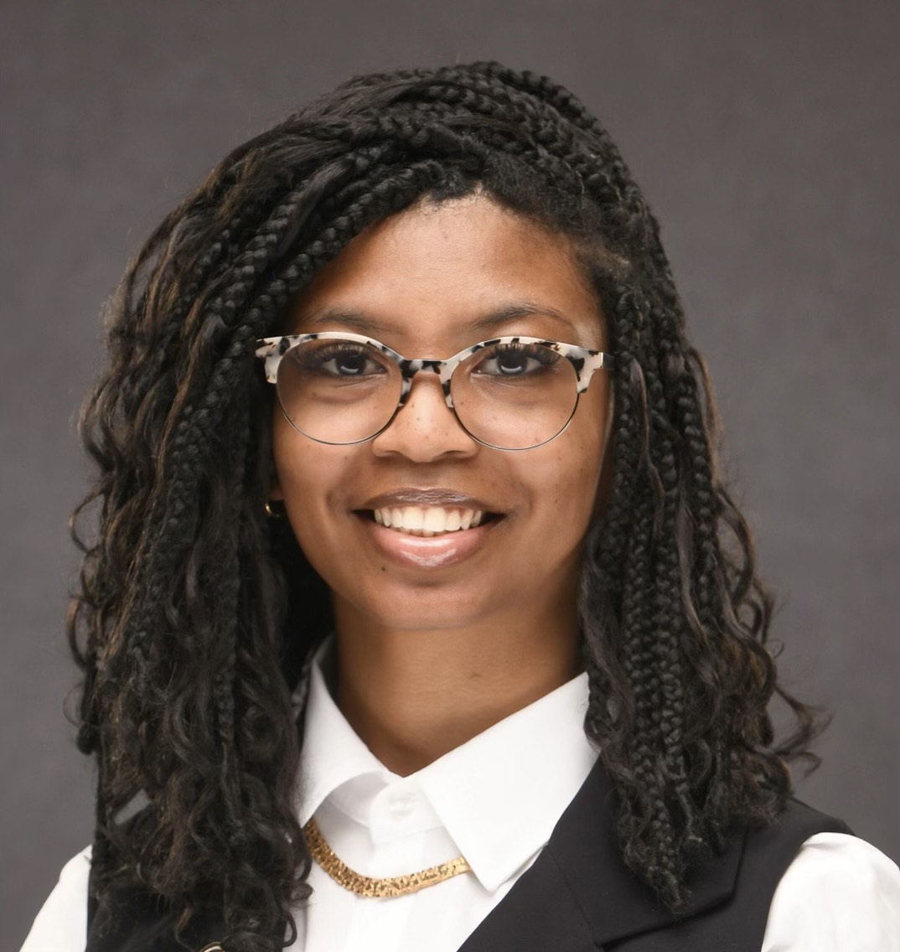
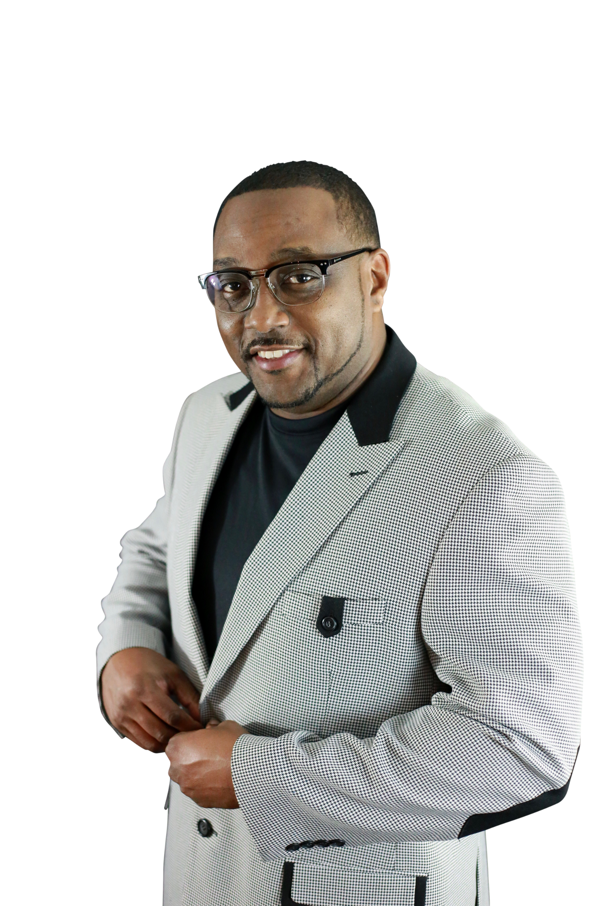
Patricia Mims-Brooks, Etiquette Director
Girls Relationship with Boys
My career began as an administrative assistant after graduating from Business College I have worked for several Fortune 500 companies as an executive assistant to Directors, Sr. Vice Presidents, and Managers, I learned from these experiences, grew as a person, and developed those skills to become an entrepreneur. I serve as Vice President of Brooks Insurance Brokers LLC.
I have a rich background in serving others. I volunteered for the Dallas Urban League of Greater Dallas for 36+ years, serving as President of the Dallas Urban League Guild, and Secretary My signature program was “The Gifted Ten” scholarship initiative where 10 accomplished seniors were provided scholarships not just by making the grade but because of their devotion to serving their community.
I have a deep devotion to children to ensure they grow with high self esteem and respect for others.
Tiara Freeman – Etiquette Coordinator – Ladies Club
Health/Ladylike Presence
Tiara Freeman is an artist, educator, and mentor with a passion for teaching etiquette as a tool for confidence, character, and lifelong success. She holds a Master’s degree in Mass Communication from Grambling State University, where she also served as Graduate Student Association President and led several campus and community leadership initiatives. She believes etiquette is a foundation for confidence, character, and lifelong success. Tiara is dedicated to empowering youth to carry themselves with grace, purpose, and presence in every space they enter.
Pastor Detorin Gipson, Etiquette Coordinator, Gentlemen by Design
Gentlemen’s Relationship with Girls
Gentlemen’s and Ladies Finances
Pastor Gipson is a graduate of Grambling State University • He graduated from Omega Bible Institute and Faith Bible Institute with a Doctoral Degree in Ministry • Dr. Gipson is the Pastor of Antioch Baptist Church located in Homer, LA • He is a devoted husband and a father of 2 children • He is the Director of the Board of Christian Education for the Gum Spring Missionary Baptist Association • Pastor Gipson is an entrepreneur of several businesses - Just to name a few:
He is a Regional Vice President with Primerica– the #1 Most Trusted Life Insurance Company and the #3 Most Trusted Financial Company in North America. He is known as the Financial Coach and the Co-Owner of Destined 4 Greatness Financial Services.
One scripture that fits him best is: “You intended to harm me, but God intended it all for good. He brought me to this position so I could save the lives of many people.” – Genesis 50:20 NLT

Slide 2
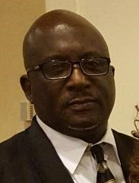
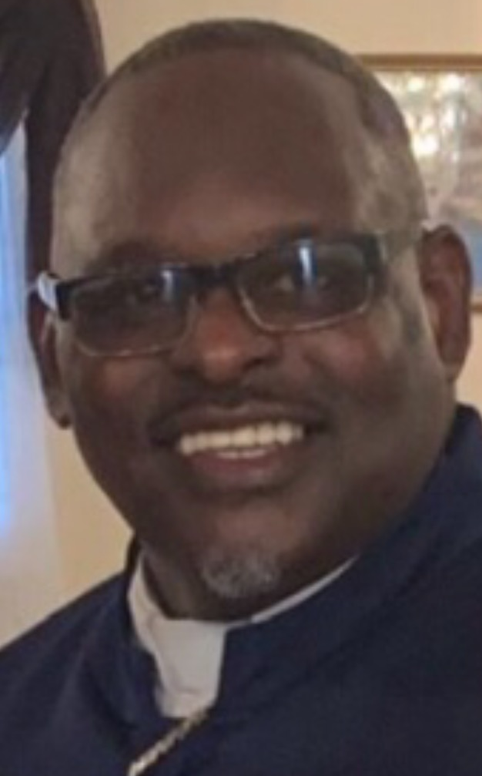
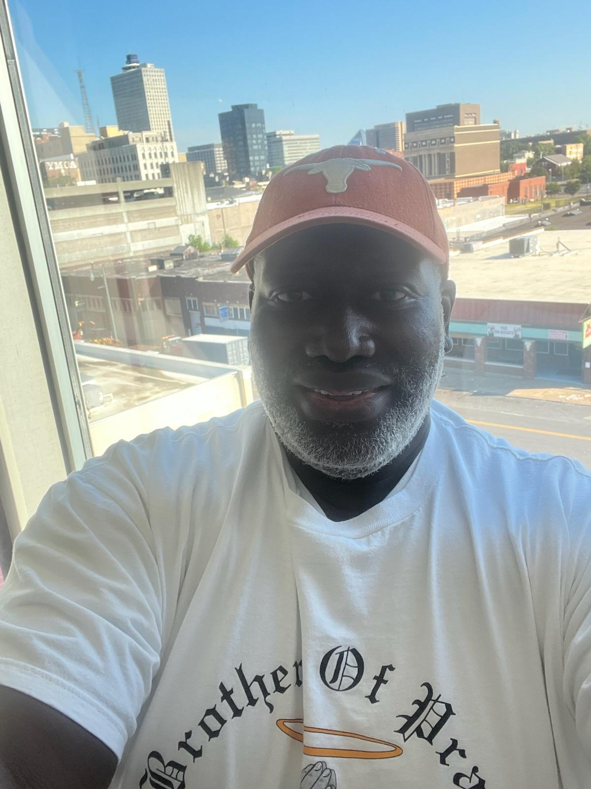
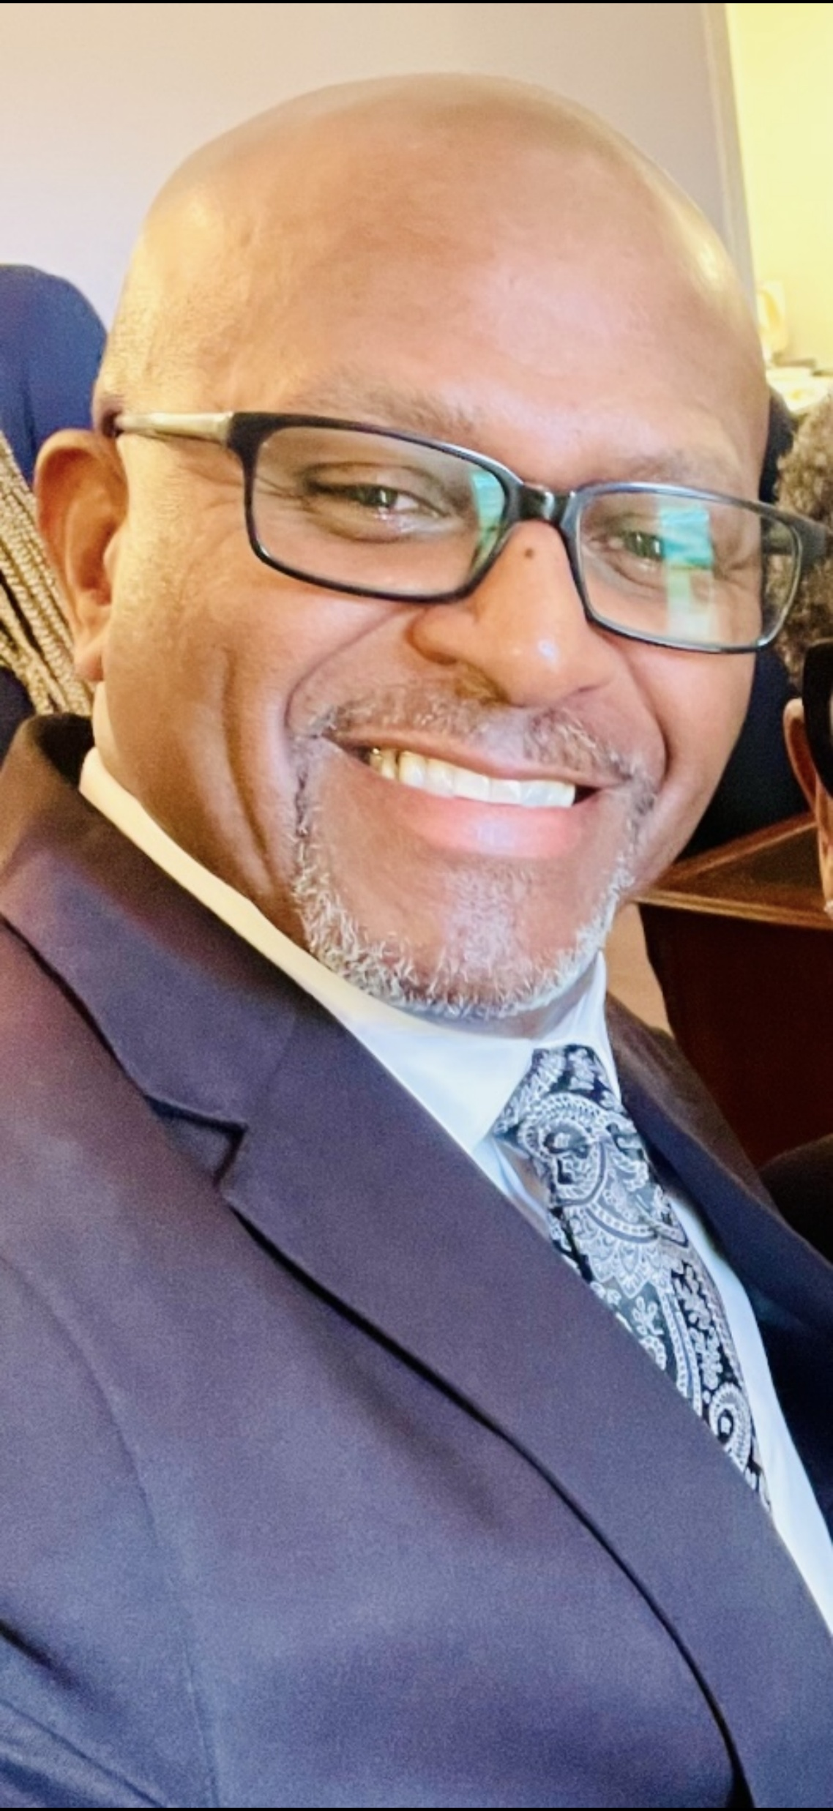
Instructors
Gentlemen by Design (Continued)
I am a native of Ruston. I have been a licensed agent for over 25 years experienced in insurance, banking/finance, and mortgage. I have worked for major companies such as New York Life, Pennsylvania Life Insurance, Dialog Direct, AmSouth Bank and Regions Bank just to name a few. I am Licensed and authorized to sell annuities, life insurance, MAPD plans, Medicare Supplement, 40lK, GIUL and IRAs.
As a military veteran for many years, I was an ROTC Administrator/Instructor at Alcorn State University, training cadets on how to be an “Officer and a Gentleman”.
I am truly committed to growing this next generation to be “gentlemen” and leaders.
Troy Brooks, Sr –
Gentlemen’s Speech/
Communication
Wayne L. Buggs is a native of Ruston, LA. He is a 1983 graduate of Ruston High School. He attended Louisiana Tech University for two years, and then decided to join the Army. While serving in Military Active Duty from 1987-1996 he earned many medals and badges for his achievements, conduct, service, and handling machinery.
Following his diligent work with the youth he became a Deacon, Superintendent of the Sunday School at the Zion Hill Baptist Church.
Married in June/2004, became an ordained Minister in 2006 and was called to pastor his first church (St. John Baptist Church: Lillie, LA) in 2007, and he now pastors two churches (Mt. Sinai Baptist Church: Choudrant, LA and Antioch Baptist Church: Monroe, LA).
President of Lincoln United Community Coalition and passionate about our youth succeeding and leading
Pastor Wayne Buggs –
Gentlemen’s Pubity
Gentlemen’s Attitude
A Career Fireman, working his way over the past 36 years from basic firefighter to paramedic, driver, Assistant Chief and Chief.
Serves as Deacon for Pilgrim Rest Baptist Church
Vice President of the HBCU Boster Club
Assistant Treasurer for Lincoln United Community Coalition
Has a passion for making sure our youth get the training they need to become future leaders.
Tommie Woods –
Gentlemen’s Health &
CPR Training
James Grant a longtime resident of Ruston and a die hard Cowboy Fan.
He is employed with the Lincoln Parish School Board as a bus driver and The Bridge Community Church. He also has a mortuary service, Grant’s Precious Cargo, LLC and works part-time in the funeral home business.
He is a member of Zion Traveler Baptist Church where he serves as a Sunday School teacher, transportation driver and head of the Brotherhood ministry.
His passion is serving especially our youth and elderly senior citizens.
James Grant –
Gentlemen’s Presence

Slide 3
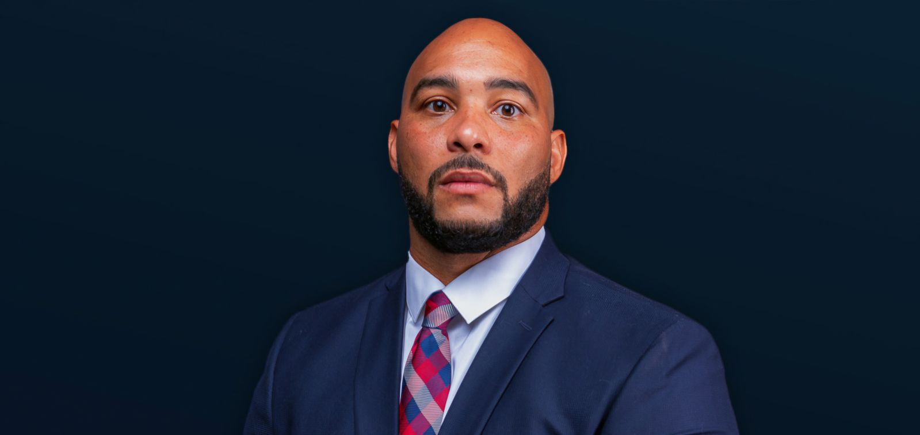
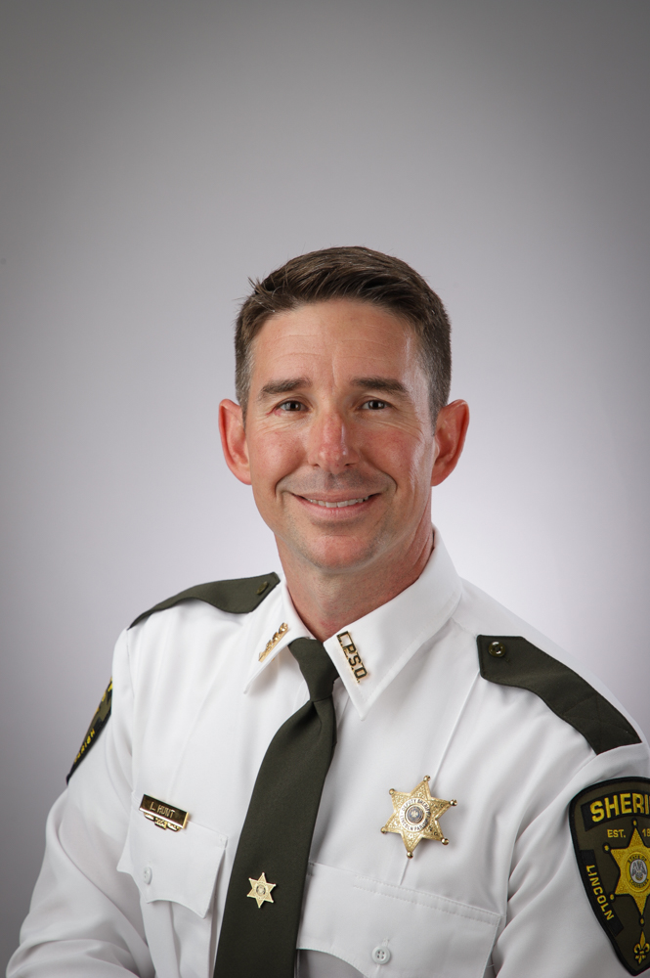
Instructors
Gentlemen by Design (Continued)
Graduated Lynwood Charter College – Lynwood, WA - Associate Degree in Criminal Justice
Parole officer with Ruston Police Department for 8 years, Families In Need of Services (FINS) Coordinator - to reduce formal juvenile court involvement whenever possible and generate appropriate community services. River City Professional Counseling working with individuals and families to improve mental health.
Recognized for work ethic and abilities in leadership and communication skills by supervisors. Well versed in defense tactics, law enforcement protocol. Exceptional trainer and mentor with skills in motivating top individual performance within an agency.
Arthur Eleam –
Gentlemen’s Safety
Chief Deputy Landon Hunt has served the citizens of Lincoln Parish for 21 years. He began his law enforcement career at Grambling State University Police Department in 2004 and is currently serving as Chief Deputy under Sheriff Stephen Williams assisting in managing all divisions at the Lincoln Parish Sheriff’s Office. He has been married to Anna Michelle Hunt for 19 years, they have a daughter, Reese Caroline (13) and son Grayson David (12). The Hunts attend The Bridge Community Church where Landon serves as a deacon.
Loves his community and is committed to serving and sowing in to our youth guiding them to great leadership.
Chief Deputy Landon Hunt
Gentlemen’s Safety

