Slide 1
KANDAVAS LAUKSAIMNIECĪBAS TEHNIKUMS
LAUKSAIMNIECĪBAS MEHANIZĀCIJAS TEHNIĶIS
LAUKSAIMNIECĪBAS MEHANIZĀCIJAS TEHNIĶIS
«LAUKSAIMNIECĪBAS TEHNIKAS UN IEKĀRTAS TA»
«COMMON RAIL (CR) IESMIDZINĀŠANAS SISTĒMA UN DEVĒJU PĀRBAUDE»
I.Ešenbergs
08.01.2026

Slide 2
«COMMON RAIL (CR) IESMIDZINĀŠANAS SISTĒMA UN DEVĒJU PĀRBAUDE»

Slide 3
B00. Engine designation
Engine designation according to model
BRAND | ENGINE TYPE
Deutz-Fahr, 6160, 6180, 6190 TTV7210,7230,7250 | TCD 6.1 L4 SCR
Lamborghini MACH 210, 230, 250 | TCD 6.1 L4 SCR
Significance of nomenclature used in engine type TCD 6.1 SCR (example)
4 valve/cylinder engine
T: Turbocharger
S: Intercooler
D: Fast Diesel engine
4.1/6.1: Displacement:
L: In-line
6: 6 cylinders
SCR: Urea injection emissions control system

Slide 4
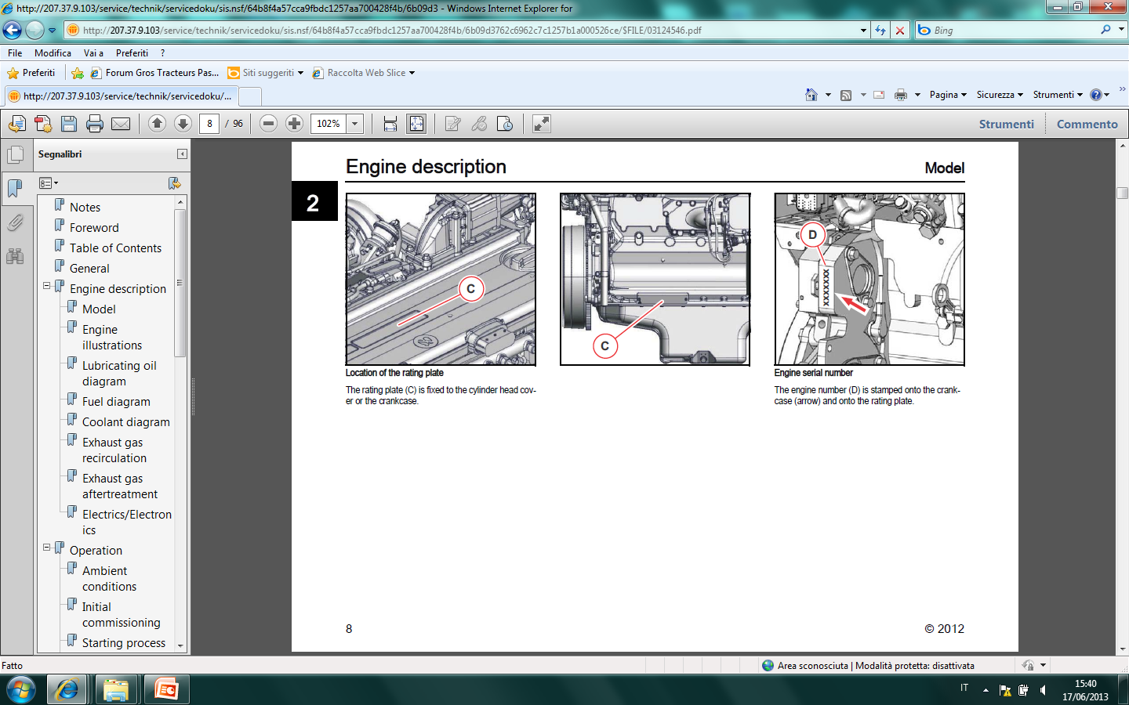
B00. Location of engine identification plates
Engine identification plate
KEY:
C = Engine identification plate
D = Stamped engine serial number

Slide 5
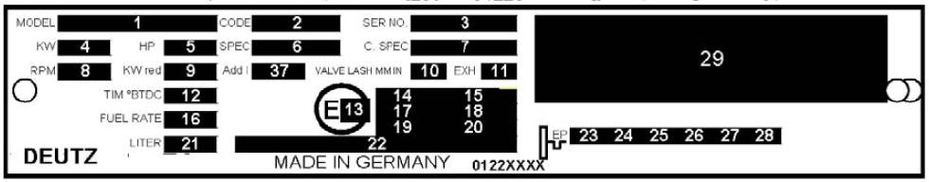
B00. Identification plate
Information on engine identification plate

Slide 6
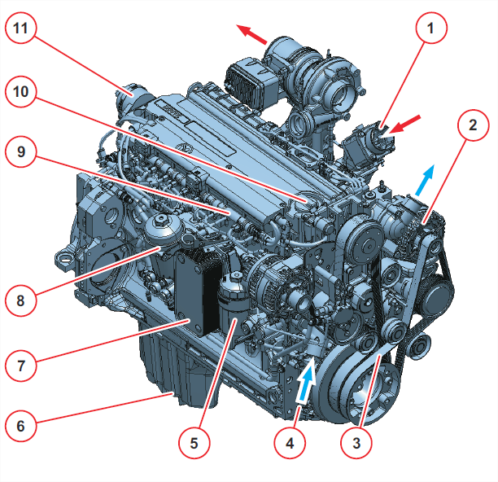
B00. View of the engine
Right hand side view of engine TCD 6.1 L6 SCR
Aspirated air inlet
Alternator
Poly-V belt
Coolant inlet
Engine oil filter
Oil sump
Engine oil cooler
Fuel filter
Rail
Oil filler cap
Bleed screw

Slide 7
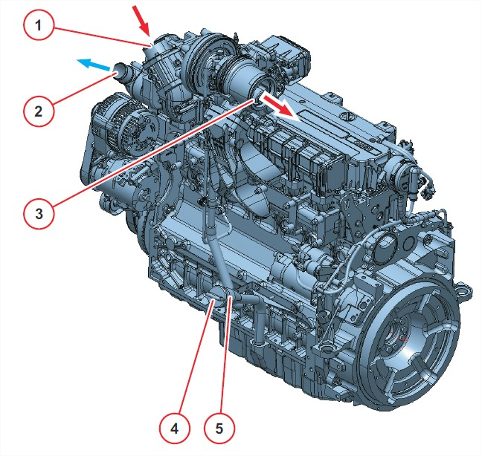
B00. View of the engine
Left hand side view of engine TCD 6.1 L6 SCR
Aspirated air inlet
Coolant outlet
Turbocharger outlet (exhaust)
Engine oil filler neck
Engine oil dipstick

Slide 8
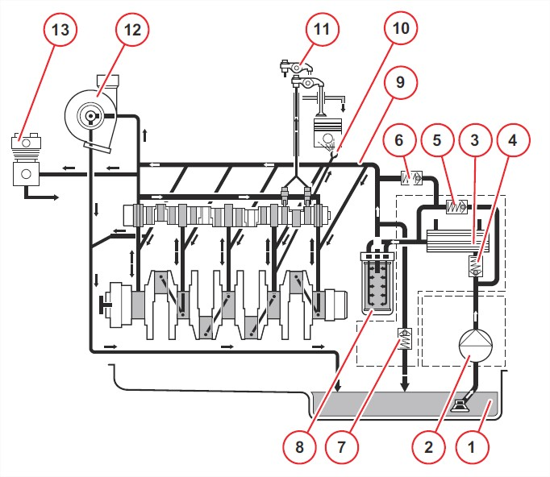
B06. Lubrication circuit
1. Oil sump
2. Oil pickup line
3. Oil cooler
4. Check valve
5. Radiator bypass
6. Filter bypass
7. Pressure cut-off valve
8. Filter
9. Primary line
10. Piston cooling nozzle
11. Rocker
12. Turbocharger
13. Compressor and/or hydraulic pump

Slide 9
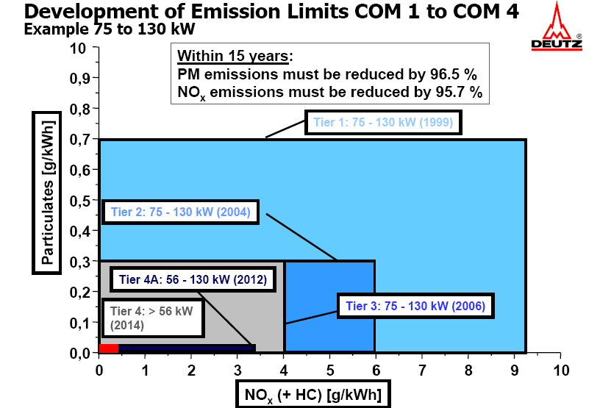
B07. The Deutz engine and emissions compliance
Diagram of emissions regulations
The diagram above illustrates the engine emissions limits permitted by different tiers of emissions regulations in a simplified format.
Note that while tiers COM II and COM III
permit the same level of particulate emissions.
the lower limit for NOx emissions requires a reduction from approximately 6 g/kWh to approximately 4 g/kWh.
Over the next 15 years, the particular and NOx emissions produced by Diesel engines must be reduced by over 96% and over 95% respectively.

Slide 10
B07. The Deutz engine and emissions compliance
Possible technical solutions
Particulate
"Cold combustion"
Euro I, Tier I
EGR injection
Optimisation of combustion with EGR
DPF
Euro IIIa
Tier 3
Higher engine temp.
High pressure injection
Tier4i
Stage IIIB
SCR
"Hot combustion"
NOx
- Compliance with COM II regulations is achieved by modifying injection rates while maintaining high injection pressures.
Compliance with COM III regulations for NOx emissions is only possible with exhaust gas recirculation.
- To achieve compliance with IIIB regulations, a selective catalytic reduction system with urea injection is used. This solution makes it possible to eliminate the exhaust gas recirculation system.
Reducing NOx emissions:
NOx emissions are reduced with an after-treatment system. Urea (AdBlue) is injected into the exhaust gases before they are passed through a catalytic converter. The reaction catalysed on contact with the surface of the catalytic converter breaks NOx compounds down into H₂O and N₂. The SCR system is used to eliminate the NOx compounds produced during combustion.
Reduction of particulate, HC and CO emissions:
Particulate, HC and CO emissions are reduced by higher combustion temperatures, made possible by the use of urea injection to reduce NOx emissions. High combustion temperatures reduce HC and CO emissions and also reduce consumption

Slide 11
B07. Operating principle of Deutz Common Rail system
Common Rail system layout
ECU
2
Pressure sensor
Injectors
3
MProp
(FCU)
p
= -0.3 to 0 Bar
p
= 6 Bar (+/- 1 Bar)
p
= 300 to 1,600 Bar
Pressure sensor
p
= 0 to 0.5 Bar
Rail
DBV
3
10 µm pre-filter with
water separator
3
HP pumps
2
2
FCU
Fuel pump
Main filter (2 µm)
Manual pump
ECU: Electronic Control Unit
FCU: Fuel Control Unit
DBV:
Pressure cut-off valve
The fuel in the tank is aspirated by the fuel pump.
A manual pump ahead of the fuel pump makes it possible to prime the circuit when necessary, such as after replacement of the filter.
A fuel pre-filter is situated after the pump. This filter removes the coarser particles contained in the fuel (15 microns). Water is also separated to keep it out of the high pressure circuit.
The main fuel filter, with a filtration capacity of 5 microns, is situated after the fuel pump.
The fuel pressure is monitored by a pressure sensor, which sends the relative pressure signal directly to the ECU.

Slide 12
B07. Operating principle of Deutz Common Rail system
Common Rail system layout
The fuel is now fed into the FCU valve. This valve dispenses the precise quantity of fuel necessary for engine operation.
The FCU valve is piloted directly by the ECU. This means that the high pressure pumps receive only the precise quantity of fuel that the system effectively needs.
The two high pressure pumps are driven by the camshaft. These pumps deliver fuel to and pressurise the rail (raising pressure from 400 to approximately 1,600 bar).
The rail constitutes the high pressure reservoir of the system, and is connected directly to the injectors.
A sensor monitors the pressure in the rail and sends the relative pressure signal to the ECU.
A pressure limiting valve, calibrated to open at 1,800 bar, is also installed on the rail.
The injectors deliver the necessary quantity of fuel into the combustion chambers. The aperture and closure of the injectors are controlled electrically by the ECU. The injectors are opened multiple times during a single combustion cycle to produce the required torque and reduce the exhaust emissions produced by the engine.
A number of other sensors are installed in the engine to monitor the functions of the engine itself. These sensors are connected to the ECU.

Slide 13
B07. Operating principle of Deutz Common Rail system
Control unit
EDC 17
1,600 bar circuit
Injectors
Fuel pump
Rail pressure sensor
DBV
6 bar
Rail
max. 70 °C
FCU 3
Main filter with pressure sensor
PF45-16
Pre-filter with water separator
max. +0.5 bar
a
Tank
Steuer
CRIN3.3-20
Injectors
gerät
-
Rail
max. 70 °C
a
Tank

Slide 14
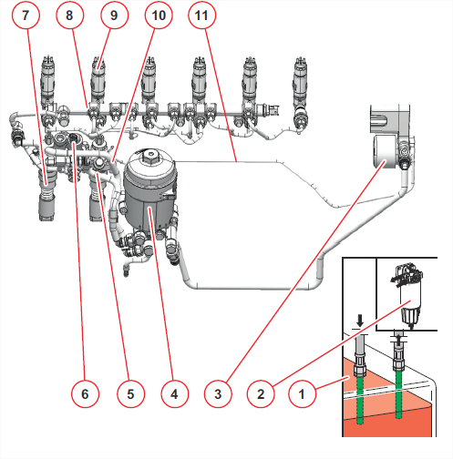
B07. Operating principle of Deutz Common Rail system
The following diagram illustrates the positions on the engine of the main elements of the fuel injection circuit.
Fuel tank
Fuel pre-filter
Fuel pump
Fuel filter
FCU valve feed
FCU valve
High pressure pump
Rail
Injector
Return line to tank
Return line (2,000 bar system)

Slide 15
B07. Low pressure circuit
The fuel pump.
TCD 6.1
p
[bar]
n
Engine
[rpm]
Q [L/min]
3
100
0.333
10
1,000
1.83
10
2,300
2.92
Characteristics of the fuel pump
6
(back pressure back p = 6 bar)
5
4
3
Flow capacity [l/min]
2
1
0
0
500
1,000
1,500
2,000
2,500
3,000
3,500
4,000
4,500
5,000
5,500
6,000
6,500
7,000
Pump speed (pump n) in rpm
The fuel pump aspirates fuel from the tank via the pre-filter and delivers fuel to the FCU.
The pressure ahead of the pump must be between -0.3 and 0 Bar, while the pressure after of the pump must be approximately 6 Bar.

Slide 16
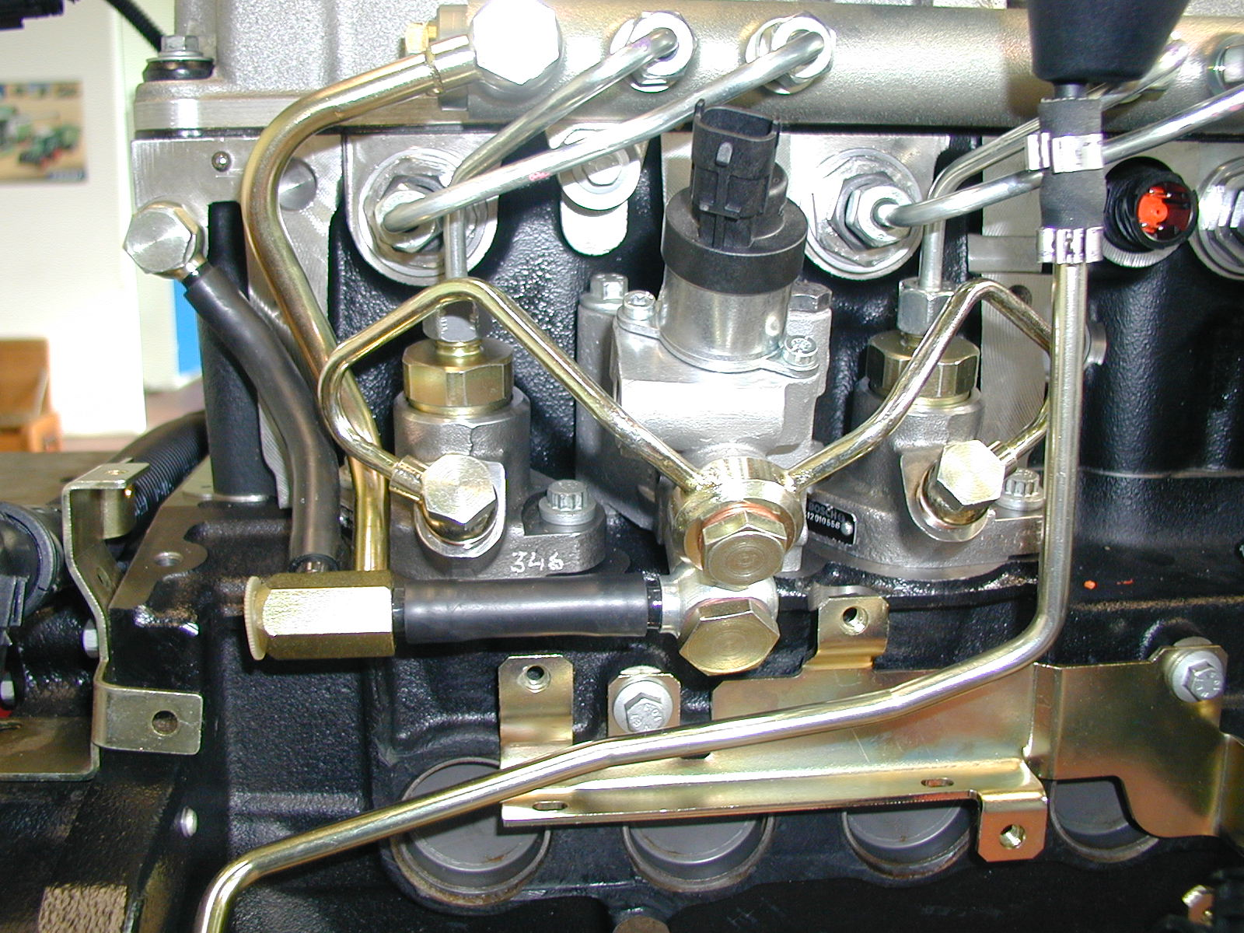
B07. High pressure circuit
Overview
7
6
5
1
8
4
3
10
9
2
FCU valve
FCU outlet to HP pumps
HP pump
HP pump outlet to rail
Rail
Line to injector
Return line from rail via pressure limiter
Return line from injectors
Return line from FCU valve
To tank

Slide 17
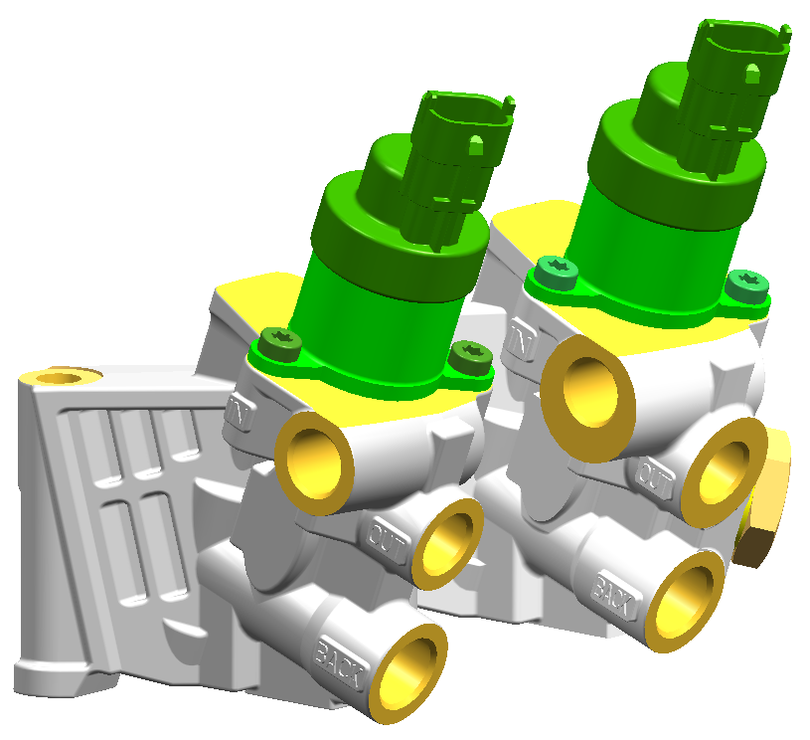
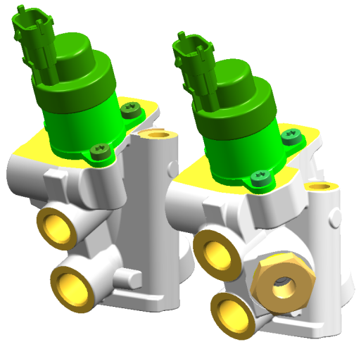
B07. High pressure circuit
FCU valve
The FCU valve, controlled by the ECU unit, delivers the necessary quantity of fuel to the pumps in relation to engine speed and engine load.
This pressurises the rail.
The FCU valve contains a proportional solenoid valve powered with PWM current.
There are two different types of FCU valve, 3.0 and 3.1. The type used depends on the injection system.
FCU Version 3 (left hand view)
→ CRSN 2, 1600 bar
FCU Version 3.1 (right hand view)
→ CRSN 3.3, 2000 bar
Feed to
To HP pumps
To fuel pump
Return line
What is the difference between the FCU 3.0 and FCU 3.1?
The FCU 3.1 has an auxiliary return line from the 2,000 Bar system.
The auxiliary return line of the FCU 3.1 (from 2,000 Bar system only) is connected to the fuel pump inlet and is used to produce a negative pressure (vacuum).
This is necessary due to the seal tightness of the injectors when closed, and is the only solution possible for producing a return pressure of 0 to 0.5 Bar in the return circuit. If there were no auxiliary return line, excessively high pressures would develop in the system.
An auxiliary return line is not necessary in the 1,600 Bar system as the injectors deliver fuel continuously.
IMPORTANT:
While the FCU 3.0 and FCU 3.1 are similar in appearance, they not interchangeable!
Risk of engine damage

Slide 18
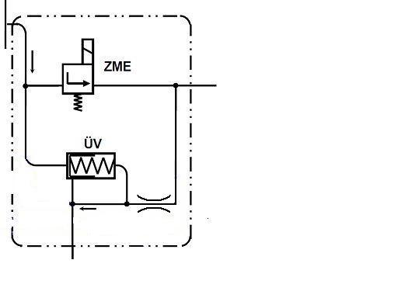
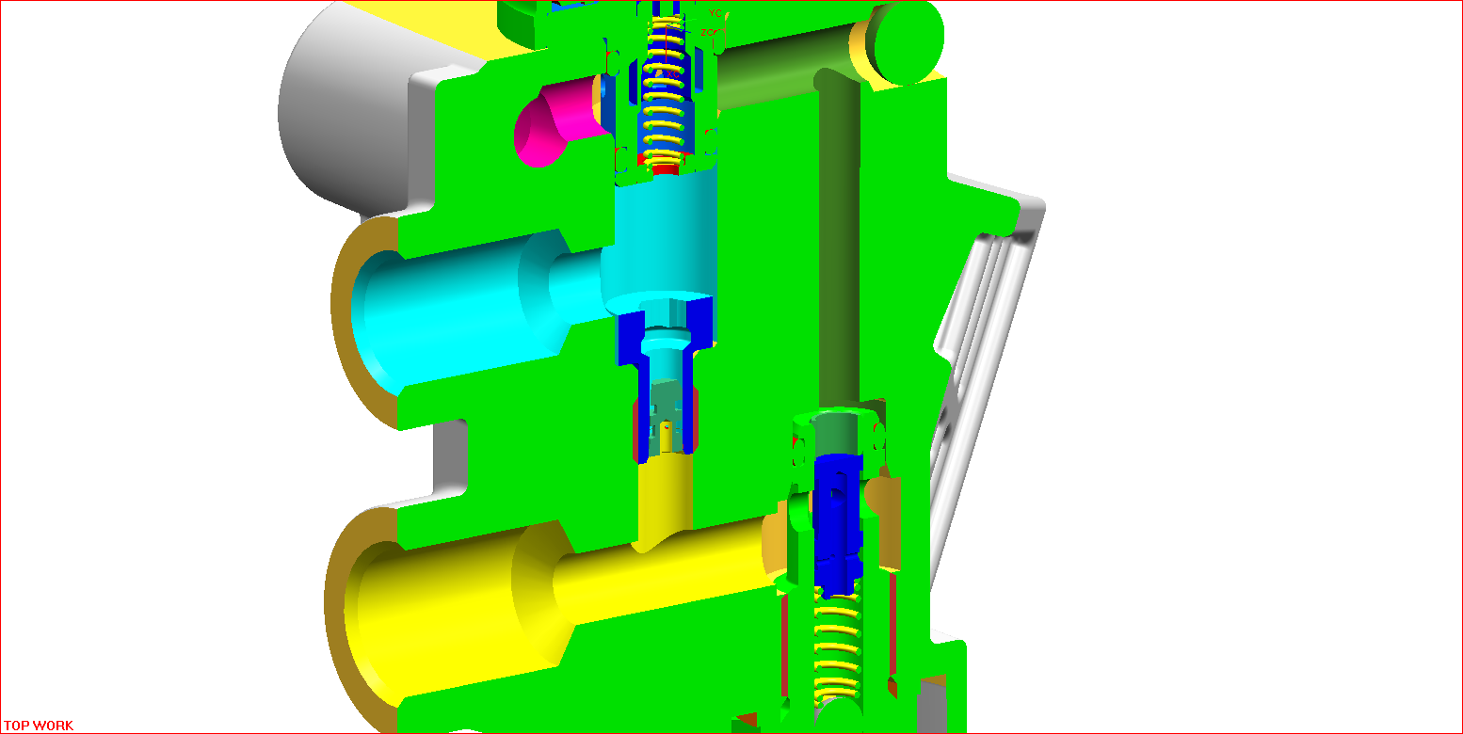
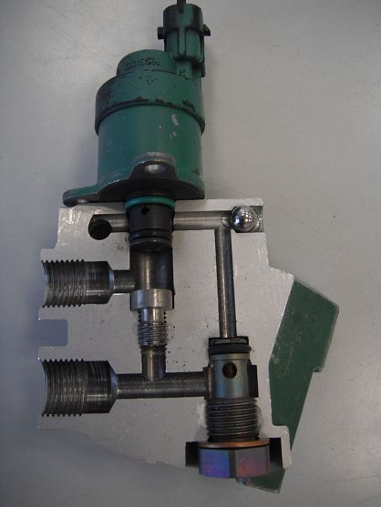
B07. High pressure circuit
FCU valve 3.0
- CRNS 2 injectors, 1,600 Bar
1
Feed to
To HP pumps PF45-xx
Return line
M-Prop
2
ÜV- flow rate regulator valve P_{max}: 6 bar
Zero flow drain line
3
Delivery </= 8 Bar
Zero flow drain line, 0.4 mm diam.
To HP pumps
Return </= 0.5 Bar

Slide 19
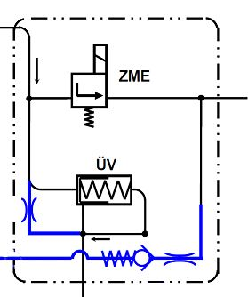
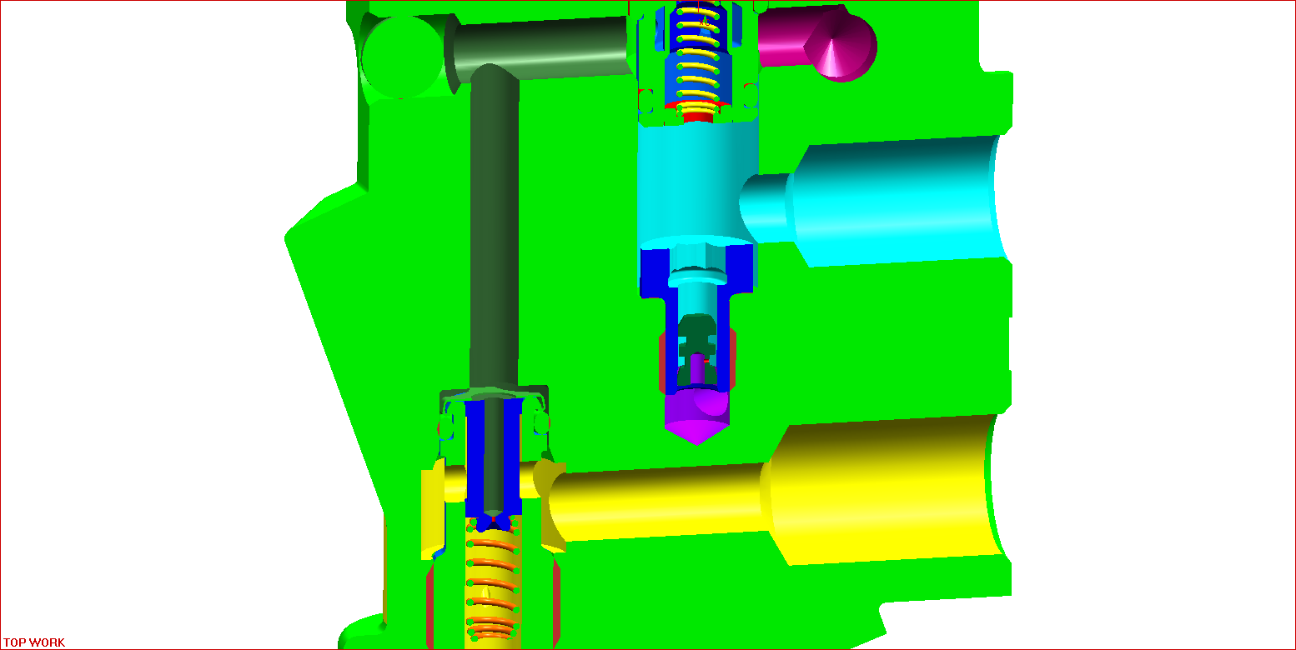
B07. High pressure circuit
FCU valve 3.1
- CRNS 3.3 injectors, 2,000 Bar
1
Feed to
To HP pumps PF45-xx
Return line to tank
To fuel pump
M-Prop
2
ÜV- Relief valve P_{max}: 6 Bar
4
Zero flow drain line
3
Delivery, </= 8 Bar
Zero flow restrictor,
0.4 mm diam.
To HP pumps
Return to fuel pump
</= 200 mbar
Degassing orifice
0.4 mm diam.
Return to tank </= 0.5 Bar

Slide 20
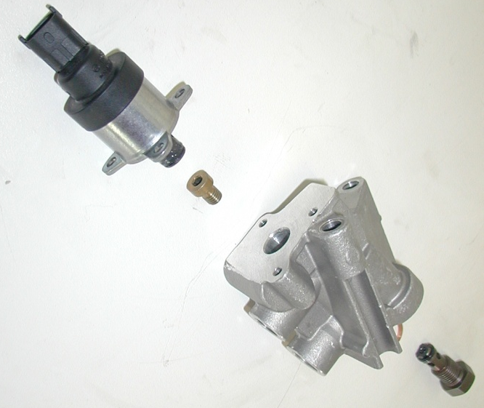
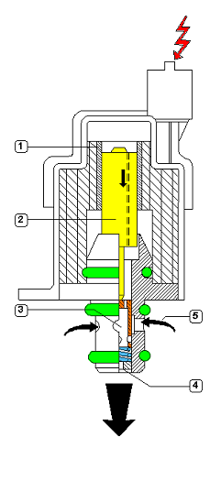
B07. High pressure circuit
FCU valve
When the FCU is not electrically powered, the valve shutter (orange) is held back by the spring at the base of the shutter itself.
In this state, the valve is 100% open and large quantities of fuel received from the fuel pump passes through the valve to the HP pumps.
When the valve is electrically powered, the shutter closes, permitting only a part of the fuel delivered to pass through to the HP pumps. This quantity is metered by varying the PWM current energising the FCU valve.
When the valve is completely closed, the HP pumps receive no fuel. In this state, fuel received from the fuel pump is sent back to the return line.
1. Solenoid valve
2. Core
3. LP pump feed
4. To HP pumps
5. LP pump feed

Slide 21
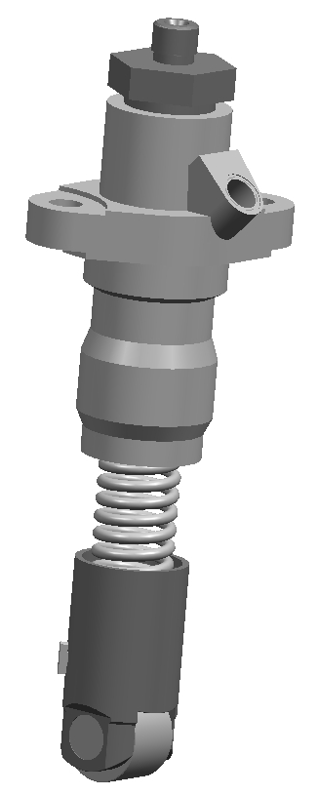
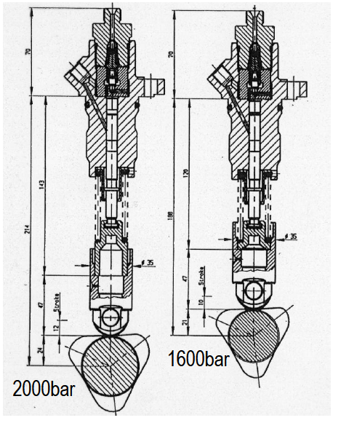
B07. High pressure circuit
High pressure pump
To rail
The two high pressure pumps feed the rail with fuel.
Two conditions must be met for fuel to be delivered correctly to the rail.
- There must be no communication between the rail and the pump during the descending stroke of the pump piston ("aspiration" stroke)
- There must be a pressure of at least 1.7 Bar to feed the HP pumps correctly
There are two types of pump:
- PF45-16: CRSN 2, 1,600 Bar
- PF45-20: CRSN 3.3, 2,000 Bar
The two pumps are identical externally.
Installing pump PF 45-16 instead of pump PF 45-20 may cause engine damage.
Installing PF 45-20 instead of PF 45-16 may cause malfunction
Check valve
Feed to
Tappet
The two high pressure pumps are driven by the camshaft.
Each pump has 3 cams.
The cams are offset by 60° relative to one another.
This ensures that the rail is filled at each injection system, for optimum pressure stability in the rail.
The two pumps (PF 45-16 and PF 45-20) differ in the stroke of the piston (10 and 12 mm).

Slide 22
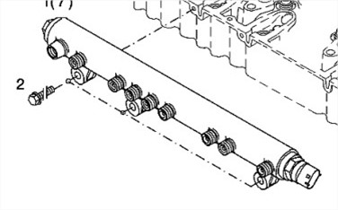

B07. High pressure circuit
Rail
The rail protects the system and acts as a high pressure injection reservoir.
The TCD 6.1 L6 engine may be fitted with two different types of rail, depending on the desired operating pressure for the system.
- CRSN 2
- max. operating pressure 1,600 Bar,
- valve aperture pressure 1,850 Bar.
- CRSN 3.3
- max. operating pressure 2,000 Bar,
- valve aperture pressure 2,650 Bar.

Slide 23
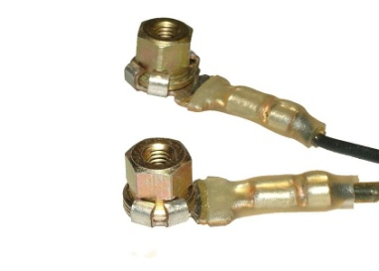
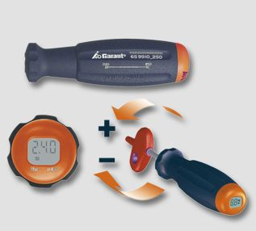
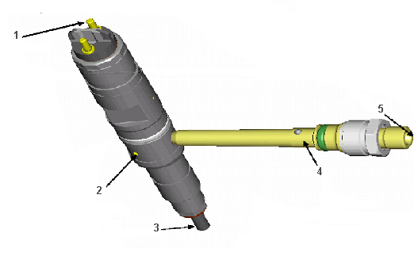
B07. High pressure circuit
Injectors
Two different types of injector may be installed in Deutz TCD SCR engines.
Fuel is delivered via an 'internal' line, with a line inside the head connecting the injector with the rail.
The resistance measured between the two contacts of the injector is approximately 0.5 ohm.
The two types of injector available are:
CRIN2
→ CRSN2, 1,600 Bar
CRIN3.3
→ CRSN3.3, 2000 Bar
(when the engine is switched off, the pressure in the rail is released by forcing the injectors open and holding them open for a few seconds, which produces a very loud whistling/buzzing noise)
Model:
With CRIN 2 and CRIN 3.3 injectors, a filter is installed in the pressurised line
Injector for 4-valve engines
Important:
Observe the correct torque when tightening the terminals of the injectors to prevent electrical damage to the injectors themselves. Do not exceed 1.5 Nm.

Slide 24
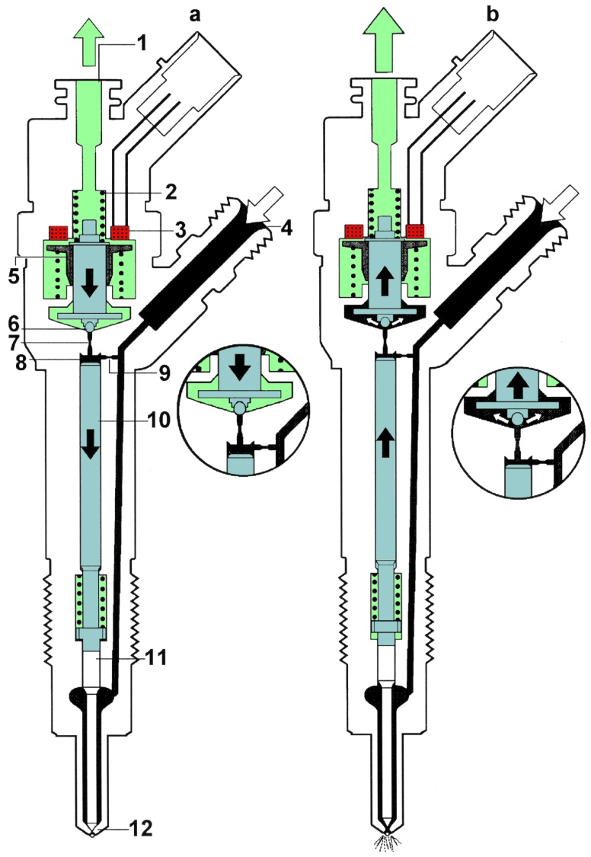
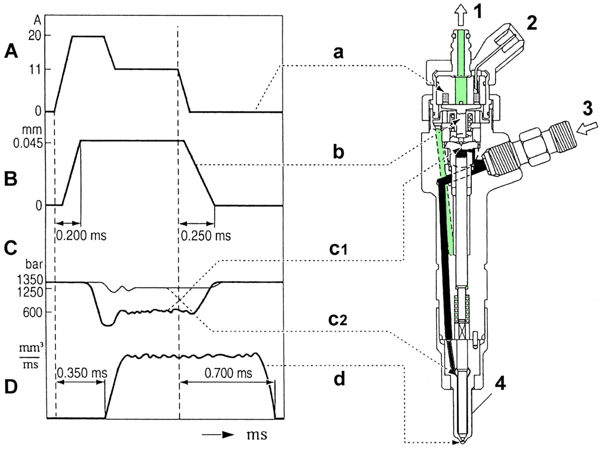
B07. High pressure circuit
Injectors
Operating principle
The fuel reaches the injector (4) at high pressure, and flows through the restriction (9) the base of the injector, to fill the chamber (8).
The rail pressure is the same on both sides of the injector actuator rod (10).
An additional 50 N spring prevents the roller from moving while the pressure is too low.
The excitation current (approx. 20 A) acts on the armature (5) and overcomes the force of the spring (2).
The high current causes the injector needle to lift rapidly.
The solenoid valve lifts the sphere (6) (0.26 mm), causing the pressure in the actuating chamber (8) to drop.
Once at maximum injector needle travel (approx. 50 µm), 0.3 ms after excitation of the solenoid valve, the current drops to approximately 12A, which is sufficient to keep the injector open.
U = 12 V

Slide 25
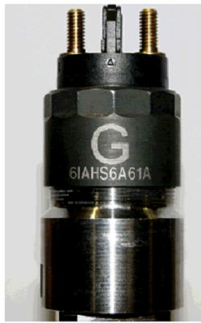
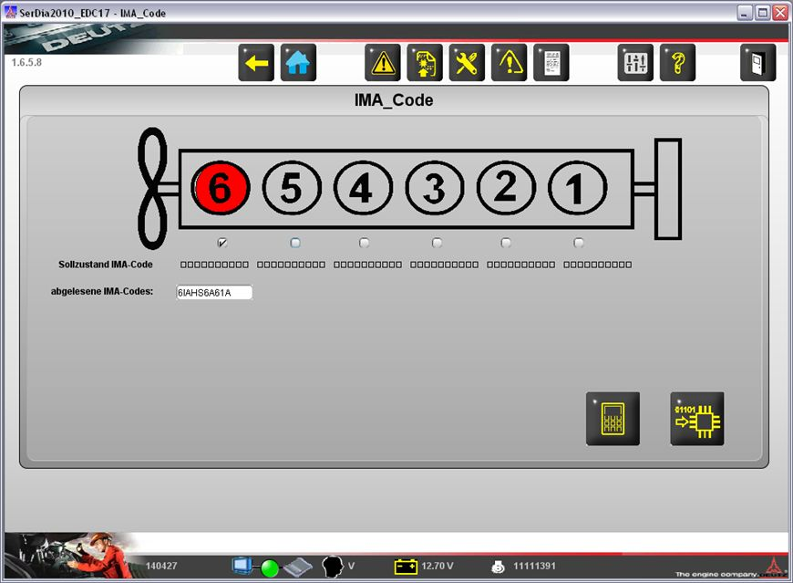
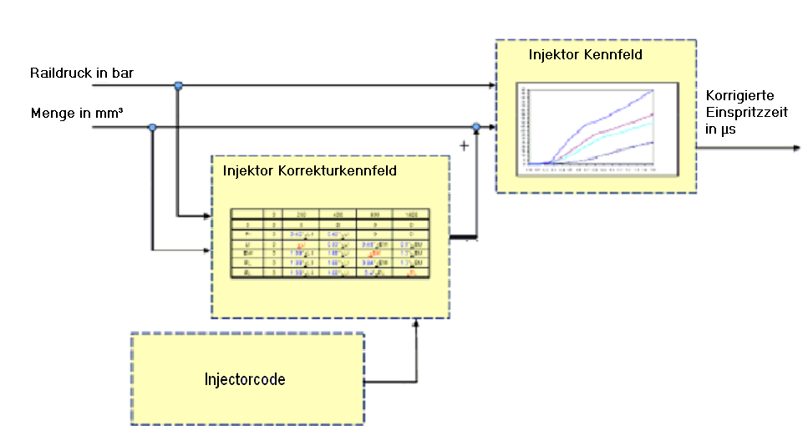
B07. High pressure circuit
Injectors
CRIN 3.3 (2,000 Bar) injectors differ from CRIN 2 units in a number of aspects, among which the fact that they are assigned an IQA (Injector Quantity Adjustment) code. This code is used to adjust the flow rate of the injector in relation to a reference table, and makes it possible to adjust injection times in relation to the specific characteristics of the injector.
The injector has two different markings:
- G: Assembly letter (used only for the assembly line)
- 6IAHS6A61A: IQA code
The code for each injector must be entered in the engine control unit memory. On the production line, the IQA codes are entered directly in the engine dataset.
In the event of replacement of an injector, the code of the new injector must be entered using SERDIA 2010. Replacing an injector without entering the IQA code is not permitted.
After replacing an EDC 17 ECU programmed with the original dataset, the IQA codes must also be entered (if any injectors have been replaced).
Entering codes into Serdia 2010
Entering IQA codes
Recording IQA values
Transferring values to ECU

Slide 26
B07. High pressure circuit
Injector calibration
IMA code (2,000 Bar)
Entering codes into Serdia 2010
Entering IQA codes
Recording IQA values
Transferring values to ECU
On assembly line
The injector codes are entered in the dataset.
Replacing an injector
After replacement, the code of the new injector must be entered using Serdia 2010. Replacing an injector without entering the respective code is not permitted.
After replacing an EDC ECU programmed with the original dataset, the IQA codes must also be entered (if any injectors have been replaced).

Slide 27
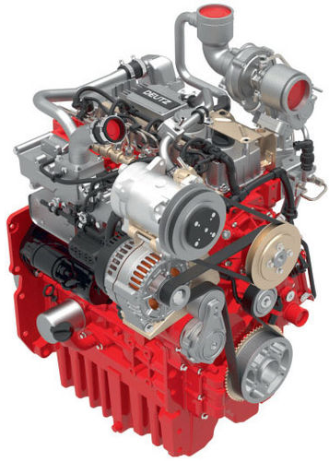
B07. High pressure circuit
Injectors
ZFL (Zero Fuel calibration during Low idle) = injector calibration at zero-load idle speed (for 2,000 Bar system only)
Purpose:
The purpose of ZFL calibration is to compensate for injector wear. With increased wear, the injection time increases to such an extent that injection becomes perceptible to the crankshaft speed sensor. Performing this procedure adapts the injection time accordingly. ZFL has no influence on engine performance. Failure to perform ZFL calibration may result in excessive engine noise.
Required conditions:
ZFL calibration is launched automatically as soon as the following conditions are met:
    Engine speed = idle, zero load
    Coolant temperature = between 65 and 100 °C
    Aspirated air temperature > 0 °C
    no variation in engine load
The procedure is conducted at different rail pressure values (500, 900 and 1300 Bar). An interval of 30 minutes is allowed to elapse between each calibration run. The interval is interrupted if the ECU is switched off. The calibration run for each rail pressure value takes 5 minutes. Data is memorised only when the ECU is powered.
Important:
In the event of injector replacement, the values stored in the dataset must be re-initialised using the SERDIA 2010 (UseCase - operating hours). The engine must then be run at operating temperature at idle speed and with zero load until the new injectors have been calibrated with the ZFL procedure.

Slide 28
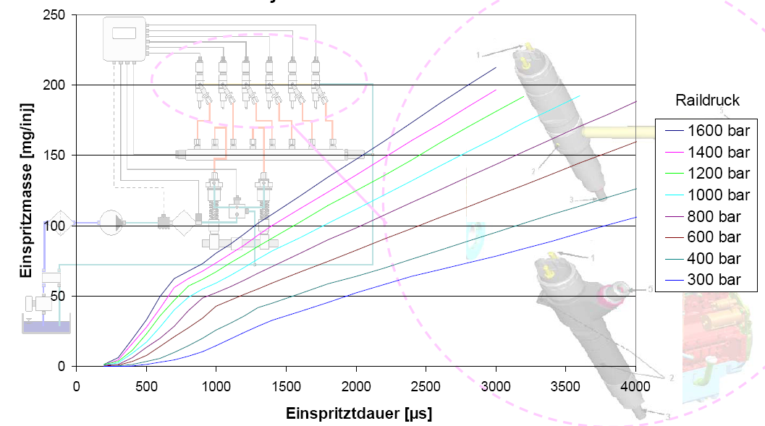
B07. High pressure circuit
Injectors
The quantity of fuel injected depends on two parameters:
- The injector aperture time
- The injector feed pressure
The longer the injector aperture time, the greater the quantity of fuel injected.
However, it is not physically possible to increase injections times, which must be brief to ensure correct engine operation and low emissions.
This means that the injection pressure must also be modified in order to increase or decrease the flow rate of injected fuel.
The following graph shows the relationship between injector aperture time, rail pressure and quantity of fuel injected.

Slide 29
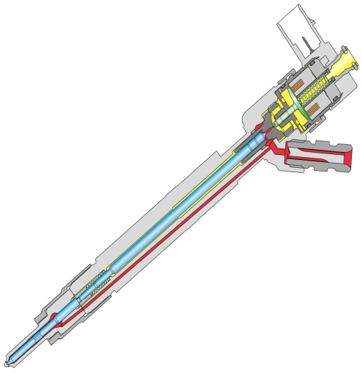
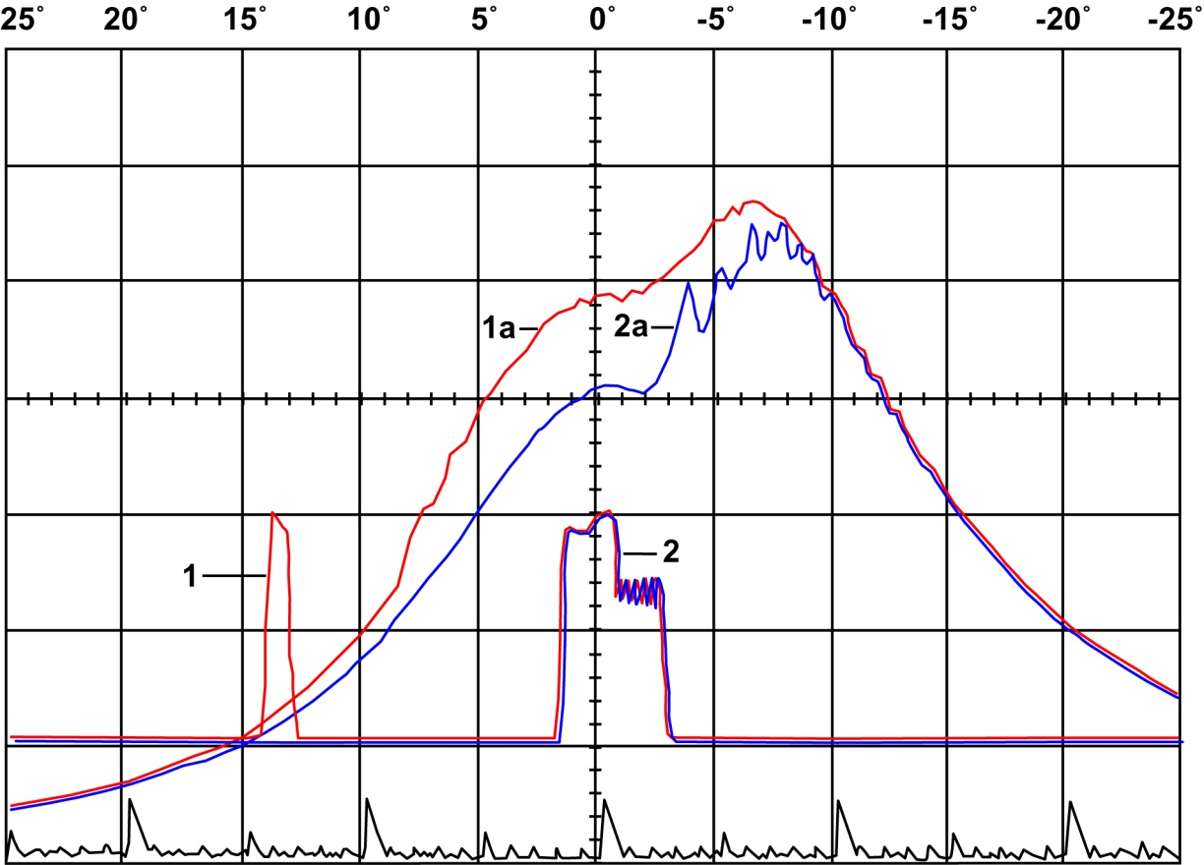
B07. High pressure circuit
Injectors
3 injection pulses are performed for each engine cycle,
1. Pre-injection
2. Main injection
3. Post-injection
These 3 injection pulses are performed within a time period of approximately 4 ms.
pre-injection:
Prepares the combustion chamber for the main injection pulse:
- pressure and temperature;
- shortening the ignition time for the main injection pulse;
- optimising combustion
This reduces: - combustion noise;
- hydrocarbons emissions;
- fuel consumption.
Results of post-injection:
- reduced NOx emissions;
- reducing fuel consumption.
1a. Pressure increase with pre-injection
2a. Pressure increase without pre-injection
3

Slide 30
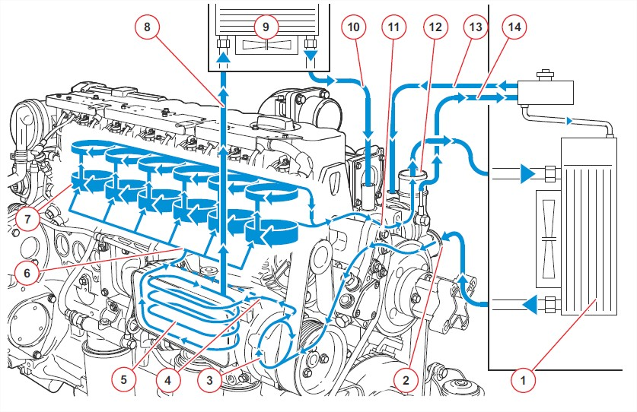
B09. Cooling circuit
Engine cooling
Engine coolant radiator
Coolant inlet
Water pump
Partial coolant bypass for oil radiator
Engine oil cooler
Coolant delivery to engine
Upper engine cooling circuit
To cab heater
Heat exchanger
Return line from cab
Thermostat feed line
Return line from radiator
from expansion tank
to expansion tank

Slide 31
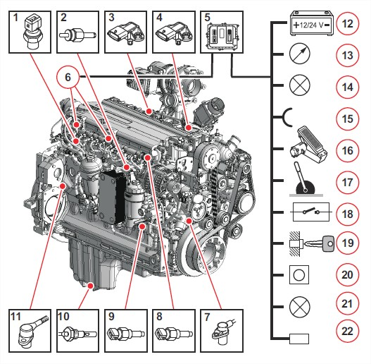
B08. Testing sensors
Location of sensors
      Intake air pressure and temperature sensor (TCD 6.1L6)
  Low fuel pressure sensor
Coolant temperature sensor
Intake air pressure and temperature sensor (TCD 4.1L4)
Engine ECU
6. Central connectors
7. Crankshaft speed sensor
8. Rail pressure sensor
9. Lubricant oil pressure sensor
10. Oil level sensor (optional)
11. Camshaft speed sensor

Slide 32
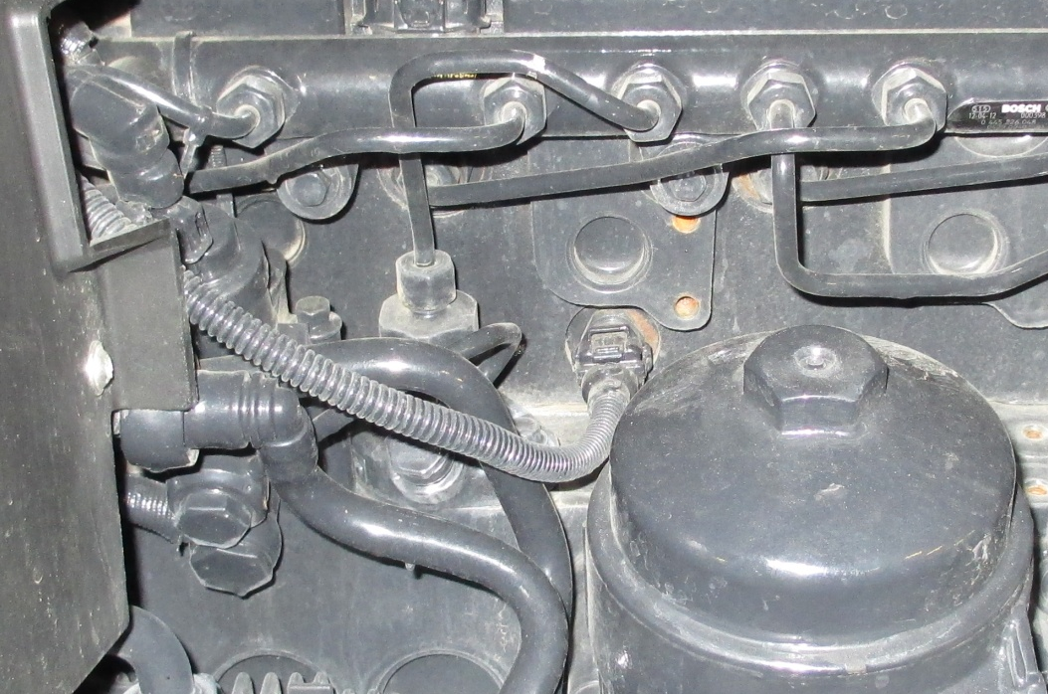
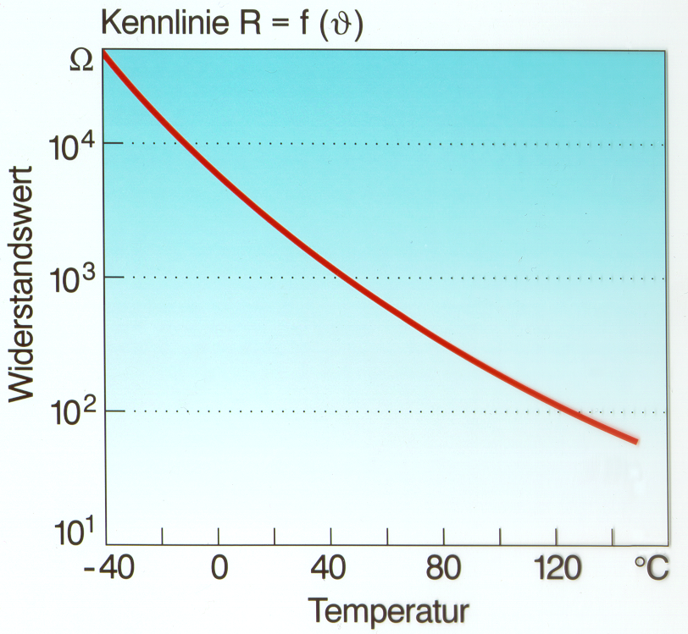
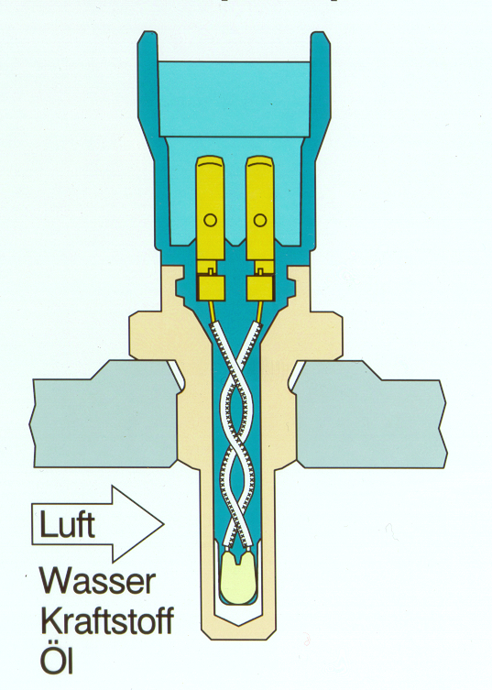
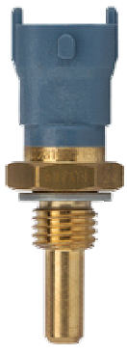
B08. Testing sensors
Coolant temperature sensor
Pin measured to test sensor
ECU cv52 | ECU cv56b | Connector X 17 | Sensor | Function
D2.1.35 | D2.2.57 | 27 | 1 | Ground
D2.1.13 | D2.2.28 | 24 | 2 | Signal

Slide 33
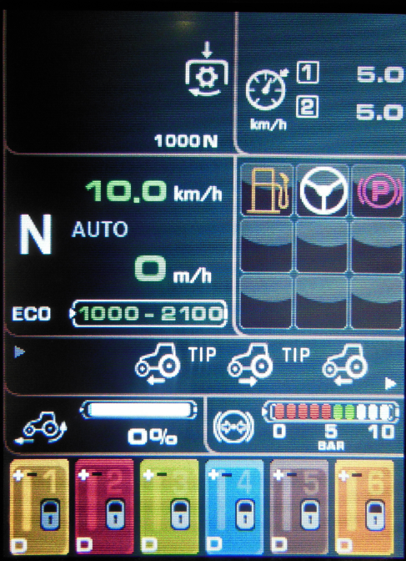
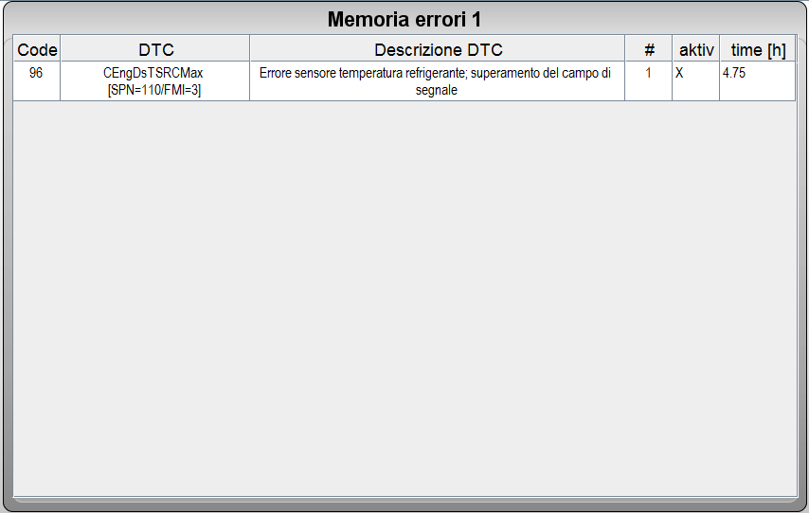
B07 Electrical components
Example alarm produced by disconnecting engine coolant temperature sensor.
Engine alarm:
SPN 110 FMI 3
Alarm code on Infocenter / WOD:
The engine will start in this state.
Alarm code in Serdia 2010 diagnostic system

Slide 34
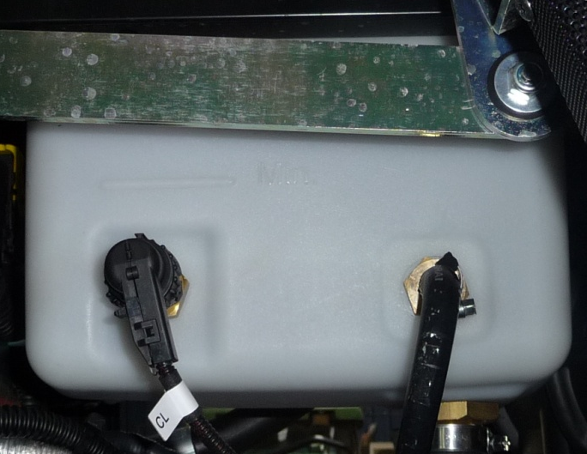
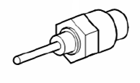
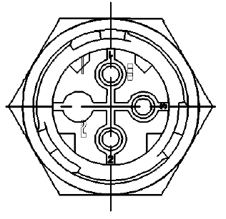
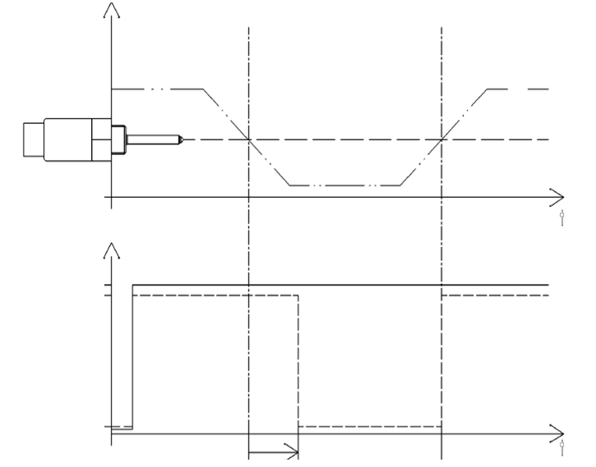
B08. Testing sensors
Coolant level sensor
1 = 12 V power feed
3 = Signal
2 = Ground
Coolant level
Level OK
Level too low
Level OK
Voltage measured
U max.
U high signal
U low signal
Interval 7 s
Pin measured to test sensor
ECU cv52 | Connector MS1 cv52 | ECU cv56b | Connector MS1 cv56 | Sensor | Function
D2.2.62 | B5 | D2.1.13 | B5 | 1 | Power
 |  |  |  | 2 | Ground
D2.2.57 | B6 | D2.1.29 | B6 | 3 | Signal

Slide 35
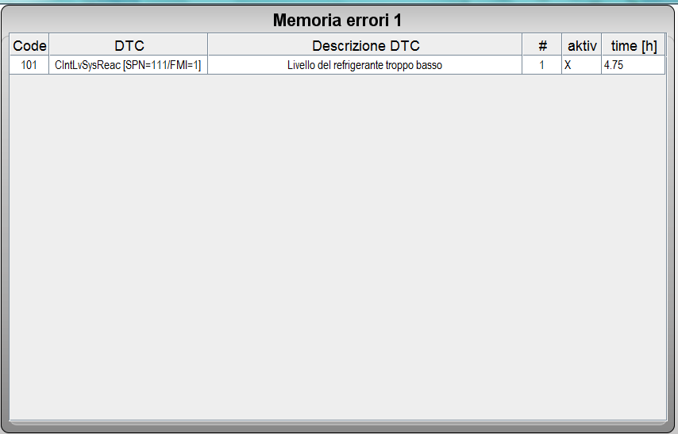
B07 Electrical components
Example alarm produced by disconnecting low coolant level sensor.
Engine alarm:
Coolant level
Alarm code on Infocenter / WOD:
The engine will start in this state.
Alarm code in Serdia 2010 diagnostic system

Slide 36
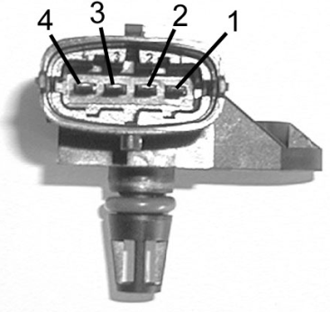
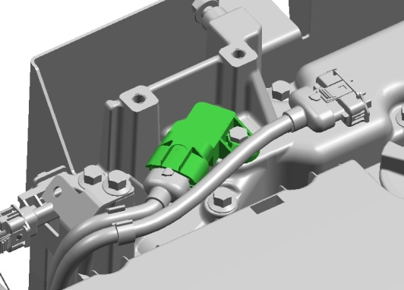
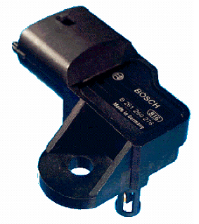
B08. Testing sensors
Aspirated air pressure and temperature sensor
Temperature values
Temperature in °C | Temperature in °F | Resistance in ohms
- 40 | - 40 | 44.373K
0 | 32 | 5,774
25 | 77 | 2,014
40 | 104 | 1,150
80 | 176 | 315
125 | 257 | 98
Relative turbocharger pressure in Bar | Signal in volts
0 | approx. 1.0
0.5 | approx. 1.55
1.0 | approx. 2.1
max. 1.6 | approx. 2.7
Pin measured to test sensor
ECU cv52 | ECU cv56b | Connector X 17 | Sensor | Function
D2.1.74 | D2.1.42 | 28 | 1 | Ground
D2.1.11 | D2.1.27 | 29 | 2 | Temperature signal
D2.1.21 | D2.1.24 | 22 | 3 | Power feed (5 VDC)
D2.1.73 | D2.1.43 | 23 | 4 | Pressure signal

Slide 37
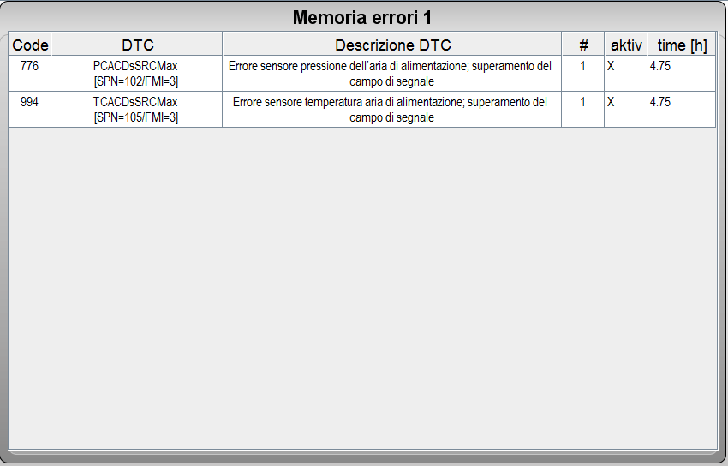
B07 Electrical components
Example alarm produced by disconnecting turbo temperature and pressure sensor.
Engine alarm:
Turbo pressure/Intake manifold air temp.
Alarm code on Infocenter / WOD:
The engine will start in this state.
Alarm code in Serdia 2010 diagnostic system

Slide 38
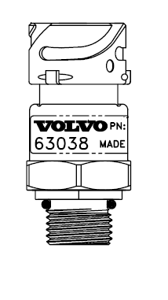

B08. Testing sensors
Low fuel pressure sensor
Low fuel pressure sensor
Pin measured to test sensor
ECU 52 | ECU 56b | X 17 | Sensor | Function
D2.1.21 | D2.1.24 | 23 | 1 | Power feed (5 VDC)
D2.1.54 | D2.1.85 | 17 | 2 | Signal
D2.1.35 | D2.1.57 | 27 | 4 | Ground
3
1
4
2

Slide 39

B07 Electrical components
Example alarm produced by disconnecting low fuel pressure sensor.
Engine alarm:
fuel pressure
Alarm code on Infocenter / WOD:
The engine will start in this state.
Alarm code in Serdia 2010 diagnostic system

Slide 40
B08. Testing sensors
Oil pressure sensor
Oil pressure sensor
Pin measured to test sensor
ECU 52 | ECU 56b | X 17 | Sensor | Function
D2.1.21 | D2.1.24 | 23 | 1 | Power feed (5 VDC)
D2.1.72 | D2.1.44 | 26 | 2 | Signal
D2.1.35 | D2.1.57 | 27 | 4 | Ground
3
1
4
2

Slide 41

B07 Electrical components
Example alarm produced by disconnecting engine oil pressure sensor.
Engine alarm:
Oil pressure
Alarm code on Infocenter / WOD:
The engine will start in this state.
Alarm code in Serdia 2010 diagnostic system

Slide 42



B08. Testing sensors
Crankshaft speed sensor
Pin measured to test sensor
ECU cv52 | ECU cv56 | X 17 | Sensor | Function
D2.1.75 | D2.1. | 1 | 3 | Shielding
D2.1.102 | D2.1. | 21 | 2 | Ground
D2.1.101 | D2.1. | 15 | 1 | Signal
Camshaft speed sensor
Engine off (0 rpm) | Frequency
 | 0 Hz
Idle speed (800 rpm) | Approx. 800 Hz
Mid speed (1,600 rpm) | Approx. 1.60 KHz
Rated speed (2,100 rpm) | Approx. 2.1 KHz
1.6.
1.6.
Signal indicating crankshaft position with pistons 1 and 6 at TDC

Slide 43

B07 Electrical components
Example alarm produced by disconnecting crankshaft speed sensor.
Engine alarm:
SPN 190 FMI 12
Alarm code on Infocenter / WOD:
The engine will start in this state, but after a delay.
Alarm code in Serdia 2010 diagnostic system

Slide 44


B08. Testing sensors
Camshaft speed sensor
Pin measured to test sensor
ECU cv52 | ECU cv56 | X 17 | Sensor | Function
D2.1.99 | D2.1. | 13 | 1 | Signal
D2.1.100 | D2.1. | 14 | 2 | Ground
D2.1.75 | D2.1. | 9 | 3 | Shielding
Crankshaft speed sensor
Engine off (0 rpm) | Frequency
 | 0 Hz
Idle speed (800 rpm) | Approx. 47 Hz (6 cyl.) Approx. 33 Hz (4 cyl.)
Mid speed (1,600 rpm) | Approx. 94 Hz (6 cyl.) Approx. 67 Hz (4 cyl.)
Rated speed (2 100 rpm) | Approx. 123 Hz (6 cyl.) Approx. 88 Hz (4 cyl.)
3
5
6
1
2
4
4
1
5
Signal indicating camshaft position with piston 1 at TDC at end of compression stroke

Slide 45

B07 Electrical components
Example alarm produced by disconnecting camshaft speed sensor.
Engine alarm:
SPN 190 FMI 12
Alarm code on Infocenter / WOD:
The engine will start in this state.
Alarm code in Serdia 2010 diagnostic system

Slide 46


B08. Testing sensors
Rail pressure sensor
The rail pressure sensor.
Pin measured to test sensor
ECU cv52 | ECU cv56 | X 17 | Sensor | Function
D2.1.36 | D2.1.25 | 31 | 1 | Power feed (5 VDC)
D2.1.78 | D2.1.26 | 25 | 2 | Signal
D2.1.17 | D2.1.07 | 32 | 3 | Ground
Sensor torque: 70 Nm
Torque for pressure cut-off valve: 110 Nm
V
Correlation between pressure / voltage
1,800 Bar sensor
CRSN 2, 1,600 Bar
2,200 Bar sensor
CRSN 3.3, 2,000 Bar
0.3
bar

Slide 47

B07 Electrical components
Example alarm produced by disconnecting Rail sensor
Engine alarm:
SPN 157 FMI 3
Alarm code on Infocenter / WOD:
The engine will start in this state.
Alarm code in Serdia 2010 diagnostic system

Slide 48

B08. Testing sensors
FCU valve
Pin measured to test FCU
EDC cv52 | EDC cv56b | PIN on socket X 17 | PIN on FCU | Function
D2.1.25 | D2.2.5 | 20 | 1 | Power
D2.1.46 | D2.2.4 | 19 | 2 | Ground
Measuring FCU resistance
Pin measured | PIN | Value | Condition | Note
Resistance in ohms | 1 - 2 | 3.6 OHM | 20 °C | Tolerance +/- 15%
Voltage measurement (at zero engine load)
PIN | Ignition switch position | Voltage
Between 1 and 2 | Ignition on, engine off | 1.8 VDC - 0 VDC
 | Engine running at idle speed | 4.3 VDC

Slide 49

B07 Electrical components
Example alarm produced by disconnecting proportional FCU solenoid valve installed on fuel control unit.
Engine alarm:
SPN 523615 FMI 5
Alarm code on Infocenter / WOD:
The engine will start in this state.
Alarm code in Serdia 2010 diagnostic system

Slide 50



B08. Testing sensors
Turbocharger with wastegate controlled by BusCan
Wastegate aperture controlled by engine ECU.
The wastegate is closed when the connector is disconnected.
Pin measured to test wastegate
EDC cv52 (ECU) | EDC cv52 (socket X17) | EDC cv56b (ECU) | EDC cv56b (socket X17) | PIN on wastegate | Function
 | 2.1 |  | 1.5 | 1 | Power feed from KENG and FY25 relays
 | 2.34 |  | 1.4 | 2 | Ground
D2.1.98 | 2.23 | D2.1.53 | 1.18 | 3 | Can L
D2.1.77 | 2.22 | D2.1.75 | 1.11 | 4 | Can H
KENG relay (21) located close to battery compartment (right hand side of tractor)

