Slide 1


Premature Adrenarche
A reference for healthcare providers
Premature adrenarche (PA) refers to the appearance of pubic hair in girls before the age of 8 years old. PA is characterized by modest hyperandrogenism; other causes of androgen excess need to be excluded from diagnostic consideration. PA may also occur in boys and is defined as pubic hair before the age of 9 years. Boys who present with early pubic hair are more likely to have an organic cause. The female to male ratio of “benign” PA is 9:1.
By definition, PA in girls occurs without signs of estrogenic pubertal changes such as breast development or vaginal discharge. The presence of pubic hair may be associated with other androgenic features such as the development of axillary hair, adult body odor, seborrhea, and a minor degree of acne. Some children with PA manifest a modest increase in height velocity. Typically, skeletal maturation is not excessively advanced. Generally, pubertal timing and adult height remain uncompromised among children with PA. Increased central adiposity is a common comorbidity in this condition.
AE-PCOS Society Education Committee
Diagnosis
In girls, the initial history and physical examination should focus on whether PA is truly isolated without clinical signs of estrogenization. The occurrence of breast development suggests the possibility of central or gonadotropin-dependent precocious puberty. Therefore, an accurate assessment of the extent of breast and genital development, as well as height and growth velocity, are essential in the baseline evaluation of PA. For boys, the presence of testicular enlargement raises concern for central puberty. While there is no definitive diagnostic study, some endocrinologists consider a bone age as the single most important test for PA. If the bone age is advanced, further evaluation is recommended. A caveat to interpreting the significance of an advanced bone age is that obesity and insulin resistance also drive the maturation of bone age.
In general, children with PA exhibit higher serum levels of dehydroepiandrosterone (DHEA), dehydroepiandrosterone sulfate (DHEAS), androstenedione, testosterone and 17OH-pregnenolone. The serum concentration of DHEAS is the best marker for the presence of PA (level greater than 50 µg/dL). However, exceedingly elevated levels of DHEAS should prompt imaging examination for adrenal tumors. Ultrasound is
the initial radiographic study of choice to screen for neoplasms in the pelvis or adrenal gland. However, ultrasonography may not detect adrenal neoplasms if they are small or if the patient is obese. Therefore, adrenal CT is recommended in suspicious cases. To exclude congenital adrenal hyperplasia (see AE-PCOS Society Provider Reference on congenital adrenal hyperplasia) as the etiology of early pubic/axillary hair, 17-hydroxyprogesterone (17OH-P) should be part of the initial screening. Elevation of 17OH-P should prompt an adrenocorticotropic hormone (ACTH) stimulation test – the definitive test for congenital adrenal hyperplasia.

Slide 2
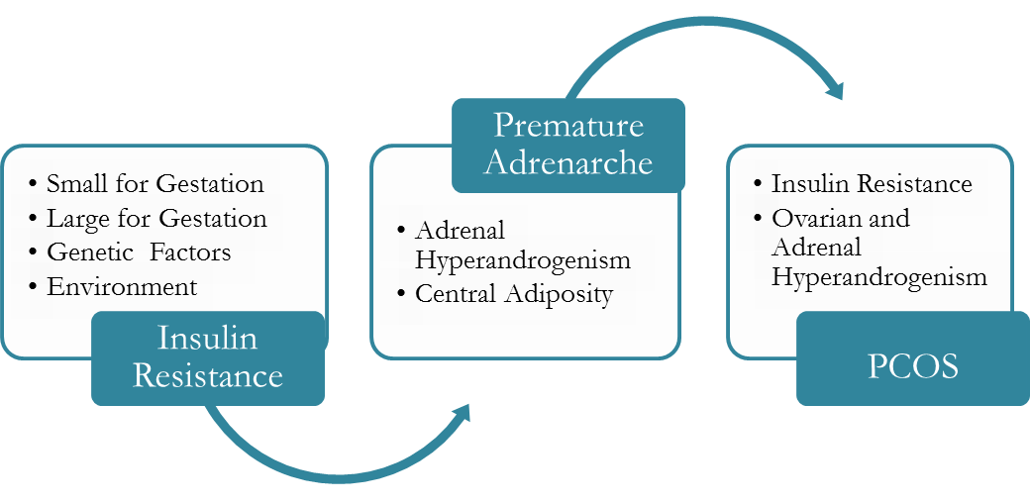
Diagnosis (continued)
Although PA is generally considered to be a benign variant of pubertal development, the strong association with insulin resistance should warrant a metabolic evaluation, especially in those with central adiposity. Infants born small for gestational age may manifest insulin resistance, central adiposity in the peripubertal period, and may have an increased risk to develop PA. PA may be the first manifestation of PCOS for some girls.
Treatment
If the diagnosis of PA is made, no specific treatment is generally required. Deodorants can be used, and pubic or axillary hairs may be shaved or clipped. Counseling about diet and exercise is indicated for those with obesity and metabolic syndrome. Although pharmacotherapy is not recommended, metformin may reverse changes in body composition and cardiometabolic health.
AE-PCOS Society Education Committee
Implications for Health and Wellness
Since PA is a diagnosis of exclusion, some girls will need to undergo more extensive laboratory testing (such as ACTH stimulation testing) and/or imaging before the diagnosis of PA can be established. For some girls and their families, the process involved in a diagnostic evaluation may be stressful.
Some girls with PA have an increased risk to develop polycystic ovary syndrome (PCOS) as well as type 2 diabetes or metabolic syndrome. This is particularly true for obese girls and/or girls that gain too much weight during or after puberty. Thus, PA patients should be followed regularly with particular attention to the signs and symptoms suggestive of PCOS after menarche. Awareness of the interrelatedness of these two conditions may help slow the rate of progression and allow for earlier treatment of PCOS in adolescents.
Resources
Links to additional resources may be found on our website under Resources: www.ae-society.org
This pamphlet is designed to be informative and educational. It is not intended as a practice guideline.
The information contained in this document is based on current medical knowledge as of August 2020.
© 2016, 2020 AE-PCOS Society

