Slide 1
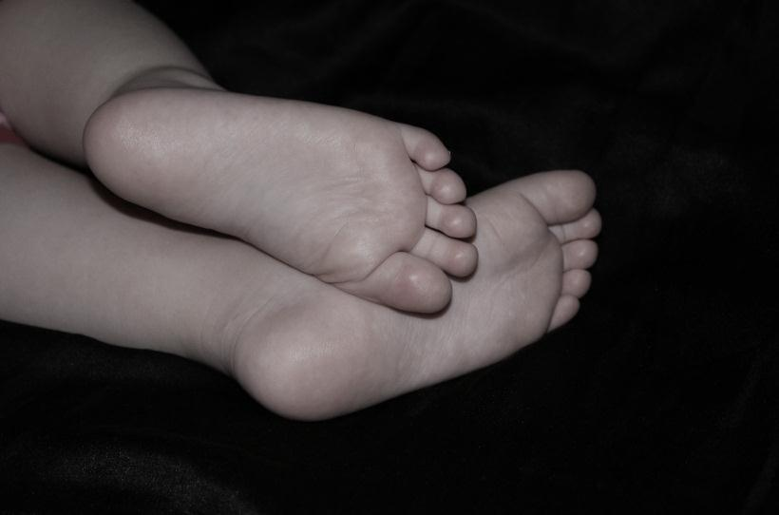
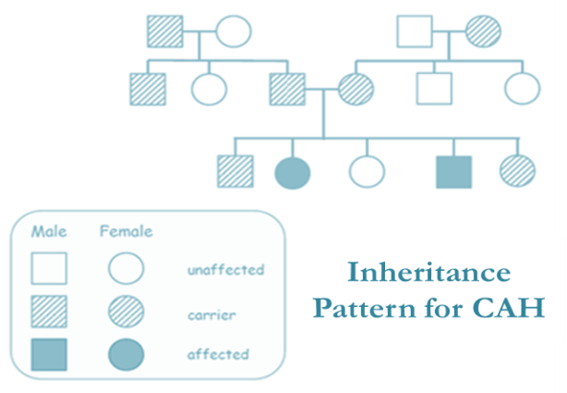
Congenital Adrenal Hyperplasia
A reference for healthcare providers
Congenital adrenal hyperplasia (CAH) is a genetic condition with autosomal recessive inheritance. There is a wide spectrum of clinical severity ranging from the more severe classic to the milder non-classic forms.
Of those born with classic CAH, symptoms are mainly related to glucocorticoid (cortisol) and mineralocorticoid (aldosterone) deficiency as well as variable androgen excess. Clinically, this is expressed as hypoglycemia and low sodium (salt wasting) with elevated potassium and a varying degree of virilization.
Some infants/children with classic CAH who do not suffer from salt wasting, but still have prominent androgen excess, are classified as simple virilizing classic CAH.
Diagnosis
Genetic female infants with the classic severe form typically present at birth with some degree of virilization of the external genitalia, often expressed as clitoromegaly. In boys, who are naturally virilized at birth, external genitalia appear normal. If the condition goes undiagnosed after birth, life threatening adrenal crisis can present within the first week of life, but most commonly occurs at two to four weeks of life. In the non-classic form, symptoms are primarily related to milder androgen excess and occur later in childhood. Premature adrenarche and early acne can be found in both boys and girls. Hirsutism and irregular menses can be seen in adolescent girls.
AE-PCOS Society Education Committee
The most common form of CAH is due to 21-hydroxylase deficiency. This form results from mutations in the CYP21A2 gene, which encodes the adrenal 21-hydroxylase enzyme. To date, over 250 mutations have been reported and over 90% of patients with CAH have mutations in the CYP21A2. The disorder has an overall incidence of 1:10,000 to 1:20,000 although the milder form of non-classic CAH may be as common as 1:1000 in specific ethnic groups such as the Ashkenazi Jewish population.
Although genetic testing has become more available, hormone lab testing is often the first diagnostic approach. Due to the specific defect in the 21-hydroxylase enzyme, its precursor/substrate: 17- hydroxyprogesterone (17OHP) builds up in serum. In addition, this enzymatic deficit increases other precursor products, which then are shunted towards increased androgen production that is 21-hydroxylase independent.

Slide 2
Diagnosis (continued)
Algorithms have been developed for the ascertainment of patients with non-classic CAH, where there is reduced 21-hydroxylase activity instead of near absent activity. Specific cut-off levels for early morning 17-OHP values (follicular phase in postmenarchal women) are useful for initial screening, and if elevated, should be followed by an adrenal challenge test called an adrenocorticotropic hormone (ACTH) stimulation test.
Diagnosis of classic CAH in the newborn period has been facilitated in the United States and many countries by the institution of newborn screening. This usually involves measurement of 17OHP levels obtained from dried blood on filter paper specimens. Molecular tools, particularly for the most common genetic mutations, are then used in adjunct when values are not clearly diagnostic.
Hormonal Profiles in Congenital adrenal hyperplasia
 | Classic Salt Wasting | CLASSIC Simple Virilizing | Non-Classic
Cortisol | ↓↓ | near normal | normal
Aldosterone | ↓↓ | normal | normal
17OHP | ↑↑↑ | ↑↑ | ↑
Androgens | ↑↑↑ | ↑↑ | ↑
Treatment
In the classic form of the disorder, one of the key enzymes in the cortisol and mineralocorticoid production cascade is impaired, resulting in cortisol and mineralocorticoid deficiency. Therefore, the primary aim of therapy is to prevent adrenal insufficiency and salt wasting. This requires life-long treatment with cortisol replacement, as well as early life mineralocorticoid replacement. Children with classic CAH need close follow up with frequent laboratory monitoring of hormonal levels during all stages of development. While most adult women with non-classic CAH do not require glucocorticoid therapy, treatment may be initiated to improve fertility in those seeking to conceive. Women with non-classic CAH often use oral contraceptives and/or antiandrogens to treat cosmetic and menstrual manifestations of their hyperandrogenism. All patients who do require glucocorticoid therapy should have knowledge of sick day increases in their basal glucocorticoid requirements and should be trained in the use of emergency intramuscular stress dosing. A medic alert bracelet is recommended for all patients on chronic steroids.
AE-PCOS Society Education Committee
Implications for Health and Wellness
Implications for health and wellness occur mainly from under or overtreatment as this is a difficult and delicate balance to strike in CAH patients. CAH patients may benefit most from being under the care of physicians specializing in CAH, often who are endocrinologists (pediatric, medical, or gynecologic/reproductive). In the child/adolescent patient with classic CAH, growth and development are intimately linked to optimal management. Therefore, care for young patients should be sought from specialists with particular expertise in the pediatric age group. Unless great care is taken during physical stress such as trauma and illness, adrenal crisis can be precipitated in those with classic CAH at any age group. In adult women, unless good hormonal balance is achieved and shunting towards androgen production is reduced, irregular and anovulatory menstrual cycles can contribute to sub/infertility. Cosmetically, a poor hormonal balance can contribute to development of acne and hirsutism.

Slide 3

Implications for Health and Wellness (continued)
In those girls with classic CAH who have had genital surgery to correct virilization of the genitalia, newer techniques are aimed to preserve the ability to experience sexual relations. Women who have undergone genital surgery generally require Caesarian section for delivery. Both women with classic and non-classic CAH have an increased risk to have a child with CAH, largely due to the high prevalence of these gene mutations in the general population.
Male patients with CAH may develop non-malignant growth of testicular adrenal rest tumors (TARTs). As the size of TARTs increases within the testes, so does the risk for increased obstructive azoospermia and the reduction of fertility. Therefore, regular screening with testicular sonograms starting in adolescence is recommended. Although TARTs are more likely to occur in poorly controlled CAH, they can also occur in those with seemingly well controlled androgen hormones. Independently of the perceived control, an intensified glucocorticoid regimen is usually recommended to decrease TART size.
Resources
Links to additional resources may be found on our website under Resources: www.ae-society.org
AE-PCOS Society Education Committee
This pamphlet is designed to be informative and educational. It is not intended as a practice guideline.
The information in this document is based on current medical knowledge as of August 2020.
© 2016, 2020 AE-PCOS Society

