Slide 1
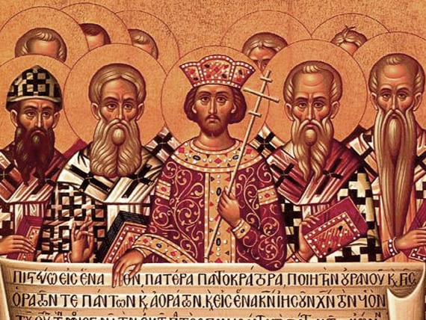
The Early Church was the Catholic Church

Slide 2
The People of God
Abraham, father in faith, GN 12 – 21, ~2000 BC
Israel in a foreign land, Egypt, GN 37 – 45, ~1600 BC
Moses, sent to free God’s people, EX ~1250 BC
From slavery to freedom, EX, DT, Johua, Judges ~1200 BC
From Judges to Kings, 1 & 2 Samuel, 1 & 2 Kings ~1050 BC
Split Kingdom, Prophets, and Exile, 1 & 2 Kings – 1 & 2 Maccabees, 922 – 63 BC

Slide 3
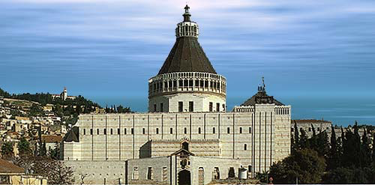
Basilica of the Annunciation
Nazareth, Israel

Slide 4
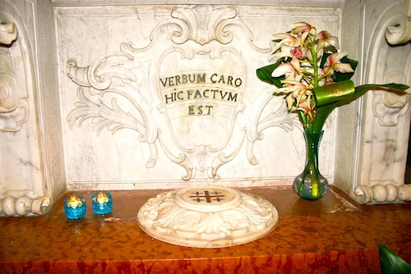
The Word Became Flesh (Est) “Here”

Slide 5
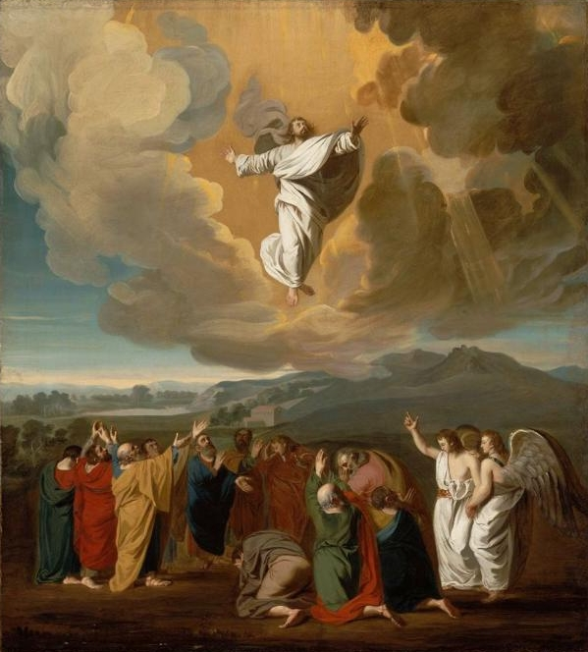
The Early Church

Slide 6
Acts of the Apostles Starts the Story
Before starting Acts of the Apostles,,, read 1:1-4 of Luke’s Gospel
Then read 1:1-2 in Acts of the Apostles
From this we know, Acts is a continuation of the same salvation story Luke started with his Gospel
Jesus’ salvation message is first initiated in Paul’s Letters, then the Gospels, then continued through Acts of the Apostles
The two pivotal events within Acts of the Apostles are:

Slide 7
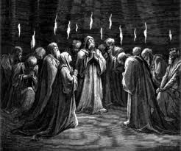
Pentecost (“Birthday of the Church”)

Slide 8
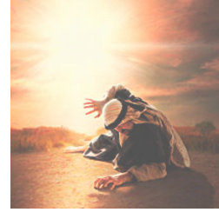
Paul’s Conversion

Slide 9
The Revelation Process
Events: God reveals himself through events (Pentecost, Paul’s conversion, 1st Council, etc.)
Oral Tradition: People talk about these events as faith experiences
Written Tradition: Some oral traditions are gradually written down (sermons, letters, etc.)
Edited Tradition: Luke edits the inherited traditions; “I too have decided, after investigating everything accurately anew, to write it down in an orderly sequence…” (Lk 1:3)
Canonical: The Church (faith community) embraces Letters, Epistles, Gospels as inspired by God

Slide 10
It’s All About Our Salvation
Note: Biblical sources were not historians by our modern definition but “ministers of the word”
They were answering questions like; “What is the significance of this event for our salvation?”
Speeches, dialogues, etc. should not be viewed as exact quotations but as teaching techniques for the salvation message
The main audience of a particular speech is usually not the listener portrayed in the text but the reading audience of the event
Only crucial salvation events are included
Various literary forms are used

Slide 11
The Holy Spirit at Work
Even with Jesus’ instructions the disciples could not figure out God’s complete plan in advance
God intervenes through the Holy Spirit at critical turning points in the story of Acts and beyond
The disciples are NOT manipulated puppets
They have to “figure out” the significance of their experiences (Act 10:9-15, 27-28)
At some point Luke becomes an eye witness himself to many events (“we & I” sections in Acts 16:10-17, 20:5-15, 21:1-18, 27:1-28)

Slide 12
The Scholars’ Outline of Acts
Prep for the Christian Mission (1:1 – 2:13)
  Waiting in Jerusalem, replacing Judas, Pentecost
The Mission in Jerusalem (2:14 – 8:3)
  Peter’s sermons, 1st Deacons, trial and death of Stephen
Mission in Judea and Samaria (8:4 – 9:43)
  Philip preaches in Samaria, Paul’s conversion
Inauguration of the Gentile Mission (10:1 – 15:35)
  Cornelius’ conversion, Paul’s 1st Mission, 1st Council
Paul’s Mission to the ends of the earth (15:36 – 28:31) Paul’s 2nd & 3rd Missionary Journeys, his arrest in Jerusalem, his journey to Rome

Slide 13
Paul’s Missionary Journeys
Acts 13-14, from ~46 to ~49 AD
  Generates the Jerusalem Council (~49 AD)
Acts 15:36-18:22, from ~50 to ~52 AD
Acts 18:23-21:15, from ~53 to ~58 AD
Acts 21:16-28:31, From ~59 to ~63 AD
  Arrested in Jerusalem
  Imprisoned in Caesarea
  Sailed for Rome as a prisoner
  Shipwrecked on Malta
  Imprisoned in Rome

Slide 14
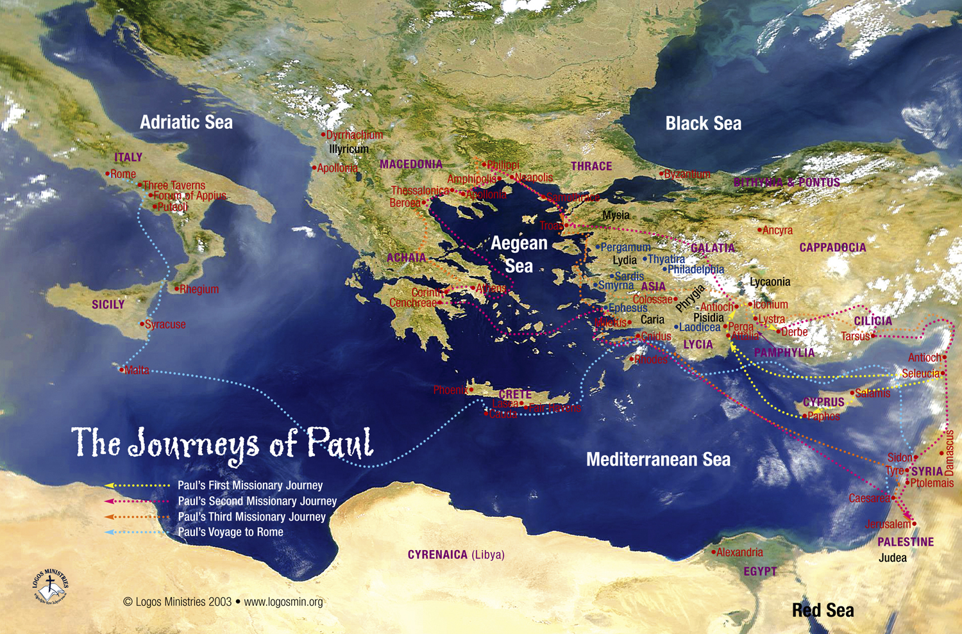

Slide 15
The Story Continues
The salvation which God offers us is the work of his mercy (the saving death and resurrection of Jesus Christ is the ultimate message)
The Church is sent by Jesus Christ as the mission of the salvation offered by God
God has found a way to unite himself to every human being in every age
God has chosen to call a Church together as a people and not as isolated individuals
No one is saved individually or by his or her own efforts

Slide 16
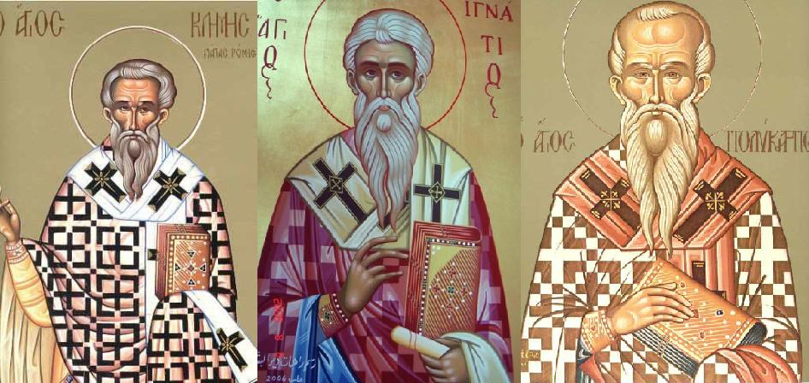
The Apostolic Fathers
Clement of Rome
Ignatius of Antioch
Polycarp of Smyrna

Slide 17
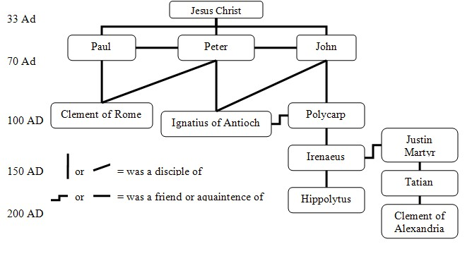
The Process of Passing the Gospel Begins

Slide 18
Evangelization: The Mission of the Church
REMEMBER; all of us are the Church!
  Evangelization is not simply the job of the organic institution
She (Church) is first and foremost a people advancing on its pilgrim way towards God
She is a mystery rooted in Trinity
She exists concretely in history as a people of pilgrims and evangelizers, transcending the physical institution
The Church is a people for everyone!

Slide 19
The Mission Continues
“There can be no true evangelization without the explicit proclamation of Jesus as Lord and without the primacy of the proclamation of Jesus Christ in all evangelizing work.” – St John Paul II, 6 Nov 99
“If the Church is to fulfill its providential destiny, evangelization as the joyful, patient, and progressive preaching of the saving death and resurrection of Jesus Christ must be your absolute priority.” – Pope Francis, Evangelii Gaudium

Slide 20
Tradition (Big T)
The first serious Christian crisis; Acts 15:1-2
The solution; The Council of Jerusalem (~49 AD)
Acts 15:23-28
“It is the decision of the Holy Spirit and of us”
This TRADITION of an inerrant, Holy Spirit guided, council, gave us the Christianity we know today
Church TRADITION defined:
  Jesus Christ is true God coeternal with the Father (Nicea 325)
  The Trinity: three divine persons; Father, Son, Holy Spirit – only one God (Nicea 325, 1st Constantinople 381, Chalcedon 451, 4th Constantinople 870)
  Mary is the Mother of God (Theotokos) (Ephesus 431)
  Jesus is truly God and truly man (two distinct natures) (Chalcedon 451, 2d Constantinople 553)
Without Big “T” Christianity As We Know It Would Not Exist!
Notes:
325: Nicea; 381: Constantinople; 431: Ephesus; 451: Chalcedon; 553: 2nd Constantinople; 681: 3rd Constantinople; 787: 2nd Nicea; 870: 4th Constantinople

