Slide 1
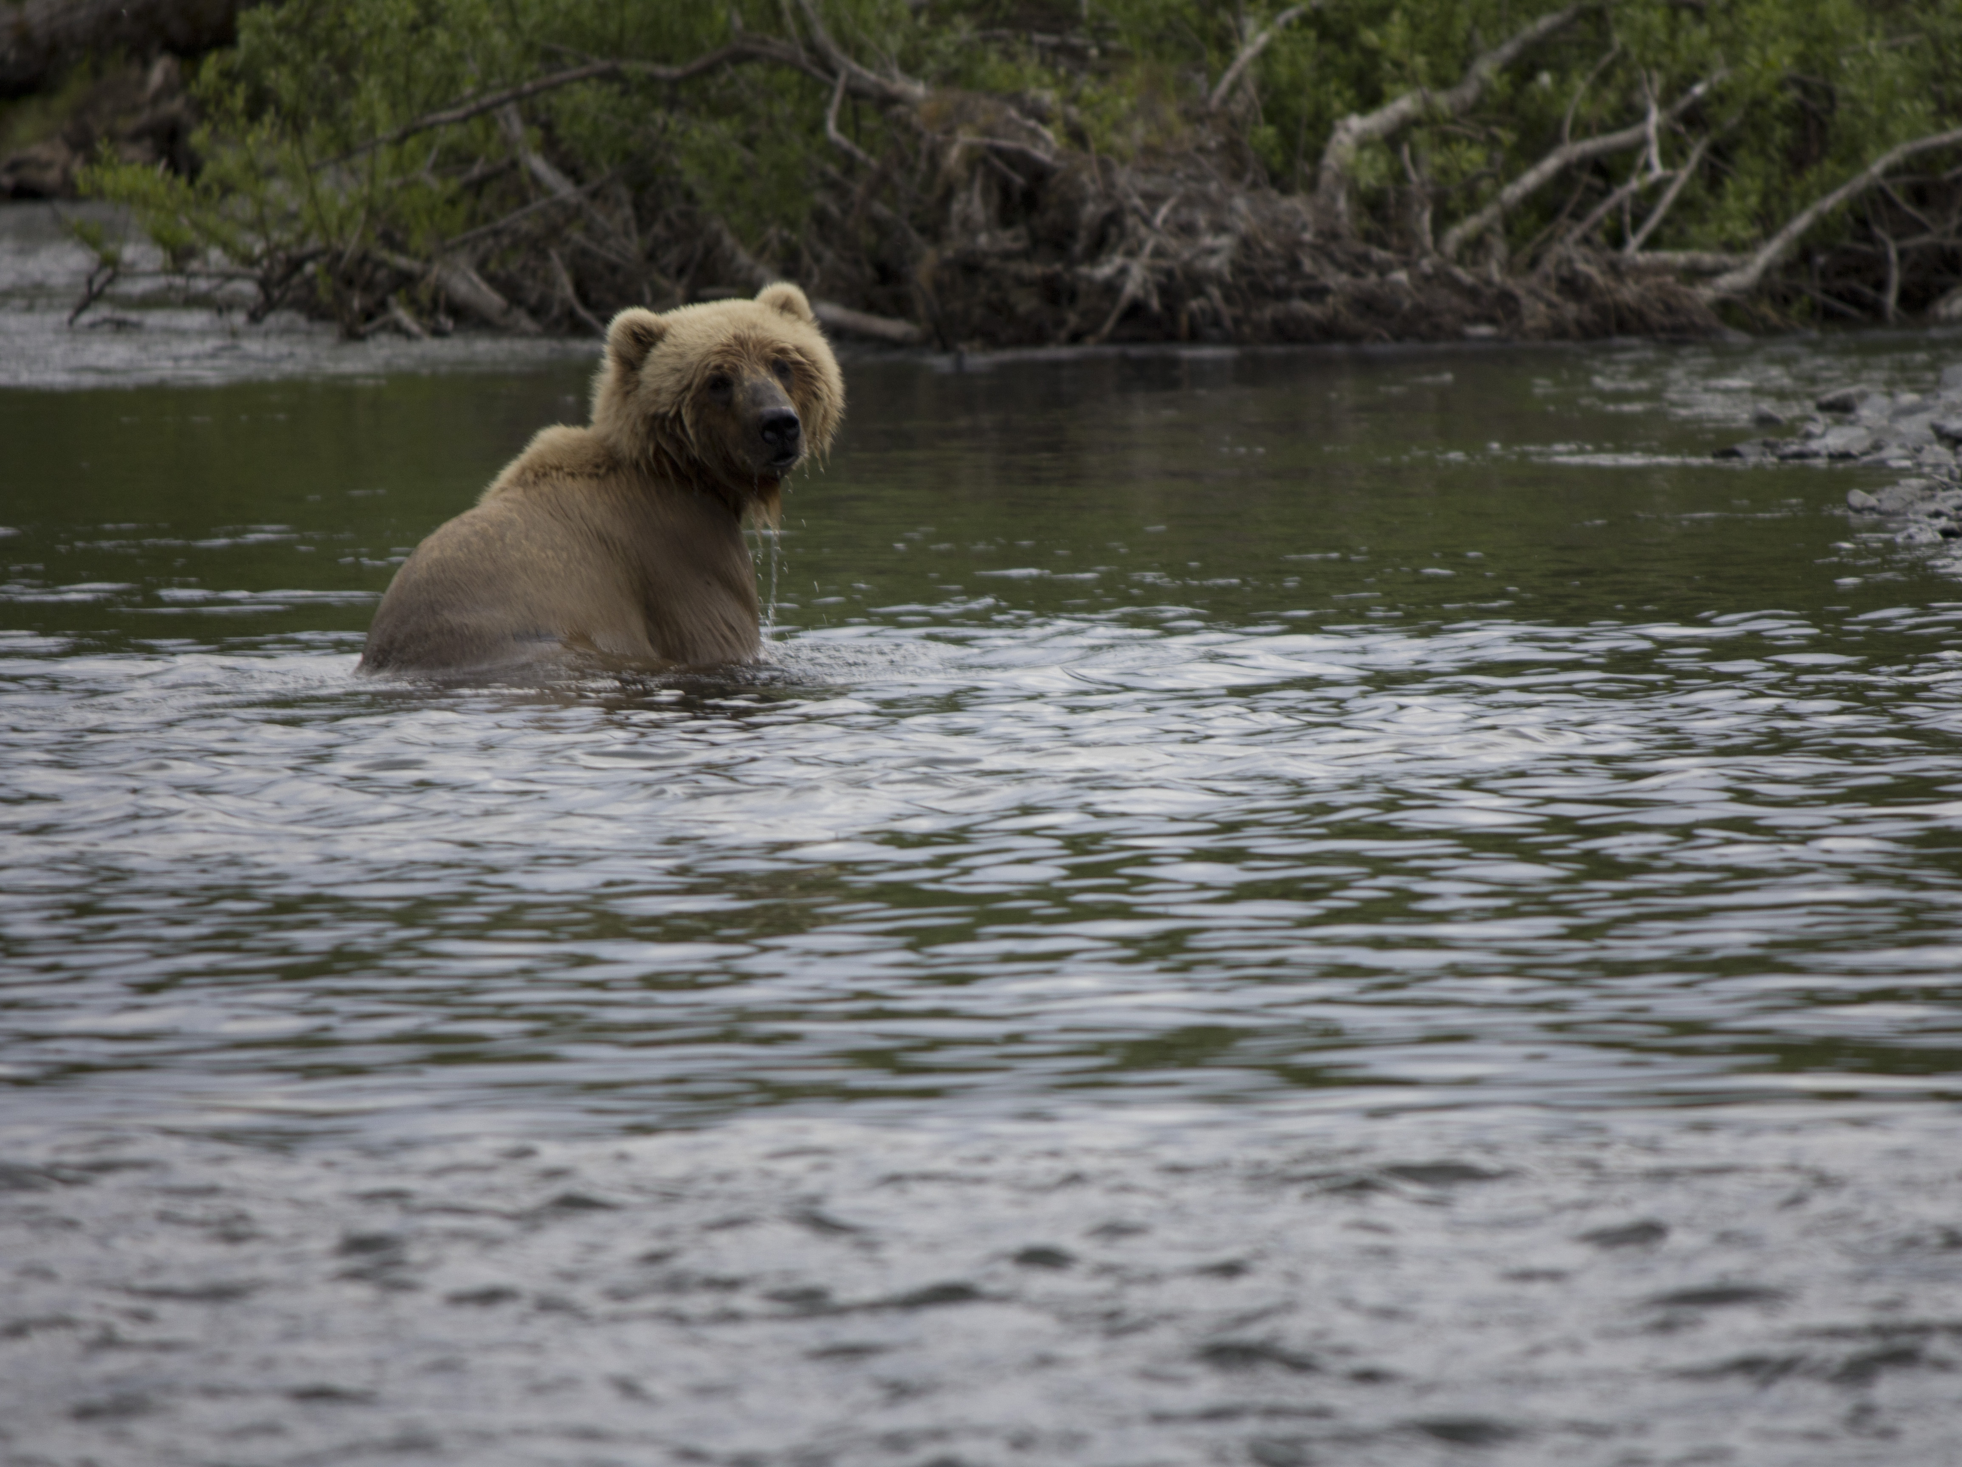

Bear Spray Works

Slide 2
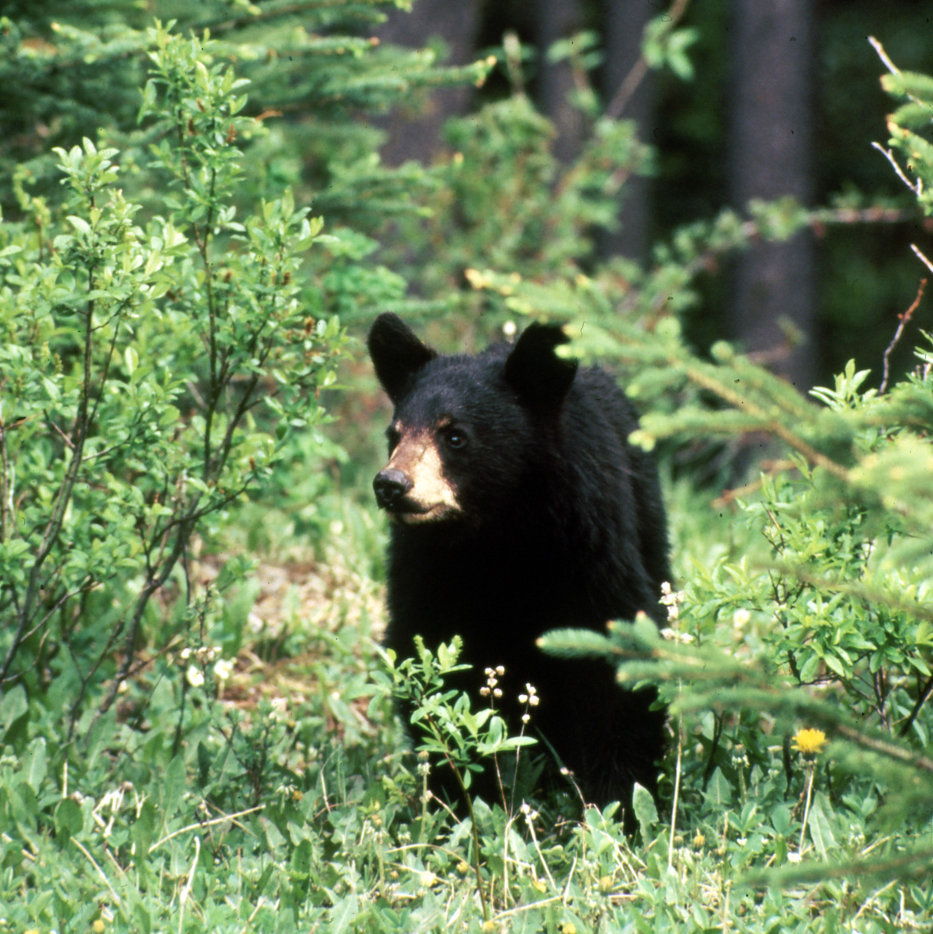
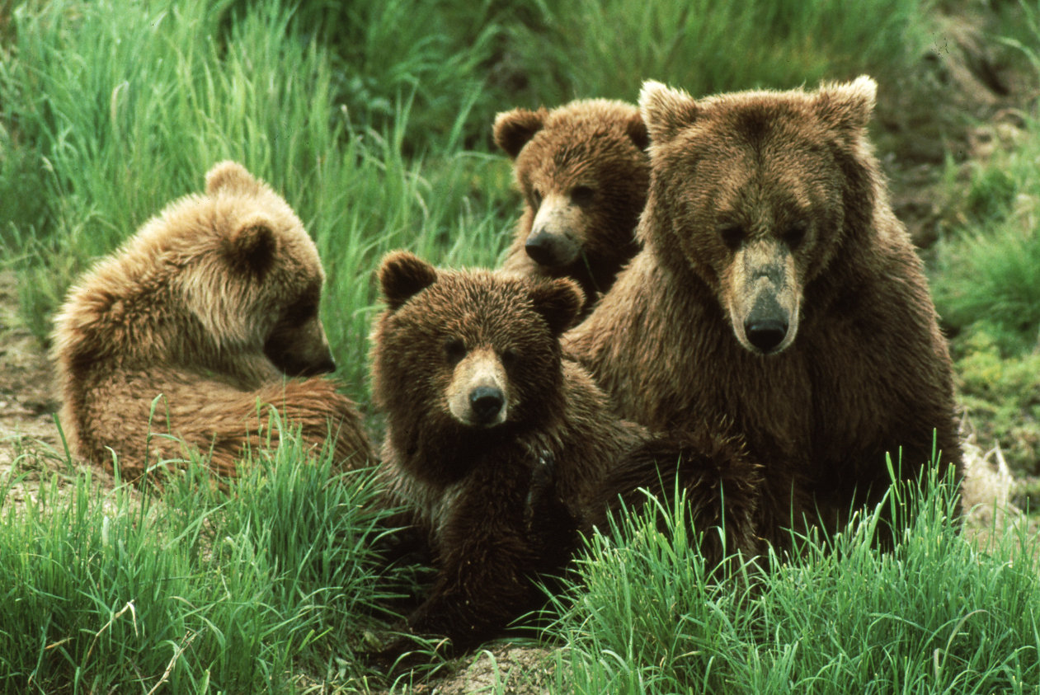
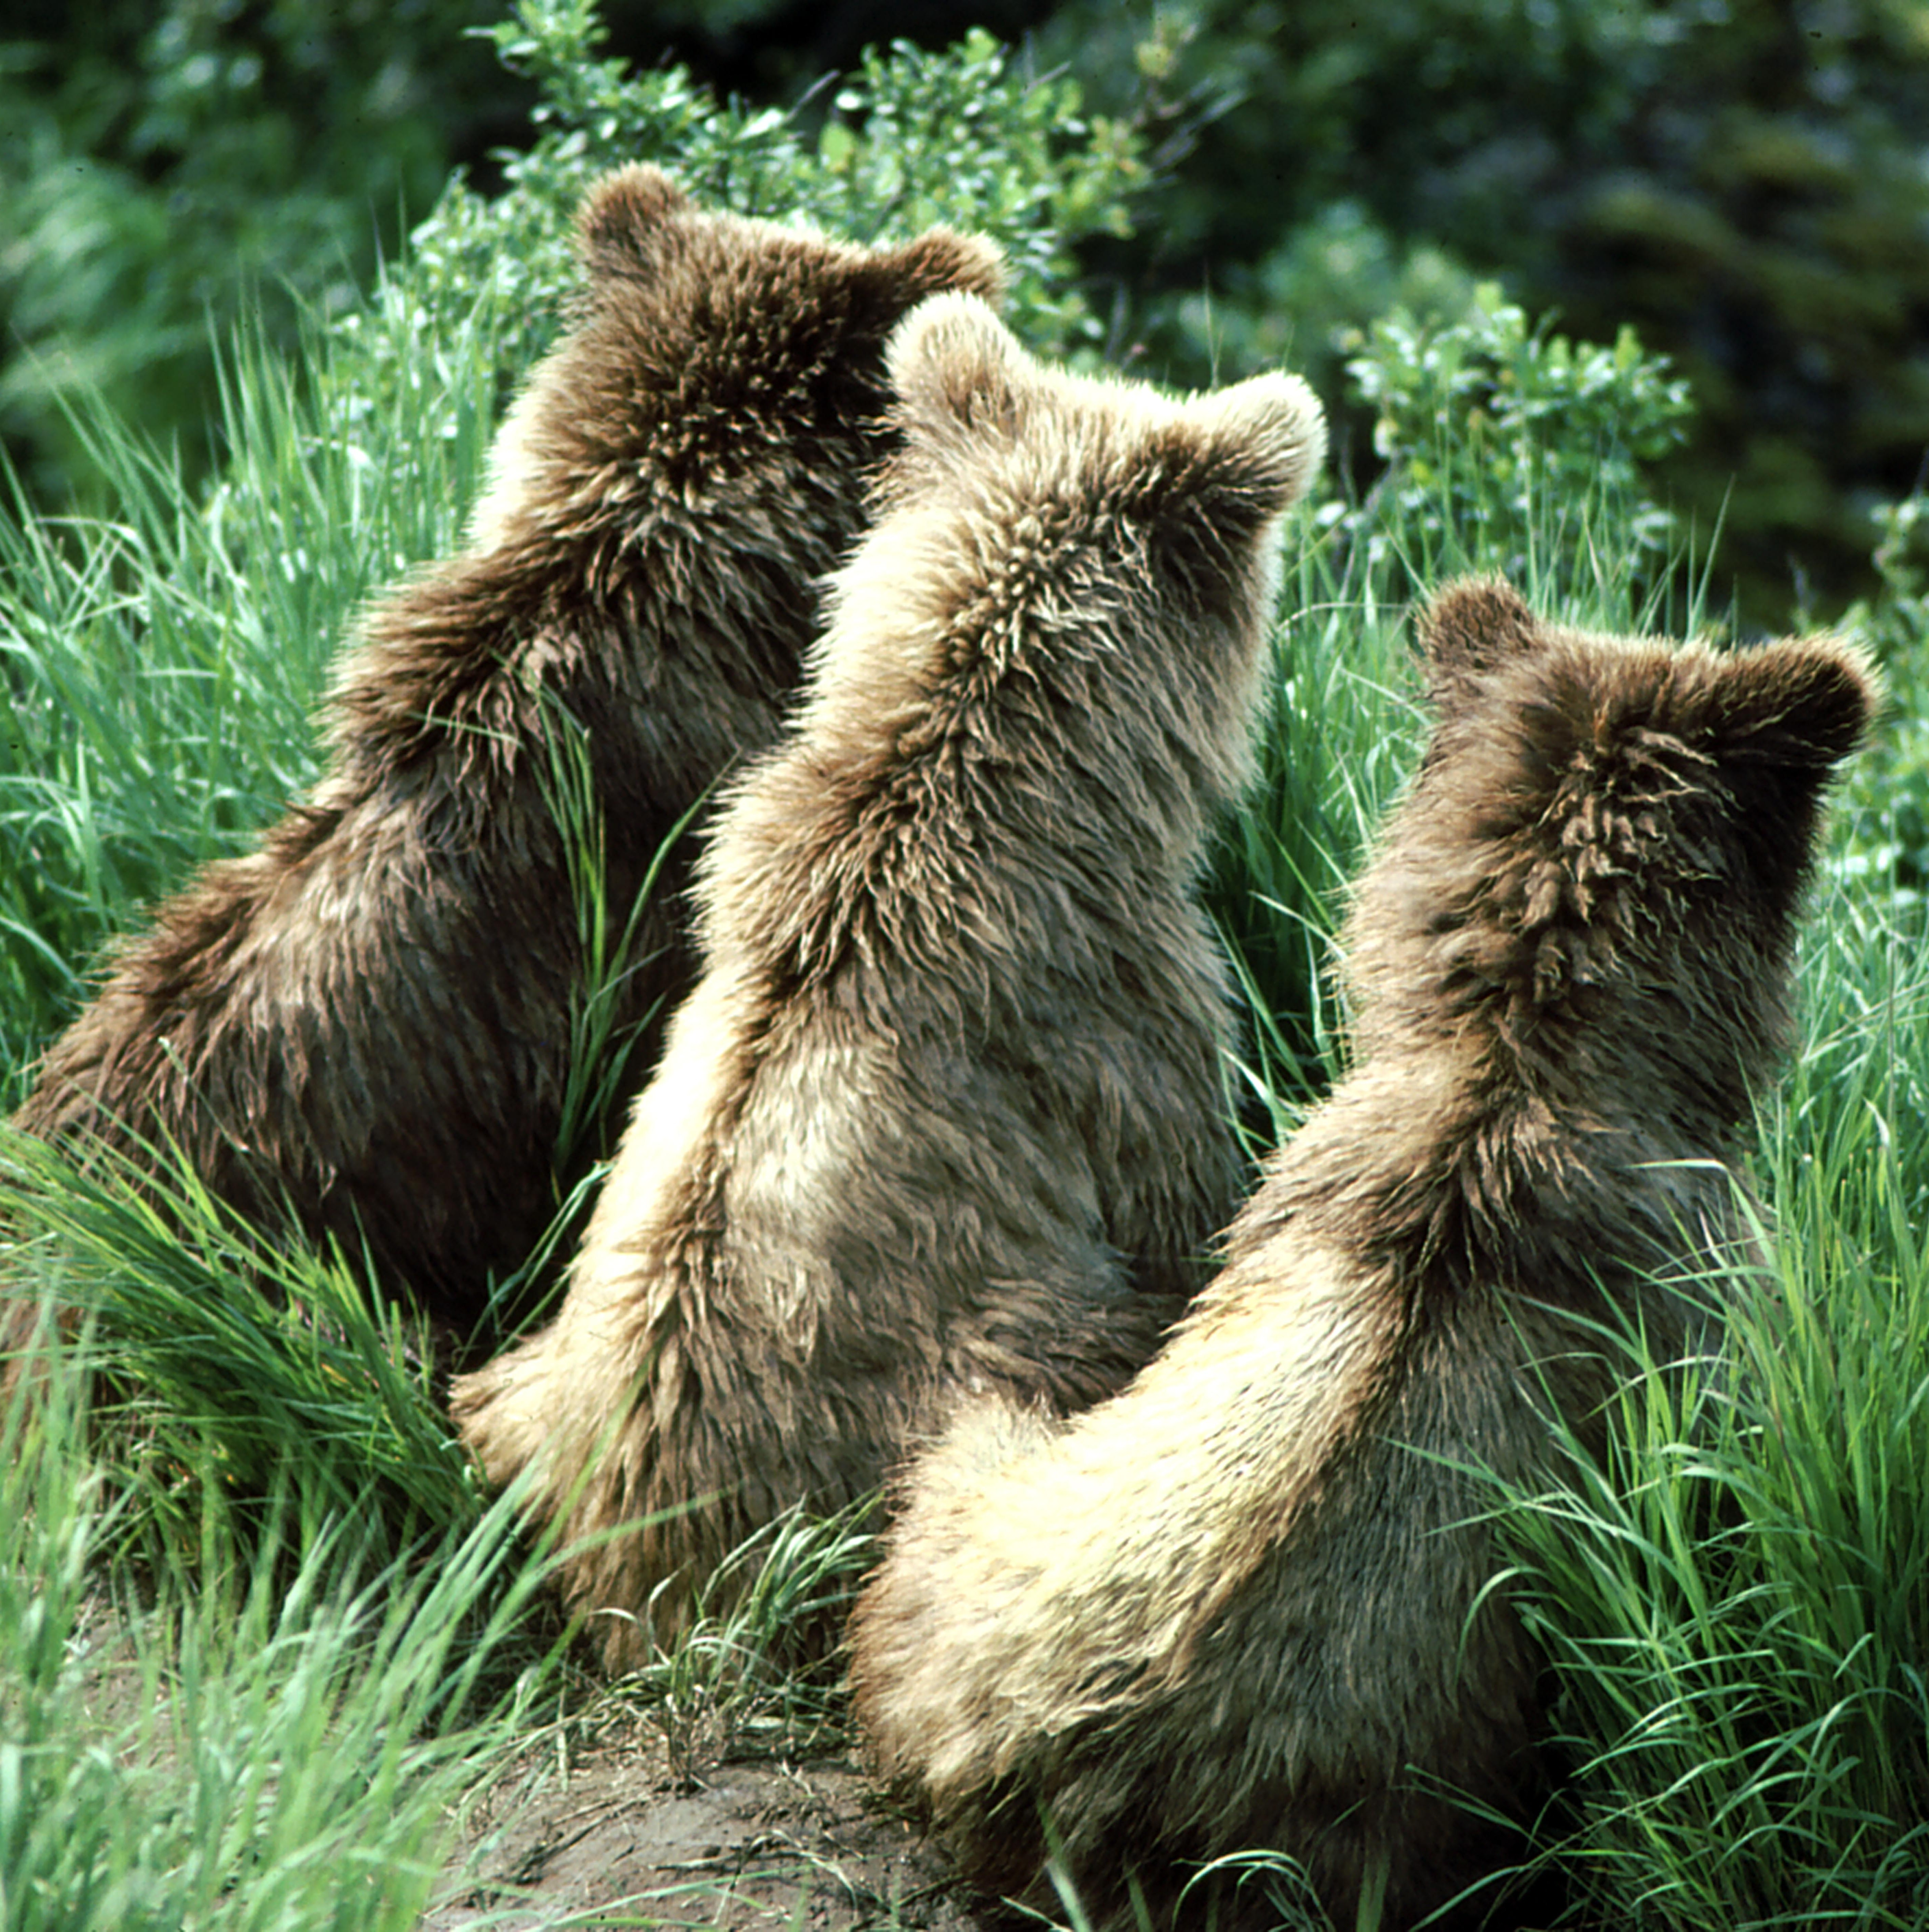

Every year millions of people in North America, from Florida to the Arctic, have the opportunity to enjoy watching bears in the wild. They get to see bears fish, mothers interact with their cubs, or search for food amongst wildflowers and waterfalls.
This presentation was prepared for those rare instances where you may need to use your Bear Spray. Your goal should be to avoid encounters by practicing appropriate bear avoidance techniques and wildlife stewardship.
Notes:
2

Slide 3

Bear Spray works.
Notes:
3

Slide 4
Dr. Tom Smith (Brigham Young University) Dr. Stephen Herrero (University of Calgary)
Terry Debruyn (National Park Service) James Wilder (Minerals Management Service)
“Bear spray stopped bears' undesirable behavior 92% of the time when used on brown bears, 90% for black bears, and 100% for polar bears. Of all persons carrying bear sprays, 98% were uninjured by bears in close-range encounters.
All bear-inflicted injuries (three incidences) associated with using bear spray involved brown bears and were relatively minor (i.e., no hospitalization required).”
Bear Spray works.

Slide 5
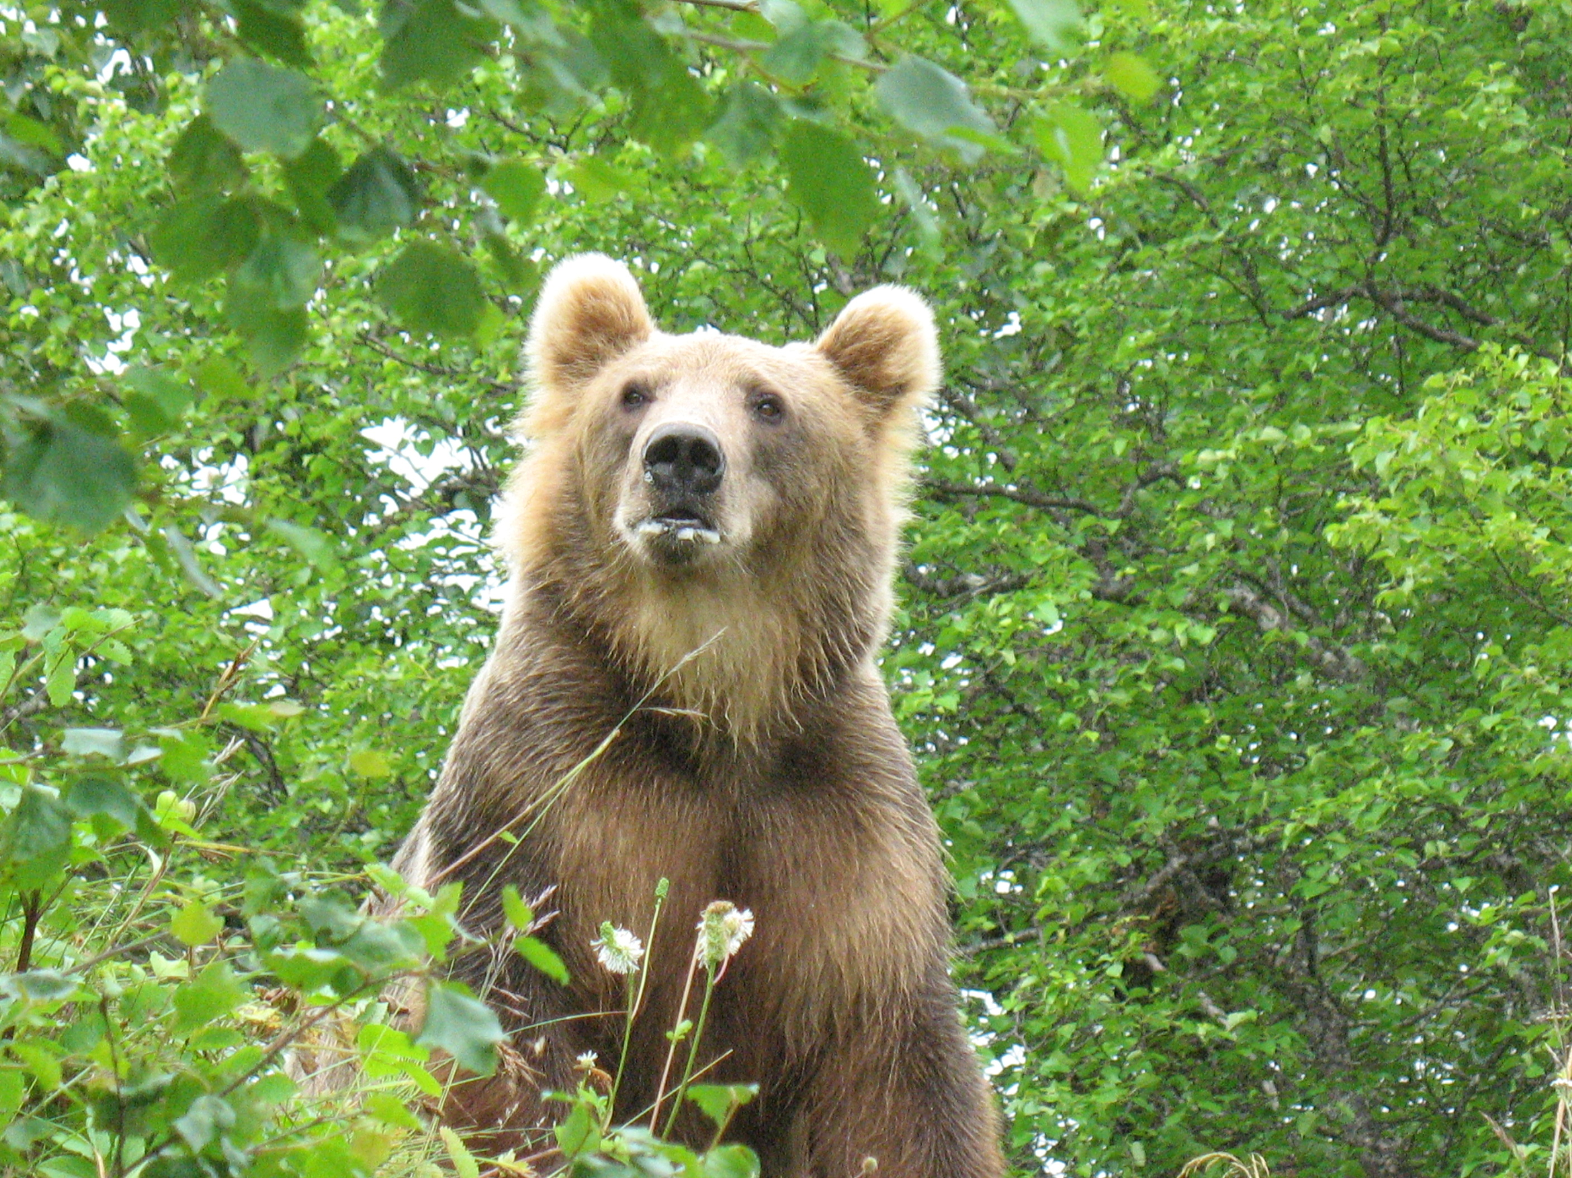
Section One
History of Bear Spray

Slide 6
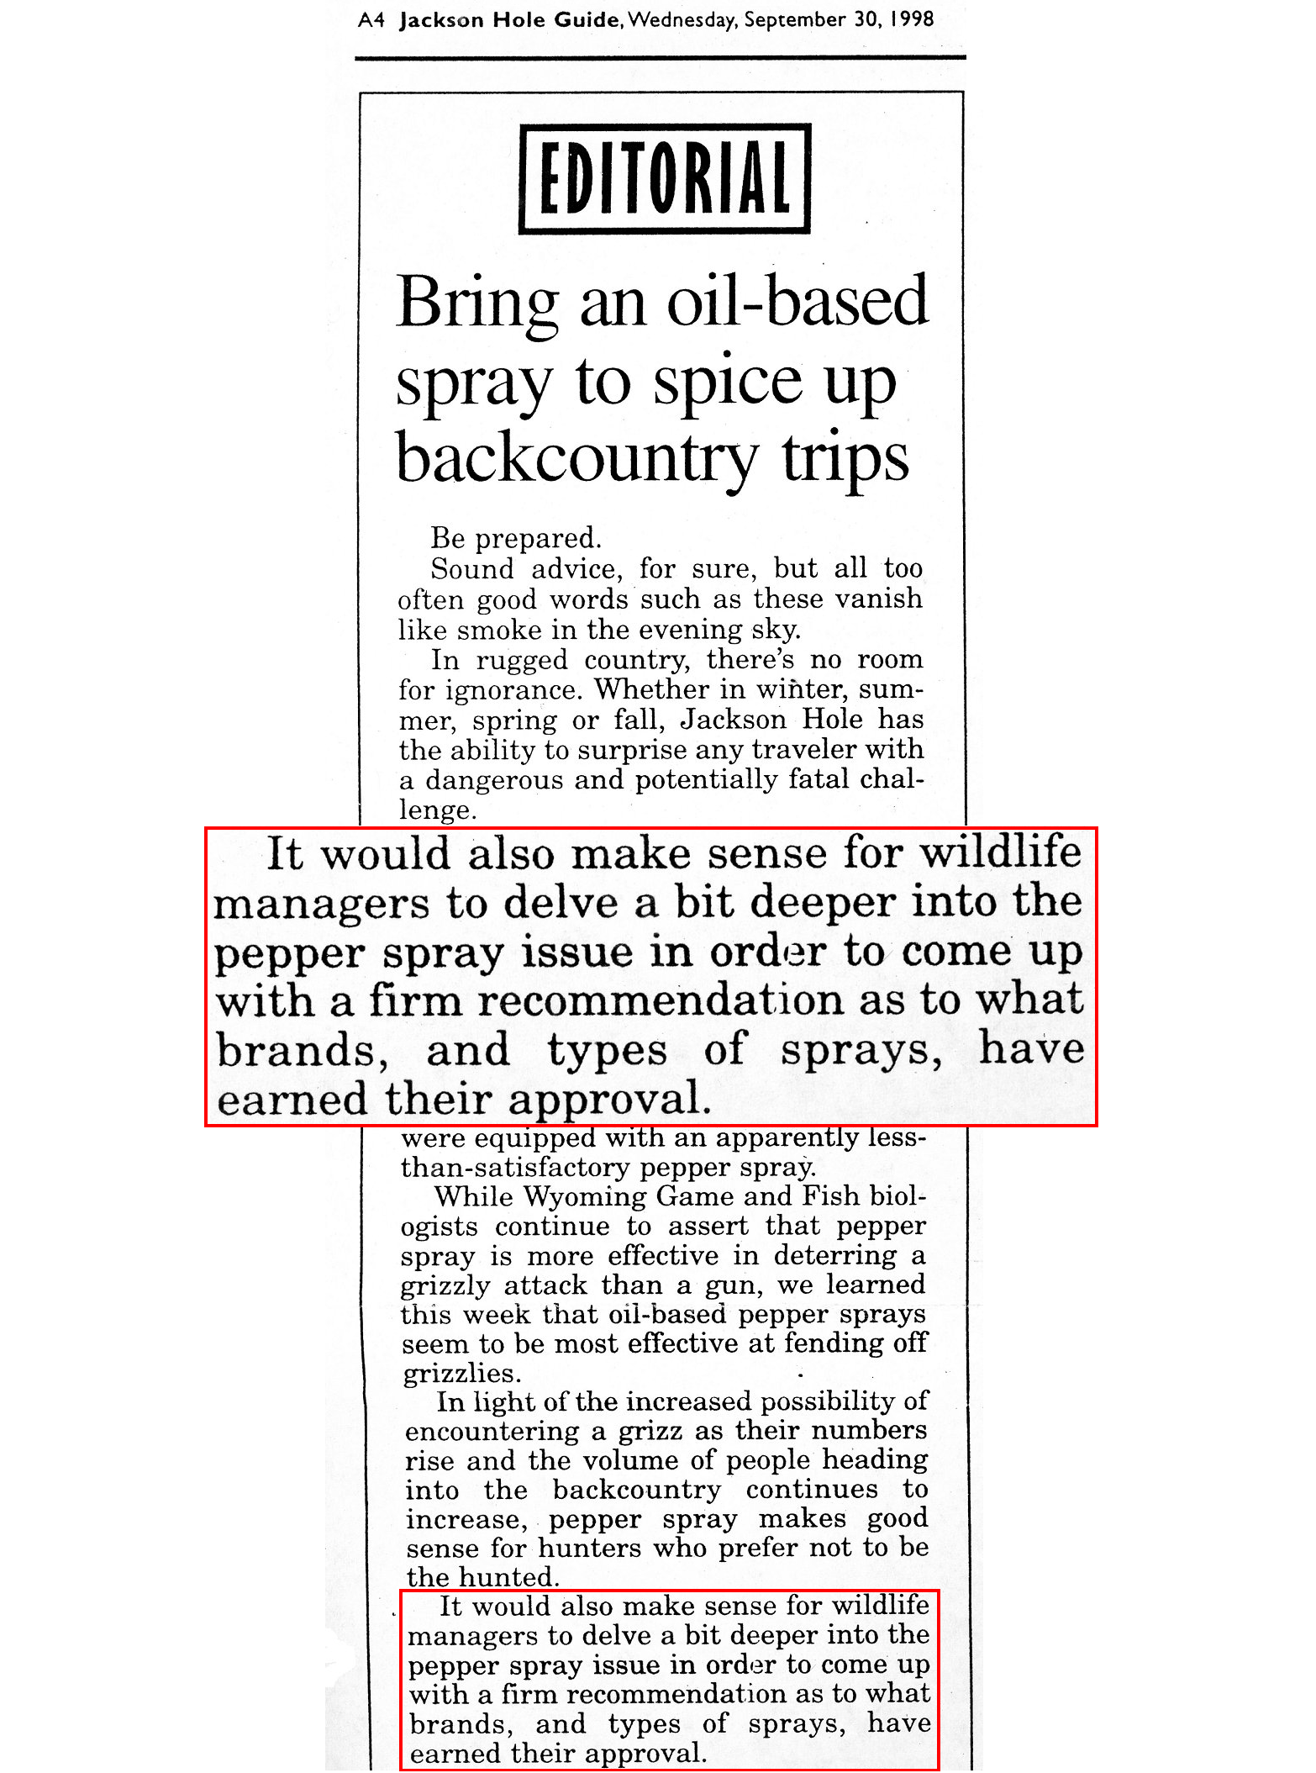
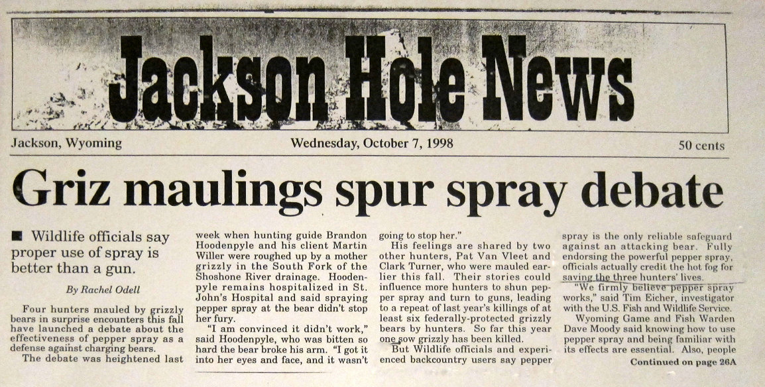
Bear Spray: History
Bear Spray was working in some areas but not others.
Some individuals using Bear Spray were injured, and some died.
Regional and national news media were asking why.
In 1998, the Yellowstone Ecosystem Subcommittee of the Interagency Grizzly Bear Committee asked Chuck Bartlebaugh and the Be Bear Aware Campaign to conduct a review of what was and wasn’t Bear Spray.
Notes:
6

Slide 7
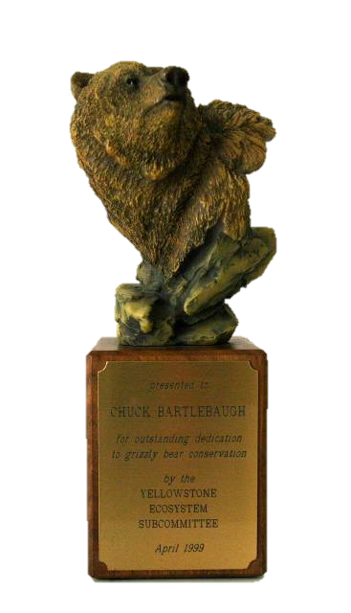
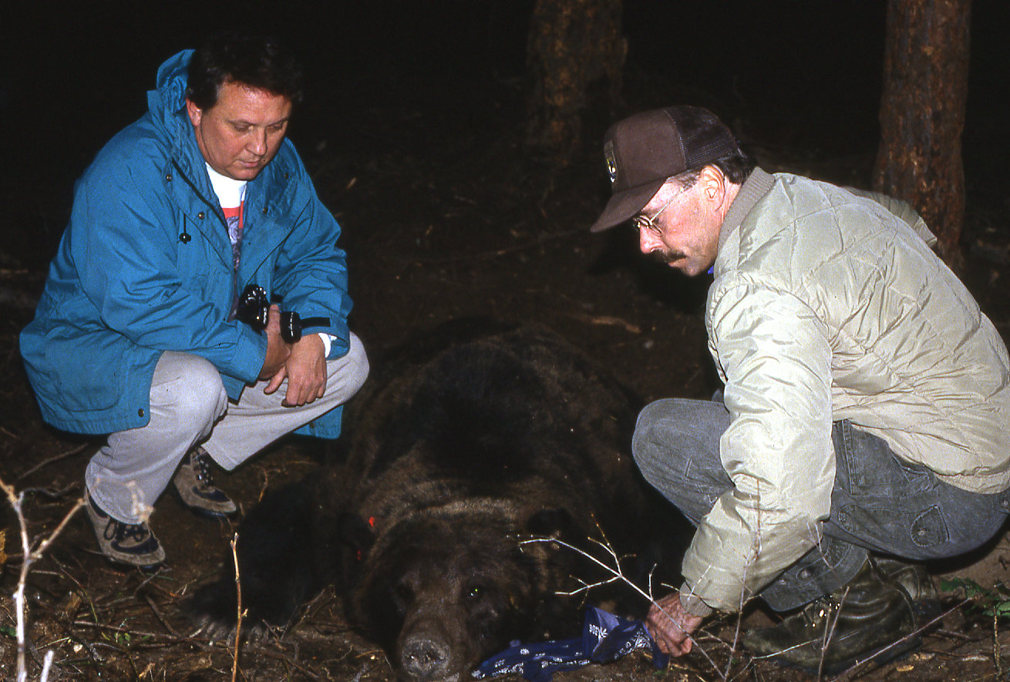
Bear Spray: History
Chuck Bartlebaugh, BBA & Dr. Chris Servheen, USFWS.
The market research done by the Be Bear Aware Campaign garnered considerable recognition from wildlife and land management agencies.
The Yellowstone Ecosystem Subcommittee recognized their work with an award for, “Outstanding dedication to grizzly bear conservation.”
Notes:
7

Slide 8
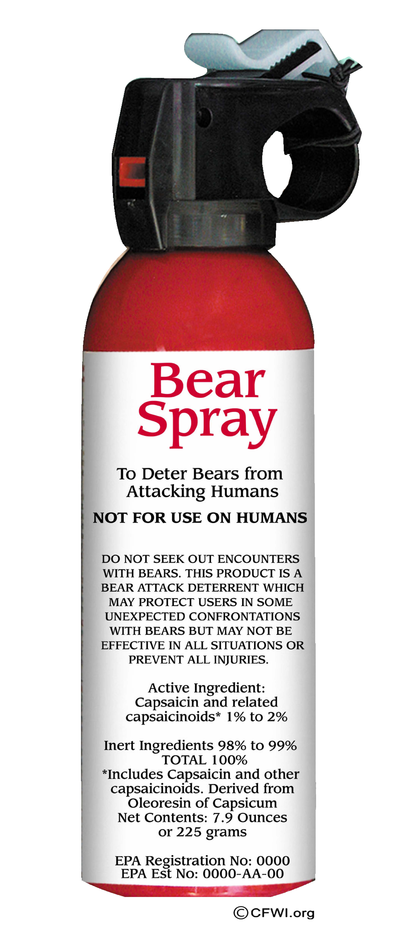
Bear Spray: History
Sources for the following presentation include:
Initial Bear Spray research by Dr. Charles Jonkel, Bill Pounds and lead investigator Carrie Hunt.
Dr. Tom Smith, Brigham Young University, who published numerous papers on Bear Spray and firearms.
Dr. Stephen Herrero, University of Calgary (emeritus), Author of Bear Attacks: Their Causes and Avoidance and many scientific papers on Bear Spray and bear deterrence.
Be Bear Aware Campaign’s media research, incidence reports, study of bear attacks and survivor interviews.
State and Federal Wildlife, Land Management, and bear professionals.
Environmental Protection Agency registration requirements.
Notes:
8

Slide 9
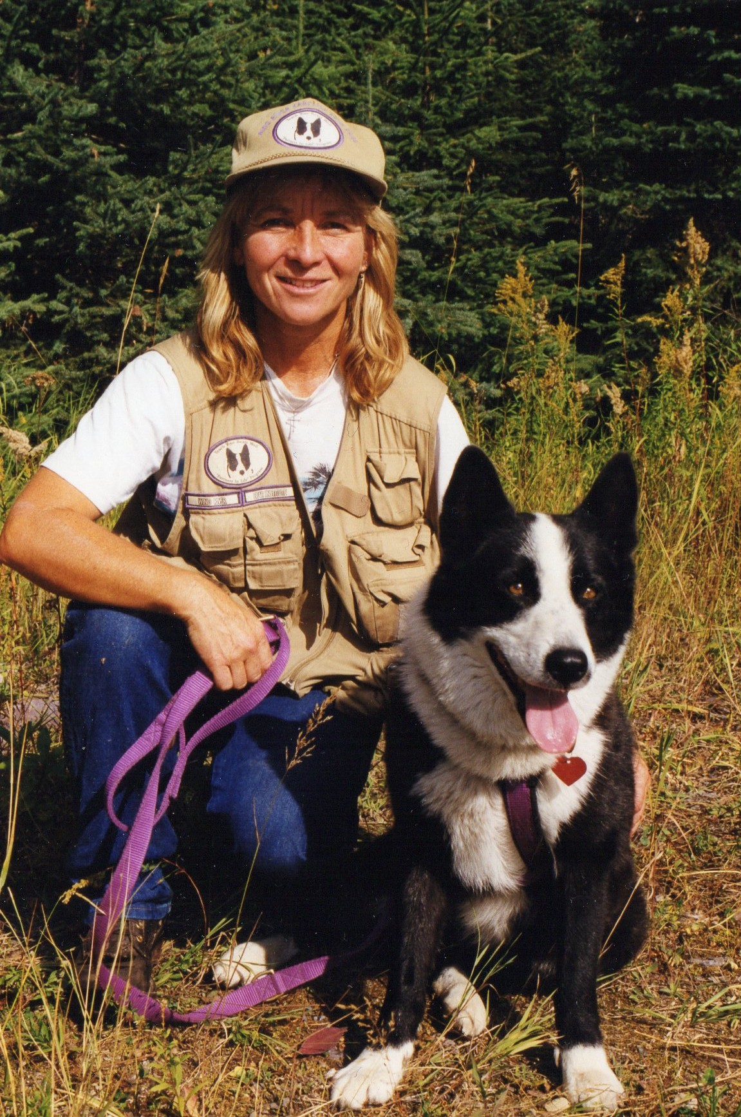
Bear Spray: Research & Development
Bear Spray was developed in the mid-1980s during a research project conducted by Border Grizzly Project at the University of Montana.
Carrie L. Hunt
Principle Investigator
Overseeing the project was:
Dr. Charles J. Jonkel
Border Grizzly Bear Project Leader
Dr. Bart O’Gara
Wildlife Professor
Bill Pounds
Founder of Counter Assault Bear Spray
Carrie Hunt and Cassie.
Notes:
9

Slide 10
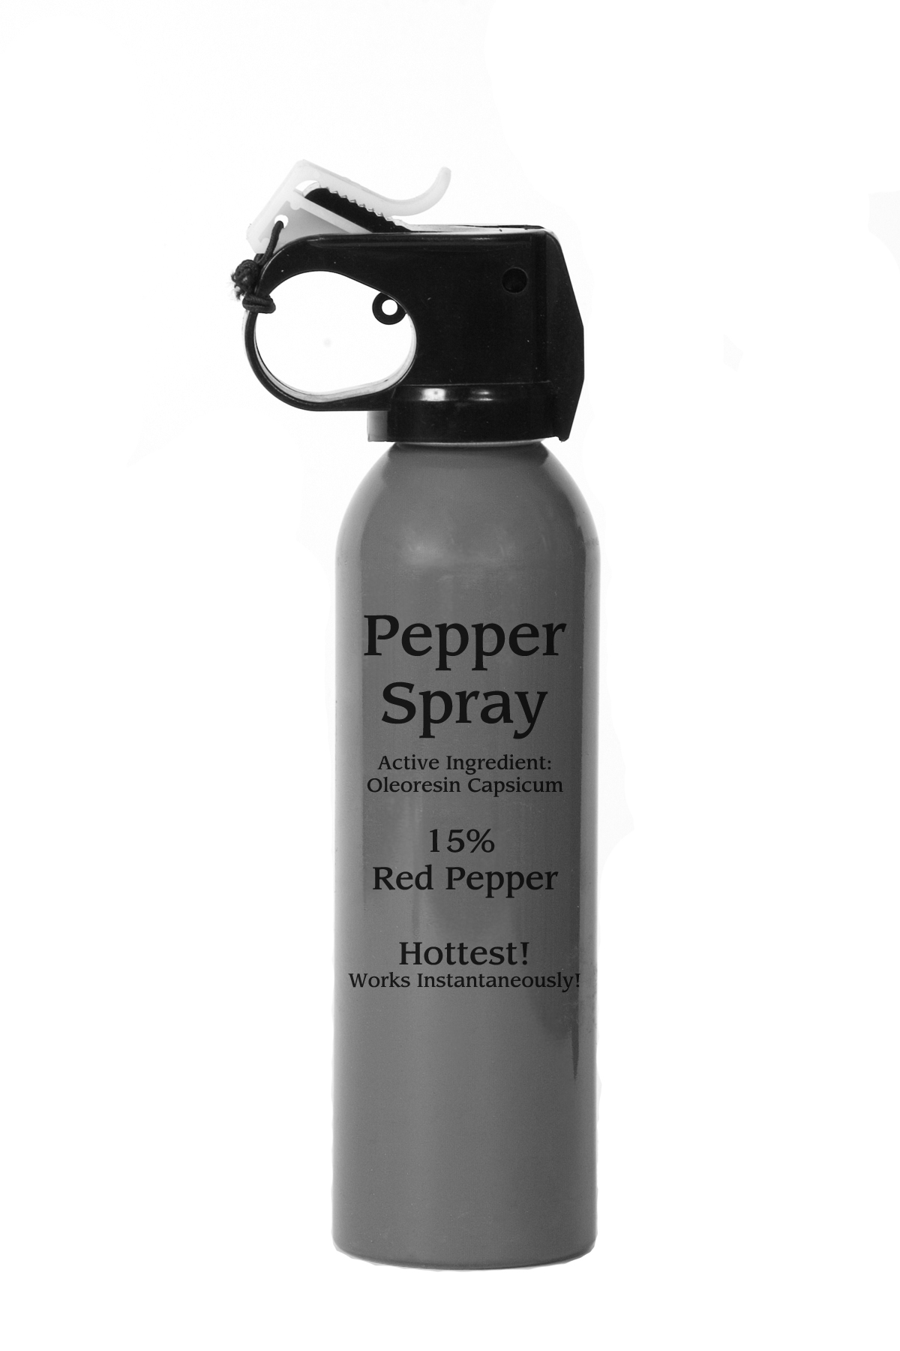
Pepper Spray: What Didn’t Work
When researchers tested pepper spray utilized for personal defense or law enforcement, they learned the following:
Pepper spray was often dispersed in a narrow stream that required precise aim. This required the charging bear be too close, resulting in contact.
Pepper spray only went a short distance allowing the bear to remain focused on the person it was charging.
The potency of the ingredients in pepper spray was inconsistent and unreliable.
The quality and effectiveness of different brands of pepper spray varied greatly.
The actual ingredients in a given pepper spray were often unknown.
Pepper spray is often sold in small, palm-sized cans with limited spray duration and spray distance, ineffective against a charging bear.
Notes:
10

Slide 11
Bear Spray: What Did Work
Researchers successfully developed a spray for black bears, brown bears, grizzly bears and polar bears.
Bear Spray contained quality solvents, and active ingredient, 1%-2% capsaicin and related capsaicinoids.
Bear Spray used a new nozzle mechanism that improved the distance, duration and expansion of the spray cloud.
Bear Spray was now deployed in a powerful expanding cloud, creating a barrier that the bear would pass through. This cloud could be directed rather than aimed.
Bear Spray duration was increased to 7+ seconds, providing additional spray to correct for the wind, multiple bears, zig-zagging bears, those that stop and recharge and for the hike out.
Bear Spray distance increased to 25+ feet so that a bear charging from within 60 feet would meet an expanding cloud at approximately 30 feet (if not affected by wind, cold or rain).
Notes:
11

Slide 12
Bear Spray: What’s in a Name
Bear Spray
Only Bear Spray is allowed to use the word bear in their labeling or text, by EPA regulation.
Only Bear Spray is allowed to be sold for deterring charging or attacking bears.
Bear Spray must be registered with the EPA and tested by certified labs.
Bear Spray uses a special nozzle that provides the distance, duration and expansion of the spray cloud.
Pepper Spray
Neither pepper spray nor law enforcement spray is monitored by the EPA or tested in certified labs.
No one monitors the ingredients or dispersal systems of pepper sprays to see if they are using what they claim.
There are hundreds of pepper sprays with unknown ingredients and dispersal systems.
It’s against the law to sell pepper spray for use on bears.
Notes:
12

Slide 13

Section Two
EPA Registration
The EPA implemented a formal registration and verification program with all manufacturers claiming to produce a Bear Spray.

Slide 14
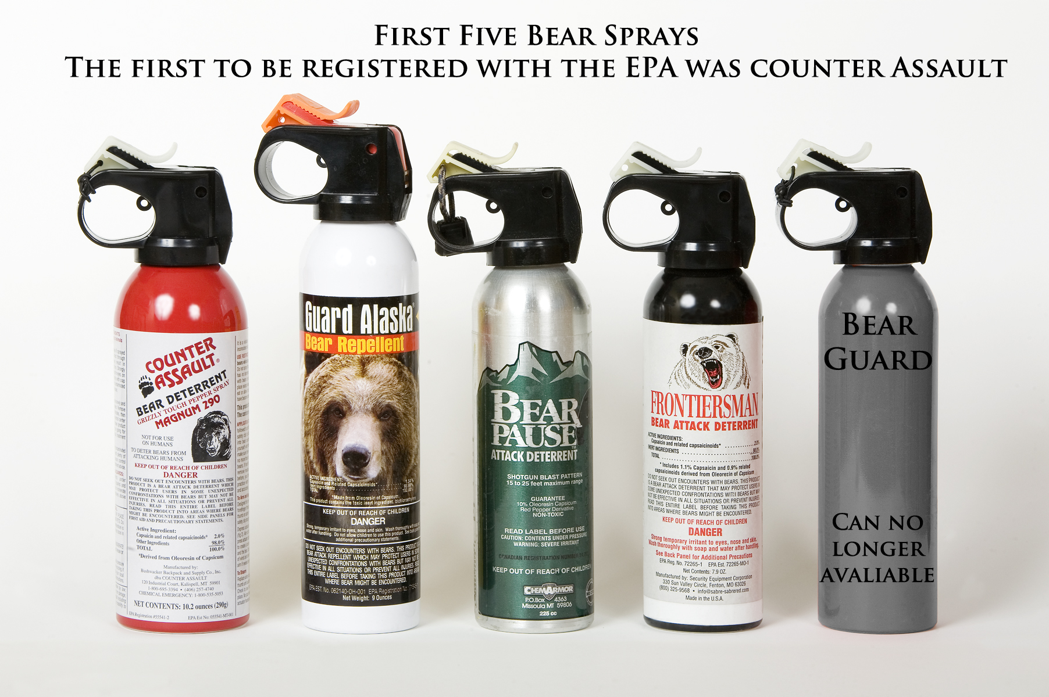
Bear Spray: EPA Registration
Bear Spray is a powerful chemical formula, specifically prepared for use on charging or attacking bears.
By law, all formulas and ingredients have to be verified, tested and registered with the EPA.
All labels, counter displays and promotional packaging have to be approved and registered with the EPA.
The EPA or state agencies have the authority to review the records of any Bear Spray manufacturers.
This verifies they are in compliance and using the ingredients listed on the can and registered with the EPA.
Notes:
14

Slide 15
Bear Spray: What is Bear Spray
Bear Spray is developed specifically to deter aggressive, charging or attacking bears by directly affecting the nervous system, irritating and inflaming the bear’s eyes, nose, mouth, throat
and lungs.
Active Ingredient:
1%-2% capsaicin and related capsaicinoids.
Disperses in a powerful, expanding cloud, so you do not have to aim for the eyes, nose or mouth.
The powerful, expanding cloud creates a wide barrier which the charging bear must pass through, exposing the bear’s eyes, nose and mouth to the active ingredient.
Minimum Net Contents is 7.9 ounces or 225 grams.
Research has shown a spray duration of 7 seconds and a spray distance of 25 feet are important to deter bears in a variety of charging scenarios.
Notes:
15

Slide 16
Bear Spray: Ingredients
CRC (capsaicin and related capsaicinoids): An irritant and inflammatory agent that temporarily overwhelms the bear’s senses, affecting the bear’s eyes, nose, mouth, throat, and lungs. Listed as “Active Ingredient.”
Propellants: These liquid propellants help project the active ingredient from the can.
Listed as “Other Ingredients.“
Solvents: Such as 134A mixing all ingredients so they can be projected from the can in a powerful atomized expanding cloud. Listed as
“Other Ingredients.”
OC, Oleoresin Capsicum: What the active ingredient is derived from (it is not the active ingredient).
The EPA requires all the ingredients to be tested to determine their effects on the skin, eyes and the Ozone layer.
Notes:
16

Slide 17
Bear Spray: Misinformation
The Environmental Protection Agency does not allow these marketing terms on Bear Spray labels because they can be misleading or inaccurate:
‘SHU, Scoville Heat Units’: This information can often be very misleading and inaccurate.
‘10%, 15%, or 20% Oleoresin Capsicum’: Not found on Bear Spray labels and can be misleading.
‘The hottest’: How ‘hotness’ affects Bear Spray has never been tested, and can be misleading.
‘Pharmaceutical-grade Capsaicin and related Capsaicinoids’: Does not exist.
‘Empties faster, delivering more ‘pepper’ to the bear.’:
Just empties the can faster. 2% does not become 4%.
‘The most powerful.’: No testing has been performed to determine who has the most powerful.
Notes:
17

Slide 18
Bear Spray: Misinformation
Claims that it worked ‘instantaneously’ or ‘like hitting a brick wall,’ gave a false sense of effectiveness.
Claiming that their product is the ‘hottest, or most powerful.’ The EPA does not allow this type of claim because it can be misleading and inaccurate.
Often listed ‘Oleoresin of Capsicum’ as the active ingredient. It is not! The active ingredient is 1%-2% capsaicin and related capsaicinoids.
‘Disperses more capsaicin and related capsaicinoids quicker.’ 2% CRC does not become 4% CRC.
Pepper spray labels often do not reflect the actual ingredients. It’s something in a can?
The Internet provides even more misinformation that is not allowed on Bear Spray labels or promotional material. What is on the can’s label is regulated by the EPA.
Notes:
18

Slide 19
Bear Spray: Registration Enforcement
Some Bear Spray companies were in violation of the EPA’s registration policy and continued to misinform customers about their products and their capabilities.
September, 2003: A $17,000 fine was placed against UDAP by the EPA for misleading labeling and
marketing materials.
November, 1999: The stop-sale of the Bear Pause product line manufactured by ChemArmor, Inc. The company falsified their ingredients while registering their product. They were removed from retail outlets in the United States and Canada.
October, 1998: Sales of Carlton’s Calls Pepper Spray were stopped and products were removed from retail outlets.
The Environmental Protection Agency, in partnership with state agencies continues to monitor Bear Spray for compliance of their registration.
Notes:
19

Slide 20
Bear Spray: Registration Enforcement
September, 2003: UDAP fined $17,208.
Notes:
20

Slide 21
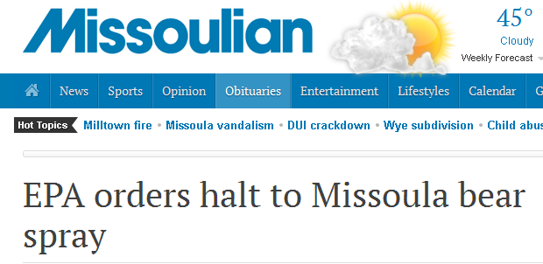
Bear Spray: Registration Enforcement
November, 1999:
"We don't want people going into bear country with a product on their hip that may not do its job if needed.”
—Tim Osag, EPA.

Slide 22
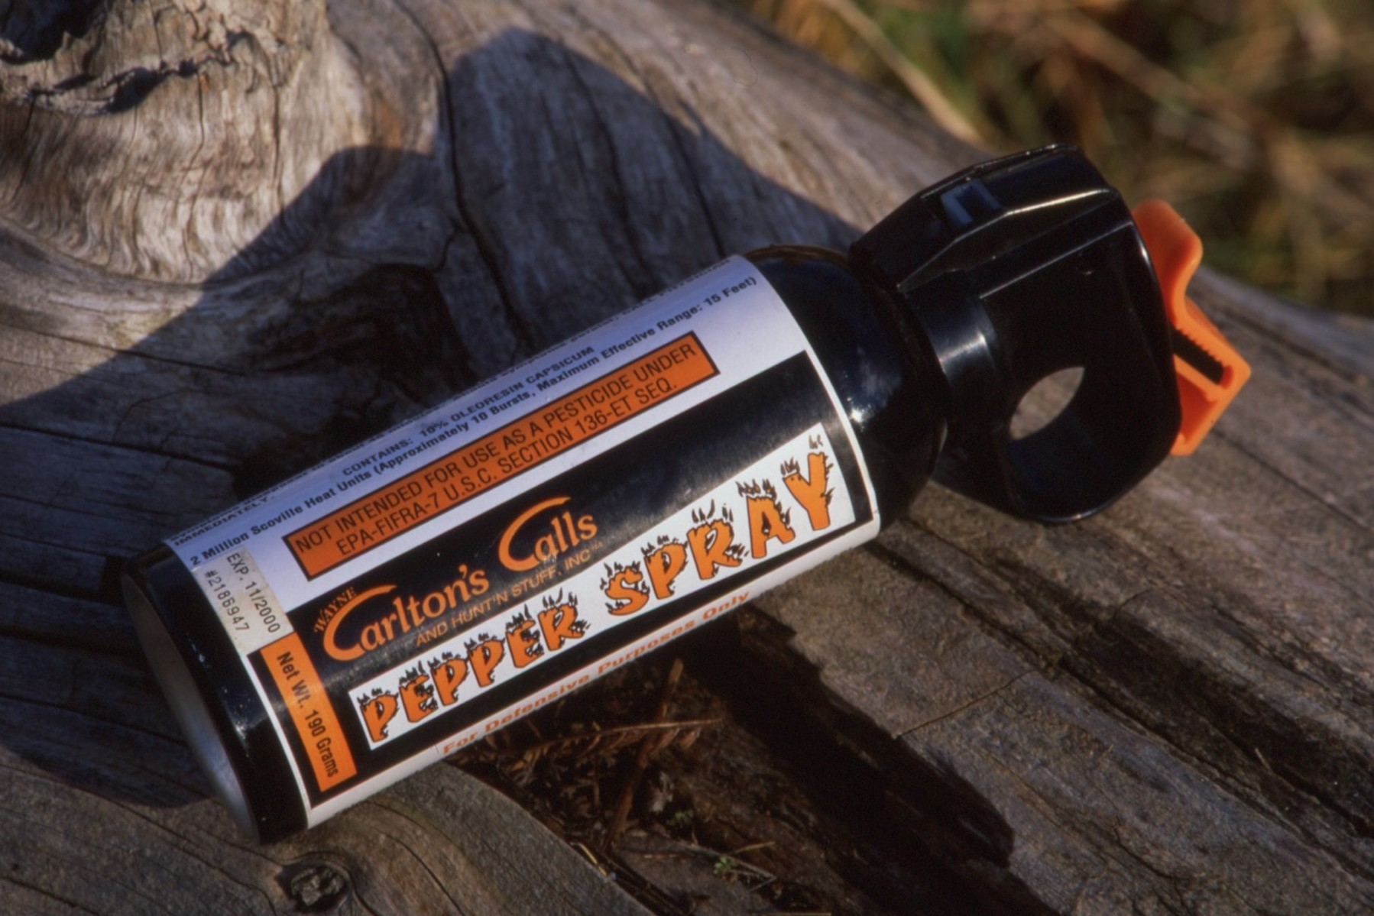
Pepper Spray is not Bear Spray.
October, 1998: Carlton’s Calls
EPA Stop Sale, Use or Removal Order
“Not intended for use as pesticide (aka Bear Spray) under EPA-FIFRA-7 U.S.C. Section 136-ET SEQ.”
‘This is not a Bear Spray.’
Notes:
22

Slide 23
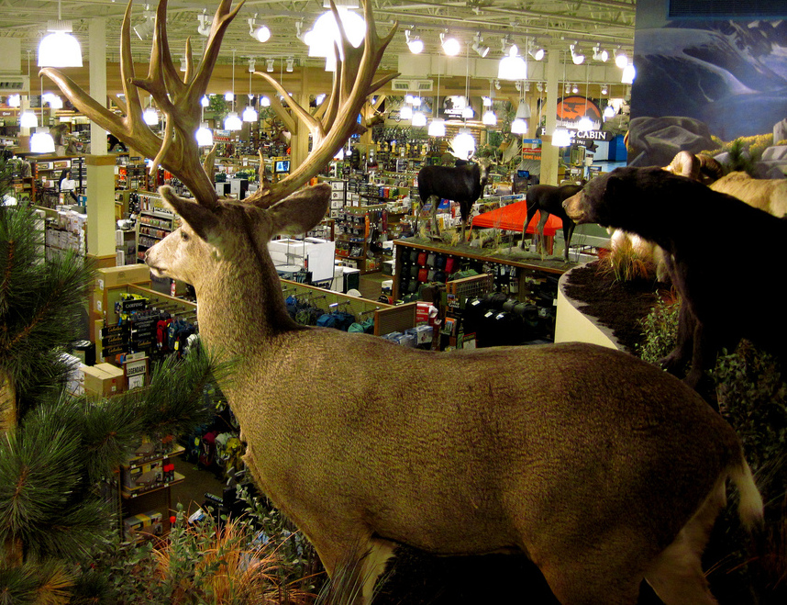
Section Three
Buying & Selling

Slide 24
Bear Spray: Buying & Selling.
Whether you are buying or selling Bear Spray, it is important to read the label and specifically ask for “Bear Spray.” Always call it “Bear Spray.”
Only Bear Spray is allowed to use the word “bear” on the label to identify the product. It will say either, “bear deterrent” or “to deter bears from attacking humans.”
Active ingredient:
1%-2% capsaicin and related capsaicinoids (derived from Oleoresin of Capsicum).
Suggested spray duration until the can empties is 7 seconds and a spray distance of 25 feet.
Bear Spray durations vary from 4 seconds to 9+ seconds, and the spray distance varies from 15 feet to 30+ feet, depending on the brand. Check the performance standards of the product you are considering.
Net content will be at least 7.9 ounces or 225 grams.
EPA registration numbers and EPA Est. numbers are located on the bottom of the label.
Notes:
24

Slide 25
Bear Spray vs. Pepper Spray
Bear Spray:
Will clearly state for use on bears and not people.
Active ingredient: 1%-2% capsaicin and related capsaicinoids.
EPA restricts what can be stated on the label.
Label must represent actual ingredients.
Net weight a minimum of 7.9 ounces or 225 grams.
Pepper Spray:
Not allowed to indicate it may be used on bears and is illegal to sell for use on bears.
May say it has 10, 20, or 30% Oleoresin of Capsicum—this is not allowed on bear spray cans.
Label may make exaggerated claims such as, “works instantaneously,” “the hottest,” and “like hitting a brick wall.”
Label and contents are not regulated by any agency.
When buying or selling, always call it “Bear Spray.”

Slide 26
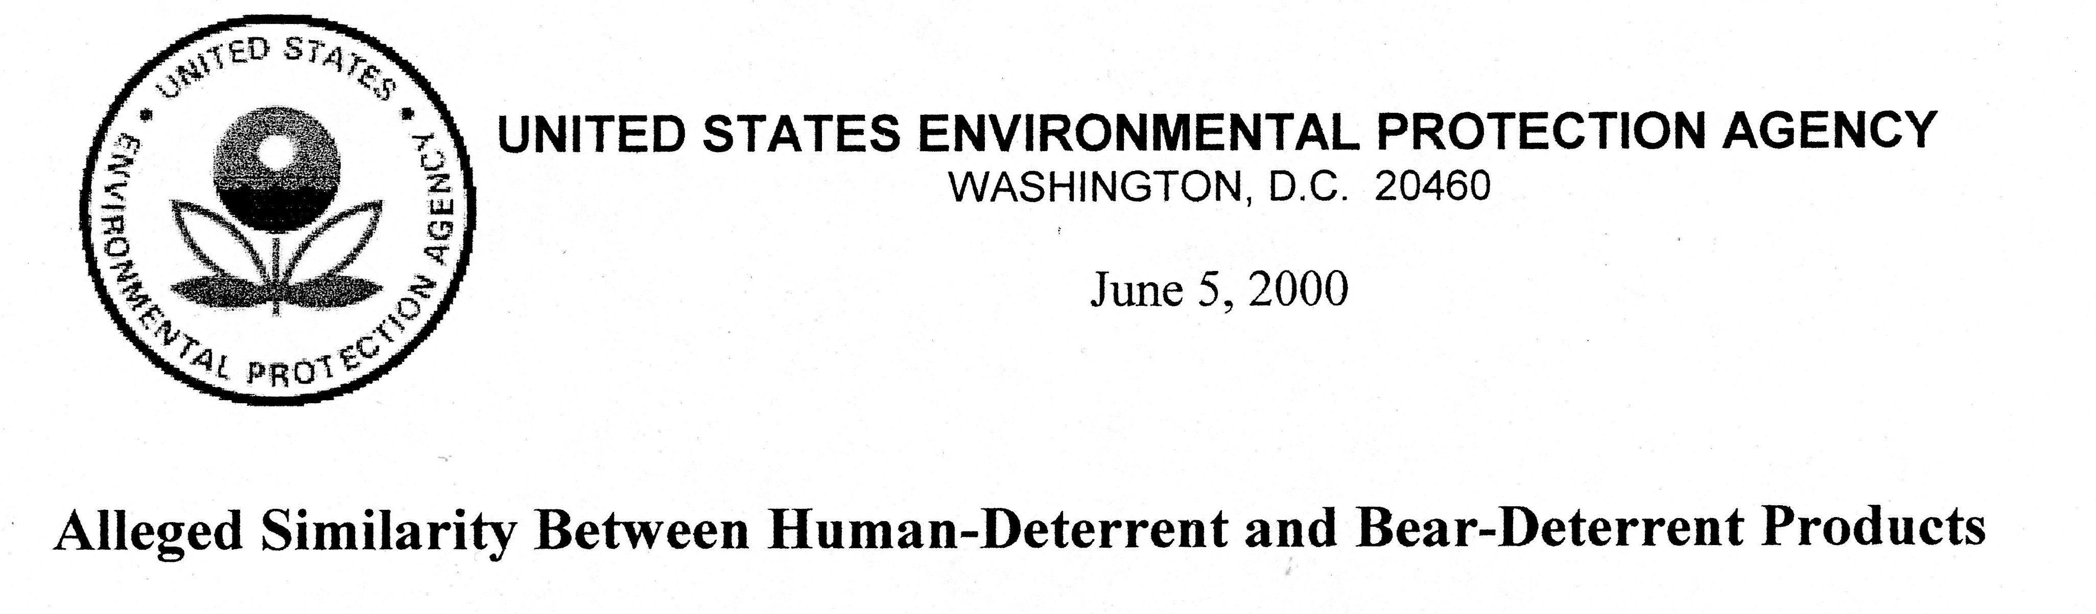

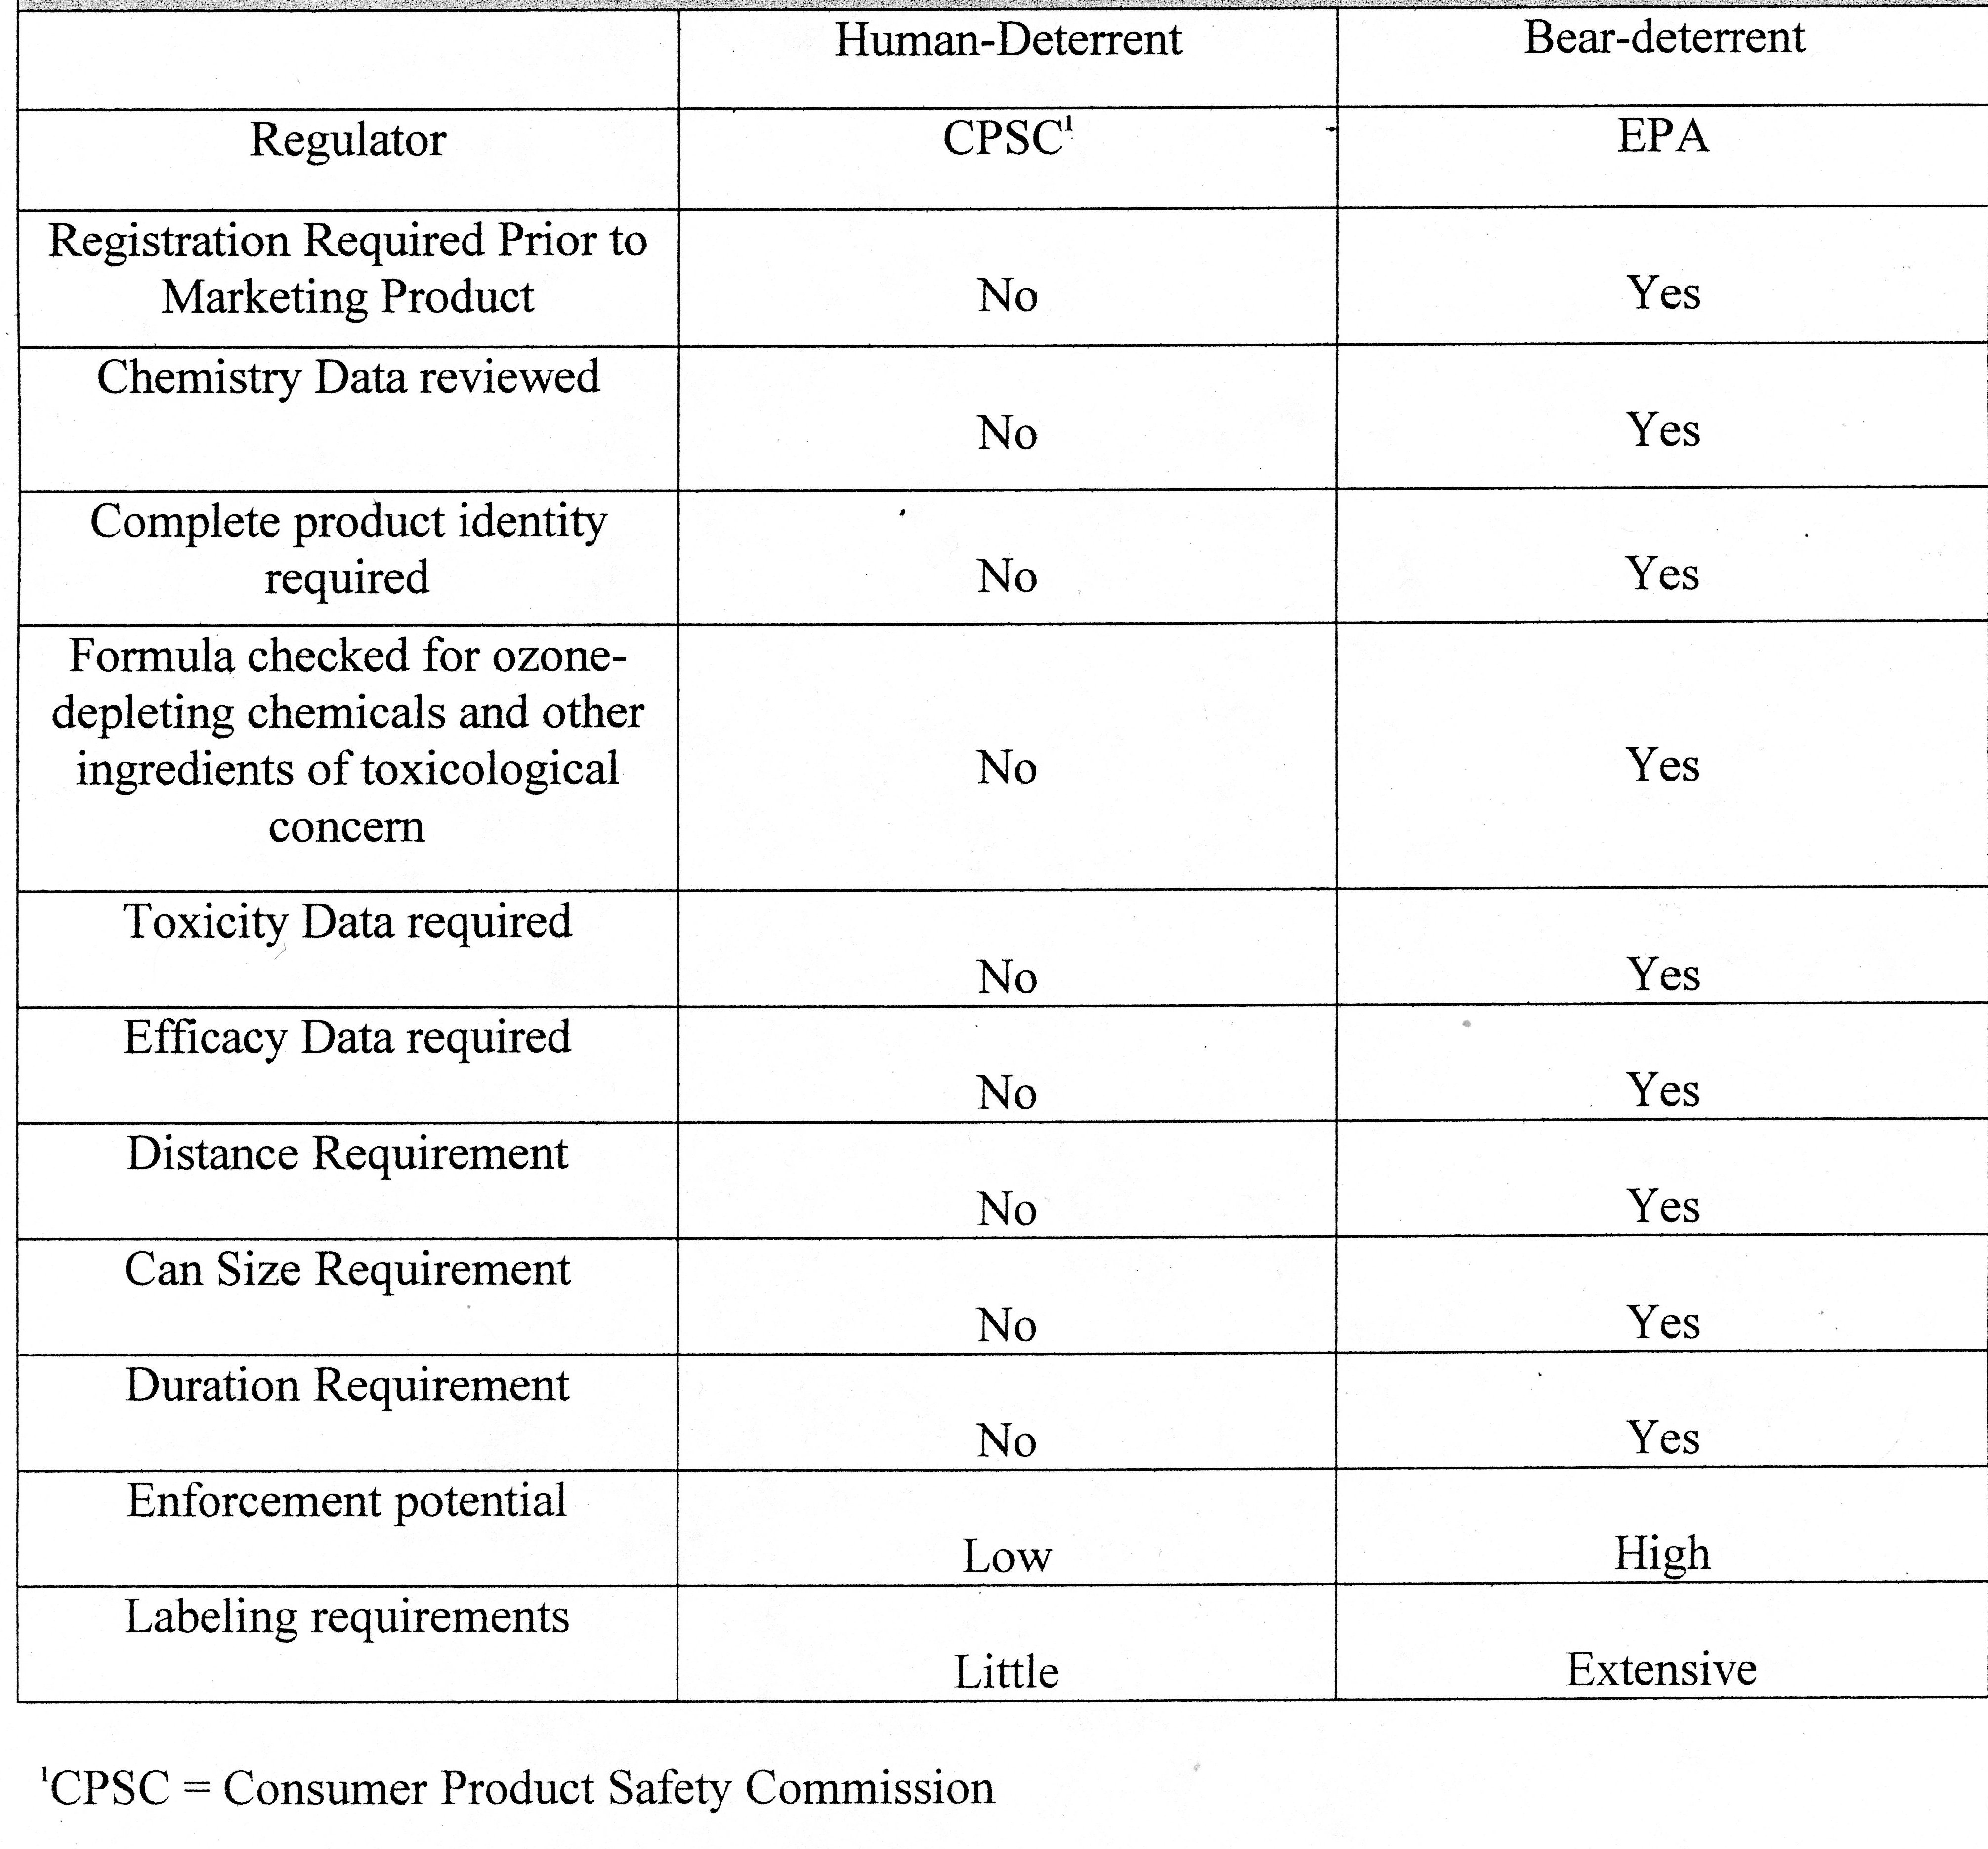
Pepper Spray
Bear Spray

Slide 27
Bear Spray: Read the Label
Look for the following when purchasing Bear Spray:
  Uses the word “Bear” to indicate that it is a Bear Spray.
  Clearly indicates the product is for deterring bears from attacking humans.
  Clearly indicates the product is not for use on humans.
  Active ingredient:
  1% to 2% capsaicin and related capsaicinoids.
  States that the active ingredients capsaicin and related capsaicinoids are derived from Oleoresin of Capsicum.
  States that the minimum net contents is: 7.9 ounces or 225 grams.
  Must show the EPA registration number and EPA establishment number.
Notes:
27

Slide 28
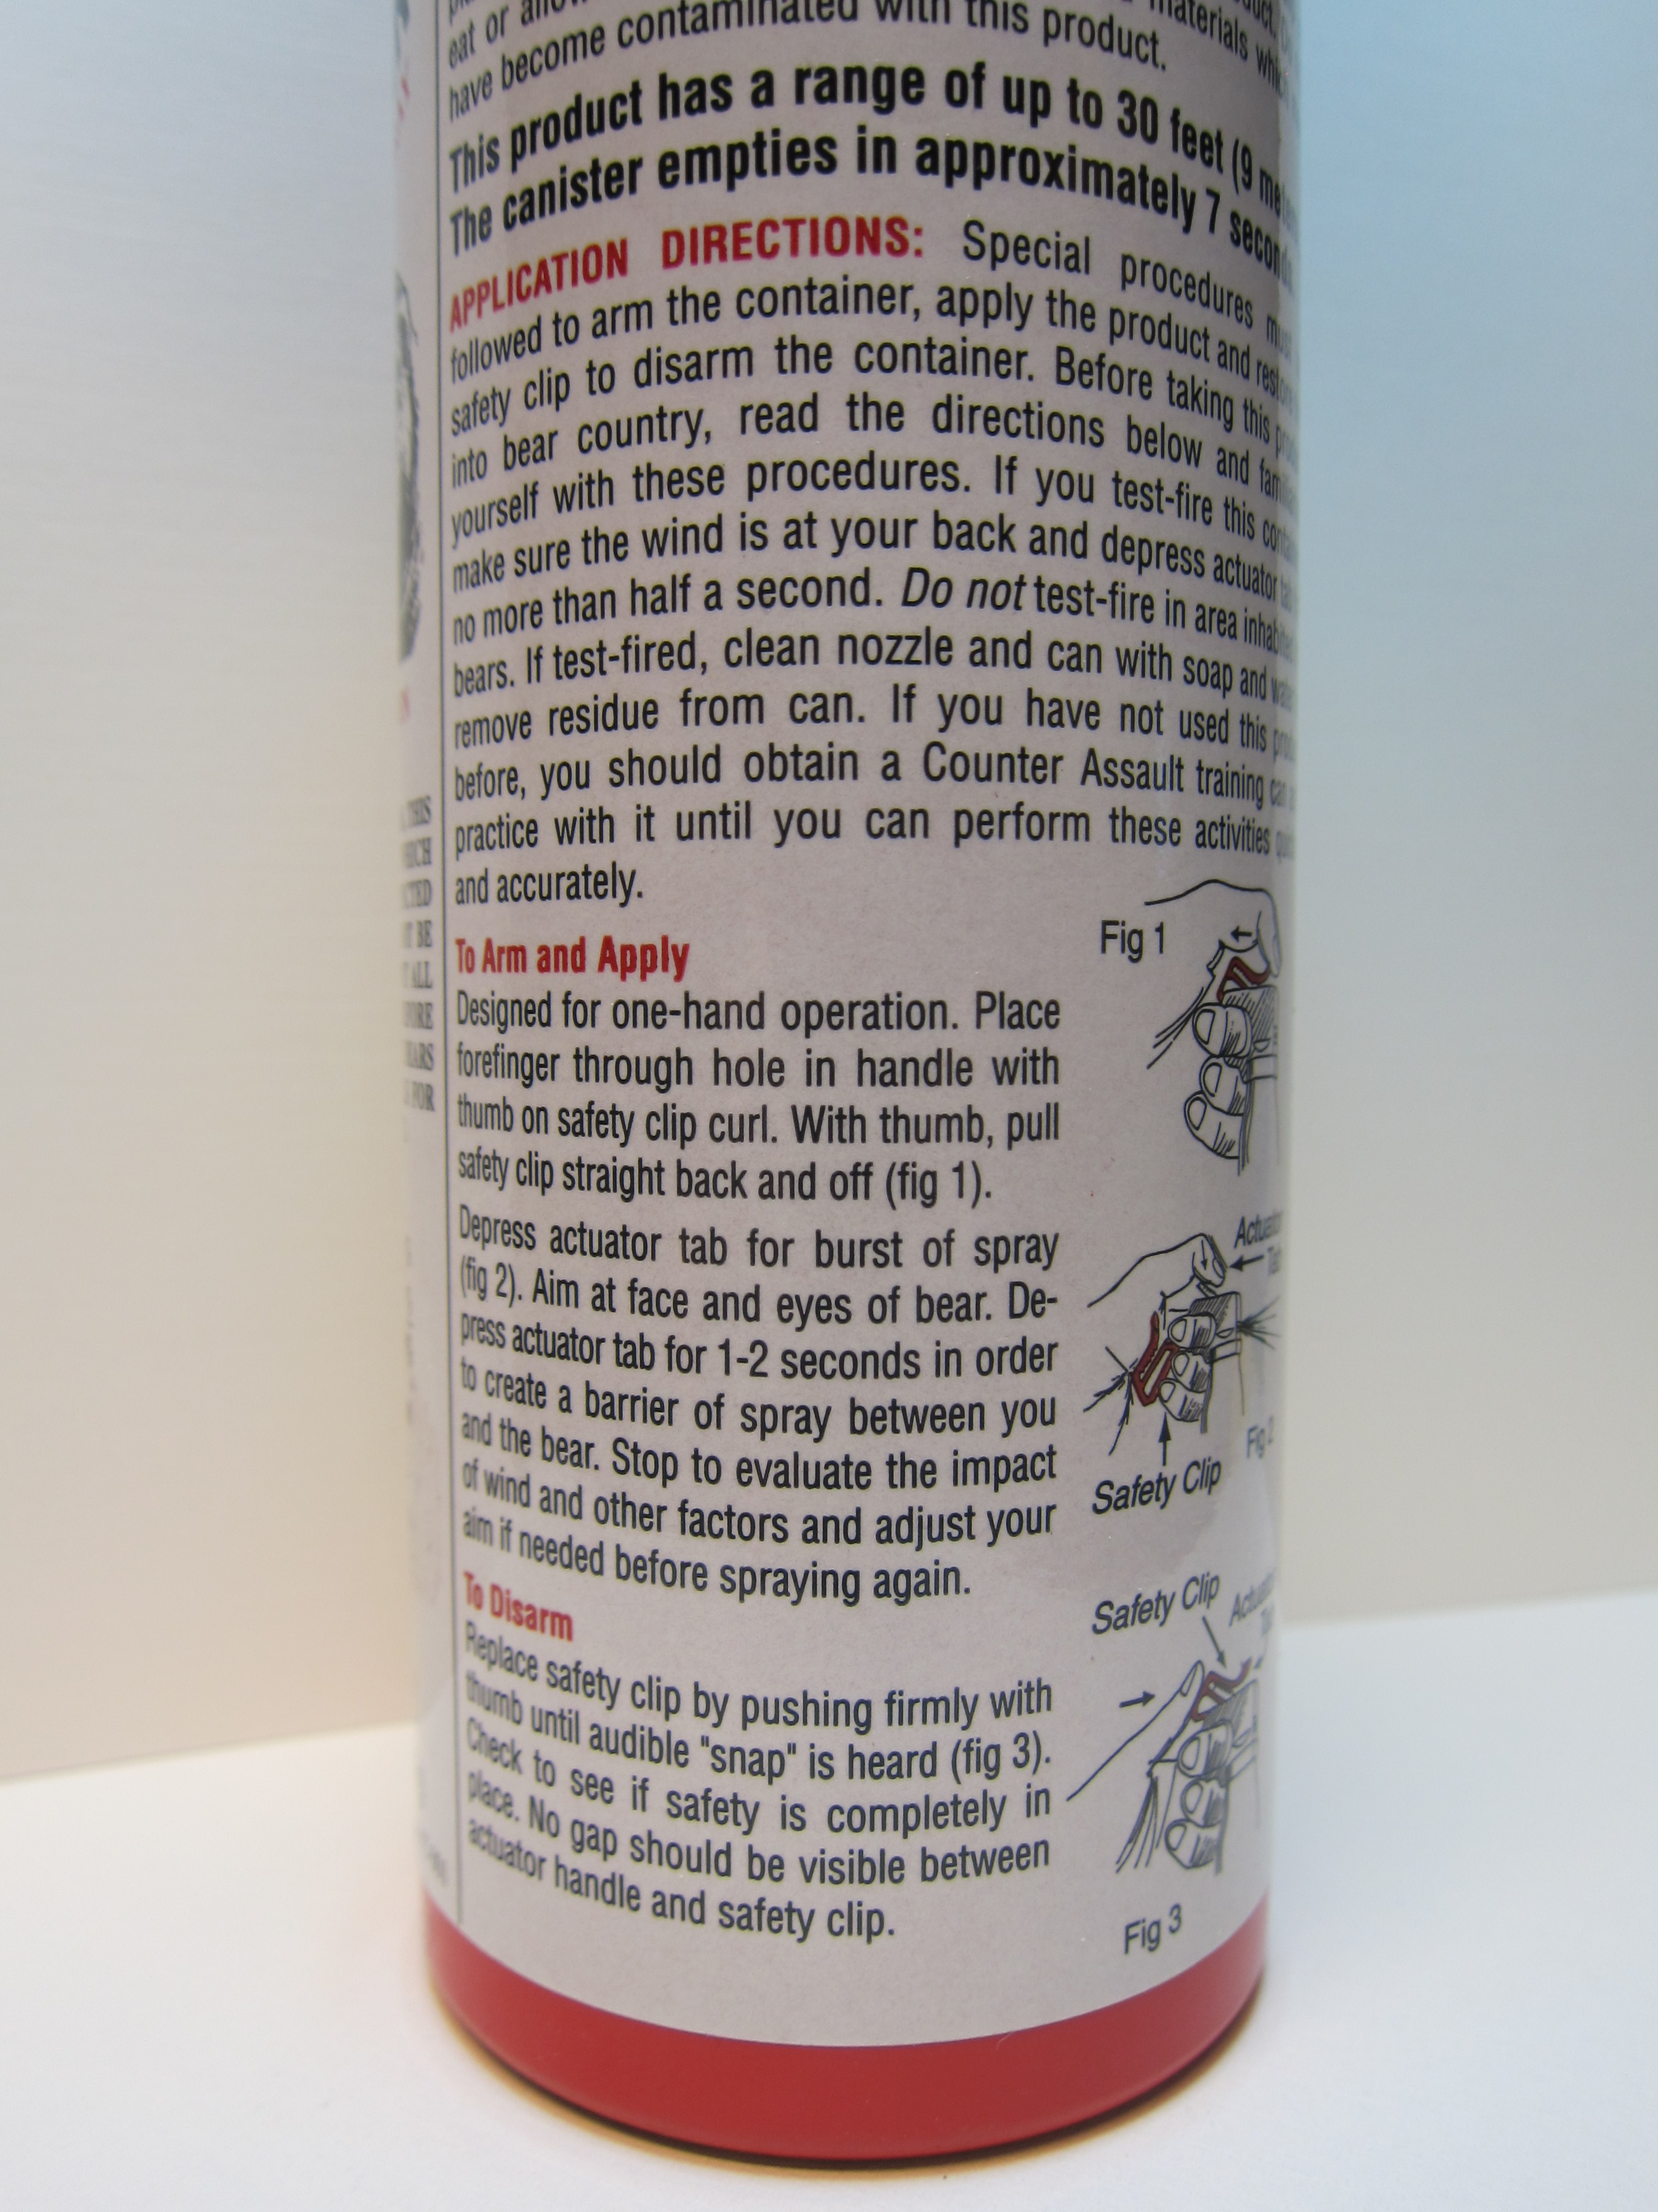
Bear Spray: Back Label
Check for the specific duration and distance standards of the product you are looking at:
  Suggested bear spray duration of 7 seconds to deal with a variety of charging scenarios and to adjust for wind.
  Suggested bear spray distance of 25 feet to allow a charging bear to meet the expanding cloud far enough away to feel the effects and divert its charge.
  The section that tells you how to use Bear
  Spray on the label has insufficient space to go
  into proper detail for a variety of different types
  of bear charges.
  It may still contain information that carries over
  from pepper spray labeling and suggest that you
  ‘aim’ for the bear’s face and eyes. (Aiming
  requires extra time. The bear may be too
  close to stop its charge.)
  Instead, direct the powerful expanding cloud in
  front of the charging bear. This creates a barrier
  that the bear must pass through.
Notes:
28

Slide 29
Bear Spray: Buying Questions
Ask specifically to be shown only Bear Spray and make sure to look for the following details when buying or selling Bear Spray:
  The words “For deterring bear attacks.”
  Active Ingredient:
  1%-2% Capsaicin and related capsaicinoids.
  Suggested spray duration at least 7 seconds.
  Suggested spray distance at least 25 feet.
  Net contents at least 7.9 ounces and 230 grams.
  EPA registration and establishment numbers.
  Know the performance of what you are buying.
  It will state, “Not for use on humans.”
Notes:
29

Slide 30
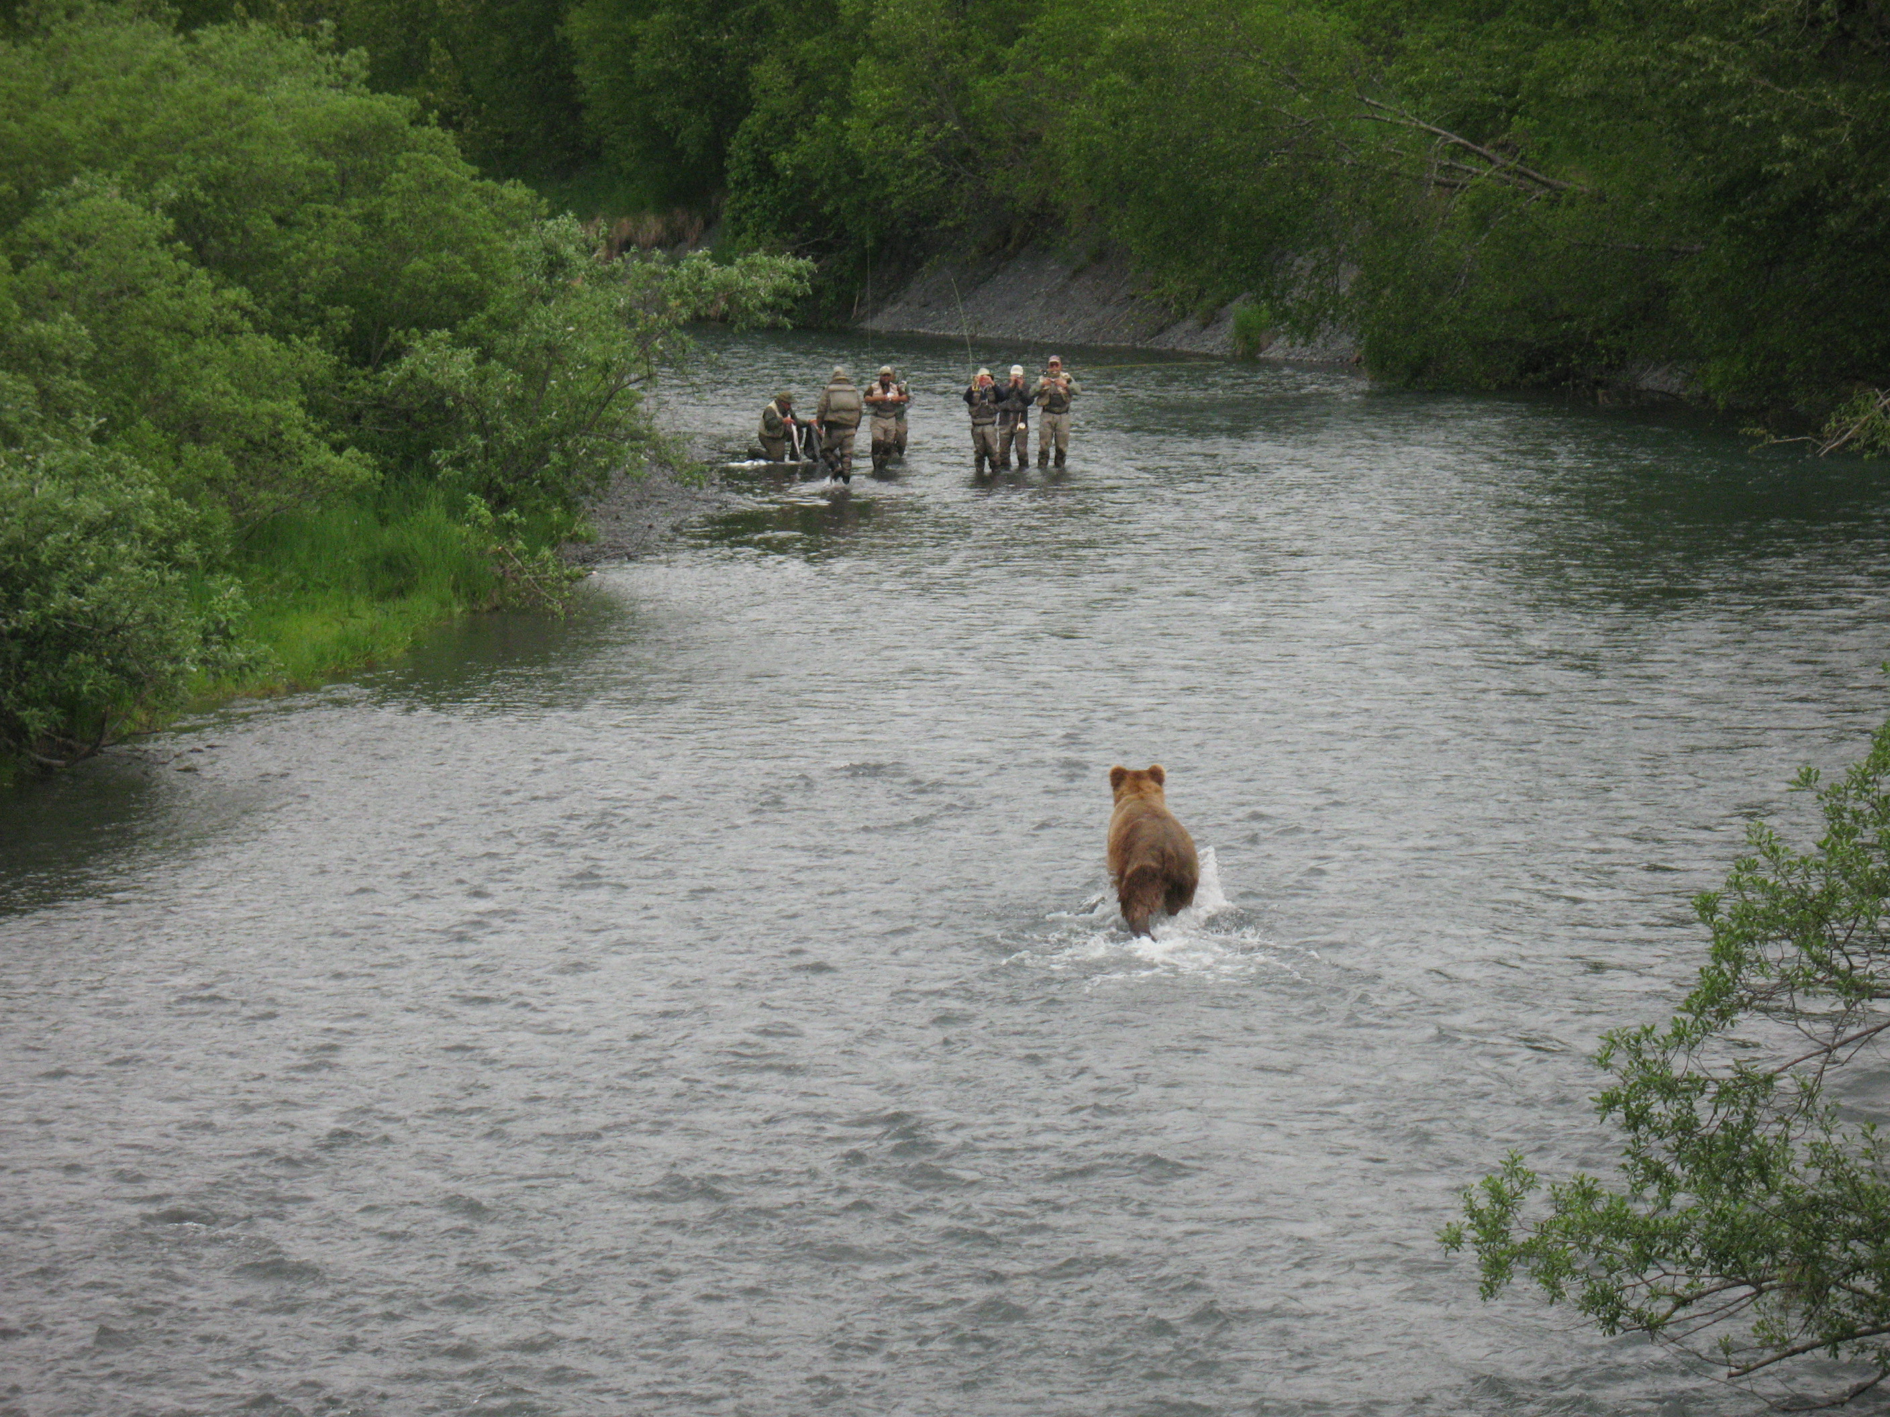
Section Four
How & When to Use Bear Spray

Slide 31
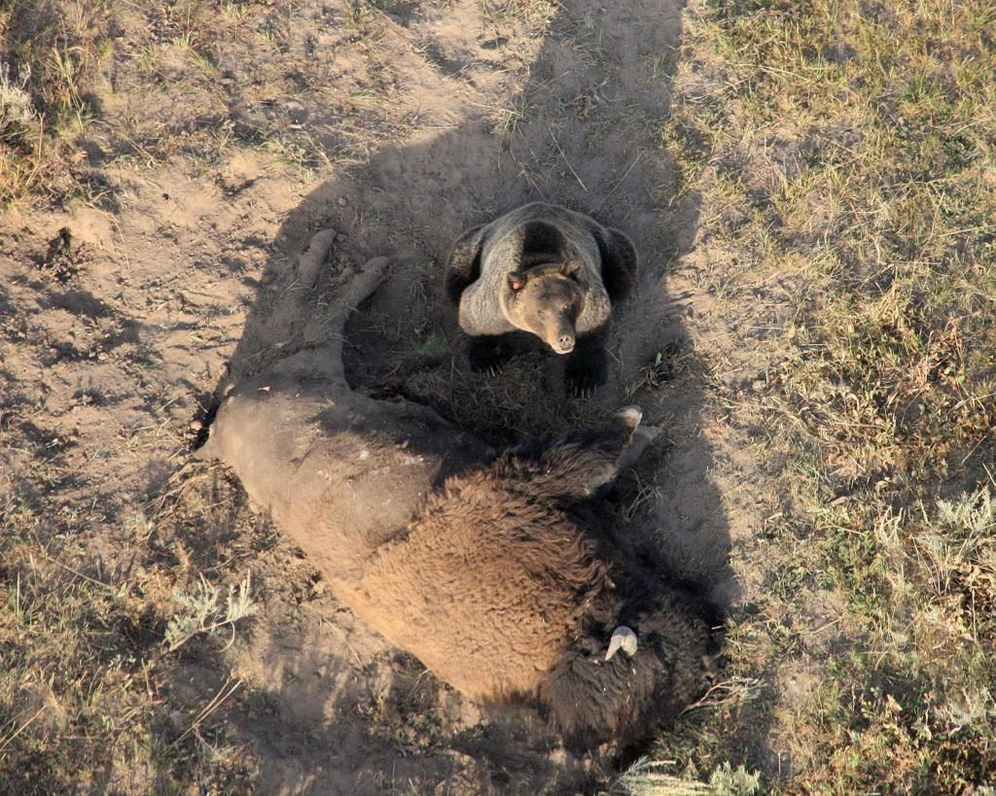
If you came across this situation on foot, how would this bear respond? How would it charge? How would you use your Bear Spray?
This bear is obviously on a fresh kill and could charge spontaneously and very aggressively, leaving little time to respond. (Be prepared.)

Slide 32
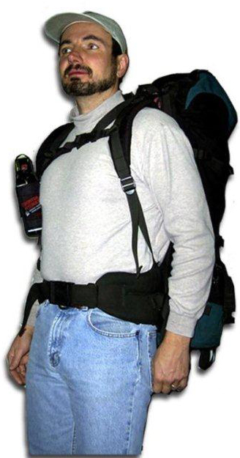

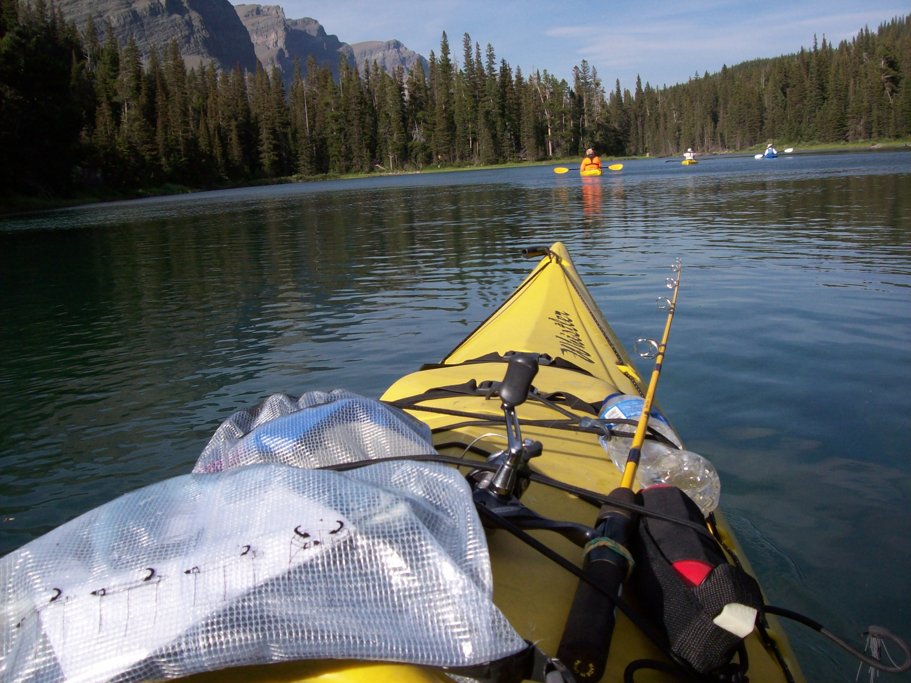
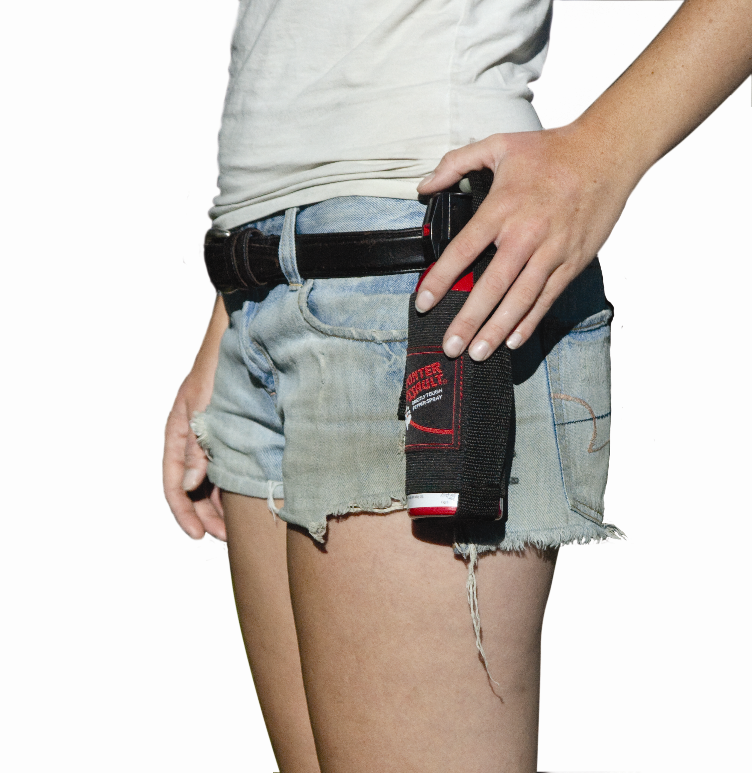
Bear Spray: Carrying Bear Spray
Bear Spray can easily be carried in an accessible hip or chest holster. (Practice removing the can from the holster so that it is spontaneous.)
During winter months, put your Bear Spray in an insulated bottle warmer and place in a readily accessible side pocket to keep the ingredients warm for better performance.
Rafters and kayakers can attach to their craft or carry in a chest holster.
Mountain bikers should have it readily accessible in either a chest or hip holster.
Notes:
32

Slide 33
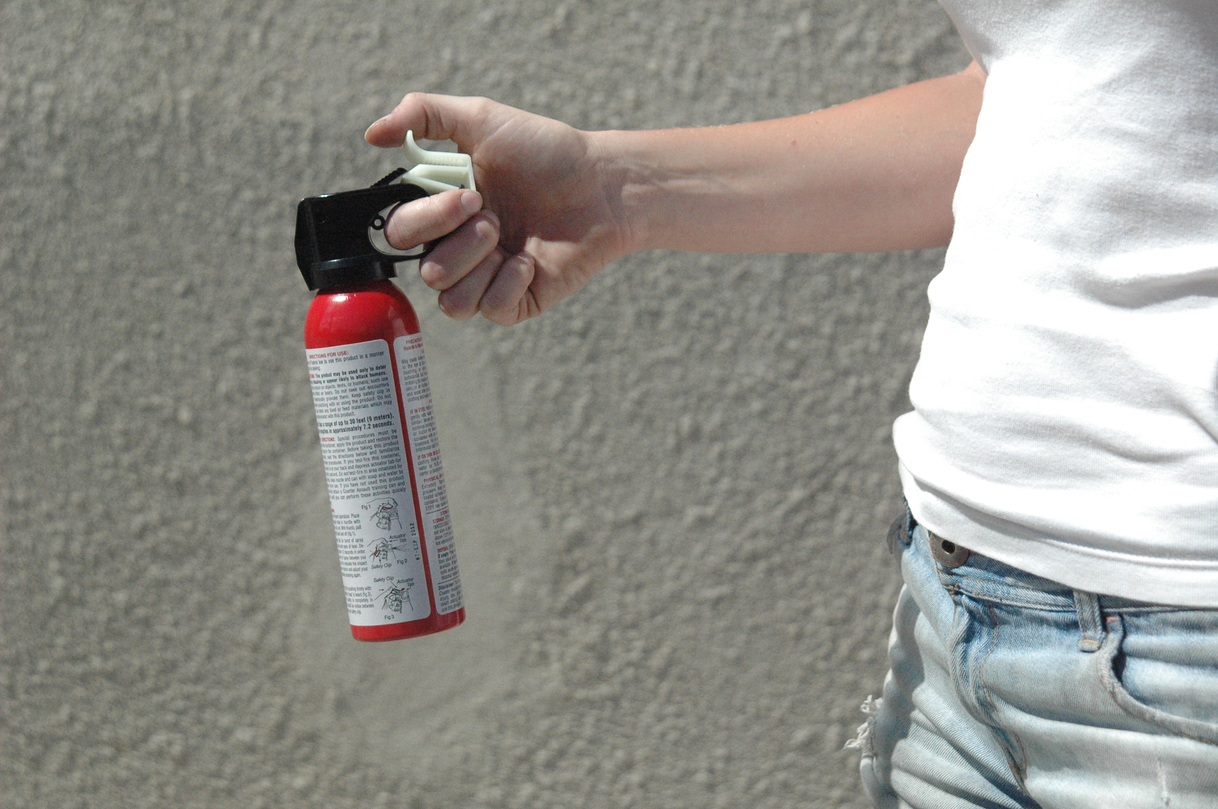
Bear Spray: Removing Safety Wedge
Firmly grasp the can with one hand by placing your finger through the circular hole located under the trigger.
Place your thumb in front of the safety wedge and pull directly back toward you. The safety wedge will pull back and fall from can.
The trigger is now accessible and is operated by simply pushing down with your thumb.
Hold the can firmly so it does not tilt up and spray above of the bear.
Safety Wedge
Practice removing the canister from the holster and the safety wedge so that it is spontaneous.
Notes:
33

Slide 34
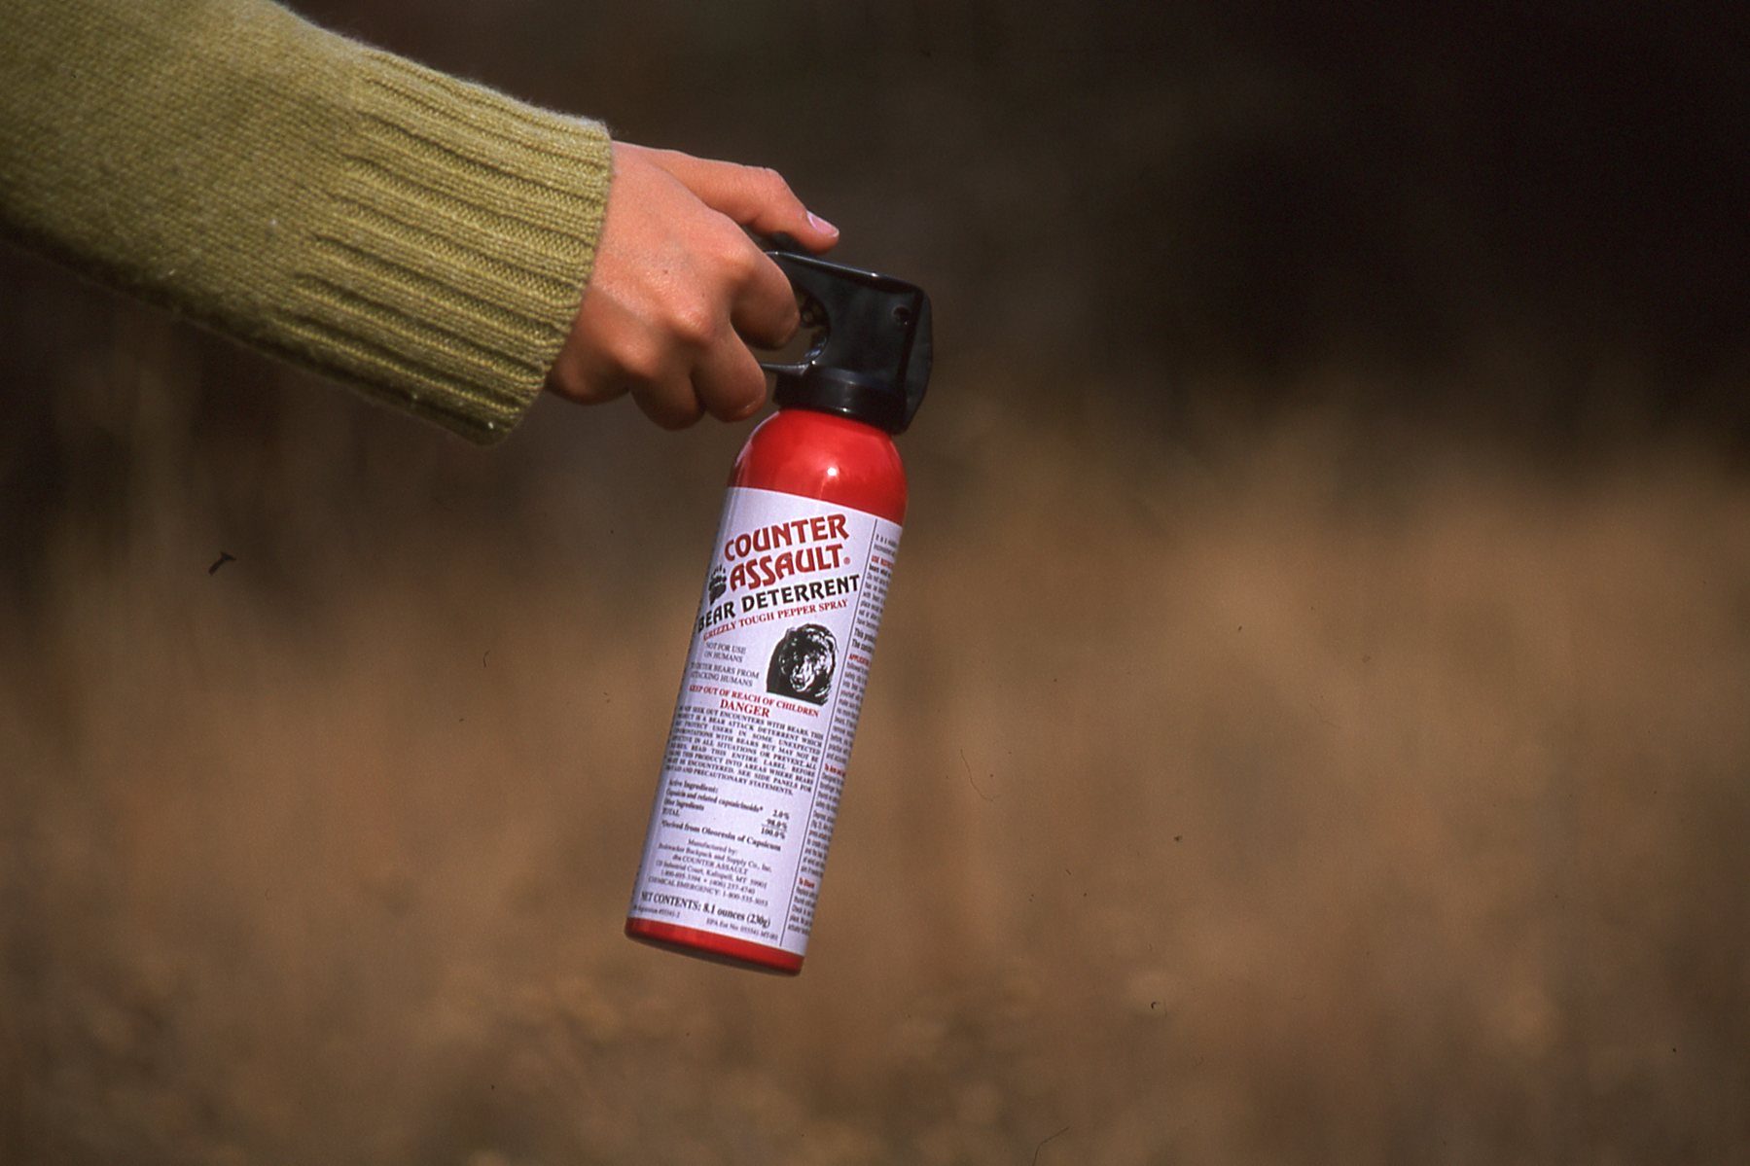
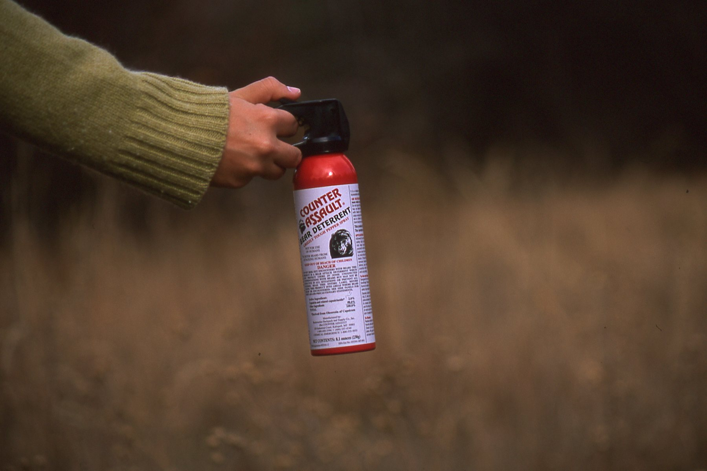
Bear Spray: It Billows Up
Correct Spray (so it billows up):
Bear spray is dispersed in a powerful expanding cloud that will billow up in front of the charging or attacking bear. Direct the spray slightly downward to create a large expanding cloud in front of the charging bear.
Incorrect Spray (shoots above):
If the bear spray canister is not held firmly, when you push down on the trigger, the can will tilt upward and disperse the powerful expanding cloud above the charging bear.
Notes:
34

Slide 35
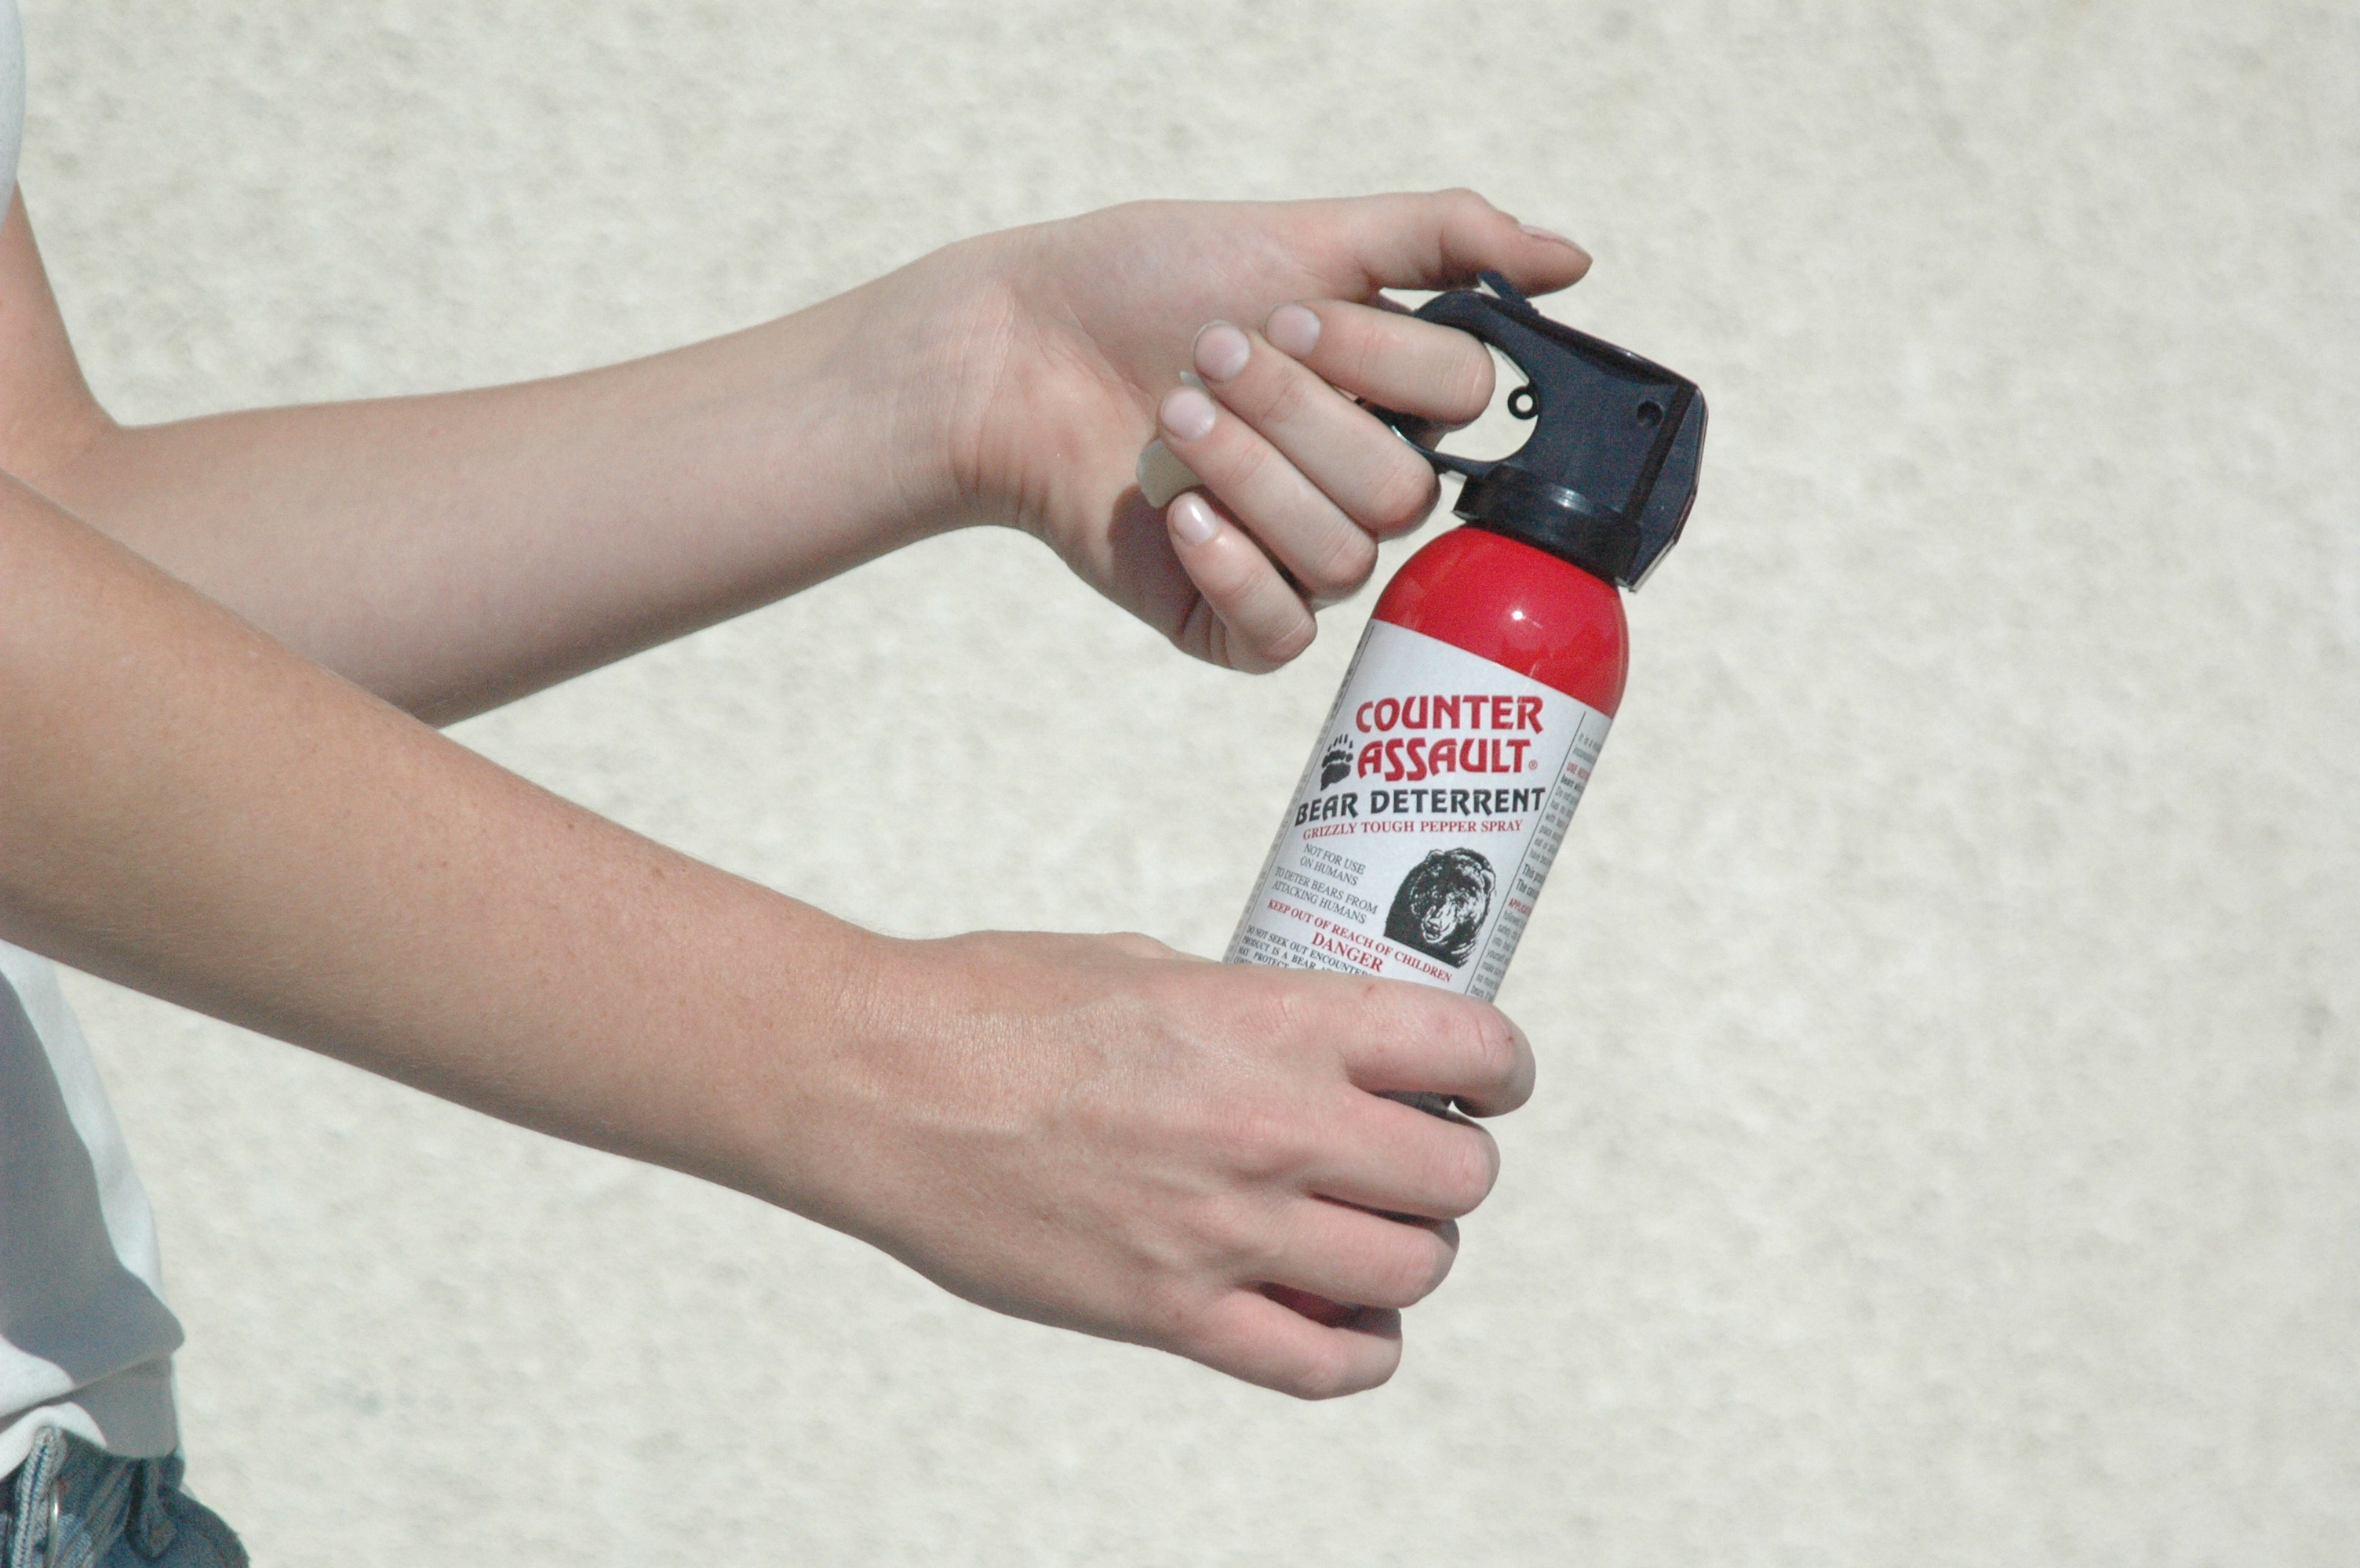
Bear Spray: Holding the Can
One-Handed
Two-Handed
A person with firearm experience or practice with Bear Spray can firmly hold and direct the spray slightly downward and remain facing the charging bear.
A person with no firearm experience may need to hold the can with two hands in order to hold it firmly in a downward position and remain facing the charging bear
Notes:
35

Slide 36
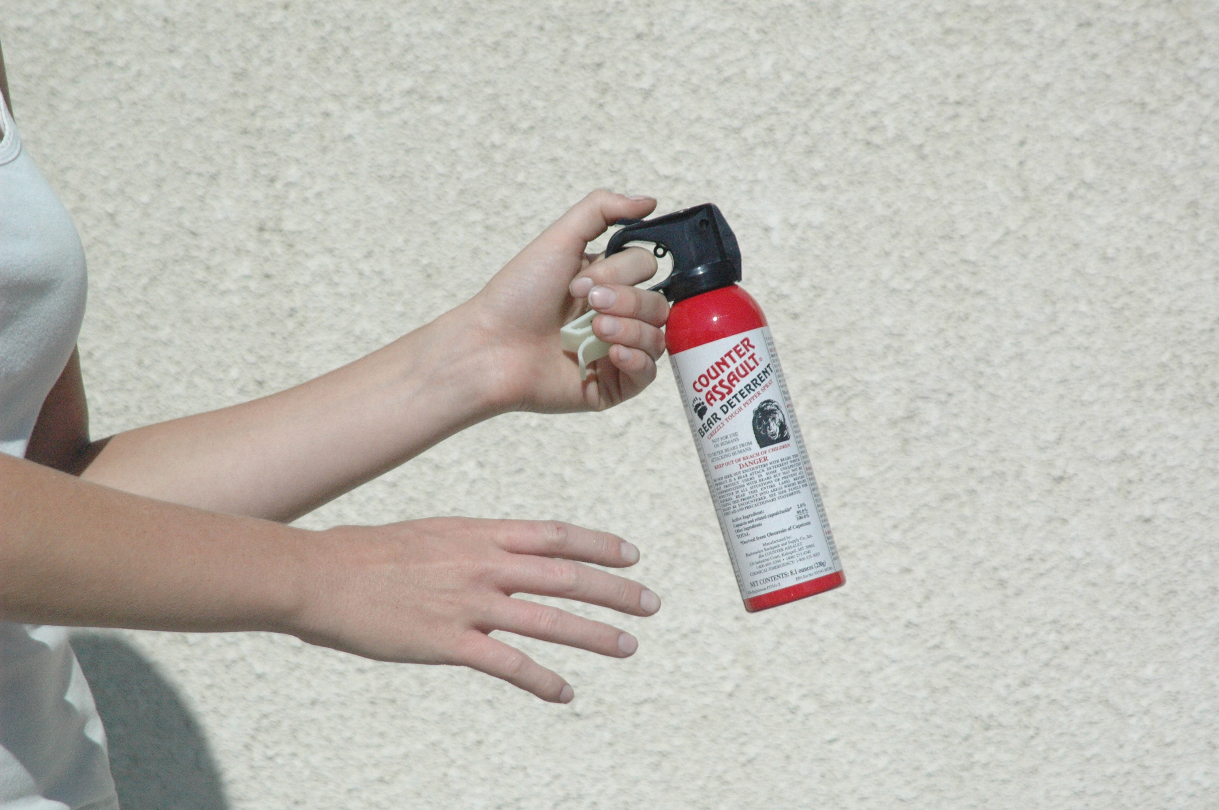
Bear Spray: Angle of Spray
Tilt can slightly downward so the spray billows up in front of the charging bear.
Do not let the can tilt upward. It will shoot over top of the charging bear.
Correct
Incorrect
Downward
Overshooting
It is important to spray slightly downward. A bear often charges with its head down near the ground, making it easy to spray above the charging bear.
Notes:
36

Slide 37
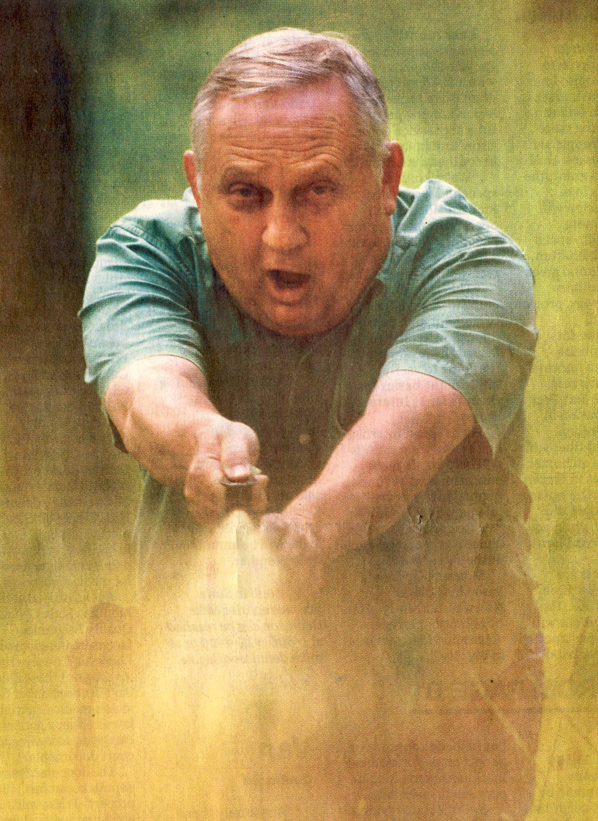
Bear Spray: Body Language
Your voice and body language while spraying
can help convey a message to the charging bear to stop or divert its charge.
Thrust the Bear Spray in front of you, while telling the charging bear in a firm voice to “STOP” or “GO AWAY.” The bear does not know these terms but may recognize the tone of your voice and body language.
If you don’t have experience using a firearm or confronting bears you may need to hold the Bear Spray in two hands so that you remain facing and spraying slightly downward at the front of the charging bear.
Photo by: Michael Gallacher, Missoulian
Let the Bear Spray do its job by affecting the charging bear’s nervous system, temporarily overwhelming its eyes, nose, mouth and lungs.
Bears have responded to the whooshing sound, the expanding cloud, the voice and the body language by diverting their charge without entering the spray cloud.
Once the charging bear has retreated, leave the area immediately.
Notes:
37

Slide 38
Bear Spray: Suggested Spray Duration
Suggested minimum spray duration is 7 seconds. This is how long the can will spray until it empties, not how long you spray a charging bear. It is suggested you spray a burst for 2-3 seconds, but you may need to re-spray for the following reasons:
  To compensate for wind or cold weather.
  Multiple bears—mating pairs, mothers with cubs or juvenile pairs.
  Bears may zig-zag or circle around the spray cloud
  when charging.
  Bears may charge, stop, retreat and recharge.
  For other encounters during the hike out.
  Any charging bear may require more than one spray.
  For these reasons, it is suggested that group leaders carry two cans and other adults and responsible teenagers carry their own can for backup.
Notes:
38

Slide 39
Bear Spray: Short Bursts?
The use of a ‘half-second’ or a ‘short-burst’ spray is
not practical and has never been tested.
With a half-second burst, the propellant, solvent, and active ingredients will only begin to combine and atomize into a fine, powerful spray.
A short burst may only spray 10-12 feet. This may not be far enough to stop an extremely agitated and charging bear.
A bear charging at full speed (35 mph) is traveling 51 feet every second and has the potential to make contact within 2-3 seconds. There is no time for you to spray a short or warning burst, pause, then spray again, etc.
The products that marketed a half-second or short burst also included marketing claims that it “works instantaneously” or “like hitting a brick wall.” These are unsubstantiated claims.
No testing has been provided to show that short bursts work.
If you’re facing an extremely agitated bear in a full charge, you only have time to take the canister out of your holster, remove the safety wedge and push the trigger down, directing the expanding cloud slightly downward in front of the charging bear.
Notes:
39

Slide 40
Bear Spray: Suggested Spray Distance
Suggested minimum spray distance is 25 feet. This is
how far the expanding spray cloud can be directed
(without wind).
  This creates a wide and expanding cloud, a barrier between you and the bear.
  When the charging bear is within 60 feet, it will meet the cloud at approximately 25 feet, giving the bear time to feel the effects of the Bear Spray and divert its charge.
  Be prepared for the bear to re-charge, or for other bears to charge, requiring additional sprays.
  Be prepared to adjust for wind or cold.
  Charging bears may stop short of you, posture aggressively and retreat. They may then complete
  the charge.
Source: Bear management specialists with State and Federal Wildlife Management Agencies and incident reports, and the original Bear Spray research.
Notes:
40

Slide 41
Bear Spray: More Than 60 Feet Away
If an extremely agitated bear is charging from more than 60 feet away, prepare but do not spray. The spray may be depleted before the charging bear is in range.
Once the bear is within 60 feet, direct your spray downward, with a side-to-side movement in 2-3 second burst of spray. This will create a wide barrier that the bear will meet at approximately 25-35 feet.
In some cases, merely the whooshing sound and the orange cloud may cause the bear to stop, reassess its charge and either retreat or charge again.
Wind towards you or a cross-wind may redirect Bear Spray away from the bear. Prepare to re-spray in order to adjust for the wind.
Some bears may circle around the orange cloud. Be prepared to re-spray.
Notes:
41

Slide 42
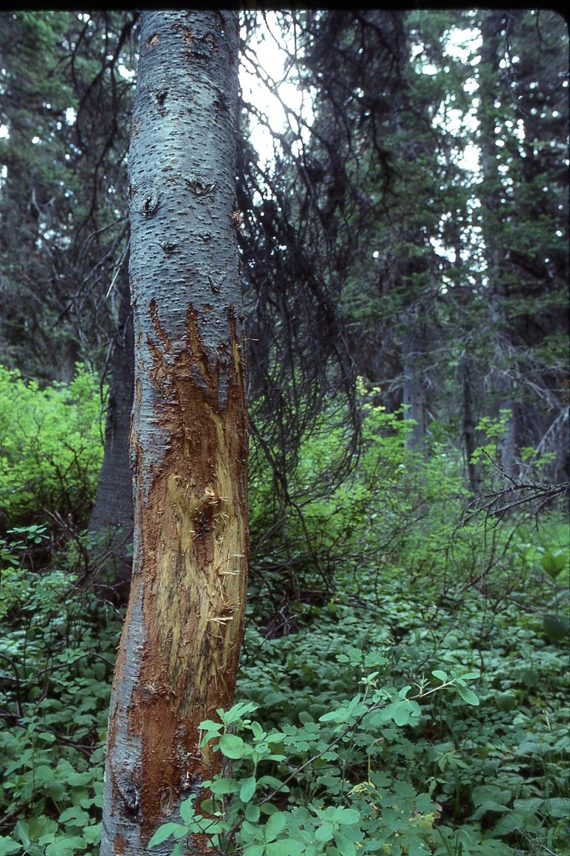
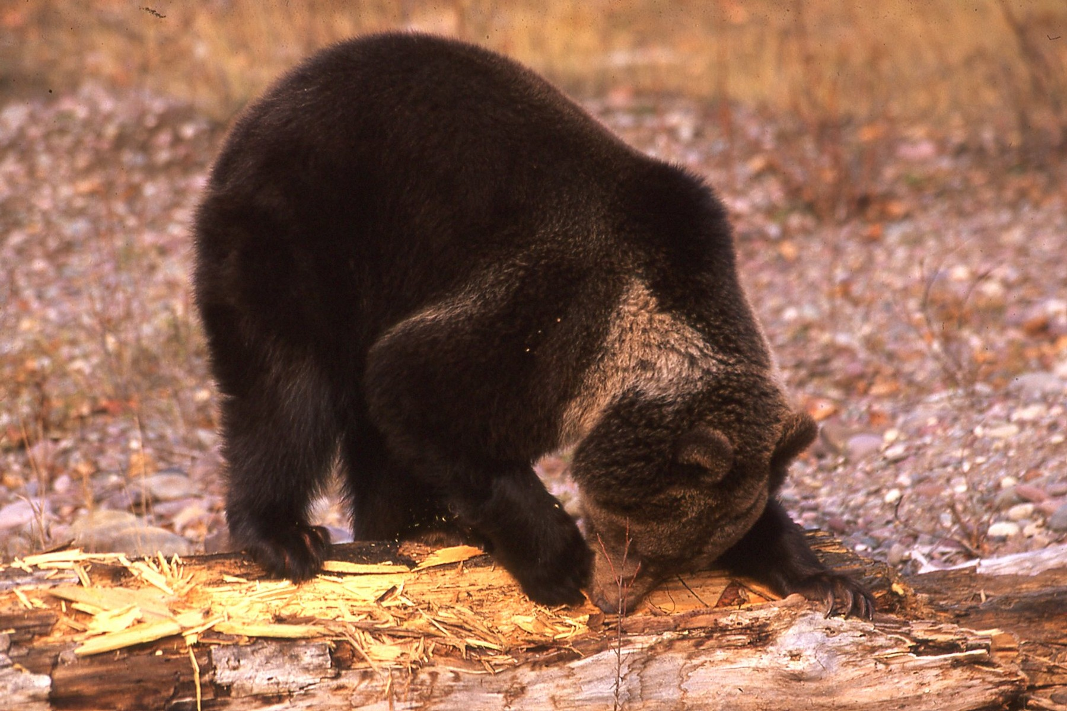
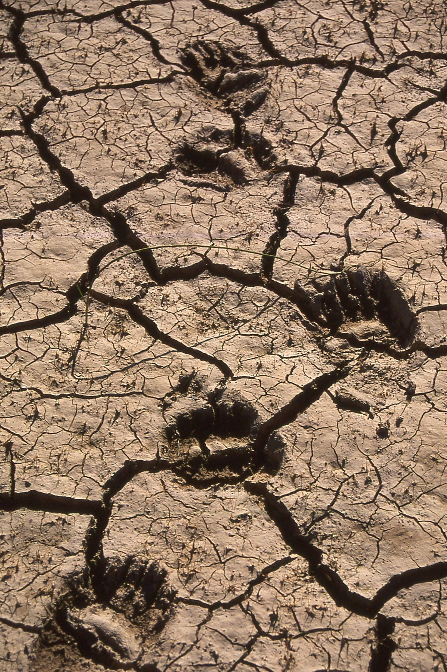
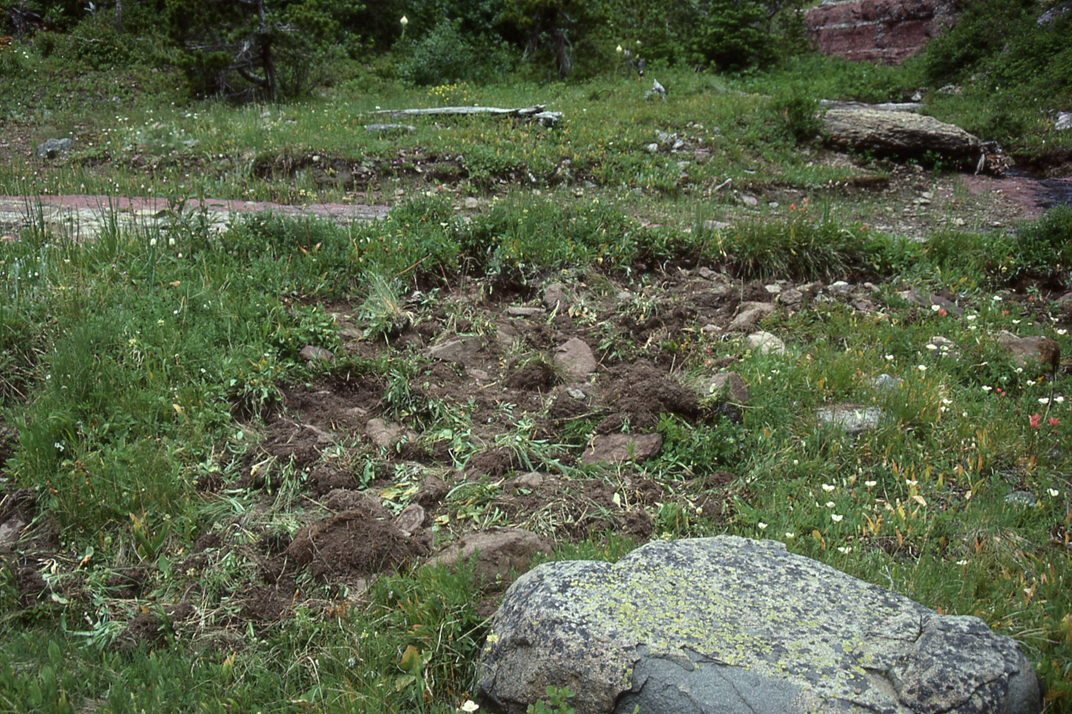
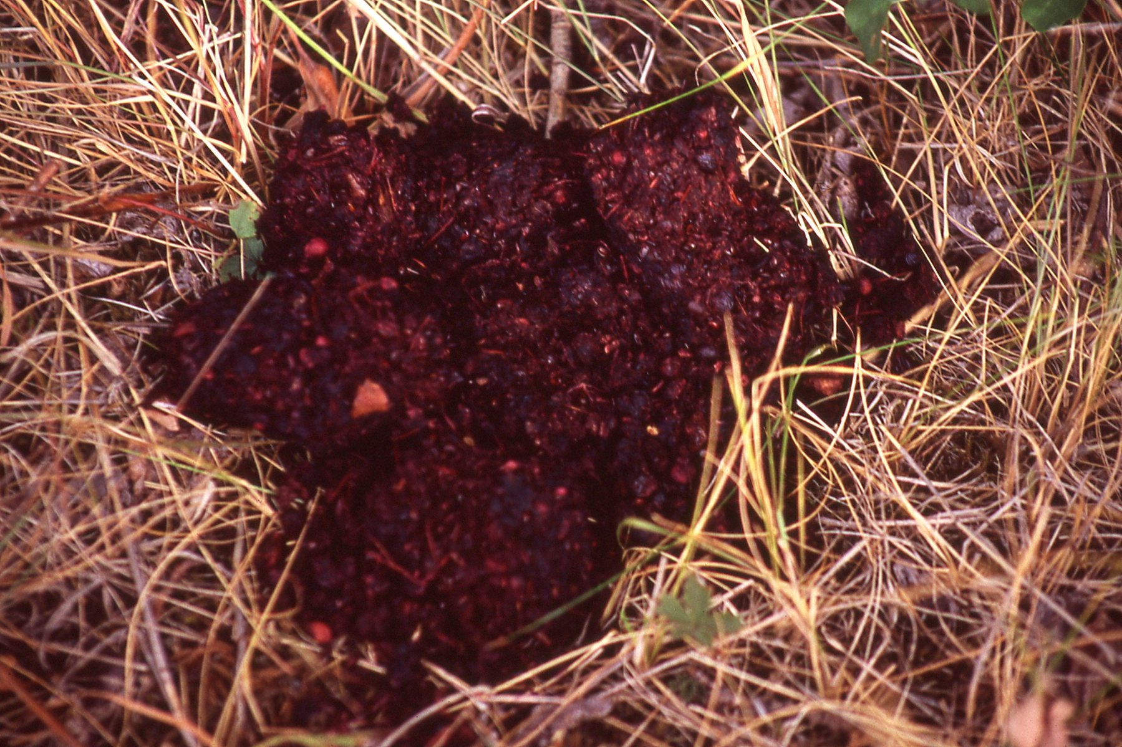
Bear Spray: Be Bear Aware
Be aware of your surroundings and react to signs
of bear activity. If you see fresh signs like these,
be prepared for a possible bear encounter. You may consider having your Bear Spray out and ready.

Slide 43
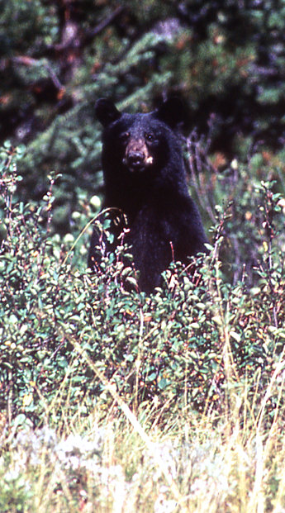
Bear Spray: Don’t Spray?
If a bear is close to you (within 50 feet) but not menacing, do not spray or confront the bear. Simply back away and return the way you came or pass by the bear allowing as much distance as possible.
Standing bears are trying to better see, hear and smell what has disturbed them. They do not charge standing up. Only spray if a bear drops and charges.
If a bear is acting curious but not aggressive, encourage the bear to leave by grouping together and speaking in a firm voice to help the bear identify who and what you are.
If a bear is approaching in a non-aggressive fashion, group together and move away from the bear’s line of travel, allowing it to pass by.
If a bear is acting agitated, popping its jaws, clacking its teeth, woofing or pacing back and forth but not charging, let the bear assess the situation, and be prepared to spray if it does charge.
Try to leave the area without spraying the bear if possible.

Slide 44
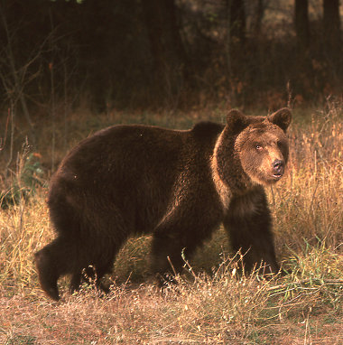
Bear Spray: Bear Behavior
The degree of aggressiveness by bears can vary greatly.
Nuisance or curious bears may not show any
aggressive behavior, but once close enough,
could charge.
A startled bear may charge towards you to find
out what you are. Bears may bounce on their
front legs, have their ears erect, stomp, turn
sideways, and pace back and forth. They will
then either retreat or recharge.
A startled mother bear with cubs may be more
agitated and respond more aggressively by
charging immediately.
A dominant bear guarding a fresh kill may respond aggressively in a spontaneous and non-stopping charge.
A predatory bear (black or grizzly) may show stalking behavior, such as disappearing and reappearing, but not showing aggression. It may charge when it gets close enough or finds the opportunity.
Bears that have learned to tolerate other bears or people may approach closer than normal, then charge. When bears are near, have your Bear Spray ready.
Notes:
44

Slide 45
Bear Spray: Irritating & Inflammatory
Active Ingredient:
1%-2% capsaicin and related capsaicinoids.
These produce an irritating and inflammatory reaction that is amplified by a bear’s more developed sense of smell. This overwhelms the bear’s primary means of perception.
The charging bear’s eyelids become swollen, watering and burning and difficult to keep open. The bear’s ability to see is disrupted and it can no longer focus on its target.
The nose becomes swollen, irritated and runny. The bear’s sense of smell is overloaded and interrupted.
The mouth, throat, and lungs become irritated and inflamed. The mouth fills with saliva, the throat swells, and the lungs contract. The bear’s ability to breathe deeply is made difficult. The muscles may no longer receive enough oxygen to sustain the attack.
None of these effects are permanent or long-lasting.

Slide 46
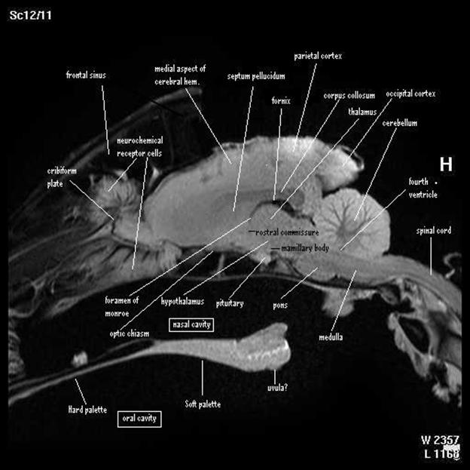
Bear Spray: Why it Works
The structures in a bear’s brain that correspond to smell are 5-7 times larger than ours. There is significant observational evidence that their sense of smell is thousands times more sensitive. This pronounced sense is what makes bears susceptible to the active ingredients in Bear Spray.
Research done with humans and mice show that capsaicin and related capsaicinoids activate receptors not only in the olfactory system (for smelling), but the trigeminal nerves responsible for sensation of touch, temperature and pain in the face and skin, as well as control over muscles around the jaws.¹
These systems signal other parts of the brain that govern decision-making, adrenaline and hormone release, as well as motor function and memory.
While the specific neurological effect has not been
investigated in bears, observational evidence suggests
that Bear Spray affects bears more thoroughly than the
initial irritation, and is amplified by their pronounced senses.
This suggests that it is this effect on the nervous system, amplified by the bear’s anatomy, that explains the effectiveness of Bear Spray.
1. See Vanilloid (Capsaicin) Receptors and Mechanisms (Szallasi & Blumberg, 1999) and Olfactory/trigeminal interactions in nasal chemoreception (Brand, 2006) for more information.

Slide 47
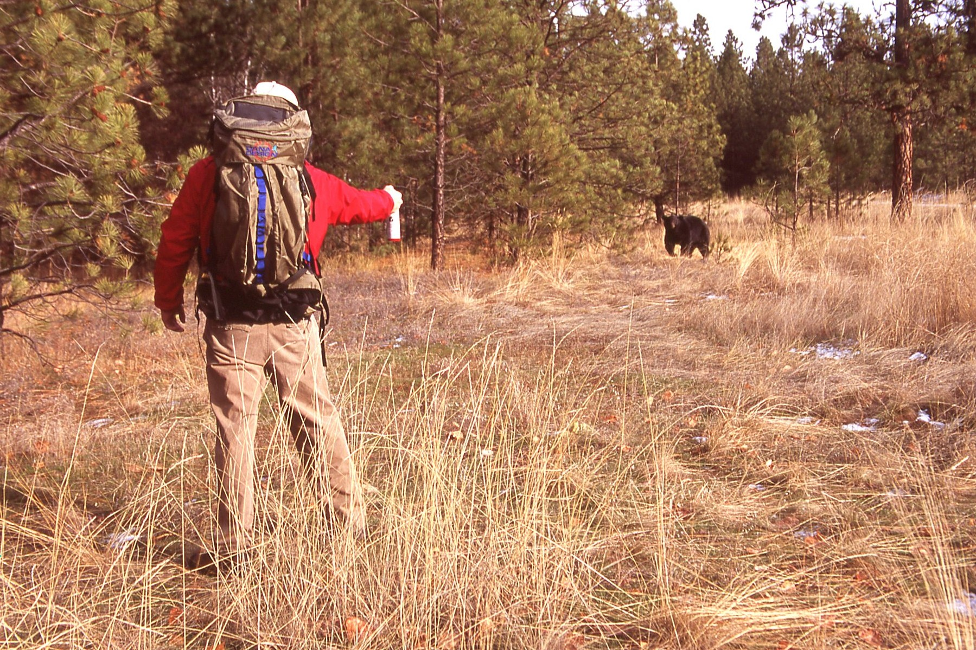
Bear Spray: Close Distance Charge
If the bear is charging from a close distance of 30-60 feet, spray for 2-3 seconds. Direct the can downward and use a slight side-to-side movement to create a wide barrier that the charging bear must pass through to reach you. Monitor any effects of wind.
The bear spray will billow up in front of the charging bear and the charging bear will meet the expanding cloud at about 20-30 ft.
60 ft
30 ft
Meets the cloud.
Notes:
47

Slide 48
Bear Spray: Close Distance Charge
Monitor the expanding cloud to see if it drifts from in front of the charging bear or if the bear stops or circles around the expanding cloud.
Prepare to spray a second or third time if the bear continues to re-charge. Monitor the area for other bears.
60 ft
30 ft
Meets the cloud.
Notes:
48

Slide 49
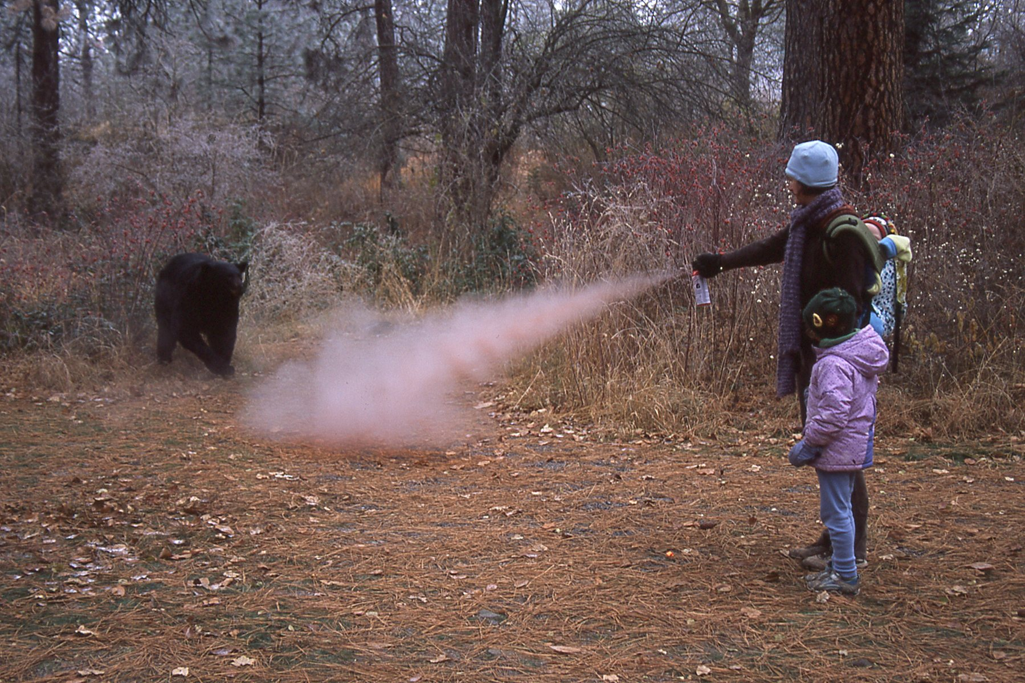
Bear Spray: Extremely Close Charge
If the bear is charging from an extremely close distance (within 30 feet), direct the can slightly downward and direct the spray at the front of the bear. Continue spraying until the bear breaks off its charge.
Monitor the bear closely. It may zig-zag or circle around to try to avoid the expanding cloud. Continue to spray in front of the bear while tracking the bear’s movements.
30 or less ft
Notes:
49

Slide 50
Bear Spray: Extremely Close Charge
If the bear is about to (or does) make contact, try to hang on to the can, drop to the ground on your stomach, and clasp your hands behind your neck to protect your neck and face.
The bear may smell you and swat you to determine if you are a threat. The Bear Spray will reduce the severity and length of the contact. It will abruptly leave the area. Make sure it is gone before you get up.
30 or less ft
30 or less ft
Notes:
50

Slide 51
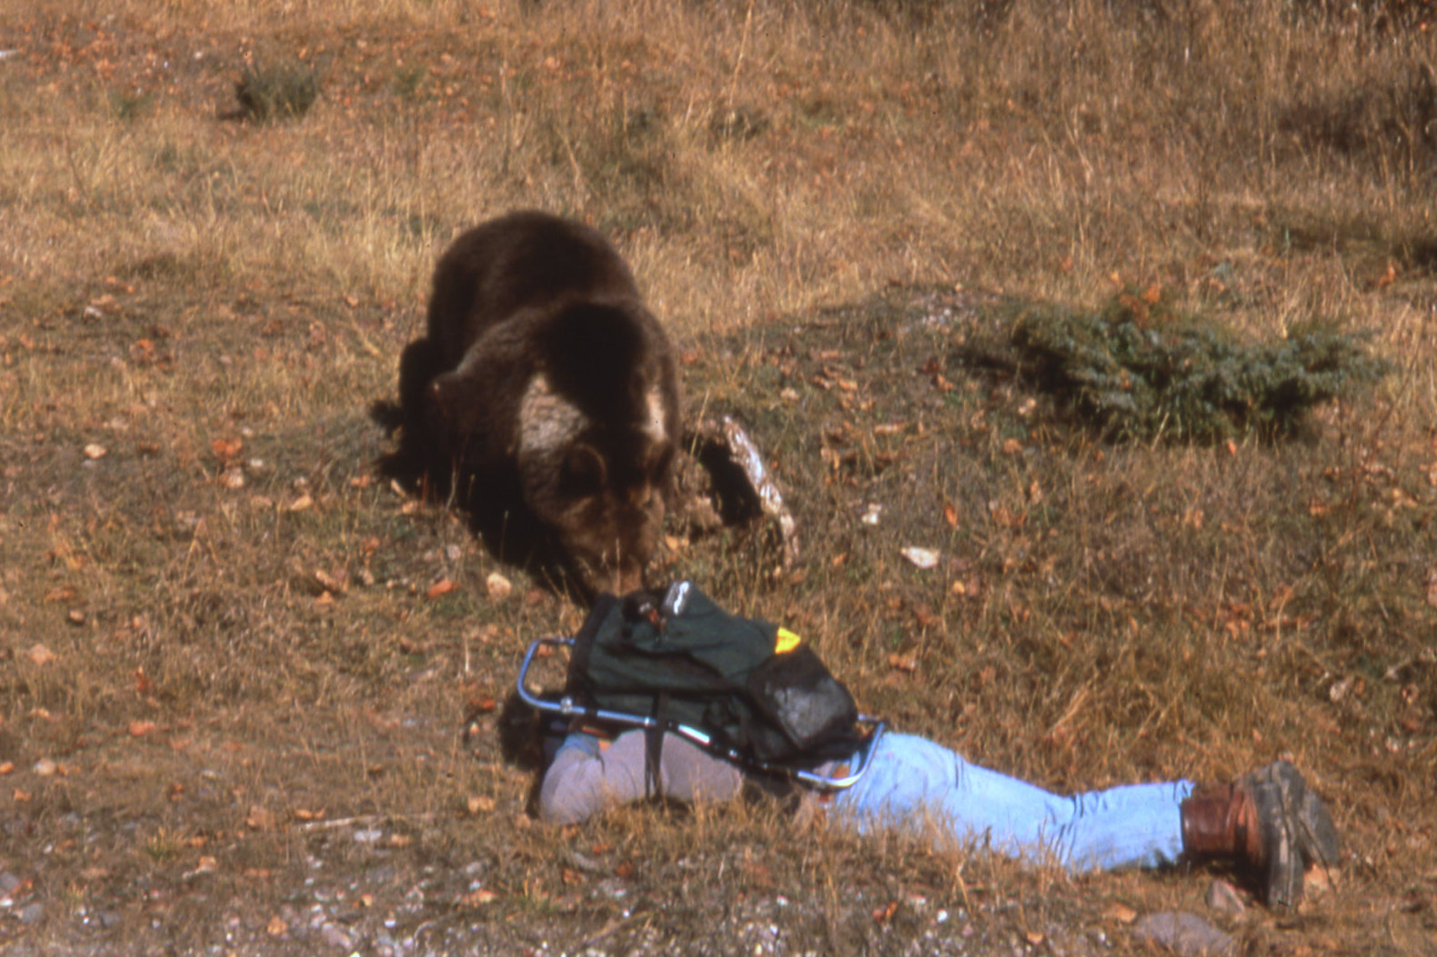
Bear Spray: Contact Charge
If a bear is charging from within 15 feet, such as from a day bed, a berry patch, or a stream bed, you may only have time to spontaneously spray in front of the bear.
If the bear does make contact, hold the can firmly, drop to the ground on your stomach, laying flat, clasping your hands and the can behind your head. Remain absolutely still.
Once the bear feels the effects of the inflammatory and irritating agent, it should retreat.
Do not move or get up until you are sure the bear has left the area.

Slide 52
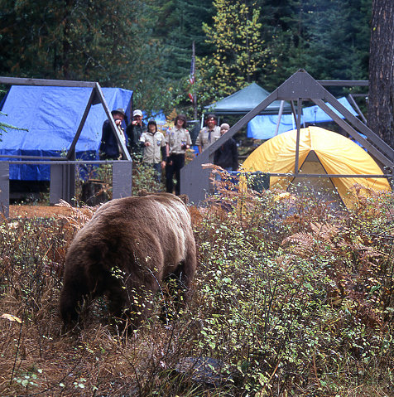
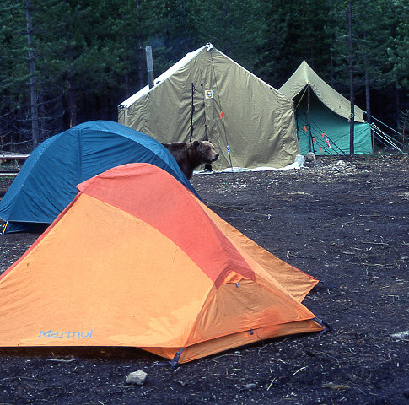
Bear Spray: Bear in Camp
Habituated and food conditioned bears may enter your campsite during the day or at night. This requires working as a group. Once you are close together, do the following to chase the bear out of the camp:
As a group, yell at the bear. If possible bang pots and pans to get the bear away from the tents and camping equipment.
Only use your Bear Spray in a way that will not compromise your group or camping equipment.
Bear Spray has been successfully used to get a bear to leave a camp site but not necessarily to keep it away.
Testing on dump bears that were not acting aggressive showed they could be chased from the dump but would return later for the established food source.
Set up a monitoring system and a buddy system in case the bear does come back.
Leave the area and report the incident to local authorities.
Notes:
52

Slide 53
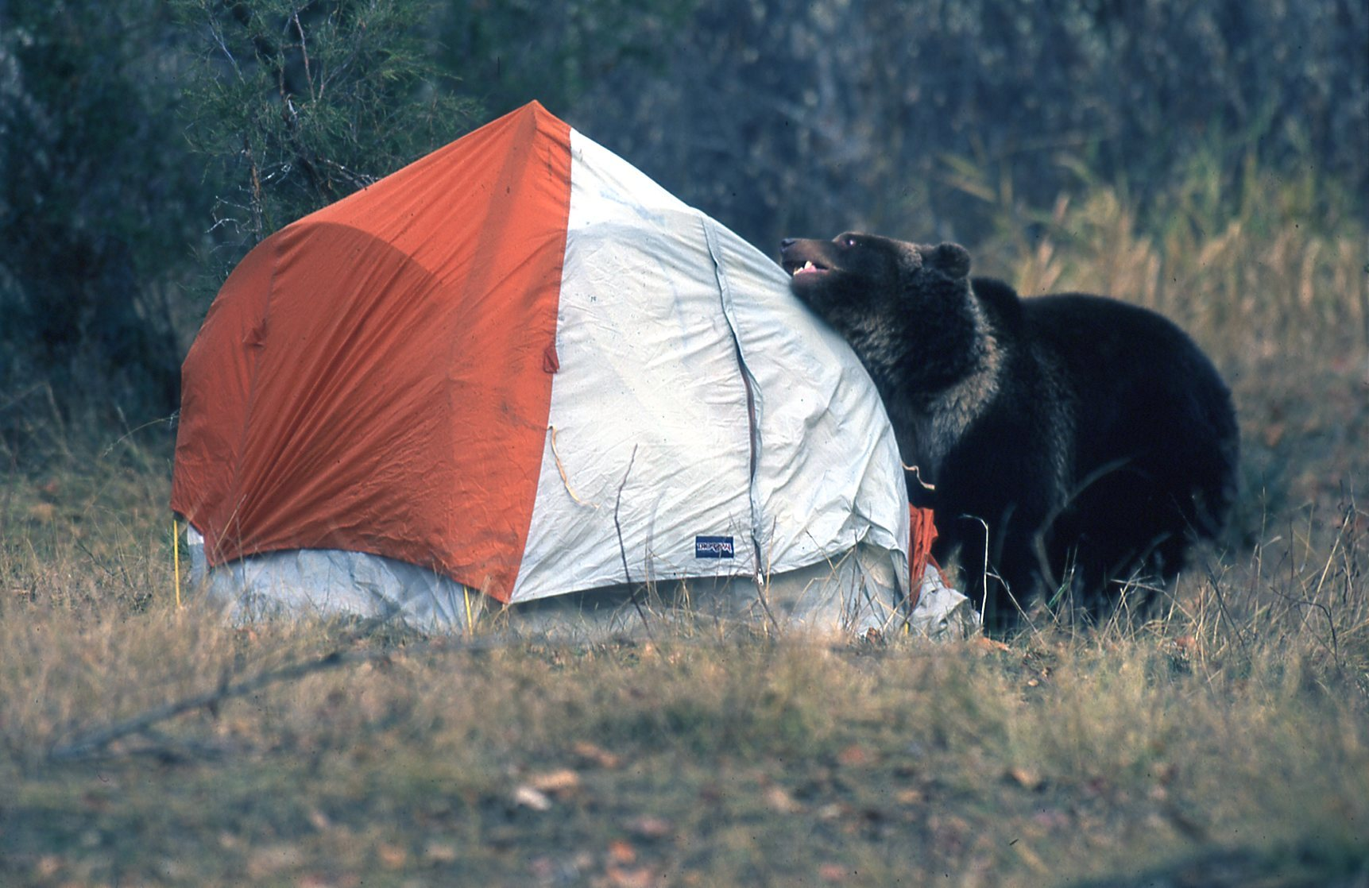
Bear Spray: Entering Your Tent
Exit the tent as quickly as possible to avoid excessive inhalation of bear spray. Most people should be able to function but it’s important to leave the confined space as quickly as possible.
Be prepared to spray the bear again once out of the tent.
Group together and retreat to a place of safety (car, tree, building, etc.).
Bears often visit camps at night, sniff around and leave. In case one doesn’t:
When sleeping, keep your bear spray and flashlight together in a consistent spot and within easy reach.
If a bear is entering your tent, either through the entrance or by ripping the side, spray a
short burst directly into the bear’s face.
Notes:
53

Slide 54
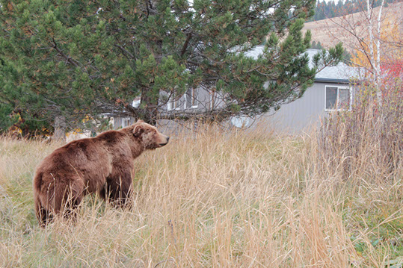
Bear Spray: Nuisance Bear
In situations where a bear approaches a group of people or enters a residential, picnic or camping area, but is not showing aggressive behavior, you may want to spray a short burst (2 seconds) toward the bear. Be careful not to force the nuisance bear toward other people.
This may cause the bear to charge. Be prepared to spray for an extended period until the bear breaks off the charge and retreats.
Bear spray tested on dump bears that were not charging or attacking showed only temporary deterrence.
Non-aggressive bears that have been sprayed often return to areas of food reward.
Report the incident to local authorities.
Notes:
54

Slide 55
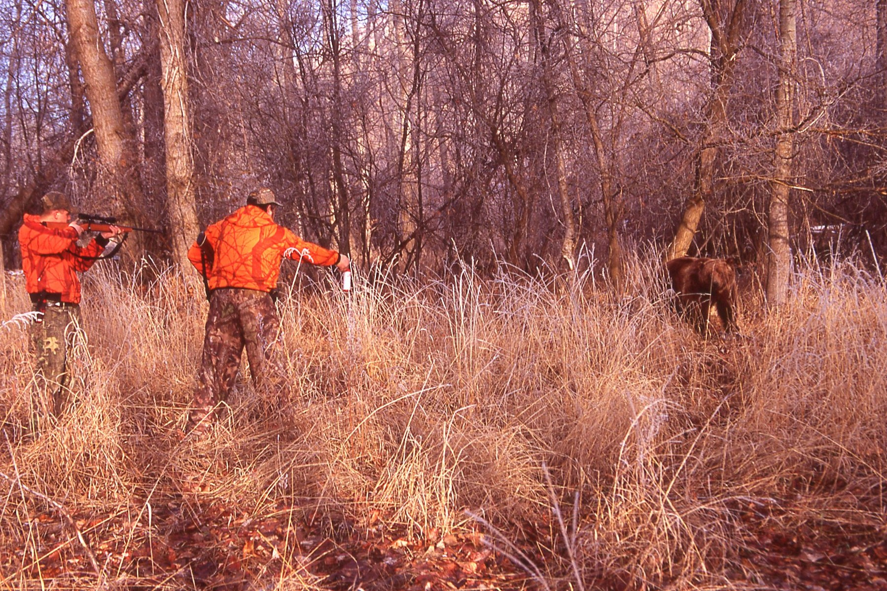
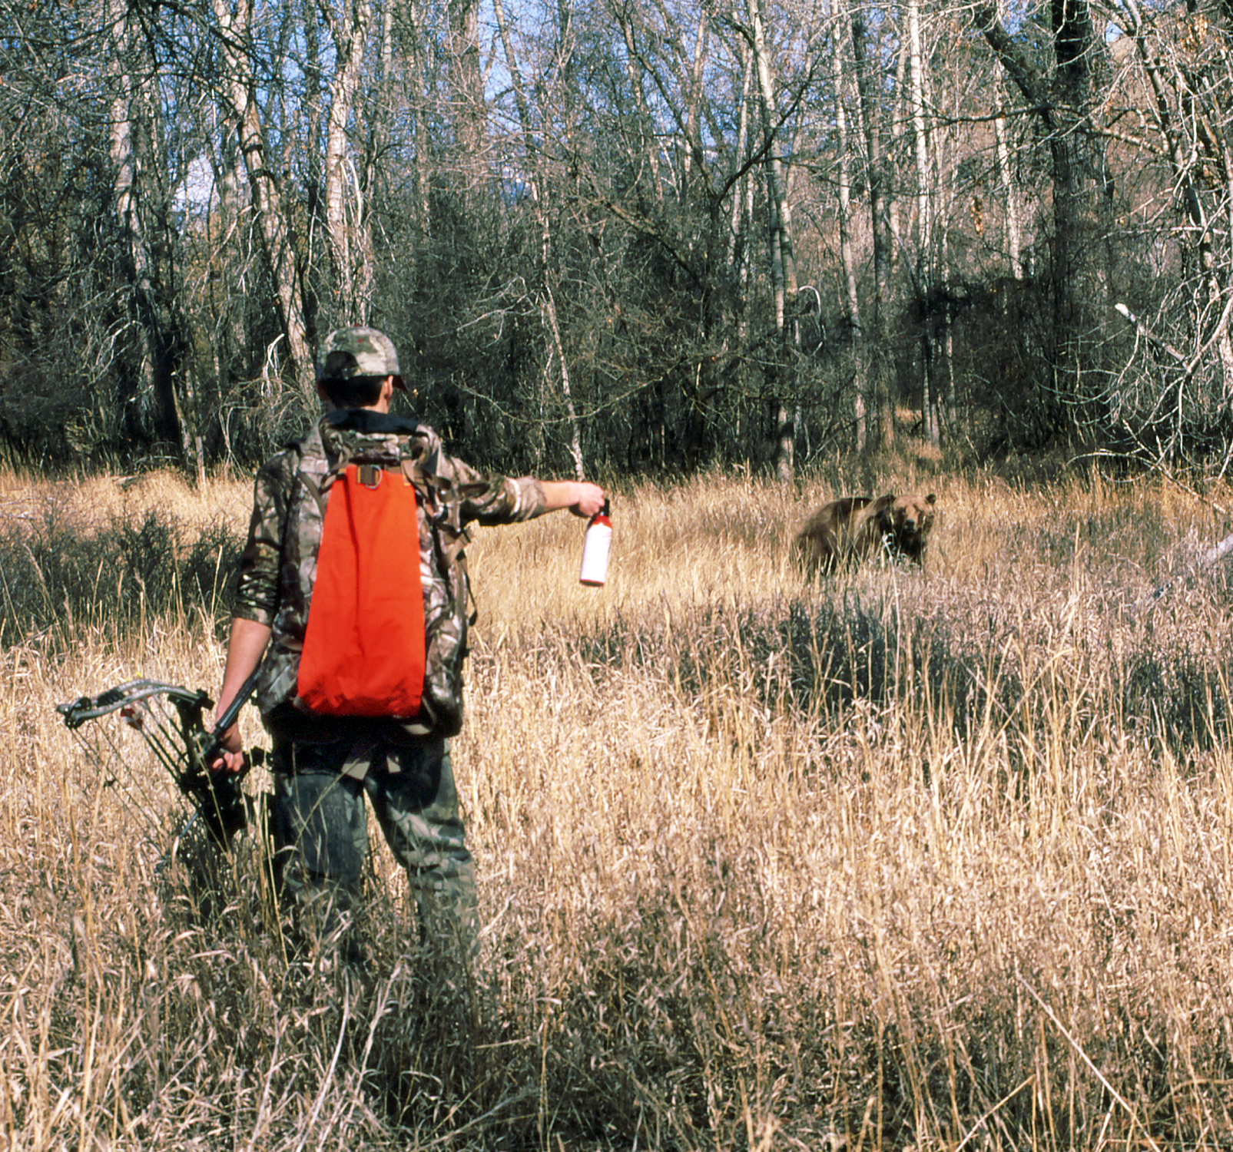
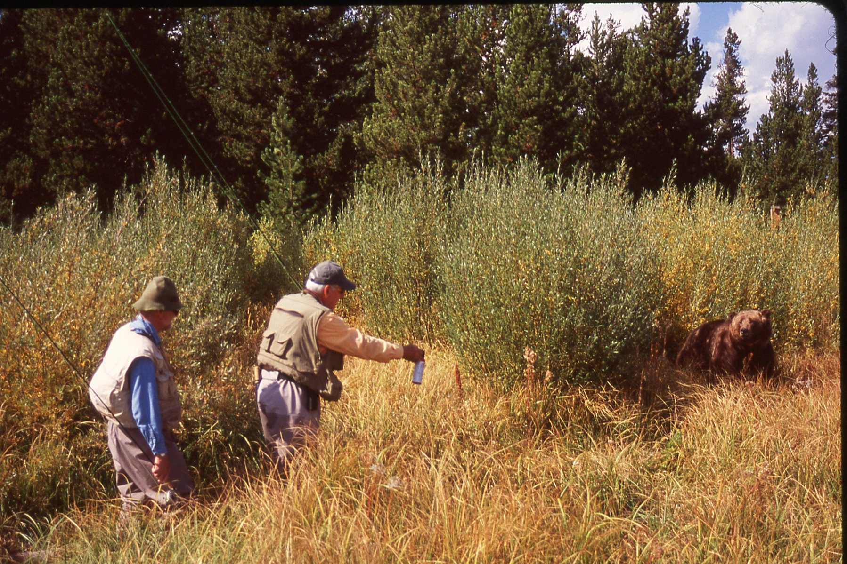
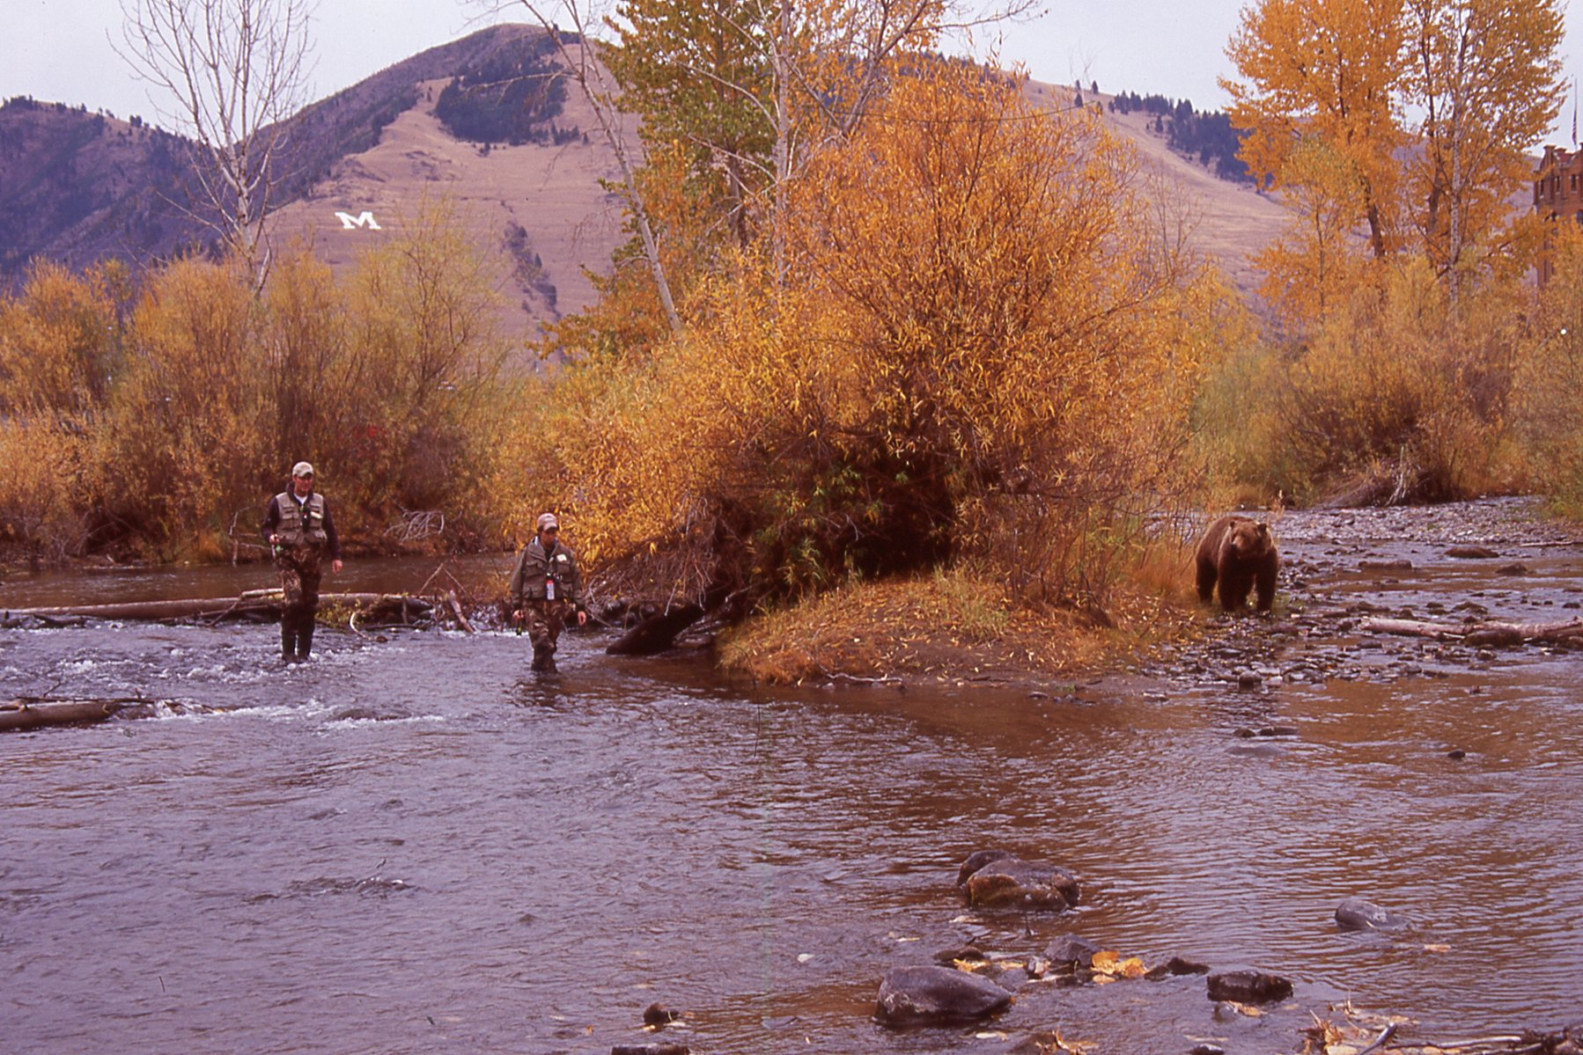
Bear Spray: Hunting & Fishing
Always carry your Bear Spray.

Slide 56
Bear Spray: Off-Trail
Hunting and working in bear country sometimes requires individuals to travel off-trail. This can lead to a higher risk of sudden close encounters. Use the following techniques to increase your awareness in bear country:
  Heighten your ability to listen carefully for breaking branches, rustling leaves, and even heavy breathing and growling.
  Use your sense of smell to locate carrion before you find it with an overprotective bear on it. Bird activity may indicate a bear.
  When traveling off-trail try to avoid going through thick brush. Go around or between large brushy areas.
  When near fast-moving water or on windy days be extra alert. Your sounds and scent may not alert a bear of your presence.
  Scan the area ahead on both sides and periodically behind you, looking for things out of place, and monitor shadows.
  Have your Bear Spray ready if you feel uneasy or you start seeing numerous bear signs (scat, diggings, claw marks on trees, rocks and logs flipped over, etc.).
Notes:
56

Slide 57
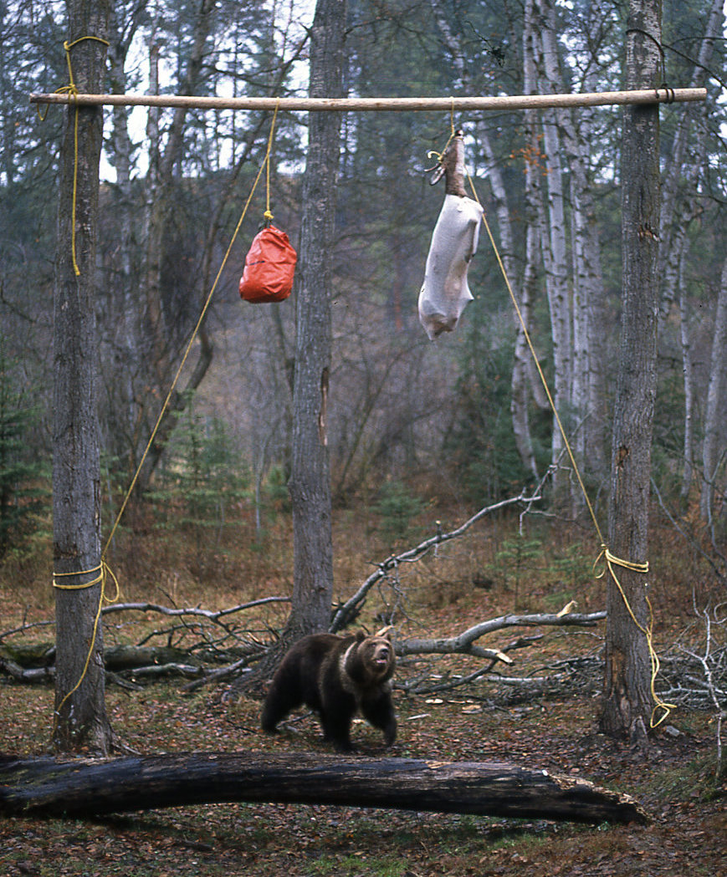
Bear Spray: Retrieving Game
Hunt and field dress your game with a partner and monitor your surroundings.
Field Dressing & Quartering
Be aware that more than one bear may be drawn to your kill-site.
When field dressing, have your Bear Spray within reach with the safety wedge off.
Monitor the area around you while you work. (Avoid tunnel vision.)
Separate the carcass from the entrails and leave in a clearing where it can be seen from a distance on return.
Retrieving
When returning to your game, watch for ravens and other scavengers. They can signal the presence of bears.
More than one bear may have bedded down near your game. Monitor the carcass from a distance before approaching.
If a bear has claimed your carcass, leave the area and report it to your local wildlife management agency.
Always have your Bear Spray ready.

Slide 58
Bear Spray: Bear Spray vs. Gun?
It’s not bear spray versus guns, it’s about having options. Both have advantages and disadvantages.
Bear Spray Advantages:
You do not have to aim bear spray, just create a cloud barrier for the bear to pass through.
Bear spray allows you to spray the bear even if the bear is mauling your partner (avoiding accidentally shooting your partner).
Bears respond more quickly to the active ingredients of Bear Spray than a bullet.
You do not have to see the bear to spray it.
The orange spray cloud and whooshing sound may deter a charging bear.
Bear Spray Disadvantages:
Bear spray is adversely affected by wind and cold.
A sudden close charge may leave little time to use either Bear Spray or a firearm.

Slide 59
Bear Spray: Bear Spray vs. Gun?
It’s not bear spray versus guns, it’s about having options. Both have advantages and disadvantages.
Guns Advantages:
You are already carrying it.
It is not affected by wind or cold.
The muzzle blast and sound may deter a charging bear.
Guns Disadvantages:
Difficult to aim (especially if the charging bear is not yet visible due to high grass or brush).
May not immediately stop the bear.
Bears can die very slowly.
Risk of shooting others.
Hunters are often carrying an insufficient caliber or load to stop a charging bear.
Firearms require more training for effective use.
A sudden close charge may leave little time to either spray or use a firearm.

Slide 60


Bear Spray: Bear Spray vs. Gun?
Shot by partner during a
polar bear attack:
Notes:
60
Charging bear from image 1 is frozen on screen with claws extended. “It works!” appears at the bottom in red. The charging bear footage is from our bear spray DVD. On the right side, we may want to have the generic, red can of bear spray appear.

Slide 61


Bear Spray: Farm & Ranch
On the eastern front of the Rocky Mountains grizzly bears have followed creeks and rivers away from the mountains onto the plains, visiting farms and ranches to feed on crops such as corn, peas and grains. This has been a common occurrence elsewhere in North America with black bears.
To avoid encounters, the following safety precautions are recommended:
When working before dawn and after sunset be extra alert for sudden bear encounters. Call out to alert unseen bears.
Monitor kids who walk to school bus stops or to school.
Windbreaks, hedge rows and fence lines are all potential bed sites for bears and mountain lions.
Equipment operation and noise can easily distract from a bear’s approach. Scan the area often.
Creeks, streams and rivers can be corridors for bears. Be extra alert when working close to them.
Always carry your Bear Spray.

Slide 62



Bear Spray: Predatory Bears
Predatory bears are very rare but extremely dangerous. They can become very focused on an individual, groups or children. They will try to take down or reach the individuals they are focused on and ignore all other activities.
Bear Spray or a firearm are crucial for the person who is being attacked.
Spontaneous response with your Bear Spray. This is where practice unholstering your Bear Spray and removing the safety wedge provides vital seconds when protecting someone being attacked.
If an attacking bear has someone down or is about to take them down. First, stop the behavior and spray the attacking bear with a 2-3 second burst before attending to the victim.
Be prepared for the attacking bear to focus on you and charge. Be prepared to re-spray.
Work as a group to make it clear to the attacking bear that it should retreat and stop its attack.
Always carry your Bear Spray.
Kids under car.

Slide 63

Bear Spray: Polar Bears
Bear Spray has not been formally tested on polar bears, but there have been numerous recorded accounts of biologists successfully using Bear Spray to
deter polar bears. Many of these instances have been recorded and are available online. The following precautions should be used in polar bear habitat:
Cold temperatures directly affect the Bear Spray distance, so the bear will need to be closer than what is recommended to be sprayed effectively.
Carry Bear Spray in a bottle warmer, inside of an insulated pocket that is still readily accessible.
At night Bear Spray should be readily accessible and protected from the cold.
Polar bear habitat also often includes extremely high wind. Prepare to redirect or re-spray.
Appropriate back up protection is recommended such as a shotgun with slugs and proper load.
Travel and work in groups.
Carefully scan the area around you and in the distance. Polar bears can disappear and re-appear in the snow-covered environment.

Slide 64


Bear Spray: Cougars, Wolves, Coyotes
Bear spray has been successfully used in deterring attacks by cougars, wolves and coyotes.
As with charging bears, additional sprays (up to two or three times) were sometimes needed to stop the aggressive advances.
There is only anecdotal evidence for this and there has been no formal EPA testing to verify its effectiveness. Because of this, bear spray cannot be sold for use on other animals, but individuals can use it in self-defense against them.
Use the same techniques for spraying bears to spray cougars, wolves and coyotes.

Slide 65


Visualizing Bear Encounters
Practice removing the bear spray canister from the holster until it is spontaneous.
Practice removing the safety wedge until it is spontaneous.
Practice holding the can firmly with either one hand or two hands until it
is spontaneous.
Practice directing the canister slightly downward so the spray billows up in front of the bear.
Use mental visualization to prepare yourself for a charge that may never happen.
Use your ears, eyes, and nose to be aware of your surroundings and your voice to
call out, “Oh bear, hey bear,” to let bears know you are coming down the trail.
Learn to identify bear activity signs, such as scat, diggings, rocks and logs rolled
over, claw marks, and pungent smells.

Slide 66
Bear Spray: Test What You’ve Learned
The scenario:
You are hunting, hiking or working off trail in a bushy area and you have seen lots of bear sign.
How prepared are you for a bear encounter and what would you do?
Are you ready?
Are you practicing bear awareness?

Slide 67

Video here

Slide 68
Bear Spray: Test What You’ve Learned
The scenario:
You are hiking in bear country and you come upon a photographer and tourists watching a bear eat clover. It is non-aggressive. Do you take out your camera and start taking photos?
How prepared are you for a bear encounter and what would you do?
Are you ready?
Are you practicing bear awareness?

Slide 69


Slide 70

Bear Spray: Bear Encounter
A mother grizzly and her three cubs come out of the woods onto the road you’re walking on. Notice that the cubs are almost as big as the mother. The Bear Spray you are carrying sprays for 4 seconds? 5 seconds? 7 seconds? Or 9 seconds? Which bear would you spray first, and will you have enough additional spray for the others? Did you bring one can or two?

Slide 71
Bear Spray: Carefully Review
Active Ingredient:
1%-2% capsaicin and related capsaicinoids.
You do not aim bear spray, you direct the powerful, expanding cloud in front of the charging bear.
Short or half-second bursts are ineffective unless in a confined situation, such as a tent.
Spray distance is 25 feet, enabling you to spray a charging bear within 60 feet. The bear will meet the spray cloud at approximately 25 feet, giving it time to divert its charge.
Spray duration of 7 seconds allows you to compensate for wind, cold, multiple bears and multiple charges.
Hold the can firmly so it doesn’t tilt up and spray above the charging bear. The spray cloud will naturally billow up.
If the bear is within 60 feet, spray with a side-to-side movement, creating a barrier in front of the charging bear.
If the bear is charging within 30 feet, direct the spray slightly downward in front of the bear and continue spraying until it breaks away.

Slide 72

Section Five
Transportation & Storage

Slide 73


Bear Spray: Storage
General:
Cool dry place out of reach of children.
Transport carrier designed for spray.
Low tech: Ammunition box lined with foam (add vent hole for propellant to escape) or multiple layers of towels.
Vehicles:
In separate area away from driver (i.e. trunk or rear of vehicle).
In storage canister or other form if available.

Slide 74

Bear Spray: Shipping
Bear Spray can be shipped home by ground using a Limited Quantity Label with the following information included:
Shipping classification:
Ground: Limited Quantity
UN 1950, Aerosols Flammable
Chemical emergency phone number.
List the product as Bear Spray.
The size of the canister.
It should be packaged in a reinforced box with a tie strip around the safety wedge.
Labels are available online under “Limited Quantity Label.” Some shippers have them.
Please note, these are new requirements and may change.

Slide 75


Bear Spray: Transporting
Aircraft
Fixed aircraft or helicopters ship bear spray in floats or external storage areas.
Some outfitters have taped bear spray to the outside of the aircraft.
Store in protective transporting container.
It is illegal to take Bear Spray on commercial airlines.
Vehicles
Follow departmental policy.
Store as far away from the driver as possible.
Secure the canister to prevent it from moving around.
Do not store in direct sunlight.

Slide 76
Bear Spray: Accidental Discharge
Do not store where temperatures are above 120º F. An increase in temperature creates an increase in pressure, which may cause seals and seams to fail. Do not leave in direct sunlight in a vehicle.
If you have an accidental discharge or leakage:
The bear spray cloud will degrade in sunlight in 48 to 72 hours, but the oil will remain.
Open door and windows.
Clean surfaces with soap (Dawn or Simple Green), water, and
wear gloves.
Discharge container outdoors and into the ground on a calm day.
Wrap in paper and discard with normal waste.

Slide 77
Bear Spray: Other Considerations
Cans should be replaced after 3-4 years. Check your manufacturer’s guidelines.
Cans should be disposed of after any type of use, even if it was only partially used.
Avoid storing cans in areas above 120 °F. Cans may rupture at these temperatures. Avoid direct sunlight or through a window, which causes magnification.
Bear spray is flammable, keep away from flame or spark.

Slide 78
Bear Spray: First Aid
Treatment
Move into uncontaminated area.
Remove your contacts immediately. They may need to be replaced.
Remove and replace clothing that has been sprayed.
Thoroughly rinse affected areas with cool water.
Use non-oil based soaps and rub the affected area VERY gently.
Do not use creams or lotions.
Irritation may last 45 minutes or longer.
If symptoms persist or if you have breathing or vision problems, seek medical attention.

Slide 79
Completion of “Certificate of Need” and Supervisor Approval/Signature is required for certification to carry/use Bear Spray.
USGS Employee Certification
USGS 445-2-H - Appendix 46-2
Certificate of Need/Completion of Training for Use/Issuance of Bear Spray
First Name MI Last Name
Name of Requestor: ________________________________________________________
Project: __________________________________________________________________
Location of field work: _____________________________________________________
Purpose of Use: ___________________________________________________________
Start Date Return Date Date of Request
Time Frame of Use: _______________________________________________________
Employee Training Certification: I certify that I have completed all appropriate training requirements as outlined in Chapter 46 of the Occupational Hazards and Safety Procedures Handbook (445-2-H) on the use of bear spray as follows:
  Date of Bear Pepper Student Manual review:____________
  Date of Completion of USGS Instructor Led; CD-ROM or Online Training:__________
  Date of Completion for Instructor Led practical hands-on demonstration or conducting a practice release using an inert canister in accordance with the directions and method of use outlined in the Student Manual ________
Employee’s Printed Name/Signature: ________________________________
Date:______________
Supervisor Approval: I certify that the following employee has a need for the use of bear spray in connection with his/her official duties and that he/she has met the training requirements outlined in the USGS Occupational Hazards and Safety Procedures Handbook (445-2-H), Ch. 46.
Supervisor's Printed Name/Signature: ________________________________
Date:______________
Original: Filed locally by the Employee’s Supervisor.
Copies: Employee and Collateral Duty Safety Program Coordinator
Sample

Slide 80
Employee Training
To be certified to carry/use Bear Spray:
Read and understand bear spray BBA instructions and PowerPoint.
Train using an inert bear spray canister.
Complete a “Certificate of Need for Use/Issuance of Bear Spray” with your Supervisor’s Approval and Signature.
Forward copies of the Certificate of Need to your Supervisor and Team/Local Safety Officer.
Employees who carry Bear Spray should be first-aid and CPR-certified.

Slide 81
Recommended Policy & Guidelines
Bear Spray can only be carried/used by employees who have completed the training requirements.
Completion of bear habitat/behavior training is strongly recommended.
Bear Spray is only intended to deter against charging bears. It has shown effectiveness with wolves, cougars, and coyotes, but has not been officially tested on them.
Bear Spray should always be handled with care and safety in mind.
Storage and transportation of Bear Spray shall meet Department of Transportation (DOT), Environmental Protection Agency (EPA), and DOI regulations/policies.
Continued…

Slide 82
Recommended Policy & Guidelines
Bear Spray canisters will be replaced every four years if unused and as soon as possible following any usage. Only full canisters should be carried in the field.
Bear Spray shall meet the guidelines of the Interagency Grizzly Bear Committee (IGBC).
Bear Spray Refresher training may be required with significant bear spray product changes.
All animal encounters where deterrence was required shall be reported to local authorities, your immediate supervisor, and appropriate Safety personnel.
All accidental releases of bear spray shall be reported to your immediate supervisor.

Slide 83
Bear Spray: References & Credits
Carrie Hunt
Dr. Charles Jonkel
Bill Pounds
Dr. Stephen Herrero
Dr. Tom Smith
James Claar, USFS, retired
Kim Barber, USFS, retired
Karrie Gunther, NPS
John Waller, NPS
Ellen Beller, Biologist
Dan Lowe, Mac to Basics
Chuck Bartlebaugh, Be Bear Aware Campaign
Montana Fish, Wildlife & Parks
Parks Canada
U. S. Forest Service
U. S. Fish & Wildlife Service
National Park Service
Alaska Game and Fish
Wyoming Game and Fish
Environmental Protection Agency
Aerosol Spray Industry
Morgan Sparks, Biologist

Slide 84


Slide 85

Presenting bear avoidance education programs across
the United States and Canada since 1976.

